Slide 1
SpaceX Falcon 9 first stage landing prediction
Lidia Danilov,
23.03.2025

Slide 2



OUTLINE
Executive Summary
Introduction
Methodology
Results
Visualization – Charts
Dashboard
Discussion
Findings & Implications
Conclusion
Appendix

Slide 3

EXECUTIVE SUMMARY
Overview
The SpaceX Falcon 9 launch system is a partially reusable rocket designed to deliver payloads into orbit while enabling cost reduction through booster recovery. Predicting the first stage landing location and conditions is crucial for mission planning, safety, and operational efficiency.
Objective
The primary objective of Falcon 9 first stage landing prediction is to accurately estimate the booster’s touchdown location, taking into account various factors such as launch trajectory, atmospheric conditions, propulsion parameters, and landing site constraints. Achieving precise predictions enhances the success rate of recovery missions and improves the reusability of boosters.

Slide 4

INTRODUCTION
This capstone project focuses on predicting the successful landing of the Falcon 9 rocket's first stage, a critical factor that directly influences the cost efficiency of SpaceX launches. This is framed as a binary classification problem, where the target variable is whether the first stage landed successfully (1) or failed to land (0).
The outcome of this project will not only enhance cost estimation accuracy but also support strategic decision-making in the commercial spaceflight industry.
Historical launch data from SpaceX were used, which includes information such as payload mass, orbit type, rocket version, landing type, launch site, and weather conditions. The data was sourced from public SpaceX records and supplemented with external data from NASA and other open-source APIs where applicable.

Slide 5

METHODOLOGY
Data collection, using SpaceX API
Data cleaning, using:
Data Wrangling
Web scraping
Exploratory data analysis (EDA), using:
SQL
Pandas and Matplotlib
Data visualization, using:
Folium
Dash
Machine learning prediction

Slide 6
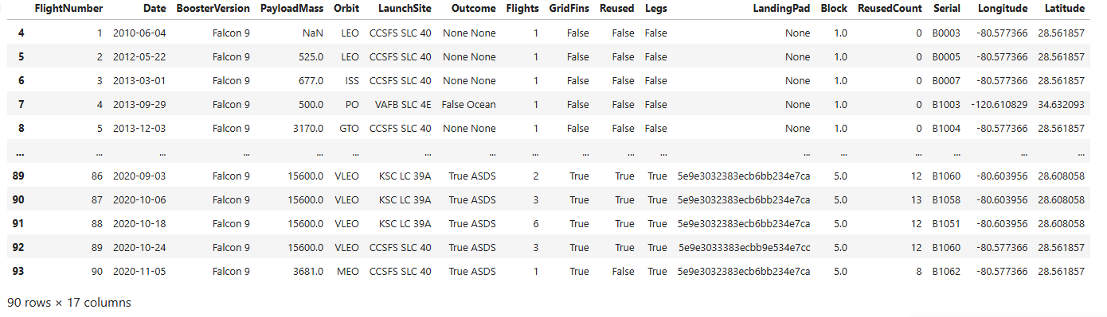
Data collection using SpaceX API
To gain a deeper understanding of SpaceX's Falcon 9 launch history, the SpaceX API (https://api.spacexdata.com/v4/rockets/) was used to retrieve detailed information about all SpaceX rockets.
The API provides extensive data on various SpaceX rockets, including Falcon 1, Falcon 9, Falcon Heavy, and Starship. However, this analysis focused specifically on Falcon 9 launches:

Slide 7
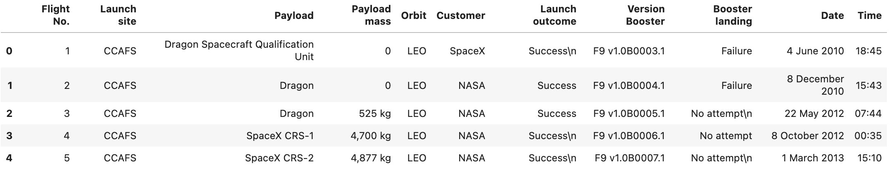
2. Data cleaning
Data Wrangling - Every missing value in the data is replaced with the mean of the column it belongs to.
Web scrap from: List_of_Falcon_9_and_Falcon_Heavy_launches
The picture below shows the first few rows of the data:

Slide 8
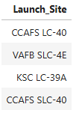
3. Exploratory Data Analysis - SQL
Diving into SpaceX’s historical launch data, I needed to uncover key insights about launch sites, mission success rates, and the most powerful boosters. I used SQL for efficiently extracting and analyzing this critical information.
The first step was to understand the launch sites. Using SQL, I queried the database to list all the unique launch sites used by SpaceX. This helped me identify their geographical distribution and frequency of use.
The picture below ilustrates the unique launch sites name:

Slide 9
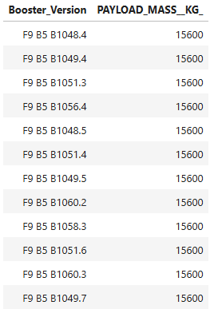
3. Exploratory Data Analysis (1) - SQL
With a clear view of the launch sites, the attention turned to mission outcomes. The total number of successful and failed missions is 101.
Next step was to identify the booster versions that carried the maximum payload mass. To achieve this, I wrote an SQL query to retrieve the names of the boosters that transported the heaviest payloads.
The query revealed the most powerful booster versions ever used by SpaceX, showcasing their evolving engineering capabilities, like it is shown in the image from the side:

Slide 10
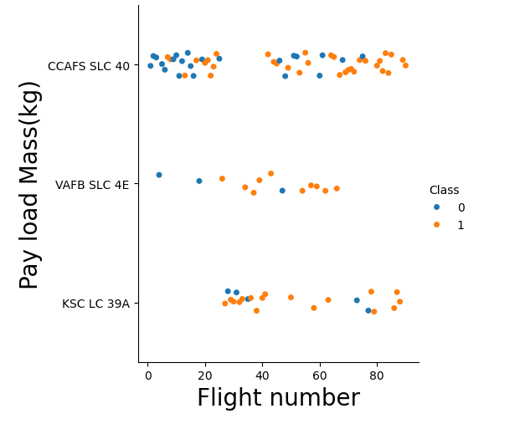
3. Exploratory Data Analysis (2) - Pandas and Matplotlib
Using Pandas for data manipulation and Matplotlib for visualization, some patterns that influence launch success were revealed.
1. Flight Numbers and Launch Sites: Identifying Trends
The first visualization examined the relationship between Flight Number and Launch Site. Plotting this helps us understand which sites handled the most launches and how frequently they were used. I observed that CCAFS SLC 40 and KSC LC 39A had the highest flight numbers:

Slide 11
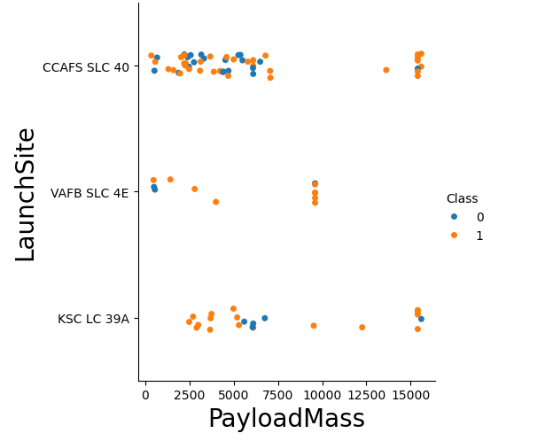
3. Exploratory Data Analysis (3) - Pandas and Matplotlib
2. Payload Mass vs. Launch Site: Analyzing Capacity
Next, I explored the Payload Mass for each Launch Site to determine how different locations handled varying payload capacities. The visualization revealed that some sites specialized in handling heavier payloads, talking again about CCAFS SLC 40 and KSC LC 39A:

Slide 12
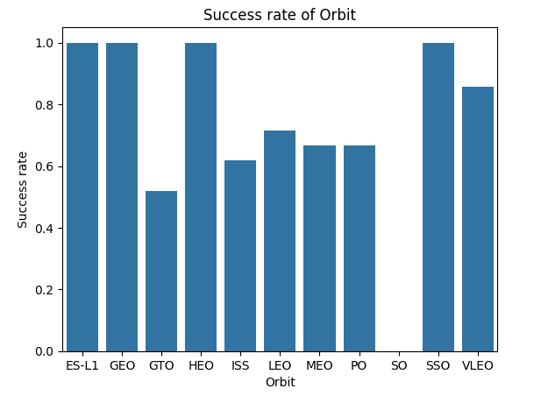
3. Exploratory Data Analysis (4) - Pandas and Matplotlib
3. Success Rate Across Orbit Types
The results showed that SSO, HEO, GEO and ES-L1 orbits had the highest success rates, whereas GTO orbit presented slightly lower:

Slide 13
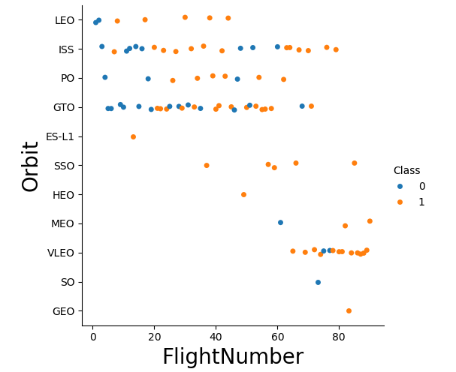
3. Exploratory Data Analysis (5) - Pandas and Matplotlib
4. Flight Number vs. Orbit Type: Tracking Evolution
Understanding how Flight Number correlates with Orbit Type provided valuable insights into SpaceX’s progression. It can be observed that in the LEO orbit, success seems to be related to the number of flights. Conversely, in the GTO orbit, there appears to be no relationship between flight number and success:

Slide 14
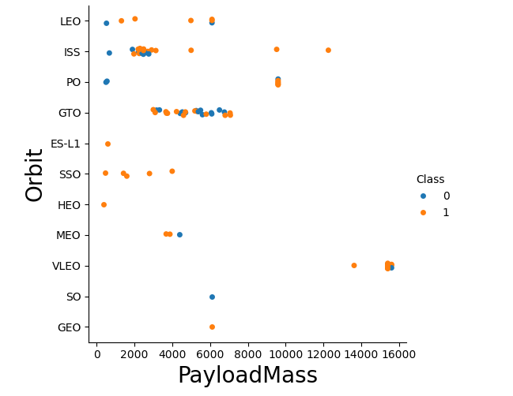
3. Exploratory Data Analysis (6) - Pandas and Matplotlib
5. Payload Mass vs. Orbit Type: Examining Performance
By plotting Payload Mass against Orbit Type, I observed that with heavy payloads the successful landing or positive landing rate are more for Polar,LEO and ISS. However, for GTO, it's difficult to distinguish between successful and unsuccessful landings as both outcomes are present.

Slide 15
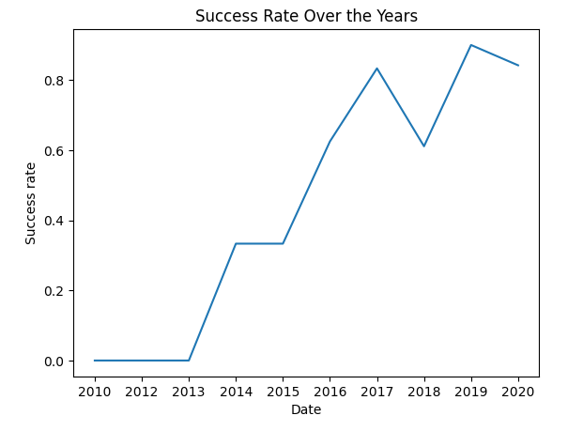
3. Exploratory Data Analysis (7) - Pandas and Matplotlib
6. Yearly Launch Success Trends: Measuring Progress
Finally, I visualized launch success trends over the years, revealing an impressive growth trajectory. It can be observed that the sucess rate since 2013 kept increasing untill 2020.

Slide 16
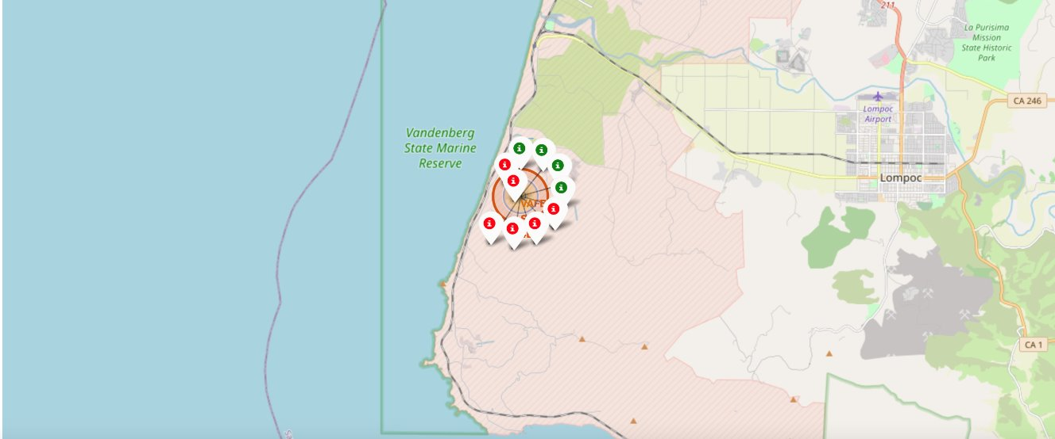
4. Data visualization - Folium
Using Folium, I created an interactive map that displayed every Falcon 9 launch site, with color-coded markers indicating mission outcomes—green for success and red for failure:

Slide 17
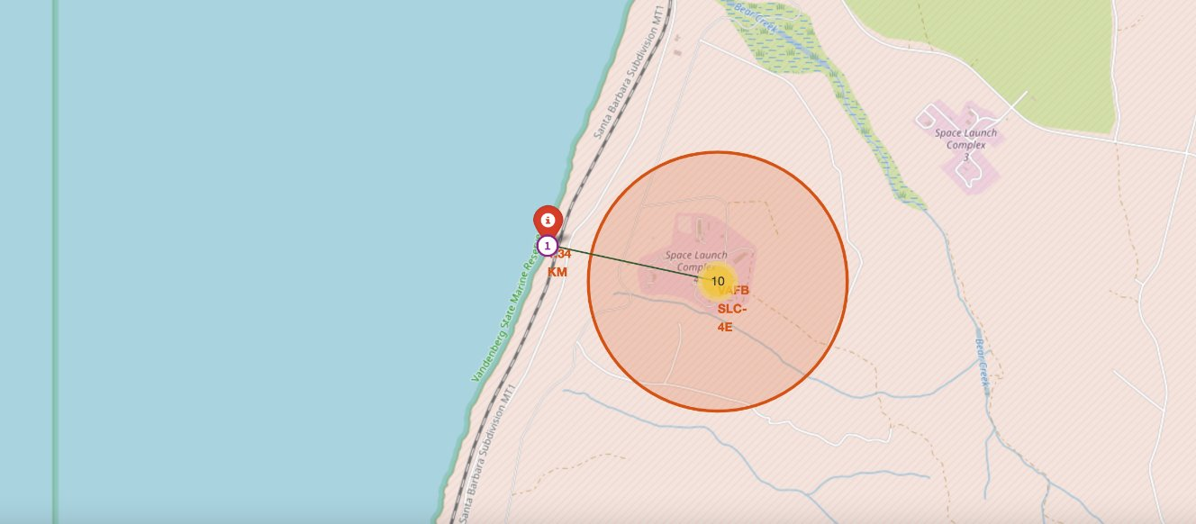
4.Data visualization (1) - Folium
The distances between a launch site to its proximities such as the nearest city, railway, or highway
The picture below shows the distance between the VAFB SLC-4E launch site and the nearest coastline:

Slide 18
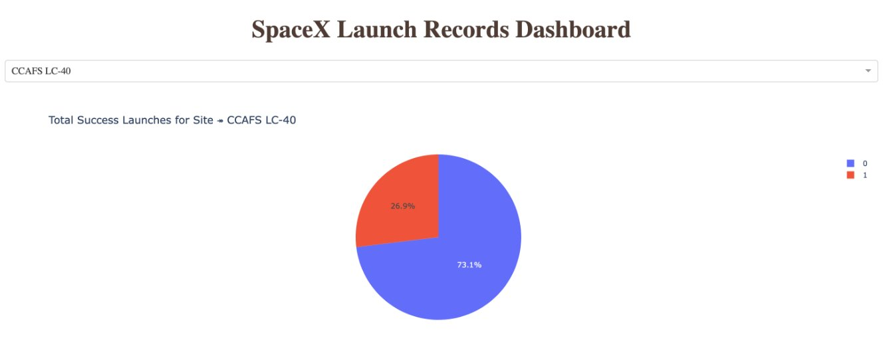
4.Data visualization (3) - Dash
The picture below shows a pie chart when launch site CCAFS LC-40 is chosen.
0 represents failed launches while 1 represents successful launches. We can see that 73.1% of launches done at CCAFS LC-40 are failed launches.

Slide 19
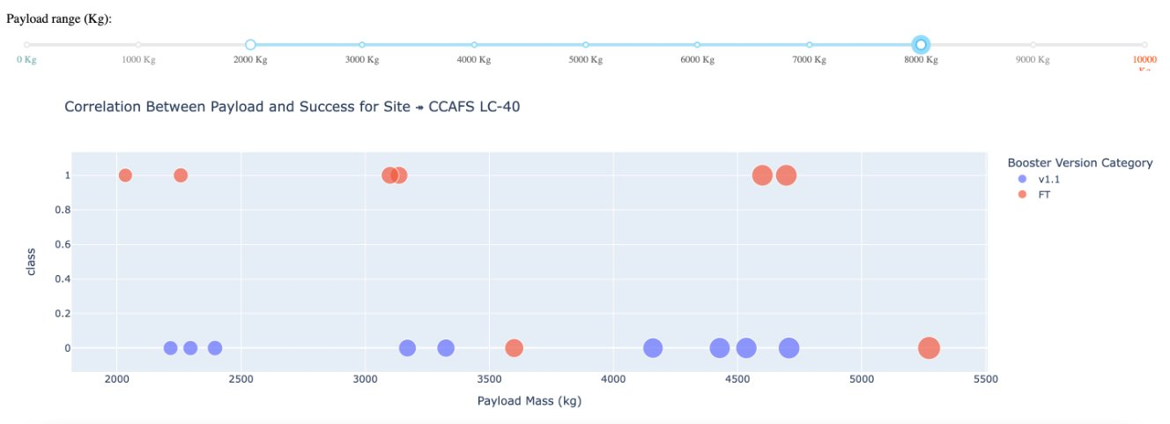
4.Data visualization (4) - Dash
The picture below shows a scatterplot when the payload mass range is set to be from 2000kg to 8000kg.
Class 0 represents failed launches while class 1 represents successful launches.

Slide 20

DASHBOARD
<testrepo/spacex-dash-app.py at main · LidiaVlaicu/testrepo>

Slide 21
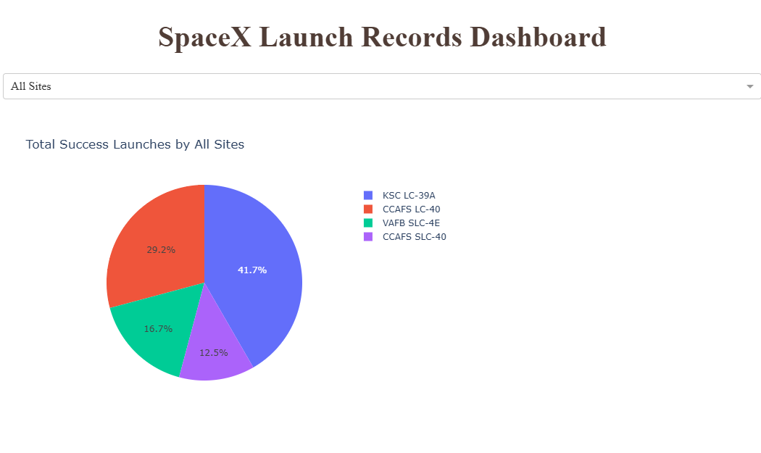
DASHBOARD TAB 1

Slide 22
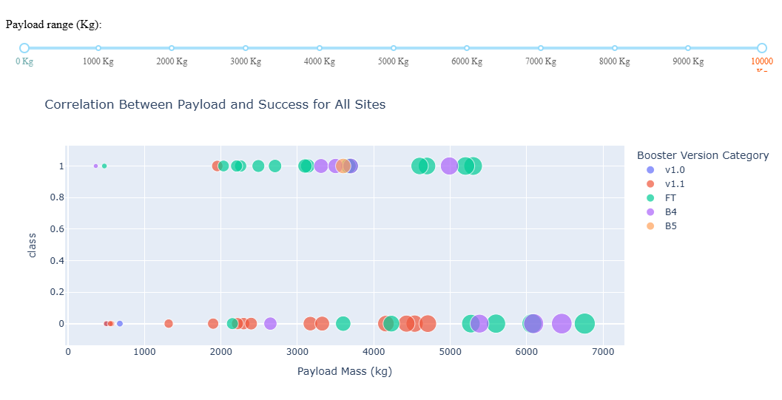
DASHBOARD TAB 2

Slide 23
5. Machine learning prediction
The main goal is to use a machine learning model to predict whether the first stage of the Falcon 9 rocket would land successfully. To ensure accuracy, I split the dataset into training and test sets, allowing the evaluation of the model performance effectively.
To optimize predictions, I experimented with different classification algorithms, including Support Vector Machines (SVM), Classification Trees, and Logistic Regression. By tuning hyperparameters, I identified the best-performing model, refining its ability to distinguish between successful and failed landings.
This machine learning approach provided data-driven insights into Falcon 9's landing patterns, paving the way for more reliable and cost-effective spaceflight operations.

Slide 24
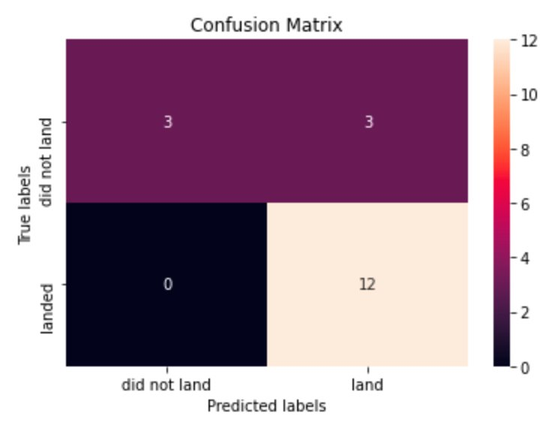
5. Machine learning prediction (1) - Logistic regression
GridSearchCV best score: 0.8464285714285713
Accuracy score on test set: 0.8333333333333334
Confusion matrix:

Slide 25
5. Machine learning prediction (2) - SVM
GridSearchCV best score: 0.8482142857142856
Accuracy score on test set: 0.8333333333333334
Confusion matrix:

Slide 26
5. Machine learning prediction (3) - Decision tree
GridSearchCV best score: 0.8892857142857142
Accuracy score on test set: 0.8333333333333334
Confusion matrix:

Slide 27
5. Machine learning prediction (4) - KNN
GridSearchCV best score: 0.8482142857142858
Accuracy score on test set: 0.8333333333333334
Confusion matrix:

Slide 28
RESULTS (1)
After training four different machine learning models to predict the first-stage landing success of Falcon 9, I was eager to compare their performance. Initially, all models produced identical accuracy scores and confusion matrices on the test set, making direct comparisons difficult.
To break the tie, I turned to GridSearchCV best scores, a metric that captures each model’s optimized performance. The results revealed a clear ranking:
1️⃣ Decision Tree – Best performer with a GridSearchCV score of 0.889 2️⃣ K-Nearest Neighbors (KNN) – 0.848 3️⃣ Support Vector Machine (SVM) – 0.848 (slightly trailing KNN) 4️⃣ Logistic Regression – 0.846

Slide 29
RESULTS (2)
With this ranking, it became evident that the Decision Tree model was the most effective in predicting Falcon 9 landings, offering the highest optimized score. However, since KNN and SVM performed closely, additional fine-tuning could potentially improve their results.
This analysis reinforced the importance of hyperparameter tuning and model selection in machine learning, proving that accuracy alone isn’t always the best measure of performance. By leveraging GridSearchCV, I was able to differentiate models and select the most reliable approach for predicting Falcon 9’s landing success.

Slide 30
DISCUSSION
As I explored the data visualization section, intriguing patterns emerged. Certain features seemed to correlate with the success of Falcon 9 landings, though not in uniform ways. For instance, missions carrying heavy payloads to Polar, LEO, and ISS orbits demonstrated a higher success rate. However, for GTO missions, the distinction wasn’t as clear—both successful and failed landings were present, making it harder to draw a definitive conclusion.
This raised an important question: How exactly do these features impact the final mission outcome? While correlations were evident, the complexity of rocket launches made it difficult to pinpoint precise cause-and-effect relationships. Many factors—such as weather conditions, launch site, and booster reuse—interact in ways that aren’t immediately obvious through visualization alone.

Slide 31

CONCLUSION
In this project, our goal was to predict whether the first stage of a Falcon 9 launch would land successfully, providing valuable insights into the cost and efficiency of future missions. We explored how various features—such as payload mass and orbit type—influence the mission outcome, and how these relationships can be leveraged for more accurate predictions.
By applying several machine learning algorithms, we were able to train models on historical Falcon 9 launch data, learning the underlying patterns that determine landing success. After evaluating the performance of different models, we found that the decision tree algorithm outperformed the others, providing the most reliable predictive capability.
This analysis not only enhances our understanding of Falcon 9 launch dynamics but also offers a data-driven approach to improve launch planning, reduce costs, and increase the success rate of future space missions.

Slide 32

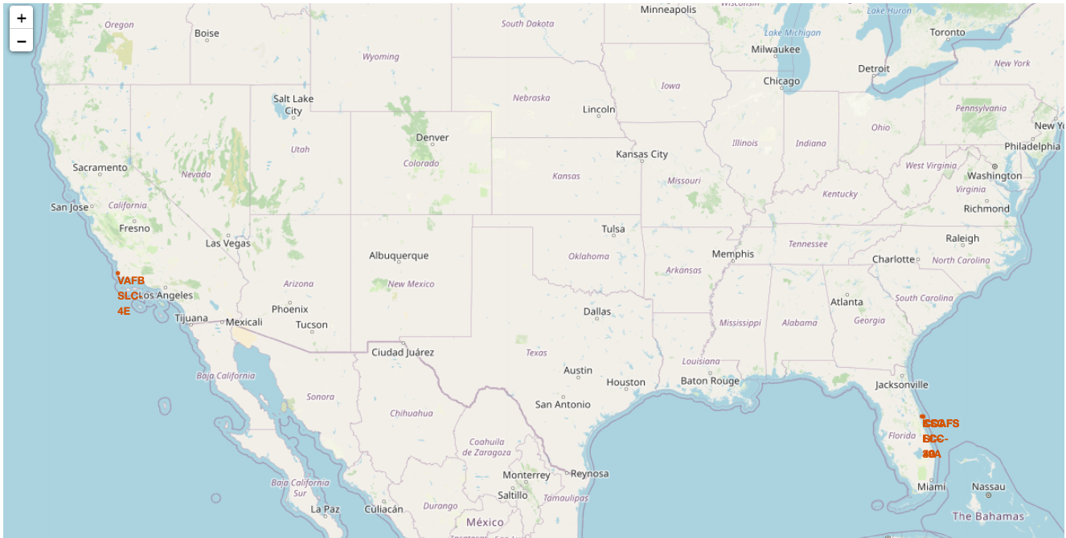
APPENDIX
All launch sites on a map

