Slide 1
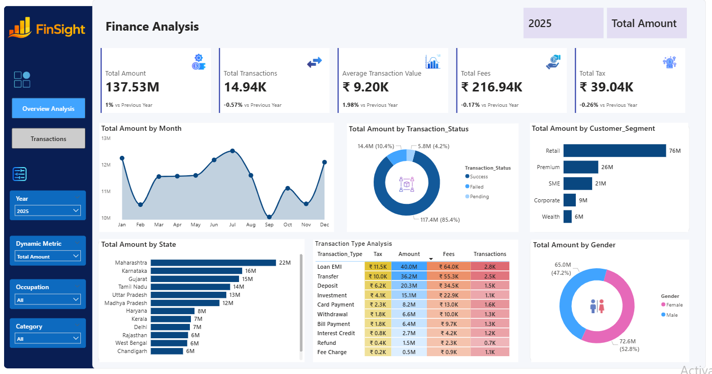
Finance Analytics Dashboard
Task 3 – Dashboard Design
Prepared by: Lidiya Mitiku Duguma
Organization: Ministry of MSME Internship
Tools: Power BI • Power Query • DAX
MSME Data Analyst Internship | Finance Analytics Dashboard | 1

Slide 2
📈 Business Objective
Objectives
• Monitor KPIs in real time.
• Analyze transaction trends.
• Compare customer segments and states.
• Track fees, tax and transaction performance.
• Support business decision-making.
MSME Data Analyst Internship | Finance Analytics Dashboard | 2

Slide 3
Executive Dashboard Overview
💰Key Highlights
• ₹137.53M Total Amount
• 14.94K Transactions
• ₹9.20K Average Value
• Retail segment leads
• Maharashtra highest state
• 85%+ Successful transactions
MSME Data Analyst Internship | Finance Analytics Dashboard | 3

Slide 4
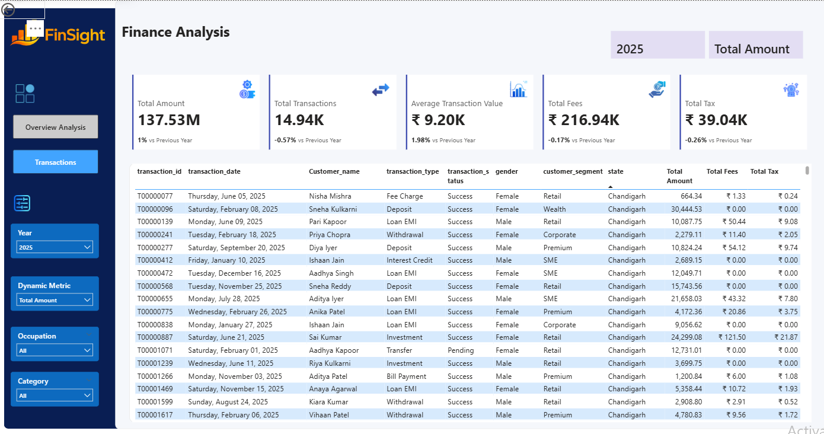
Transaction Analysis
📊Dashboard Features
• Detailed transaction records
• Interactive filters
• Customer-level analysis
• Transaction status
• Fees & tax monitoring
MSME Data Analyst Internship | Finance Analytics Dashboard | 4

Slide 5
Key Insights
Business Insights
• Retail customers generated the highest amount.
• Loan EMI was the top transaction type.
• Monthly trends reveal seasonal changes.
• Dashboard supports YoY KPI monitoring.
• Interactive slicers improve analysis.
MSME Data Analyst Internship | Finance Analytics Dashboard | 5

Slide 6
Business Recommendations
💡Recommendations
• Focus on high-value customer segments.
• Reduce failed and pending transactions.
• Monitor KPIs monthly.
• Use dashboard for executive reporting.
• Expand successful financial products.
MSME Data Analyst Internship | Finance Analytics Dashboard | 6

Slide 7
Skills Demonstrated
🚀 Technical Skills
• Power BI
• Power Query
• DAX
• Data Cleaning
• Data Modeling
• Dashboard Design
• Financial Analytics
• Business Intelligence
MSME Data Analyst Internship | Finance Analytics Dashboard | 7

