Slide 1
ExtJS 3
For 2019 ITA(Day2)

Slide 2
Agenda
Phylogeny
Quick Start
Component
Form
Event & Class
Tree
Menu
Util
Grid
Layout

Slide 3
Form

Slide 4
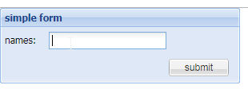
Ext.form.FormPanel
ExtJS use Ext.form.FormPanel component as form UI, it provides default data validation and default prompt for validation failure etc.
Create a simple form:
var form = new Ext.form.FormPanel({
defaultType : 'textfield',
labelAlign: 'center',
title: 'simple form',
labelWidth: 50,
frame: true,
width: 300,
items: [{
fieldLabel: 'names'
}],
buttons:[{
text: 'submit'
}]
});
Form.html

Slide 5
Ext.form.BasicForm
Encapsulates the DOM <form> element at the heart of the FormPanel class, and provides input field management, validation, submission, and form loading services.
FormPanel object: getForm().
Key Method
clearInvalid: Clears all invalid messages in this form.
getValues: Returns the fields in this form as an object with key/value pairs as they would be submitted using a standard form submit. If multiple fields exist with the same name, they are returned as an array.
markInvalid: Mark fields in this form invalid in bulk.
reset: Resets this form.
submit: Shortcut to do a submit action.

Slide 6

Practice
Try to define a form and add a reset button to reset the input fields and a submit button for pop-up a message box with message “hello word!”.
Notes:
10 + 10 minutes

Slide 7
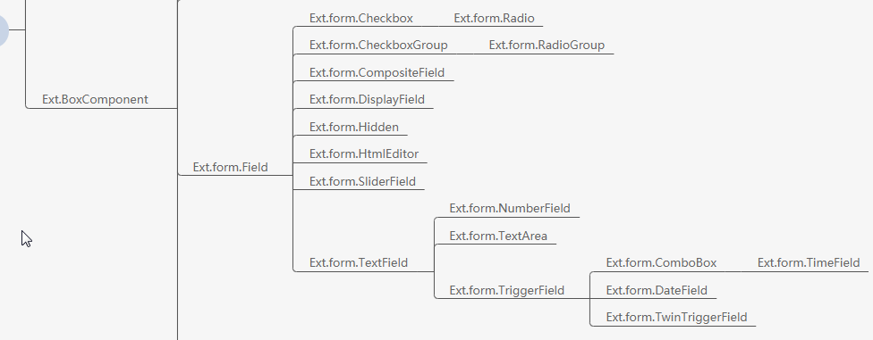
Ext Form Elements

Slide 8
Ext.form.Field
Basic form component class for all form components, it provide basic properties that can be group into 3 groups:
CSS Style:
clearCls, cls, fieldClass, focusClass, itemCls, invalidClass, labelStyle…
Component Config:
autoCreate, disabled, fieldLabel, hideLabel, inputType, labelSeparator, name, readOnly, tabIndex, value…
Data Validation:
invalidText, msgFx, msgTarget, validateOnBlur, validateDelay, validateEvent…

Slide 9
Field Validation
By default, all input form component listen on ‘blur’ event, and when validation not passed, it will display the error message that setting on ‘msgTarget’ properties.
QuickTip :
qtip: Default value for ‘msgTarget’, display a quick tip containing the message when the user hovers over the field. Ext.QuickTips.init must have been called for this setting to work.
title: Display the message in a default browser title attribute popup.
side: Add a block div beneath the field containing the error message.
under: Add an error icon to the right of the field, displaying the message in a popup on hover.
[element id]: Add the error message directly to the innerHTML of the specified element.
QuickTip.html
Notes:
15 minutes + 15 minutes

Slide 10

Ext.form.TextField
This component provide empty input validation, control the input content length(min and max).
var textField = new Ext.form.TextField({
fieldLabel: ‘name’,
allowBlank: ‘false’,
emptyText: ‘please input your name’,
maxLength: 10,
minLength: 3
});
TextField.html

Slide 11
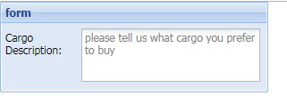
Ext.form.TextArea
This component support multiple line text input.
var textArea = new Ext.form.TextArea({
width: 200,
grow: true,
preventScrollbars: true,
fieldLabel: ‘Cargo Description’,
allowBlank: false,
emptyText: ‘please tell us what’s your cargo’,
maxLength: 20,
minLength: 5,
});
TextArea.html

Slide 12
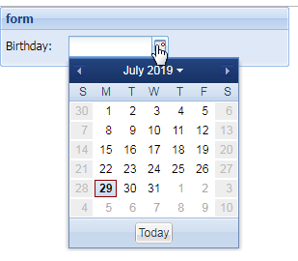
Ext.form.DateField
This is date pick component.
var dateField = new Ext.form.DateField({
fieldLabel: ‘Birthday’,
emptyText: ‘please tell us your birthday’,
format: ‘Y-m-d’,
disabledDays: [0,6]
});
DateField.html

Slide 13
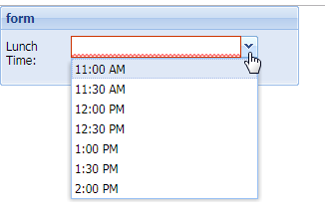
Ext.form.TimeField
This is time pick component.
var timeField = new Ext.form.TimeField({
fieldLabel: ‘Lunch Time’,
emptyText: ‘your Lunch Time’,
minValue: ’11:00 AM’,
maxValue: ’14:00 PM’,
increment: 30
});
TimeField.html
Notes:
5*4 minutes + 10 minutes break -- 10:20

Slide 14
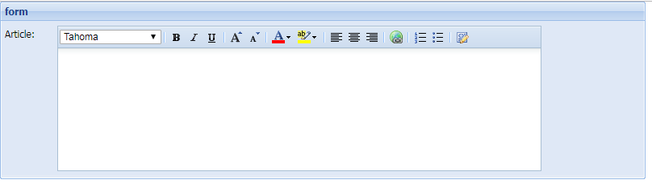
Ext.form.HtmlEditor
This is simple online editor for rich text input.
var htmlEditor = new Ext.form.HtmlEditor({
fieldLabel: ‘Article’,
enableAlignments: true,
enableColors: true,
enableFont: true,
enableFontSize: true,
enableFormat: true,
enableLinks: true,
enableLists: true,
enableSourceEdit: true
});
HtmlEditor.html

Slide 15
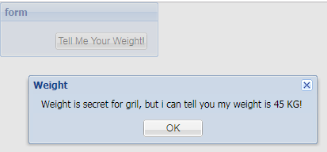
Ext.form.Hidden
This component is for some value that don’t want to show in UI but need to put it in form when submit data to backend.
var hiddenField = new Ext.form.Hidden({
name: ‘hiddenId’
});
hiddenField.setValue(‘some thing I don\’t want you to know.’);
Hidden.html

Slide 16

Ext.form.TriggerField
This component is the super class of ComboBox/DateField/TimeField, it support manual input data or select the data from the specified list.
var triggerField = new Ext.form.TriggerField({
id: 'age’,
fieldLabel: 'Age',
emptyText: 'Choose/Input your age',
onTriggerClick: function(e) {
Ext.getCmp('age').setValue(22);
}
});
TriggerField.html

Slide 17

Ext.form.ComboBox
Combox is a new implementation of ExtJS that completely different from HTLM select element.
var combox = new Ext.form.ComboBox({
fieldLabel: 'Age',
emptyText: 'Choose/Input your age',
mode: 'local',
store: new Ext.data.ArrayStore({
id: 0,
fields: ['age', 'description'],
data: [[22, 'i\'m 22 years old'], [23, 'i\'m 23 years old'], [24, 'i\'m 24 years old']]
}),
valueField: 'age',
displayField: 'description'
});
ComboBox.html

Slide 18
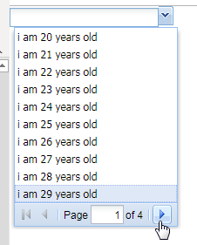
Ext.form.ComboBox
pageSize: this param limited the max page side of the drop-down list, ExtJS will auto calculate the list records. This config only valid when the mode is ‘remote’.
ComboBox2.html

Slide 19
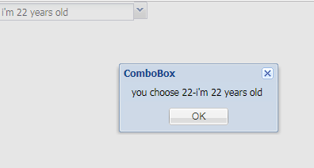
Combox Selection Event
combox.on(‘select’, function(combo){
Ext.MessageBox.alert(‘you choose ’ + combo.getValue() + ‘-’ + combo.getRawValue());
});
ComboBox3.html

Slide 20
Practice
Try to define combo box that support to select one “province”, then display all “City” of the province
Notes:
30 + 20 minutes practice, -11: 10

Slide 21
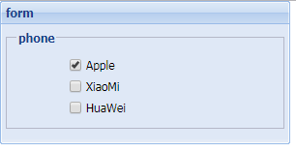
Ext.form.Checkbox
This component cannot change its CSS style.
var checkbox = new Ext.form.Checkbox({
boxLabel: ‘Apple’,
checked: true
});
Checkbox.html

Slide 22
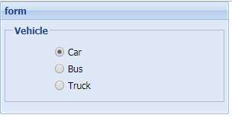
Ext.form.Radio
Same as Checkbox but provided as a convenience for automatically setting the input type. Radio grouping is handled automatically by the browser if you give each radio in a group the same name.
var radio = new Ext.form.Radio({
boxLabel: ‘Car’,
name: ‘vehicle’,
inputValue: ‘car’,
checked: true
});
Radio.html

Slide 23

File Upload
ExtJS not component call Ext.form.FileField, instead of using Ext.form.Field by setting the ‘inputType’ attribute as ‘file’, but we can’t change this component CSS style:
var form = new Ext.form.FormPanel({
fileUpload: true,
url: ‘test.jsp’,
items:[{
xtype: ‘textfield’,
fieldLabel: ‘Resume’,
inputType: ‘file’
}]
});
FileUpoad.html

Slide 24

Ext.data.JsonReader
ExtJS provide Ext.data.JsonReader read and convert data in form.
Define a reader:
var jsonReader = new Ext.data.JsonReader({}, [
{name: ‘name’, type: ‘string’},
{name: ‘age’, type: ‘int’},
{name: ‘birthday’, type: ‘date’, dateFormat: ‘Y-m-dTH:i:s’},
{name: ‘weight’, type: ‘float’}
]);

Slide 25
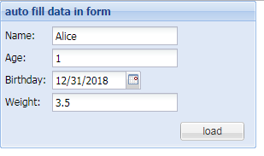
Form Data Read & Load
Use Ext.data.JsonReader:
var form = new Ext.form.FormPanel({
title: ‘auto fill data in form’,
width: 300,
reader: jsonReader
});
form.getForm().load({url: ‘json_reader.txt’});
FormAutoFill.html

Slide 26
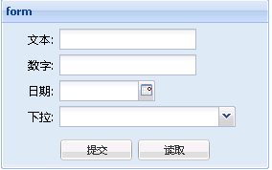
Practice
Implement below form, after clicking ‘read’ button, Json data could be loaded into form.
Notes:
25 + 15 minutes practice, -11: 50, 13:30 PM ask whether need more time to do this practice(give more 10~20 minutes)

Slide 27
Form Submission
Ext.form.BasicForm provide ability to submit form data, there have 3 ways to submit our form data:
BasicForm submission
HTML form data submission
Ajax form data submission

Slide 28
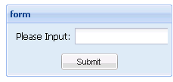
BasicForm Submission
var form = new Ext.form.FormPanel({
url: 'abc/cd’
});
form.getForm().submit();
form\formSubmission.html

Slide 29
HTML Form Data Submission
var form = new Ext.form.FormPanel({
url: 'abc/cd’
});
form.getForm().getEl().dom.submit();
form\orinalHtmlSubmission.html

Slide 30
Ajax Form Data Submission
Ext.Ajax.request({
method:'POST',
form: 'testForm',
url: 'abc/cd'
});
form\ajaxSubmission.html

Slide 31
Practice
Choose one way to submit your form!
Notes:
20 + 15 minutes practice, --14:20

Slide 32
Layout
ContainerLayout, FitLayout, ColumnLayout, BoxLayout, HBoxLayout, VBoxLayout, BorderLayout, AnchorLayout, FormLayout, TableLayout, MenuLayout, ToolbarLayout,

Slide 33
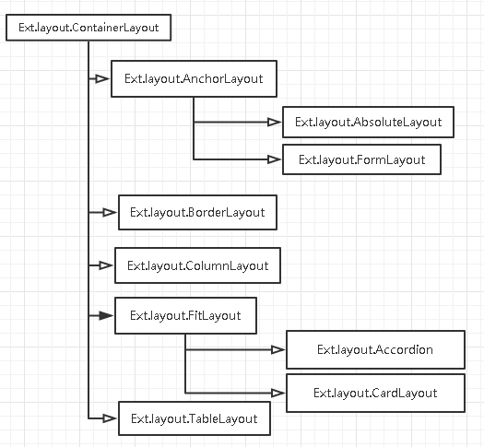
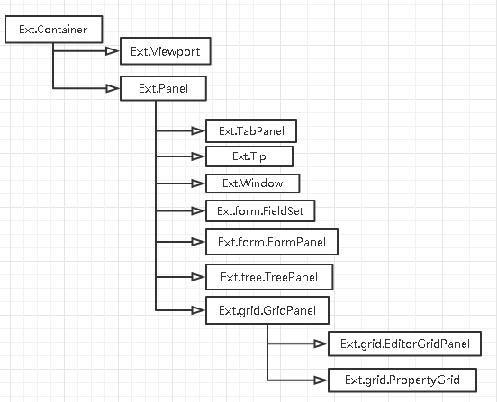
Layout

Slide 34
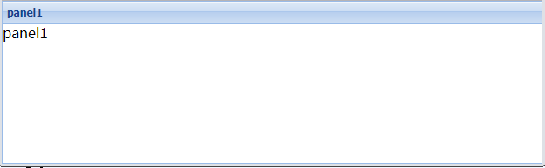
FitLayout
This is a base class for layouts that contain a single item that automatically expands to fill the layout's container.
layout\fitLayout.html
Notes:
Mark: change to panel instead of grid

Slide 35
Practice
Try to add two panels with fit layout, what will happen?
Notes:
5 + 10 minutes practice, --14:35

Slide 36
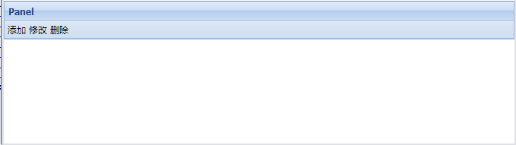
AutoHeight in FitLayout
var panel = new Ext.Panel({
title: 'Panel',
autoHeight: true,
style: 'background-color: red'
});
layout\fitLayoutLimitation2.html

Slide 37
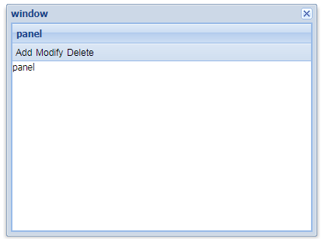
Size Inherit in FitLayout
It fit itself by parent component
var win = new Ext.Window({
title: 'window',
width: 400,
height: 300,
layout: 'fit',
items: [panel]
});
layout\fitLayoutLimitation4.html

Slide 38
Practice
Try to use ‘autoHeight’ and window with fit layout.
Notes:
10 + 10 minutes practice + 10 minutes break, --15:05

Slide 39
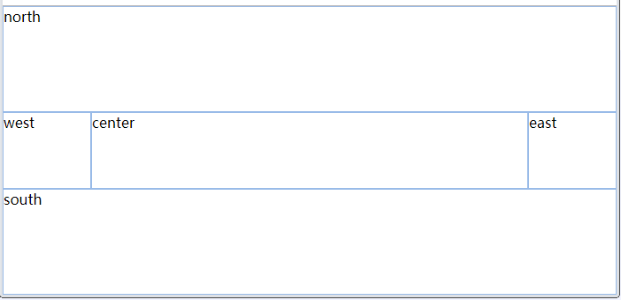
BorderLayout
It splits region into EAST, NORTH,WEST,SOUTH,CENTER area
Center region is mandatory
layout\borderLayout1.html

Slide 40
Practice
1.Use borderLayout, allow to resize north region.
2.Use borderLayout, allow to collapse west region and north region.
layout\borderLayout3.html
layout\borderLayout5.html
Notes:
5+10 + 10 minutes practice --15:30

Slide 41
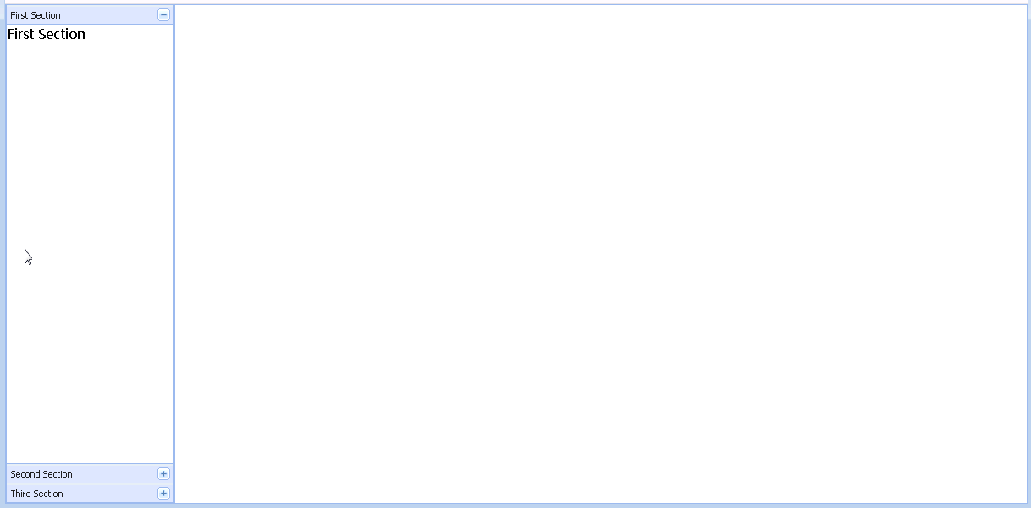
AccordionLayout
layout\accordionLayout.html

Slide 42
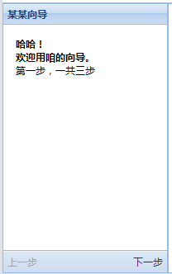
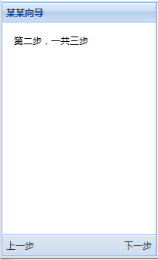
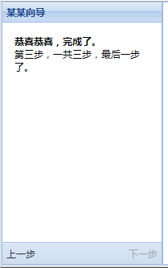
CardLayout
It is used for guide
layout\cardLayout.html

Slide 43
Practice
Try use AccordionLayout and CardLayout
layout\borderLayout3.html
layout\borderLayout5.html
Notes:
15+10 minutes practice --15:55

Slide 44
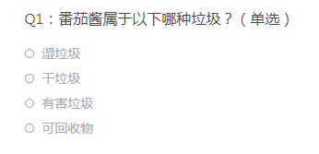
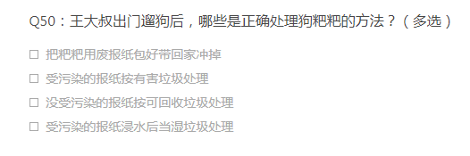
Day2 Homework
Use card layout with 3 cards, first card for Q1, second card for Q50, last card for confirm Q1 and Q50 result with submit from button, when click submit button, alert ‘Congratulation!’

