Slide 1
ExtJS 3
For 2019 ITA(Day5)

Slide 2
Agenda
Phylogeny
Quick Start
Component
Form
Event & Class
Tree
Gird
Layout
Menu&Toolbar
Util

Slide 3
Grid

Slide 4
Ext.grid.GridPanel
This class represents the primary interface of a component-based grid control to represent data in a tabular format of rows and columns. The GridPanel is composed of the following:
Store: The Model holding the data records (rows)
Column Model: Column makeup
View: Encapsulates the user interface
Selection Model: Selection behavior

Slide 5
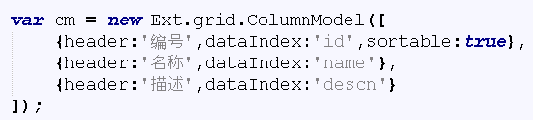
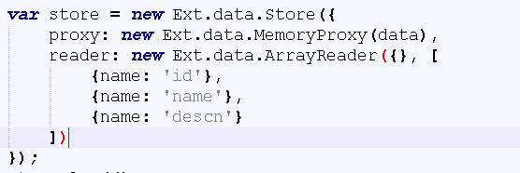
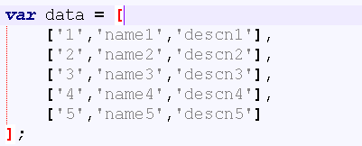
Define a Simple Grid
Define columns
3. Define data model
Define data

Slide 6
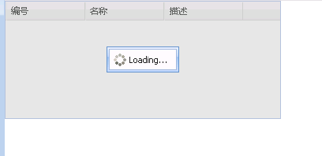
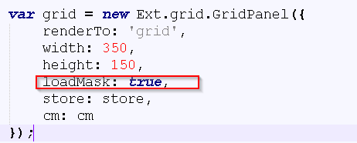
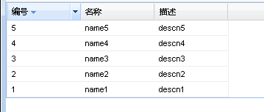
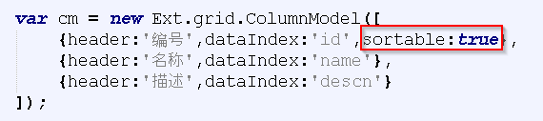
Mask And Sort
grid\maskGrid.html, grid\simpleGrid.html

Slide 7
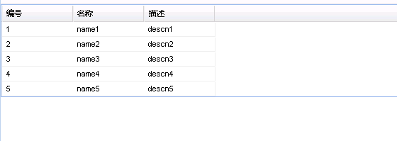
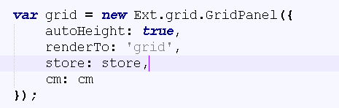
Gird Store
Store: convert data to Ext.data.Record object.
Proxy: how to get the data
Reader: how to parse the data
grid\simpleGrid.html

Slide 8
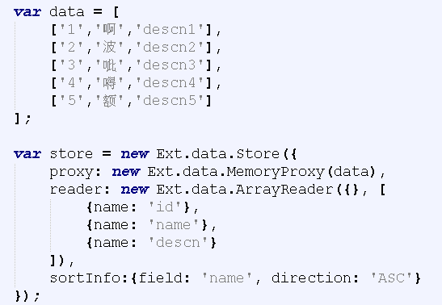
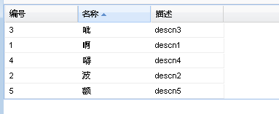
Special Character Sorting in Store

Slide 9
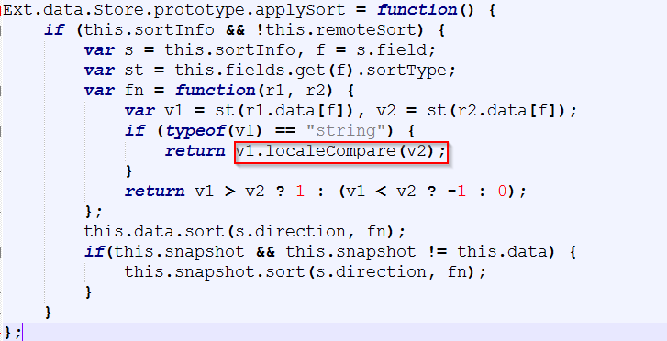
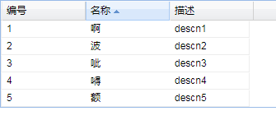
Customize Store Sorting
grid\ simeGridChinese.html

Slide 10
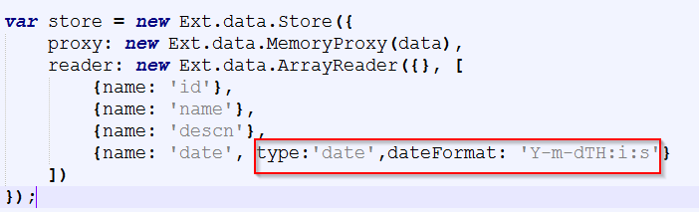
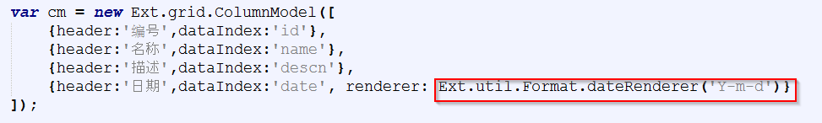
Date Handling in Store
grid\ storeDate.html

Slide 11
Ext.grid.ColumnModel
After the data has been read into the client-side cache (Store), the ColumnModel is used to configure how and what parts of that data will be displayed in the vertical slices (columns) of the grid.
grid\ gridColumnModel.html

Slide 12
Ext.grid.Column
This class encapsulates column configuration data to be used in the initialization of a ColumnModel. While subclasses are provided to render data in different ways:
ActionColumn
BooleanColumn
DateColumn
NumberColumn
TemplateColumn

Slide 13
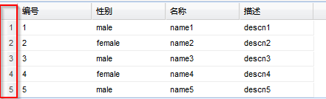
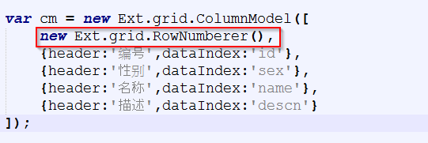
Ext.grid.RowNumberer
Provides an automatic row numbering column.

Slide 14
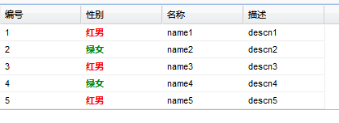
Renderer in ColumnModel
‘renderer’ property support customize display for column, such as add Color/Picture/Button.
grid\gridColumnModelRenderer.html

Slide 15

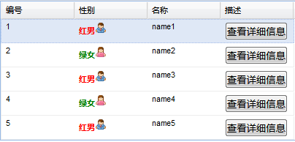
Practice
grid\gridColorPicture.html

Slide 16
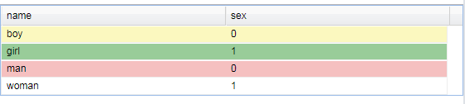
Ext.grid.GridView
This class encapsulates the UI of an Ext.grid.GridPanel. Methods of this class may be used to access UI elements to enable special display effects.
In GridPanel, there have property ‘viewConfig’ to implement the grid view.
grid\ gridView.html

Slide 17
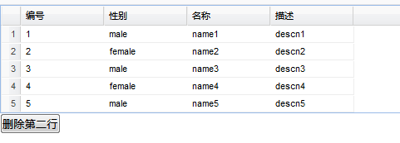
View Refresh
There have a way to manual refresh our grid while the grid view being updated:
grid.view.refresh()
grid\ displayRownumber.html

Slide 18
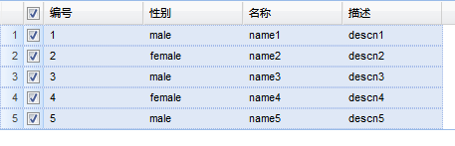
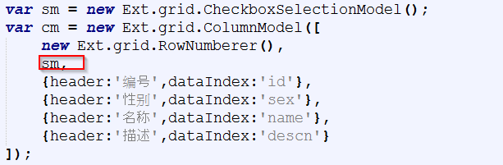
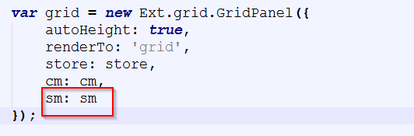
Ext.grid.CheckboxSelectionModel
Provide checkbox ability in Grid to enable check for rows.
grid\ gridWithCheckbox.html

Slide 19
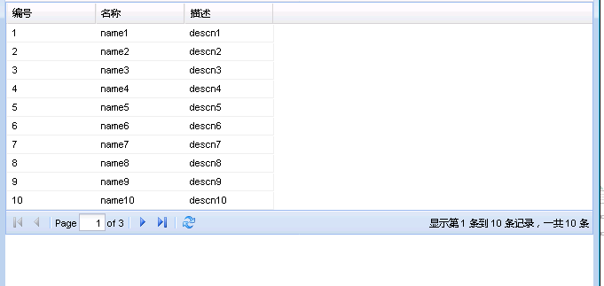
Grid Paging
bbar: new Ext.PagingToolbar({
pageSize: 4,
store: store,
displayInfo: true,
displayMsg: '显示第 {0} 条到 {1} 条记录，一共 {2} 条',
emptyMsg: "没有记录"
})
grid\ gridPaging.html

Slide 20
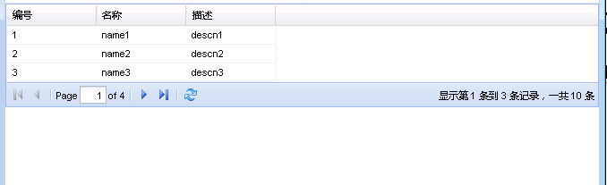
Ext.data.PagingMemoryProxy
1.<script type="text/javascript" src="PagingMemoryProxy.js"></script>
2.proxy: new Ext.data.PagingMemoryProxy(data)
3. \ext-3.0.0\examples\ux-> PagingMemoryProxy.js
grid\ gridPagingFrontend.html

Slide 21
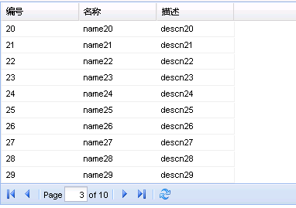
Grid Paging Ajax
reader: new Ext.data.JsonReader({
totalProperty: 'totalRecordCount',
root: ‘dataRoot’
}
store.load({params:{start:0,limit:10}});
// it will add this 2 param to HTTP request
grid\ gridPagingAjax.html

Slide 22
Practice
Try to use grid view customize display of rows and use paging toolbar in gird.

Slide 23
Store Data Flow
Store.load
Call Proxy
Send HTTP request to backend
Reader read response data

Slide 24
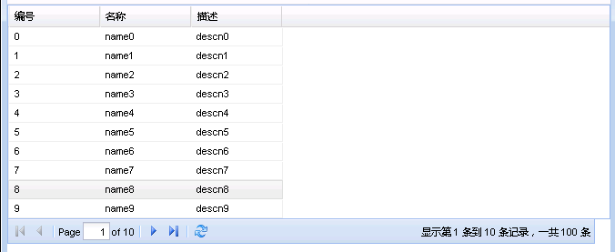
Store Sorting in Backend
By setting ‘remoteSort’ to true, then clicking on a Grid Column's header causes the current page to be requested from the server appending “sort” and “dir” in “params”.
var store = new Ext.data.Store({
remoteSort: true
});
//backend get the param
request.getParameter("sort");
request.getParameter("dir");
grid\ gridSrotBackend.html

Slide 25
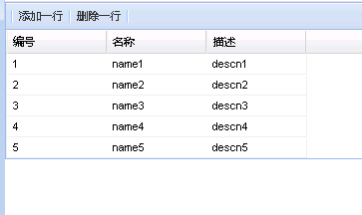
Store Record
Add:
store.insert(0, record);
Delete:
var record = store.getAt(cell[0]);
store.remove(record);
grid\ editorGrid2.html

Slide 26
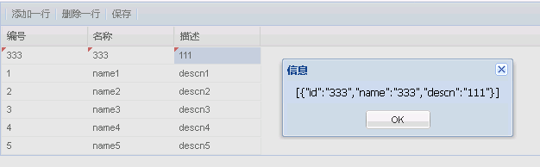
Save Gird Modified Data
var m = store.modified.slice(0);
grid\ saveModifiedGridData.html

Slide 27
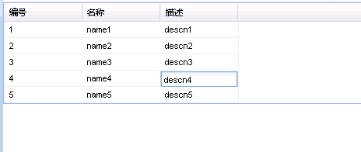
Ext.grid.EditorGridPanel
Provide ability to gird modify data and column model that support customize editor like below:
editor: new Ext.grid.GridEditor(
new Ext.form.TextField({
allowBlank: false
})
)
grid\ editorGrid1.html

Slide 28
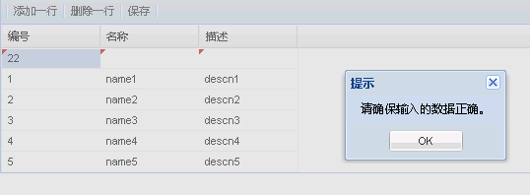
Ext.Editor
A base editor field that handles displaying/hiding on demand and has some built-in sizing and event handling logic.
var editor = cm.getCellEditor(colIndex).field;//return form field object.
grid\ gridValidation.html

Slide 29
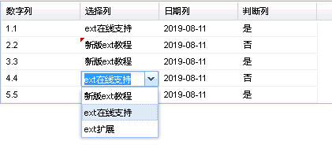
Ext.grid.GridEditor
NumberField, ComboBox, DateField, Checkbox
editor: new Ext.grid.GridEditor(new Ext.form.NumberField({
allowBlank: false,
allowNegative: false,
maxValue: 10
}))
grid\ dataTypeInGrid.html

Slide 30
Practice
Try to use store insert/add/remove gird data, customize column model editor component type.

Slide 31
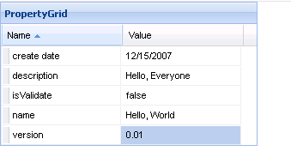
Ext.grid.PropertyGrid
source: {
"name": "Hello, World",
"create date": new Date(Date.parse('12/15/2007')),
"isValidate": false,
"version": .01,
"description": "Hello, Everyone"
}
grid\ propertyGird.html

Slide 32
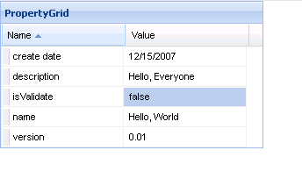
Read Only Property Grid
grid.on("beforeedit", function(e){
e.cancel = true;
return false;
});
grid\ propertyGird2.html

Slide 33
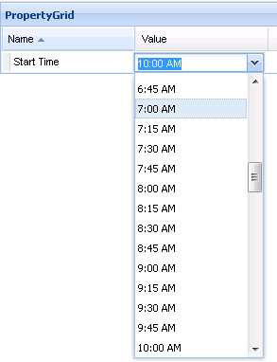
Customized Editor in Property Gird
customEditors: {
'Start Time': new Ext.grid.GridEditor(new Ext.form.TimeField({selectOnFocus:true}))
},
source: {
'Start Time': '10:00 AM'
}
grid\ propertyGird3.html

Slide 34
Practice
Try to get name and value
Ext.getCmp('proId').getStore().getById('create date').get('value’).
Notes:
25 + 15 minutes practice, -11: 50, 13:30 PM ask whether need more time to do this practice(give more 10~20 minutes)

Slide 35
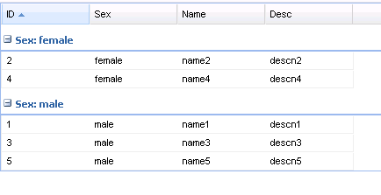
Grouping in Grid
var store = new Ext.data.GroupingStore({
groupField: 'sex',
sortInfo: {field: 'id', direction: "ASC"}
});
view: new Ext.grid.GroupingView()//GridPanel
grid\ groupingStoreGrid.html

Slide 36
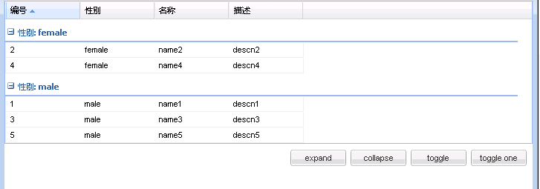
GroupView
grid.getView()
grid\ groupview.html

Slide 37
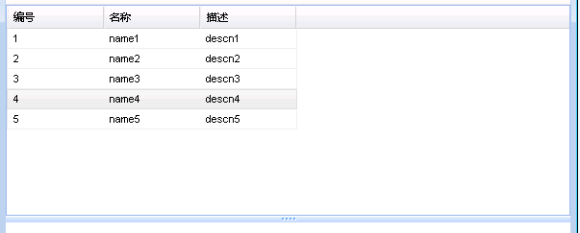
Resize in Grid
var rz = new Ext.Resizable(grid.getEl(), {
wrap: true,
minHeight:100,
pinned:true,
handles: 's'
});
rz.on('resize', grid.syncSize, grid);
grid\ gridDropDrag.html

Slide 38
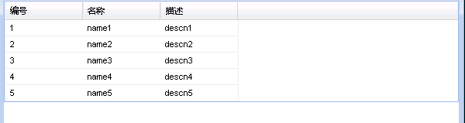
Drag and Drop in One Grid
enableDragDrop: true
Need Ext.dd.DropTarget
grid\ gridDropDrag2.html

Slide 39
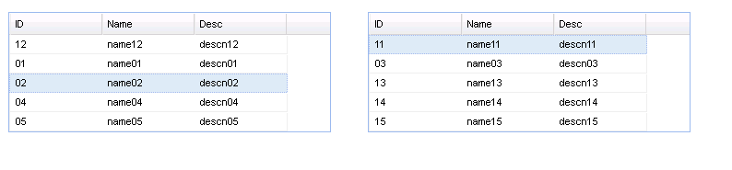
Drag and Drop between Grids
enableDragDrop: true
Need Ext.dd.DropTarget
grid\ gridDragDropBetweenGrids.html

Slide 40
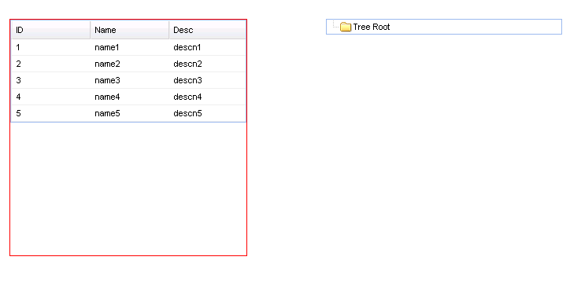
Drag and Drop Grid between Tree and Grid

Slide 41
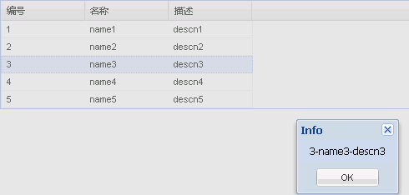
Grid ConextMenu
grid.on("rowcontextmenu", function(grid, rowIndex, e){
e.preventDefault();
grid.getSelectionModel().selectRow(rowIndex);
contextmenu.showAt(e.getXY());
});
grid\ gridContextMenu.html

Slide 42
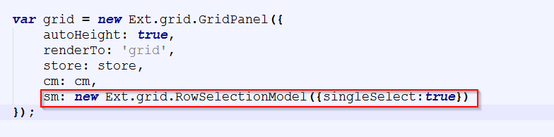
Ext.grid.RowSelectionModel
In ExtJS, grid default uses RowSelectionModel, Grid default supports to select multiple rows.
1. Allow to only select one row
grid\ selectionModelOneSingleRow.html

Slide 43
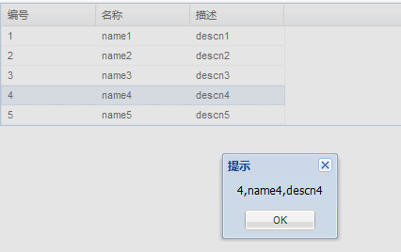
SelectionModel
How to implement such function?
grid\ selectionMultipleRows.html

Slide 44

Homework
Try to use grid component that implement student management page:
There have form[name, class, sex, age, birthday, avatar] for adding new student.
When click ‘add’ button, student will insert into selected gird rows, default insert into first row if not row selected.
Enable sorting for name and class column, can grouping by class.
The gird support edit, and support context menu to adjust row sequence, menu contains “Up”, “Down”, “First”, “Last” option.
Page support paging.
Grid should display the row number and support checkbox function, we can click “Delete” button to delete those selected rows.

