Slide 1
ExtJS 3
For 2019 ITA (Day1)

Slide 2
Learning Target
Can read ExtJS3 based code.
Know how to use standard component and layout.
Know how to customize component and event.
Know how to manage component and event.
Know how to reference on ExtJS3 API document.
Know how to debug and trace issue.

Slide 3
Agenda
Phylogeny
Quick Start
Component
Form
Event & Class
Tree
Menu
Util
Grid
Layout

Slide 4


Phylogeny
Yahoo! User Interface (YUI)
YUI-Ext
Sencha ExtJS
Jack Slocum, 2006
2007 version 1.0 released
2009.05.04 version 3.0 released!

Slide 5
Apache Server
class 1:
\\zha-ita007-w10\2019 Summer\Env Setup\httpd-2.2.25-win32-x86-no_ssl.msi
Class 2:
\\zha-ita038-w10\2019 Summer\Env Setup\httpd-2.2.25-win32-x86-no_ssl.msi
Class 3:
\\zha-ita069-w10\2019 Summer\Env Setup\httpd-2.2.25-win32-x86-no_ssl.msi
Class 4:
\\zha-ita100-w10\2019 Summer\Env Setup\httpd-2.2.25-win32-x86-no_ssl.msi
Notes:
20 minutes

Slide 6
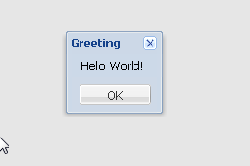
Hello World!
<Script>
Ext.onReady(function() {
Ext.MessageBox.alert('Greeting', 'Hello World!');
});
</Script>
HelloWorld.html

Slide 7

Practice
Write your Hello World!

Slide 8
Quick Start

Slide 9


Slide 10
Elements
Image
Input Field
Search Button
Layout

Slide 11
Image
{
xtype: 'box',
height: 100,
autoEl: {
tag: 'img',
src: 'google2.png'
}
}

Slide 12
Input Field
{
xtype: 'field’,
width: 1200,
height: 50
}

Slide 13
Button
{
xtype: 'button',
width: 80,
height: 40,
text: 'Google Search'
}

Slide 14
Layout
table
hbox

Slide 15
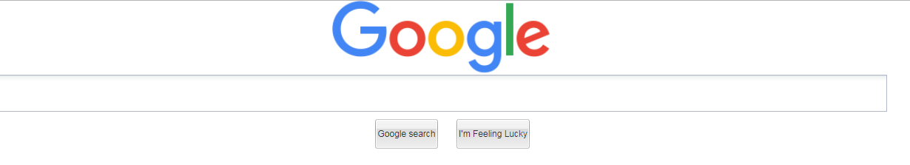
QuickStart.html

Slide 16
Event and Class

Slide 17
Event
Ext JS framework core concept is event mechanism, it divide into element event and component event.
Element event: extend from browser event
e.g: document.getElementById('test').onclick = function(){
//Do something
};
Component event: using observer pattern implement by Ext JS
Browser event limitation: can only bind one event handler

Slide 18
Class Definition
There have two ways to define a new class:
Student = function(name){
this.name = name;
};
Ext.extend(Student, Ext.util.Observable, {});
Student = Ext.extend(Ext.util.Observable, {
constructor: function(config) {
this.name = config.name;
Student.superclass.constructor.call(this, config);
}
});

Slide 19
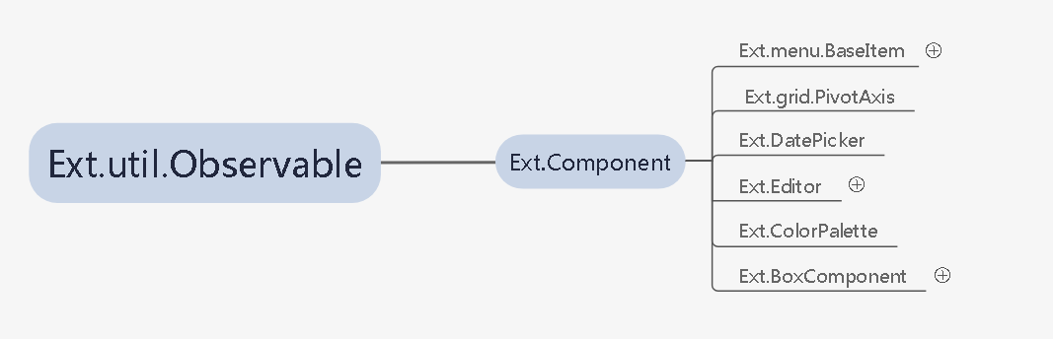
Overall map

Slide 20
Ext.util.Observable
Provide event handling for Ext components.
addListener/on
removeListener/un
addEvents
fireEvent

Slide 21
Customize Event
Create Class and Add Event:
Person = Ext.extend(Ext.util.Observable, {
constructor: function(config) {
this.name = config.name;
this.addEvents('walk', 'eat', 'sleep');
Person.superclass.constructor.call(this, config);
},
info: function (action) {
return this.name + ' is ' + action + 'ing';
}
});

Slide 22
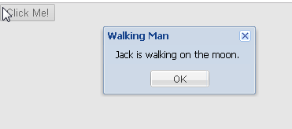
Customize Event
Bind Event Listener:
var person = new Person({name: 'Jack'});
person.on('walk', function() {
Ext.Msg.alert(‘Walking Man', person.name + ' is walking on the moon.');
});
Trigger Event:
person.fireEvent('walk').
CustomizeEvent.html

Slide 23
Ext.EventManager
onDocumentReady
onWindowResize
onTextResize
Ext.onReady()

Slide 24
Practice
Define a bird class, it can fly and sing.

Slide 25
Component

Slide 26
Ext.Component
Ext.BoxComponent
Ext.Editor
Ext.DatePicker
Ext.menu.BaseItem
Ext.ColorPalette
Ext.grid.PivotAxis

Slide 27
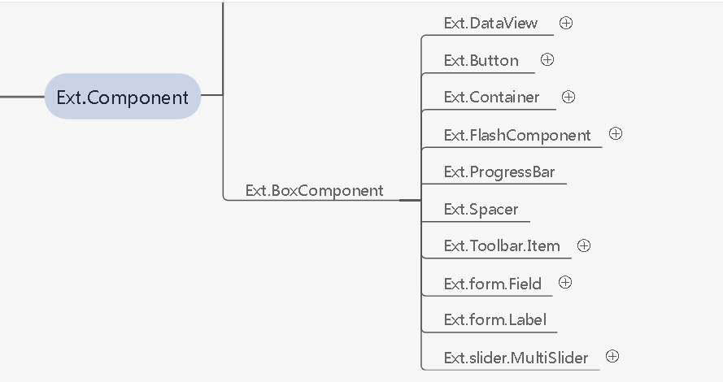
Ext.BoxComponent
This is basic component that provide positioning and resizing ability.

Slide 28

Create BoxComponent
var boxCmp = new Ext.BoxComponent({
el: 'test',
style: 'background-color: red; position:absolute; ',
pageX: 100,
pageY: 50,
width: 200,
height: 150
});
boxCmp.render();
BoxComponent.html
Notes:
Break 10mins-11:00

Slide 29
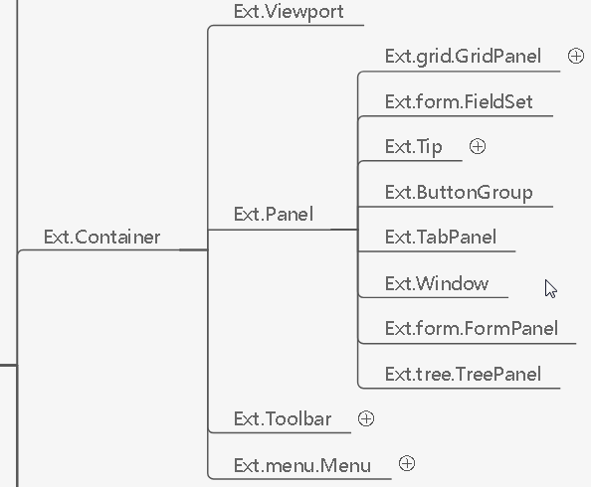
Ext.Container
Basic component that contains other components and layout.
layout and items config properties.

Slide 30

Create Container
var cntr = new Ext.Container({
renderTo: 'test',
style: 'background-color: blue; position:absolute;',
pageX: 100,
pageY: 50,
width: 200,
height: 150
});
Container.html
Notes:
10 minutes (including practice)

Slide 31
Ext.Viewport
A specialized container that renders itself to the document body, and automatically sizes itself to the size of the browser viewport and manages window resizing. There may only be one Viewport created in a page.
The Viewport does not provide scrolling, so child Panels within the Viewport should provide for scrolling if needed using the ‘autoScroll’ config.
Viewport.html

Slide 32
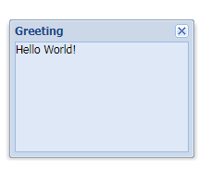
Ext.Window
A specialized panel intended for use as an application window. Windows are floated, resizable, and draggable by default. Windows can be maximized to fill the viewport, restored to their prior size, and can be minimized.
Windows can also be linked to a Ext.WindowGroup or managed by the Ext.WindowMgr to provide grouping, activation, to front, to back and other application-specific behavior.
By default, Windows will be rendered to document.body.
Window.html

Slide 33
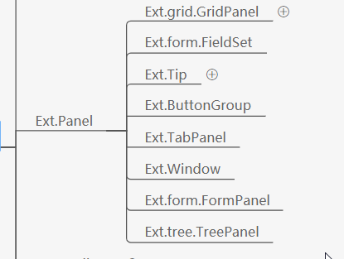
Ext.Panel
Has specific functionality and structural that make it the perfect building block with border.

Slide 34
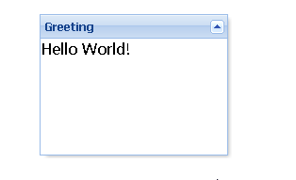
Create Panel
var panel = new Ext.Panel({
renderTo: 'test',
title: 'Greeting',
floating: true,
shadow: true,
draggable: true,
collapsible: true,
html: 'Hello World!',
pageX: 100,
pageY: 50,
width: 200,
height: 150
});
Different between Ext.Container and Ext.Panel?
Panel.html
Notes:
15 minutes

Slide 35
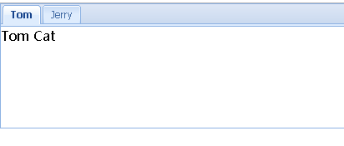
Ext.TabPanel
Commonly used component that can directly use in page, it support multiple tab to display our content.
var tabPanel = new Ext.TabPanel({
renderTo: document.body,
height: 150
});
tabPanel.add({
title: 'Tom',
html: 'Tom Cat'
});
tabPanel.add({
title: 'Jerry',
html: 'Jerry Mouse'
});
tabPanel.activate(0);
Hint: autoload property for tab item.
TabPanel.html
Notes:
10 minutes 11:35

Slide 36
Customize Component
Create customize component
Hint: Ext.ns, Ext.reg
Ext.ns('com.ita');
com.ita.CancelButton = Ext.extend(Ext.Button, {
text : 'Cancel',
initComponent : function() {
com.ita.CancelButton.superclass.initComponent.call(this);
this.on('click', this.onButtonClick, this);
},
onButtonClick : function(oEvent) {
Ext.Msg.alert('Cancel Button', 'This is customized cancel button, you clicked me. ');
}
});
Ext.reg('com.ita.CancelButton', com.ita.CancelButton);

Slide 37
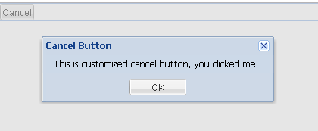
Customize Component
XTYPE
Specify component type when using component in items property.
var panel = new Ext.Panel({
renderTo: 'test',
items:[
{
xtype: 'com.ita.CancelButton'
}
]
});
panel.render();
CustomizeComponent.html

Slide 38
Practice
Define a cancel button class that extend from Ext.Button, the button with red color and can use it with xtype.

Slide 39
Component Classification
Component can be distinguished into 3 classes:
Basic Component
Toolbar Component
Form Component

Slide 40
Basic Component
xtype | component name
Box | Ext.BoxComponent
Button | Ext.Button
Colorpalette | Ext.ColorPalette
Component | Ext.Component
Container | Ext.Container
Cycle | Ext.CycleButton
Dataview | Ext.DatatView
Datepicker | Ext.DatePicker
Editor | Ext.Editor
Editorgrid | Ext.gird.EditorGridPanel
Grid | Ext.grid.GridPanel
Paging | Ext.PagingToolbar
Panel | Ext.Panel
Progress | Ext.ProgressBar
Splitbutton | Ext.SplitButton
Tabpanel | Ext.TabPanel
Treepanel | Ext.tree.TreePanel
Viewport | Ext.ViewPort
Window | Ext.Window

Slide 41
Toolbar Component
xtype | component name
Toolbar | Ext.Toolbar
Tbfill | Ext.Toolbar.Fill
Tbitem | Ext.Toolbar.Item
Tbseparator | Ext.Toolbar.Separator
Tbspacer | Ext.Toolbar.Spacer
Tbtext | Ext.Toolbar.TextItem

Slide 42
Form Component
xtype | component name
From | Ext.FormPanel
Checkbox | Ext.form.CheckBox
Datefield | Ext.form.DateField
Field | Ext.form.Field
Fieldset | Ext.form.FieldSet
Hidden | Ext.form.Hidden
Htmleditor | Ext.form.HtmlEditor
Numberfield | Ext.form.NumberField
Radio | Ext.form.Radio
Textarea | Ext.form.Textarea
Textfield | Ext.form.Textfield
Timefield | Ext.form.Timefield
Trigger | Ext.form.TriggerField

Slide 43
Ext.ComponentMgr
Provides a registry of all Components (instances of Ext.Component or any subclass thereof) on a page so that they can be easily accessed by component id.
Key Method
create: creates a new component.
createPlugin: creates a new plugin.
get: returns a component by id, same with Ext.getCmp()
register: registers a component.
registerPlugin: registers a new plugin constructor, keyed by a new Ext.Component.ptype. Same as Ext.preg.
registerType: registers a new component constructor, keyed by a new Ext.Component.xtype. Same as Ext.reg.
unregister: Unregisters a component.
Notes:
15 minutes + 10 minutes practice, CustomizeComponent.html explain how to use Ext.getCmp or Ext.ComponentMgr.get get the component object in debugger tool

Slide 44
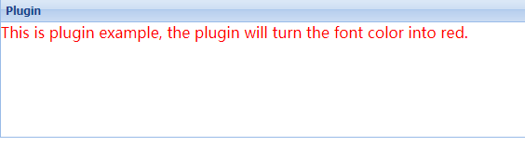
Plugin
Plugins provide custom functionality for the component; a plugin is an ExtJS class that usually don't need to extend any ExtJS class.
Define plugin:
Use plugin:
ColorPlugin = function() {
this.init = function(cmp){
cmp.bodyStyle = 'color:red';
};
};
new Ext.Panel({
plugins: [new ColorPlugin()]
});
Plugin.html

Slide 45
Ext.extend VS Plugin
When we cannot modify component scenario.
Different components but need same behavior.
Same component but different behavior.
Item | Ext.extend | plugin
Same points | Both can extend current defined class implementations or functions.
Differentia | Return new class and class name is the variable name, e.g: MyPanel = Ext.extend(Ext.Panel, {…}); | 1. Cannot run as UI component independently, it must be a plugin config item for other UI component. 2. Usually don't extend any ExtJS class.
ExtendAndPlugin.html
Notes:
20 minutes

Slide 46
Practice
Define a panel plugin, when panel html content contains “plugin” key word, the font color turn into red.

Slide 47
Component Life Cycle
Create
Generate component ID
Register into Ext.ComponentMgr
Render
addClass
Destroy
Remove element
Init event
Init component
Init plugins
Init state
Cancel task
Unregister from Ext.ComponentMgr
Purge listeners
applyStyles
addClassOnOver
Update DOM element
Apply XTemplate
Notes:
15 minutes, Show component.js source code, 15:45

Slide 48
Day1 Homework
Try to use component implement google search page UI.

