Slide 1
ExtJS 3
For 2019 ITA(Day3)

Slide 2
Agenda
Phylogeny
Quick Start
Component
Form
Event & Class
Tree
Menu
Util
Grid
Layout

Slide 3
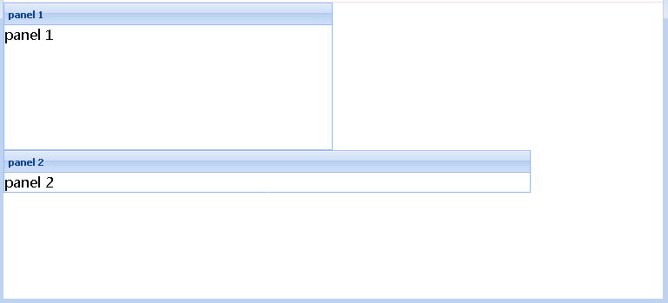
AnchorLayout
It could assign each item take percentage of whole layout.
layout\anchorLayout1.html

Slide 4

Practice
Try to use attribute ‘anchor’ with pixels value in anchor layout.

Slide 5
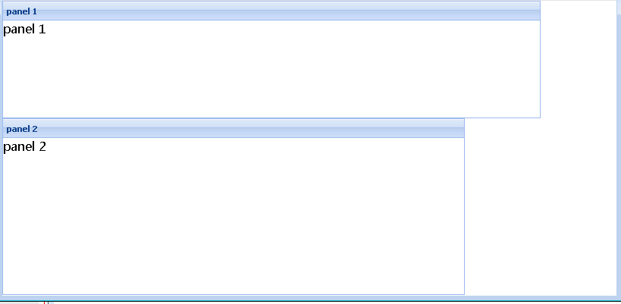
Mixed Configure in AnchorLayout
anchor: '-200 60%'
layout\anchorLayout3.html

Slide 6
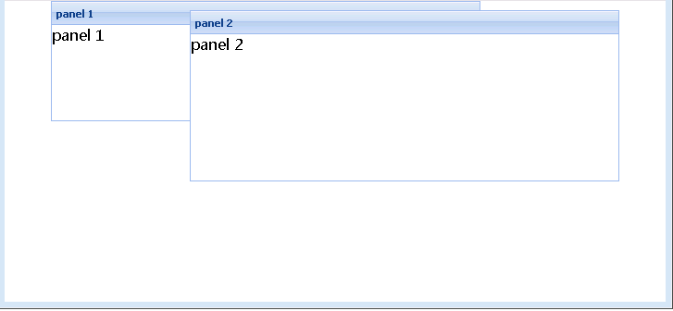
AbsoluteLayout
x: 50,
y: 0,
anchor: '-200 40%'
layout\Absolutelayout.html

Slide 7
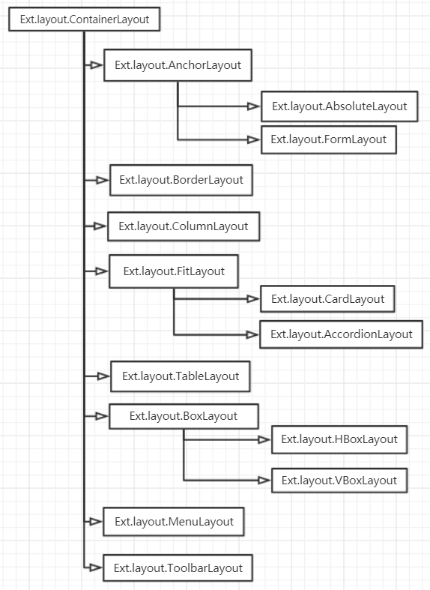
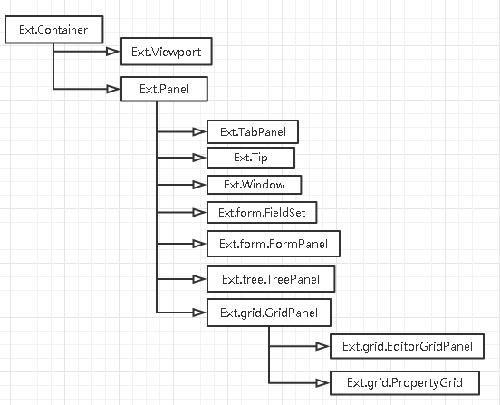
Layout

Slide 8
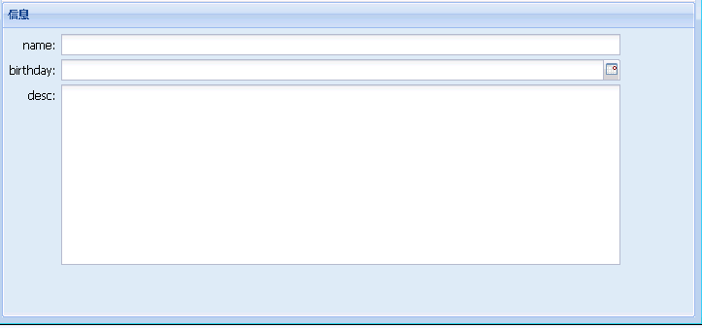
FormLayout
{
fieldLabel: 'name',
name: 'name',
anchor: '90%'
}
layout\formLayout.html

Slide 9
FormLayout
{
fieldLabel: 'name',
name: 'name',
anchor: '90%'
}
layout\formLayout.html

Slide 10
Practice
Try to use form layout with attribute ‘anchor’.

Slide 11
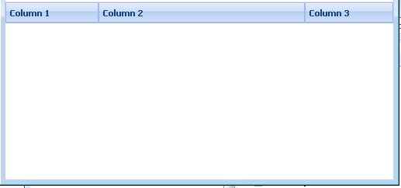
ColumnLayout
{
layout:'column',
items: [{
title: 'Column 1',
width: 120
},{
title: 'Column 2',
columnWidth: .7
},{
title: 'Column 3',
columnWidth: .3
}]
}
layout\columnLayout.html

Slide 12
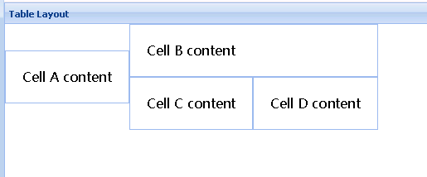
TableLayout
{
title: 'Table Layout',
layout:'table’,
layoutConfig: {
columns: 3
}
}
Layout\tableLayout.html

Slide 13
Practice
Try to use table layout.

Slide 14
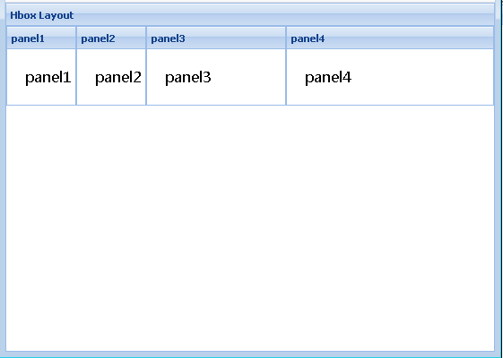
HBoxLayout
xtype: 'panel',
title: 'Hbox Layout',
layout:'hbox',
layoutConfig: {
align: 'left',
pack: 'start'
}
Layout\hboxLayout.html

Slide 15
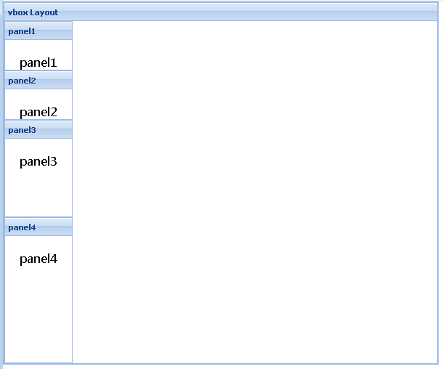
VBoxLayout
xtype: 'panel',
title: 'vbox Layout’,
layout:'vbox’,
layoutConfig: {
align: 'left',
pack: 'start'
}
Layout\vboxLayout.html

Slide 16
Practice
Try to use hbox and vbox layout.

Slide 17
Tree

Slide 18

Ext.tree.TreePanel
Provide tree structure component that can easily build tree-based UI element.

Slide 19

Create a Tree
var tree = new Ext.tree.TreePanel({
renderTo: ‘test’
});
Tree.html

Slide 20
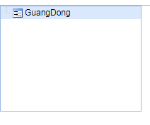
Ext.tree.TreeNode
Create Root for Tree:
var root = new Ext.tree.TreeNode({text: ‘GuangDong’});
tree.setRootNode(root);
tree.render();
Tree2.html

Slide 21
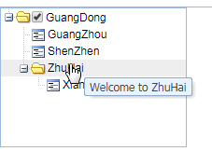
Add Leaves
var gz = new Ext.tree.TreeNode({text: ‘GuangZhou’});
var sz = new Ext.tree.TreeNode({text: ‘ShenZhen’});
var zh = new Ext.tree.TreeNode({text: ‘ZhuHai’});
var xz = new Ext.tree.TreeNode({text: ‘XiangZhou’});
root.appendChild(gz);
root.appendChild(sz);
root.appendChild(zh);
zh.appendChild(xz);
Tree3.html

Slide 22
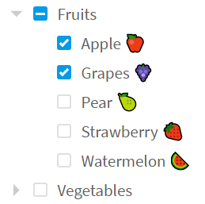
Practice
Try to create a tree.

Slide 23

Ext.tree.TreeLoader
Provide ability to auto load tree data to tree panel.

Slide 24
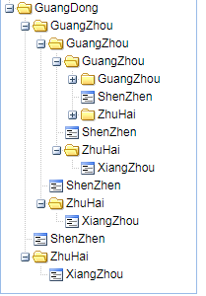
Ext.tree.AsyncTreeNode
Provide ability to Ajax load data.
var tree = new Ext.tree.TreePanel({
renderTo: ‘test’,
loader: new Ext.tree.TreeLoader({dataUrl: ‘tree.txt’}),
root: new Ext.tree.AsyncTreeNode({text: ‘GuangDong’})
});
Tree4.html

Slide 25
Practice
Try to use children property in AsyncTreeNode to read load JSON data and create the tree.

Slide 26
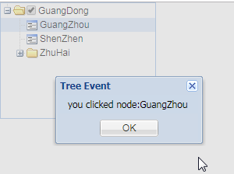
Tree Event
Ext provide click/node event for customize handling for tree component:
expandnode/collapsenode
click/dblclick
checkchange
……
Bind Event for tree:
tree.on(‘click’, function(node){
Ext.MsgBox.alert(‘Tree Event’, ‘you clicked node:’ + node.text);
});
TreeEvent.html

Slide 27
Practice
Try to alert user when expanded node or collapse node.

Slide 28
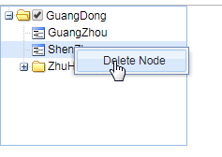
Context Menu
Context menu is a useful function when using tree UI, we can customize context menu for tree through binding ‘contextmenu’ event:
var tree = new Ext.tree.TreePanel({
contextMenu: menu,
listeners: {
contextmenu: function(node, e){……}
}
});
TreeContextMenu.html

Slide 29
Practice
Try to add a context menu for tree to show current node info.

Slide 30
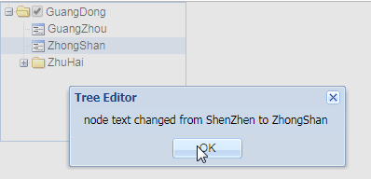
Ext.tree.TreeEditor
Provide ability to modify tree node info for tree UI component.
var treeEditor = new Ext.tree.TreeEditor(tree, {allowBlank: false}, {
listeners: {
complete: function(editor, currVal, origVal) {
Ext.Msg.alert('Tree Editor', 'node text changed from ' + origVal + ' to ' + currVal);
}
}
});
TreeEditor.html

Slide 31
Practice
Try to use tree editor, if the node text contains ‘Zh’, then node text color turn into red.

Slide 32
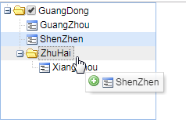
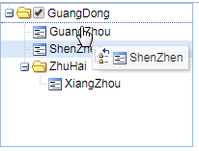
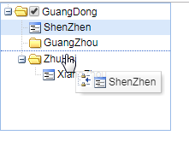
Drag and Drop
Ext.tree.TreePanel support drag and drop node while setting property enableDD to true, and drag and drop have 3 patterns:
append: drop node becomes the child of target node.
above: drop node becomes the brother node inserted before target node.
below: drop node becomes the brother node inserted after target node.
TreeDragAndDrop.html

Slide 33
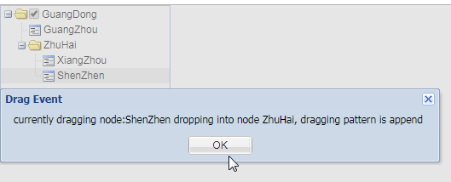
Drag and Drop Event
‘nodedrop’ event will be triggered while drop the node:
tree.on(‘nodedrop’, function(e) {
Ext.Msg.alert(‘Drag Event’, ‘currently dragging node:’ + e.dropNode.text + ‘ dropping into node:’ + e.target.text + ‘, dragging pattern is ’ + e.point);
});
TreeDragAndDropEvent.html

Slide 34
Practice
Try to drag tree1 node into tree2 node

Slide 35
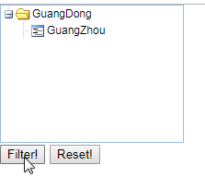
Ext.tree.TreeFilter
Provide ability to filter tree nodes when there have lots of node in tree.
Key Method:
clear: reset all filter.
filter: encapsulate the filterBy method.
filterBy
TreeFilter.html

Slide 36
Practice
Try to use input filed to do the filter while key press up.

Slide 37
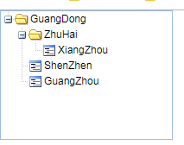
Ext.tree.TreeSorter
Provides sorting of nodes in an Ext.tree.TreePanel.
new Ext.tree.TreeSorter(tree, {
caseSensitive: true,
dir: ‘desc’,
folderSort: true
});
TreeSorter.html

Slide 38
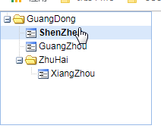
Ext.tree.TreeNodeUI
Provides the default UI implementation for Ext.tree.TreeNodes. This component implementation is separate from the tree implementation and allows customizing of the appearance of tree nodes.
tree.on(‘click’, function(node){
var ui = node.ui;
ui.addClass(‘big’);
Ext.defer(function(){
ui.removeClass(‘big’);
}, 1000);
});
TreeNodeUI.html

Slide 39
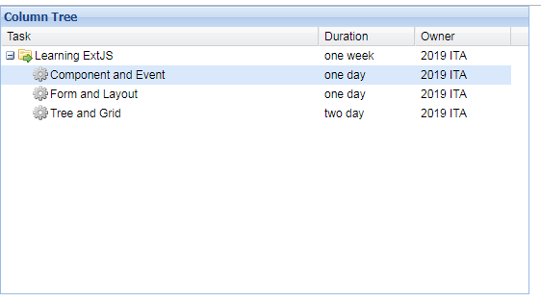
Ext.tree.ColumnTree
Currently, ColumnTree is not a standard component class, we need to manually include the CSS file and source JS file under examples/tree folder.
ColumnTree.html

Slide 40
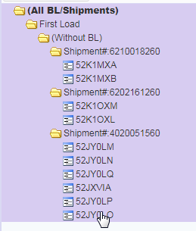
Day3 Homework
Try to use tree component that implement student management page:
There have input field for add new student or class
When click ‘add’ button, student will insert into selected tree node, if selected node is class, then add as sub-node, otherwise add as sibling
The tree node support edit, and the tree support context menu to add class or student.

