Slide 1
ExtJS 3
For 2019 ITA(Day4)

Slide 2
Agenda
Phylogeny
Quick Start
Component
Form
Event & Class
Tree
Menu&Toolbar
Util
Grid
Layout

Slide 3
Menu&Toolbar

Slide 4
Ext.Toolbar
Toolbar is a bar that contains many menu items, normally the menu item is a button.

Slide 5
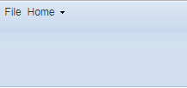
Create Simple Toolbar
var toolbar = new Ext.Toolbar({
renderTo: document.body,
width: 600,
height: 100,
items: [
{ text: ‘File’ },
{ xtype: ‘splitbutton’, text: ‘Home’}
]
});
Toolbar.html

Slide 6
Toolbar Components
xtype | component name
Toolbar | Ext.Toolbar
Tbfill | Ext.Toolbar.Fill
Tbitem | Ext.Toolbar.Item
Tbseparator | Ext.Toolbar.Separator
Tbspacer | Ext.Toolbar.Spacer
Tbtext | Ext.Toolbar.TextItem

Slide 7
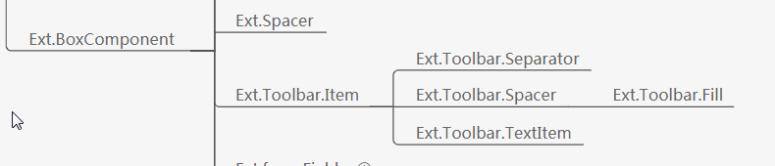
Ext.Toolbar.Item
The base class that other non-interacting Toolbar Item classes should extend in order to get some basic common toolbar item functionality.

Slide 8
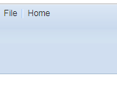
Ext.Toolbar.Separator
A simple class that adds a vertical separator bar between toolbar items (css class:'xtb-sep’):
new Ext.Panel({
tbar : [
'Item 1',
{xtype: 'tbseparator'}, // or '-'
'Item 2'
]
});
ToolbarSeparator.html

Slide 9
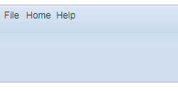
Ext.Toolbar.Spacer
A simple element that adds extra horizontal space between items in a toolbar. By default a 2px wide space is added via css specification.
new Ext.Panel({
tbar : [
'Item 1',
{xtype: 'tbspacer'}, // or ' '
'Item 2',
// space width is also configurable via javascript
{xtype: 'tbspacer', width: 50}, // add a 50px space
'Item 3'
]
});
ToolbarSpacer.html

Slide 10

Ext.Toolbar.Fill
A non-rendering placeholder item which instructs the Toolbar's Layout to begin using the right-justified button container, it is extended from Spacer class:
new Ext.Panel({
tbar : [
'Item 1',
{xtype: 'tbfill'}, // or '->'
'Item 2'
]
});
ToolbarFill.html

Slide 11
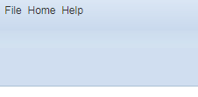
Ext.Toolbar.TextItem
A simple class that renders text directly into a toolbar (with css class:'xtb-text’:
new Ext.Panel({
tbar : [
{xtype: 'tbtext', text: 'Item 1'} // or simply 'Item 1'
]
});
ToolbarTextItem.html

Slide 12

Practice
Try to create a toolbar that contains spacer, fill and separator.

Slide 13
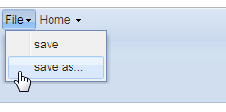
Ext.menu.Menu
Those button in toolbar is Menu.
var menu = new Ext.menu.Menu({
items: [
{text: ‘save’}, {text: ‘save as…’}
]
});
Menu.html

Slide 14
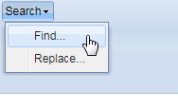
Ext.menu.Item
A base class for all menu items that require menu-related functionality (like sub-menus) and are not static display items. Item extends the base functionality of Ext.menu.BaseItem by adding menu-specific activation and click handling.
MenuItem.html

Slide 15
Practice
Try to create a toolbar that contains menu item.

Slide 16
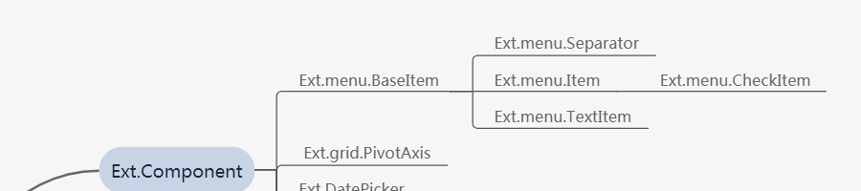
Ext.menu.BaseItem
The base class for all items that render into menus. It provides default rendering, activated state management and base configuration options shared by all menu components.

Slide 17
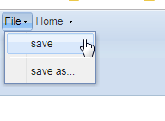
Ext.menu.Separator
There have 3 ways to implement the separator for menu item list:
Add “-” by menu.
Add “separator” by menu.
Add Ext.menu.Separator by menu.
MenuSeparator.html

Slide 18
Practice
Use 3 types separator in menu.

Slide 19
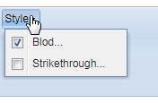
Ext.menu.CheckItem
This component is a special menu item that contains the checkbox component.
MenuCheckItem.html

Slide 20
Practice
Use ‘checkHandler’ to alert current checked item and check status.
Use ‘group’ property implement radio check.

Slide 21
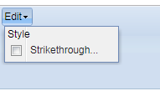
Ext.menu.TextItem
Adds a static text string to a menu, usually used as either a heading or group separator.
MenuTextItem.html

Slide 22
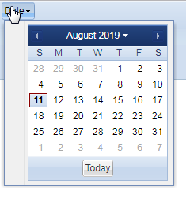
Ext.menu.DateMenu
A menu containing an Ext.DatePicker Component. Constructor for this class accepts all the configuration options of Ext.DatePicker.
DateMenu.html

Slide 23
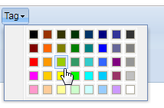
Ext.menu.ColorMenu
A menu containing an Ext.ColorPalette Component. Constructor for this class accepts all the configuration options of Ext.ColorPalette.
ColorMenu.html

Slide 24
Practice
Try to use date menu and color menu to alert out selected value.

Slide 25
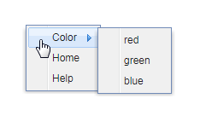
Context Menu
We can customize browser context menu by binding ‘contextmenu’ event:
Ext.get(document).on(‘contextmenu’, function(e){
e.preventDefault();
contextmenu.showAt(e.getXY());
});
ContextMenu.html

Slide 26
Ext.menu.MenuMgr
Provides a common registry of all menu items on a page so that they can be easily accessed by id.
get: Returns an Ext.menu.Menu object.
hideAll: Hides all menus that are currently visible.

Slide 27
Util

Slide 28
Ext.onReady
Adds a listener to be notified when the document is ready (before onload and before images are loaded). Shorthand of Ext.EventManager.onDocumentReady.

Slide 29
Ext.get
Retrieves Ext.Element objects which encapsulate DOM elements. Shorthand of Ext.Element.get.
Note: It always return a new Element object by calling this method, it will cause OOM if call too many times, there have another solution for performance call Ext.fly.

Slide 30
Ext.getCmp
This is shorthand reference to Ext.ComponentMgr.get. Looks up an existing Component by id.

Slide 31
Ext.getDom
Return the dom node for the passed String (id), dom node, or Ext.Element. Same as Ext.get().dom.

Slide 32
Ext.getBody
Returns the current document body as an Ext.Element. This method return the document.body object which warped by Ext.Element.

Slide 33
Ext.getDoc
Returns the current HTML document object as an Ext.Element. This method return the document object which warped by Ext.Element.

Slide 34
Practice
Try to use Ext.get, Ext.getCmp, Ext.getDom, Ext.getBody, Ext.getDoc.

Slide 35
Dom Query and Select
Ext.query: Selects an array of DOM nodes by CSS/XPath selector. Shorthand of Ext.DomQuery.select.
Ext.select: Selects elements based on the passed CSS selector to enable Element methods to be applied to many related elements in one statement through the returned CompositeElement or CompositeElementLite object.
Ext.select.html
Ext.query.html

Slide 36
Practice
Try to use query and select method with css selector.
Try to user xpath selector in query method.

Slide 37
Encode and Decode
Modified version of Douglas Rockford's json.js that doesn't mess with the Object prototype http://www.json.org
Ext.encode: Shorthand for Ext.util.JSON.encode.
Ext.decode: Shorthand for Ext.util.JSON.decode.
Note: HTTP only support ISO-8859-1 encoding, thus need to encode for special character such as Chinese characters.

Slide 38
Ext.extend
Extends one class to create a subclass and optionally overrides members with the passed literal. It is essential that you call the superclass constructor in any provided constructor:
Subclass.superclass.constructor.call(this, config);

Slide 39
apply and applyIf
Ext.apply: Copies all the properties of config to obj.
Ext.applyIf: Copies all the properties of config to obj if they don't already exist.

Slide 40
Ext.namespace
Creates namespaces to be used for scoping variables and classes so that they are not global. Specifying the last node of a namespace implicitly creates all other nodes, shorthand method Ext.ns. Usage:
Ext.namespace('Company', 'Company.data’);
Ext.namespace('Company.data');

Slide 41
Ext.isEmpty
Returns true if the passed value is empty, the value is deemed to be empty if it is:
null
undefined
an empty array
a zero-length string (Unless the allowBlank parameter is true)

Slide 42
Ext.each
Iterates an array calling the supplied function:
Ext.each([1, 2, 3], function(e) {
console.log(e);
});

Slide 43
Practice
Try to use Ext.encode/Ext.deconde, Ext.apply/Ext.applyIf, Ext.ns, Ext.isEmpty, Ext.each

Slide 44
Ext.DomQuery
Provides high performance selector/xpath processing by compiling queries into reusable functions.
Ext.DomQuery.html

Slide 45
Ext.DomHelper
Provides a layer of abstraction from DOM and transparently supports creating elements via DOM or using HTML fragments:
var list = Ext.DomHelper.append(‘testId’, {tag:‘div’, cls:‘red’});
//add a div element to ‘testId’ element and set the div CSS class to ‘red’.

Slide 46
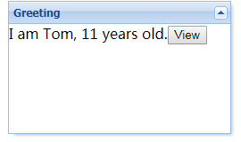
Ext.Template
Represents an HTML fragment template:
var data = {name: ‘Tom’, age:11};
var tpl = new Ext.Template([
‘<table><tr>’,
‘<td>I am {name}, {age} years old.</td>’,
‘<tr></table>’
]);
tpl.compile();
Template.html

Slide 47
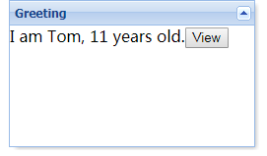
DomHelper Create Template
var tmpl = Ext.DomHelper.createTemplate({
tag: 'tr', children:[
{tag: 'td', html: 'I am {name}, {age} years old.'},
{tag: 'td', html: '<Button>View</Button>'}
]
});
tmpl.append('template', {name:'Tom', age:11});
Template2.html

Slide 48
Practice
Try to use Template in Panel.

Slide 49
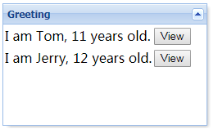
Ext.XTemplate
A template class that supports advanced functionality like:
Auto filling arrays using templates and sub-templates
Conditional processing with basic comparison operators
Basic math function support
Execute arbitrary inline code with special built-in template variables
Custom member functions
Many special tags and built-in operators that aren't defined as part of the API, but are supported in the templates that can be created
XTemplate.html

Slide 50
XTemplate Variable
Varibale Name | Description
values | The data that provided to template
parent | If in sub-template, this variable can access parent variable
xindex | Current loop index, started from 1.
xcount | Loop size.
fm | Ext.util.Format, invoke it if want to do format, such as Ext.util.Format.ellipsis
. | In sub-template, use this access array items, first ‘.’ represent to first element, second ‘.’ represent to second element.

Slide 51
Practice
Try to use XTemplate with if condition.
Hint: there no else statement in template.

Slide 52
Ext.state
Provide ability to save our component status:
Ext.state.Manager.setProvider(new Ext.state.CookieProvider({}));
Ext.state.html

Slide 53
Ext.util.Format
Provide kinds of API method that support convert data into formatted string.
String: capitalize, ellipsis, htmlEncode, lowercase, stripScripts, stripTags, substr, trim
Date: date, dateRender
Empty Value Assertion: defaultValue, undef
Number Conversion: fileSize, usMoney

Slide 54
Ext.util.DelayedTask
Provides a convenient way to "buffer" the execution of a method, performing setTimeout where a new timeout cancels the old timeout. When called, the task will wait the specified time period before executing. If during that time period, the task is called again, the original call will be cancelled.
var task = new Ext.util.DelayedTask(function(){
console.log(‘hello world!’ + new Date().getTime());
});
task.delay(3000);
DelayTask.html

Slide 55
Ext.util.TaskRunner
Provides the ability to execute one or more arbitrary tasks in a multithreaded manner. Generally, you can use the singleton Ext.TaskMgr instead, but if needed, you can create separate instances of TaskRunner. Any number of separate tasks can be started at any time and will run independently of each other.
var task = {
run: function(){
Ext.fly('clock').update(new Date().format('g:i:s A'));
} ,
interval: 1000
}
new Ext.util.TaskRunner().start(task);// same as Ext.TaskMgr.start(task);
TaskRunner.html

Slide 56
Practice
Try to use Format, DelayTask, TaskRunner

Slide 57
Ext.util.MixedCollection
A Collection class that maintains both numeric indexes and keys and exposes events.
Key Methods:
add/addAll
insert
get
remove/removeAt/clear
replace
First/last/getCount
indexOf/find

Slide 58
Ext.KeyNav
Provides a convenient wrapper for normalized keyboard navigation.
The following are all the possible keys that can be implemented:
enter
left/right
up/down
tab
esc
pageUp/pageDown
del
home
end
KeyNav.html

Slide 59
Ext.KeyMap
Provide ability to customize key event handler not only supported by KeyNav, but also other keys.
KeyMap.html

Slide 60
Extend Date
Provide more ability to format or get date info.
Key Method:
add
between
format
parseDate

Slide 61
Extend String
Key Method:
escape
format
leftPad
trim
toggle

Slide 62
Extend Function
Key Method:
createCallback
createDelegate
createInterceptor
createSequence
defer

Slide 63
Extend Number
Key Method:
constrain

Slide 64
Extend Array
Key Method:
indexOf
remove

Slide 65
Homework
Implement a blog reply editor that support toolbar, toolbar contains menu: Edit->Reset, Insert->Table(using Template/XTemplate), there also allow to use context menu to select above menus. When click reply button, it will pop-up progress bar that will disappear after 3 seconds and alert “success”, if reply content is empty, reply button disabled.

