Slide 1

ICT305: DataTales Dashboard
Figure 1: DataTales logo
By: Wadiqa Baig, Areeba Shoaib, Lidya Tesfay Adal, Hiba Zubairi, Warda Baig

Slide 2




Introduction to the case
Problem
Goal
Central Message
Target Audience
Figure 2: Problem logo
Figure 3: Goal logo
Figure 4: Central message logo
Figure 5: Target audience logo
Identifying the specific factors that influence student academic success, as they span academics, lifestyle, and socioeconomic factors.
To build an interactive dashboard that presents actionable insights on the correlation between student habits and academic results.
The dashboard transforms raw data into compelling visual stories that guide educational interventions.
Primary: Educational administrators & advisors
Secondary: Parents
Tertiary: Researchers and policy makers.
https://icons8.com/icons

Slide 3
Group & work allocation
Group Member | Primary Roles
Wadiqa Baig | UI/UX, Introduction, Pre-Processing
Areeba Shoaib | Data Analysis, Setup Documentation
Warda Baig | UI/UX, Presentation
Lidya Tesfay | UI/UX, EDA, Video presentation
Hiba Zubairi | Visuals, Summary
Table 1: Work allocation

Slide 4



Project Deliverables
Figure 6: Interactive logo
Figure 7: Document logo
Figure 8: Camera logo
Interactive Dashboard
An interactive Dash application to explore academic, lifestyle, and socioeconomic variables.
Documentation
A setup documentation to install and run the dashboard locally.
Content
This presentation and a 5-minute video walkthrough of the dashboard.
https://icons8.com/icons

Slide 5
Live Demonstration
We will now continue to a 20-minute live demonstration of the DataTales dashboard!

Slide 6
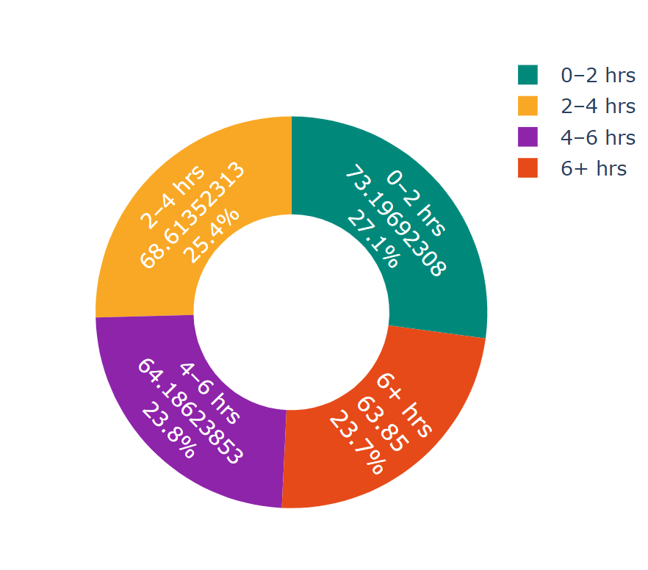
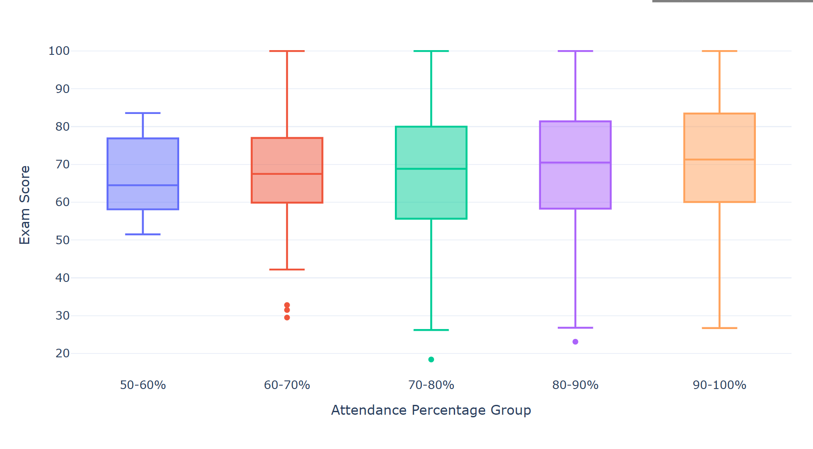
Key Findings
Figure 9 : Attendance Impact Analysis
Figure 10 : Study Efficiency Analysis
Higher attendance percentage groups consistently shows higher overall exam scores.
Students using 0–2 hours of social media have the highest average exam score

Slide 7
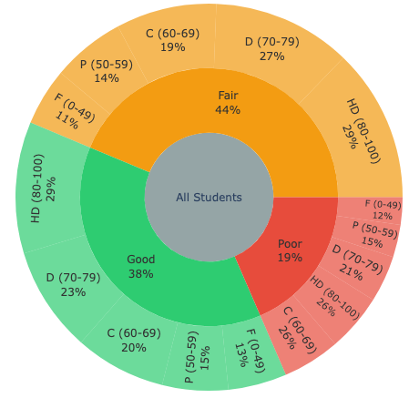
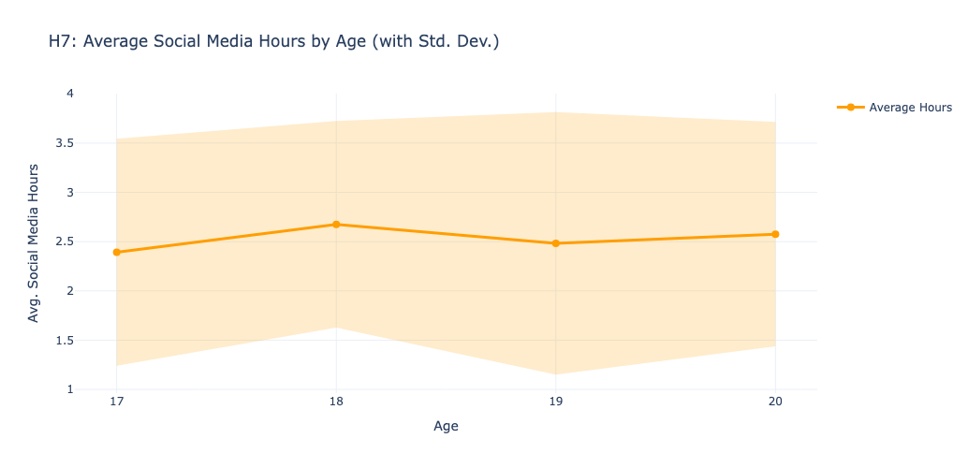
Key Findings
Figure 11 : Age & Social Media Analysis
Figure 12: Diet Quality Impact Analysis
Social media use is high across university ages, but mostly around 18 years old.
While "Good" diet correlates with top scores, the "Fair" diet group also contains a significant 29% of students achieving the highest grades (80–100), which indicates that other factors impact greatly.

Slide 8
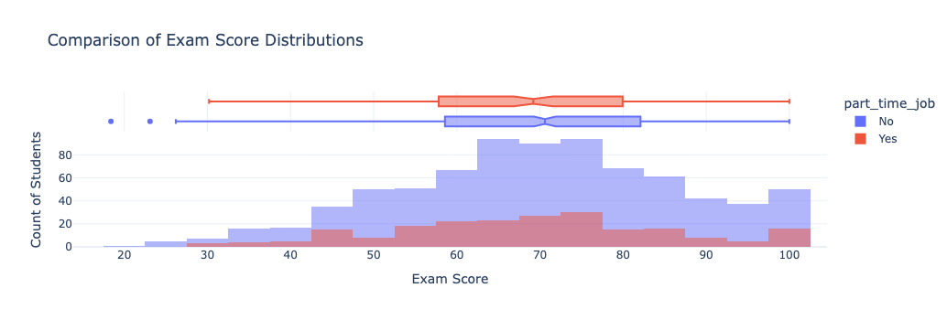
Key Findings
Figure 13: Part-Time Work Impact Analysis
Students without a part-time job show a slight advantage in exam scores

Slide 9
DataTales

