Slide 1
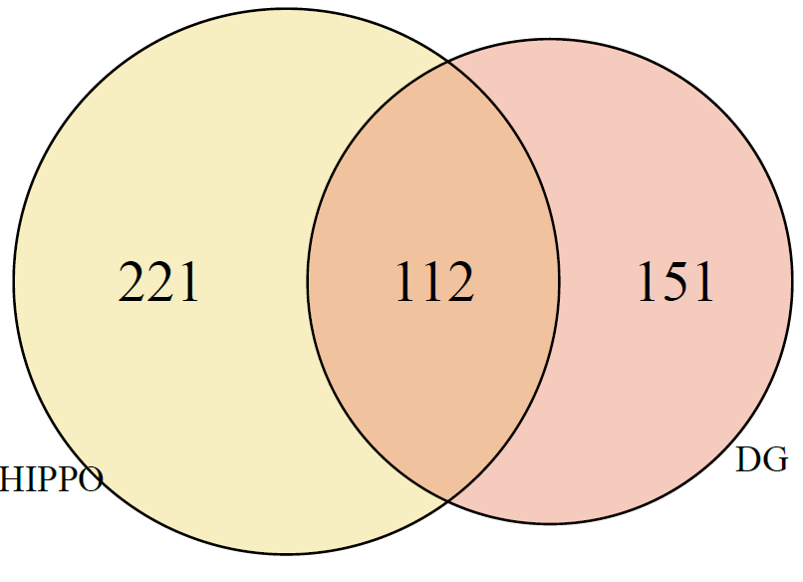
eQTL Analysis
Sample information
Brain overlaps by region:
DG | F | M
Control | 27 | 66
Schiz | 22 | 53
Bipolar | 23 | 43
MDD | 12 | 17
 | DG | HIPPO
Total | 263 | 333
Control / Schiz / Bipolar / MDD | 93 / 75 / 66 / 29 | 200 / 133 / 0 / 0
Female / Male | 84 / 179 | 104 / 229
Mean age (SD) [min, max] | 46.71 (15.31) [15.92, 84.16] | 45.15 (14.98) [17.21, 96.92]
HIPPO | F | M
Control | 57 | 143
Schiz | 47 | 86

Slide 2
eQTL Analysis – PGC Suggestive Plus Proxies (n=179)
Inputs to eQTL analysis:
SNPs
Total SNPs returned from rAggr (proxy and index) | 7221
… that are in our data (input to eQTL) | 6330
Index Loci returned from rAggr | 172
… that are in our data (input to eQTL) | 133
Index Loci that have at least a proxy in our data | 158
Features
# Genes | 21,460
# Transcripts (from # Genes) | 95,027 (33,022)
# Exons (from # Genes) | 358,280 (21,886)
# Junctions (from # Genes) | 241,957 (18,087)

Slide 3
eQTL output: Significant at FDR < 5%
 | DG | HIPPO
# unique SNPs | 4181 | 4006
# index SNPs with FDR < 0.05 | 75 | 73
# index SNPs with proxy < 0.05 | 116 | 105
# unique features (from # gene symbols) | 1999 (432) | 1847 (436)
# Unique genes | 172 (146) | 135 (115)
# Unique transcripts | 318 (233) | 303 (221)
# Unique exons | 1144 (256) | 1052 (259)
# Unique junctions | 365 (173) | 357 (168)
# SNP-Feature Pairs | 68,153 | 54,724
# SNP-Gene Pairs | 6,426 | 4,186
# SNP-Transcript Pairs | 10,291 | 9,444
# SNP-Exon Pairs | 39,894 | 31,267
# SNP-Junction Pairs | 11,542 | 9,827

Slide 4
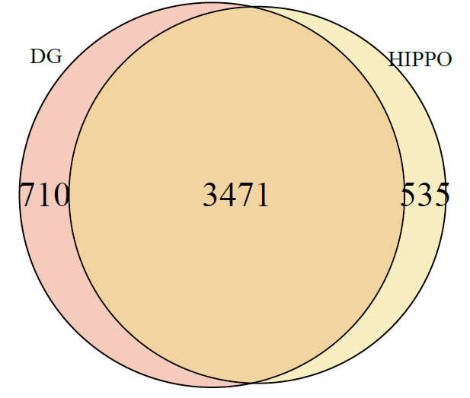
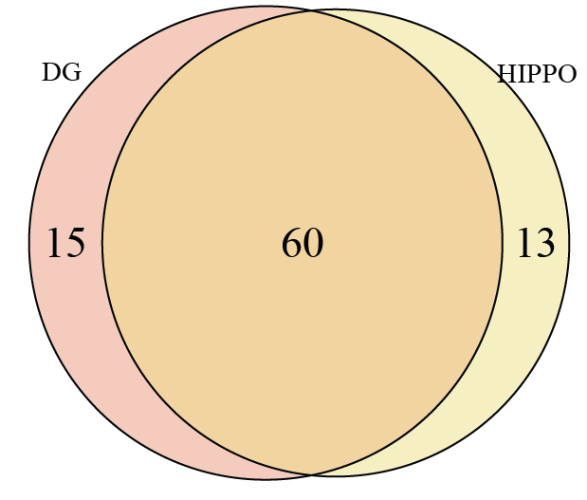
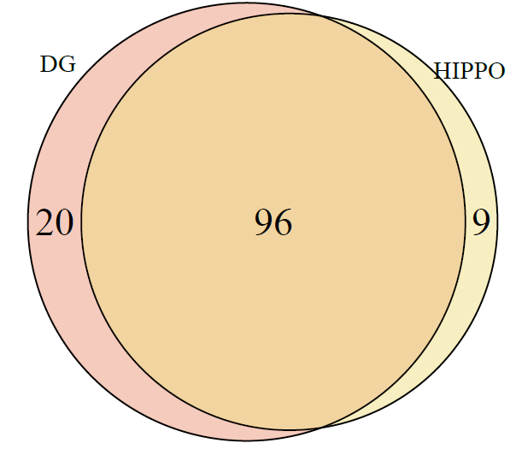
eQTL output: Significant at FDR < 5%
 | DG | HIPPO
# unique SNPs | 4181 | 4006
# index SNPs with FDR < 0.05 | 75 | 73
# index SNPs with proxy < 0.05 | 116 | 105

Slide 5
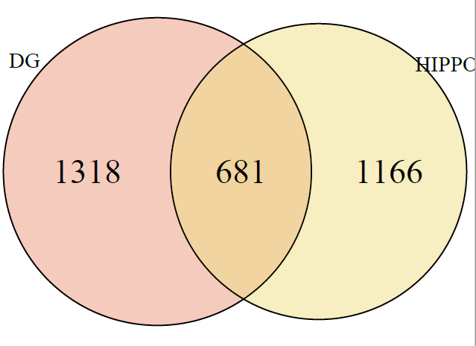
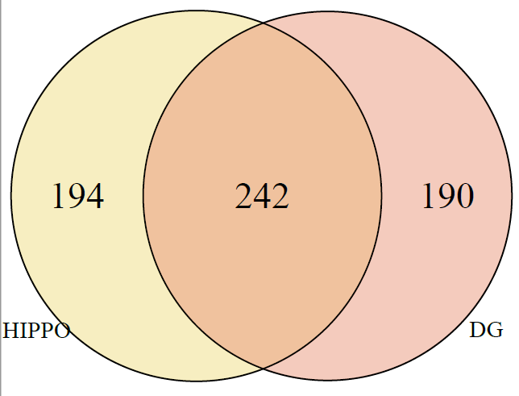
eQTL output: Significant at FDR < 5%
 | DG | HIPPO
# unique features (from # gene symbols) | 1999 (432) | 1847 (436)

