Slide 1
DepSeq: RNA Sequencing in Major Depressive Disorder
Sample information, QC, and DE results
December 30, 2019

Slide 2


Sample information
634 total samples from post mortem brain tissue
147 neurotypical controls, 487 MDD
sACC and Amygdala
Both male (n=435) and female (n=199) samples
319 unique brains: 315 brains sequenced in both regions, 4 brains sequenced in single region.
Age ranges from 18 to 95 (mean=46)
Largely samples of European ancestry (will be dropping the 6 non-European brains)

Slide 3
Data generation
RNA sequencing of sACC and Amygdala on 634 total samples
315 brains sequenced in both regions, 4 brains sequenced in single region.
Median 132M sequenced reads (IQR: 87M-138M)
RiboZero protocol, stranded
Included ERCC spike-ins

Slide 4
RNA-seq Data Processing of sACC/AMYG
0. Merge reads across lanes
1. Quality check (QC) on raw reads: FastQC
2. Failed QC? Then trim reads: Trimmomatic (This occurred with 3 samples, all 3 also failed subsequent checks and were dropped)
3. Align reads to the genome: HISAT2
4. Count features: featureCounts
5. Calculate coverage: bam2wig
6. Quantify transcripts: Salmon
7. Create count tables: R
8. Genotype samples: samtools + vcftools

Slide 5
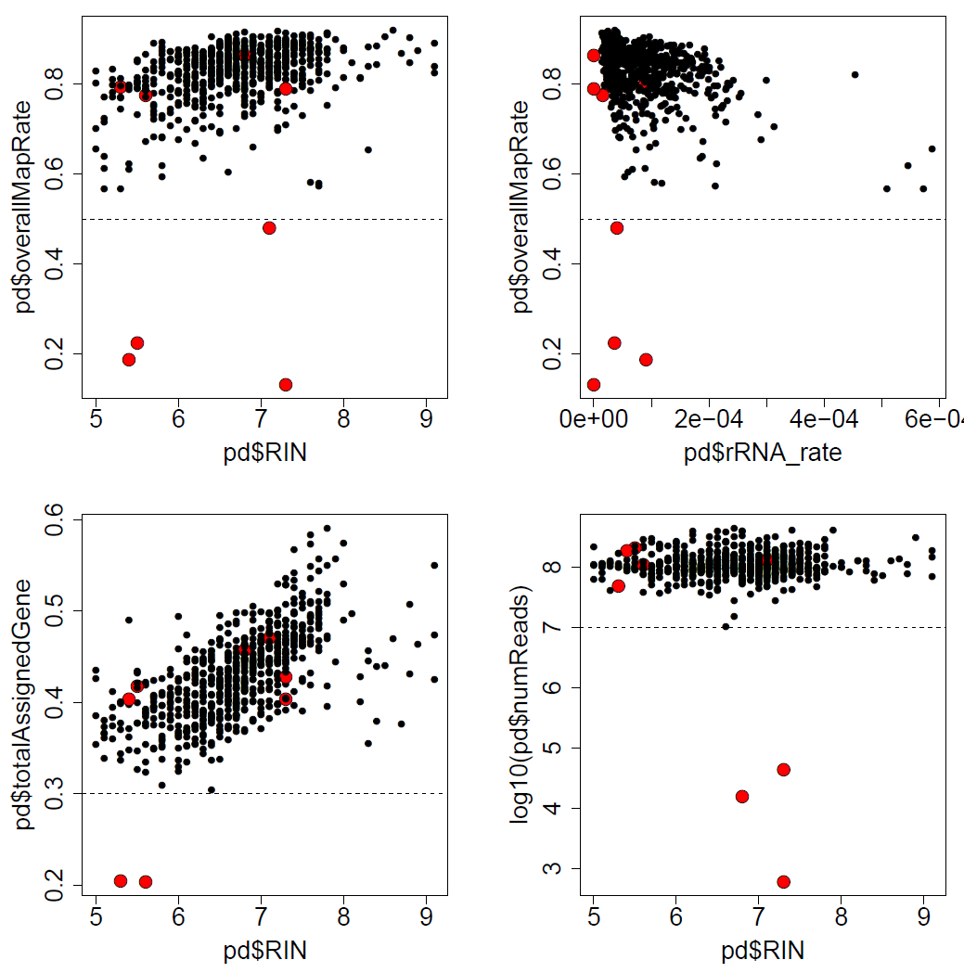
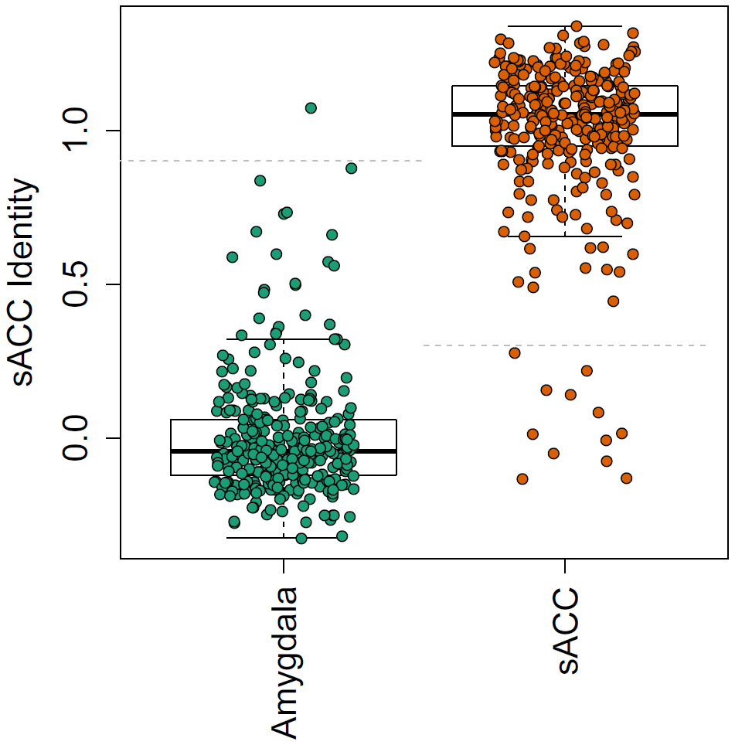
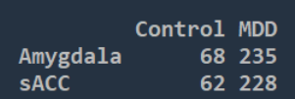
RNA-seq Data Filtering:
Starting sample size: N=634
Drop 8 samples based on alignment metrics (overall map rate<0.5) OR (gene assigned rate<0.3) OR (number of reads < 10M)
Drop 10 samples due to mislabeled/ambiguous Brain Numbers based on genotyping data
Drop 11 samples due to region discrepancy; also switch Br1469 labels between AMYG/sACC
Drop 12 samples of non-European ancestry (error when selecting samples for project)
Total of 593 samples
Unique brains: 309
284 in both regions
25 in single region
For more plots and exact samples, see previous PowerPoint and qc_dropping_results.csv

Slide 6
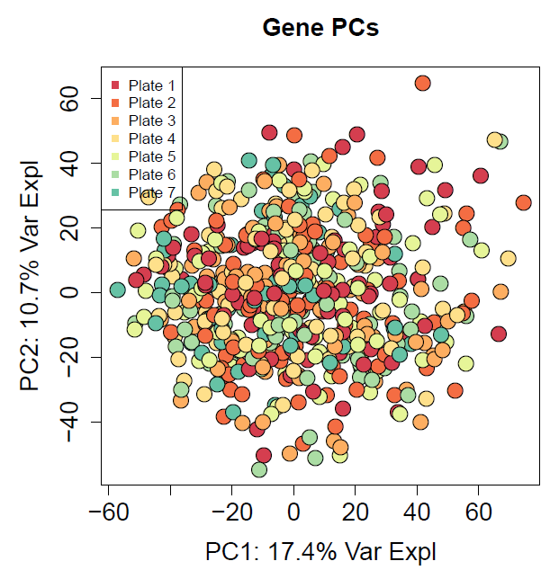
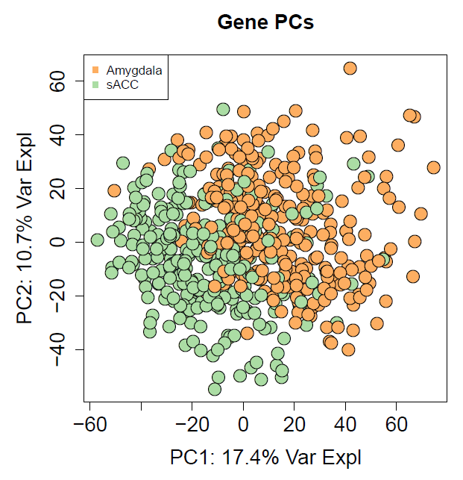
QC: Check principal components
No issues across sequencing plates
Main separation is brain region (expected)

Slide 7
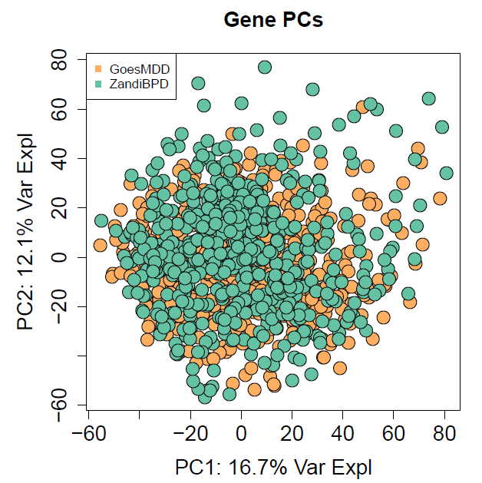
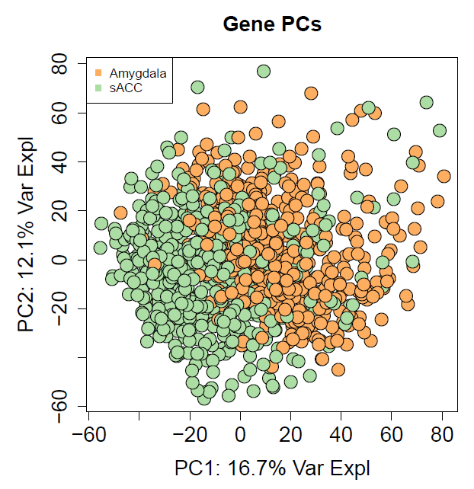
QC: Check principal components
Combine with Bipolar Disorder data from Amygdala and sACC that will be used in analyses.
No differences between datasets
Main separation is brain region (expected)

Slide 8

Sample information after merging BPD
N = 1093 (593 Goes / 500 Zandi)
BrNum overlap by Region:
(If you remmeberd that Zandi’s project had an n=511 before, there were 11 control RNums that were in both experiments, these were dropped from Zandi.)
sACC
Amyg
53
499
42
 | Amygdala | sACC
Total | 541 | 552
MDD / Bipolar / Control | 235 / 120 / 186 | 228 / 125 / 199
Female / Male | 163 / 378 | 16 / 386
Mean age (SD) [min, max] | 46.87 (16.2) [17.37, 95.27] | 46.29 (15.8) [17.37, 95.27]
Amyg | F | M
MDD | 78 | 157
Bipolar | 45 | 75
Controls | 40 | 146
sACC | F | M
MDD | 77 | 151
Bipolar | 51 | 74
Controls | 38 | 161

Slide 9
Differential expression
Test for differential expression at gene, exon, junction and transcript levels
Expression cutoffs (calculated across all 1093 samples):
Gene: 0.25 RPKM
Exon: 0.29 RPKM
Junction: 0.37 RP10M
Transcript: 0.38 TPM
DE models compared MDD to Cnt, and MDD to BPD in brain regions separately
Completely novel junctions were excluded from significant results (Partially novel [exon skipping and alternative start/end] were included in results.)
Models included: 23 qSVs (found using num.sv), Dx, Age, Sex, mitoRate, rRNA_rate, totalAssignedGene, RIN
/dcl01/lieber/ajaffe/lab/goesHyde_mdd_rnaseq/differential_expression/

Slide 10
Differential expression
Number of features tested (same in both regions):
 | # of features | From # unique genes
Gene | 25,212 | 25,212
Exon | 399,515 | 23,924
Junction | 302,304 | 18,634
Transcript | 79,795 | 28,667

Slide 11
Differential expression
Full tables of results: /dcl01/lieber/ajaffe/lab/goesHyde_mdd_rnaseq/differential_expression/tables/
Number of features significant (FDR < 0.05):
 | MDD vs Control |  | MDD vs BPD
 | sACC | Amygdala | sACC | Amygdala
Gene | 656 | 94 | 218 | 103
Exon | 3776 / 1358 | 1219 / 520 | 2045 / 844 | 2102 / 837
Junction | 1113 / 714 | 361 / 258 | 686 / 481 | 647 / 468
Transcript | 1457 / 1384 | 2101 / 1947 | 783 / 761 | 2297 / 2135
^ Second number is # of unique genes. For example, 3776 significant exons from 1358 unique genes.

Slide 12
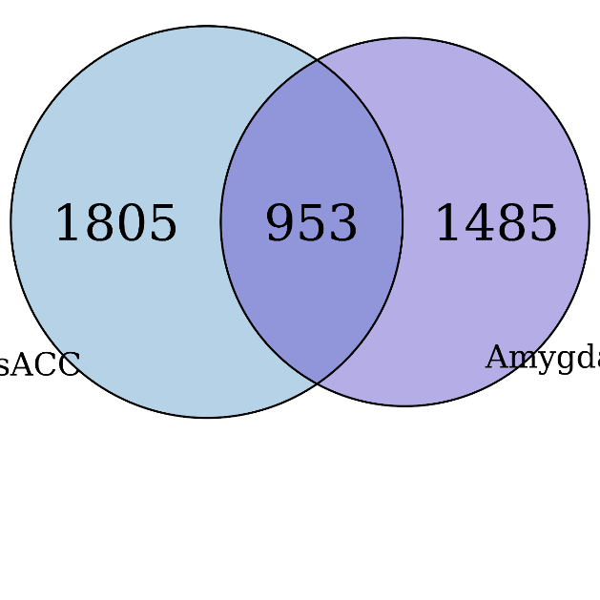
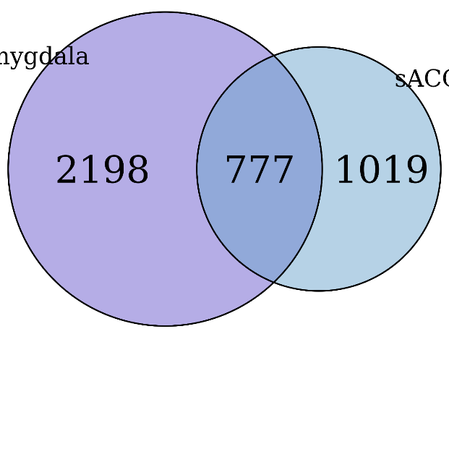
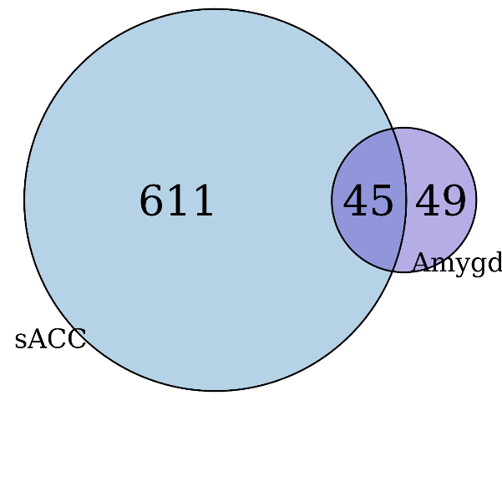
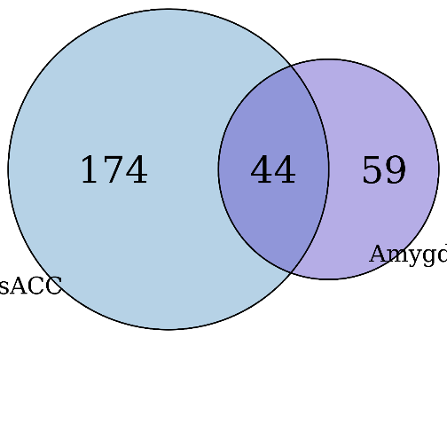
Differential expression
MDD vs CNT
MDD vs BPD
MDD vs CNT
MDD vs BPD
* Overlapping unique genes implicated by either Gn, Tx or Ex feature
* Overlapping unique genes by Gn feature
Other feature types are in folder: /dcl01/lieber/ajaffe/lab/goesHyde_mdd_rnaseq/differential_expression/venns/

Slide 13
Differential expression
Annotation classes of significant junctions:
 | MDD vs Control |  | MDD vs BPD
 | sACC | Amygdala | sACC | Amygdala
Total FDR < 0.05 | 1113 | 361 | 686 | 647
Annotated | 1090 | 355 | 668 | 630
ExonSkip | 2 | 4 | 4 | 2
AltStartEnd | 21 | 2 | 14 | 15

Slide 14
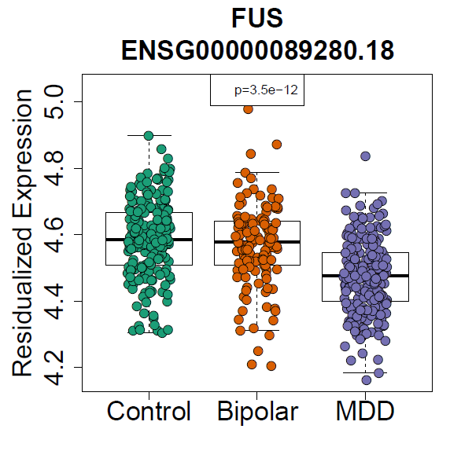
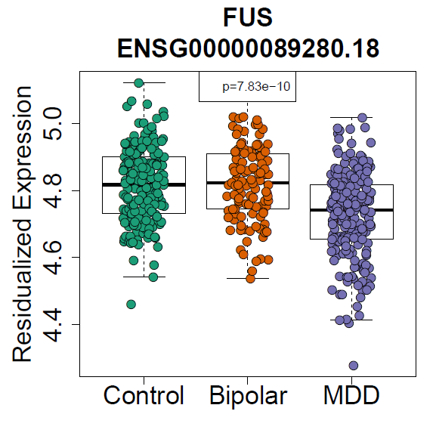
Differential expression
Plots of top features: /dcl01/lieber/ajaffe/lab/goesHyde_mdd_rnaseq/differential_expression/plots/
sACC
Amygdala

Slide 15
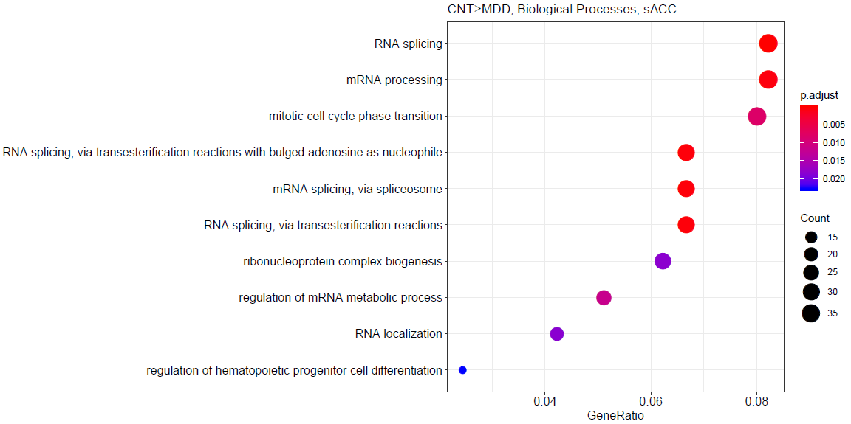
GO gene set enrichment
With genes FDR < 0.05
With genes FDR < 0.10, split into up- and down-regulated directions.

