Slide 1
DepSeq: RNA Sequencing in Major Depression Disorder
Sample information & QC
October 2, 2019

Slide 2


Sample information
634 total samples from post mortem brain tissue
147 neurotypical controls, 487 MDD
sACC and Amygdala
Both male (n=435) and female (n=199) samples
319 unique brains: 315 brains sequenced in both regions, 4 brains sequenced in single region.
Age ranges from 18 to 95 (mean=46)
Largely samples of European ancestry
Notes:
Drop other races?

Slide 3
Data generation
RNA sequencing of sACC and Amygdala on 634 total samples
315 brains sequenced in both regions, 4 brains sequenced in single region.
Median 132M sequenced reads (IQR: 87M-138M)
RiboZero protocol, stranded
Included ERCC spike-ins

Slide 4
RNA-seq Data Processing of sACC/AMYG
0. Merge reads across lanes
1. Quality check (QC) on raw reads: FastQC
2. Failed QC? Then trim reads: Trimmomatic (This occurred with 3 samples, all 3 also failed subsequent checks and were dropped)
3. Align reads to the genome: HISAT2
4. Count features: featureCounts
5. Calculate coverage: bam2wig
6. Quantify transcripts: Salmon
7. Create count tables: R
8. Genotype samples: samtools + vcftools

Slide 5
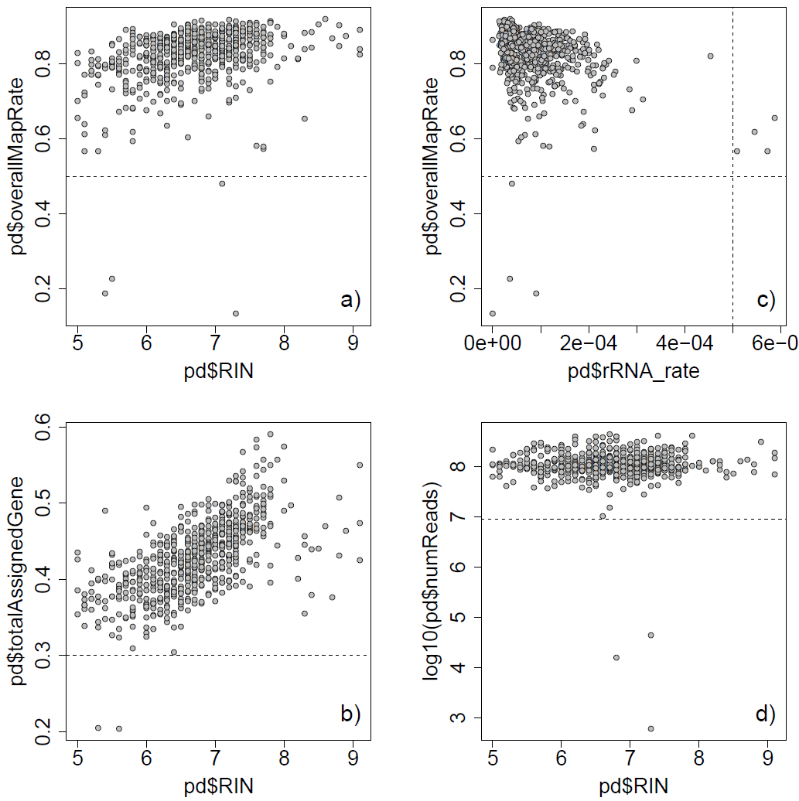
QC: Check technical / alignment metrics
Starting n=634
Drop 12 samples based on poor alignment metrics:
Overall mapping rate < 0.5
Gene assignment rate < 0.3
rRNA mapping rate > 5e-4
Number of reads < 10M
New n=622
Notes:
Don’t drop rRNA ones

Slide 6
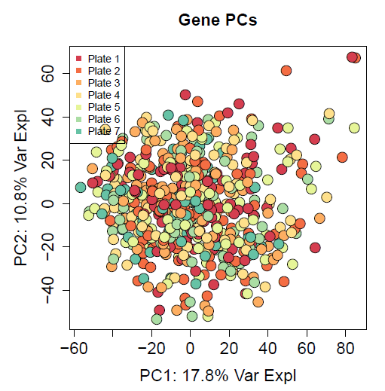
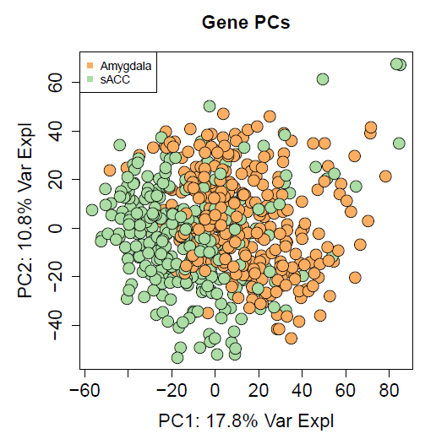
QC: Check principal components
No issues across sequencing plates
Main separation is brain region (expected)

Slide 7
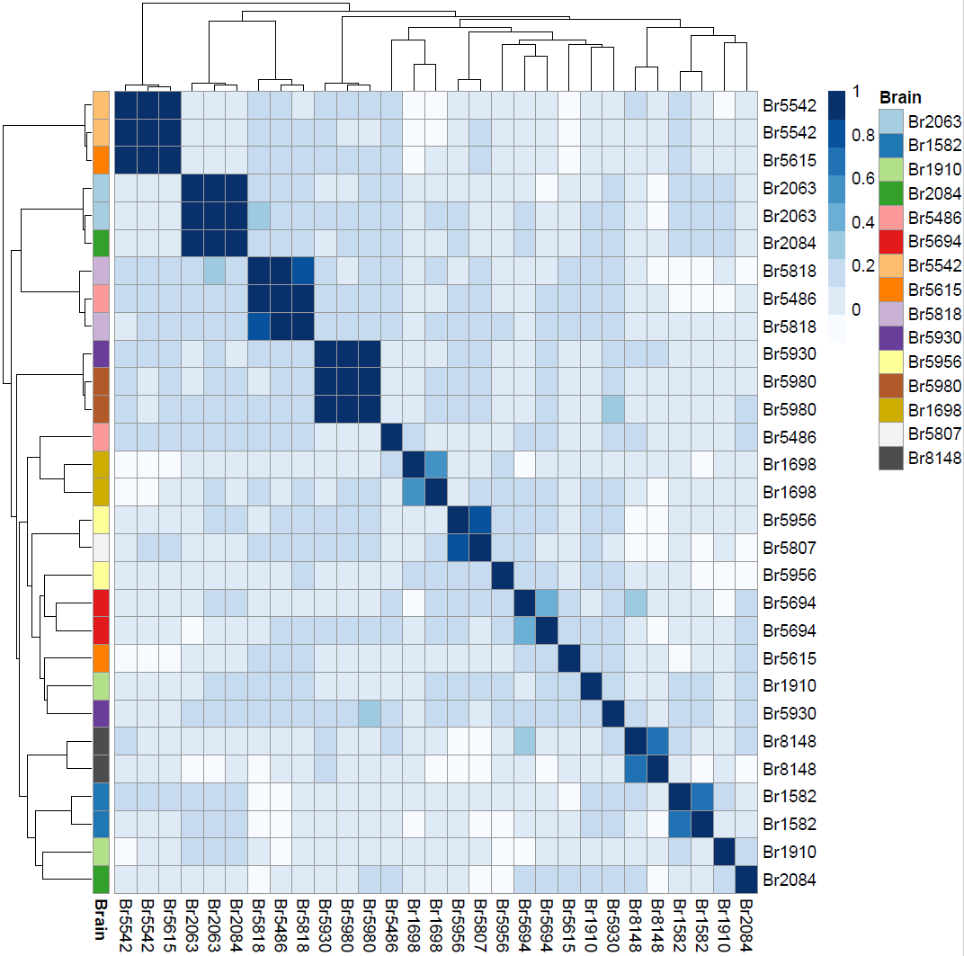
QC: Confirm sample identity
Check correlation of 740 common SNVs in replicate samples to check labeling
Mislabels:
One Br5615 appears to be Br5542
One Br2084 appears to be Br2063
One Br5486 appears to be Br5818
One Br5930 appears to be Br5980
Samples with lower than expected correlation but not matching any other sample:
Br5694 (ρ = 0.43)
Br1698 (ρ = 0.57) – one had high ERCC error
Br8148 (ρ = 0.64) – one had high ERCC error
Br1582 (ρ = 0.69) – one had med. ERCC error
Not clear:
Br1910: doesn’t match itself nor any other sample
Br5956 and Br5807 – unclear which is incorrect
Notes:
Check if mismatches are in adjacent wells – mix of 2 samples?
Check if we have genotype data for these
Look at path from Andrew – see which aren’t there, most should be in there

Slide 8
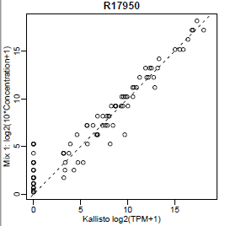
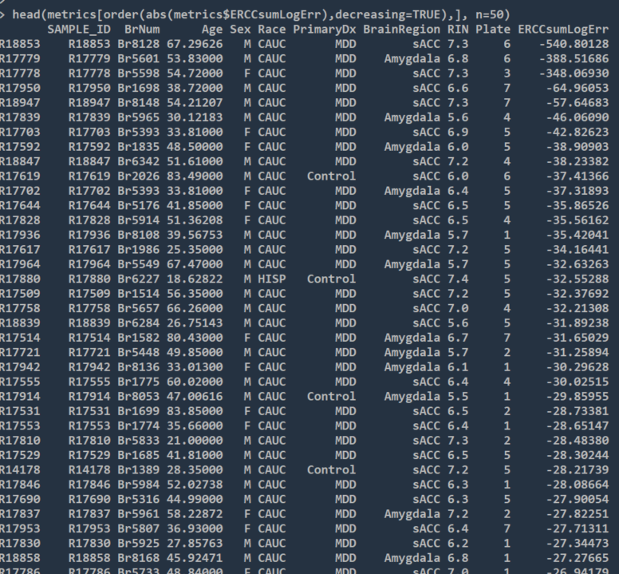
ERCC plot:
Mislabels:
One Br5615 appears to be Br5542
One Br2084 appears to be Br2063
One Br5486 appears to be Br5818
One Br5930 appears to be Br5980
Samples with lower than expected correlation but not matching any other sample:
Br5694 (ρ = 0.43)
Br1698 (ρ = 0.57) – one had high ERCC error
Br8148 (ρ = 0.64) – one had high ERCC error
Br1582 (ρ = 0.69) – one had med. ERCC error
Not clear:
Br1910: doesn’t match itself nor any other sample
Br5956 and Br5807 – unclear which is incorrect

Slide 9
QC: Confirm sample identity
Drop samples from brains with issues:
Br5615 (1 sample)
Br2084 (1 sample)
Br5486 (1 sample)
Br5930 (1 sample)
Br5694 (both samples)
Br1698 (both samples) - ?
Br8148 (both samples) - ?
Br1582 (both samples) - ?
Br1910 (both samples)
Br5956 (both samples)
Br5807 (1 sample)
New n=605
Notes:
Keep middle section ones

Slide 10
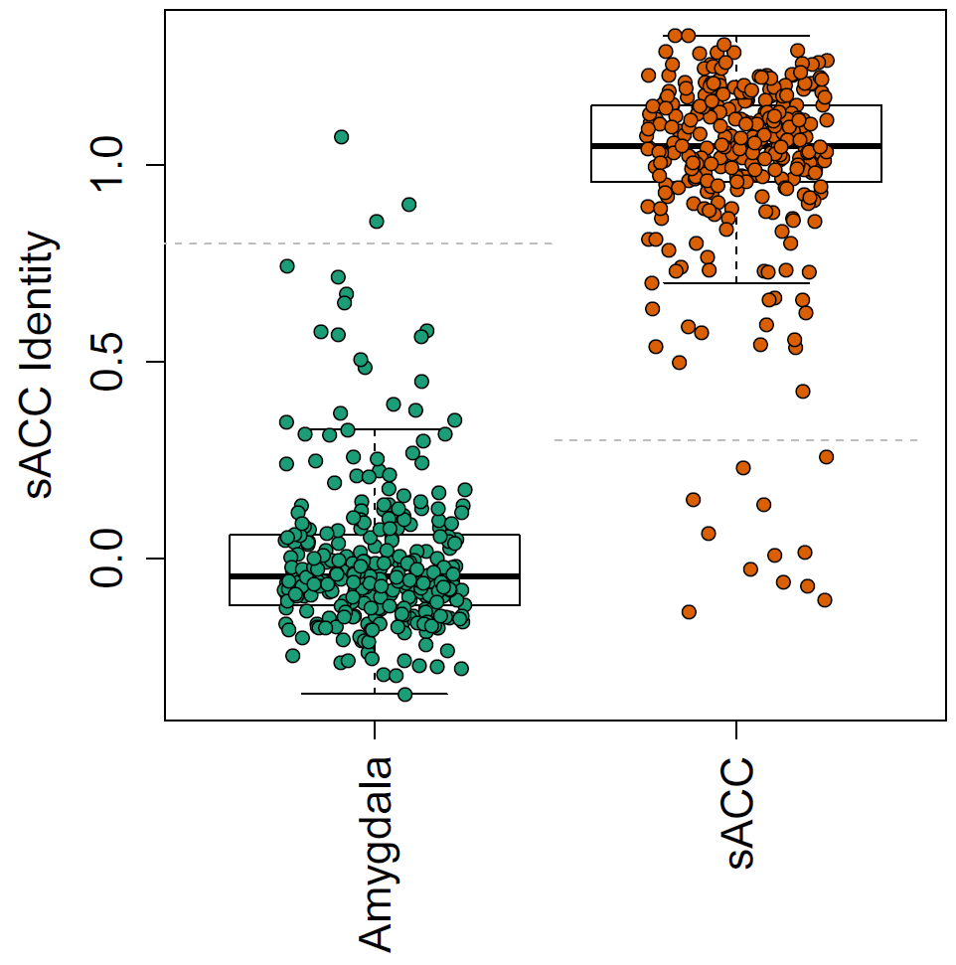
QC: Confirm Brain Region labeling
Identity based on 100
most region-associated genes
RNum | SampleID | sACC_identity
R14179 | Br1469_sACC | -0.022
R17520 | Br1635_sACC | 0.226
R17527 | Br1675_sACC | -0.061
R17547 | Br1754_sACC | 0.009
R17579 | Br6099_sACC | 0.147
R17894 | Br8017_sACC | 0.269
R17941 | Br8133_sACC | -0.103
R17951 | Br5526_sACC | -0.700
R17952 | Br5549_sACC | 0.025
R18430 | Br3863_sACC | -0.128
R18458 | Br8313_sACC | 0.145
R19186 | Br1475_sACC | 0.063
R17482 | Br1304_Amygdala | 0.849
R17496 | Br1469_Amygdala | 1.07
R18938 | Br6293_Amygdala | 0.899
Steps taken
Swap region labels for Br1469
Drop other 13 samples in list
Final n=592
Notes:
Try before dropping the genotypes – see if anything else matches

Slide 11


Samples Dropped
RNA-seq dataset
Sample selection
Starting n=634
Drop 12 samples based on alignment metrics
(overall map rate<0.5) OR (gene assigned rate<0.3) OR (rRNA rate>5e-4) OR (total reads < 10M)
Drop 17 samples due to potentially mislabeled Brain Numbers based on genotyping data
Drop 13 samples due to insufficient Brain Region identity
N=592
Age: [18,95], mean=46
Unique brains: 311
281 in both regions
30 in single region
Notes:
Drop 12 non Europeans, keep rRNA, keep some more genotyping
Keep all through all steps – just make column of what failed each step.
Merge in bp-seq (cases and controls), and redo PCA. Color by dataset
3 minute slide: number of samples
Merge with bp-seq slide

