Slide 1
DepSeq: RNA Sequencing in Major Depressive Disorder
Sample information & QC
October 7, 2019

Slide 2


Sample information
634 total samples from post mortem brain tissue
147 neurotypical controls, 487 MDD
sACC and Amygdala
Both male (n=435) and female (n=199) samples
319 unique brains: 315 brains sequenced in both regions, 4 brains sequenced in single region.
Age ranges from 18 to 95 (mean=46)
Largely samples of European ancestry (will be dropping the 6 non-European brains)

Slide 3
Data generation
RNA sequencing of sACC and Amygdala on 634 total samples
315 brains sequenced in both regions, 4 brains sequenced in single region.
Median 132M sequenced reads (IQR: 87M-138M)
RiboZero protocol, stranded
Included ERCC spike-ins

Slide 4
RNA-seq Data Processing of sACC/AMYG
0. Merge reads across lanes
1. Quality check (QC) on raw reads: FastQC
2. Failed QC? Then trim reads: Trimmomatic (This occurred with 3 samples, all 3 also failed subsequent checks and were dropped)
3. Align reads to the genome: HISAT2
4. Count features: featureCounts
5. Calculate coverage: bam2wig
6. Quantify transcripts: Salmon
7. Create count tables: R
8. Genotype samples: samtools + vcftools

Slide 5
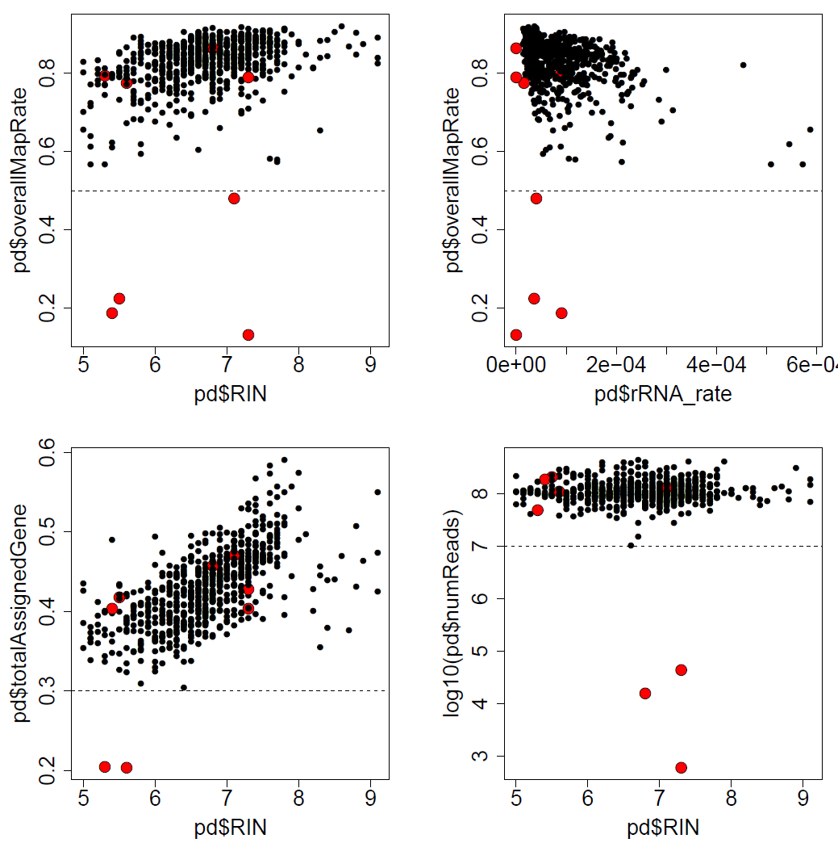
QC: Check technical / alignment metrics
a)
c)
Drop 8 samples based on poor alignment metrics:
Overall mapping rate < 0.5
Gene assignment rate < 0.3
*
Number of reads < 10M
* c) Also checked rRNA rates but all look good
b)
d)

Slide 6
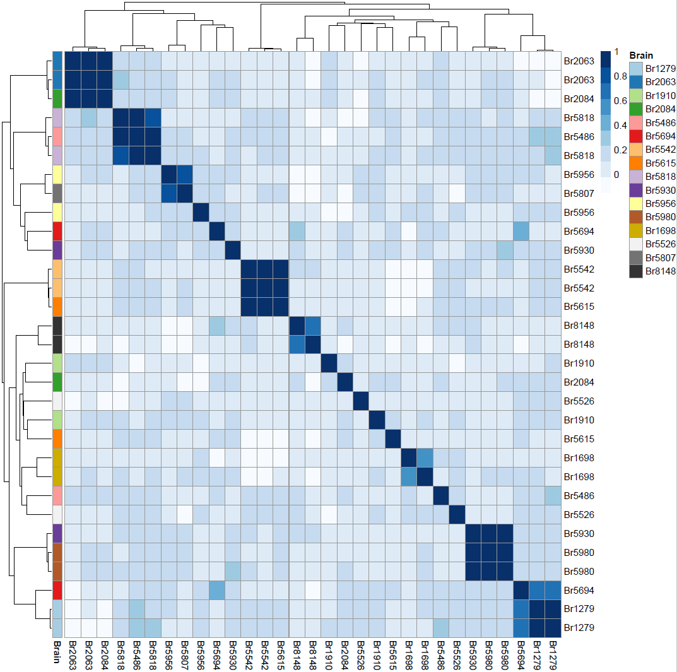
QC: Confirm sample identity
Check correlation of 740 common SNVs in replicate samples to check labeling
Mislabels:
One Br5615 appears to be Br5542
One Br2084 appears to be Br2063
One Br5486 appears to be Br5818
One Br5930 appears to be Br5980
Samples with lower than expected correlation but not matching any other sample:
Br5694 (ρ = 0.43) – contamination (see next slide)
Br1698 (ρ = 0.57) – one had high ERCC error
Br8148 (ρ = 0.64) – one had high ERCC error
Br1582 (ρ = 0.69) – one had med. ERCC error
Not clear:
Br1910: doesn’t match itself nor any other sample
Br5956 and Br5807 – unclear which is incorrect

Slide 7
QC: Confirm sample identity
Check for contamination:
One sample of Br5694 does in fact seem to have been contaminated with neighboring well Br1279 during sequencing
Check correlation of 740 common SNVs in replicate samples to check labeling
 | Br1279 R13950 | Br1279 R17490 | Br5694 R17737 | Br5694 R17738
Br1279 R13950 | 1 | 0.985 | 0.095 | 0.649
Br1279 R17490 | 0.985 | 1 | 0.077 | 0.653
Br5694 R17737 | 0.095 | 0.077 | 1 | 0.428
Br5694 R17738 | 0.649 | 0.653 | 0.428 | 1
Mislabels:
One Br5615 appears to be Br5542
One Br2084 appears to be Br2063
One Br5486 appears to be Br5818
One Br5930 appears to be Br5980
Samples with lower than expected correlation but not matching any other sample:
Br5694 (ρ = 0.43)
Br1698 (ρ = 0.57) – one had high ERCC error
Br8148 (ρ = 0.64) – one had high ERCC error
Br1582 (ρ = 0.69) – one had med. ERCC error
Not clear:
Br1910: doesn’t match itself nor any other sample
Br5956 and Br5807 – unclear which is incorrect
BrNum | RNum | Plate | Position
Br1279 | R13950 | 4 | F08
Br1279 | R17490 | 4 | A10
Br5694 | R17738 | 4 | B10
Br5694 | R17737 | 4 | A06
Result: Drop Br5694 _ R17738

Slide 8
QC: Confirm sample identity
Check correlation of 740 common SNVs in replicate samples to check labeling
Mislabels:
One Br5615 appears to be Br5542
One Br2084 appears to be Br2063
One Br5486 appears to be Br5818
One Br5930 appears to be Br5980
Samples with lower than expected correlation but not matching any other sample:
Br5694 (ρ = 0.43)
Br1698 (ρ = 0.57) – one had high ERCC error
Br8148 (ρ = 0.64) – one had high ERCC error
Br1582 (ρ = 0.69) – one had med. ERCC error
Not clear:
Br1910: doesn’t match itself nor any other sample
Br5956 and Br5807 – unclear which is incorrect
Result:
Drop one Br5615
Drop one Br2084
Drop one Br5486
Drop one Br5930
Drop one contaminated Br5694
Drop both Br1910
Drop all Br5956 and Br5807

Slide 9
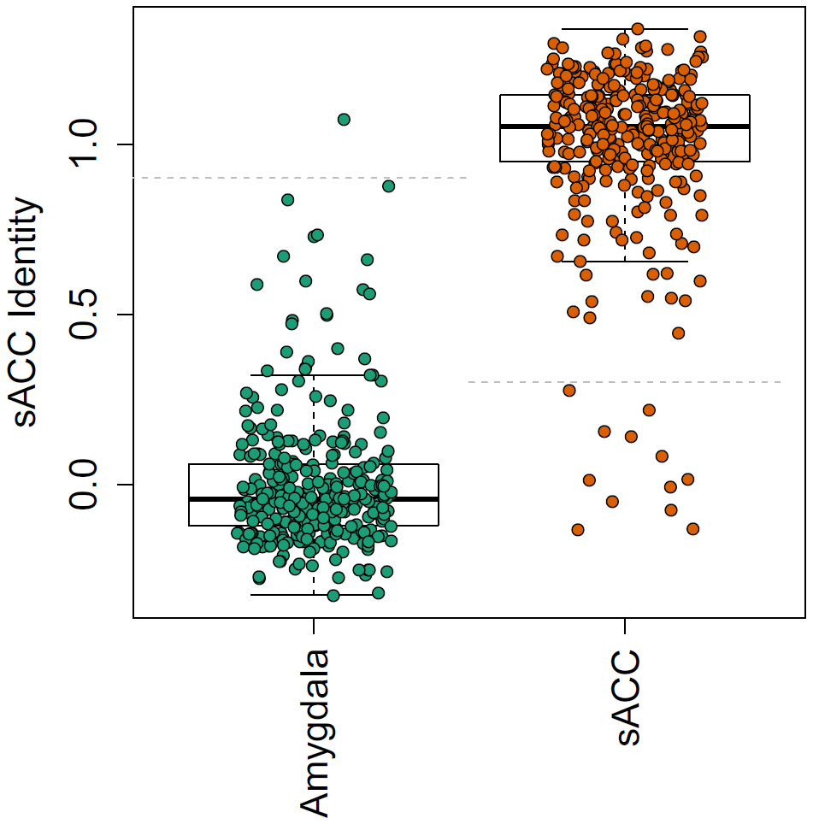
QC: Confirm Brain Region labeling
Identity based on 100
most region-associated genes
RNum | SampleID | sACC_identity
R14179 | Br1469_sACC | -0.022
R17520 | Br1635_sACC | 0.226
R17527 | Br1675_sACC | -0.061
R17547 | Br1754_sACC | 0.009
R17579 | Br6099_sACC | 0.147
R17894 | Br8017_sACC | 0.269
R17941 | Br8133_sACC | -0.103
R17951 | Br5526_sACC | -0.700
R17952 | Br5549_sACC | 0.025
R18430 | Br3863_sACC | -0.128
R18458 | Br8313_sACC | 0.145
R19186 | Br1475_sACC | 0.063
R17496 | Br1469_Amygdala | 1.07
Steps taken
Swap region labels for Br1469
Drop other 11 samples in list

Slide 10

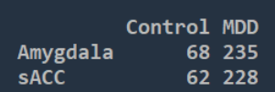
Samples Dropped
Final N=593
Starting n=634
Drop 8 samples based on alignment metrics
(overall map rate<0.5) OR (gene assigned rate<0.3) OR (total reads < 10M)
Drop 10 samples due to potentially mislabeled Brain Numbers based on genotyping data
Drop 11 samples due to insufficient Brain Region identity
Drop 12 samples from 6 non-European brains that were mistakenly added to sample set
Note: there was no sample that failed multiple steps.
Total of 41 dropped samples.
N=593
Age: [18,95], mean=46
Unique brains: 309
284 in both regions
25 in single region

Slide 11
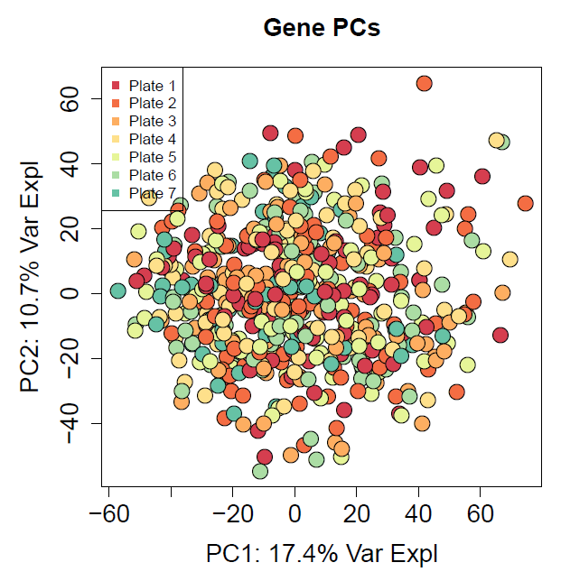
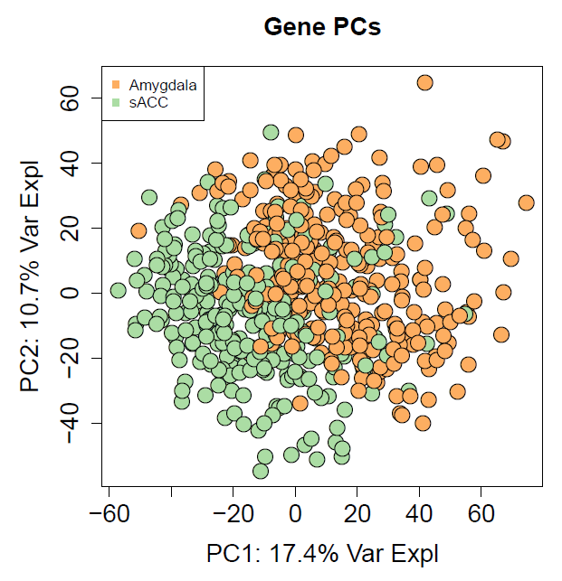
QC: Check principal components
No issues across sequencing plates
Main separation is brain region (expected)

Slide 12
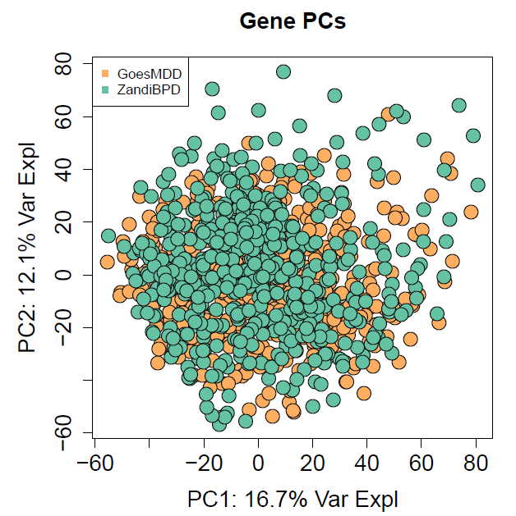
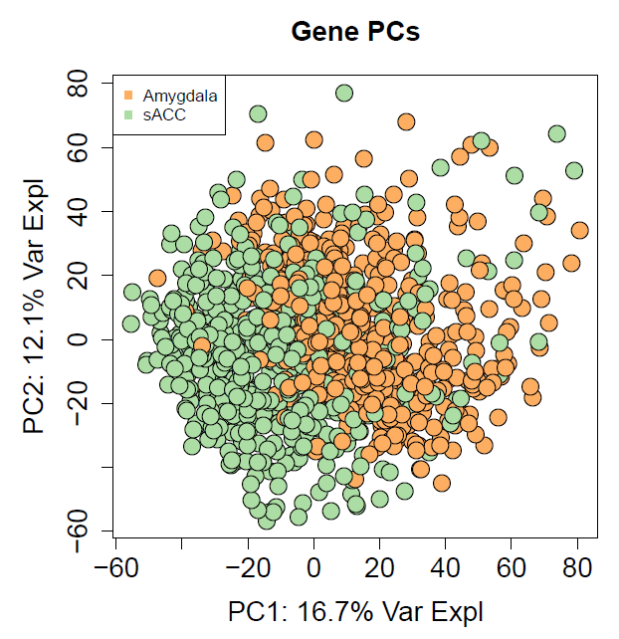
QC: Check principal components
Combine with Bipolar Disorder data from Amygdala and sACC that will be used in some analyses.
No differences between datasets
Main separation is brain region (expected)

