Slide 1
PRS
Spatial_DLPFC Subjects
Daskalakis Lab

Slide 2
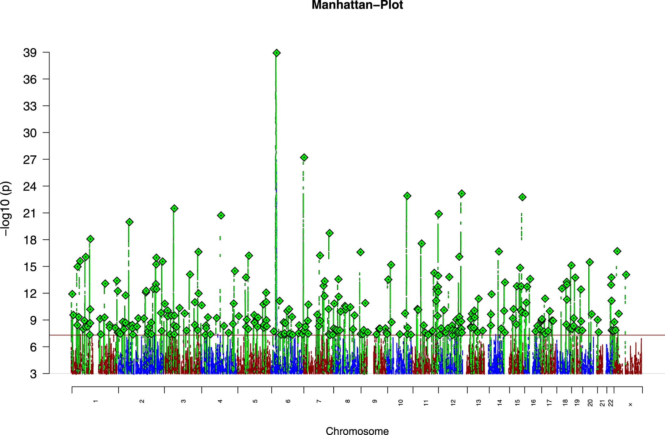
PRS score and importance of ancestry

Slide 3
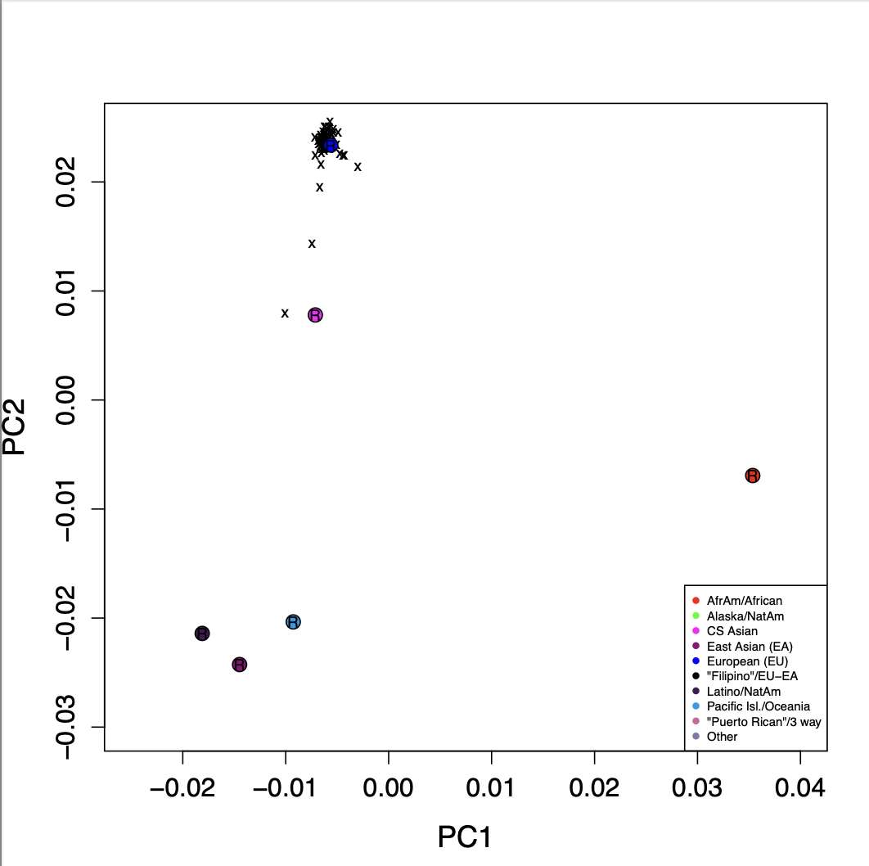
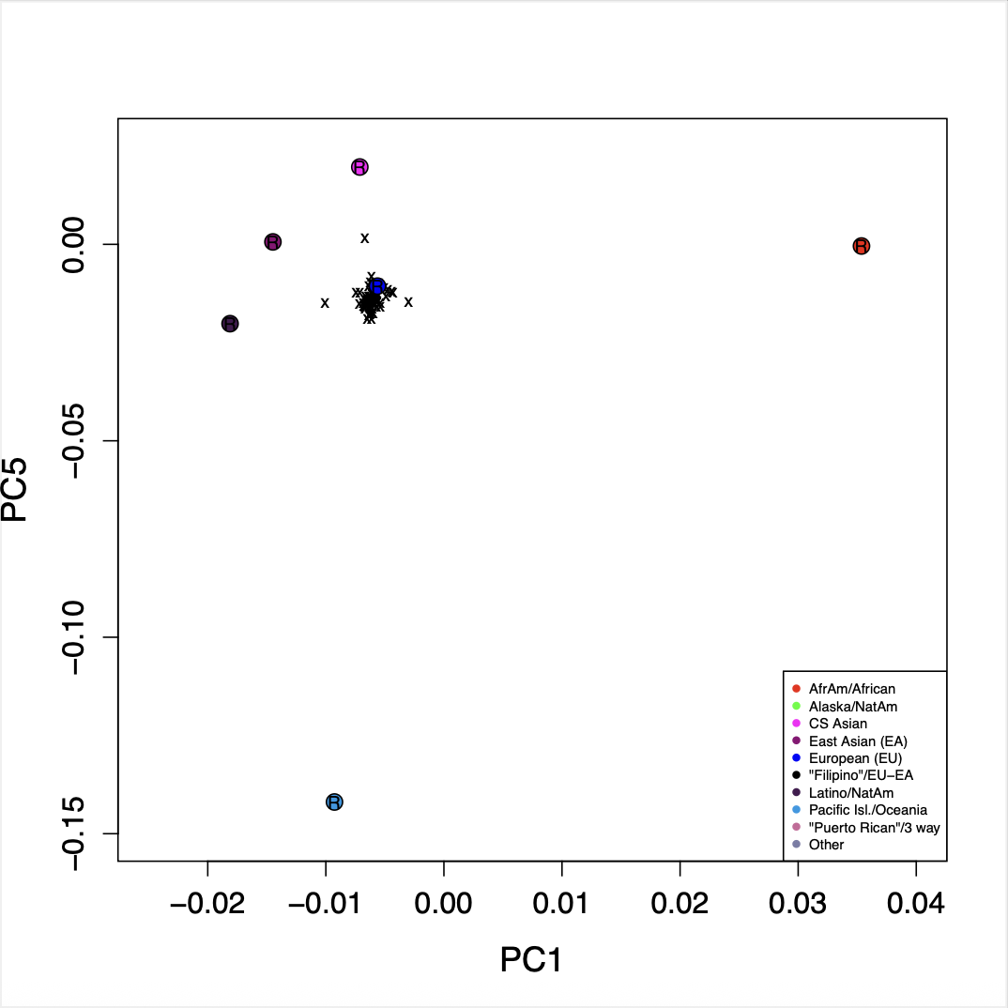
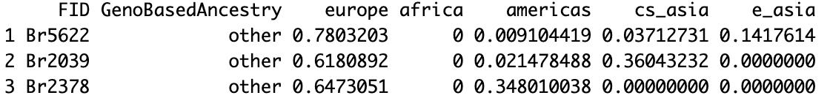
Projection of genotype data on Ancestry Markers
Notes:
Three subjects are Non-European, and they are separated from the rest of the European subject group [European > 0.9 Europe ancestry proportion]

Slide 4
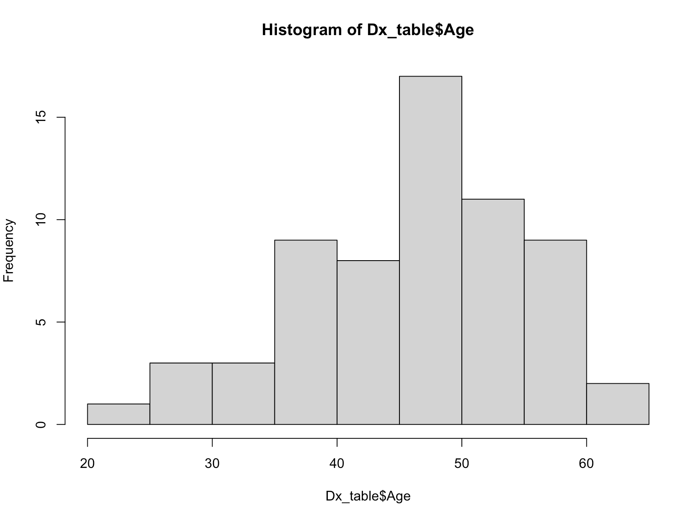
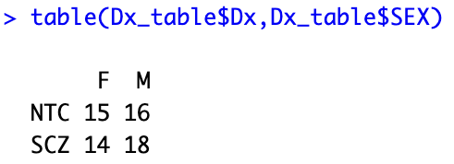
Phenotype Details
Age Range: 23 – 61
Gender:
Br3942 phenotype not available

Slide 5

SCZ PRScs [masked chr3p21 + chr6p21]
Vijetha Balakundi
Dx ~ PRS + age+sex+geneticPCs

Slide 6
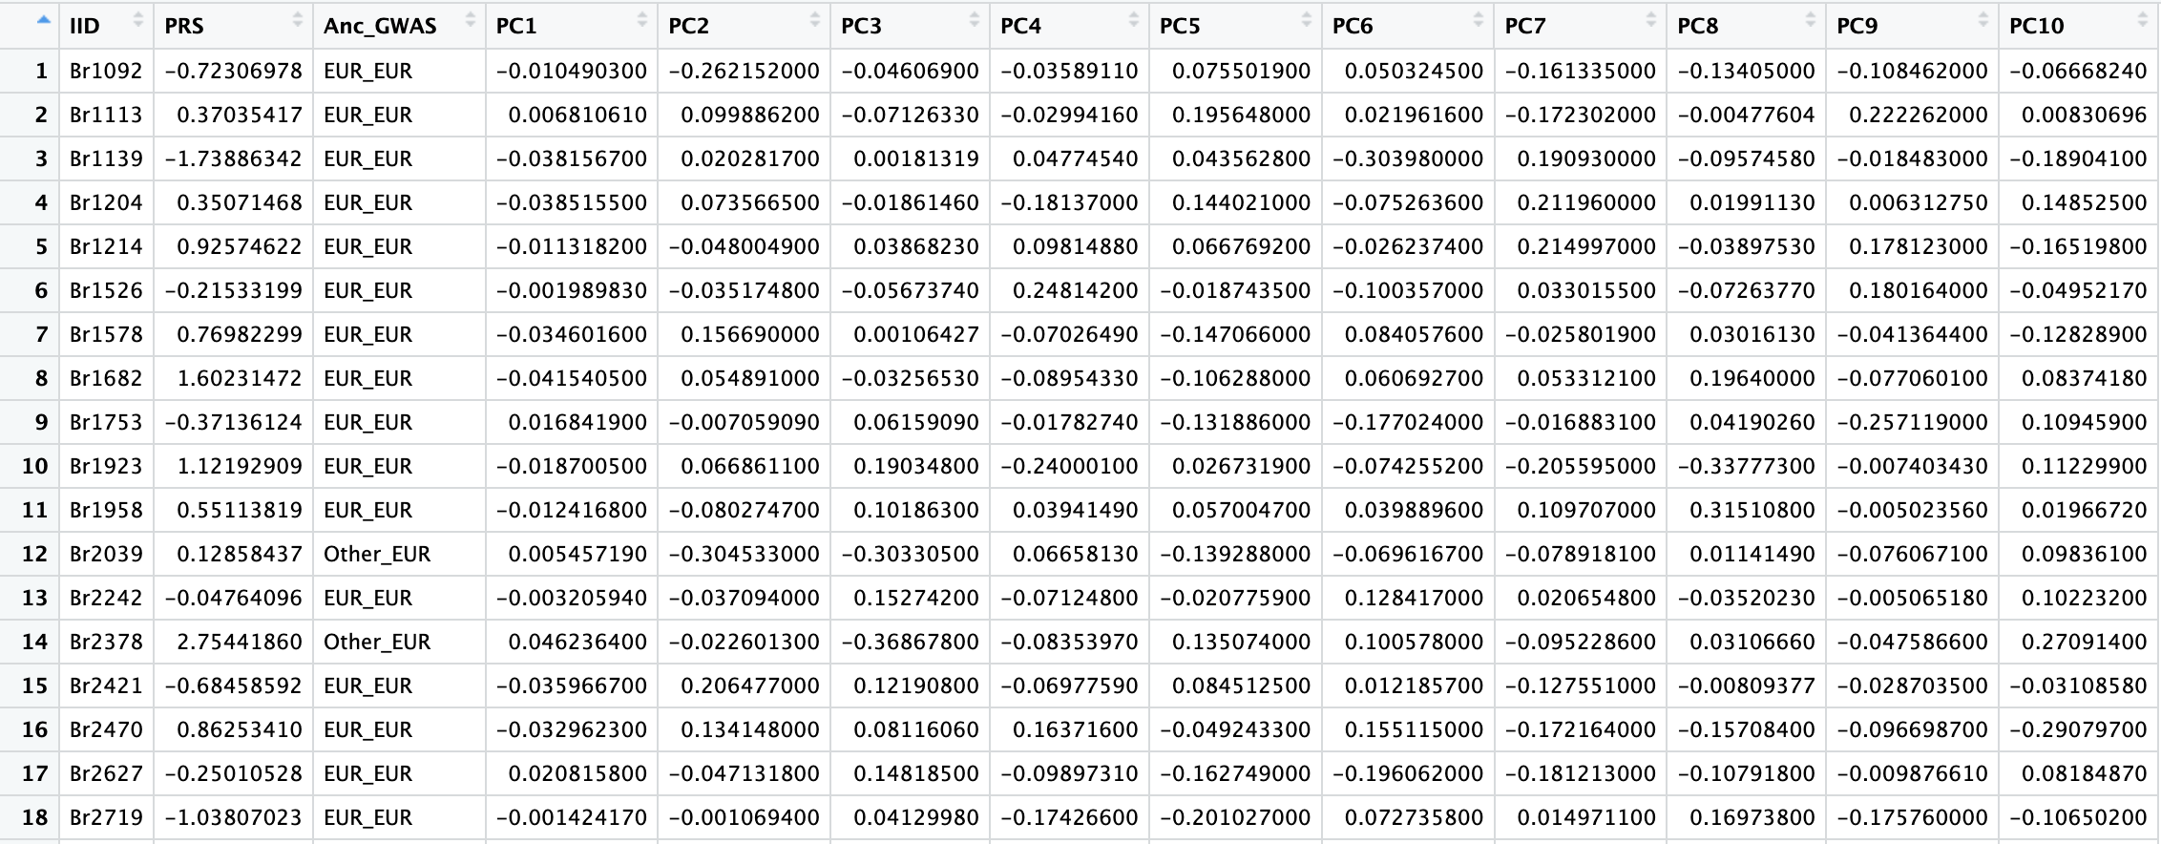
PRS Score Table

Slide 7
Method Description
Genotype quality control (QC) was conducted on total of 64 subjects. Made use of Global Ancestry pipeline [https://github.com/nievergeltlab/global_ancestry] to group subjects based on ancestry: 61 of European ancestry (EUR), and 3 classified as Other, based on ancestry proportions—EUR > 0.9. The 3 individuals in the Other category were further labelled as Admixed European (EUR ancestry between 0.6 and 0.9) [Br2378, Br2039, Br5622]. Additional QC filters applied to EUR genotypes included genotype missingness (geno < 0.01), Hardy-Weinberg equilibrium (p > 1e-6), SNP missingness (mind < 0.01), heterozygosity, and minor allele frequency (MAF > 0.01). One subject with EUR > 0.9 [Br5228] was flagged due to failing the heterozygosity threshold.
3p21 and 6p21 regions were excluded from PRS calculations. Remaining filtered SNPs were used to calculate polygenic risk scores (PRS). PRScs software [https://github.com/getian107/PRScs] was used to generate PRS weights: on EUR Schizophrenia GWAS [PGC3_SCZ_wave3.european.autosome.public.v3.vcf ; Reference: Psychiatric Genomics Consortium Wave3 Schizophrenia GWAS Meta-analysis Summary Statistics Release] with default parameters. Plink was used to calculate PRS scores using PRScs weights.
PRS scores normalization was performed. First, the mean and standard deviation (SD) of PRS were calculated separately within the EUR group (based only on individuals with EUR > 0.9). These parameters were then used to normalize scores within broader ancestry groups: EUR and Admixed EUR were normalized together using the EUR-based mean and SD.
Regression analysis was conducted using the glmnet package in R, incorporating PRS scores along with covariates such as age, sex, and the first 10 genetic principal components to assess association with disease. The Cragg and Uhler’s pseudo R-squared [ Nagelkerke R²] was computed using the pscl package.

