Slide 1
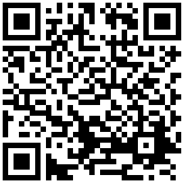


Mushroom study high school
Data collection online
Recruitment
Data collection MRI
Social Media (Qualtrics)
Schedule MRI session
Mushroom practice (Psychopy)
Mushroom (Psychopy / fMRI)
Spatial working memory (Psychopy)
https://uva.fra1.qualtrics.com/jfe/form/SV_bIaJct3N4cvToLY
Reversal learning (Psychopy)
Recruitment
Parental informed consent (Qualtrics)
Information search (Neurotask)
https://uva.fra1.qualtrics.com/jfe/form/SV_2fX3HRHRsqWh8rQ
Informed consent (Qualtrics)
BEAST social (Lioness)
https://uva.fra1.qualtrics.com/jfe/form/SV_1Uq2OZNLOeQk6y2
Flyer session 1
Instagram
Schools
Sports clubs
To do / check
Ready
Manually

