Slide 1
A: Progenitors and precursors
RSG/YSG/BSG
supernova progenitors
stripped stars
Blue giants
Red supergiants
Massive OB stars
yellow
supergiants
luminosity
main sequence
Red giants
white dwarfs
stripped star
temperature
Luminous Red novae
EL CVn-like
systems
Post-AGB
binaries
Hot Subdwarfs
He Giants

Slide 2
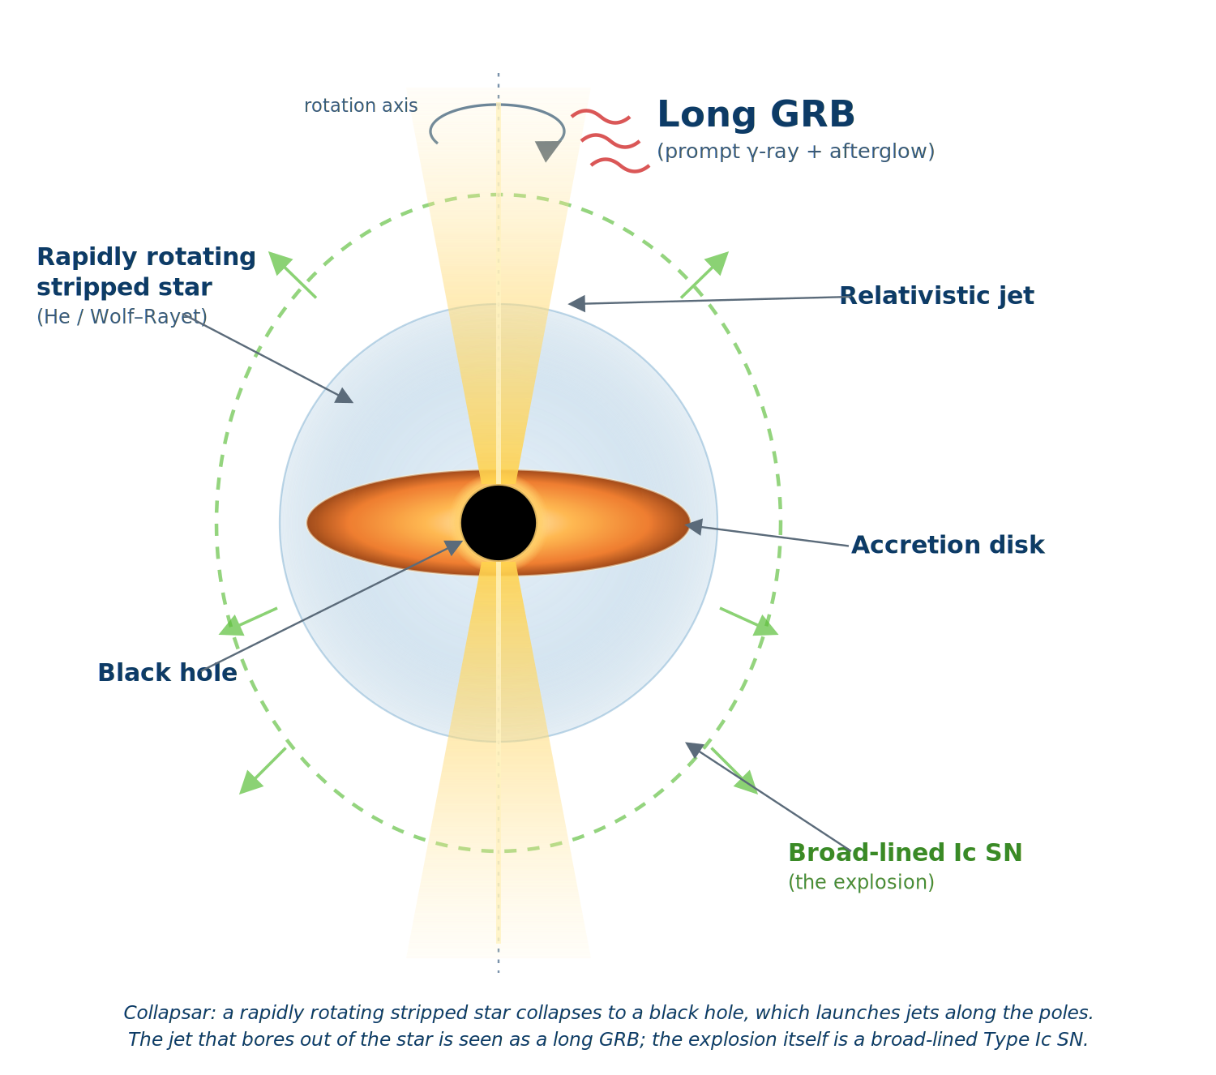
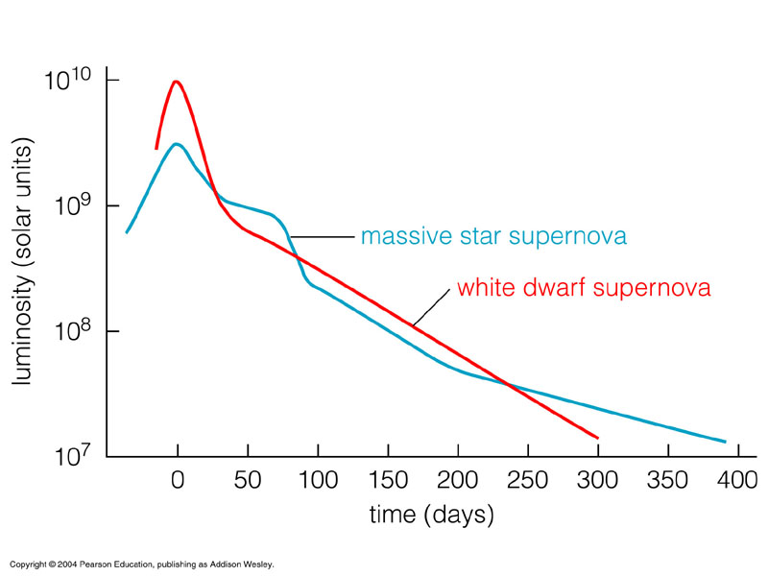

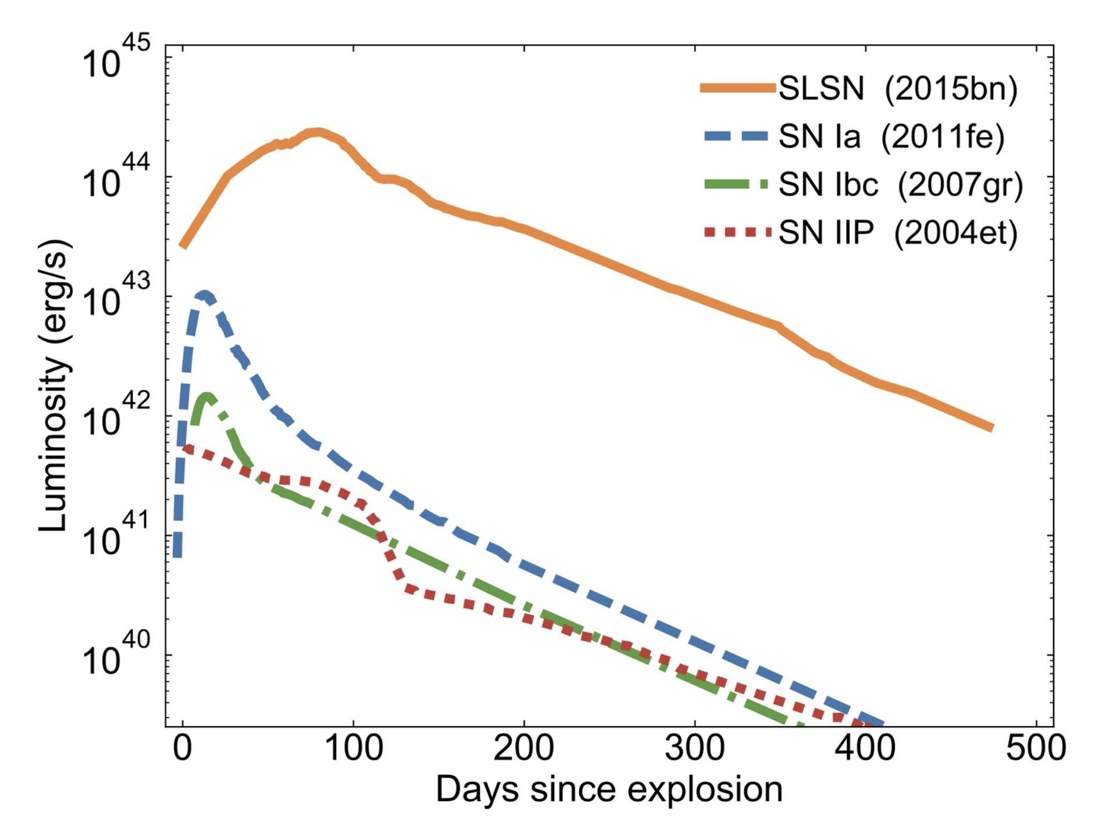
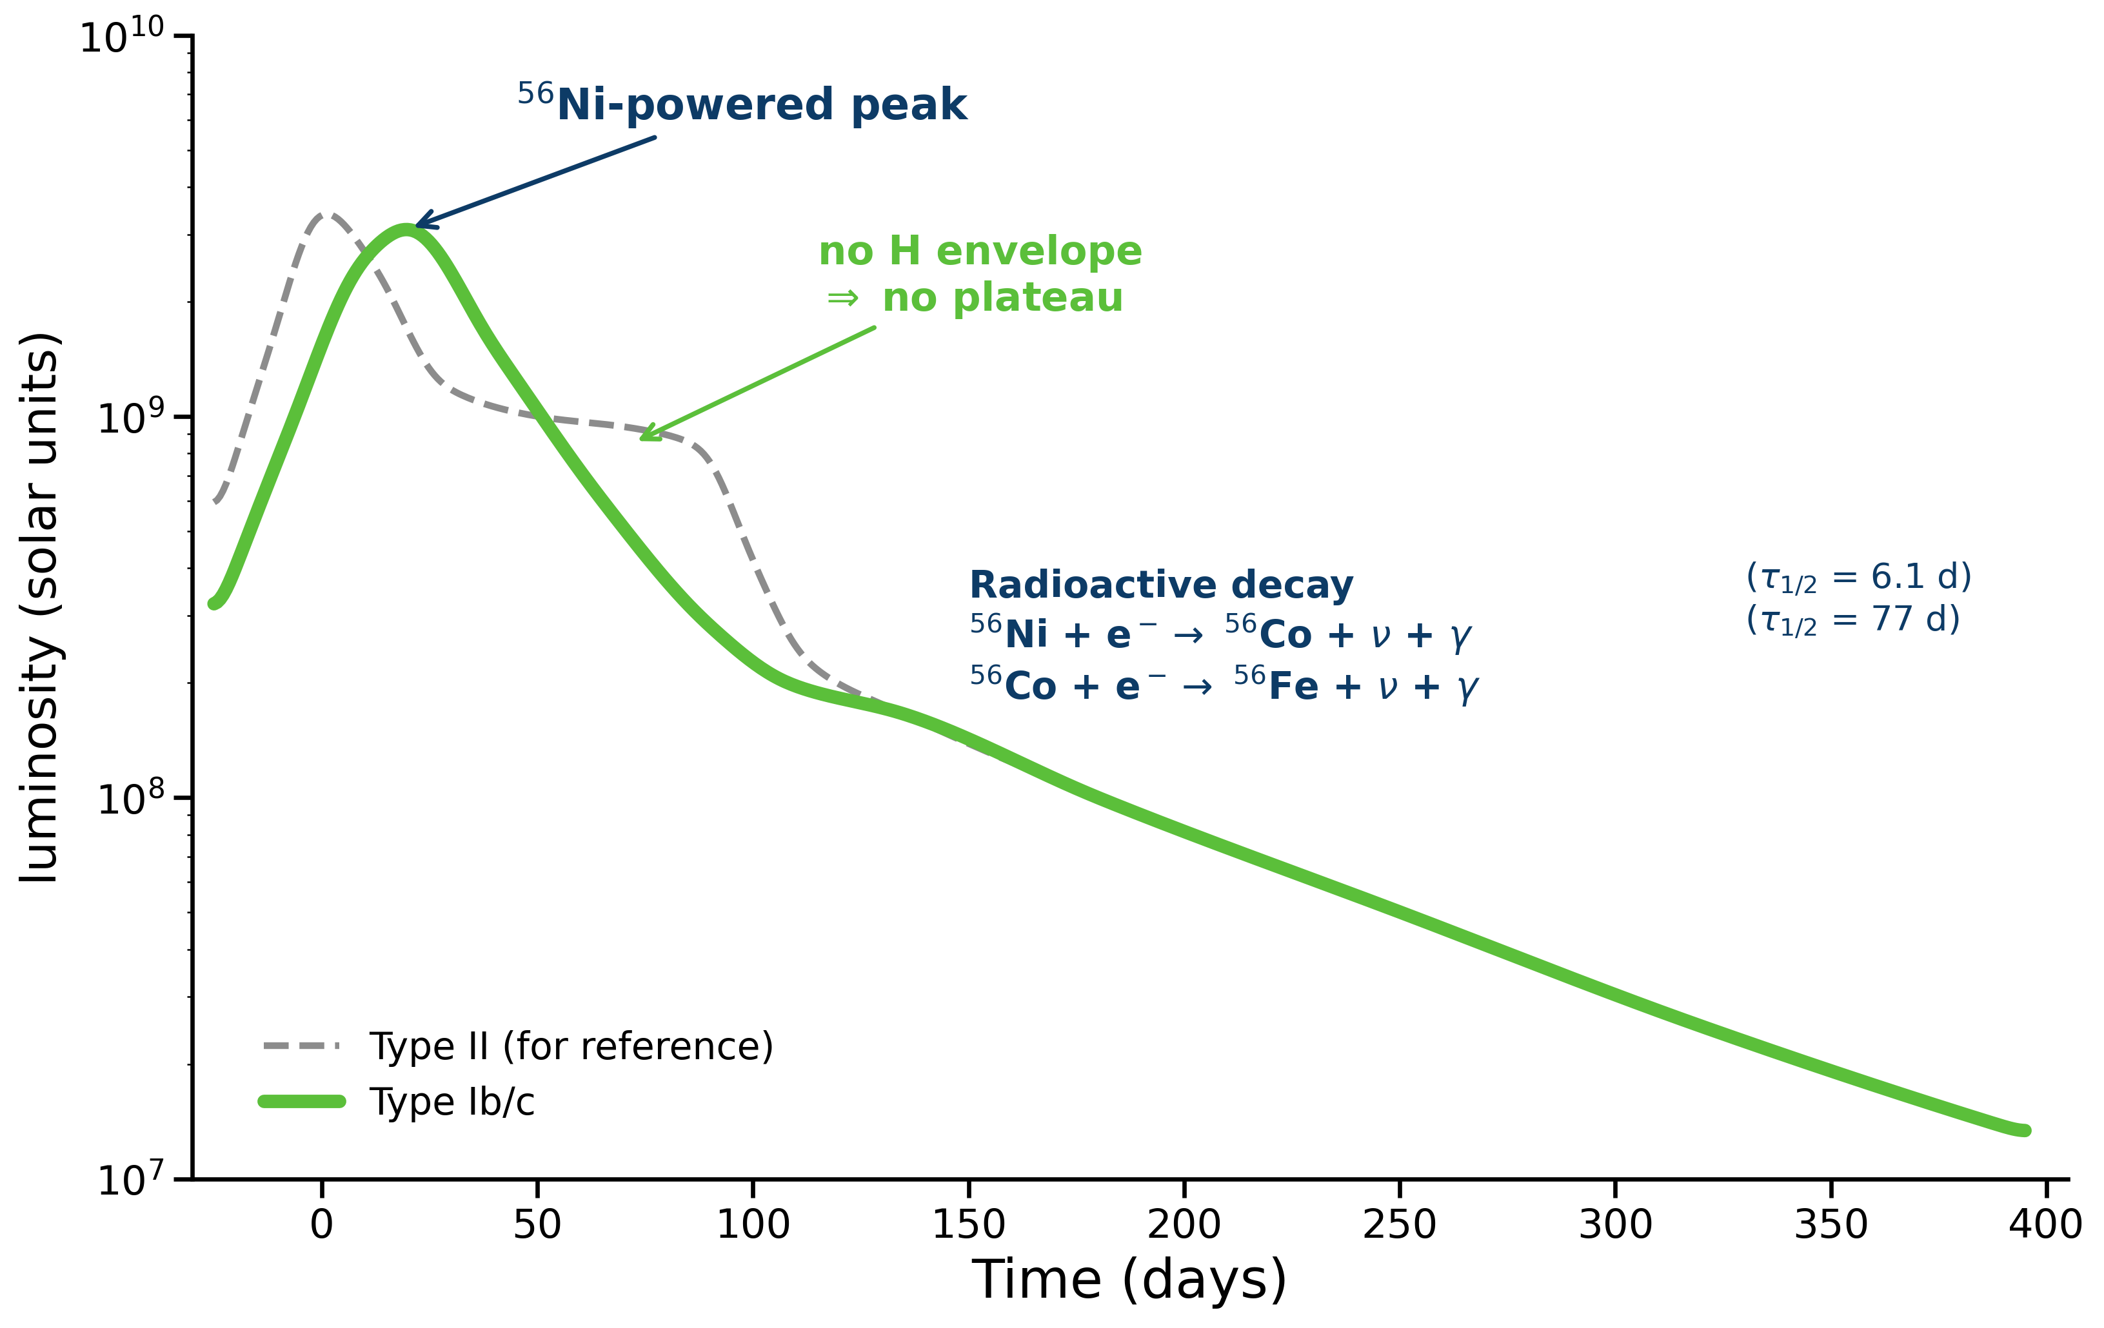
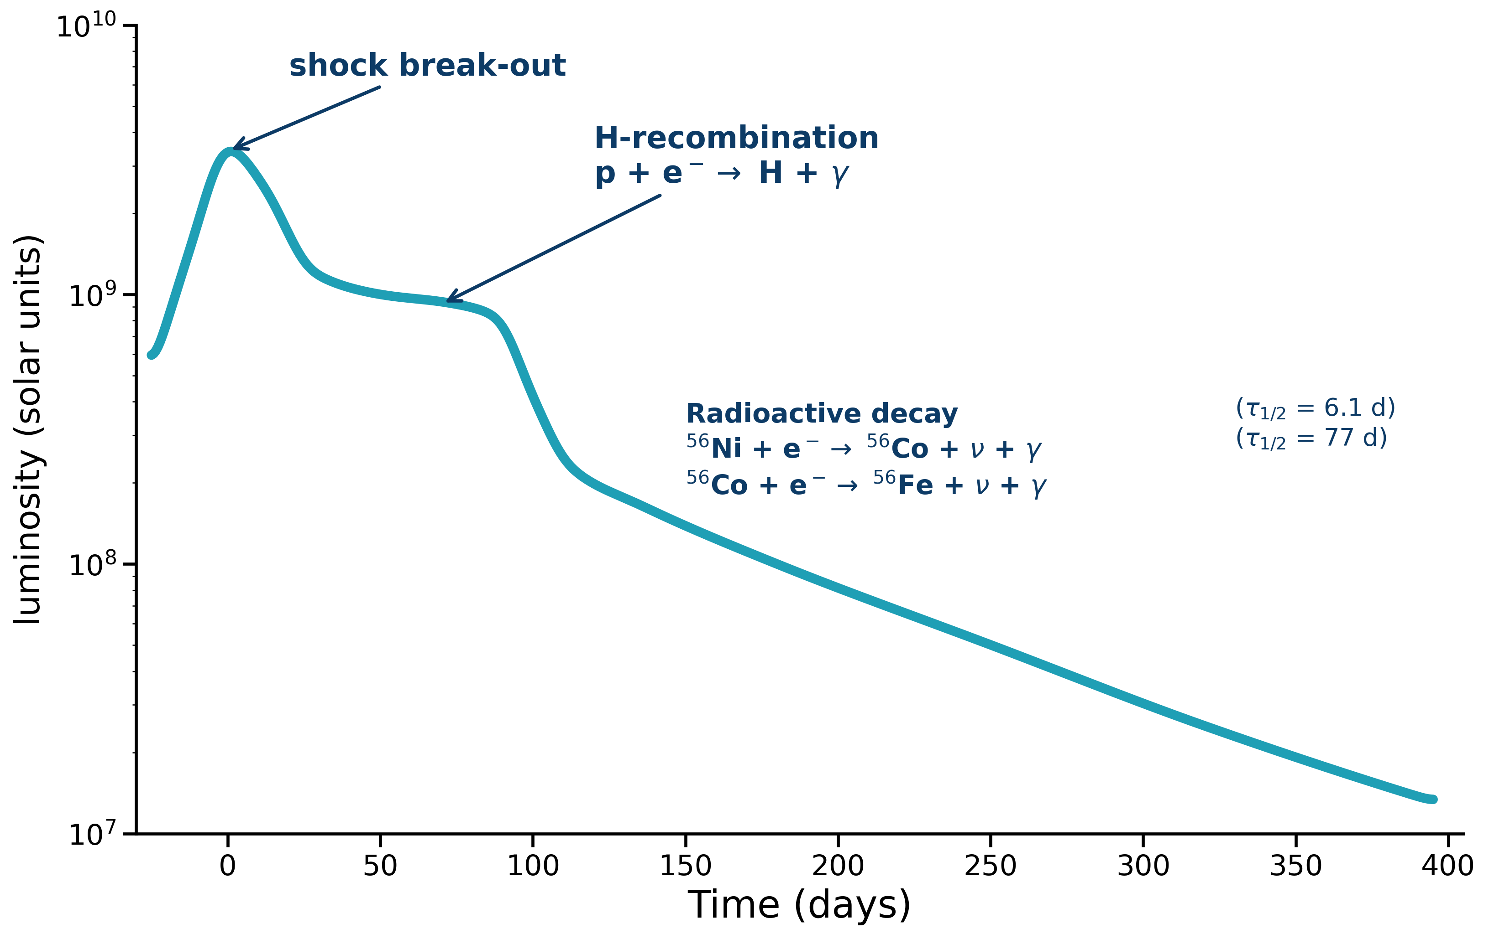
shock break-out
H-recombination
p+e−→H+γ
Radioactive decay
⁵⁶Ni + e− → ⁵⁶Co + ν + γ (τ1/2 = 6.1 d)
⁵⁶Co + e− → ⁵⁶Fe + ν + γ (τ1/2 = 77 d)
Time (days)
B, Explosive endpoints
Dissapearing stars
SLSNe
Ni-powered peak
.
Radioactive decay
⁵⁶Ni + e− → ⁵⁶Co + ν + γ (τ1/2 = 6.1 d)
⁵⁶Co + e− → ⁵⁶Fe + ν + γ (τ1/2 = 77 d)
Type Ibc
Type II
Time (days)

Slide 3
C. Single compact objects
Astrometric. C.O.
Spectroscop. C.O.
BH
NS

Slide 4
D. Compact objects in Binaries
Astrometric. C.O.
Spectroscop. C.O.
High-M
X-ray binaries
NS
BH
Pulsar
binaries
NS
NS
HMXRB
LMXRB
WD + MS

Slide 5
E. Double compact object mergers
In gas disk of Active Galactic Nuclei

Slide 6
E. Double compact object mergers
Astrometric. C.O.
Massive OB stars
High-M
X-ray binaries
Spectroscop. C.O.
Intermediate-M
stripped stars
Algol binaries
Pulsar
binaries
BH
NS
stripped star
WUMa binaries
EL CVn-like
systems
Post-AGB
binaries
WD
Hot Subdwarfs
Low M
He Giants
Chem. Peculiar stars
WD + MS
Blue straggler binary
Low-M stripped
WD binaries

Slide 7
POST MT CARTOONS
Astrometric. C.O.
Massive OB stars
High-M
X-ray binaries
Spectroscop. C.O.
Intermediate-M
stripped stars
Algol binaries
Pulsar
binaries
BH
NS
stripped star
WUMa binaries
EL CVn-like
systems
Post-AGB
binaries
WD
Hot Subdwarfs
Low M
He Giants
Chem. Peculiar stars
WD + MS
Blue straggler binary
Low-M stripped
WD binaries

Slide 8



M_{ZAMS,a}
M_{ZAMS,b}
$$Mass transf. stability$$
1st mass transfer
$$Accretion efficiency$$
Rubin, Gaia, ELT
APOGEE, BLOeM
$$Mpost MT1$$
M_{BH,a}
Remnant mass
2nd mass transfer
Core mass fraction
M_{core}
M_{BH,a}
M_{BH,b}
M_{NS,b}
LVK, ET, CE
LISA

