Slide 2
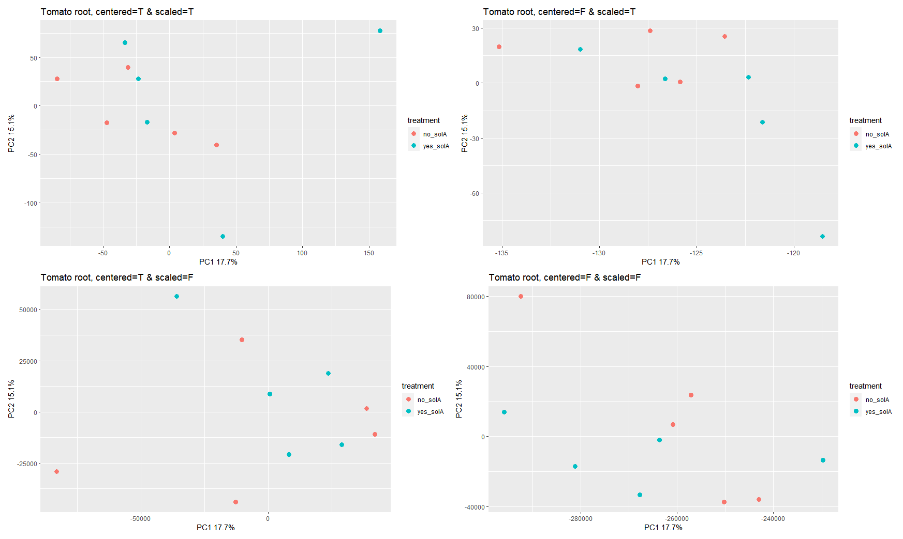
Tomato root

Slide 3
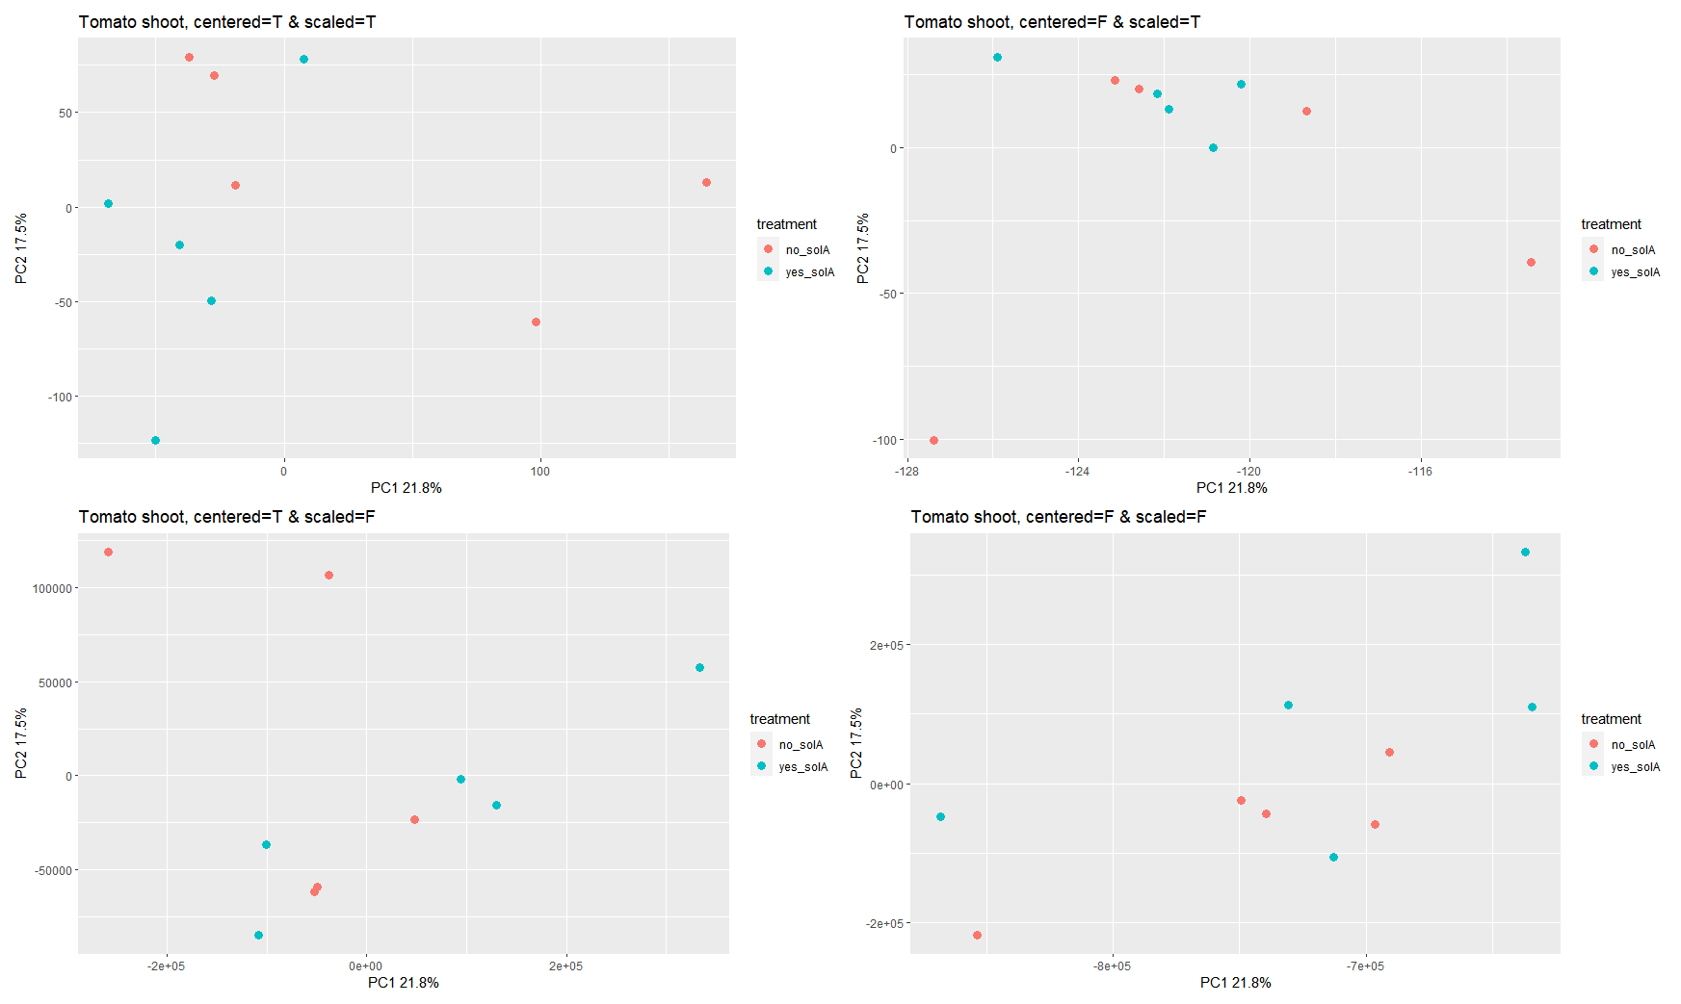
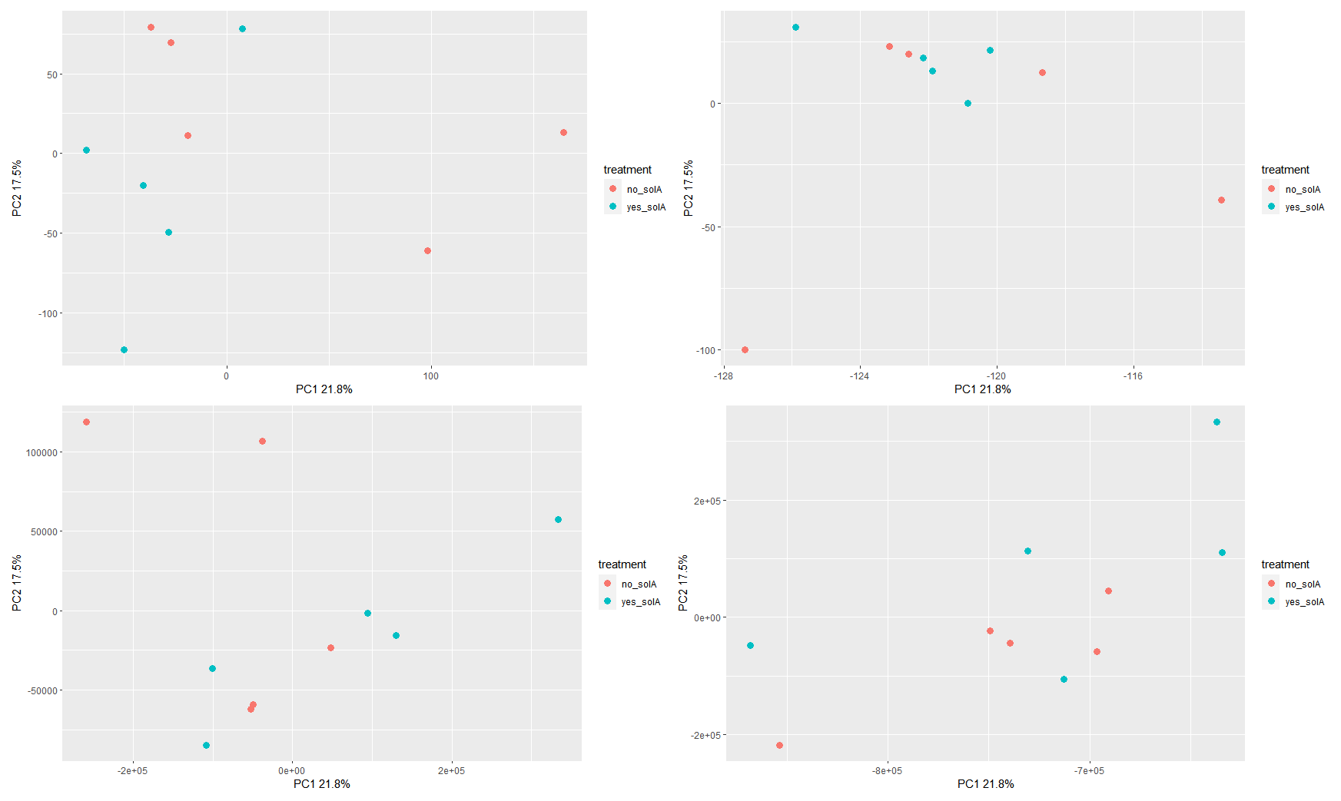
Tomato shoot

Slide 4
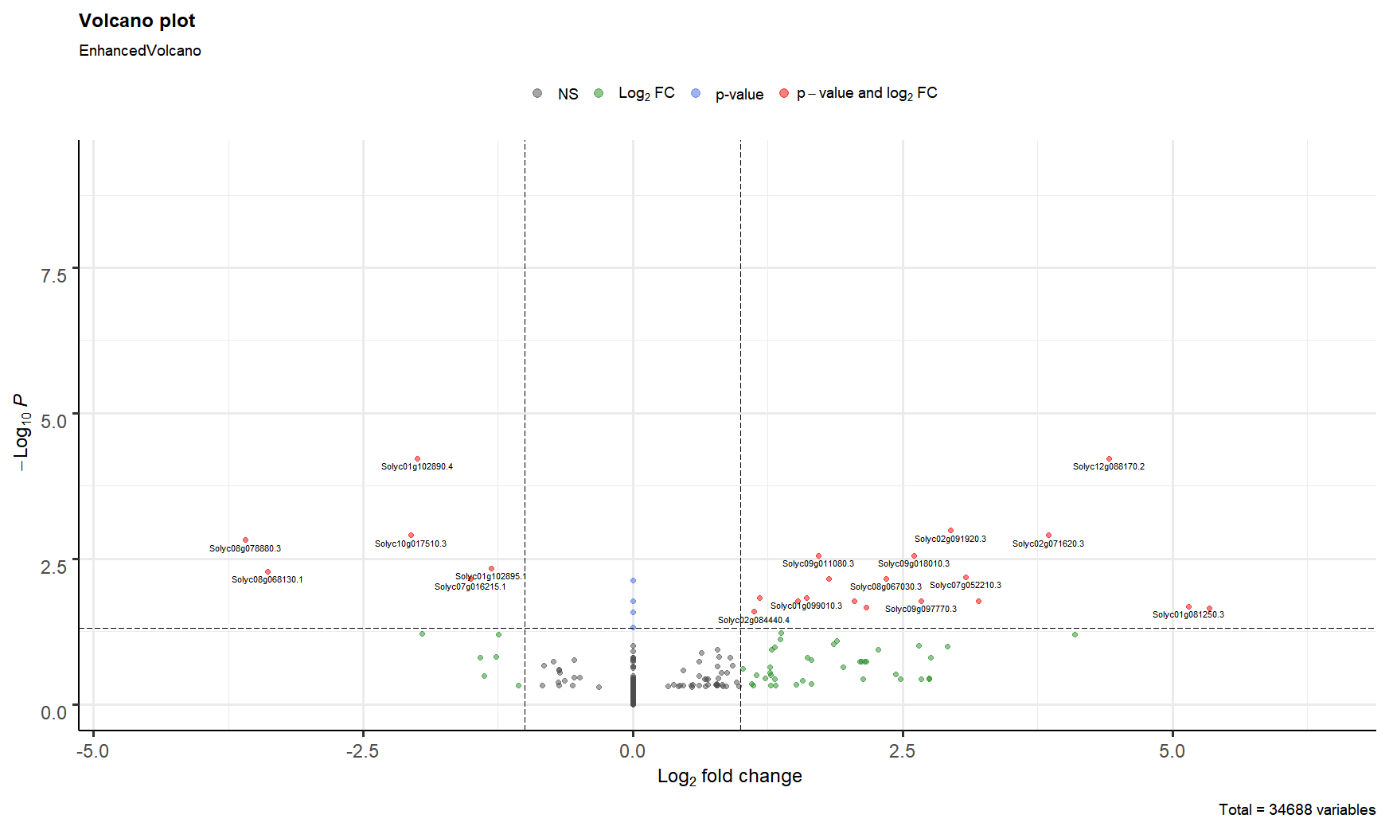
Tomato root

Slide 5
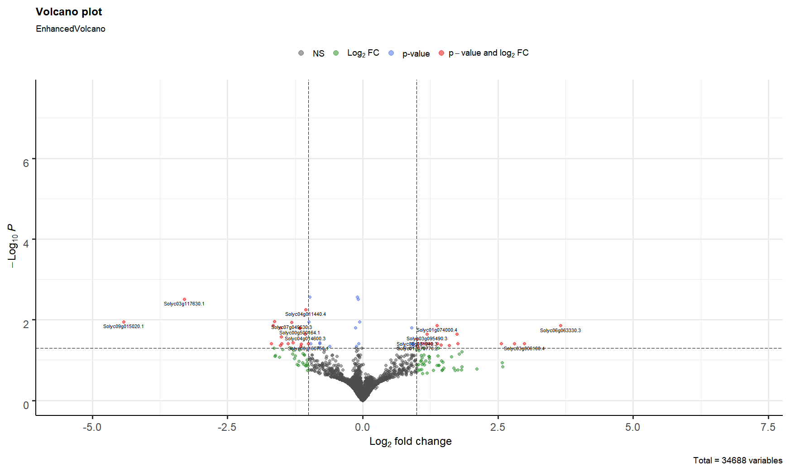
Tomato shoot

Slide 6
Overlap between groups
There are 0 overlapping genes between Sly1 and Ath1
There are 0 overlapping genes between Sly1 and Ath2_ab (no starvation)
There are 0 overlapping genes between Sly-root and Ath2_cd (under N starvation)
There is 1 overlapping gene between Sly1-shoot and Ath2_cd (under N starvation): HSP18.2
There are 2 overlapping genes between Sly1-root and Ath2-ef (under both N and P starvation): a glycosyltransferase and Germin-like protein subfamily 1 member 7
There are 3 overlapping genes between Sly1-shoot and Ath2_ef (under both N and P starvation): HSP18.2, atHSP17.4 and an unknown transmembrane protein

Slide 7
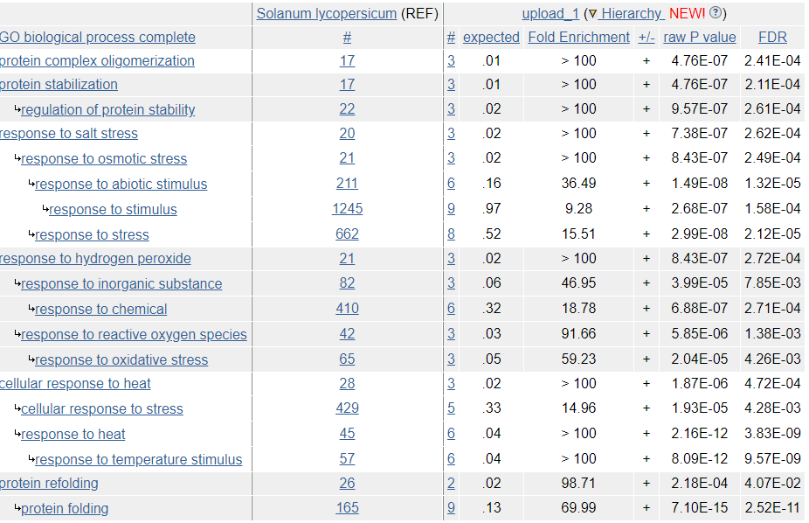
GO enrichment downregulated tomato shoot
No statistically significant results for upregulated DEGs in shoot, or any others in root

Slide 8
DEGs tomato root

Slide 9
DEGs tomato shoot
Solyc01g074000.4 | 1.542933791 | 0.013737732 | Histone H3 (AHRD V3.11 *** tr|B3TM40|B3TM40_ELAGV)
Solyc06g065970.1 | 1.61709576 | 0.039084221 | Bifunctional inhibitor/lipid-transfer protein/seed storage 2S albumin superfamily protein (AHRD V3.3 *** A0A2U1PU47_ARTAN)
Solyc03g123410.1 | 1.706359891 | 0.042410985 | Germin-like protein.1
Solyc11g072860.2 | 1.892105343 | 0.043380409 | Histone H4 (AHRD V3.3 *-* F2E7L1_HORVV)
Solyc05g054610.1 | 2.00126347 | 0.022676133 | Histone H4 (AHRD V3.3 *-* F2E7L1_HORVV)
Solyc11g065190.3 | 2.065571383 | 0.039084221 | Ubiquitin-conjugating enzyme (AHRD V3.3 *** A0A200PMH3_9MAGN)
Solyc12g042550.2 | 3.014521129 | 0.039084221 | Unknown protein
Solyc04g074900.3 | 3.312530226 | 0.039084221 | 40S ribosomal protein S.1
Solyc03g006100.4 | 3.503795384 | 0.039084221 | LRR receptor-like serine/threonine-protein kinase EFR (AHRD V3.3 *** A0A1U8GGG3_CAPAN)
Solyc06g063330.3 | 4.140267001 | 0.014028967 | Vacuolar ATP synthase catalytic subunit (AHRD V3.3 *** A0A0A7LU40_9ASPA)

Slide 10
Other possibly interesting findings
DEGs overlapping in Ath2 in all nutritional treatments:
Nematode resistance protein-like HSPRO2 is present in both Ath1 and Ath2 (not in starvation samples), but up- versus down

