Slide 1
Arabidopsis and tomato transcriptomics of solA treatment

Slide 2
Second Arabidopsis experiment
 | group a | group b | group c | group d | group e | group f | group g
P | + | + | - | - | - | - | +
N | + | + | + | + | - | - | -
add solA | - | + | - | + | - | + | -
expectation -P gene expression | control | down | up | down/unchanged | Up? | (more) down | Down
expectation -N gene expression | control | slightly up | unchanged | slightly up | Up | Up | Up
why | control | Repeat (validate) RNAseq | positive control | solA prevents -P response | negative control | solA favours -N response? | control for tomato RNAseq

Slide 3
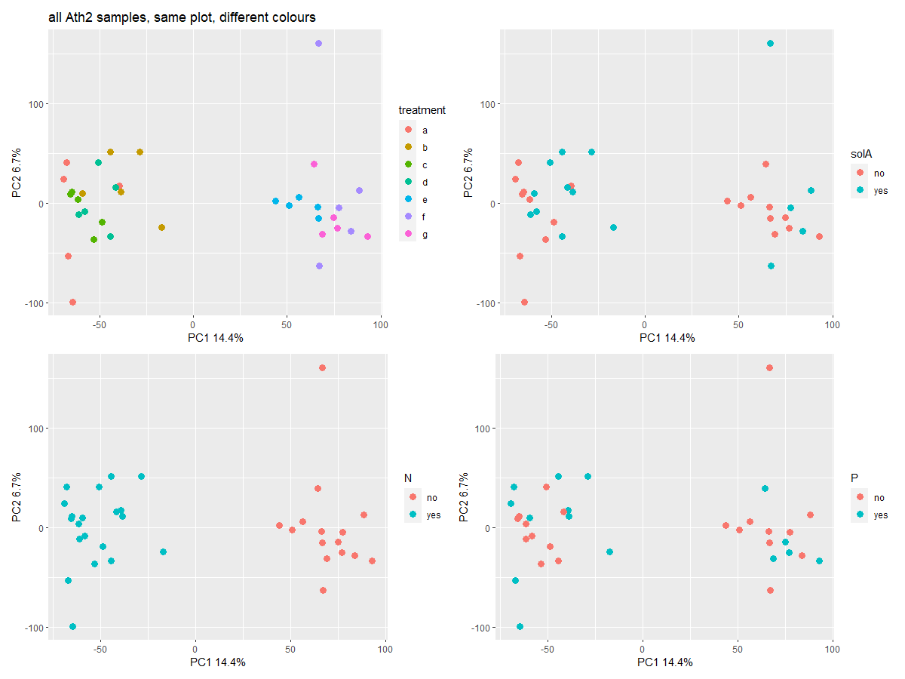

Slide 4
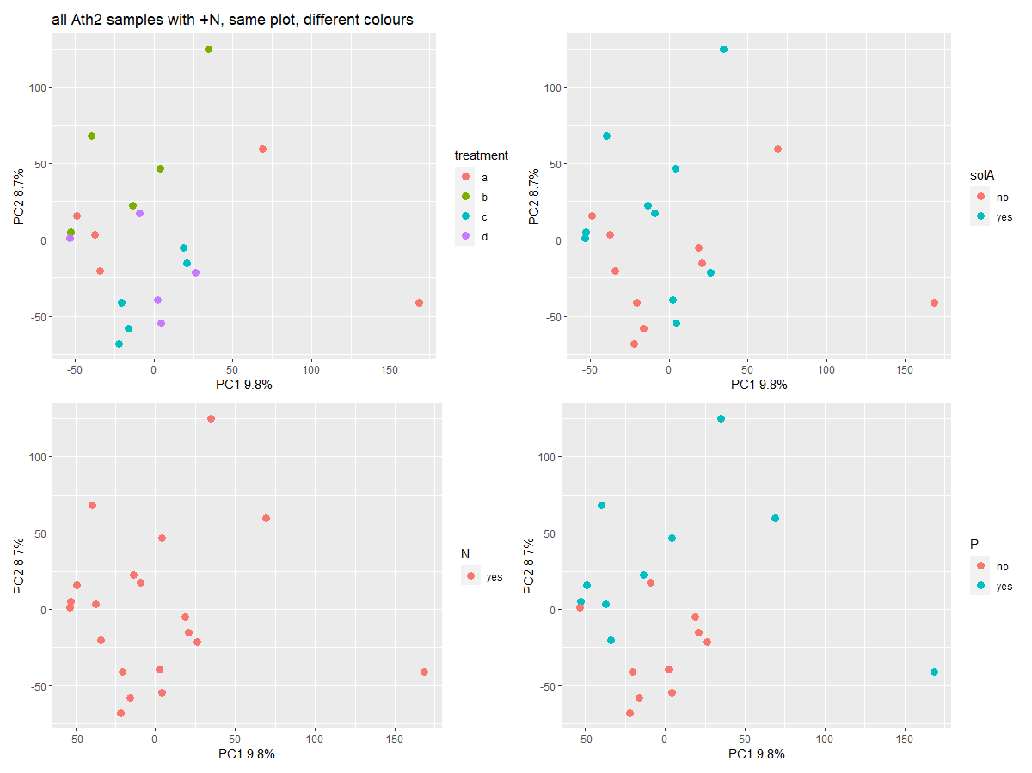

Slide 5
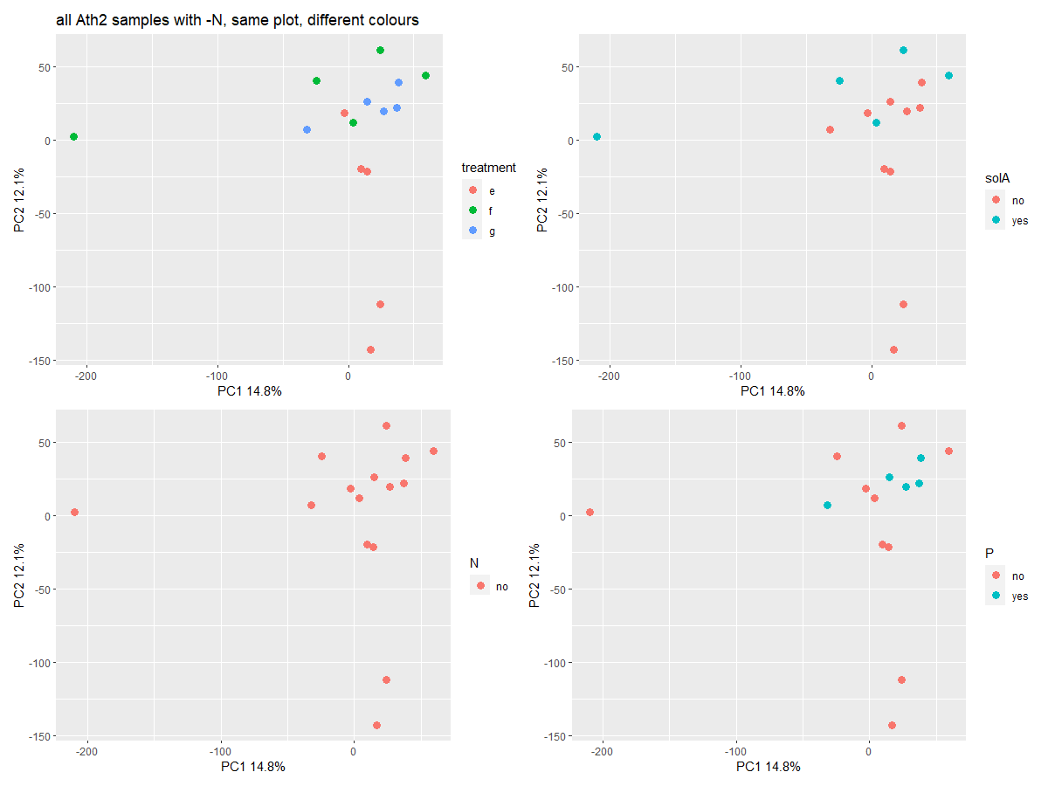

Slide 6
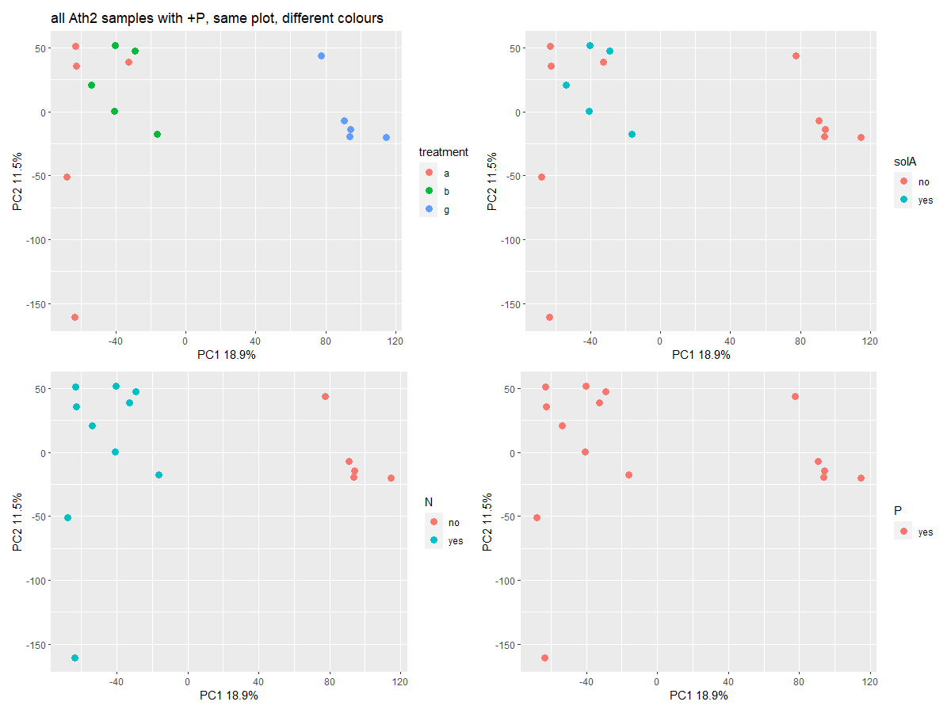

Slide 7
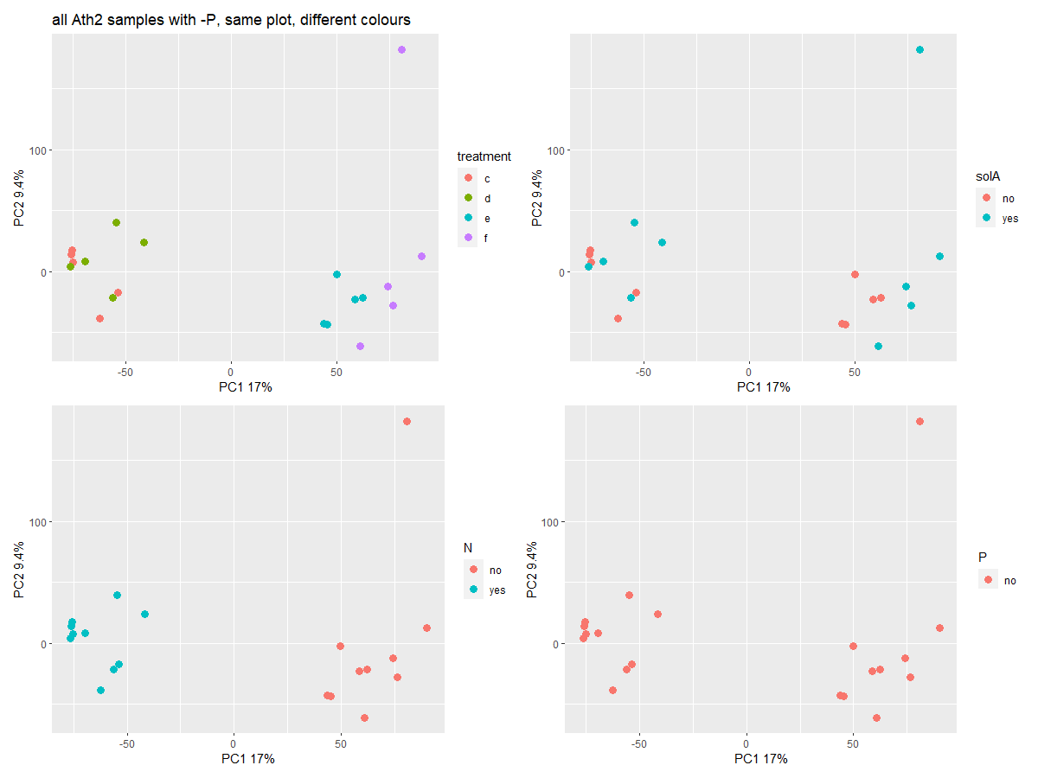

Slide 8
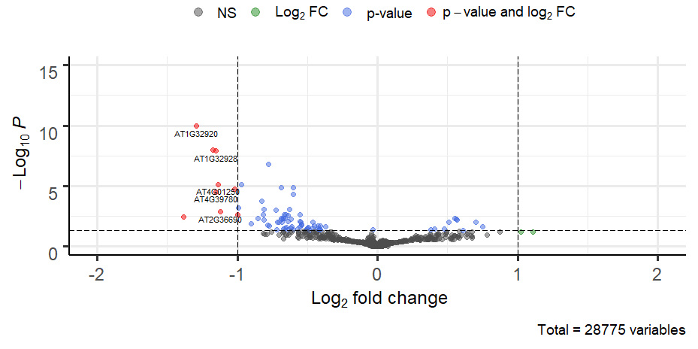
Volcano plot, no starvation, solA treatment
AT5G45630 -1.554910706 0.003715312 834603 Putative uncharacterized protein

Slide 9
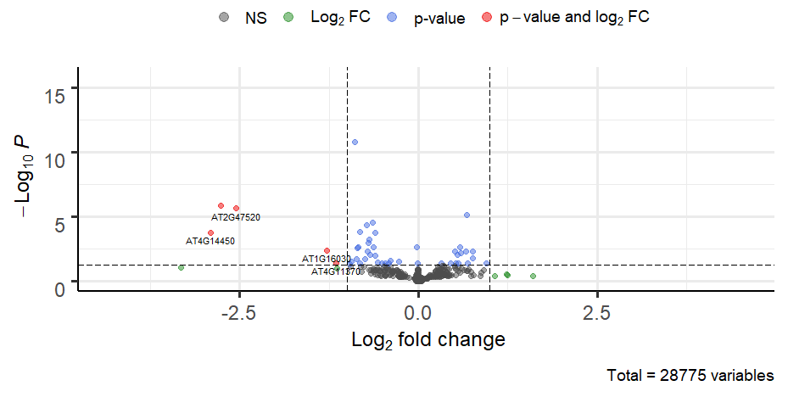
Volcano plot, P starvation, solA treatment

Slide 10
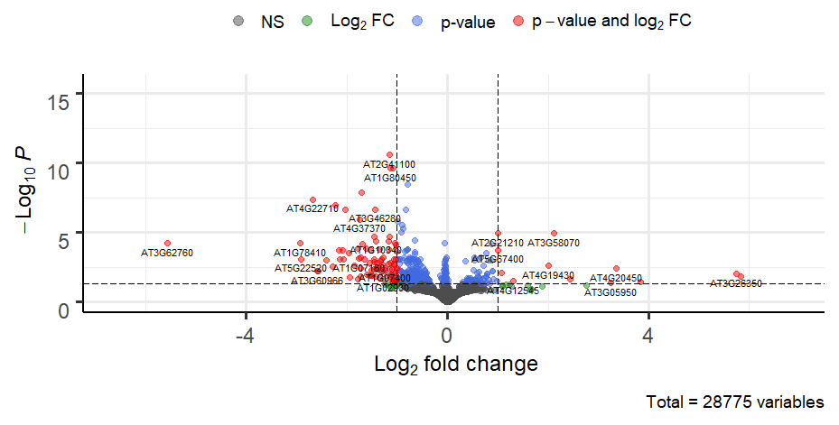
Volcano plot, P+N starvation, solA treatment

Slide 12
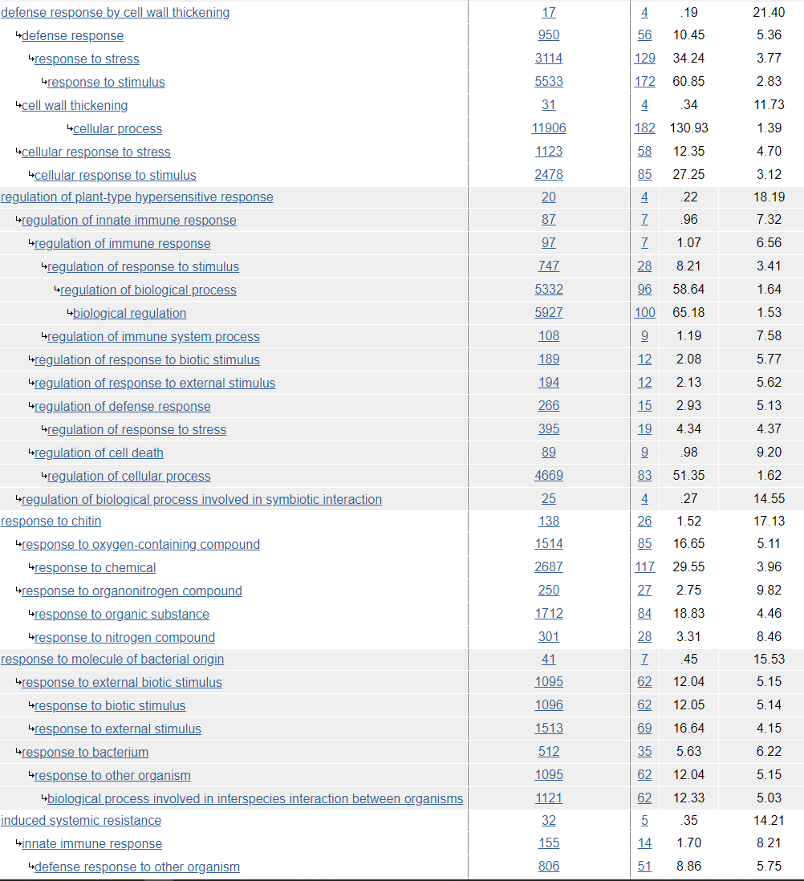
GO terms enriched in all genes in N+P starvation solA trtmnt

Slide 13
Other possibly interesting findings
DEGs overlapping in Ath2 in all nutritional treatments:
Nematode resistance protein-like HSPRO2 is present in both Ath1 and Ath2 (not in starvation samples), but up- versus down

Slide 14
Tomato RNAseq
 | + solA | - solA
Root | 5 replicates | 5 replicates
Shoot | 5 replicates | 5 replicates
Grow 14d in glass tube
Add 5 uM solA or EtOH
Harvest after 2h

Slide 15
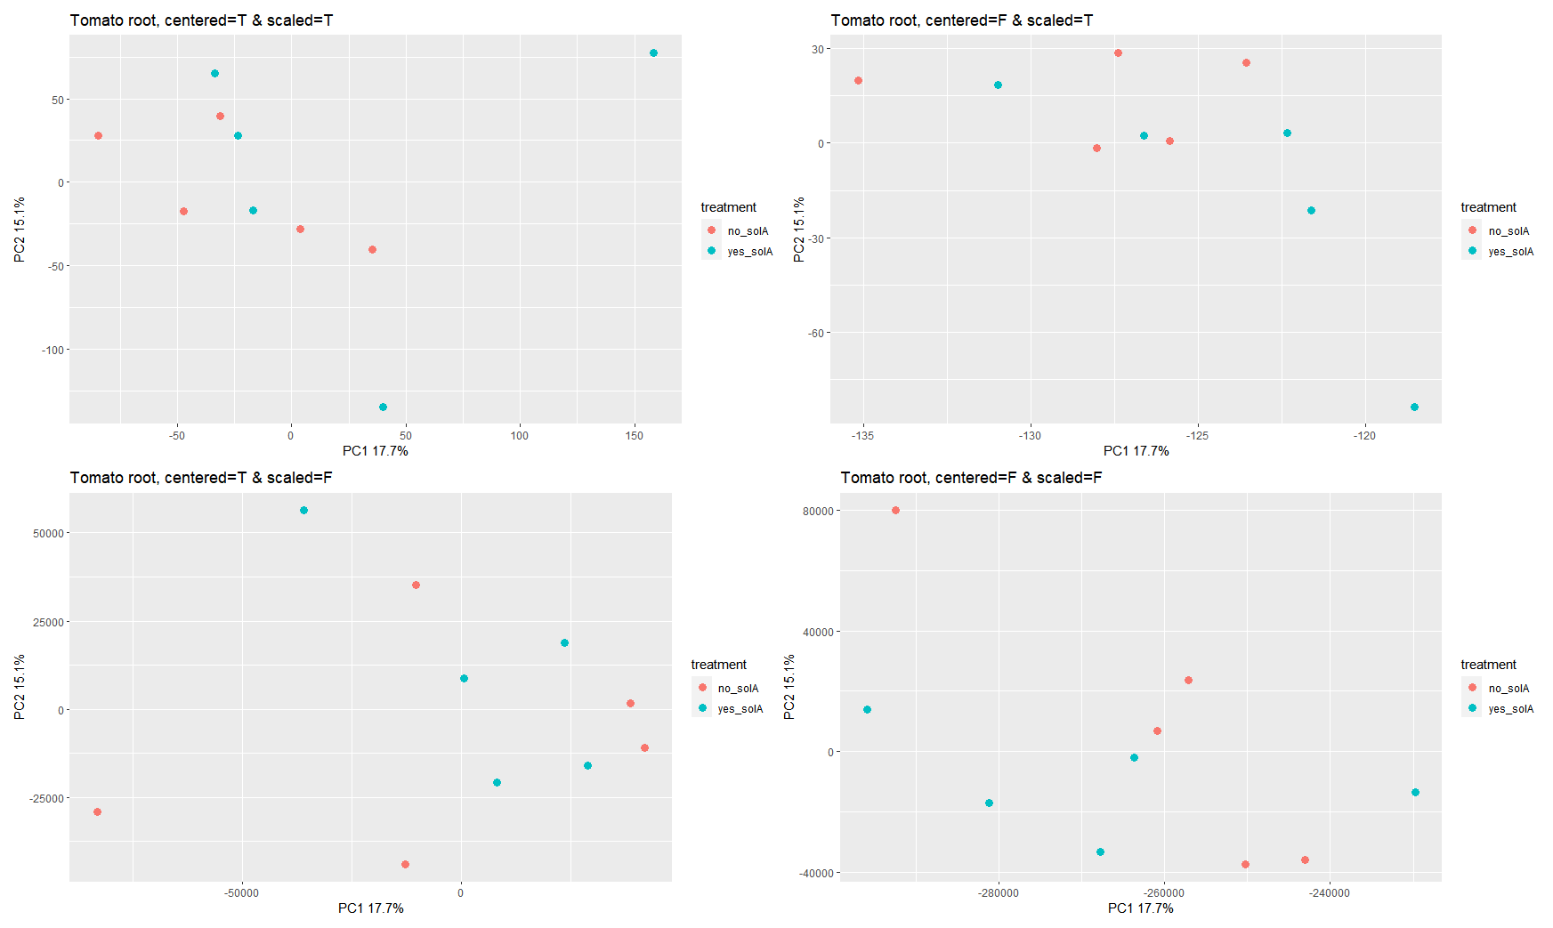
Tomato root

Slide 16
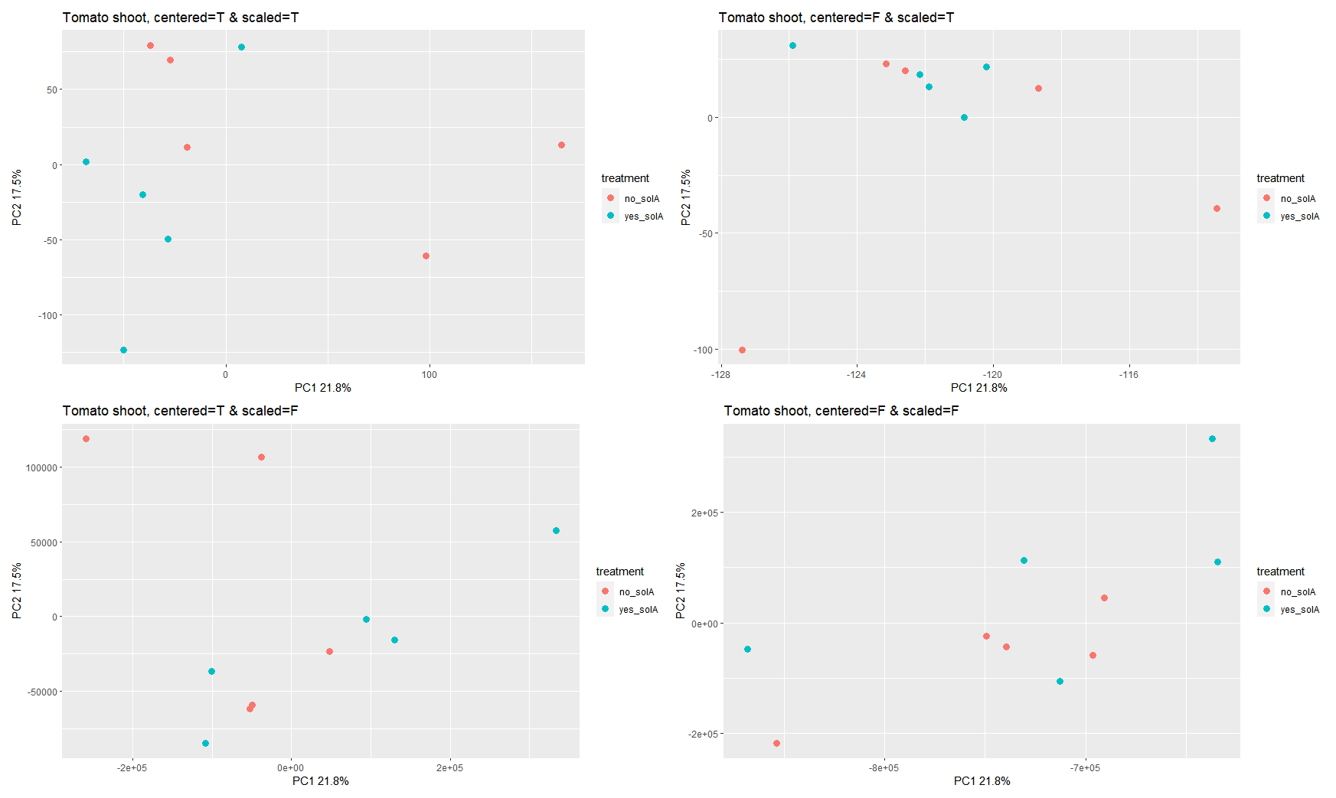
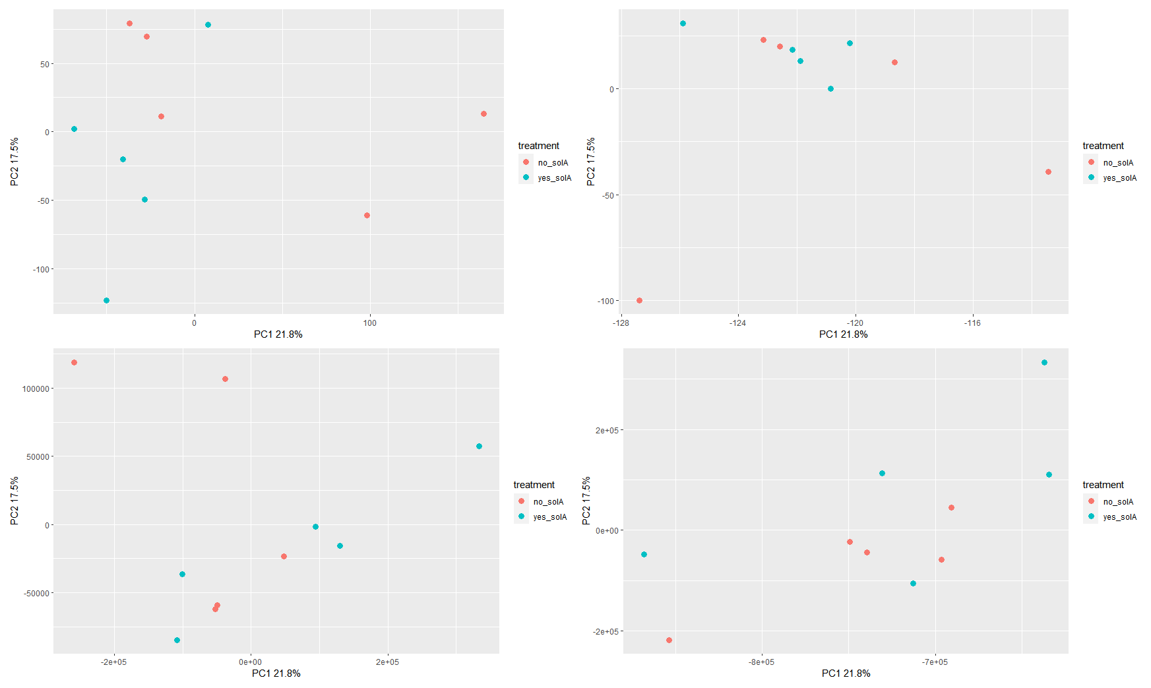
Tomato shoot

Slide 17
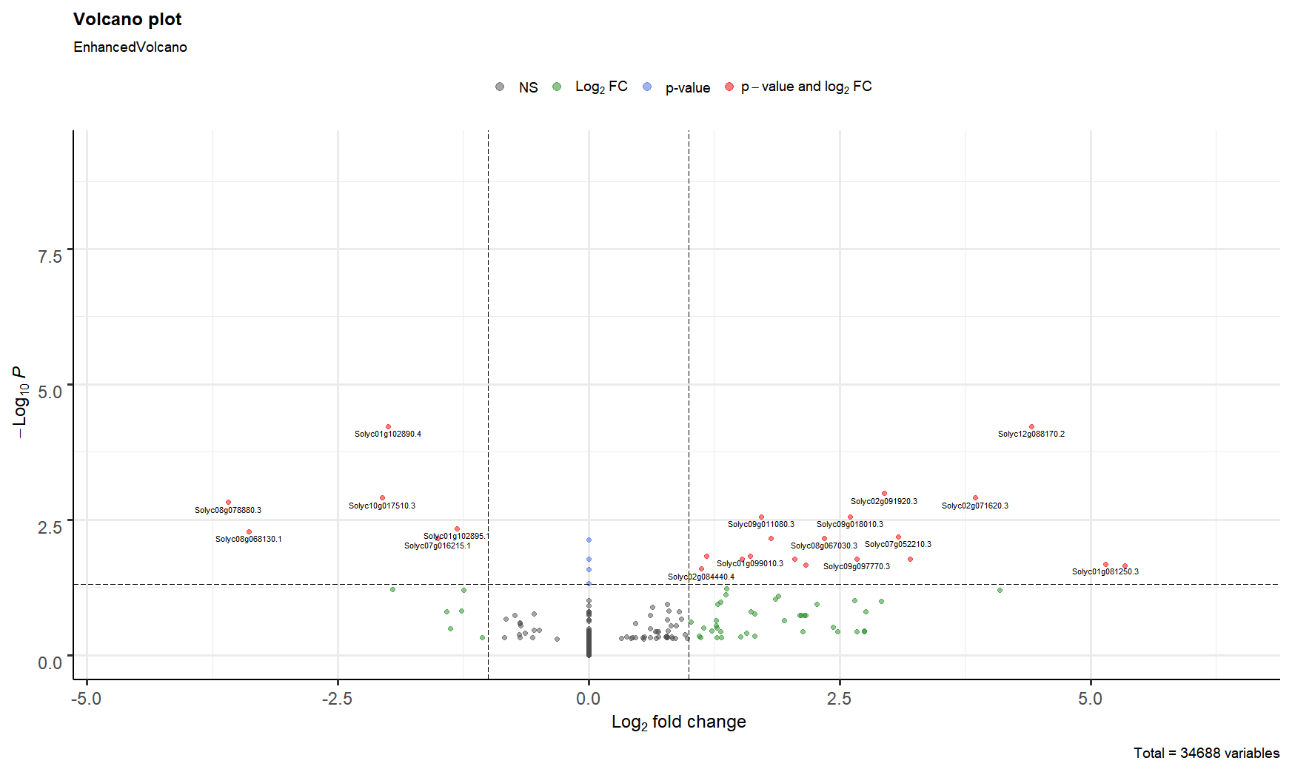
Tomato root

Slide 18
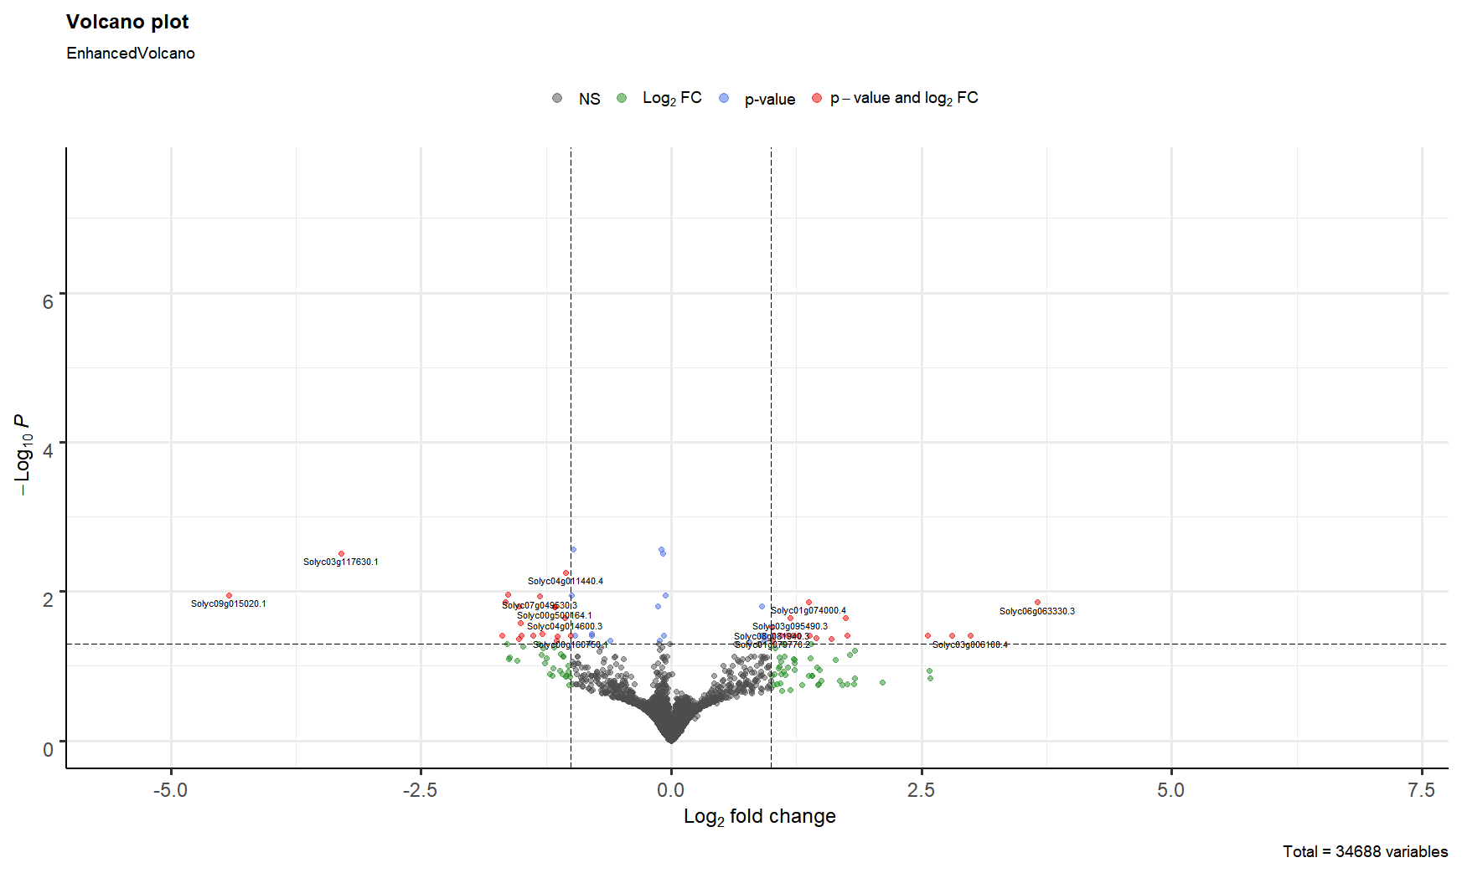
Tomato shoot

Slide 19
Overlap between groups
There are 0 overlapping genes between Sly1 and Ath1
There are 0 overlapping genes between Sly1 and Ath2_ab (no starvation)
There are 0 overlapping genes between Sly-root and Ath2_cd (under N starvation)
There is 1 overlapping gene between Sly1-shoot and Ath2_cd (under P starvation): HSP18.2
There are 2 overlapping genes between Sly1-root and Ath2-ef (under both N and P starvation): a glycosyltransferase and Germin-like protein subfamily 1 member 7
There are 3 overlapping genes between Sly1-shoot and Ath2_ef (under both N and P starvation): HSP18.2, atHSP17.4 and an unknown transmembrane protein

Slide 20
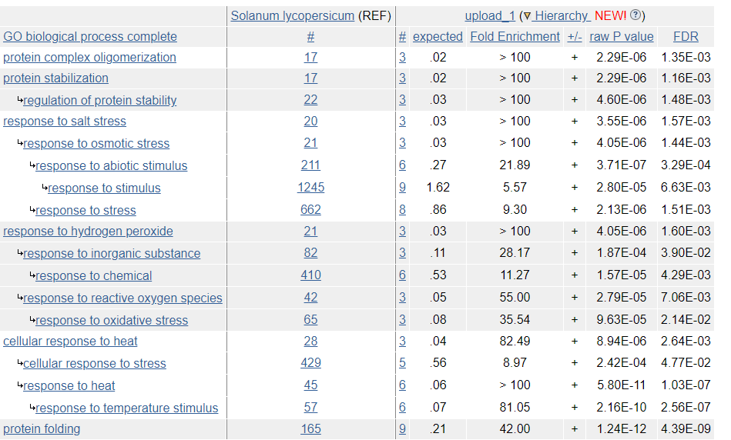
GO enrichment tomato shoot
No statistically significant results for root

Slide 21
DEGs tomato root

Slide 22
DEGs tomato shoot
Overlap with N+P starvation in Arabidopsis: HSPs
Solyc01g074000.4 | 1.542933791 | 0.013737732 | Histone H3 (AHRD V3.11 *** tr|B3TM40|B3TM40_ELAGV)
Solyc06g065970.1 | 1.61709576 | 0.039084221 | Bifunctional inhibitor/lipid-transfer protein/seed storage 2S albumin superfamily protein (AHRD V3.3 *** A0A2U1PU47_ARTAN)
Solyc03g123410.1 | 1.706359891 | 0.042410985 | Germin-like protein.1
Solyc11g072860.2 | 1.892105343 | 0.043380409 | Histone H4 (AHRD V3.3 *-* F2E7L1_HORVV)
Solyc05g054610.1 | 2.00126347 | 0.022676133 | Histone H4 (AHRD V3.3 *-* F2E7L1_HORVV)
Solyc11g065190.3 | 2.065571383 | 0.039084221 | Ubiquitin-conjugating enzyme (AHRD V3.3 *** A0A200PMH3_9MAGN)
Solyc12g042550.2 | 3.014521129 | 0.039084221 | Unknown protein
Solyc04g074900.3 | 3.312530226 | 0.039084221 | 40S ribosomal protein S.1
Solyc03g006100.4 | 3.503795384 | 0.039084221 | LRR receptor-like serine/threonine-protein kinase EFR (AHRD V3.3 *** A0A1U8GGG3_CAPAN)
Solyc06g063330.3 | 4.140267001 | 0.014028967 | Vacuolar ATP synthase catalytic subunit (AHRD V3.3 *** A0A0A7LU40_9ASPA)

Slide 23
Proposed structure of story:
Introduction: compare with strigolactones
In tomato, solanoeclepin A affects protein stabilization through, among others, Heat Shock Proteins
Without N starvation conditions, solanoeclepin A does not affect transcription in Arabidopsis (take LFS>1.5/2)
Under N starvation, solanoeclepin A suppresses defence responses in Arabidopsis
Discuss excretory role of solA; again compare with strigolactones
Include Ath1 – P starvation story? (and Ath2 – P starvation treatment) Cannot be confirmed…
What to give as reason for the starvation treatments?
Is there still possibility to use data from Ale/Davar? (tomato N starvation)

