Slide 1
Arabidopsis and tomato transcriptomics of solA treatment

Slide 2
Goal
To find out the effect of solanoeclepin A (solA) on the plant
SolA is only produced by tomato and potato
But we only have a very small amount of the molecule, so we cannot use it in big experiments
Therefore, the majority of experiments were carried out on Arabidopsis (= small plant, so less solA necessary)

Slide 3
First Arabidopsis experiment
 | M02 | N02 | E02 | M06 | N06 | E06 | M24 | N24 | E24
Time (h) | 2 | 2 | 2 | 6 | 6 | 6 | 24 | 24 | 24
solA | uM | nM | - | uM | nM | - | uM | nM | -
Only in t=2h there were DEGs, related to N and P starvation → follow up experiment with only t=2h

Slide 4
Tomato experiment
 | Group a (S01-S05) | Group b (S06-S10) | Group c (S11-S15) | Group d (S16-S20)
solA | - | - | + | -
Compartment | Root | Shoot | Root | Shoot

Slide 5
Second Arabidopsis experiment
 | group a | group b | group c | group d | group e | group f | group g
P | + | + | - | - | - | - | +
N | + | + | + | + | - | - | -
add solA | - | + | - | + | - | + | -

Slide 6
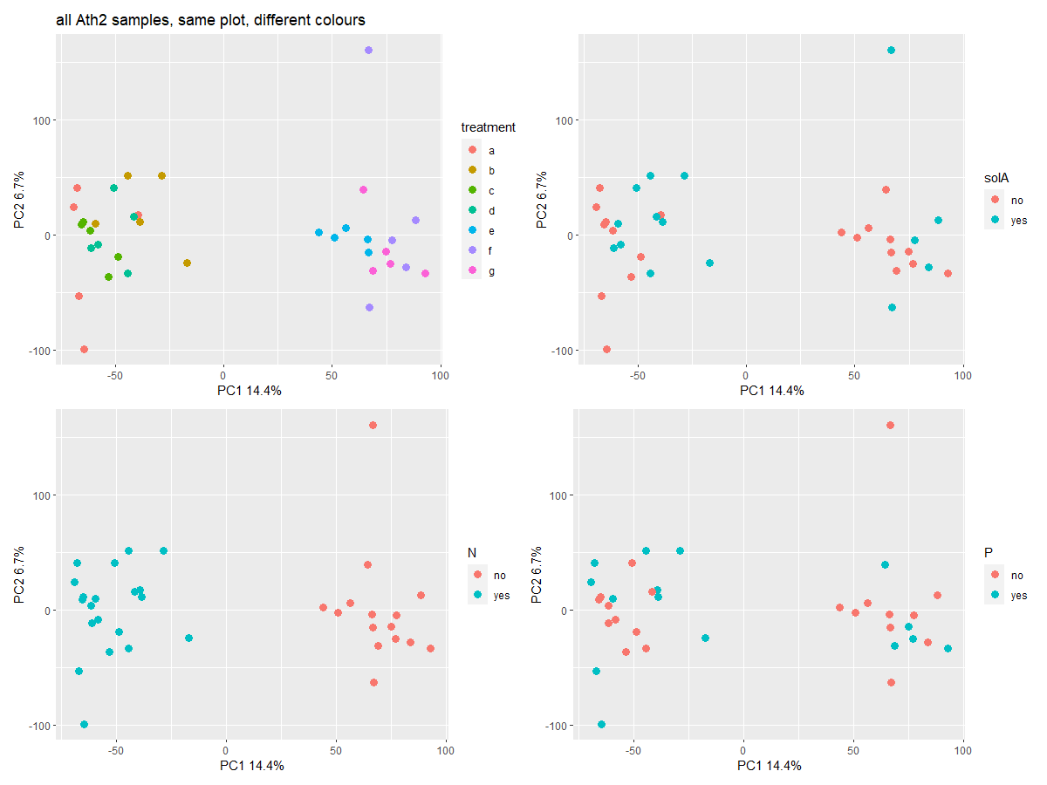

Slide 7
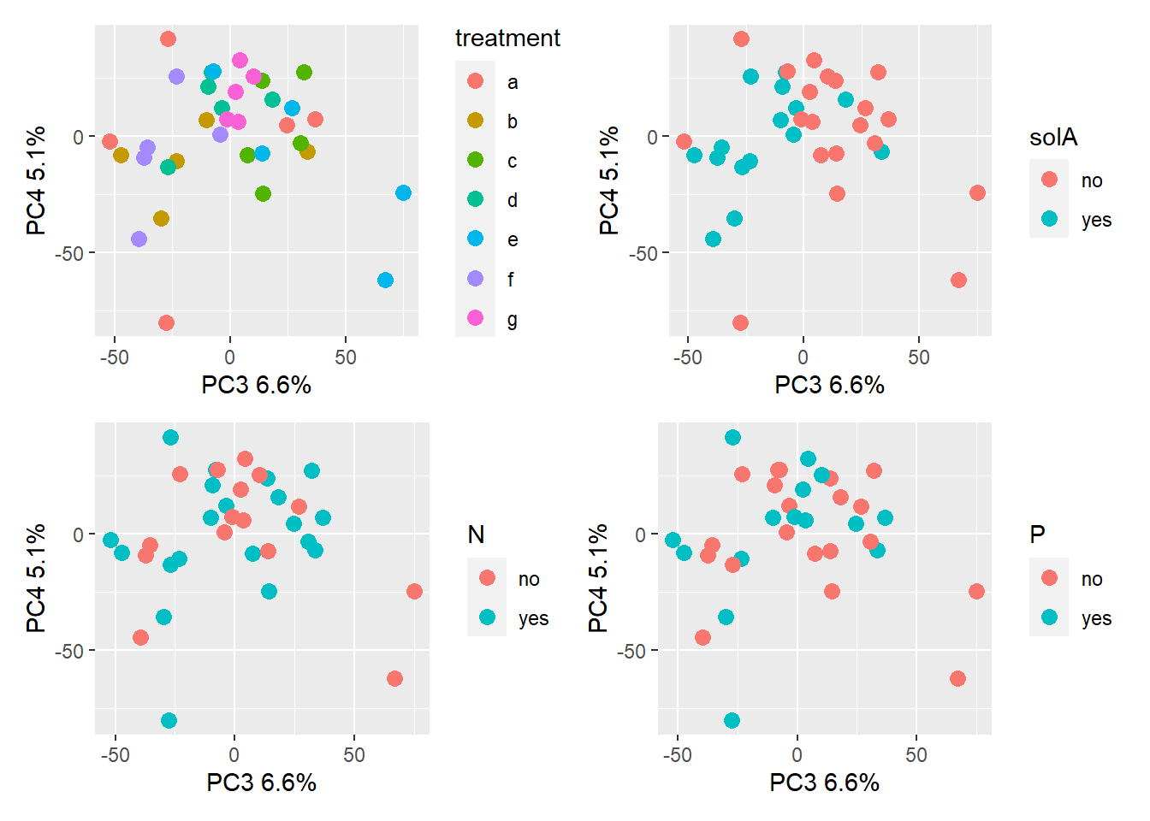
All samples, PC3 and PC4

Slide 8
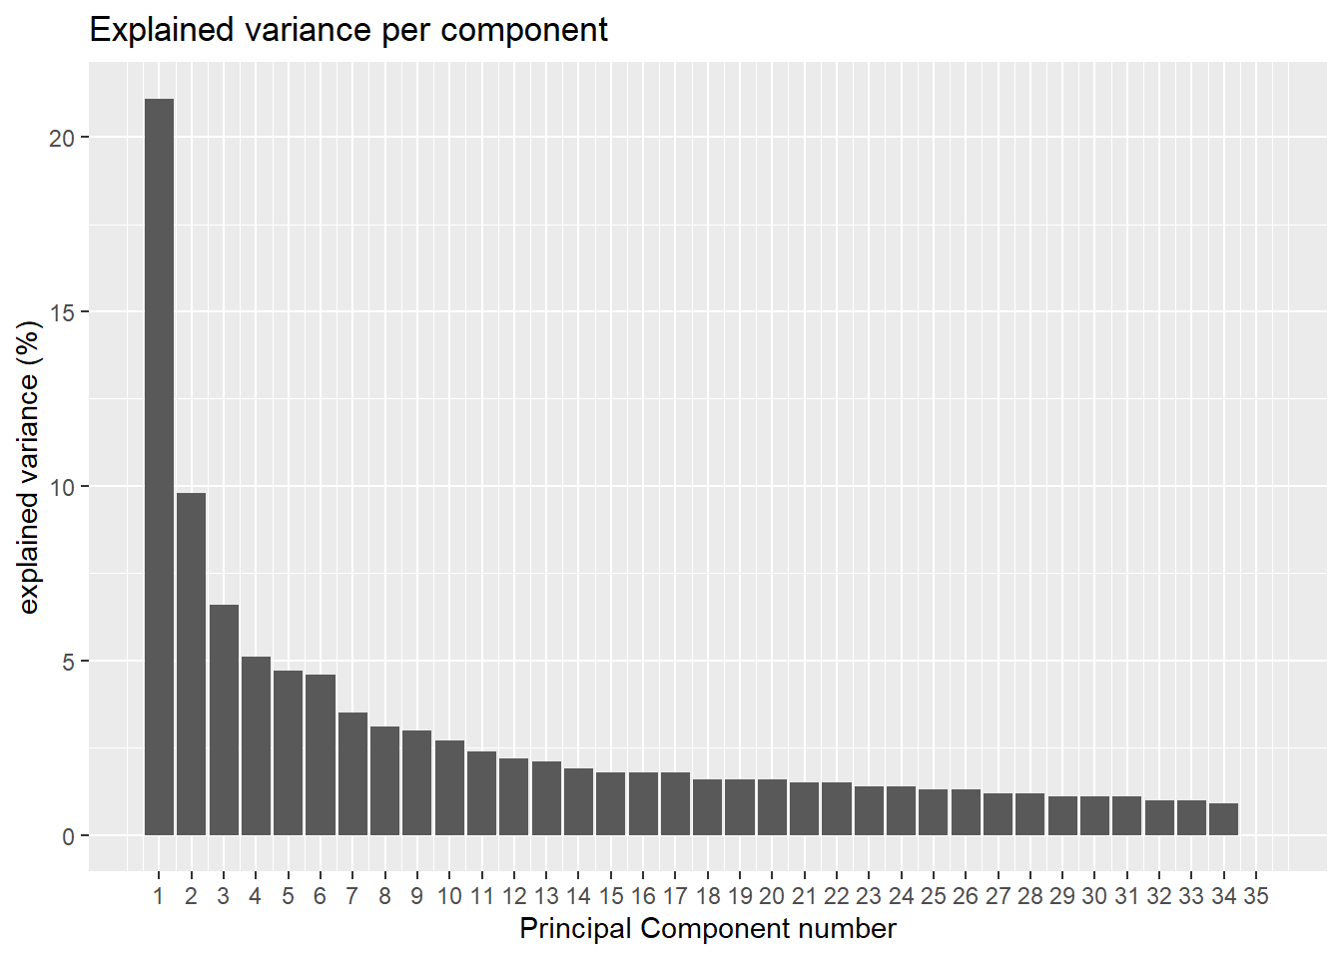
Scree plot all samples

Slide 9
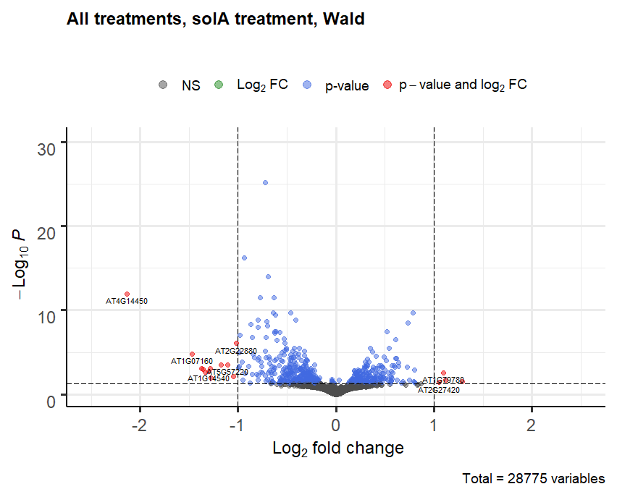
Volcano plot, all samples, solA treatment
Design in DESeq2: all datapoints
~ P + N + solA
630 DEGs,
of which 36 have LFC > 1

Slide 10
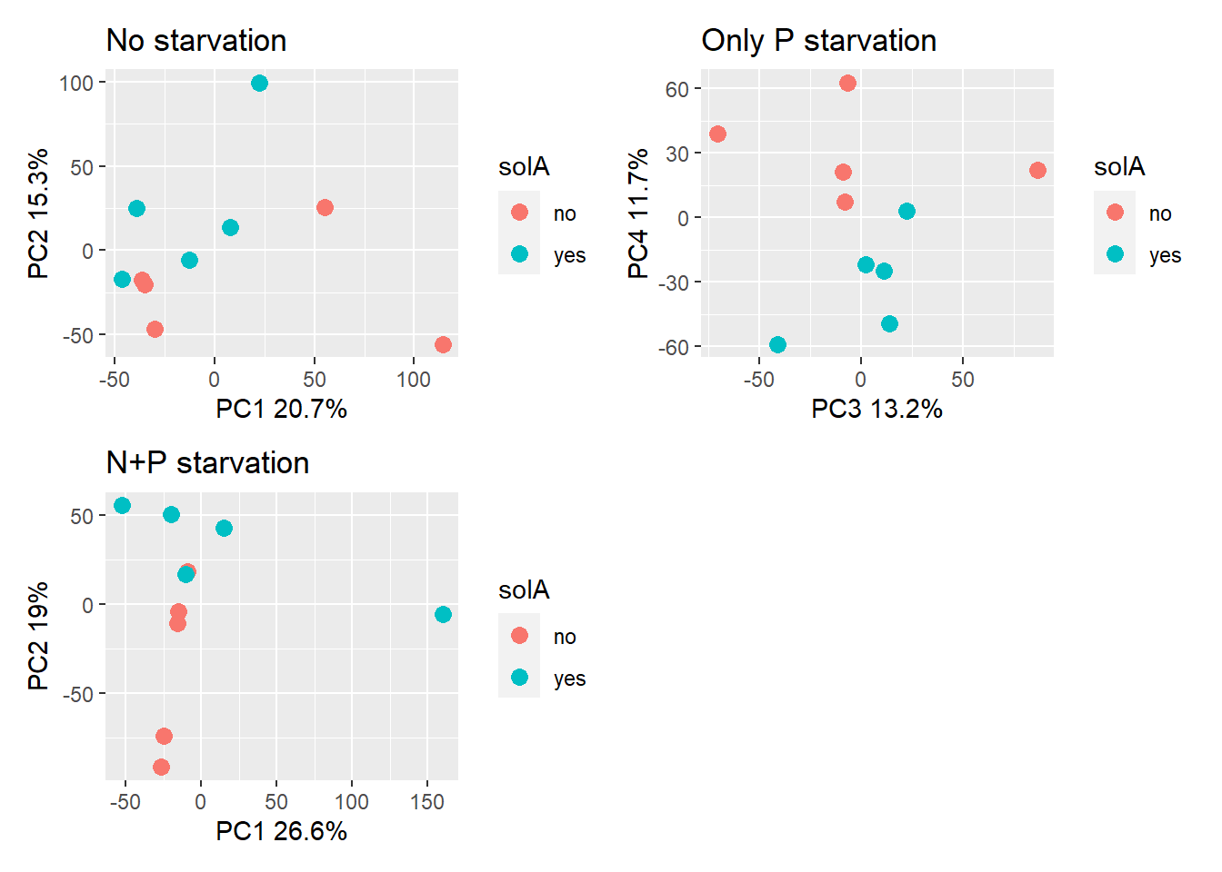
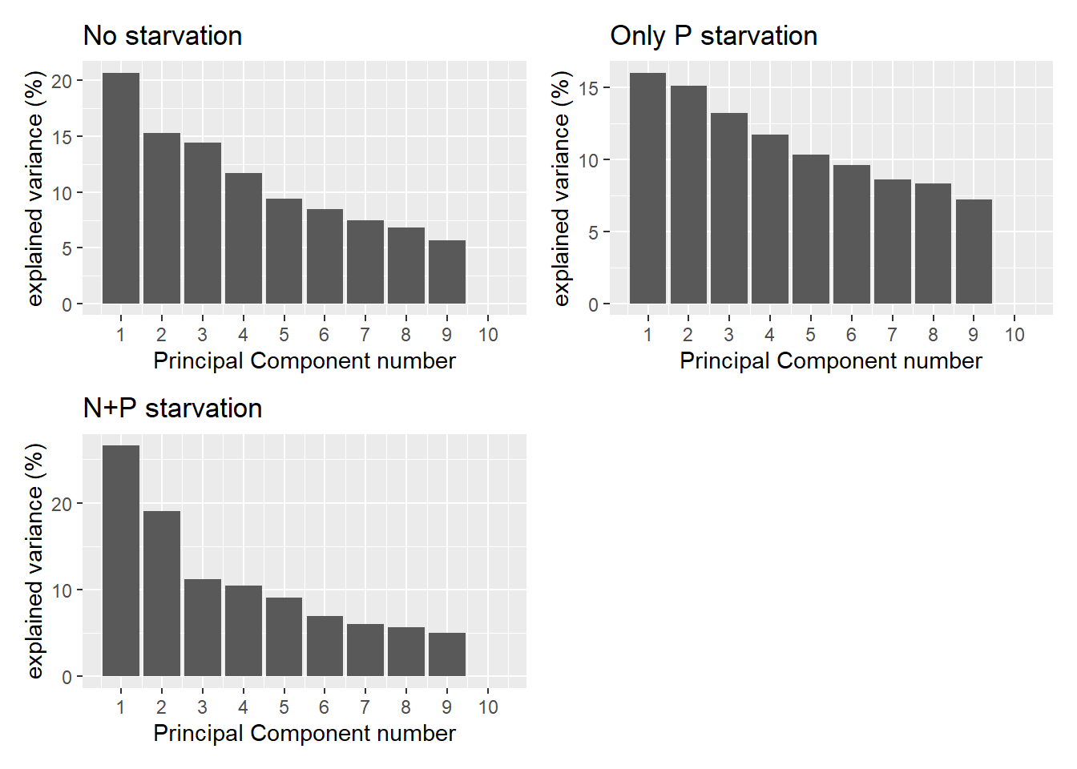
Pair-wise comparisons between samples in same nutritional conditions; plots with best separation

Slide 11
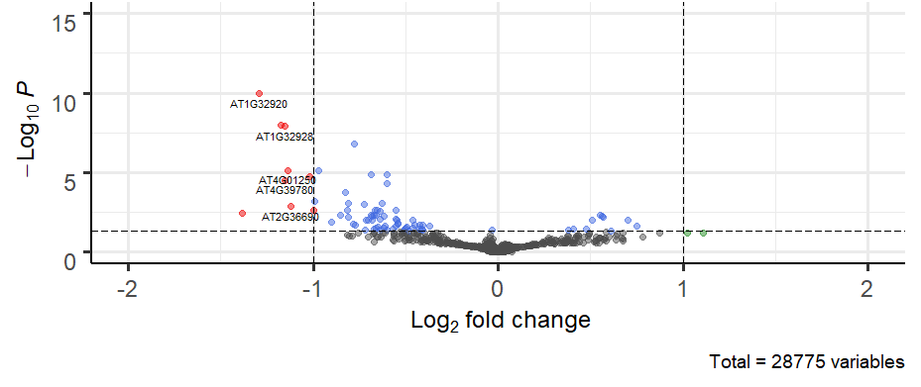
Volcano plot, no starvation, solA treatment
Design in DESeq2: subset of data (only “no starvation”)
~ treatment

Slide 12
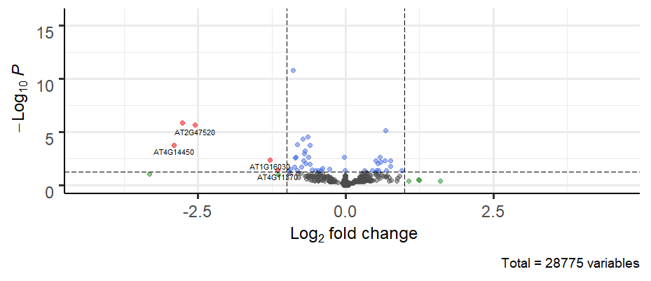
Volcano plot, P starvation, solA treatment
Design in DESeq2: subset of data; only “P starvation”
~ treatment

Slide 13
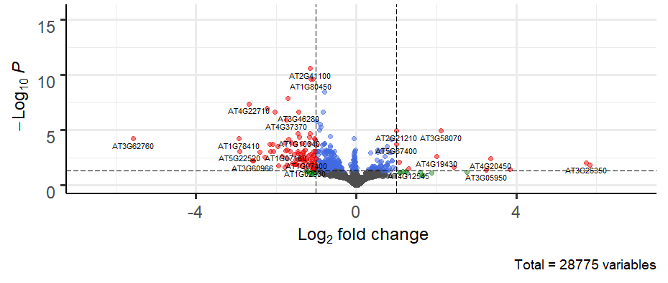
Volcano plot, P+N starvation, solA treatment
Design in DESeq2: subset of data; “P+N starvation”
~ treatment

Slide 14
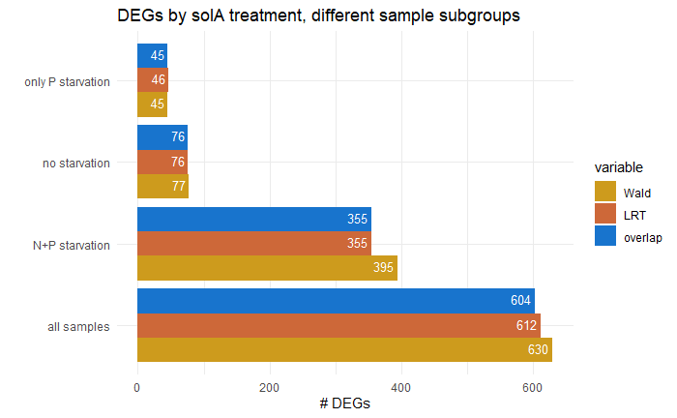
LRT
I compared all previously shown Wald outcomes with LRT
For within nutritional condition comparison: hardly any difference, only 1 DEG more or less; the rest is same. Compared models: ~ treatment vs. ~1
For all sample comparison: LRT gives 612 DEGs, while Wald test gives 630 DEGs (overlap = 604 genes). Compared models: ~ N + P + solA vs. ~N + P
Is this correct?
Is this correct?

Slide 15
Questions
Does it make sense to only use the overlap from LRT and Wald test as truly DEGs?
Should I remove outlier samples from the PCA and do all analyses without these outliers?

