Slide 1

SW-Request

Slide 2

Chapters:
How create new request:
  Create new customer package.
  Create new SaaS tenant.
  Behind the scene and request status.
How reset SaaS user password.

Slide 3
How To Create New Request

Slide 4
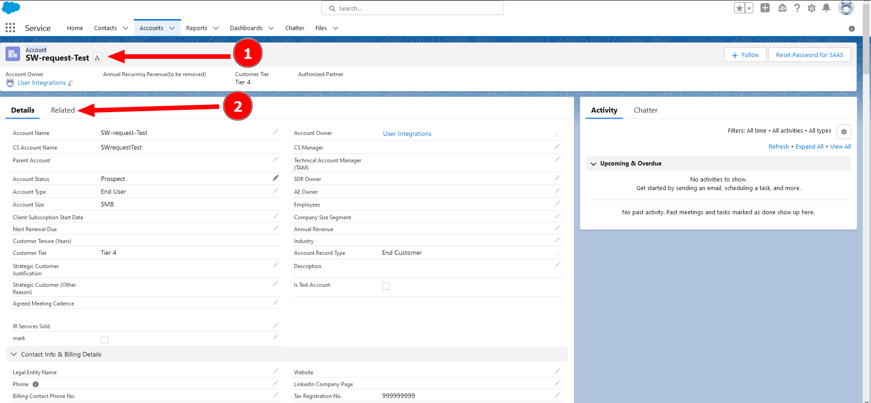
1.Choose the desired customer.
2.Click on “Related”.

Slide 5
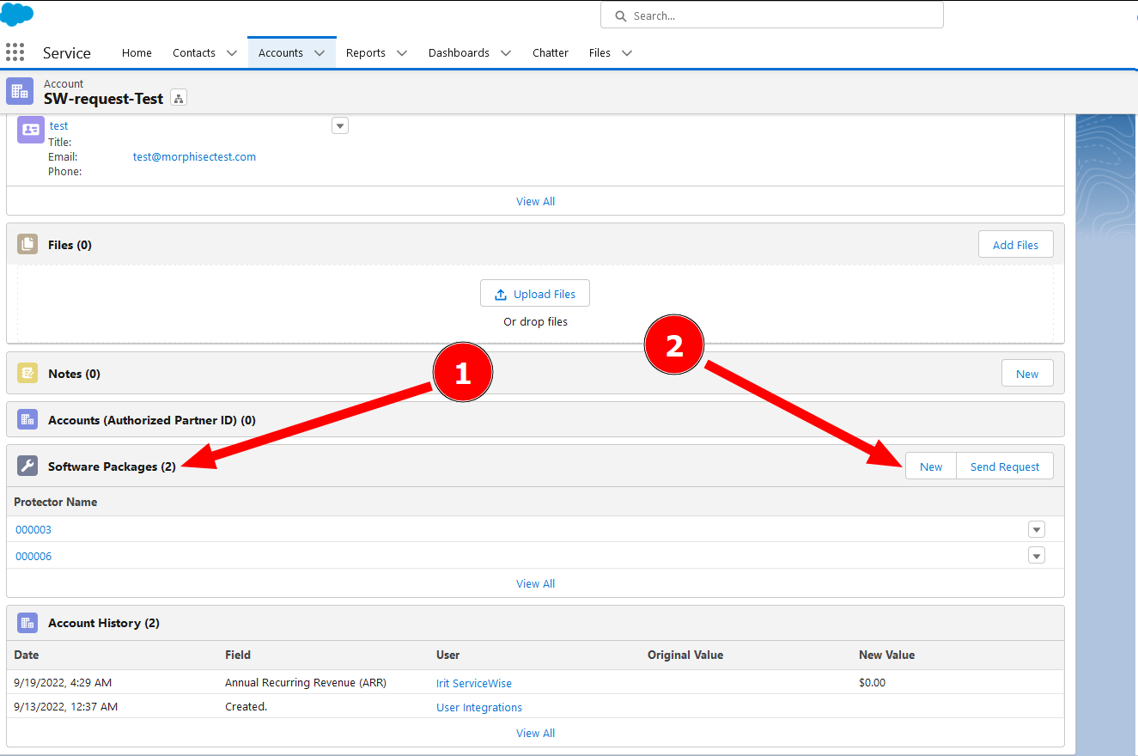
1.Scroll down to “Software Package”.
2.Click on “New”.

Slide 6
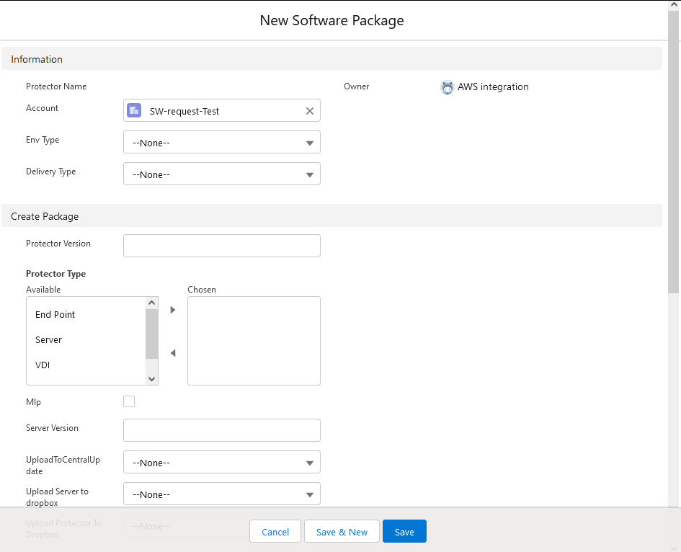
This is the new request form.
The form divided into Four parts:
1.Information - always required.
2.Create software package.
3.Create New SaaS tenant.
(You can use it to create one or both of them in same request)
4.System Information - For
getting “Success”/”Failed”
status.

Slide 7
Part 1 : Create Customer
Software Package

Slide 8
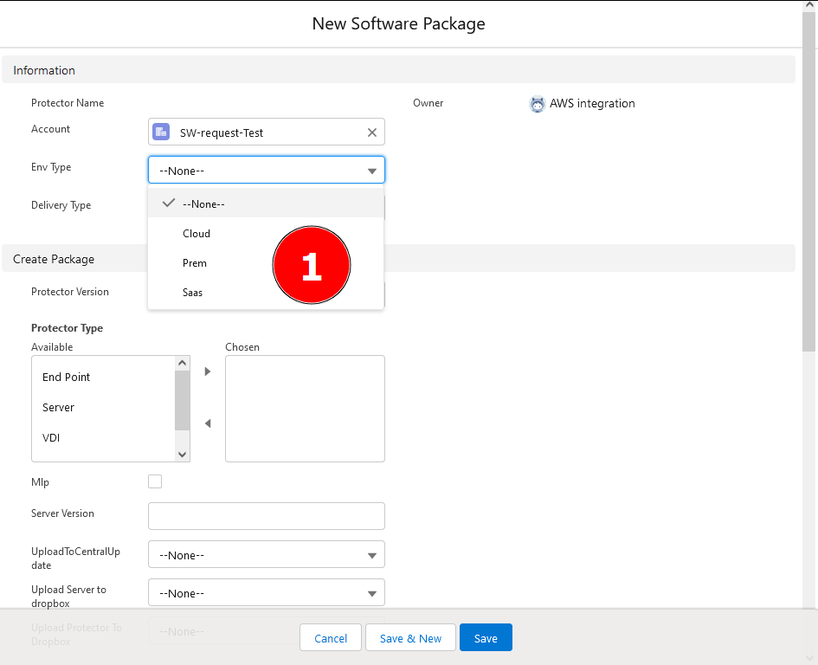
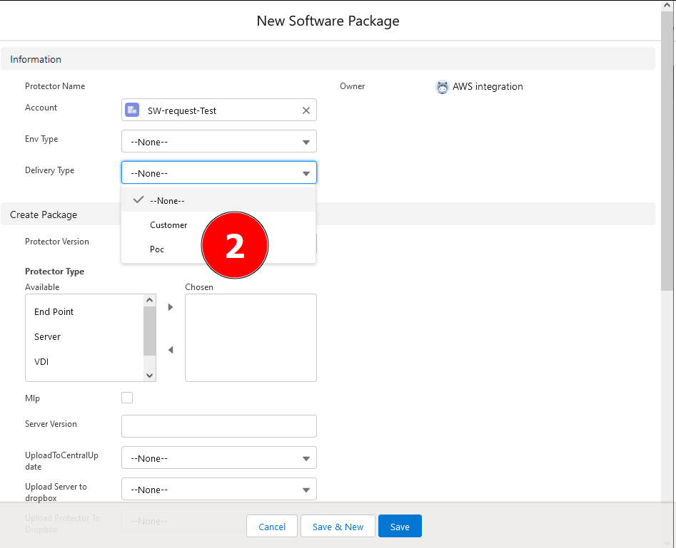
1. Select the environment type for the protector.
2. Select the Delivery type.

Slide 9
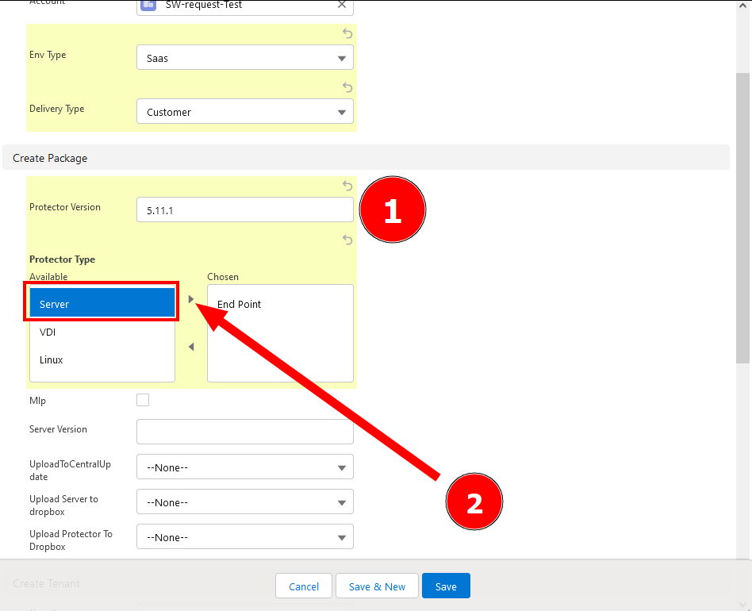
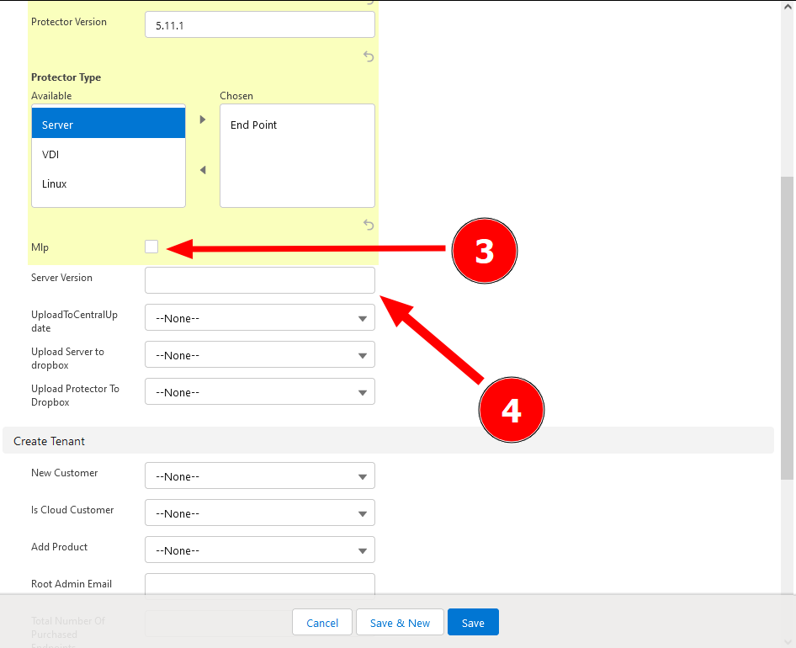
1. Enter the desired protector
version.
2. Mark the protector delivery type,
and move it to the “Chosen”
column by clicking on the small
arrow.
3. For linux protector, mark the
“MLP” checkbox.
4. In case of On-Prem customer,
enter server version to create
server installation.

Slide 10
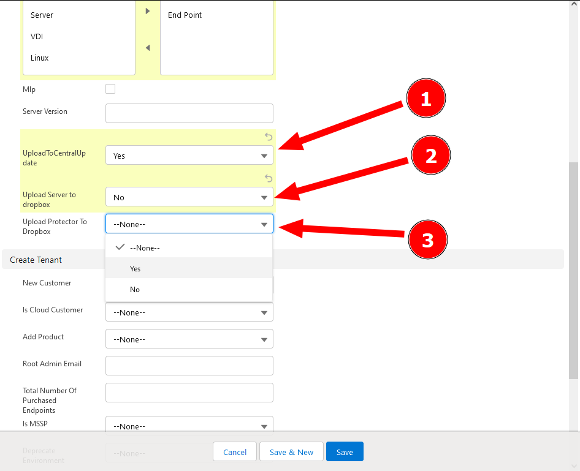
1. In case of SaaS customer, choose
“Yes” to upload the protectors to
customer Central Update,
Otherwize choose “No”.
2. In case of On-Prem customer,
choose “yes” to upload the server
Installation to Dropbox,
Otherwize choose “No”.
3. To upload the protectors to
Dropbox,choose “Yes”.

Slide 11
Part 2 : Create Customer
SaaS Tenant

Slide 12
1. Select the environment type for the protector.
2. Select the Delivery type.

Slide 13
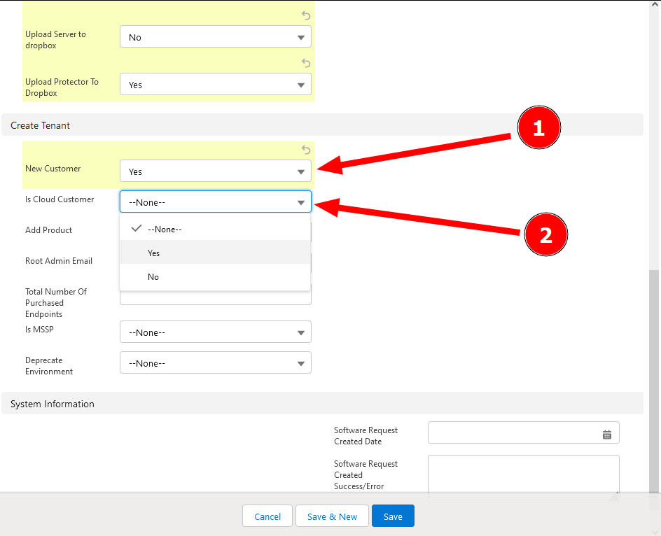
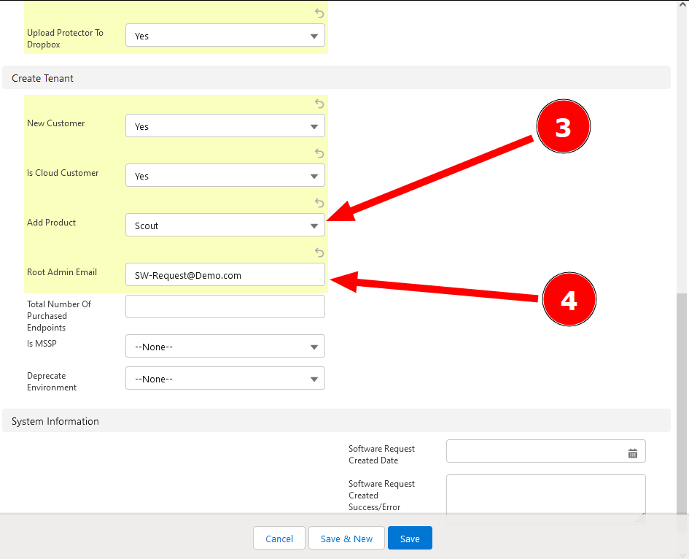
1. Choose “Yes” to create new
customer.
2. For cloud customer select “Yes”,
for On Prem customer, select “No”.
3. In “Add Product” section, select
“Scout”.
4. Enter the Root Email of the
customer.

Slide 14
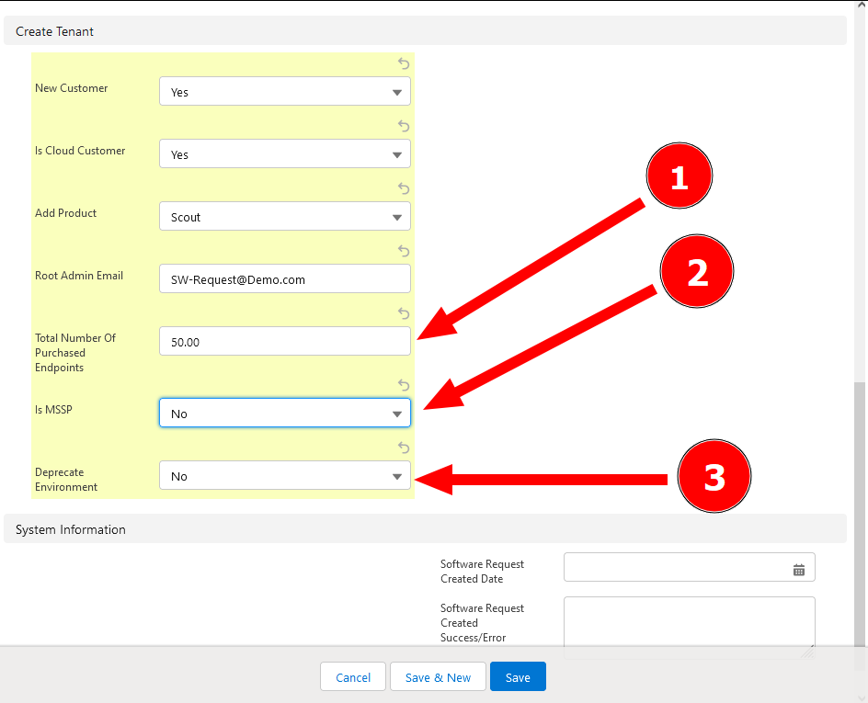
1. Enter the amount of purchased
Endpoints.
2. For MSSP customer select “Yes”,
for On Prem customer, select “No”.
3. In “Deprecated Environment”
select “No”.

Slide 15
Sending The Request

Slide 16
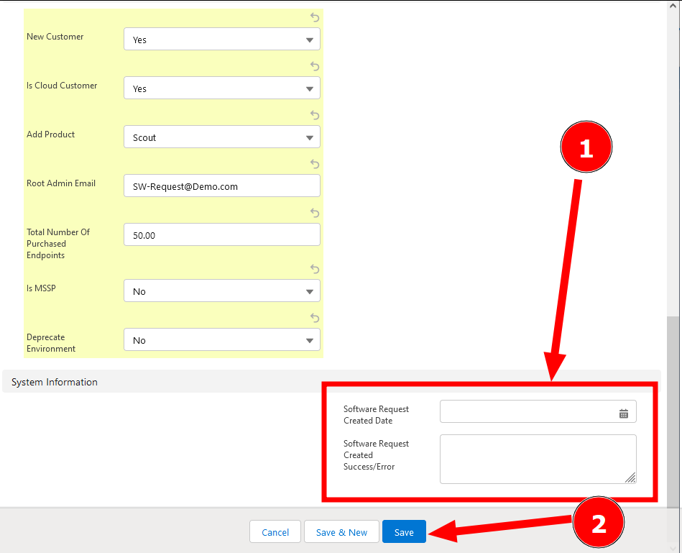
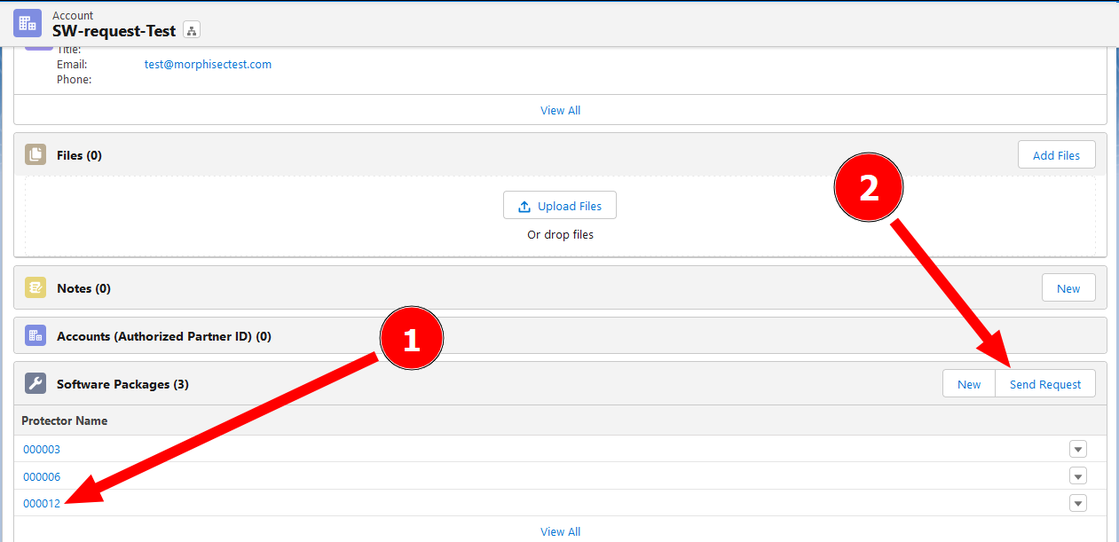
1. New request created but not sended.
You can Click it for review and edit.
2. To send the request, click on
“Send Request” button.
1. Leave empty the System
Information fields.
Jenkins will fill them automatically.
2. Click “Save”.

Slide 17
Part 3 : System Information-
Behind the scene

Slide 18
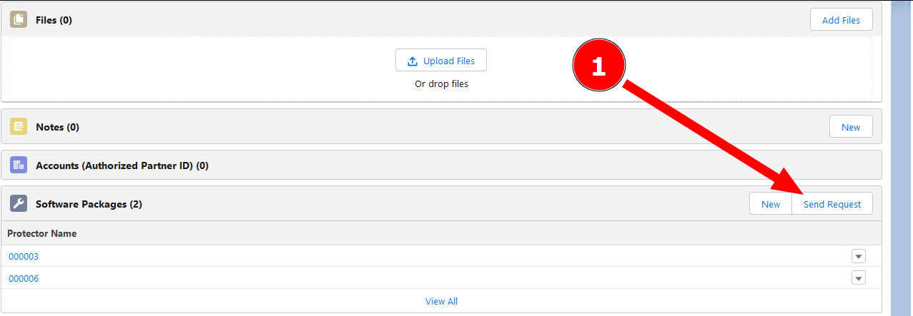
1. Clicking the “Send Request” button
will create a JSON file with all the request details.
2. The JSON file will send to AWS S3 bucket.
3. Jenkins job named “SW-Request“ check every 30 minutes if there is
files in this S3 bucket.
If there is a new file (new request), the job will download and process it.

Slide 19
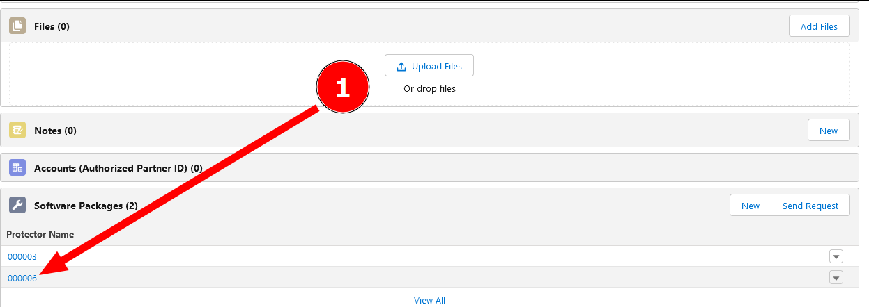
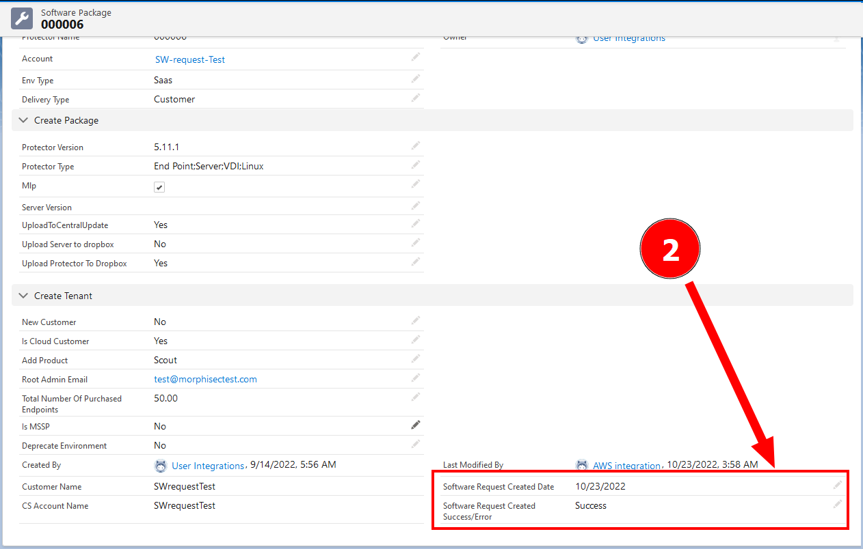
To check the request status:
1. Click on the request number.
2. When Jenkins will process the
request, you can scroll down
and check those fields:
“Software Request Created Date”.
“Software Request Created
Success/Error”.
If those are empty, Jenkins didn’t
processed the request yet.

Slide 20
How Reset Password
for SaaS User

Slide 21
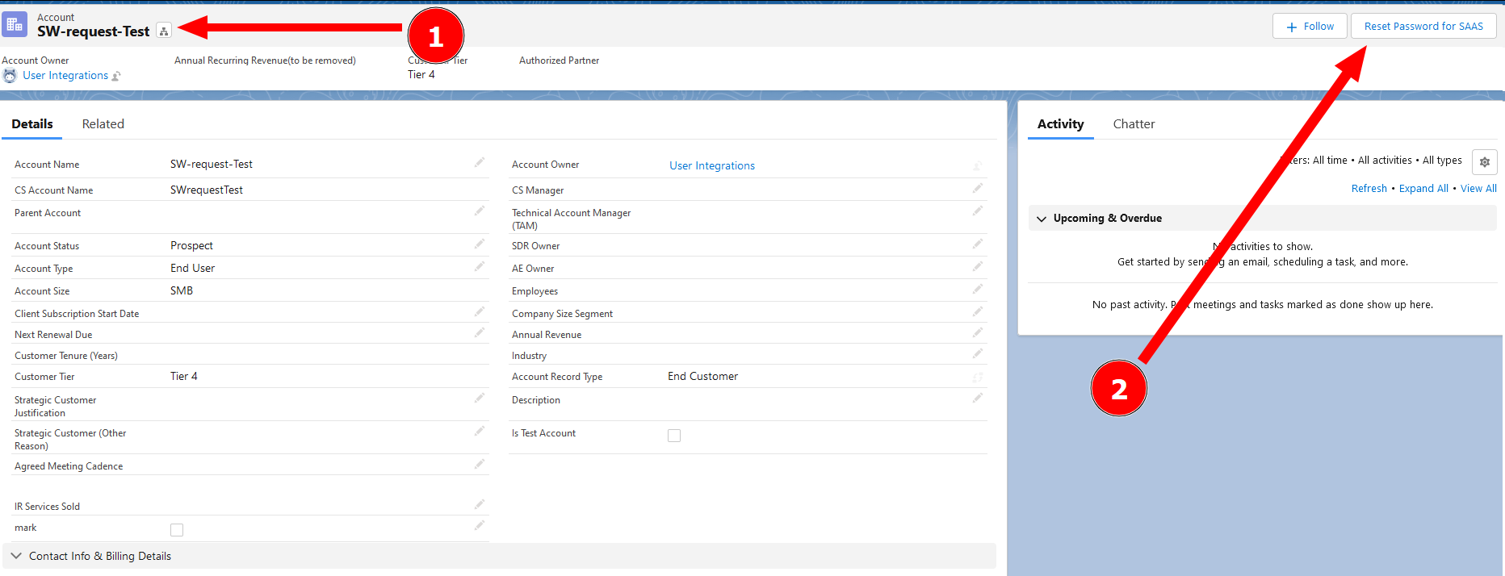
Choose the desired customer.
Click on “Reset Password for SAAS”.

Slide 22
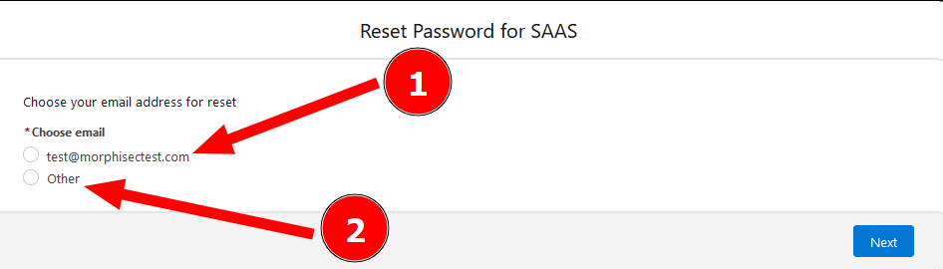
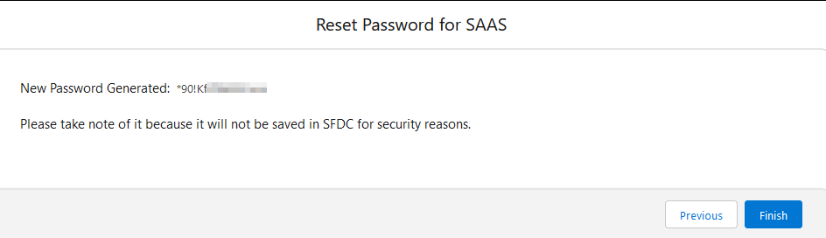
You can choose the root email from the list, or enter email address manually.
Click on “Next”.
Password Generated.

Slide 23
Questions?

