Slide 1
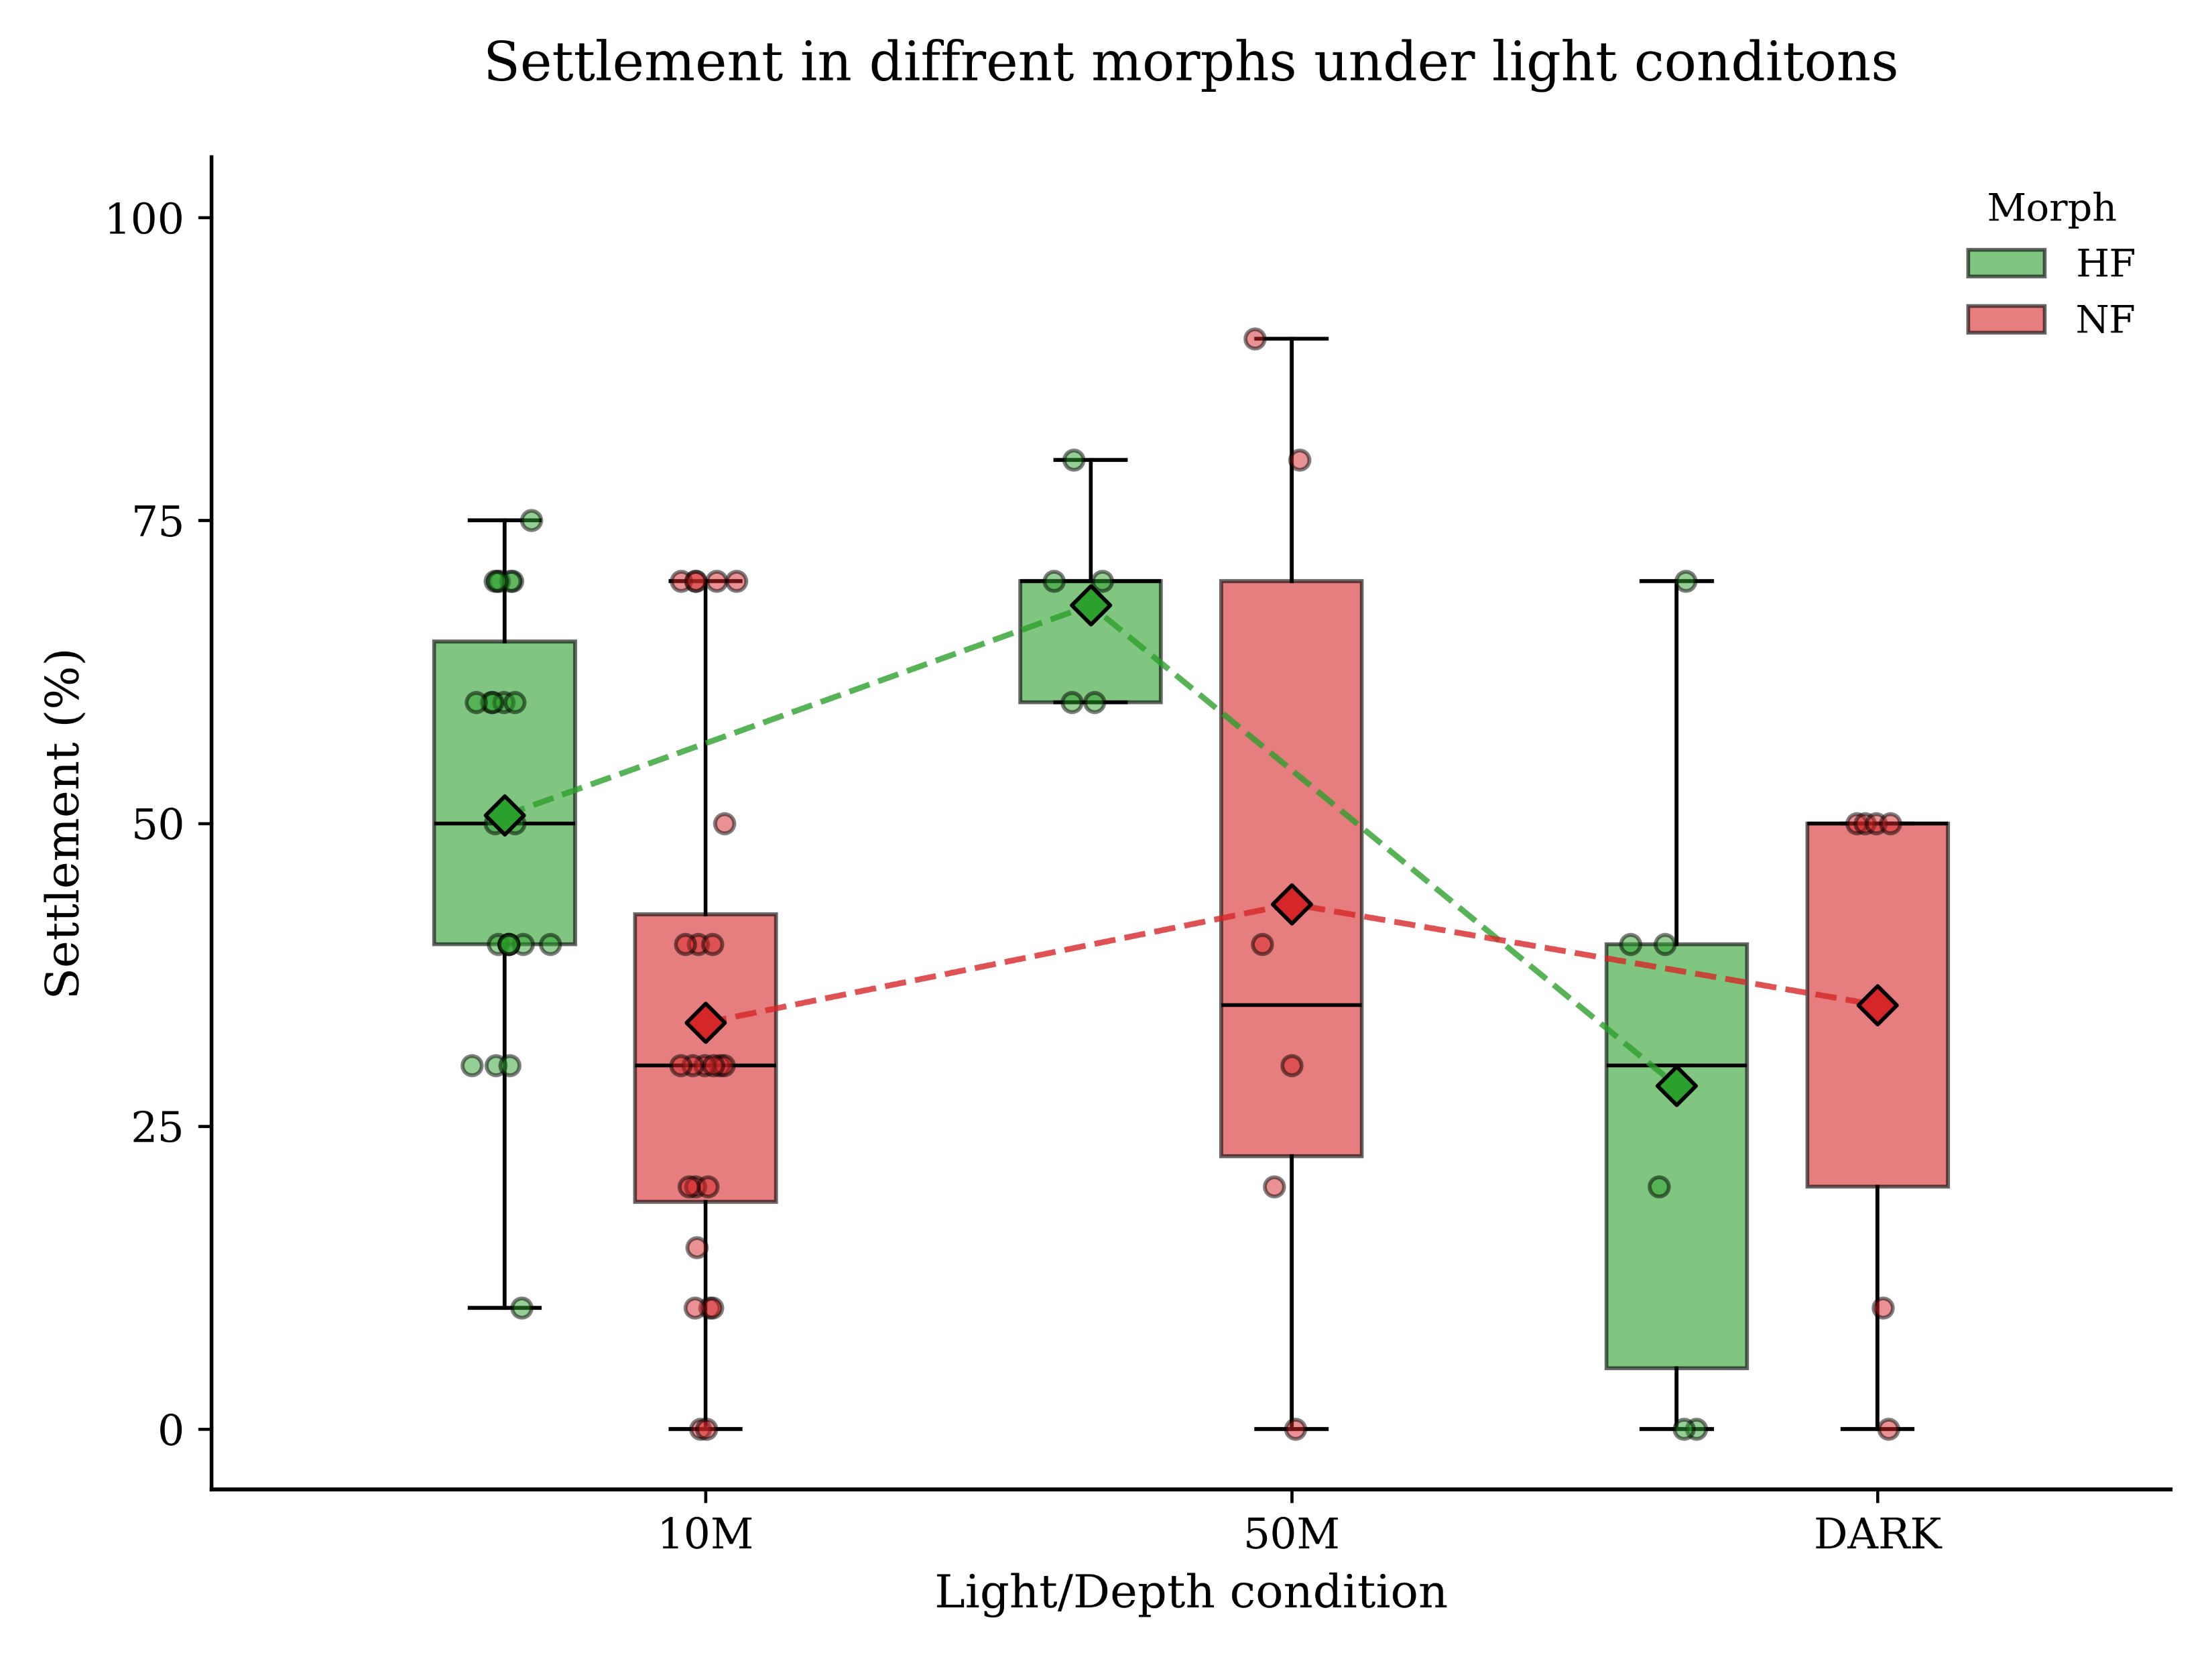
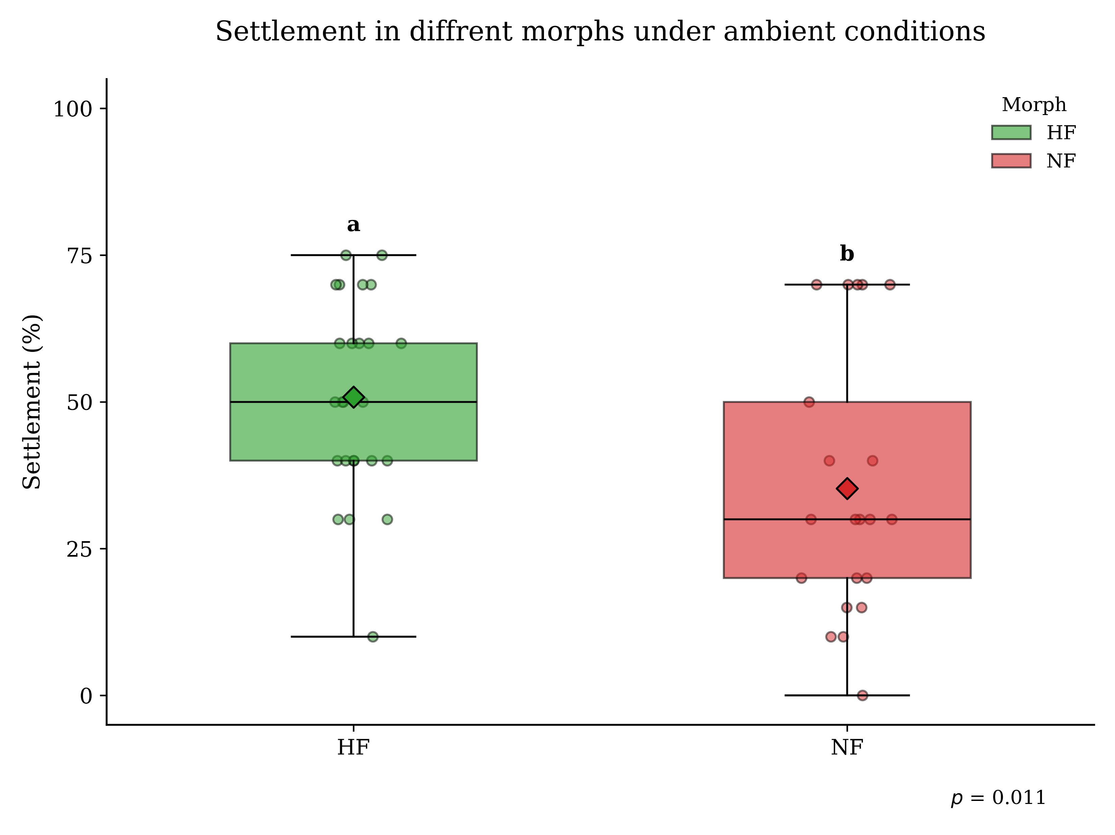
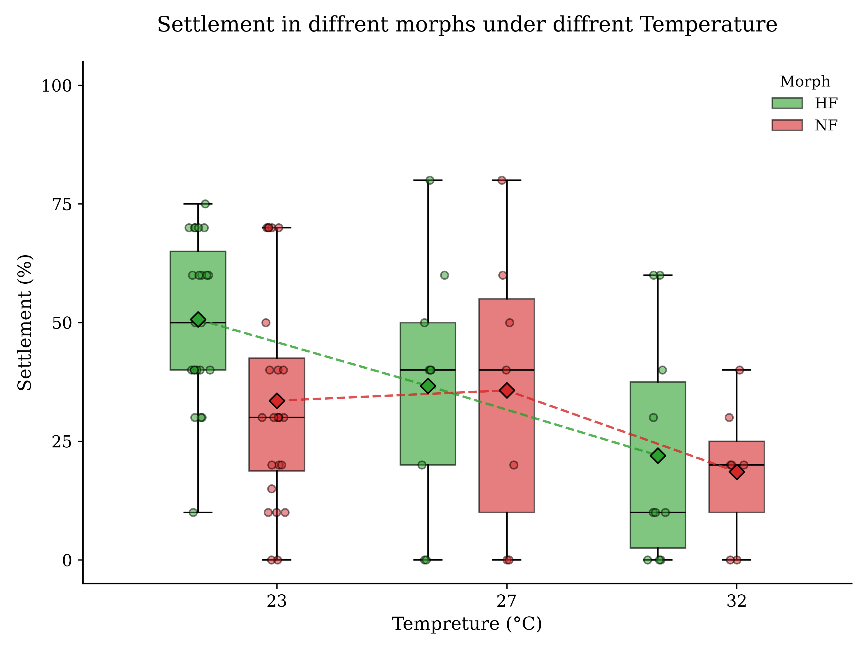
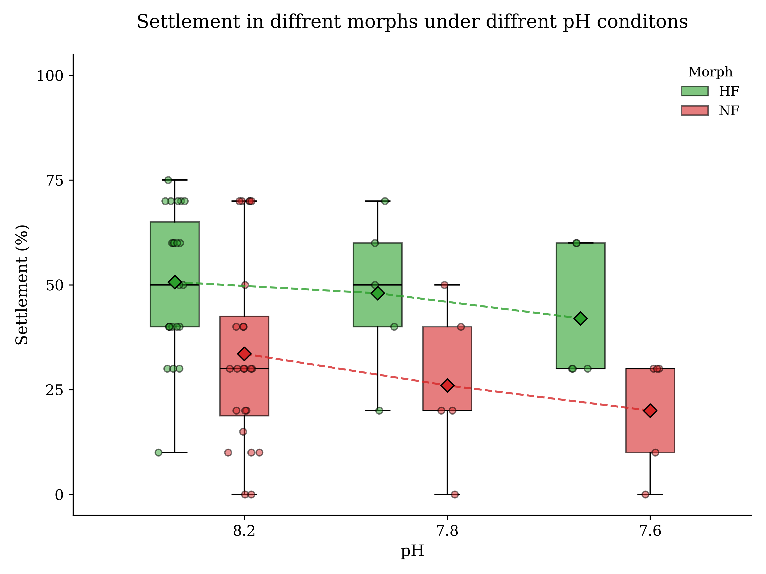

Slide 2
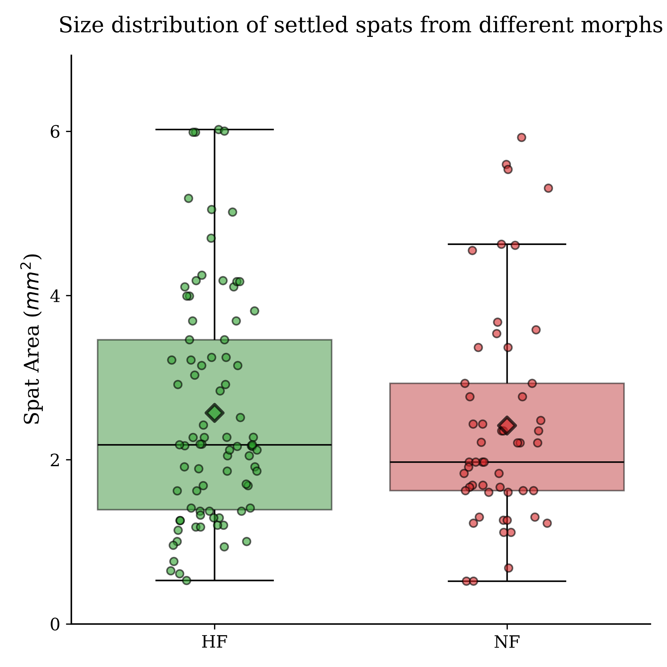

Slide 3
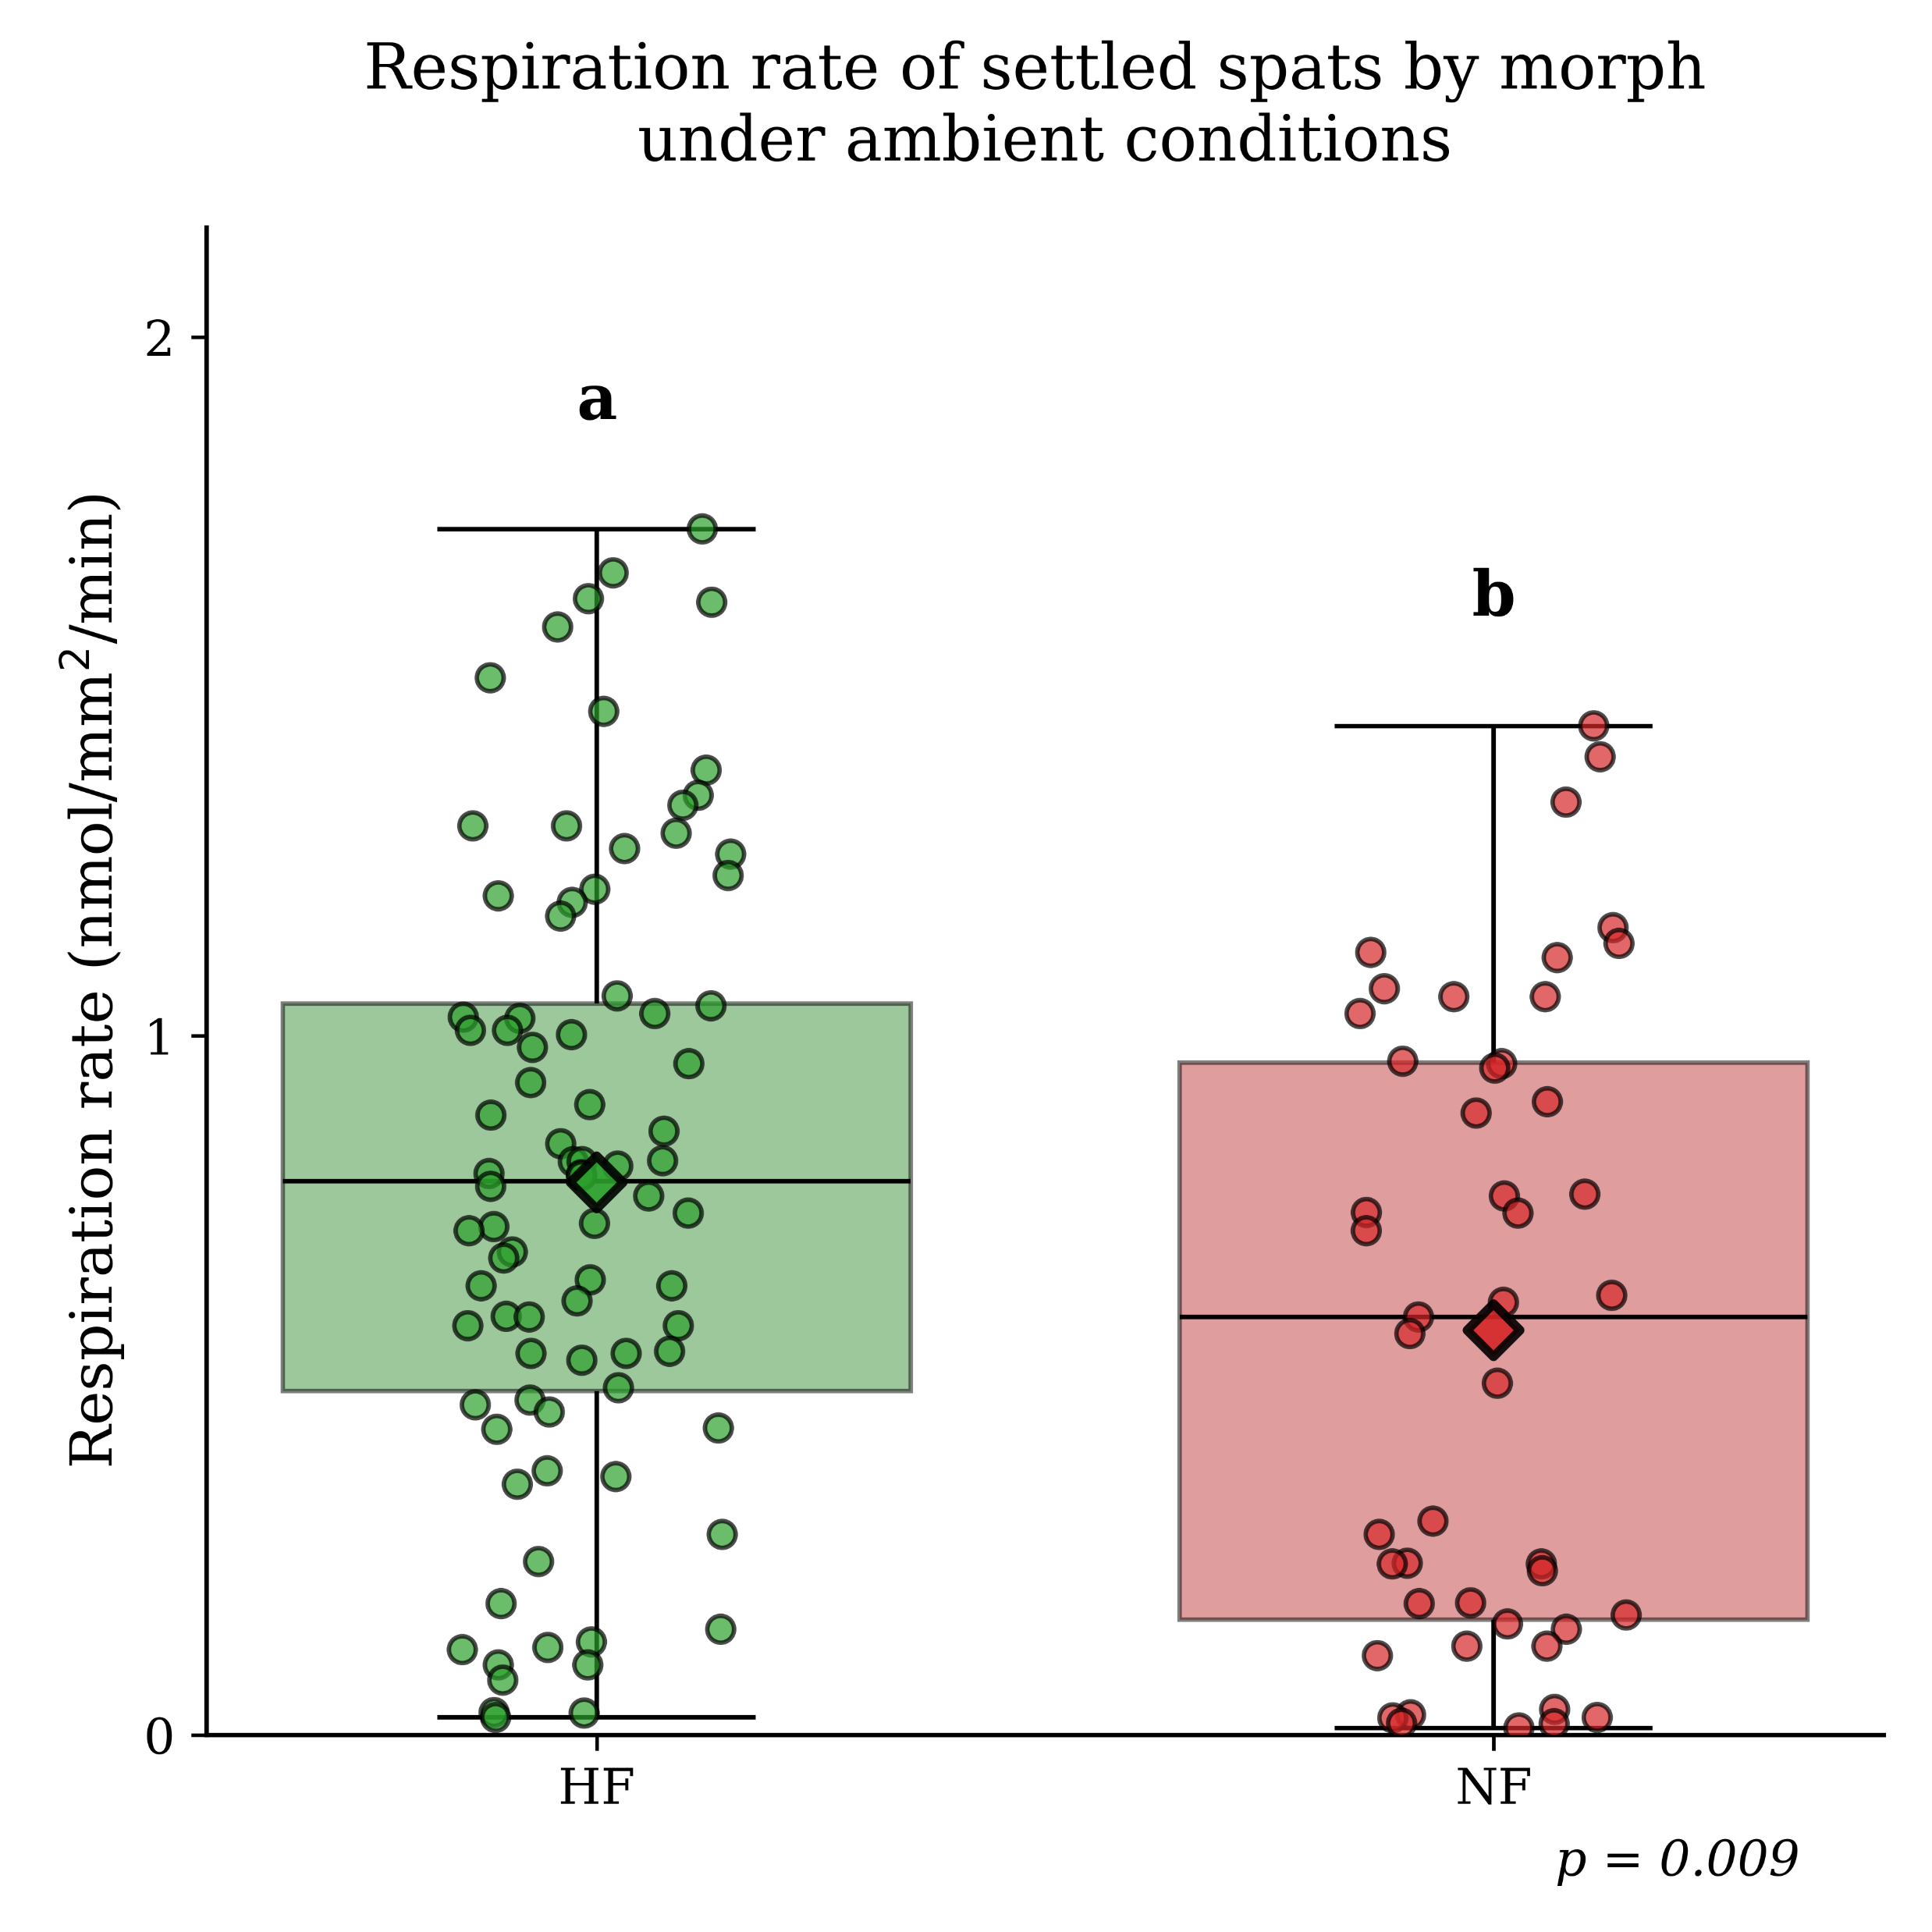

Slide 4
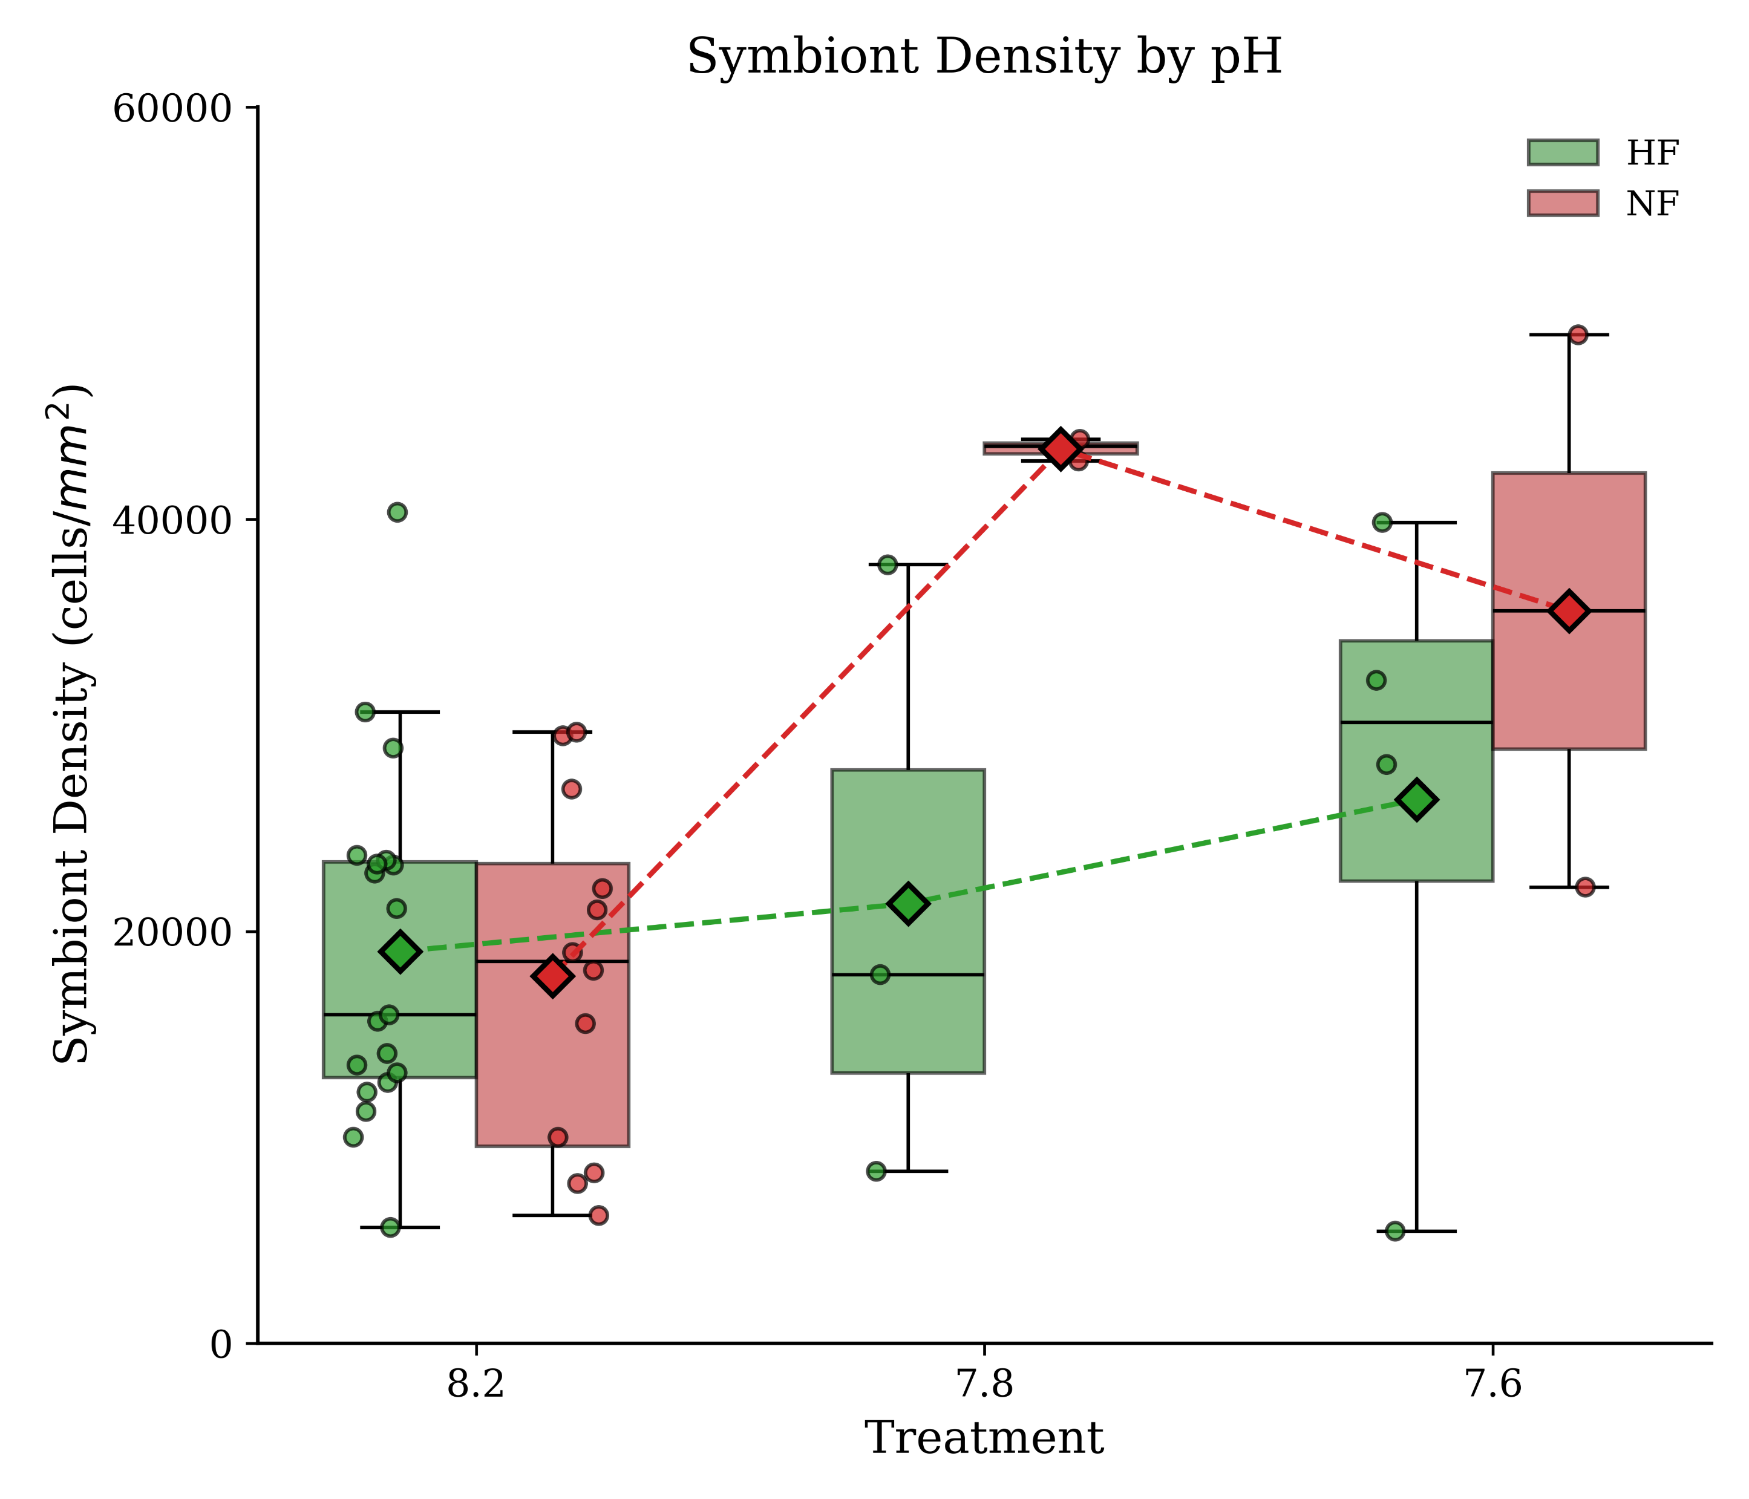
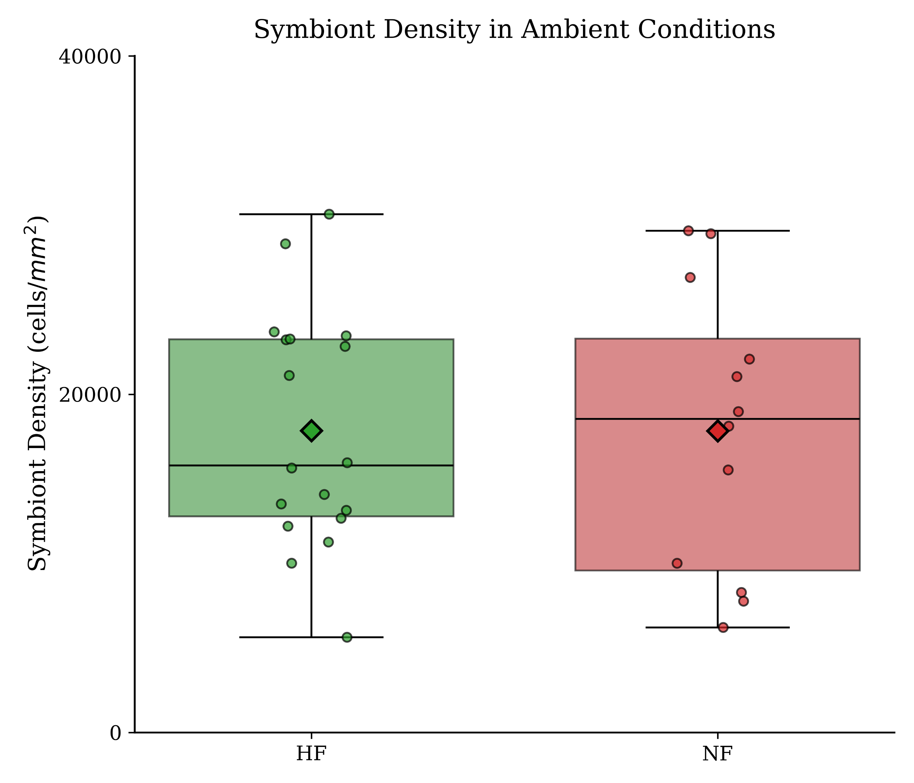
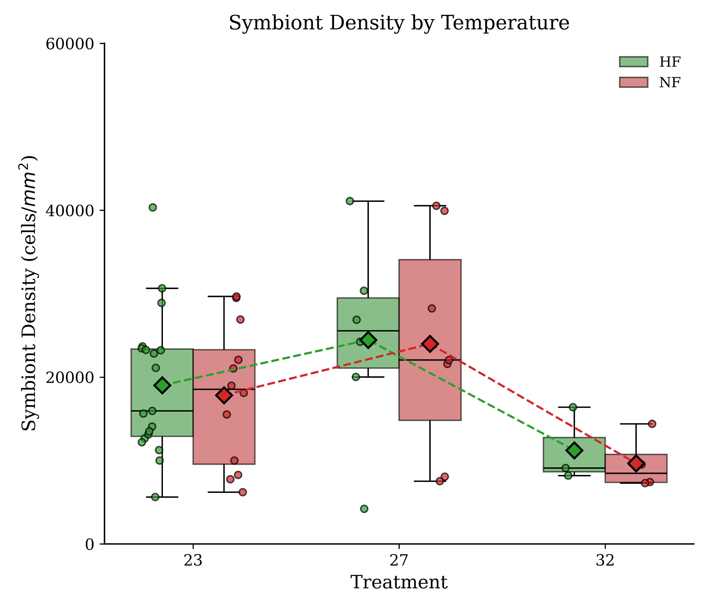
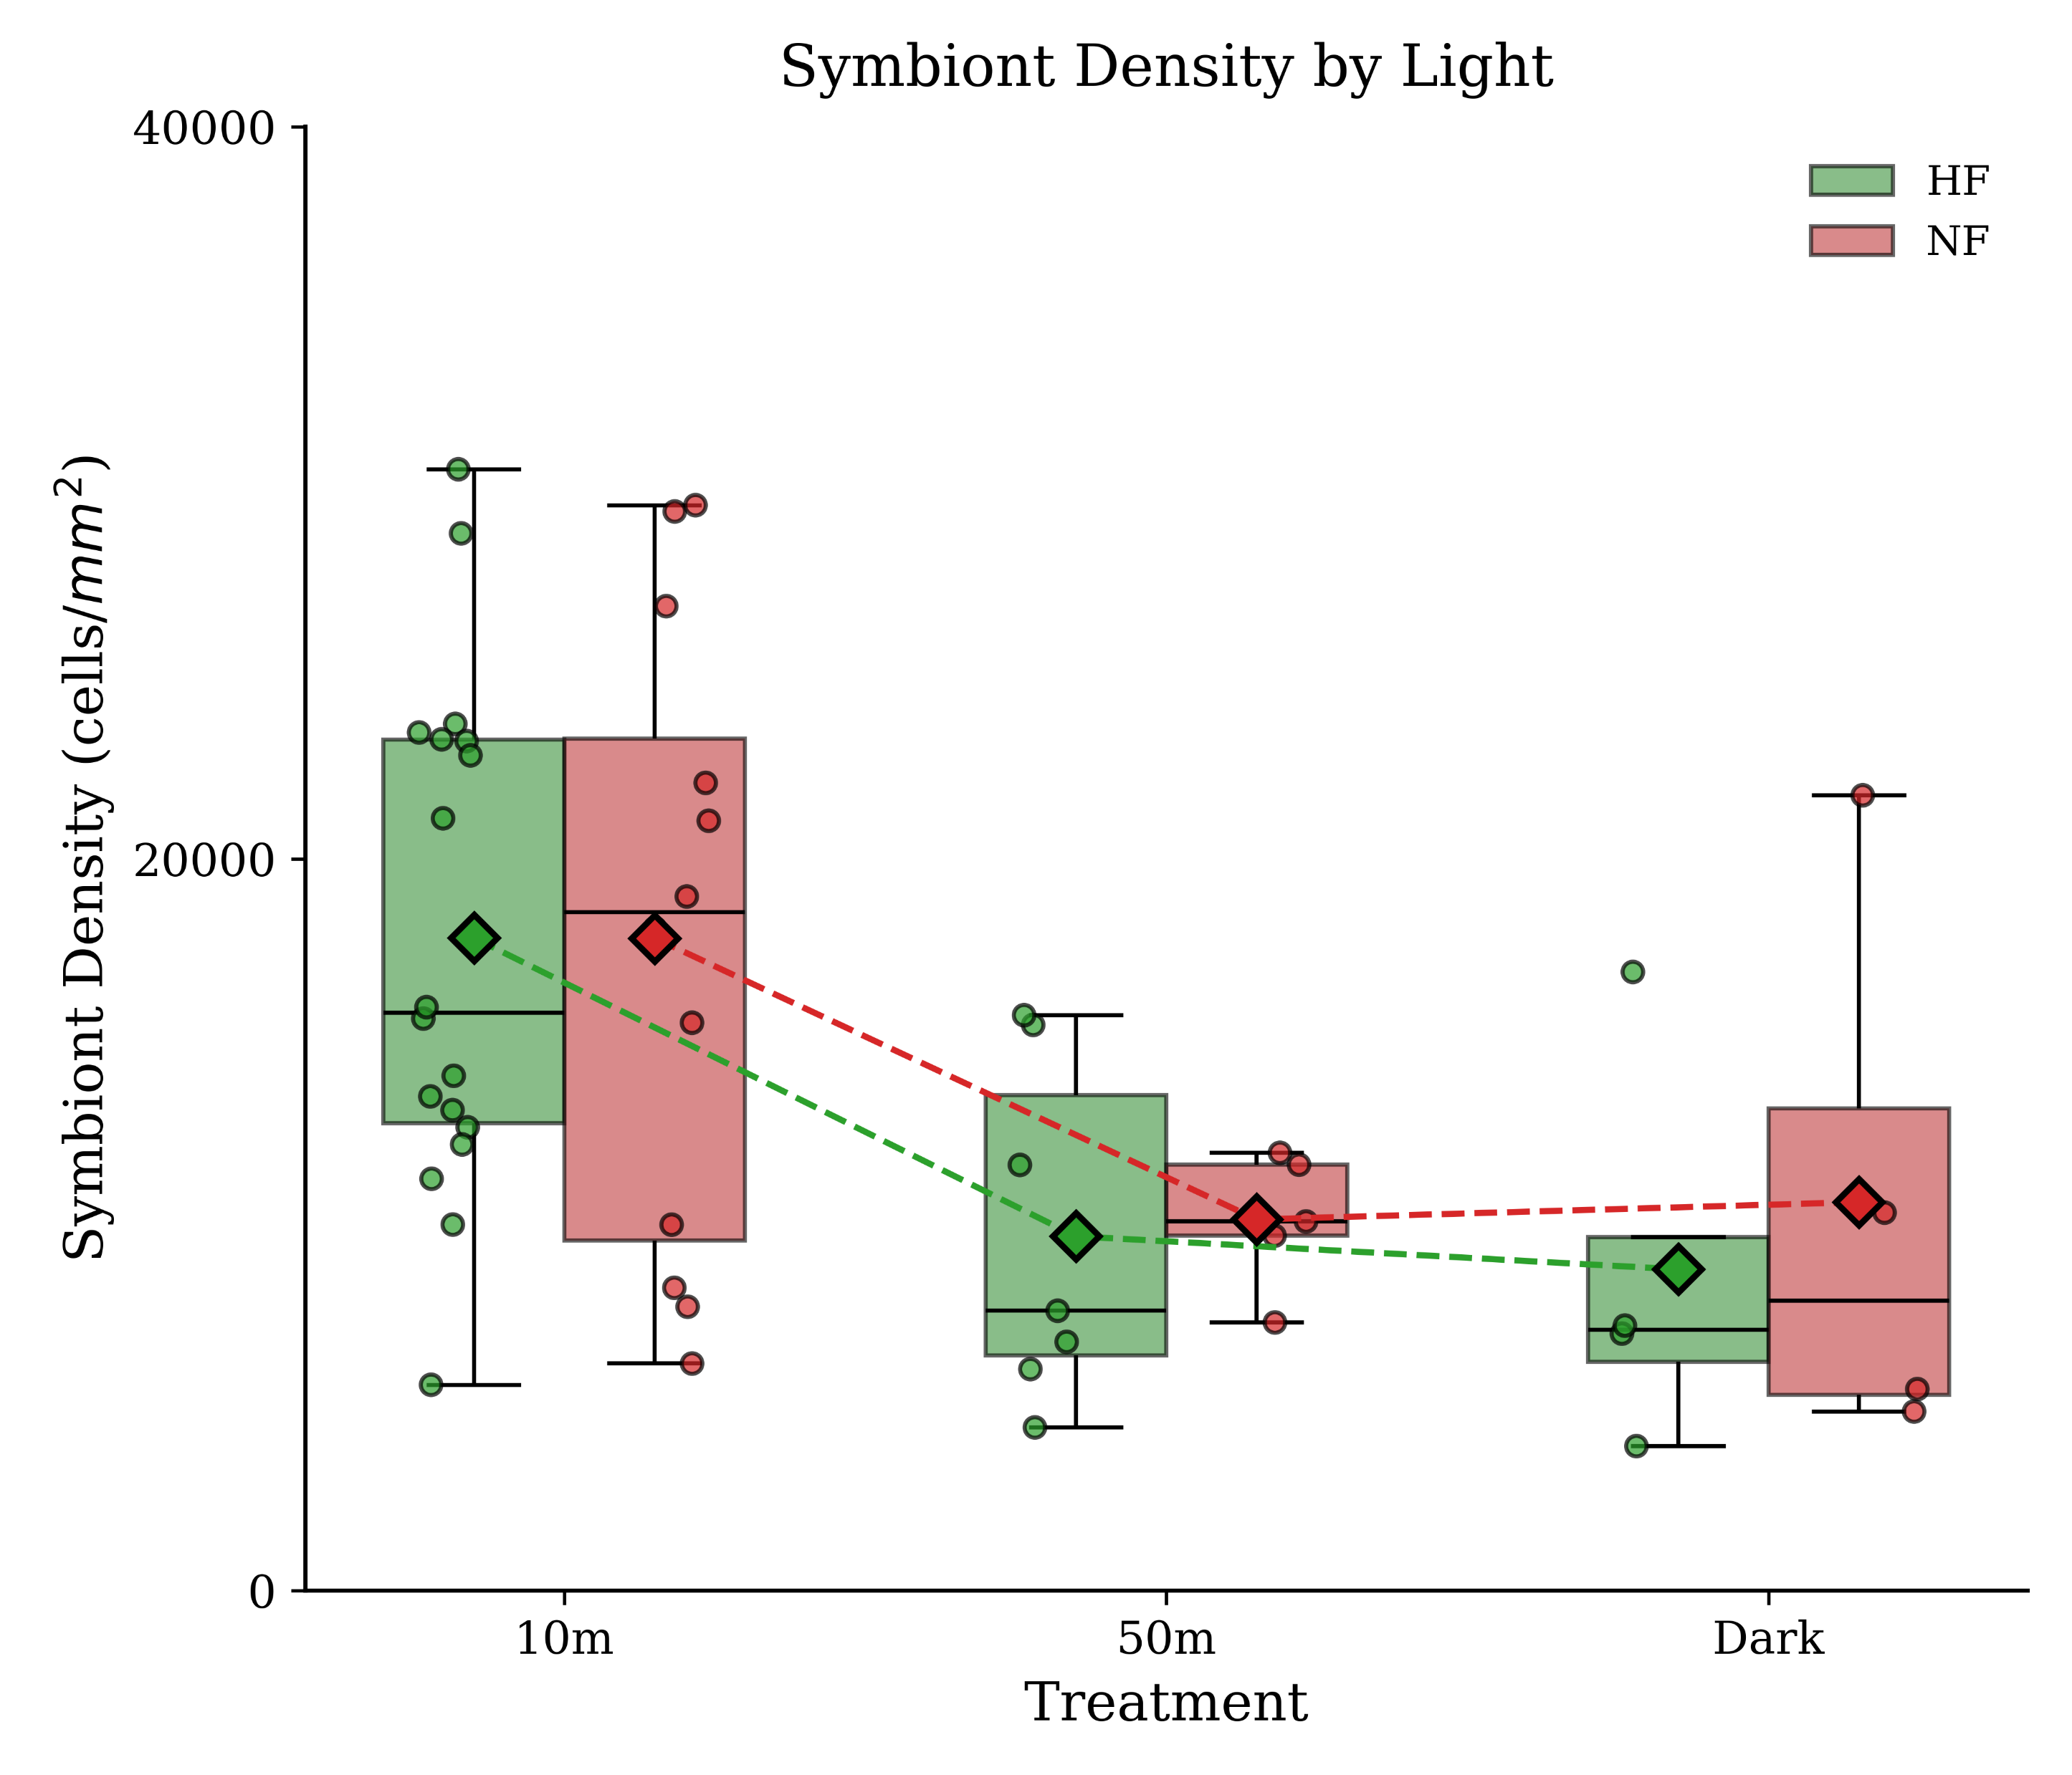

Slide 10
 | settlement | size | OxyRate | Prot | Cell Count | Chl a | Fm | Fv/Fm | Connectivity | Pmax | Effective Cross Section
ambiant
Temp
pH
light

Slide 11
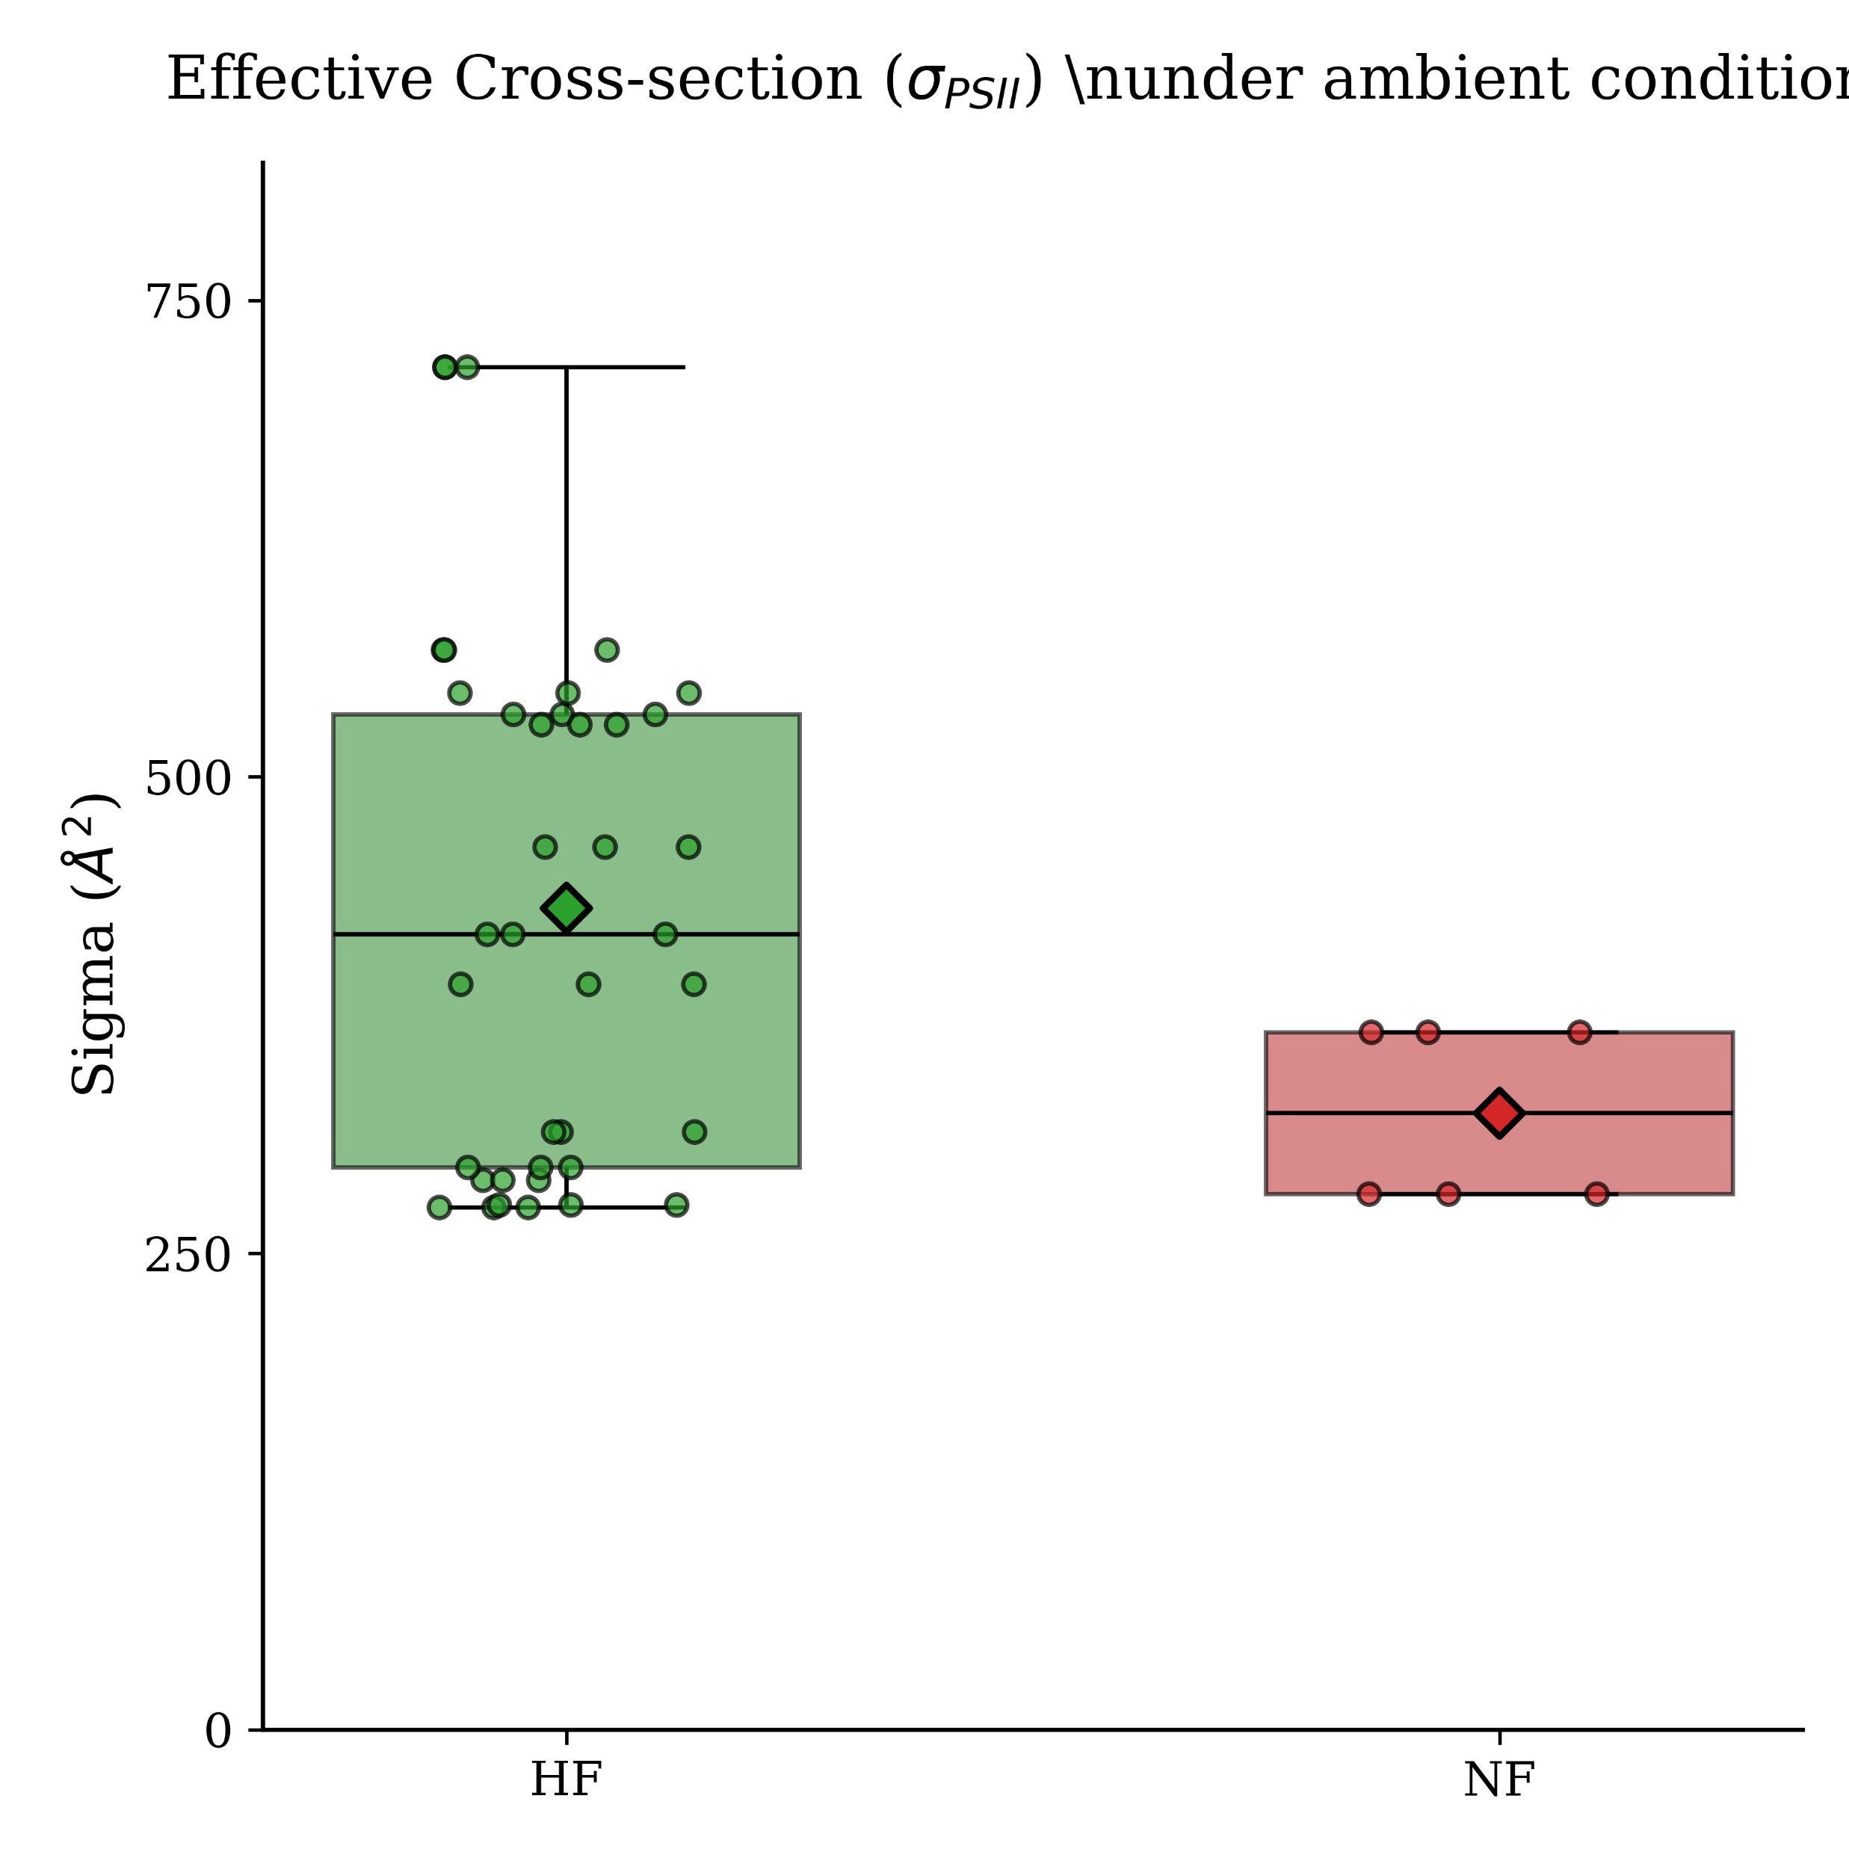
 | settlement | size | OxyRate | Prot | Cell Count | Chl a | Fm | Fv/Fm | Connectivity | Pmax | Effective Cross Section
ambiant
Temp
pH
light

