Slide 1
QA Assignment
Created By: Lien Nguyen
Date: 19/06/2022

Slide 2
Issues
Be able to create articles with empty field values
Favorited Posts not working well: when I click on button to choose favorited post then go to profile > Favorited Posts, same issue with articles created by me or another one.
Refresh page function is not working: show 404 error, after that unable to go back to previous page
Your Feed is not implemented, my own created articles only showed in My Post

Slide 3
Recommendation
Browser should display a message after creating/updating/deleting articles for the successful cases and error cases
All required fields of add/edit articles should mark with asterisk (*) so end-user will know what will have to be filled
Should have a warning message after creating a duplicated article
Font size for conduit title should be increased
It’s not issue, but if we can have element ID for each element, it will be easy for developing automation tests.
Can implement signIn, signUp with google account/facebook account,…

Slide 4
Why choosing functionality for automation
CRUD Articles
CRUD Articles
Main functions
Can be automated

Slide 5
Why Selenium
I can work with Selenium and Cypress (Javascript), but I choose Selenium C#
Many Operating Systems
Support across browsers
Open-Source
Selenium
Many languages
Ease of implementation

Slide 6
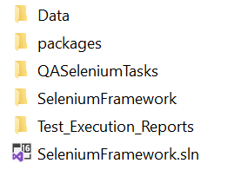
Selenium Project Structure
Data: Test data in csv, TDD
Packages: nuget packages using for Selenium
SeleniumFramework: based framework using for testing (read data, configure
Database, common codes,…)
Test_Execution_Reports: test report after running
QASeleniumTasks: test project with test files, specific setup

Slide 7
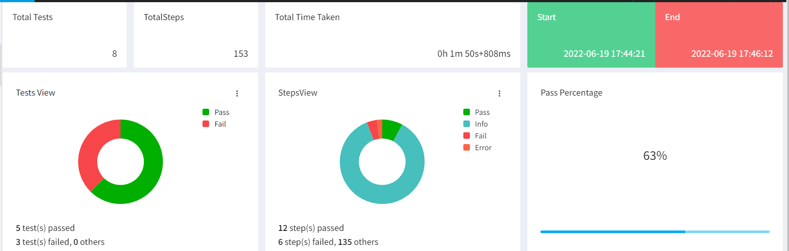
Selenium Test Report
Selenium Test Report will be generated after each run at: ..\SeleniumFramework\Test_Execution_Reports

Slide 8
Next tasks
Cover all test cases designed in WebQAAssignment.xlsx
Integrate CI/CD (GitHub, Gitlab, Jenkins)
Report test results to TestRail or any Test Management tool supported

