Slide 1
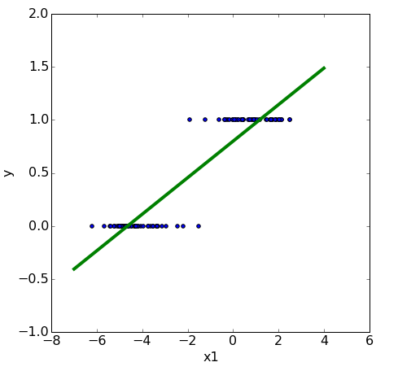

classification
We need to make
assumptions
about the
model
that generated the data.
linear relationship
linear model

Slide 2
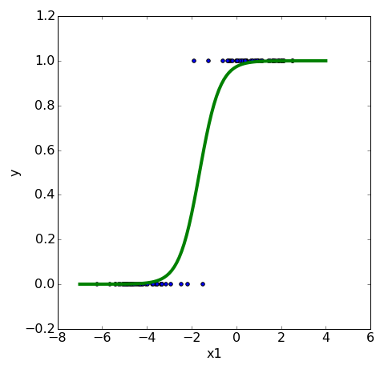

logistic regression
We need to make
assumptions
about the
model
that generated the data.
linearly separable
logistic model

Slide 3


logistic regression

Slide 4
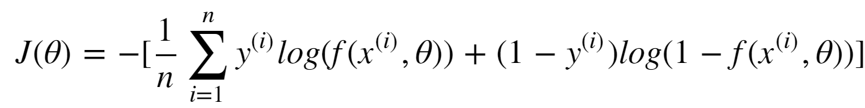
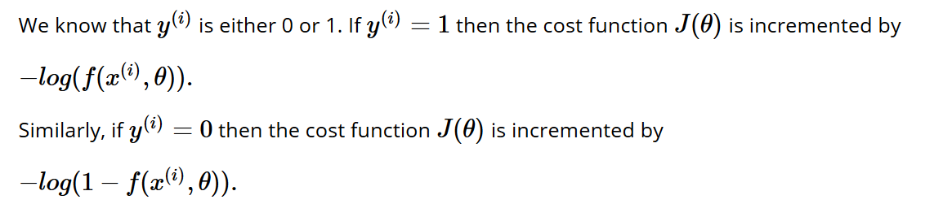
logistic regression: cost (loss function)

Slide 5
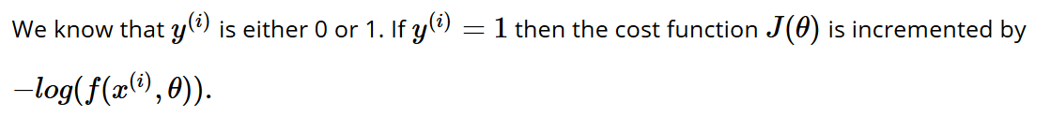
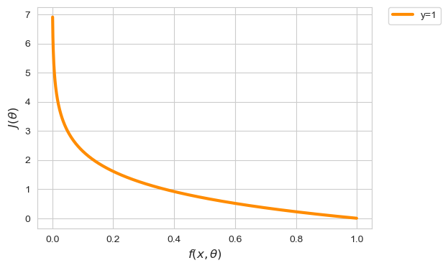
logistic regression: cost (loss function)
Notes:
X-as is predictie
Y-as is cost van predictie indien y == 1

Slide 6
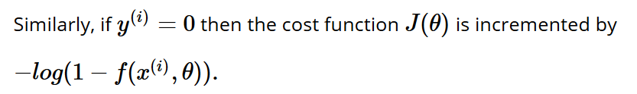
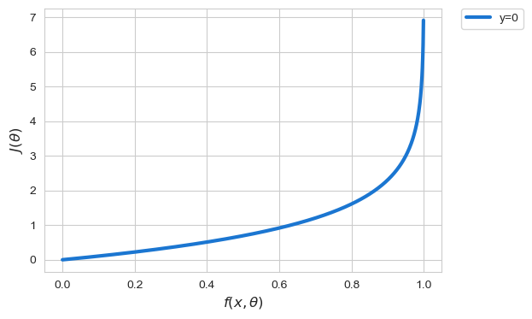
logistic regression: cost (loss function)

Slide 7

logistic regression
Fit a logistic model
to the data set such that the cost function
is minimal using gradient descent
Notes:
Also convex!

