Slide 1
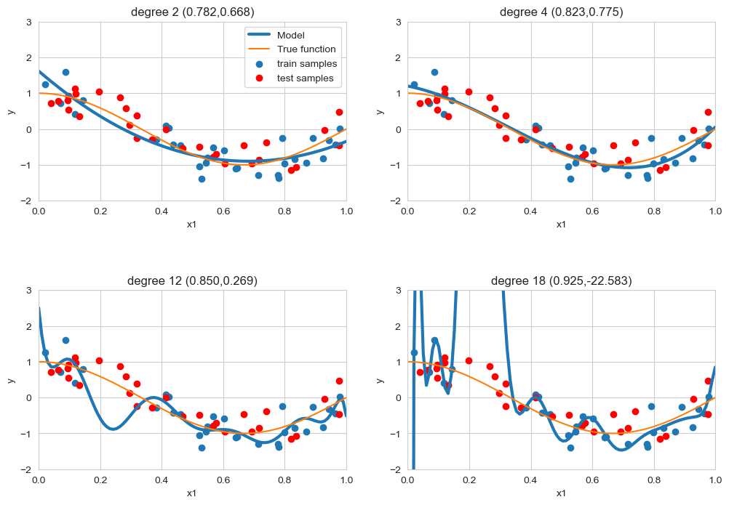
model regularization
label noise
feature noise
feature relevance
relatively small train sets
don’t try to fit the data perfectly
don’t try to use all features
notice how R² on the train set does increase with d

Slide 2





regularized linear regression
cost function
regularized cost function

Slide 3

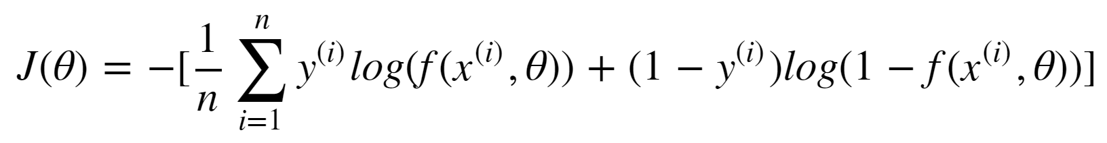
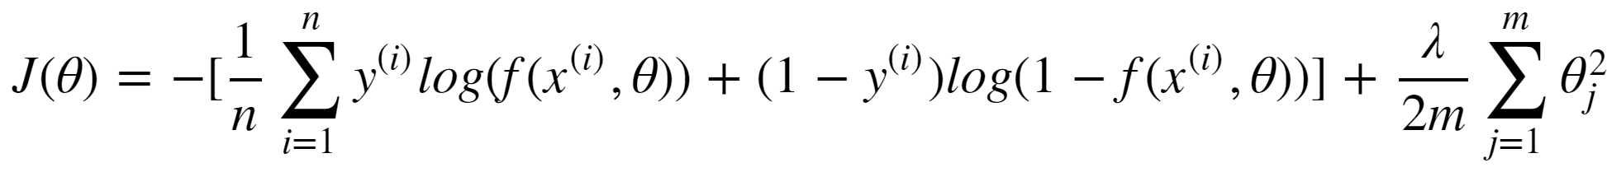
regularized logistic regression
cost function
regularized cost function

Slide 4
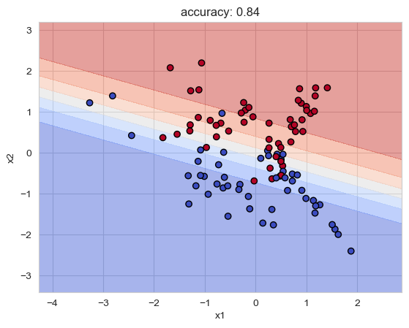
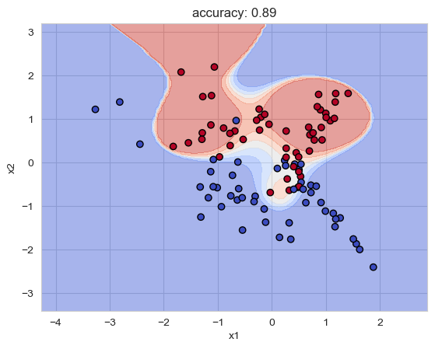
model regularization

Slide 5
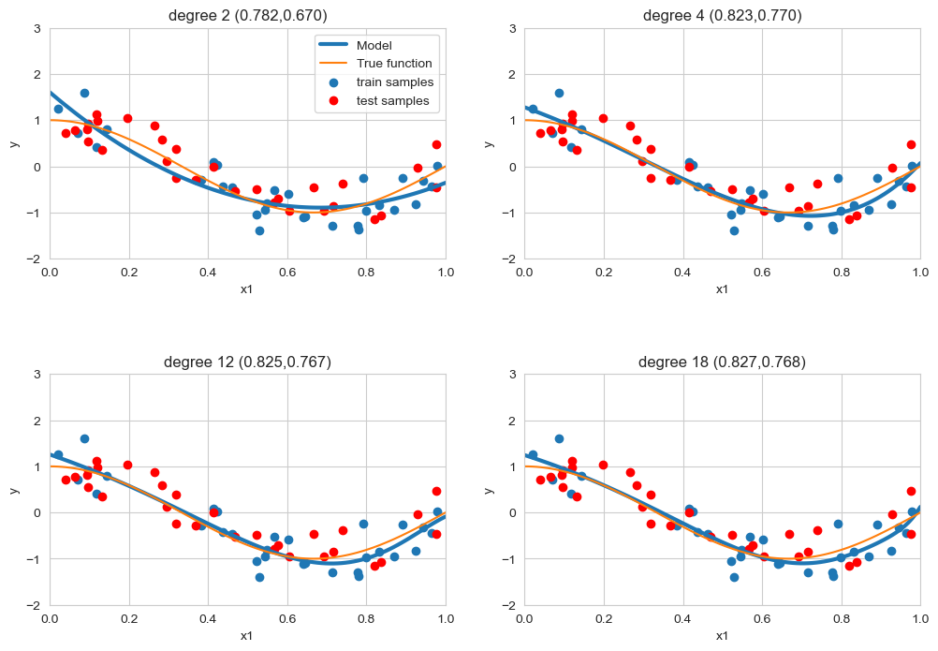
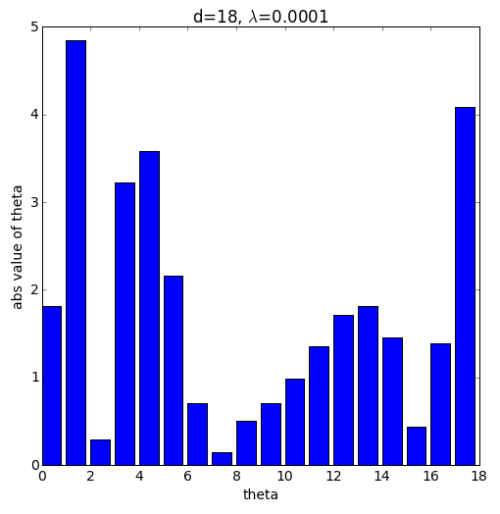
regularized linear regression

Slide 6
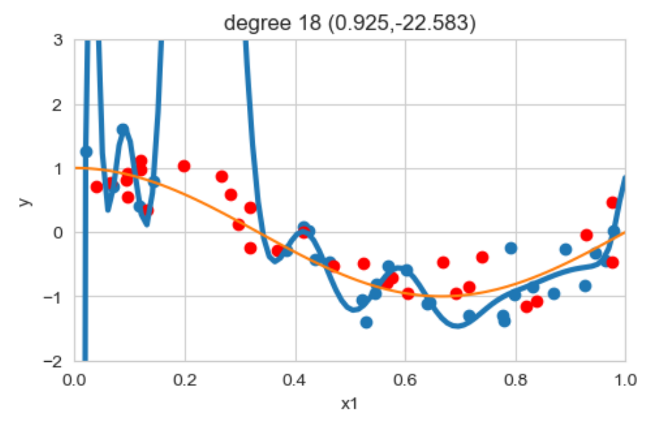
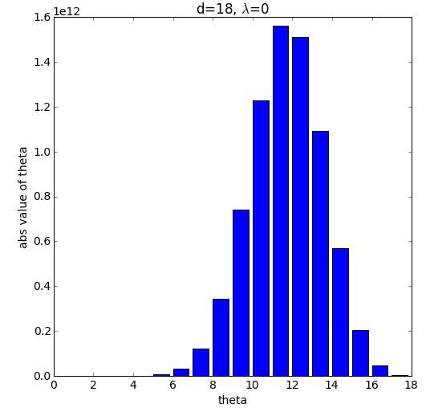
regularized linear regression

Slide 7
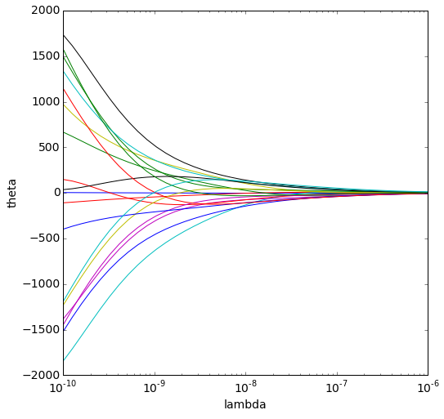
regularized linear regression
high complexity
low complexity

