Slide 1
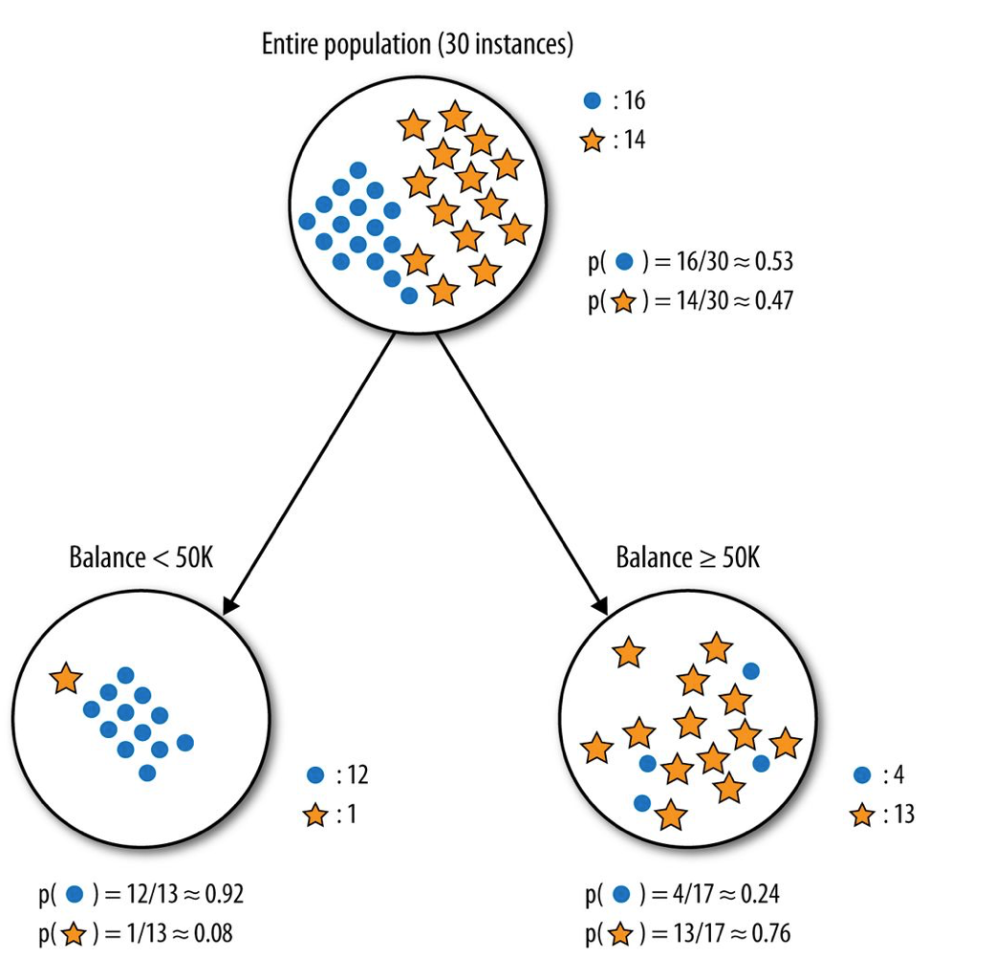

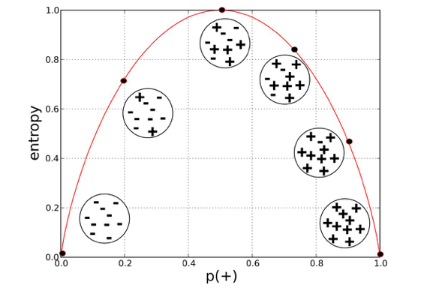
decision tree models

Slide 2
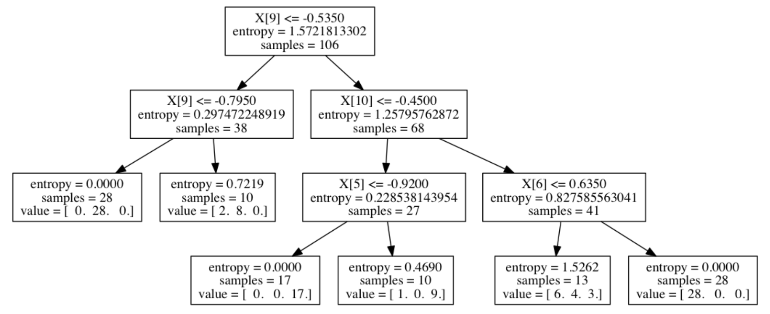
decision tree models
advantages:
ease of interpretation
handles continuous and discrete features
invariant to monotone transformation of features
variable selection automated
low bias (deep trees)
disadvantages:
high variance
overfitting

Slide 3
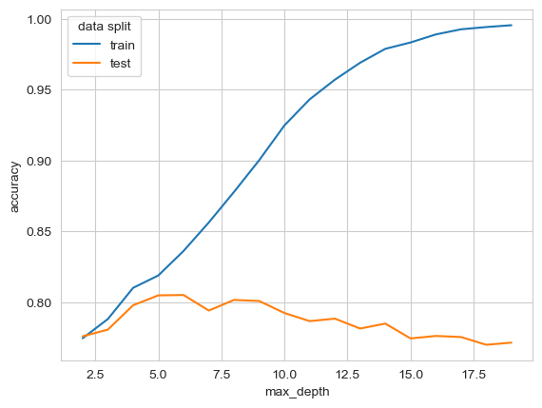
model selection

Slide 4
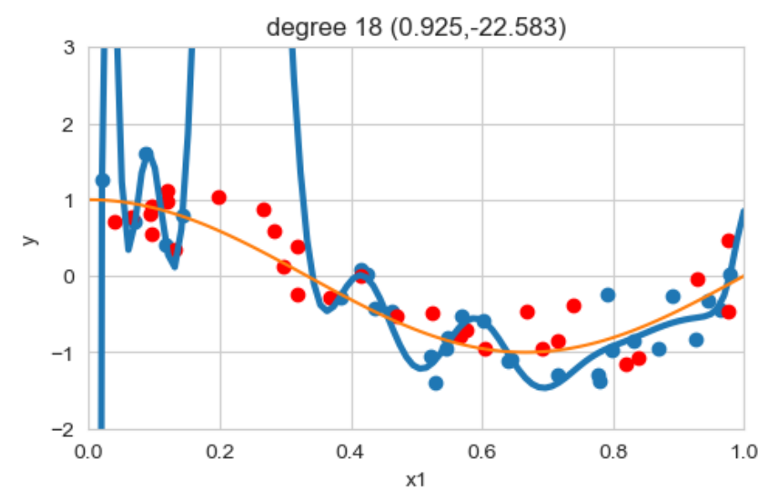
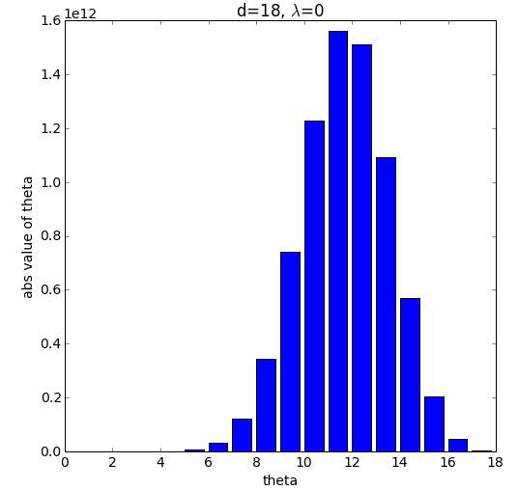
regularized linear regression

Slide 5

5-fold cross-validation

Slide 6
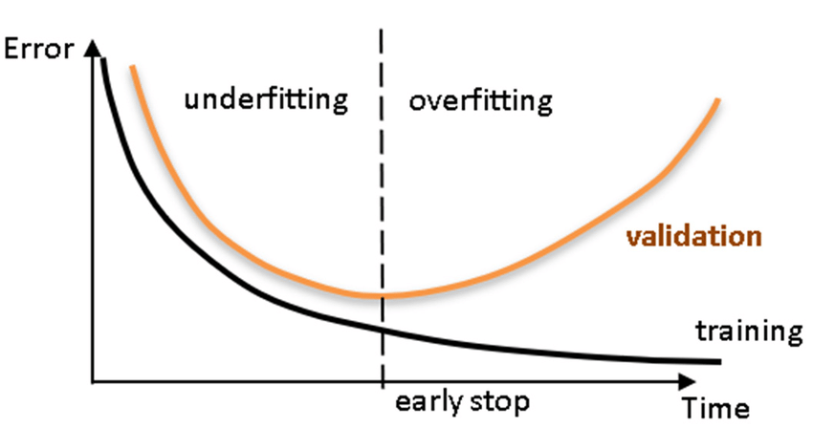
Tuning regularization
Maximum depth

Slide 7
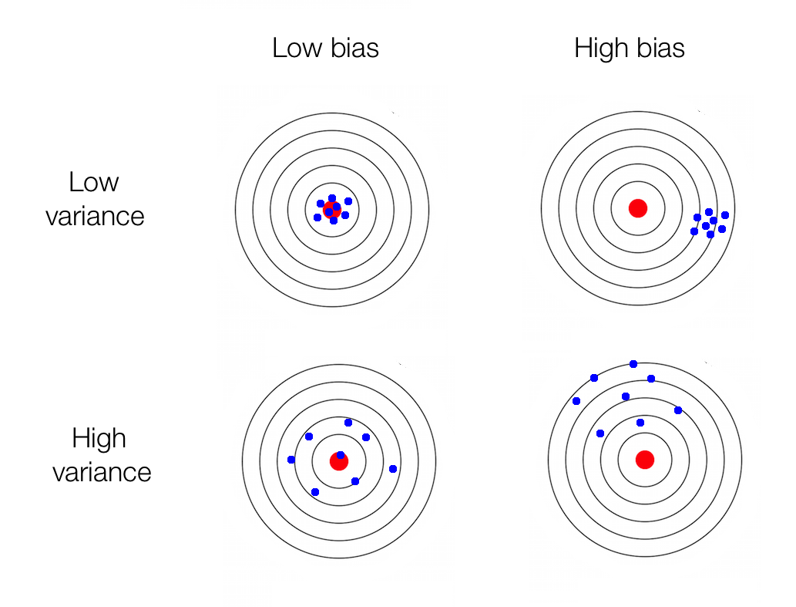
bias <> variance
Error due to bias
(systematic errors,
oversimplification)
Error due to variance
(sensitivity due to flexibility,
overcomplification)
Irreducible error

Slide 8
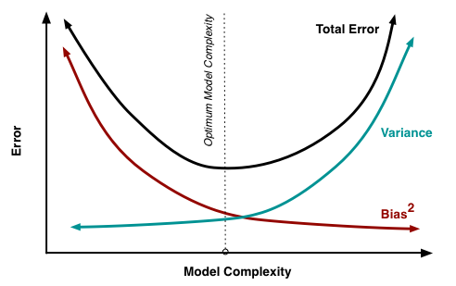
bias <> variance
Error due to bias
Error due to variance
Irreducible error

Slide 9
bagging <> boosting
boosting
bagging

Slide 10
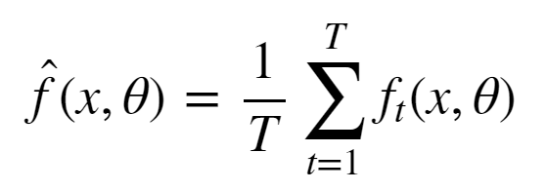
bagging
Simulate the notion of different train set samples:
sample data points from train set to create new train set
fit low bias high variance model on new train set
repeat steps (1) and (2) T times
average the predictions of the T models

Slide 11
bagging: Random Forest
Train set contains n data points with m features.
Construct T low bias high variance decision trees by following these steps:
Sample n data points at random with replacement from the train set.
At each node, select h from m features at random where (h<<m) and compute the best split using only these h features.
Each tree is grown to the largest extent possible. Or at least to a high-level complexity
Step 3 ensures that the bagged models are low bias by learning deep complex decision trees.

Slide 12
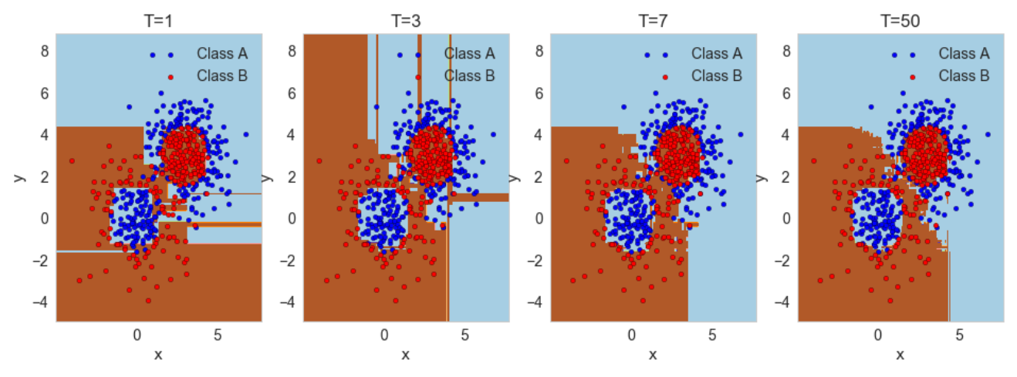
bagging: Random Forest
X2

Slide 13
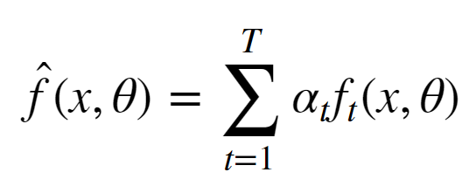
boosting
reduce the bias of a high bias low variance model
turning an ensemble of weak learners into a strong learner
the meta-model is additive, i.e. Adaboost:

Slide 14
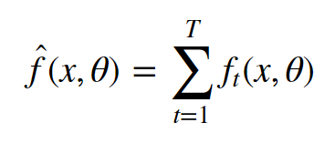
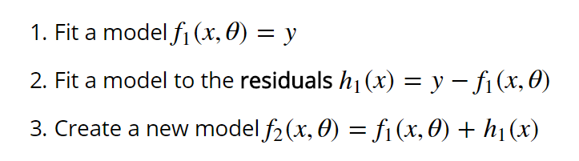
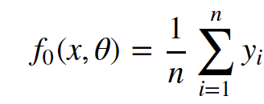

boosting: Gradient boosting

Slide 15
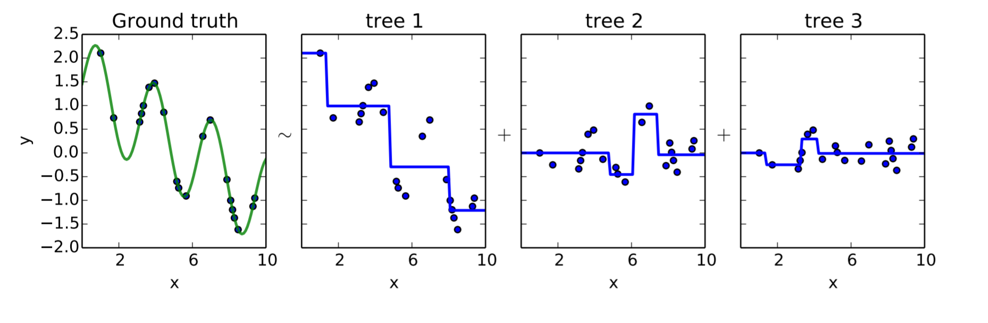
boosting: Gradient boosting
Gradient Boosting explained [demonstration]

