Slide 1
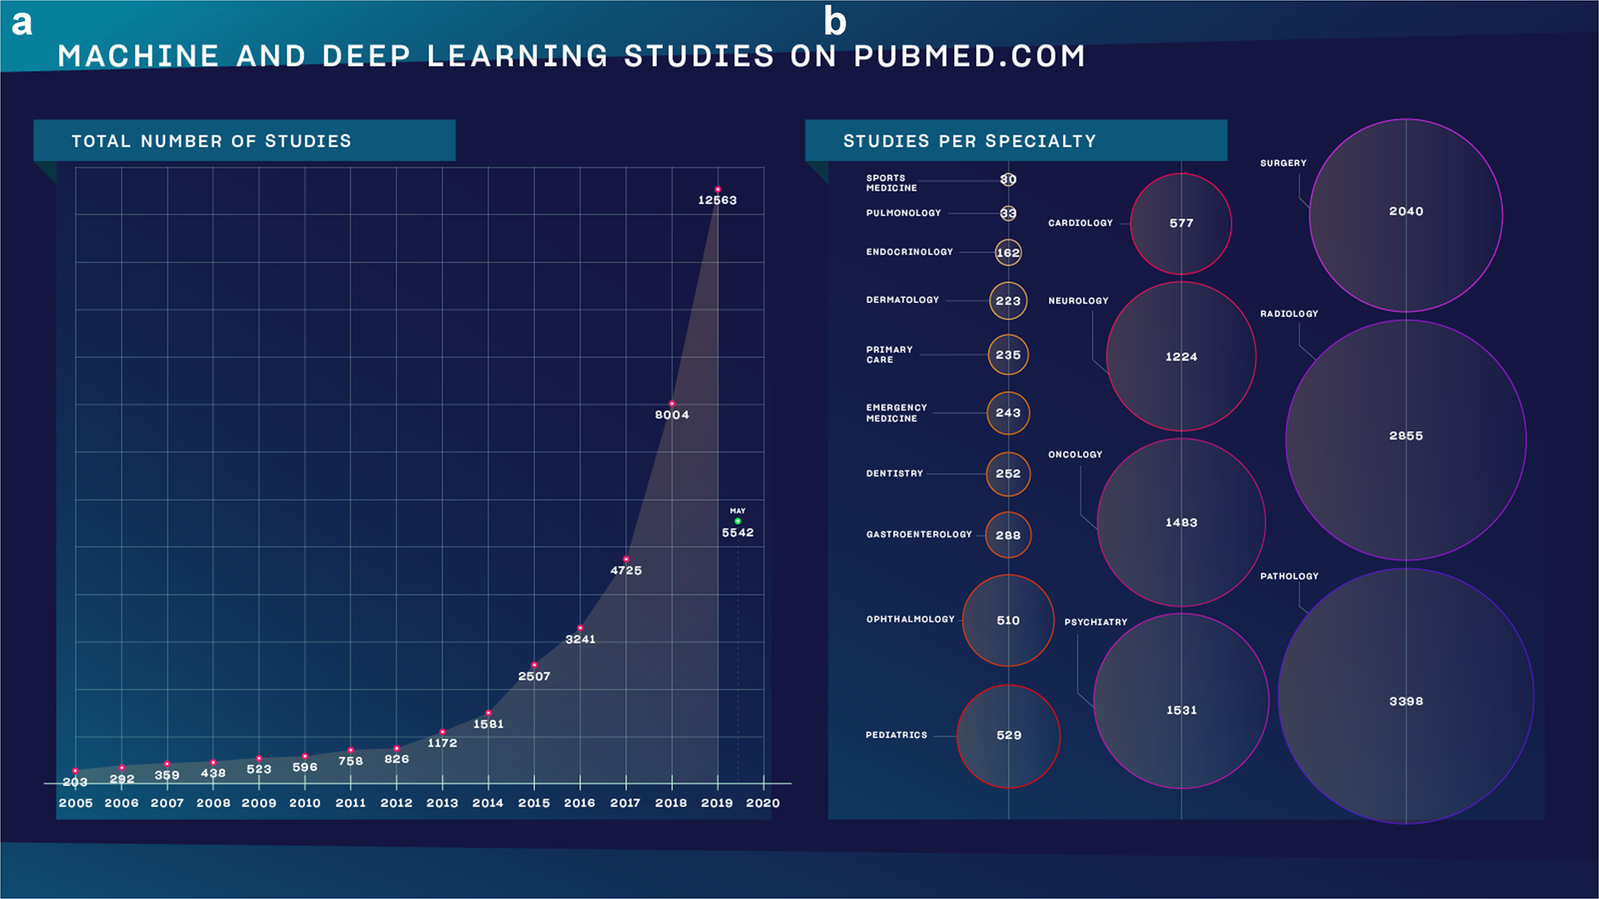
Why follow this course?
Meskó, B., Görög, M. A short guide for medical professionals in the era of artificial intelligence. npj Digit. Med. 3, 126 (2020)

Slide 2
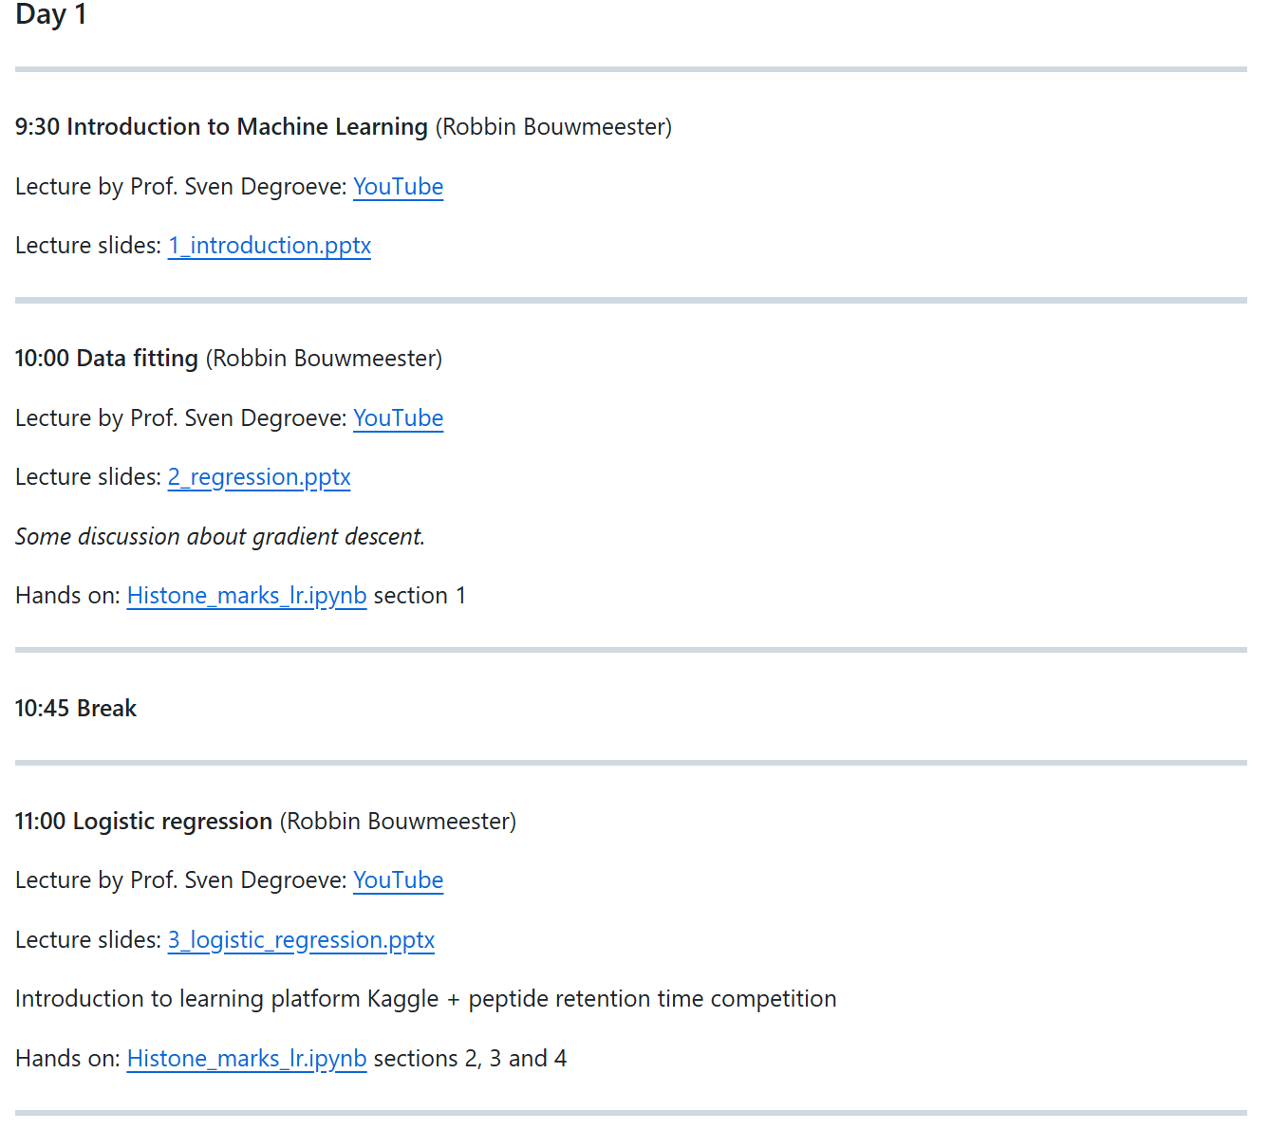
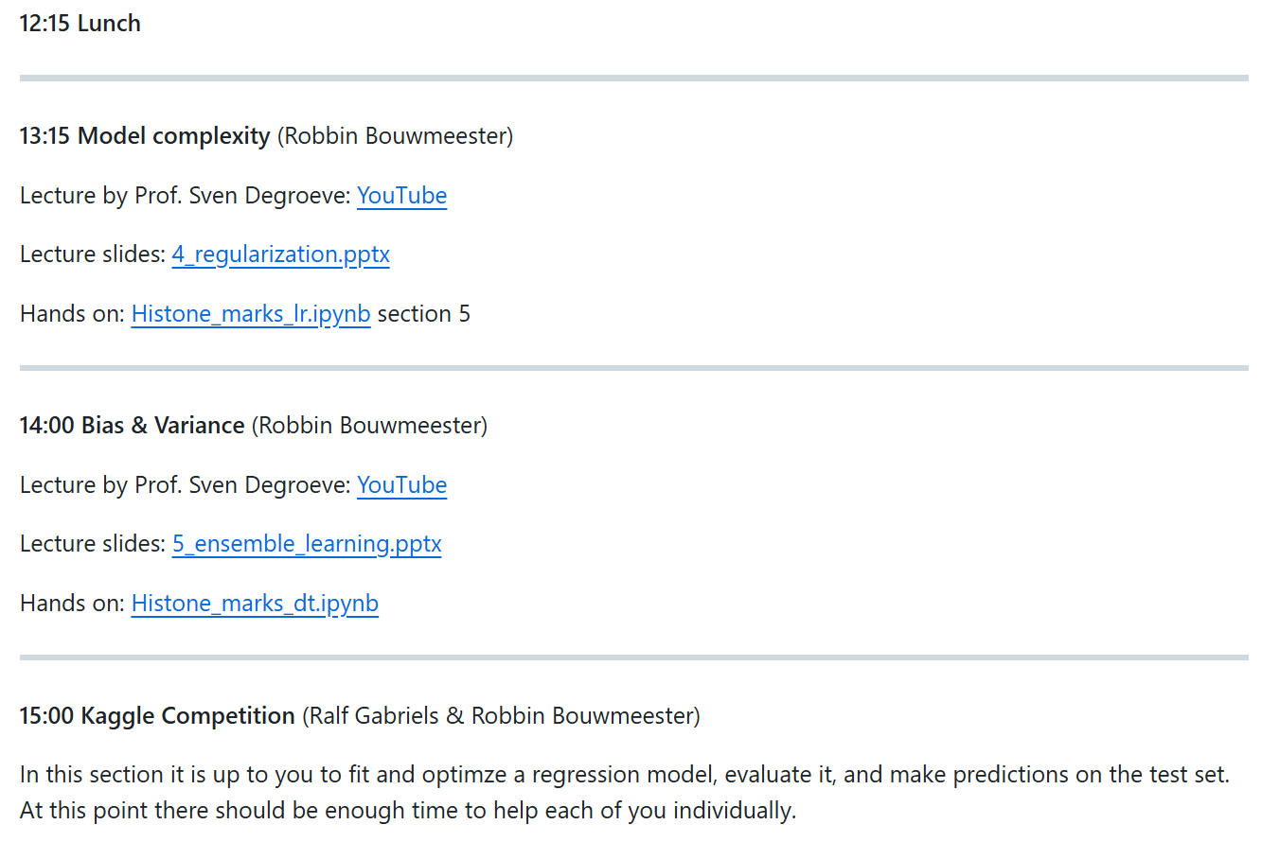



Sven Degroeve
Robbin Bouwmeester
Ralf Gabriels

Slide 3


Sven Degroeve
Robbin Bouwmeester
Ralf Gabriels

Slide 4

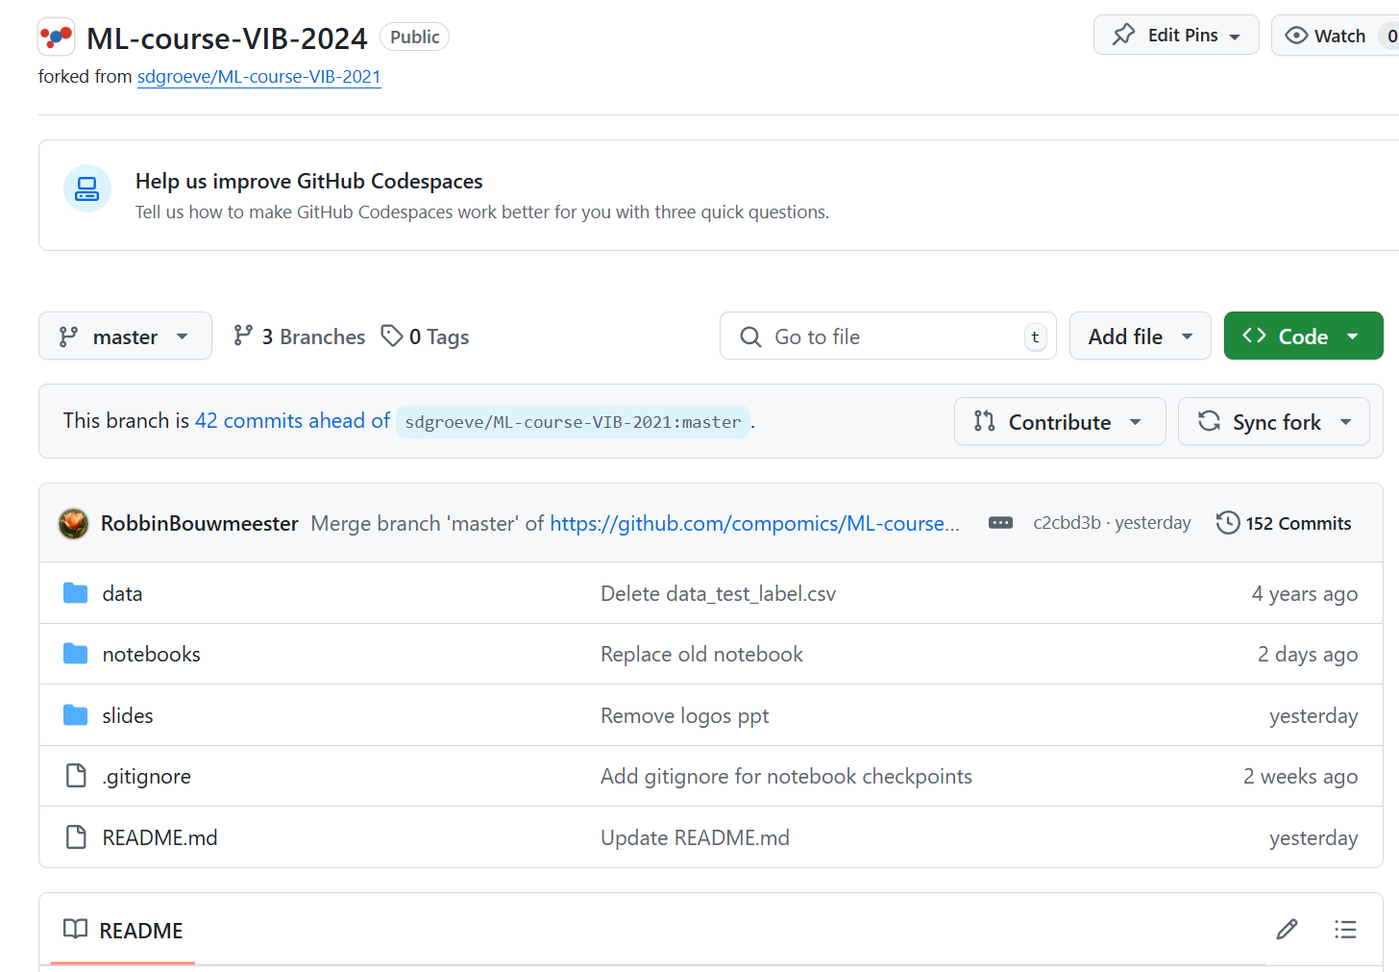

github.com/compomics/ML-course-VIB-2024
kaggle.com/competitions/
peptide-lc-retention-time-prediction

Slide 5
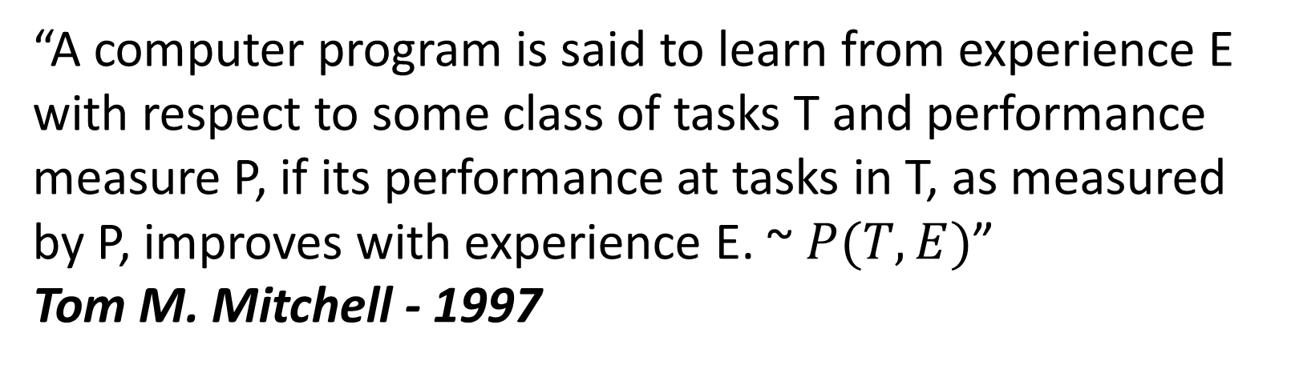
Machine learning was coined in 1958 by Arthur Samuel
“field of study that gives computers the ability to learn without being explicitly programmed.”
Arthur Samuel - 1958
“A computer program is said to learn from experience E with respect to some class of tasks T and performance measure P, if its performance at tasks in T, as measured by P, improves with experience E. ~ $P(T,E)$”
Tom M. Mitchell - 1997

Slide 6
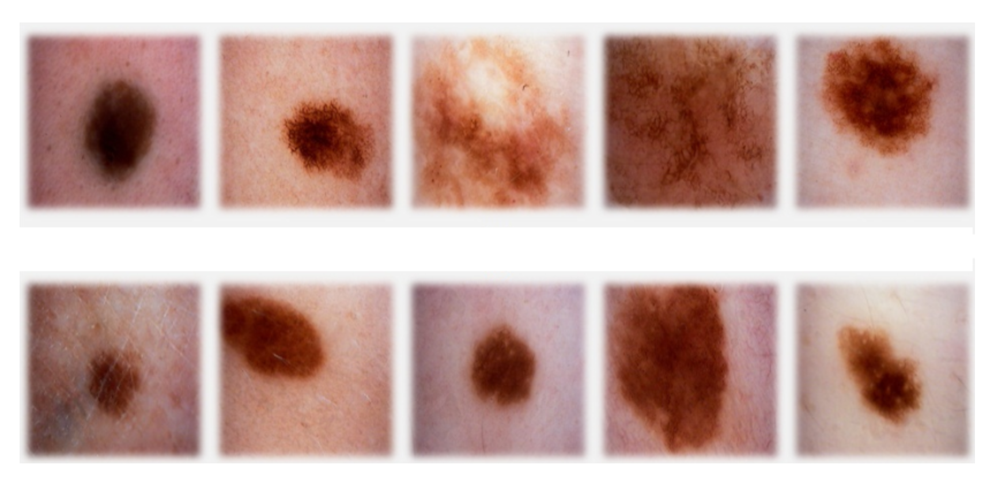
classification
sign of cancer
top row malignant
bottom row benign

Slide 7
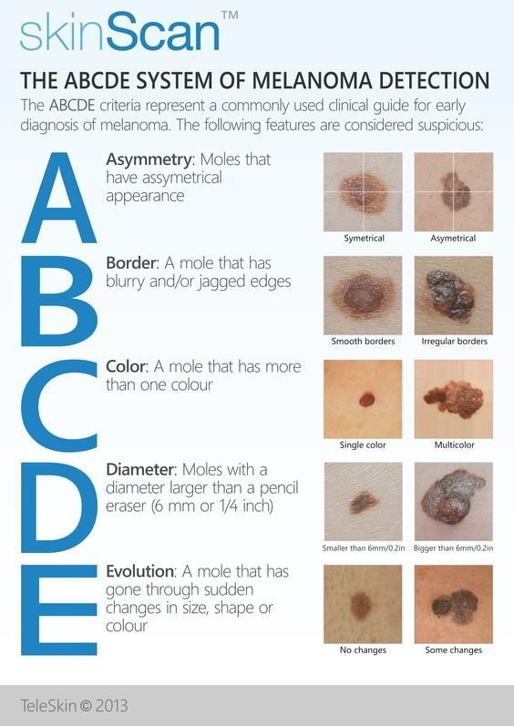
classification

Slide 8
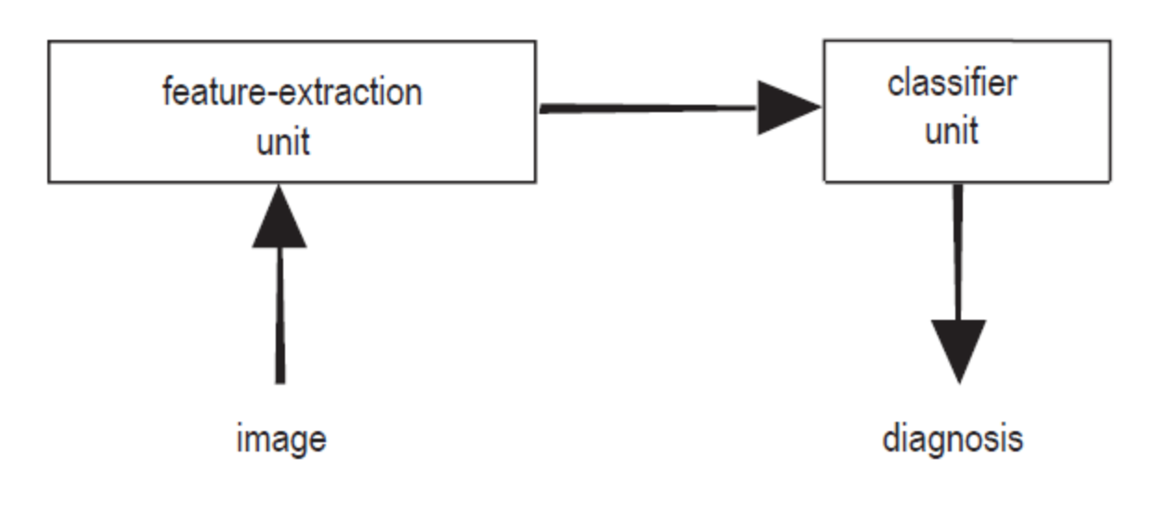
classification: terminology
feature extraction: features (a.k.a. properties or attributes)
data set, sample (a.k.a. example, instance or data point), label (a.k.a. target)

Slide 9
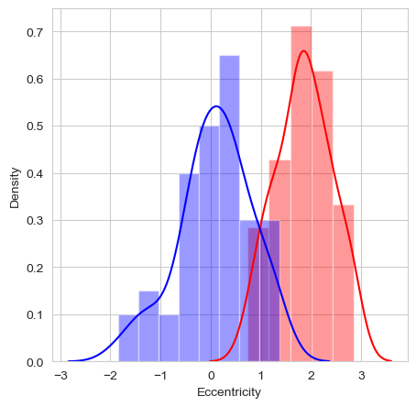
classification: a feature
feature: eccentricity of lesion (how nearly circular the lesion is)

Slide 10

classification: the model
feature: eccentricity of lesion (how nearly circular the lesion is)
model: threshold t

Slide 11
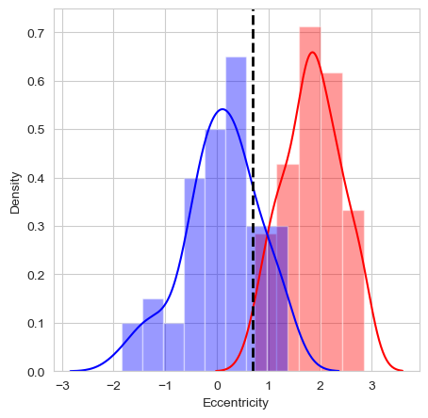
classification: the model
feature: eccentricity of lesion (how nearly circular the lesion is)
model: threshold t: consequence of the predictions

Slide 12
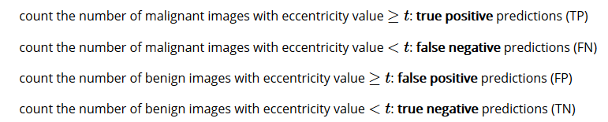
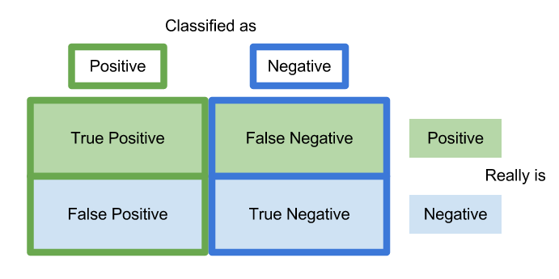
classification: prediction errors
malignant: positive class
benign: negative class

Slide 13



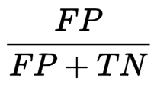
classification: prediction errors

Slide 14
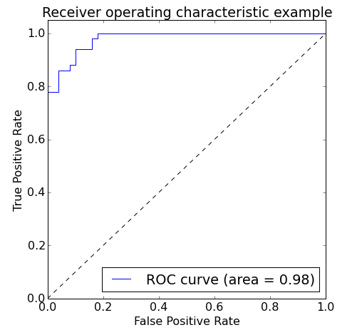
classification: prediction errors
model that classifies all images as malignant: TPR=1 and FPR=1
model that classifies all images a benign: TPR=0 and FPR=0
vary threshold t
Area Under the Curve (AUC)

Slide 15
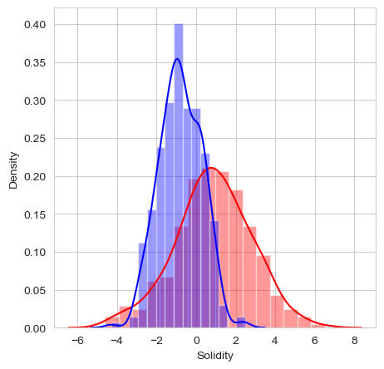
classification: multi-dimensional
add another feature?
feature vector X
Euclidean vector space

Slide 16
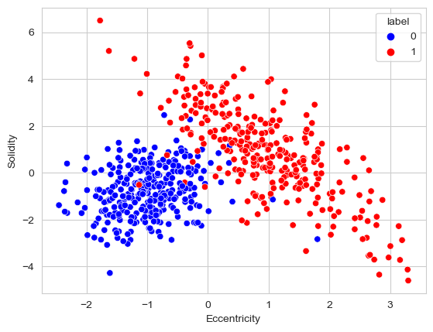
classification: multi-dimensional
feature vector X
Euclidean vector space

Slide 17
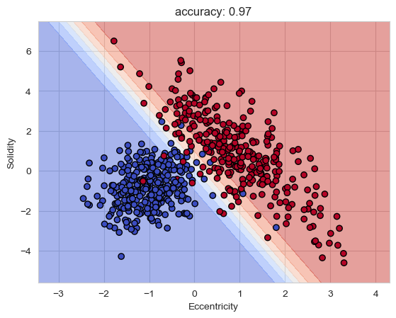
classification: multi-dimensional
linear decision boundary
blue region malignant, red region benign
yet more features
can’t look at the decision boundary
more complex

Slide 18
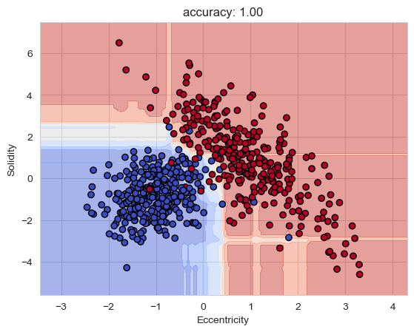
classification: model complexity
unseen external images
generalization
overfitting

Slide 19
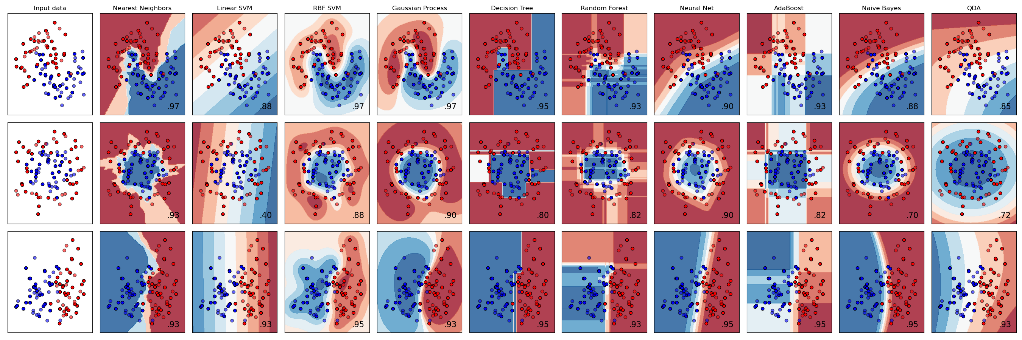
scikit-learn

Slide 20




data normalization
make all features same scale
Eccentricity [0,100], Solidity [-5,7]
weights all features equally in their representation
standardization
min-max scaling: scale the features to a fixed range

Slide 21
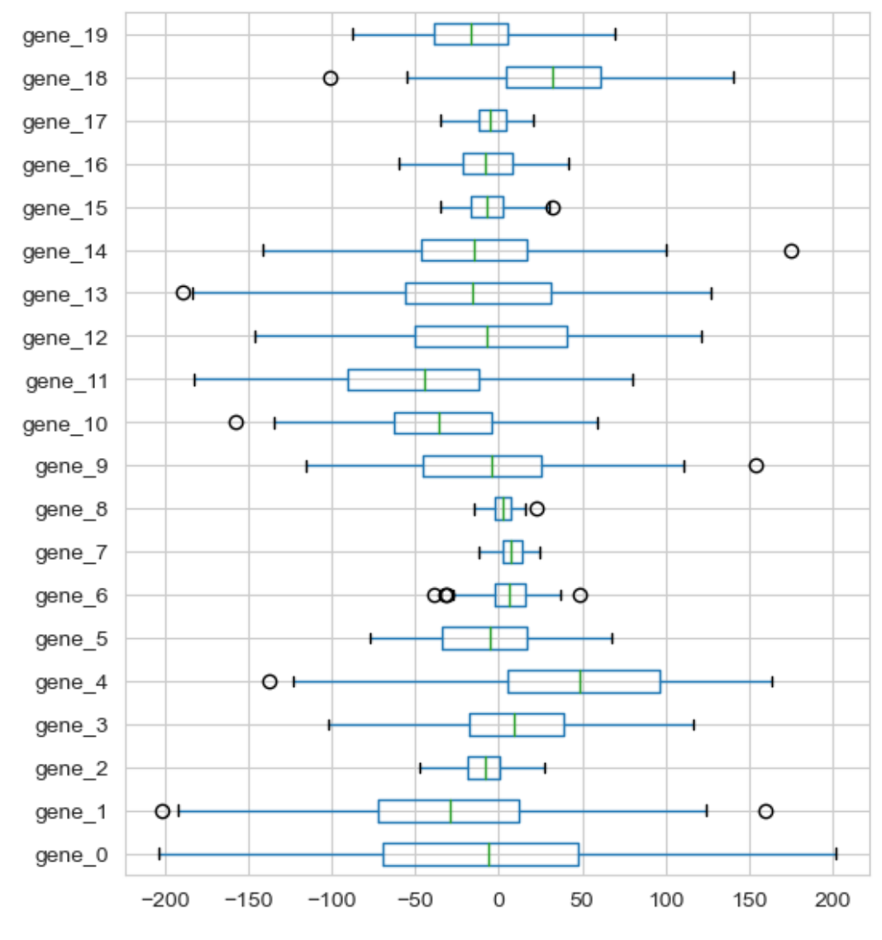
data normalization

Slide 22
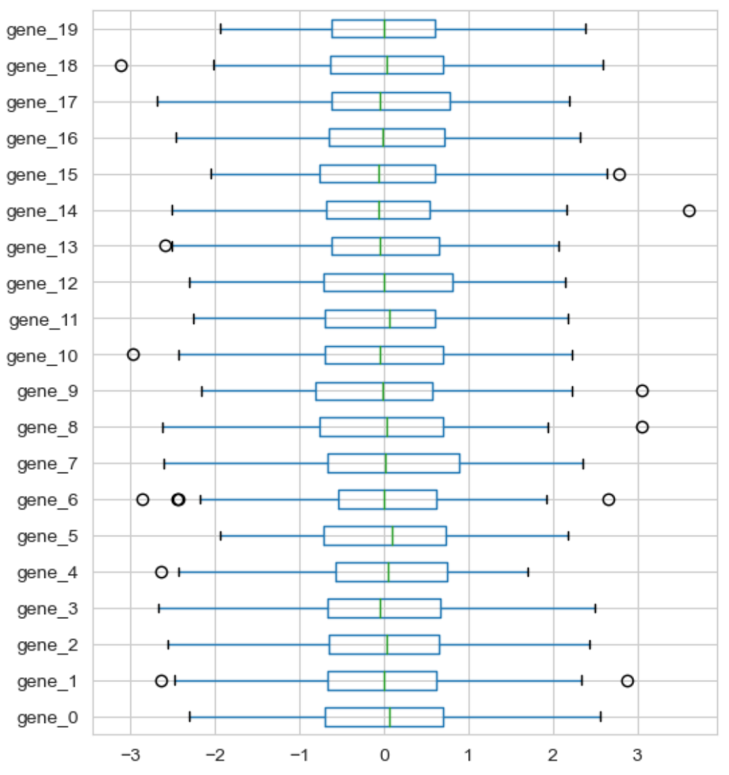
data normalization: standardization

Slide 23
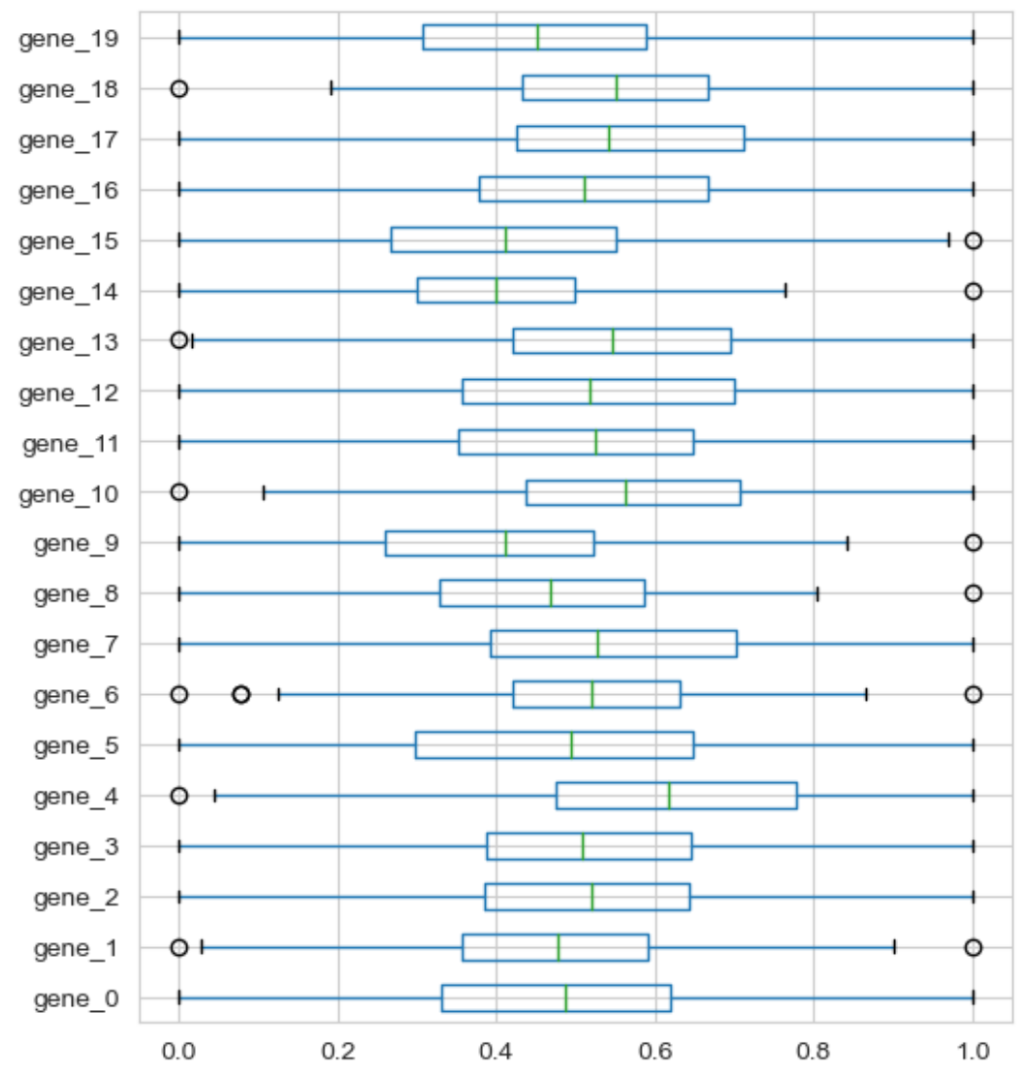
data normalization: min-max scaling

