Slide 1
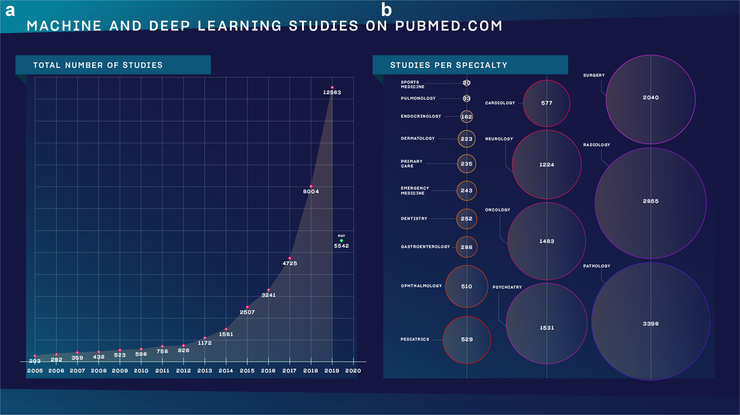
Why follow this course?
Meskó, B., Görög, M. A short guide for medical professionals in the era of artificial intelligence. npj Digit. Med. 3, 126 (2020)

Slide 2
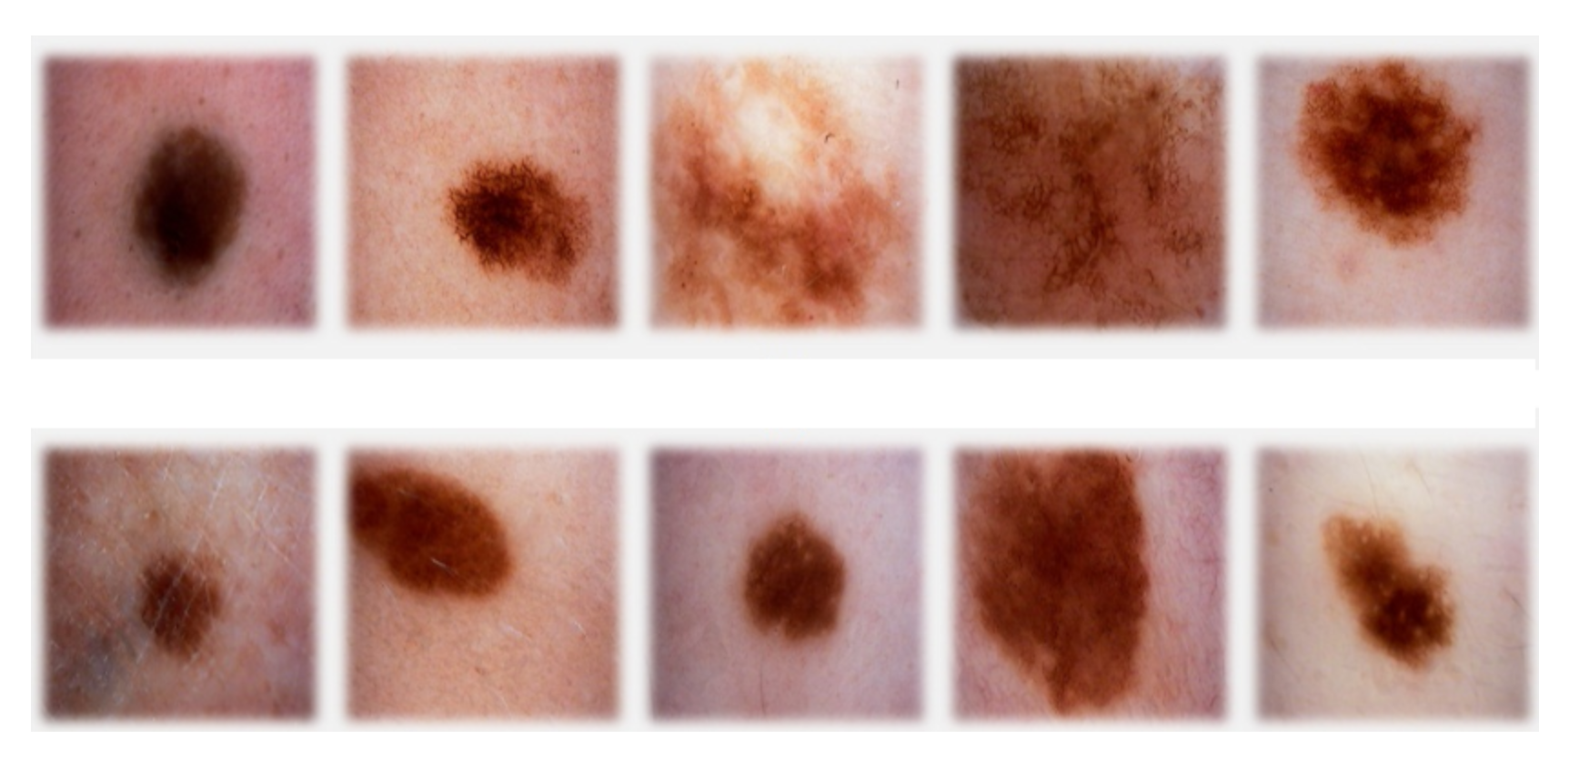
classification
sign of cancer
top row malignant
bottom row benign

Slide 3
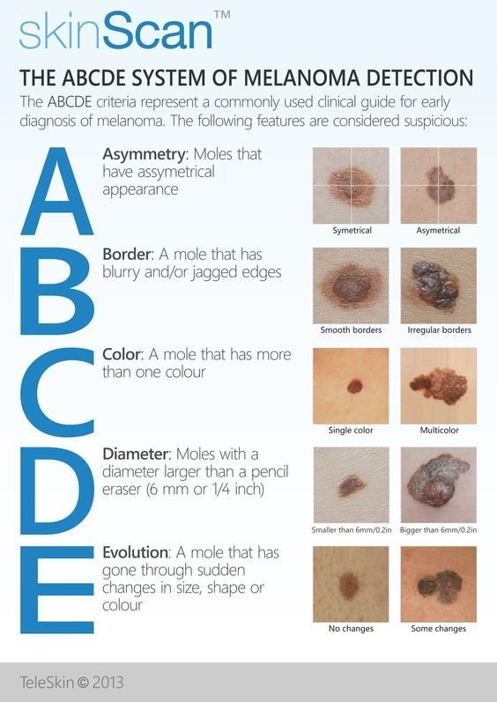
classification

Slide 4
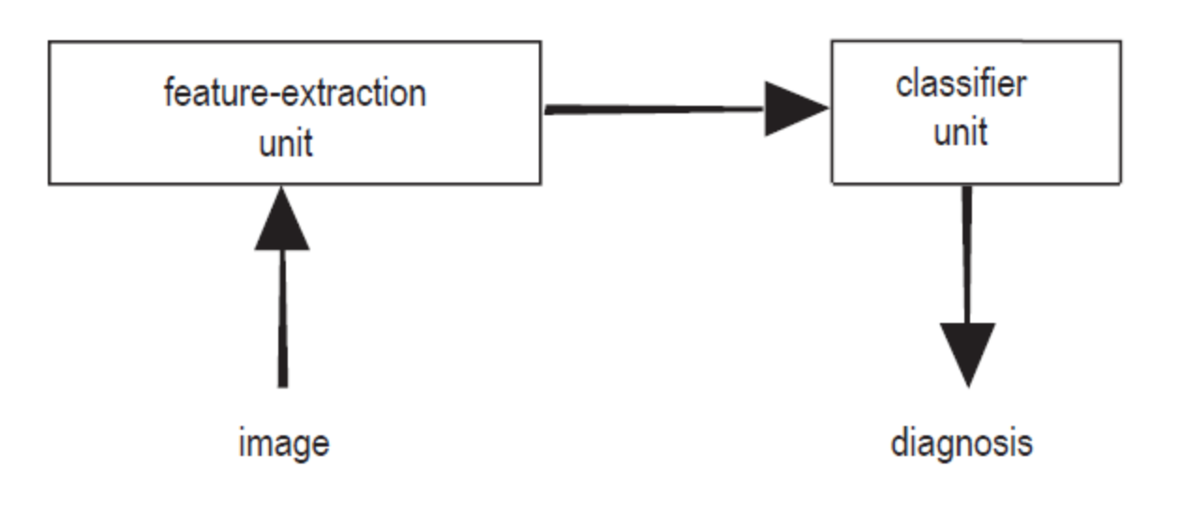
classification: terminology
feature extraction: features (a.k.a. properties or attributes)
data set, sample (a.k.a. example, instance or data point), label (a.k.a. target)

Slide 5
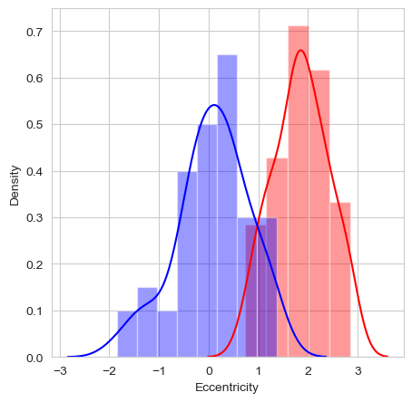
classification: a feature
feature: eccentricity of lesion (how nearly circular the lesion is)

Slide 6

classification: the model
feature: eccentricity of lesion (how nearly circular the lesion is)
model: threshold t

Slide 7
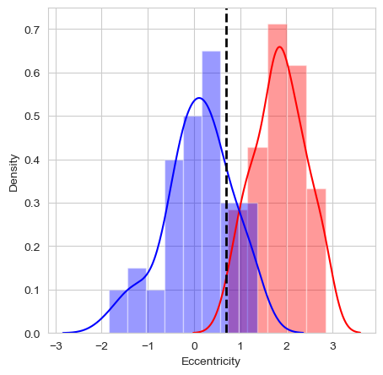
classification: the model
feature: eccentricity of lesion (how nearly circular the lesion is)
model: threshold t: consequence of the predictions

Slide 8
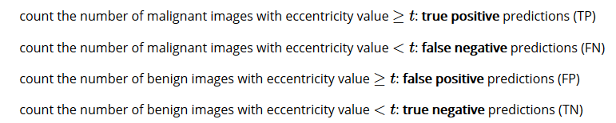
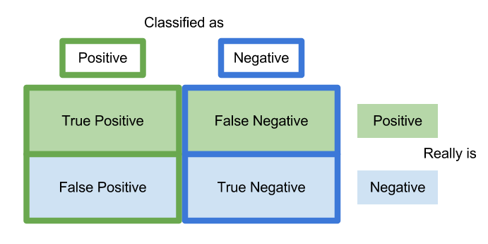
classification: prediction errors
malignant: positive class
benign: negative class

Slide 9



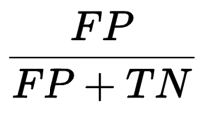
classification: prediction errors

Slide 10
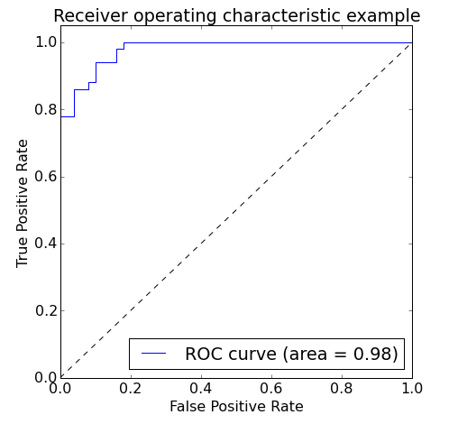
classification: prediction errors
model that classifies all images as malignant: TPR=1 and FPR=1
model that classifies all images a benign: TPR=0 and FPR=0
vary threshold t
Area Under the Curve (AUC)

Slide 11
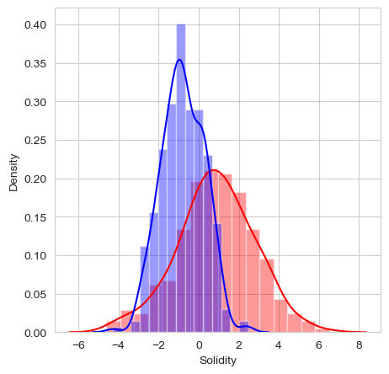
classification: multi-dimensional
add another feature?
feature vector X
Euclidean vector space

Slide 12
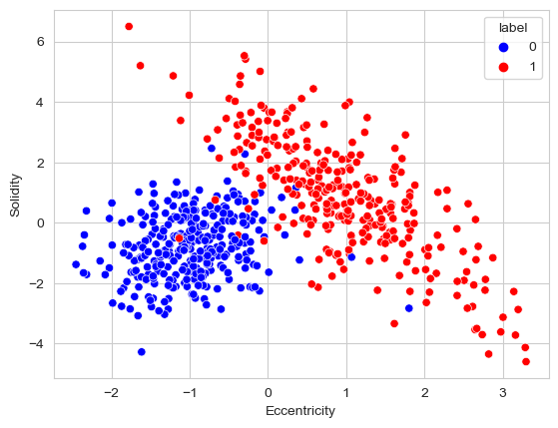
classification: multi-dimensional
feature vector X
Euclidean vector space

Slide 13
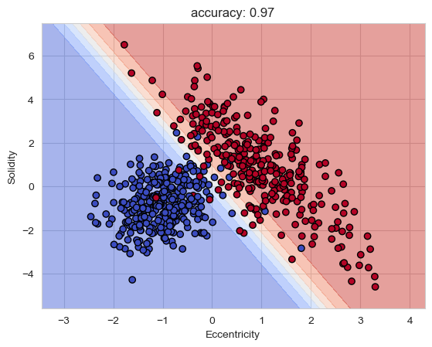
classification: multi-dimensional
linear decision boundary
blue region malignant, red region benign
yet more features
can’t look at the decision boundary
more complex

Slide 14
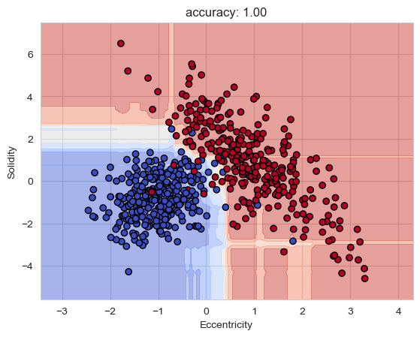
classification: model complexity
unseen external images
generalization
overfitting

Slide 15
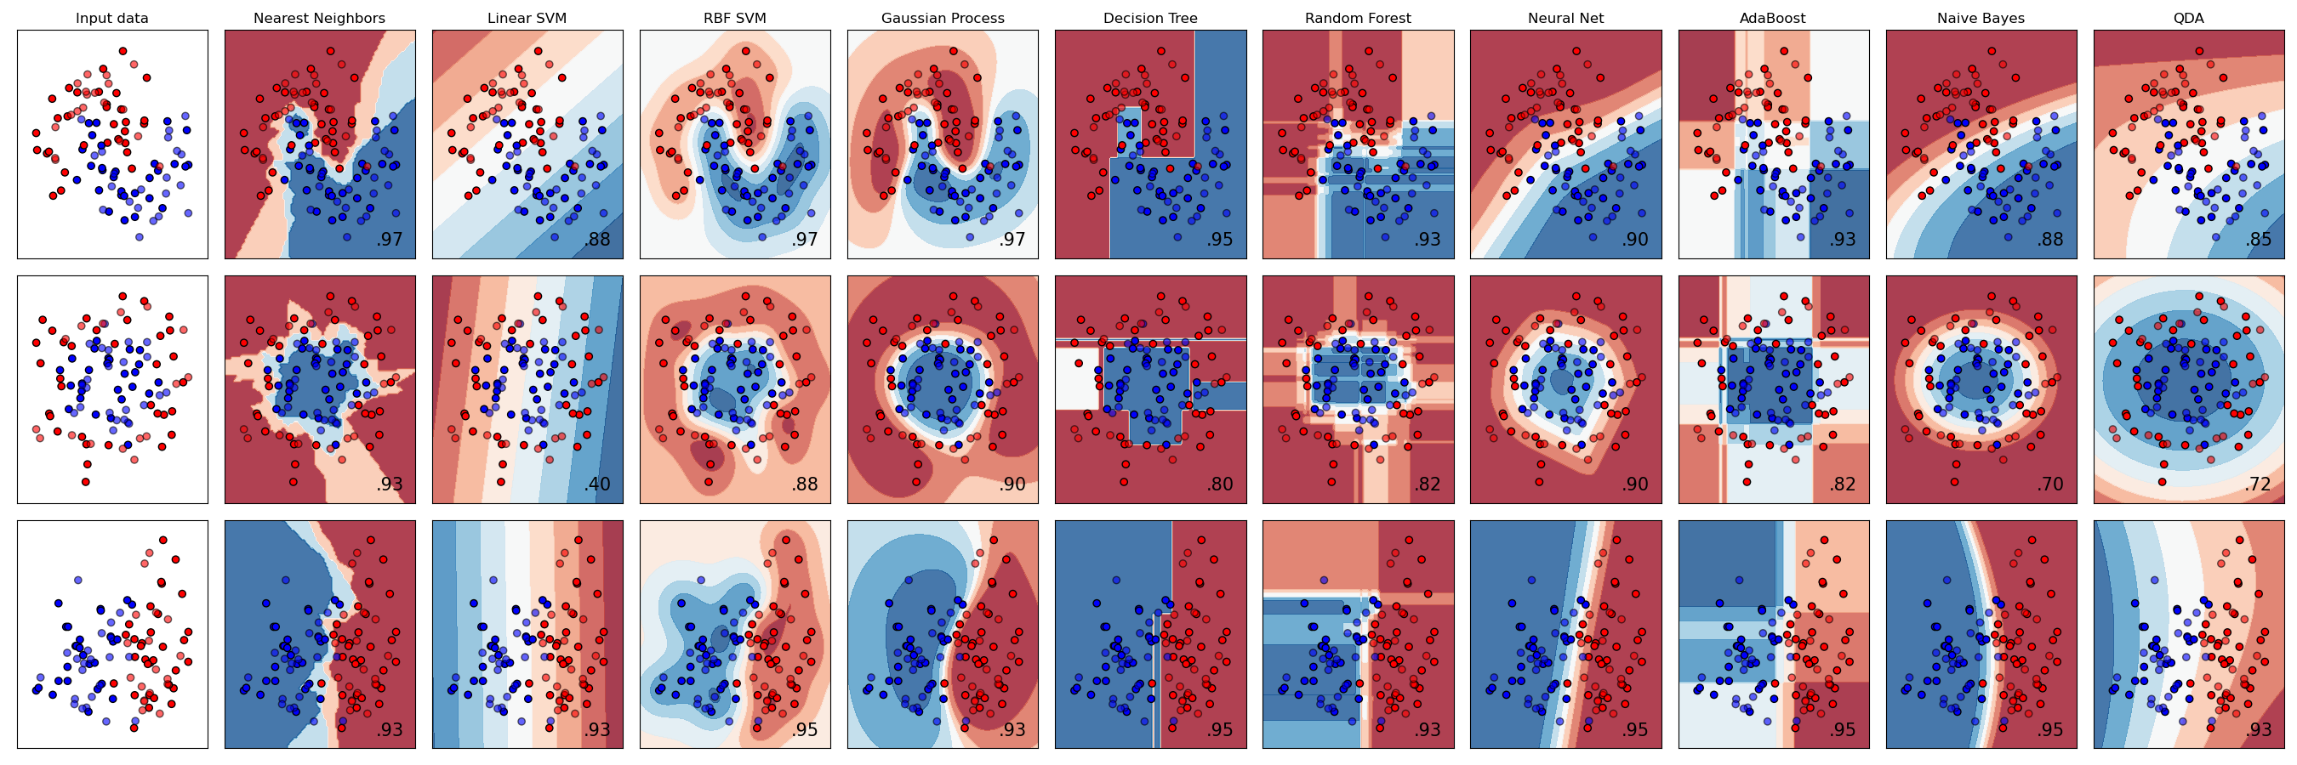
scikit-learn

Slide 16




data normalization
make all features same scale
Eccentricity [0,100], Solidity [-5,7]
weights all features equally in their representation
standardization
min-max scaling: scale the features to a fixed range

Slide 17
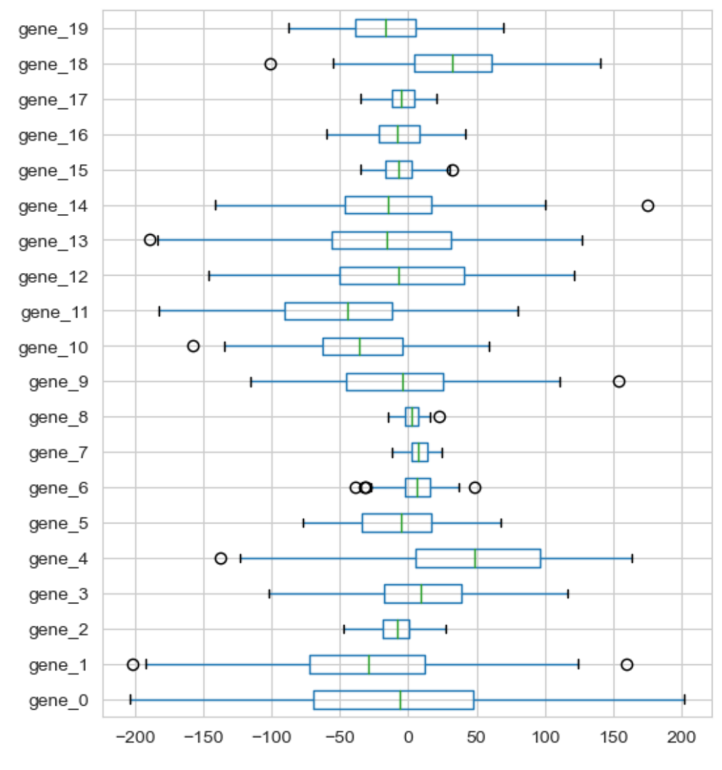
data normalization

Slide 18
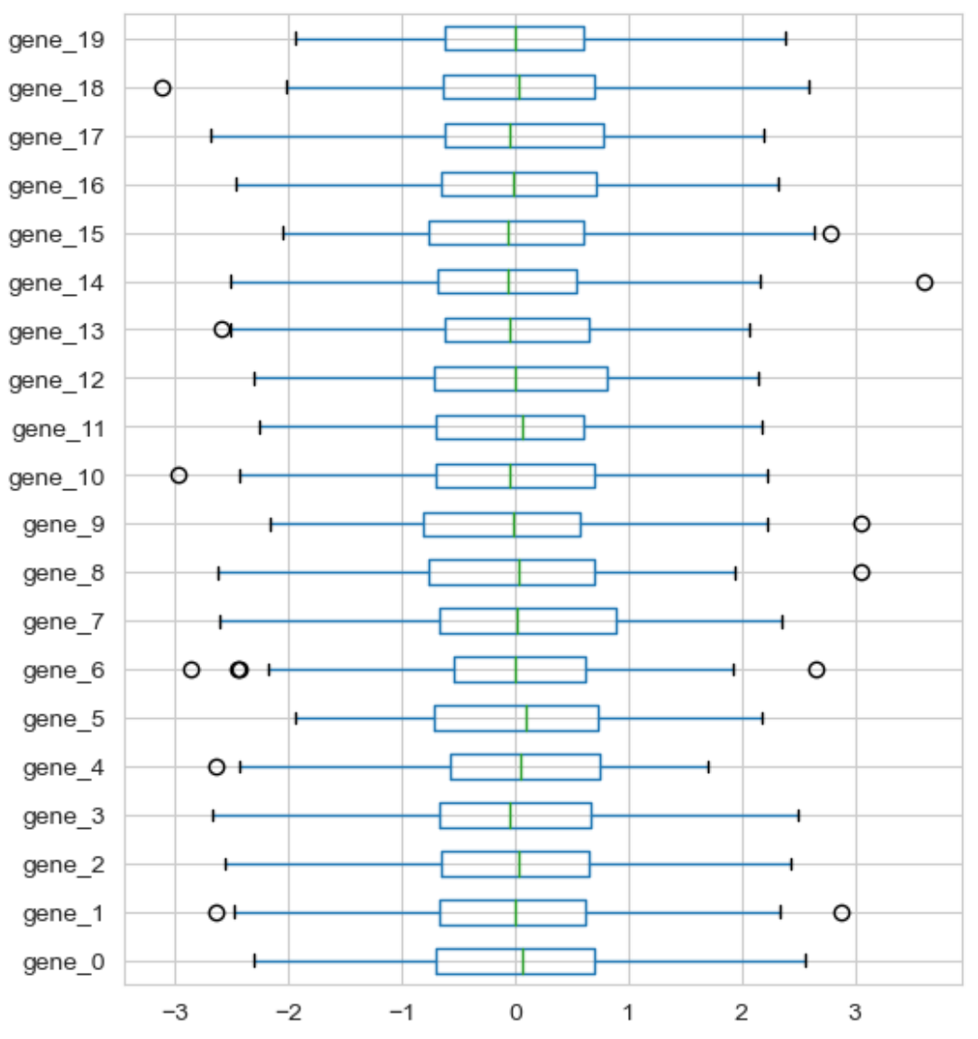
data normalization: standardization

Slide 19
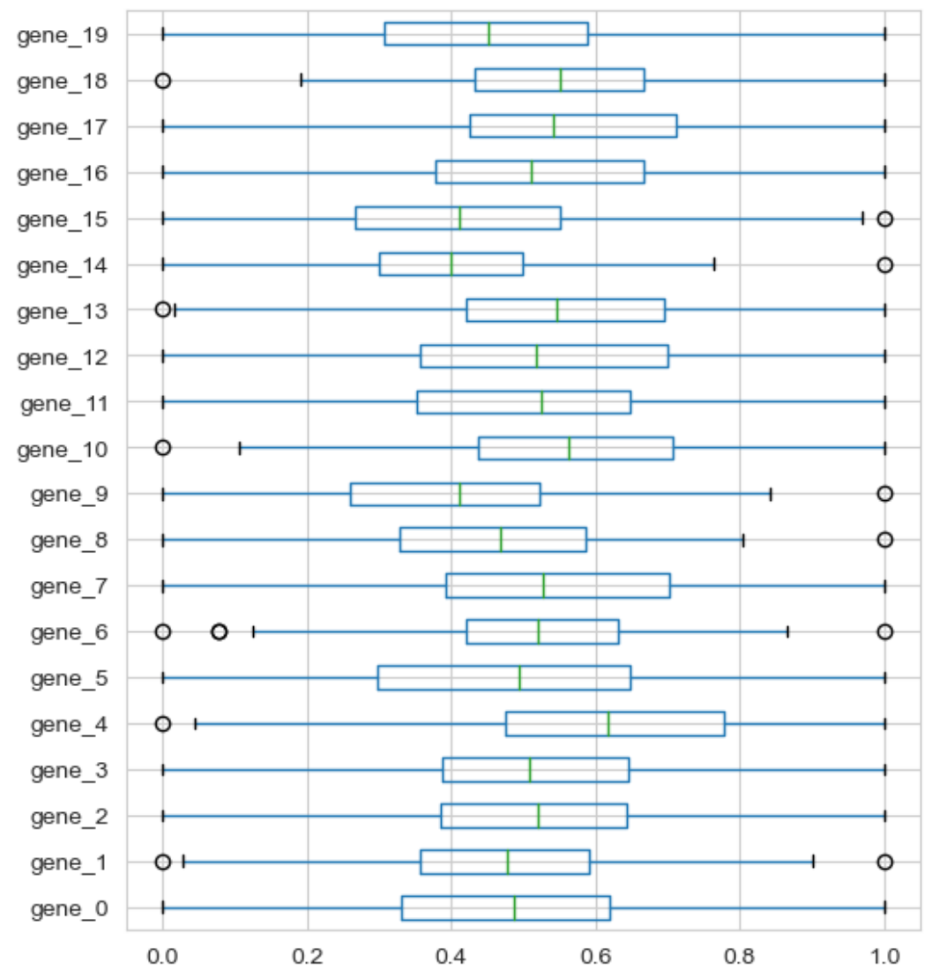
data normalization: min-max scaling

