Slide 1
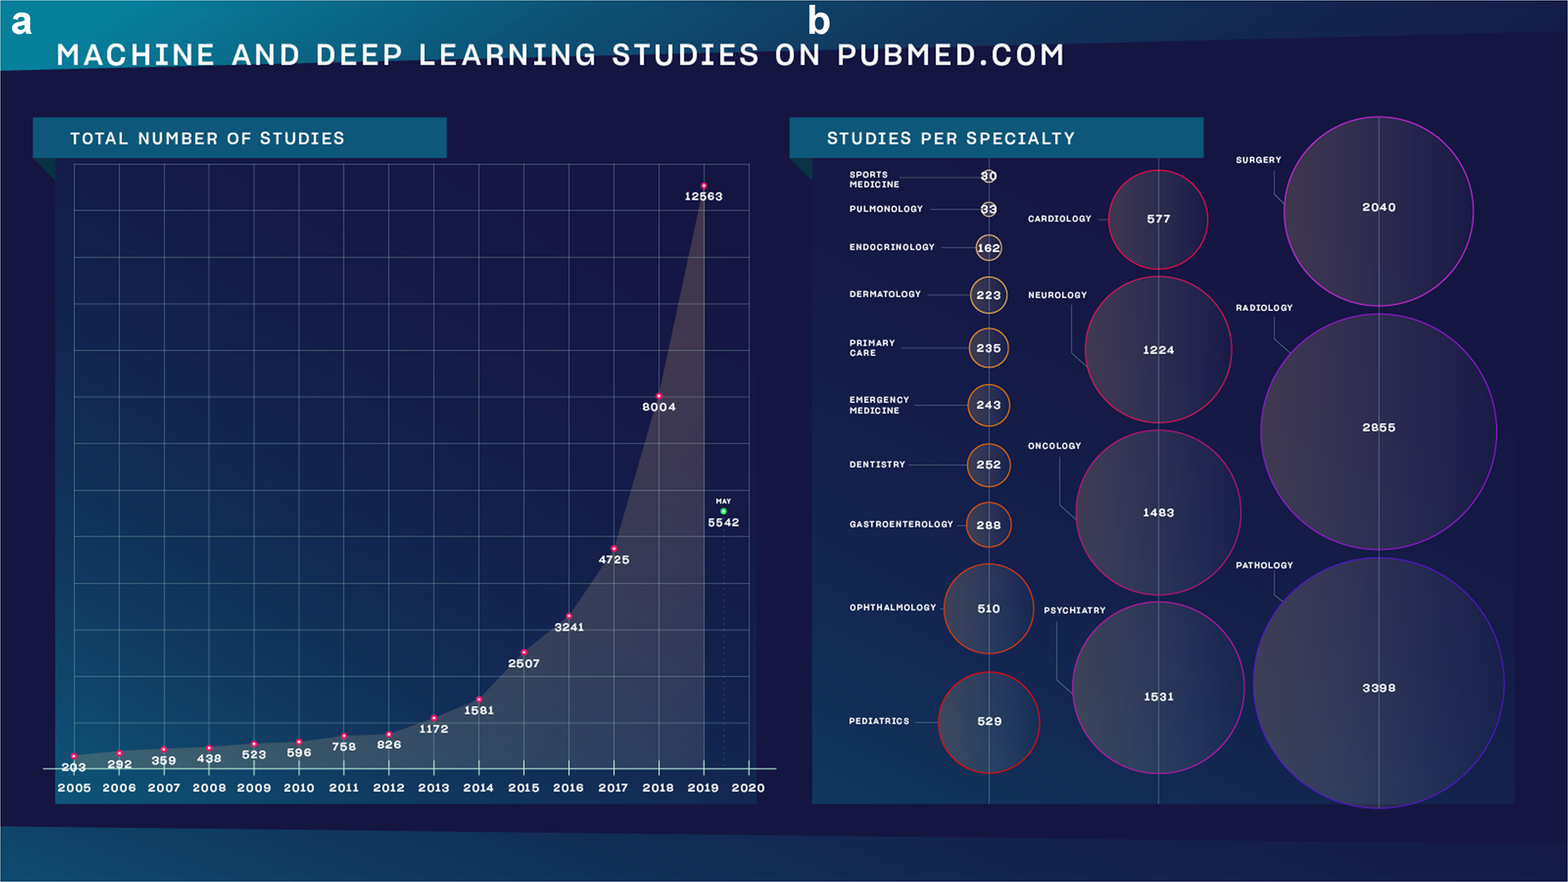

Why follow this course?
Meskó, B., Görög, M. A short guide for medical professionals in the era of artificial intelligence. npj Digit. Med. 3, 126 (2020)
Machine Learning Methods for Biomedical Data (D012554)

Slide 2
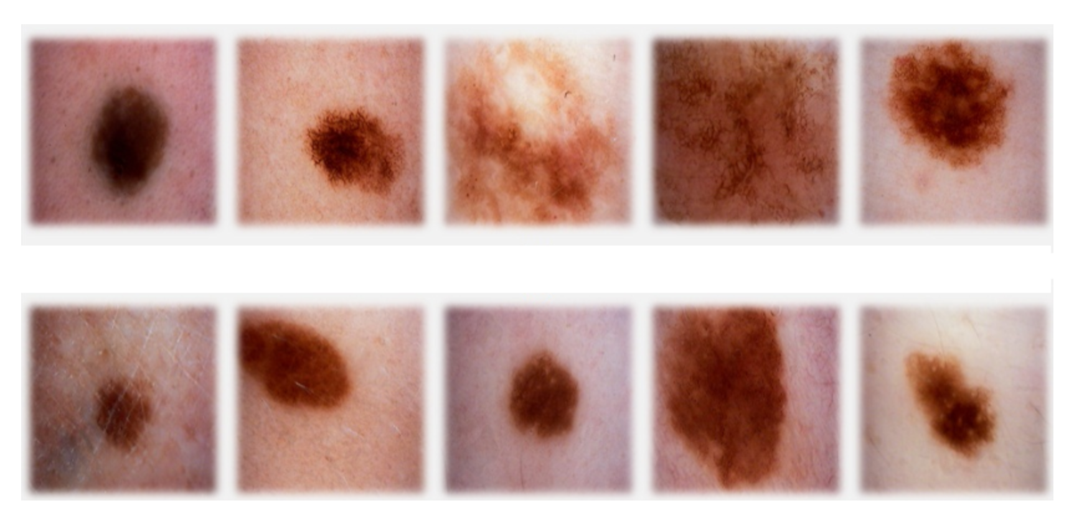
classification
sign of cancer
top row malignant
bottom row benign
Machine Learning Methods for Biomedical Data (D012554)

Slide 3
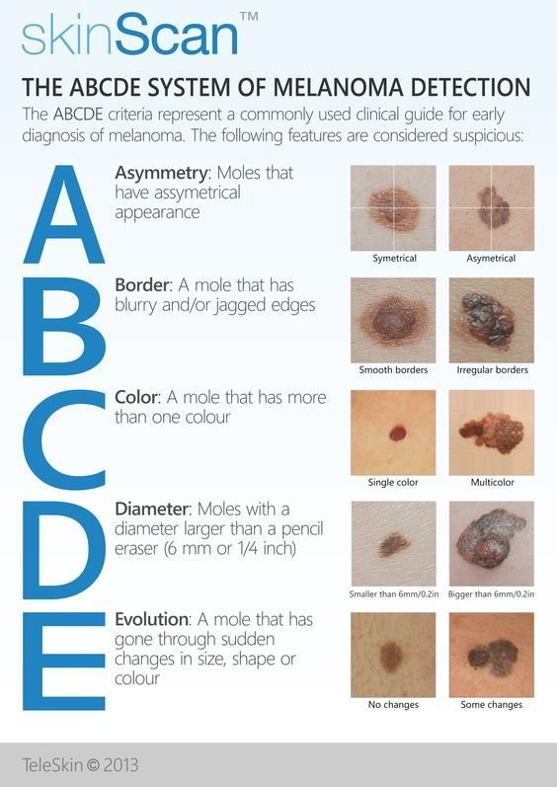
classification
Machine Learning Methods for Biomedical Data (D012554)

Slide 4
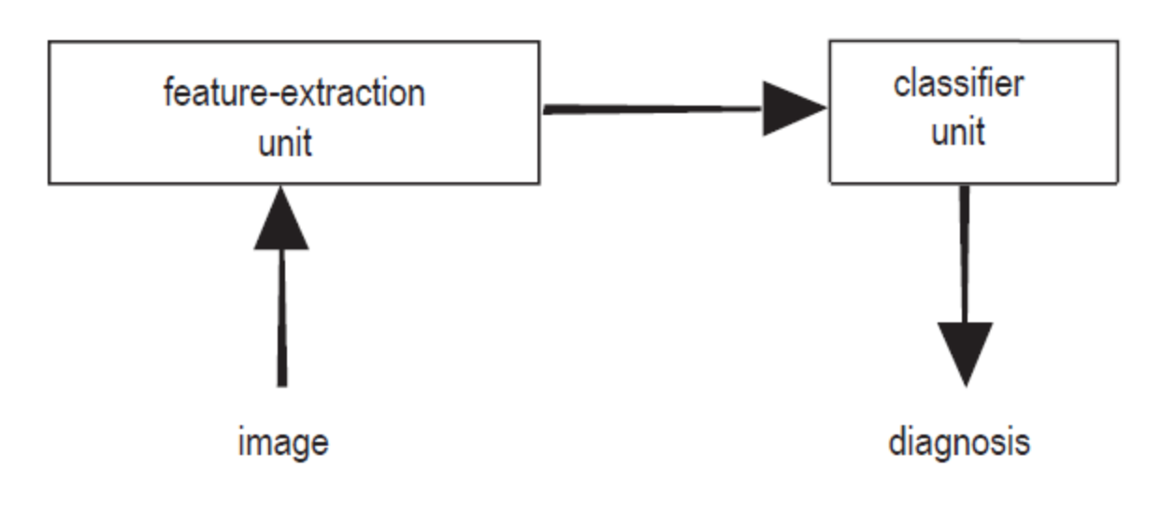
classification: terminology
feature extraction: features (a.k.a. properties or attributes)
data set, sample (a.k.a. example, instance or data point), label (a.k.a. target)
Machine Learning Methods for Biomedical Data (D012554)

Slide 5
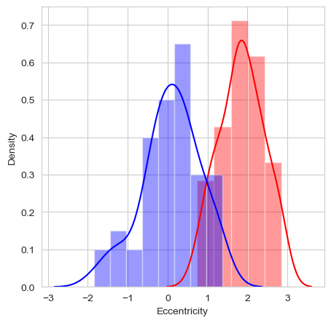
classification: a feature
feature: eccentricity of lesion (how nearly circular the lesion is)
Machine Learning Methods for Biomedical Data (D012554)

Slide 6

classification: the model
feature: eccentricity of lesion (how nearly circular the lesion is)
model: threshold t
Machine Learning Methods for Biomedical Data (D012554)

Slide 7
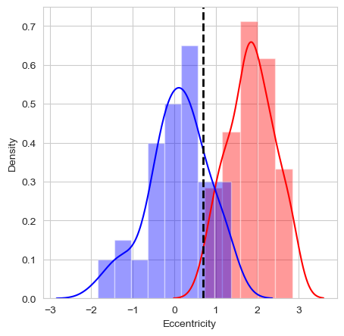
classification: the model
feature: eccentricity of lesion (how nearly circular the lesion is)
model: threshold t: consequence of the predictions
Machine Learning Methods for Biomedical Data (D012554)

Slide 8
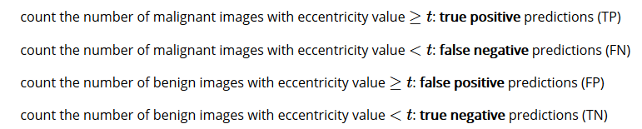
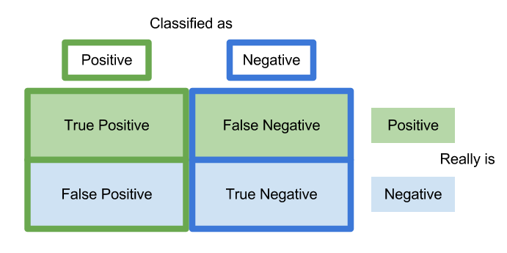
classification: prediction errors
malignant: positive class
benign: negative class
Machine Learning Methods for Biomedical Data (D012554)

Slide 9



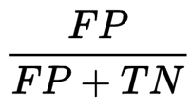
classification: prediction errors
Machine Learning Methods for Biomedical Data (D012554)

Slide 10
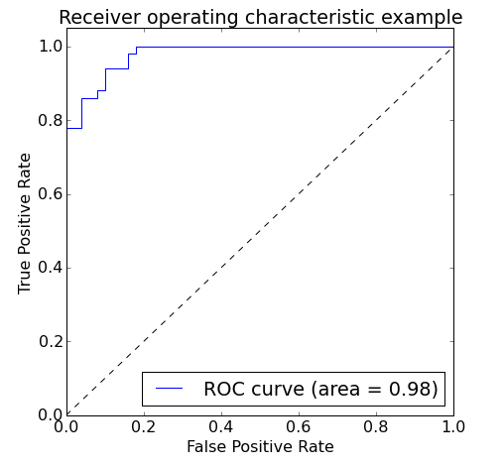
classification: prediction errors
model that classifies all images as malignant: TPR=1 and FPR=1
model that classifies all images a benign: TPR=0 and FPR=0
vary threshold t
Area Under the Curve (AUC)
Machine Learning Methods for Biomedical Data (D012554)

Slide 11
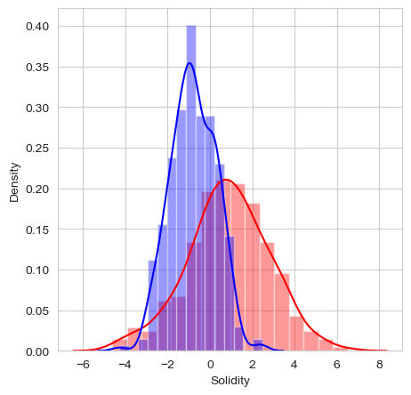
classification: multi-dimensional
add another feature?
feature vector X
Euclidean vector space
Machine Learning Methods for Biomedical Data (D012554)

Slide 12
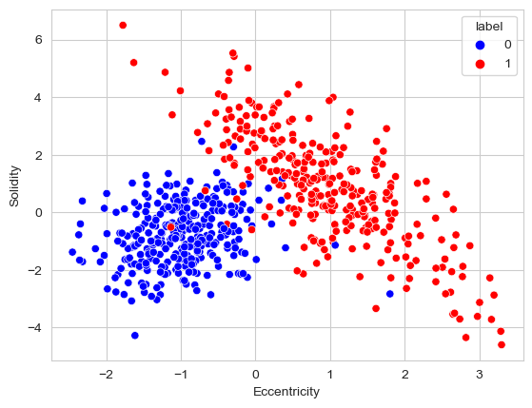
classification: multi-dimensional
feature vector X
Euclidean vector space
Machine Learning Methods for Biomedical Data (D012554)

Slide 13
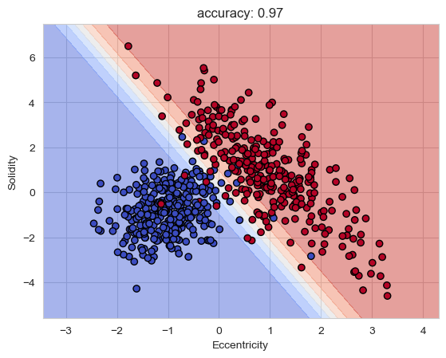
classification: multi-dimensional
linear decision boundary
blue region malignant, red region benign
yet more features
can’t look at the decision boundary
more complex
Machine Learning Methods for Biomedical Data (D012554)

Slide 14
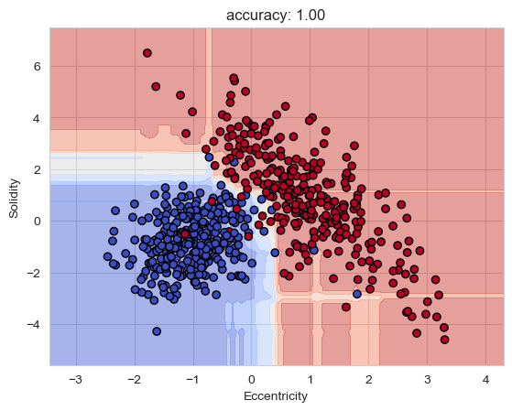
classification: model complexity
unseen external images
generalization
overfitting
Machine Learning Methods for Biomedical Data (D012554)

Slide 15
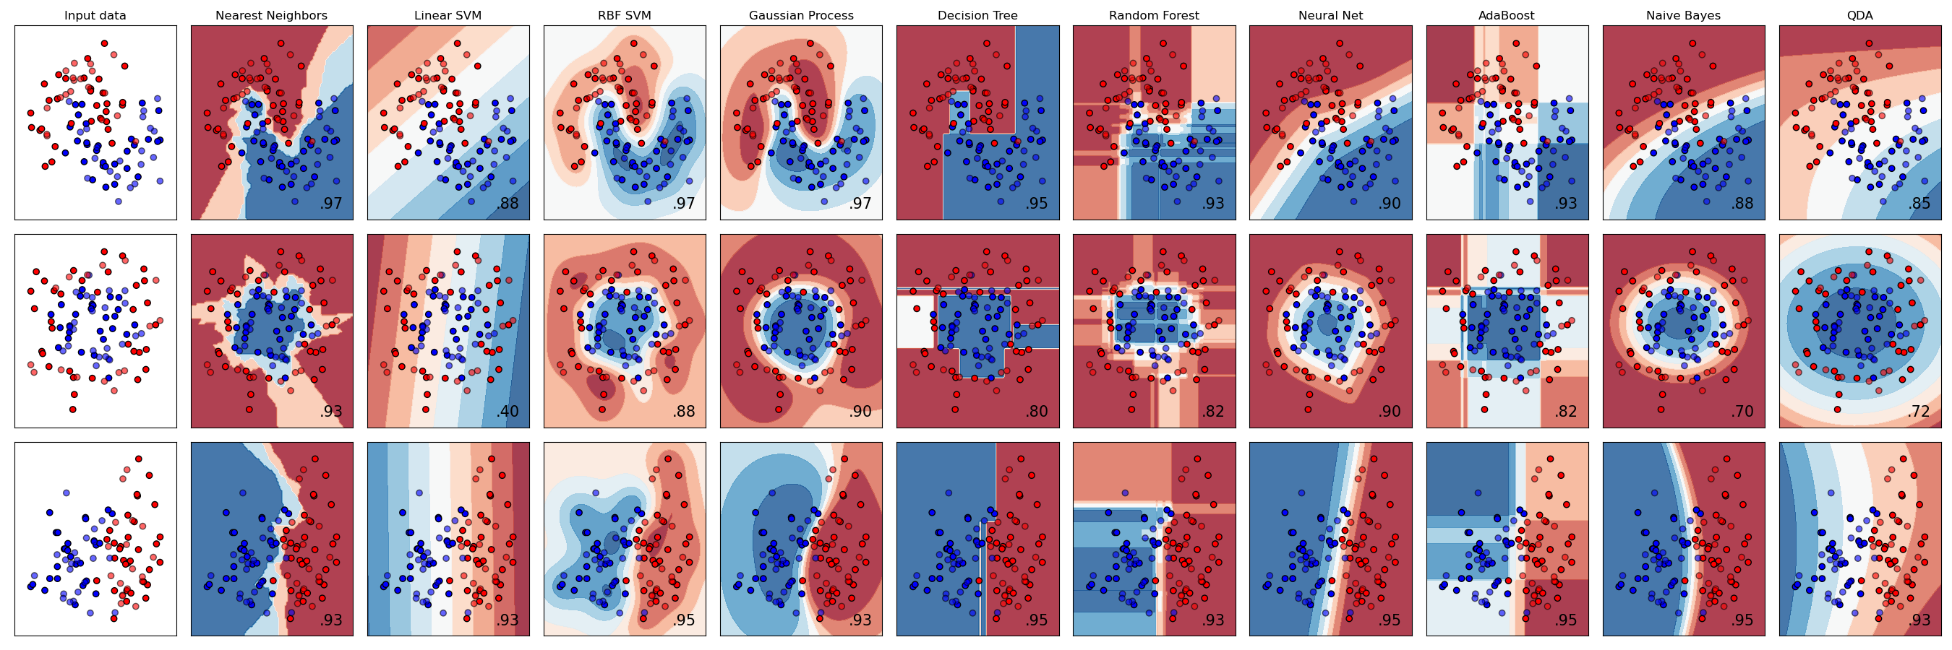
scikit-learn
Machine Learning Methods for Biomedical Data (D012554)

Slide 16




data normalization
make all features same scale
Eccentricity [0,100], Solidity [-5,7]
weights all features equally in their representation
standardization
min-max scaling: scale the features to a fixed range
Machine Learning Methods for Biomedical Data (D012554)

Slide 17
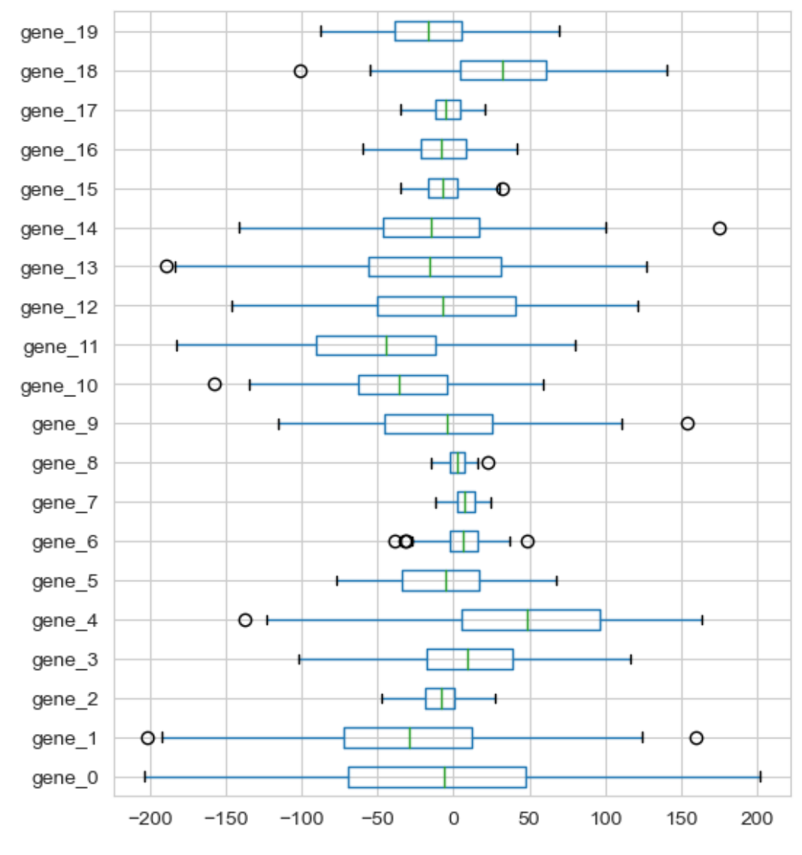
data normalization
Machine Learning Methods for Biomedical Data (D012554)

Slide 18
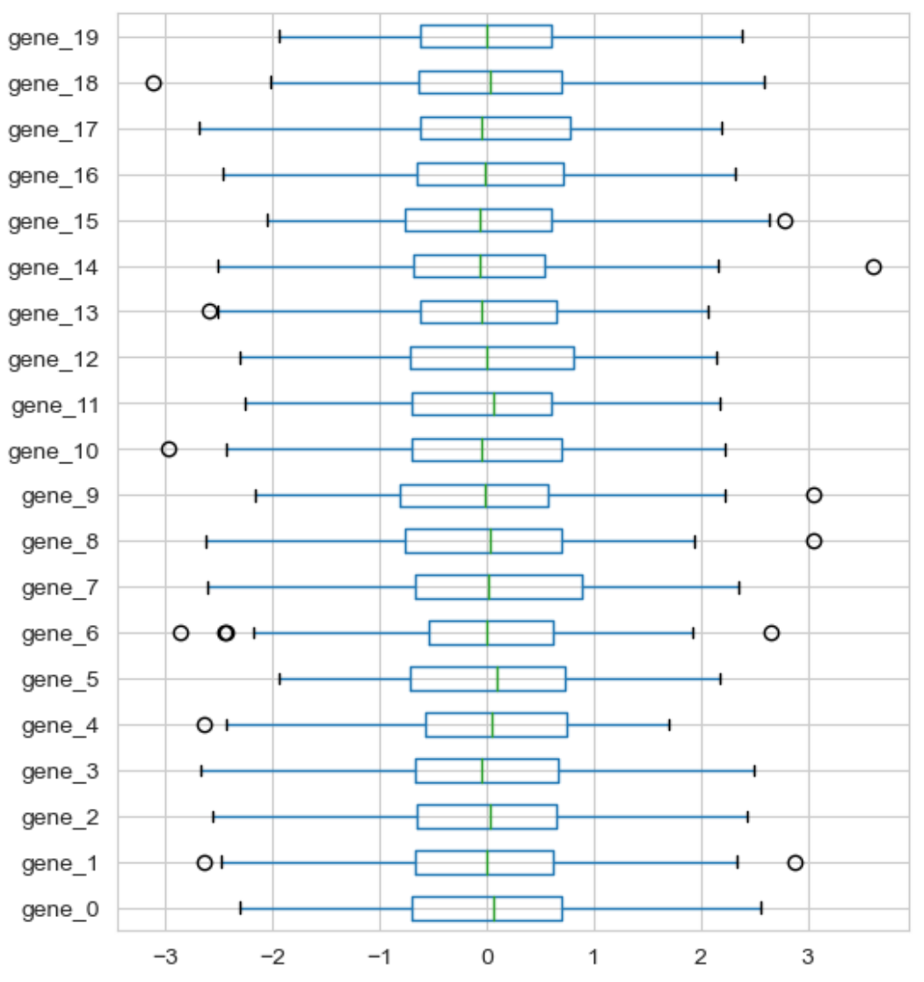
data normalization: standardization
Machine Learning Methods for Biomedical Data (D012554)

Slide 19
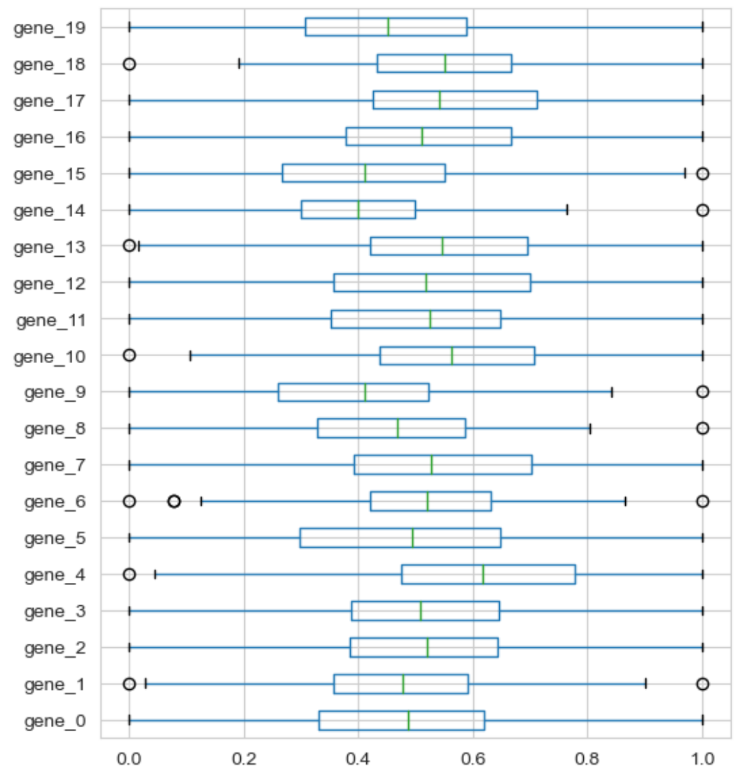
data normalization: min-max scaling
Machine Learning Methods for Biomedical Data (D012554)

