Slide 1

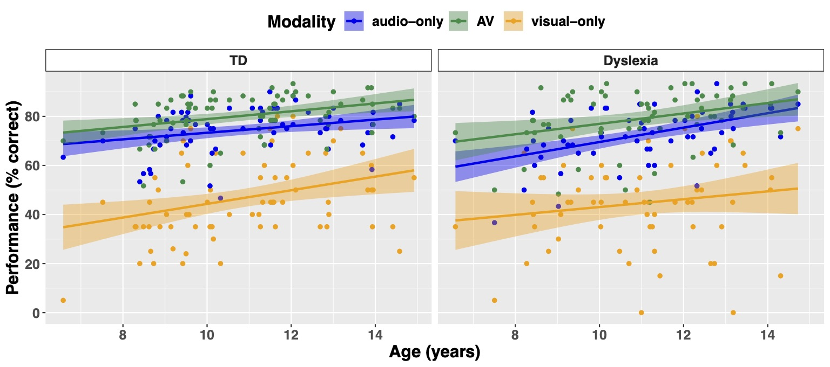




Control Group
Dyslexia Group
Modality
Auditory
AV
Visual
Auditory
AV
Visual
Control Group
Dyslexia Group
75
80
60
Performance (% correct)
Performance (% correct)
50
40
25
20
0
0
8
10
12
14
8
10
12
14
Age (years)
Notes:
For our dyslexic group we find exactly the same results, indicating that performance between the 2 groups was similar for all three modalities and developed similarly across age.

