Slide 1



Webinar | WP4 Webinar #4
Data Semantics, Formats and Quality
DG CNECT
Directorate-General
for Communications Networks, Content and Technology
DG GROW
Directorate-General
for Internal Market, Industry, Entrepreneurship and SMEs
DIGIT
Directorate-General
for Informatics

Slide 2
AGENDA
Welcome
Meeting objectives
Methodology
Selection of controlled vocabularies
Finalisation of data models
Creation of distributions and documentation publication
Quality aspects
Introduction to the second round of evidences
Timeline
Closing

Slide 3
1. Welcome
Speaker: Seth van Hooland

Slide 4
2. Meeting objectives
Speaker: Seth van Hooland

Slide 5
Meeting objectives
Present the draft methodology
Present the final data models for the five evidences together with the resolutions of GitHub issues
Initiate the two-week review period
Introduce the next round of evidences

Slide 6



Approach and scope | Reminder
Starting Point
Preliminary study and conclusions
Twofold objective
Scope
25 procedures in Article 14, including Directives 2005/36/EC, 2006/123/EC, 2014/24/EU and 2014/25/EU
Study on Data Mapping for the cross border application of the Once-Only technical system SDG
List of 10 most relevant types of evidence
Semantic mapping & proposed common data models
For a selected set of evidence, the WP develops a set of common data models following an incremental or phased approach
WP develops and tests a methodology for defining further common data models, formats and quality
Common data model per evidence as well as data minimisation approaches
Issues with requirements and technical implementation are discussed and coordinated with WP2 (context) and WP7 (evidence broker)

Slide 7













Touch base on the work done
July
September
Birth certificate
10 threads
24 comments
Marriage certificate
10 threads
Threads
Comments*
39 comments
Thanks to all contributors
50
143
Certificate of completion of secondary education
6 threads
17 comments
Income tax certificate
10 threads
27 comments
Vehicle registration certificate
14 threads
36 comments
* Comments until the 26/08 were intregrated in the presentation

Slide 8
3. Methodology
Speaker: Makx Dekkers

Slide 9
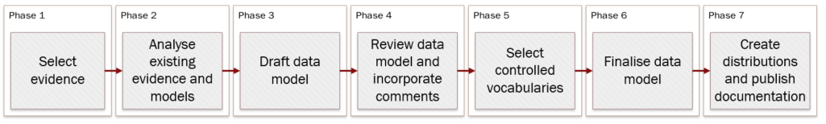
Methodology | High-level
Second round
First round
First draft of the methodology to be shared on the 14/09
https://github.com/SEMICeu/SDG-sandbox/tree/master/process_and_method

Slide 10
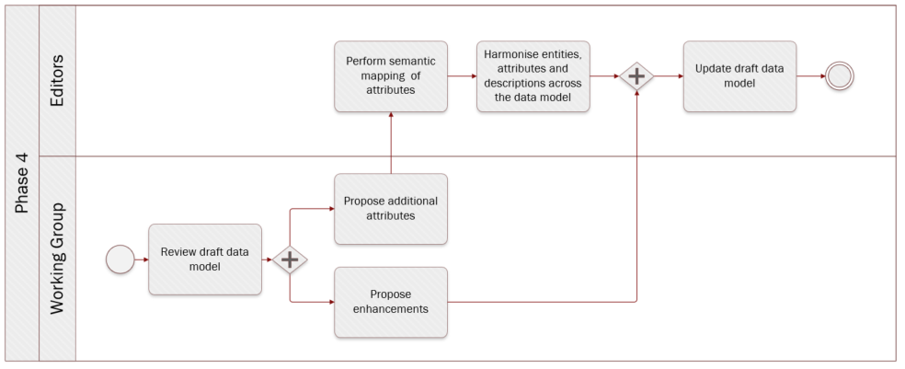
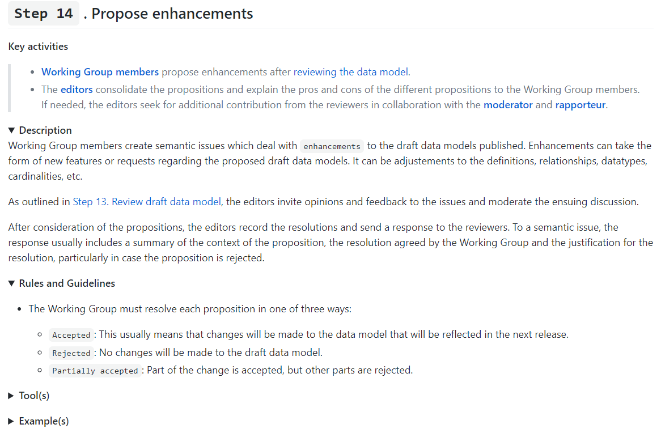
Methodology | Detailed
Phase 4
Step 14

Slide 11
Selection of controlled vocabularies
Speaker: Makx Dekkers

Slide 12
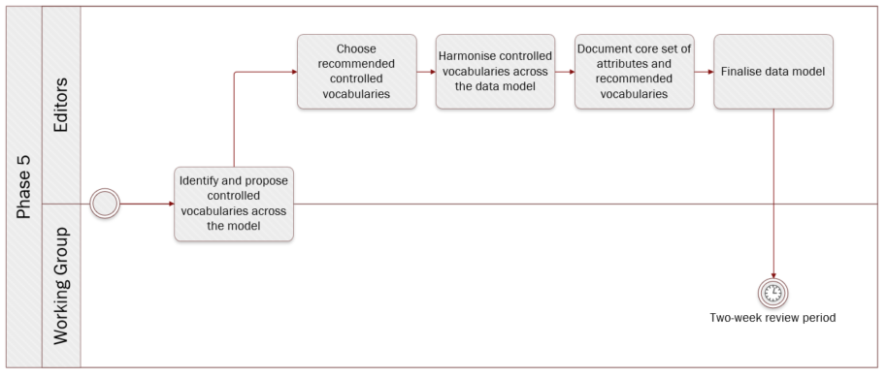
Methodology| Select controlled vocabularies / code lists
Select evidence
Analyse existing evidence and models
Draft data model
Review data model and incorporate comments
Select controlled vocabularies / code lists
Final data model
Create distributions and publish documentation
Controlled vocabularies identifiedtry
EU Vocabulary: Country
EU Vocabulary: Marital status
EU Vocabulary: Human sex
EU Vocabulary: Currency
Fuel type [TBD]
7/09 – 20/09

Slide 13
Finalisation of first five data models
Speaker: Makx Dekkers

Slide 14
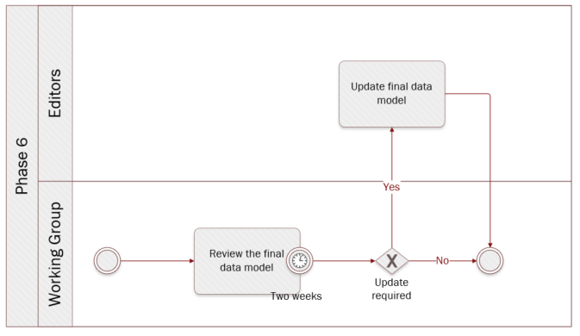
Methodology| Final data model
Select evidence
Analyse existing evidence and models
Draft data model
Review data model and incorporate comments
Select controlled vocabularies / code lists
Final data model
Create distributions and publish documentation

Slide 15
Main issues
Input parameters/data matching: this to be discussed with WP6 which is responsible for user matching
Strike balance between ‘traditional’ certificate approach and ‘modern’ data approach
Use existing consensus (eIDAS, eJustice Public Documents, EUCARIS) as basis for modelling
Consensus to be based on explicit support from at least three member states for proposal to be adopted
Proposal
Proposed resolution is included in the draft model
Issues for which at least three member states need to agree for the resolution to be implemented [not in the draft model]
Input
Won’t fix
Proposed resolution won’t be implemented

Slide 16
Issues & resolutions| Cross-cutting comments & observations
Type | Issue | Link | Status | Comment
Scope | Issuing attributes of an evidence should be present independently of the evidence |  | Proposal | Already present in the evidence entity of CCCEV (i.e. evidence entity modelled as DCAT)
Entity | Integrate "registration data" to Birth Certificate and Marriage Certificate as optional (i.e. register record) | #38 | Input | Include registrationData entity as optional
Attribute | Type of identification number for the Person entity | #37 #38 | Proposal | UN/CEFACT Identifier (i.e. amds:identifier), which is composed of 1 mandatory field and 3 optional ones
Attribute | Multiple given names and family names | #38 #42 #63 | Proposal | Use the Core Person approach; a field can contain multiple strings
Attribute | The Public Organisation model might not entirely reflect all the rules described in the definition of the preferred label attribute | #36 | Proposal | Change the datatype of preferred label from string to text, as explained here. [To be applied to all evidences]
Attribute Cardinality | citizenship is not present in national records | #35 #37 | Proposal | Make citizenship optional e.g. [0;1]
Controlled Vocabularies | authority table: country should be used for citizenship | #35 | Input | Use the country authority table
Editorial comment | Proposition to use the word ‘Evidence’ instead of ‘Certificate’ | #37 | Proposal | Change “certificate” to “edivence” to designate the models as well as the entities.
Expected type | Multilinguality; cyrillic addresses | #6 | Proposal | Note on multilinguality, see here
All evidences

Slide 17
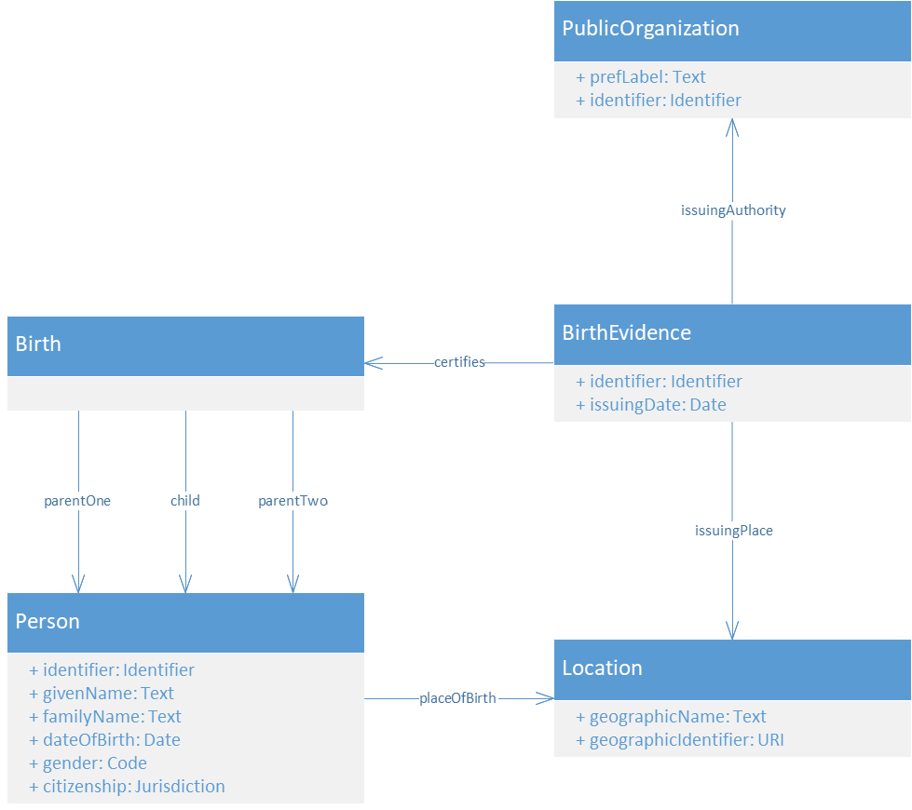
Final model| Birth certificate
Change log
Location; Address removed, two attributes changed
Birth.parentTwo; optional
Person.givenName; text
Person.familyName; text
Person.gender; optional
Person.citizenship; optional
Person.placeOfBirth; optional
BirthEvidence.issuingPlace; optional
PublicOrganisation.prefLabel; text
BirthEvidence; naming
Controlled vocabularies
gender → Human sex [EU Voc]

Slide 18
Issues & resolutions| Birth certificate
Type | Issue | Link | Status | Comment
Modelling | Remove the Birth entity (i.e. notion of birth) and have a direct relationship from the Birth Certificate to the Person (with birth information as attributes of the Person) | #37 #50 | Won’t fix
Entity | Address is not included in the evidences and suggestion to add municipality/city and country as elements of the Location entity | #62 #79 | Proposal | Remove the Address entity and add geographicName and geographicIdentifier attributes to the Location entity
Entity | Concept of Birth is not clear | #50 | Proposal | New definition: the event indicating the moment a person emerges from the body of another person (start of life).
Attribute | Addition of the clerk information, stamp and seal | #79 | Input | Waiting for further input
Attribute | Addition of the grandparents of the person born | #79 | Input | Waiting for further input
Attribute | In addition to issuingAuthority, inclusion of the registring authority | #79 | Input | Waiting for further input
Attribute cardinality | Cardinality of parentTwo should be relaxed | #31 | Proposal | Make parentTwo optional e.g. [0;1]
Attribute cardinality | The placeOfBirth for parents might be unknown | #75 | Proposal | Make placeOfBirth optional e.g. [0;1]
Attribute cardinality | IssuingPlace should be optional as not present in the national register | #75 | Proposal | Make IssuingPlace optional e.g. [0;1]
Controlled Vocabulary | What controlled vocabulary, agreed at EU level, is to be used for the gender attribute | #20 | Proposal | Use the Human Sex controlled vocabulary for the gender attribute and make it optional e.g. [0;1]
Data | Does adoption modifies / adds to the Birth Certificate retroactively (e.g. Parents, givenName, familyName) | #31 | Won’t fix | Beyond scope
Information | EU Data models & Controlled vocabularies to be used | #46 | Proposal | N/A
Birth certificate

Slide 19
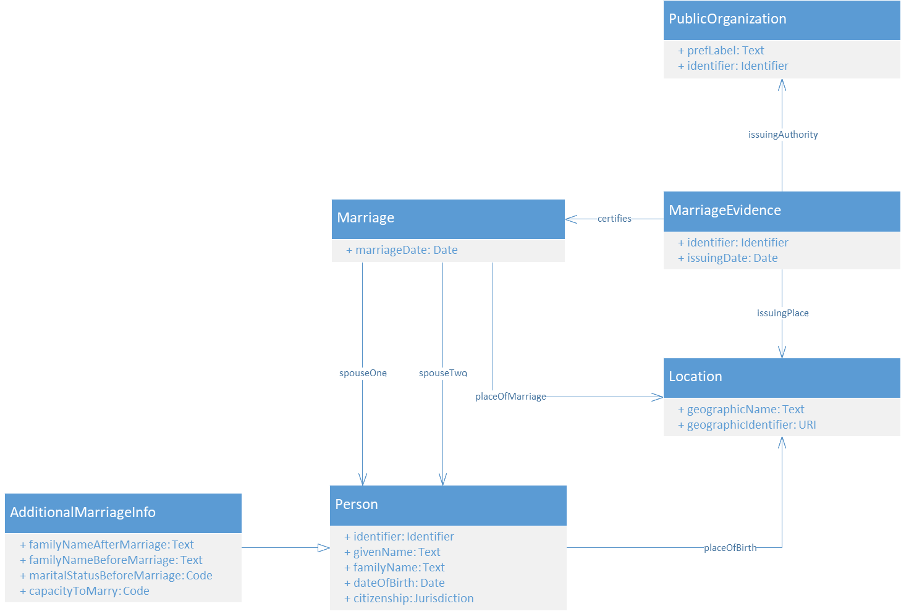
Final model| Marriage certificate
Change log
AdditionalMarriageInfo; addition
AdditionalMarriageInfo .familyNameBeforeMarriage; optional
AdditionalMarriageInfo .familyNameAfterMarriage; optional
AdditionalMarriageInfo .maritalStatusBeforeMarriage; optional
AdditionalMarriageInfo .capacityToMarry; optional
MarriageEvidence.issuingPlace; optional
Marriage.placeOfMarriage; optional
PublicOrganisation.prefLabel; text
Person.givenName; text
Person.familyName; text
Location; Address removed, two attributes changed
MarriageEvidence; naming
Controlled vocabularies
maritalStatusBeforeMarriage → Marital status [EU Voc]

Slide 20
Issues & resolutions| Marriage certificate
Type | Issue | Link | Status | Comment
Modelling | In some countries, the spouses can choose whether to keep their family names and in some others the family names are not altered. | #61 | Proposal | Make familyNameBeforeMarriage and familyNameAfterMarriage optional e.g. [0;1] and have an AdditionalMarriageInfo entity
Entity | Address is not included in the evidences and suggestion to add municipality/city and country as elements of the Location entity | #53 #80 | Proposal | Remove the Address entity and add geographicName and geographicIdentifier attributes to the Location entity and make Location optional e.g. [0;1]
Attribute | capacityToMarry is not in the national records. | #41 | Proposal | Make the capacityToMarry attribute optional e.g. [0;1]
Attributre | Information about the clerk (name and fonction), type of marriage (e.g. civil, religious), marriage regiment (e.g. rrenuptional agreement) | #80 | Input | Waiting for further input
Attribute Cardinality | Addition of marriageWitnesses as optional | #19 | Input | Waiting for further input
Attribute Cardinality | maritalStatusBeforeMarriage should be optional | #23 | Proposal | Make the maritalStatusBeforeMarriage attribute optional e.g. [0;1]
Attribute cardinality | issuingPlace and placeOfMarriage attributes should be optional as not present in the national register | #76 | Proposal | Make issuingPlace and placeOfMarriage optional e.g. [0;1]
Information | EU Data models & Controlled vocabularies to be used | #47 | Proposal | N/A
Marriage certificate

Slide 21
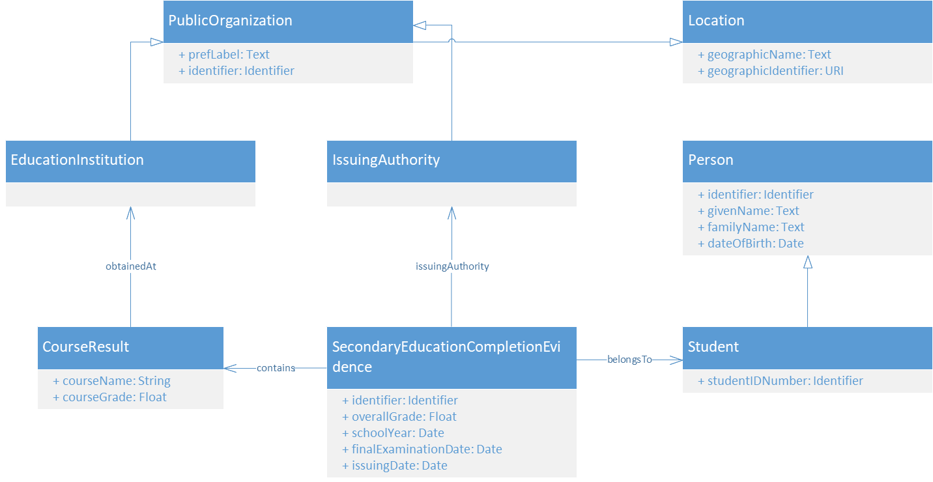
Final model| Certificate of completion of secondary education
Change log
CourseResult; optional
SecondaryEducationCompletionEvidence.schoolYear; addition optional
SecondaryEducationCompletionEvidence.finalExaminationDate; addition optional
SecondaryEducationCompletionEvidence.issuingDate; addition optional
PublicOrganisation.prefLabel; text
Person.givenName; text
Person.familyName; text
Location; Address removed, two attributes changed
SecondaryEducationCompletionEvidence; naming
Controlled vocabularies

Slide 22
Issues & resolutions| Certificate of completion of secondary education
Type | Issue | Link | Status | Comment
Modelling | Why have Organisation sub-entities? Transform the classes EducationalInsitution and IssuingAuthority into relationships to align on other data models | #56 | Won’t fix
Modelling | Refer the Educational Institution in the certificate entity | #56 | Input | Waiting for futher input
Modelling | Unclear how to model the CourseResults entity | #56 | Proposal | Make CourseResults optional e.g. [0;1]
Attribute | courseName is identified nationaly by other attributes | #42 | Input | Waiting for further input
Attribute | Education Insitution is identified by a code and the province where located | #42 | Proposal | Make a relation between Organization and Location optional and add geographicName and geographicIdentifier attributes to the Location
Attribute | placeOfBirth is not included in some national certificates | #77 | Proposal | Remove placeOfBirth attribute
Attribute | Important dates are missing; Issuing date, date on which the final examination took place, the school year, the date of delivery of the certification | #54 #55 #56 | Proposal | Proposal the following dates as optional
Attribute Cardinality | Cardinality of courseGrade should be relaxed | #42 | Proposal | Make courseGrade optional e.g. [0;1]
Expected type | overallGrade as a float is problematic | #54 | Proposal | CEN standard
Information | EU Data models & Controlled vocabularies to be used | #44 | Proposal | N/A
Information | Type of secondary education; level 2 or level 3 | #56 | Clarification | The model corresponds to level 3
Certificate of completion of secondary education

Slide 23
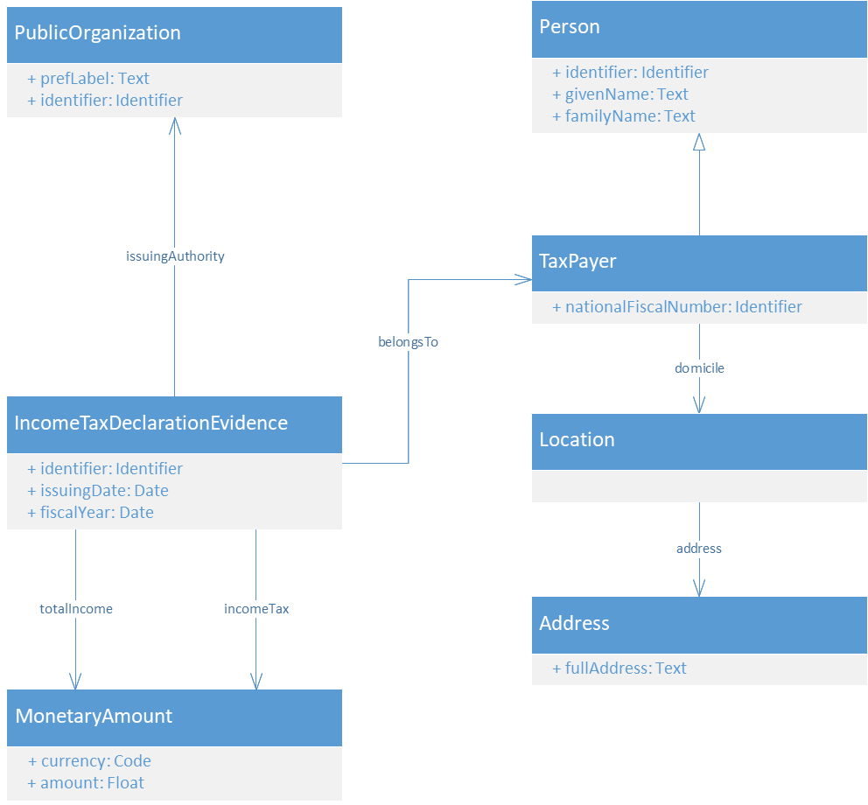
Final model| Income tax certificate
Change log
PublicOrganisation.prefLabel; text
Person.givenName; text
Person.familyName; text
Location; optional
Address; optional
Address.fullAddress; new and optional
IncomeTaxDeclarationEvidence.totalIncome; mandatory
IncomeTaxDeclarationEvidence.incomeTax; optional
IncomeTaxDeclarationEvidence; naming
Controlled vocabularies
currency → Currency [EU Voc]

Slide 24
Issues & resolutions| Income tax certificate
Type | Issue | Link | Status
Modelling | Modelise the member state, with definition; Member State where the Income Tax Declaration was made | #70 | Won’t fix
Modelling | In general the fiscal number or tax code is an attribute of a person so it could be useful to consider this property directly applied to a person with no need to indicate a Tax Payer role Insertion of the TIN number? | #58 #69 | Proposal | UN/CEFACT Identifier (i.e. amds:identifier), which is composed of 1 mandatory field and 3 optional ones
Entity | The Address of tax payer is not provided in national data models | #39 #58 | Proposal | We propose to use the fullAddress attribute and make the Address entity optional. The attribute expected type is text with address information mandatory. Such a field is available in Core Location. Additionally, we will make Location optional.
Attribute | Clarify that the incomeTax attribute can be negative | #21 | Proposal | Float can contain negative value, clarify the definition
Attribute | paymentDate should be called fiscalYear for clarity reasons | #39 #58 #67 #70 | Proposal | Rename and propose the following definition; Reference year for which the tax is due
Attribute | The tax authority then issues (upon request) a Proof of tax clearance | #67 | Input | Waiting for further input
Attribute | No information on the household and if the person is married what the tax regiment is (e.g. separate or not) | #78 | Input | Waiting for further input
Attribute | Is a clarification on the type of income needed and on the tax returned (e.g. return, billing note, etc.) needed? | #78 | Input | Waiting for further input
Attribute cardinality | It would make more sense to have incomeTax attribute optional and totalIncome attribute mandatory. | #39 #68 #78 | Proposal | Make incomeTax optional e.g. [0;1] Make totalIncome mandatory e.g. [1;1]
Information | EU Data models & Controlled vocabularies to be used | #48 | Proposal | N/A
Income tax certificate

Slide 25
Issues & resolutions| Income tax certificate
Type | Issue | Link | Status | Resolution
Definition | Change definitions of; paymentDate: the date on which the Income Tax amount due for was paid issuingAuthority: the National Competent Authority which is in charge of A Public Organisation with official authority in charge of issuing the Income Tax Declaration totalIncome: the total amount of taxable income of the Taxpayer in the respective year incomeTax: the total amount of tax due on the income in the respective year | #70 | Proposal | Change definitions
Income tax certificate

Slide 26
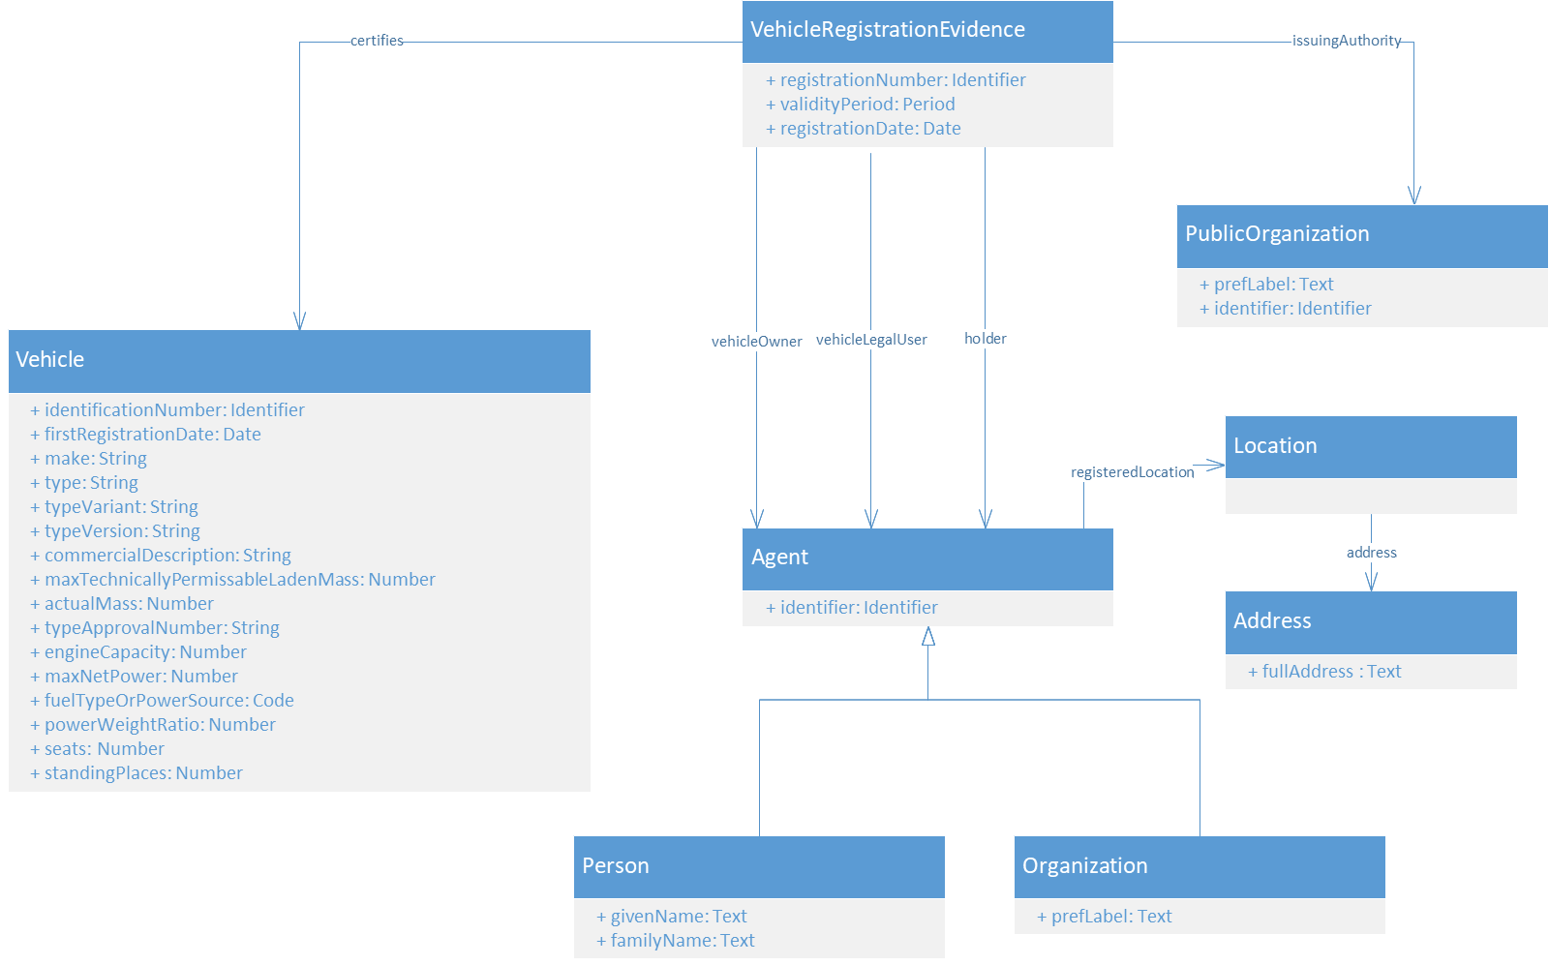
Final model| Vehicle registration certificate
Change log
Person.givenName; text
Person.familyName; text
Location; optional
Address; optional
Address.fullAddress; new and optional
Vehicle.powerToRatio; optional
Vehicle.engineCapacity;optional
VehicleRegistrationEvidence.vehicleLegalUser; naming
Controlled vocabularies
Fuel Type (in progress)

Slide 27
Issues & resolutions| Vehicle registration certificate
Type | Issue | Link | Status | Comment
Modelling | Some MS provide information on persons related to the vehicle but the owner who has requested the evidence Following our analysis of the issue #45, the owner is a relation (attribute) of the Vehicle not the Vehicle Registration certificate. | #45 #74 | Won’t fix
Modelling | The address may be attached directly to an agent | #57 | Won’t fix
Entity | Following a comparison between a national XSD and the data model proposed some elements are proposed for addition. | #15 #73 | Input | Addition of; Entity(es)/attribute(s) related to the mileage and odometer history Attribute(s) related to the colour and category Attribute(s) related to Start and end data for both the vehicle holder and owner Attribute(s) related to First, start and end date for the Registration.
Entity | Do we need the Address in the Vehicle Registration evidence? | #17 #45 | Proposal | We propose to use the fullAddress attribute and make the Address entity optional. The attribute expected type is text with address information mandatory. Such a field is available in Core Location. Additionally, we will make Location optional.
Vehicle registration certificate

Slide 28
Issues & resolutions| Vehicle registration certificate
Type | Issue | Link | Status | Comment
Attribute | In the Vehicle Registration evidence in the current design there is no place to indicate what the status of the registration is | #16 | Input | Addition of the attribute status with definition; “The status of a vehicle or vehicle registration related circumstance or qualification, that normally emerged after registration of the vehicle. A signal/status may be temporary or definite”. and list from EUCARIS VAT XSD
Attribute | Addition of the emission or environmental class attributes | #26 | Input | Create the environemental class attribute and make it optional e.g. [0;1] [Controlled List // code list?]
Attribute | Some data regarding people is missing and should be included: date of birth, place of birth, fiscal number | #57 | Input | Dates to be added as optional e.g. [0;1] UN/CEFACT Identifier (i.e. amds:identifier), which is composed of 1 mandatory field and 3 optional ones
Attribute | What is meant with “legal user”? Is that what we call “Usufruttuary” or “legal representative of the lender? And why it is not “vehicle legal user” (as it is in the “vehicle owner” property)? | #57 | Proposal | Proposition to call this attribute “vehicle legal user” to be in line with “vehicle owner”.
Attribute Cardinality | As mentioned by the Council Directive 1999/37/EC in Annex 1 - Part I - V. - (Q), the power/weight ratio is only mandatory for motorcycles. | #24 | Proposal | Make powerToRatio attribute optional e.g. [0;1]
Attribute Cardinality | Engine capacity for non-ICE vehicles | #25 | Proposal | Make engineCapacity attribute optional e.g. [0;1]
Attribute cardinality | If all the vehicle properties are mandatory, in the case they are not applicable, which valorisation of those properties should we include? Shall we put 0 or a blank string? | #57 | Input | Which one cannot be provided?
Vehicle registration certificate

Slide 29
Issues & resolutions| Vehicle registration certificate
Type | Issue | Link | Status | Comment
Controlled vocabulary | Propose a controlled list of fuel types | #27 | Input | No existing controlled vocabulary
Definition | Some of these attributes have specific measurement units. Measurement units are not considered at all | #57 | Input | Put the unit as part of the attribute name
Information | EU Data models & Controlled vocabularies to be used | #28 | Fixed | N/A
Vehicle registration certificate

Slide 30


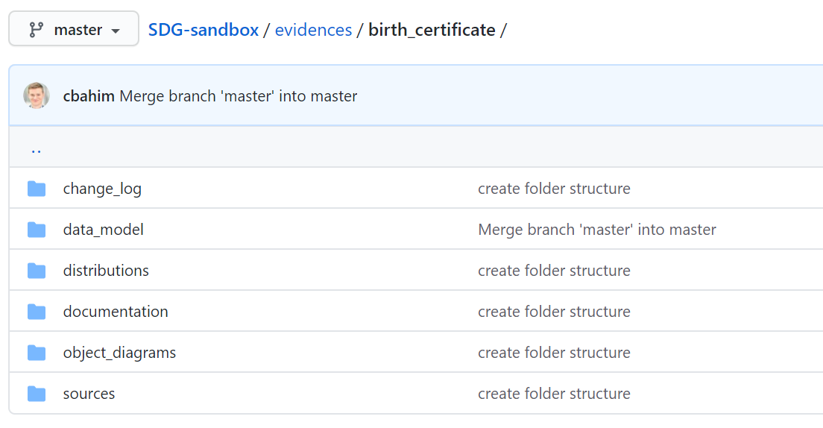
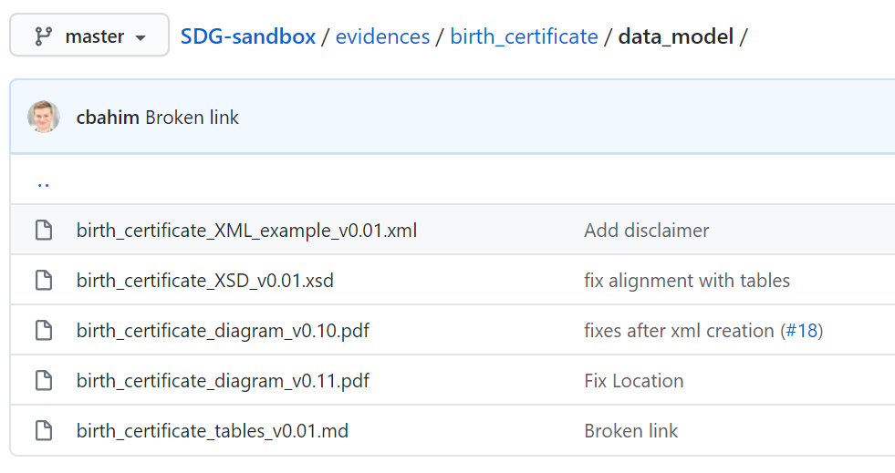
Review period
Webinar #4
Start review period
End review period
02/09
07/09
20/09
final tables
draft methodology
04/09
14/09
QUESTIONS TO BEAR IN MIND
Do I agree with the proposed controlled vocabularies (code lists)?
Do I agree with the proposed changes to the data models?
Are the entities and attributes definitions clear enough?
Does the modelling approach make sense?
Do I agree with the proposed cardinalities (i.e. mandatory versus optional)?
With data minimisation in mind, should some of the entities and or attributes stripped off?
Will my country be able to provide all the mandatory information?

Slide 31
Creation of distributions and publication of documentation
Speaker: Makx Dekkers

Slide 32
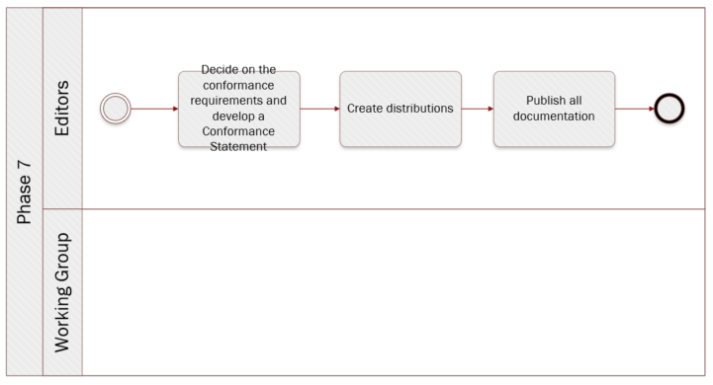
Methodology| Create distributions and publish documentation
Create distributions and publish documentation
Select evidence
Analyse existing evidence and models
Draft data model
Review data model and incorporate comments
Select controlled vocabularies / code lists
Final data model

Slide 33
Quality | Three dimensions
This is ensured by using the proposed methodology, which is based on the existing SEMIC methodology. In addition, we build as much as possible on existing resources, like the ISA² Core Vocabularies, the Public/eJustice documents, EUCARIS, EU Vocabularies of the Publications Office etc., taking into account the feedback and suggestions of the member states, building consensus and delivering detailed documentation.
Data models
[the actual evidences to be exchanged] in terms of correctness of the XML data with respect to the data models: this can be supported by tools like the Interoperability testbed and can be included as a post-development step after phase 7 (finalisation) of the methodology.
Instance data
This ensured by the requirement that all data comes from authoritative sources. Member states are responsible to identify and connect the authorities to the system.
Source of data

Slide 34
Second round of evidences
Speaker: Seth van Hooland

Slide 35
Next round of evidences
Proposed types of evidence
Extract of criminal records
ECRIS domain model
Public document regulation
Social security registration certificate
Regulations (EC) n° 883/2004 and 987/2009 on coordination of national social security systems
University diploma
University diploma supplement
Records of results from previous academic year
Bologna process
Europass framework (DG EAC)
European Student Card
To be uploaded on GitHub by the week of the 25th of September – Review period starting in October

Slide 36
Timeline
Speaker: Makx Dekkers

Slide 37

Timeline and milestones | Closing 1st and starting 2nd round
 |  | September |  |  |  | October |  |  |  | November |  |  |  | December
 | Owner | 7th | 14th | 21st | 28th | 5th | 12th | 19th | 26th | 2nd | 9th | 16th | 23rd | 30th | 7th | 14th | 21st | 28th
Meetings
Review of the final common data models | MS
Review of the (draft) methodology | MS & ED
Finalization of common data models | MS
Identification of domain experts | MS
Validation of the competent authorities | MS
Review propositions for common data models | MS
Collect and share metadata at national level | MS
Definition of a minimum set of attributes | ED
Definition of common data models | ED
Review of the final common data models | MS
Refinement of the (final) methodology | MS & ED
Finalization of the common data models | ED
Finalization of the methodology to develop data models | ED
Review & acceptance of OOP deliverables [Review cycle 1]
Review & acceptance of OOP deliverables [Review cycle 2]
First round
Second round

Slide 38
9. Closing
Speakers: Miguel Alvarez Rodriguez and Seth van Hooland

Slide 39
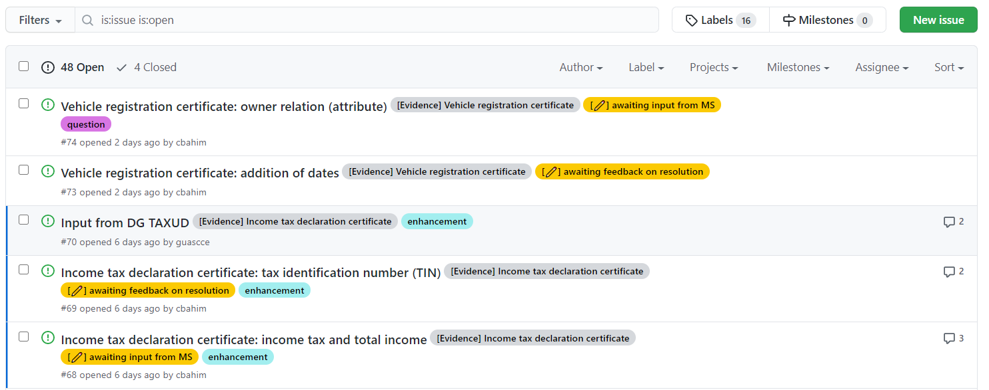
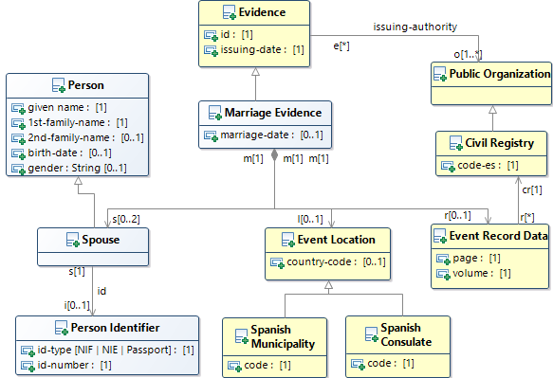
Action items and next steps
1
Review the final data models
2
Gather domain experts
Share on GitHub
3
Validate the competent authorities
4
Collect metadata & data models at national level
First round
Second round

Slide 40





ISA² programme
You click, we link!
Stay in touch
ec.europa.eu/isa2
@ EU_isa2
ISA² Programme
DIGIT-ISA2-COMM@ec.europa.eu
Run by the Interoperability Unit at DIGIT (European Commission) with 131€M budget, the ISA² programme provides public administrations, businesses and citizens with specifications and standards, software and services to reduce administrative burdens.

