Slide 1
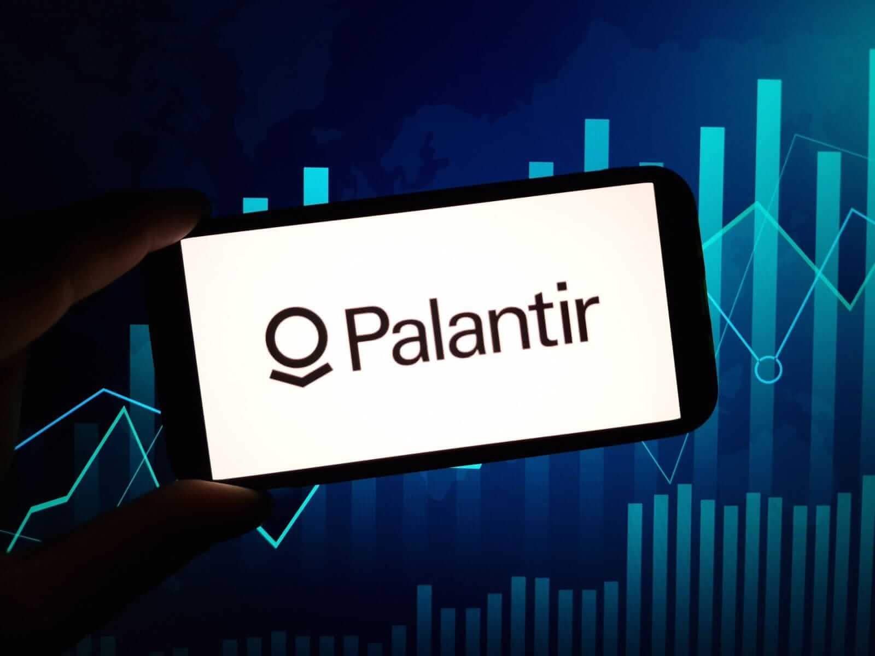
Palantir Technologies

Slide 2
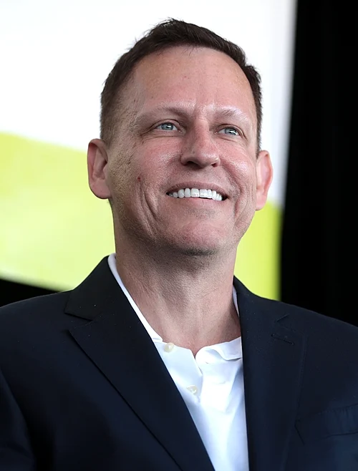
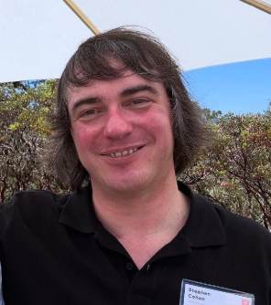
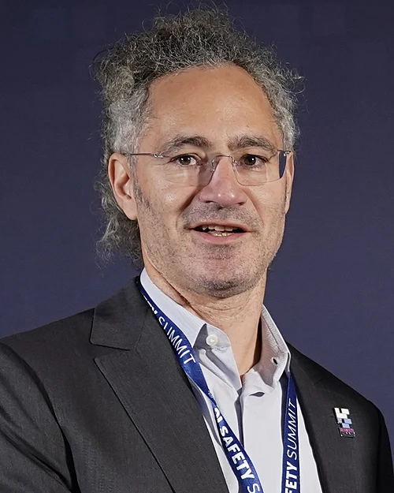
Palantir Tech. What’s it all about?
-Palantir Technologies Inc. is a publicly traded company
-Named after a crystal ball from Lord of the Rings (1954)
-Flagship product: Gotham and Foundry
-Devs data integration and analytic platforms
-Current HQ: Denver, CO
Peter Thiel
Founder / Chairman
Stephen Cohen
Founder / President
Alex Karp
Founder / CEO
Notes:
1. Founded 2003
3. analytics platforms enabling government agencies, militaries, and corporations to combine and analyze data from multiple sources.

Slide 3
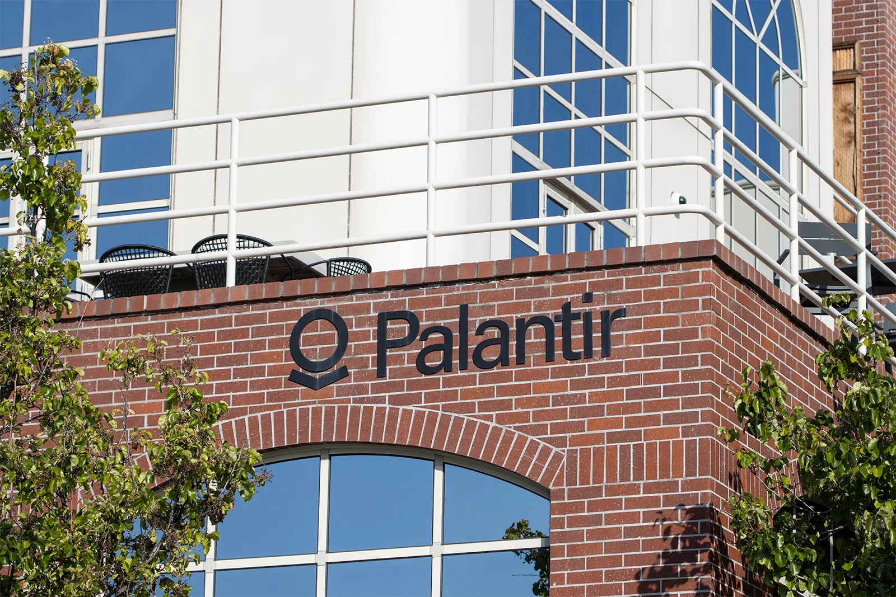

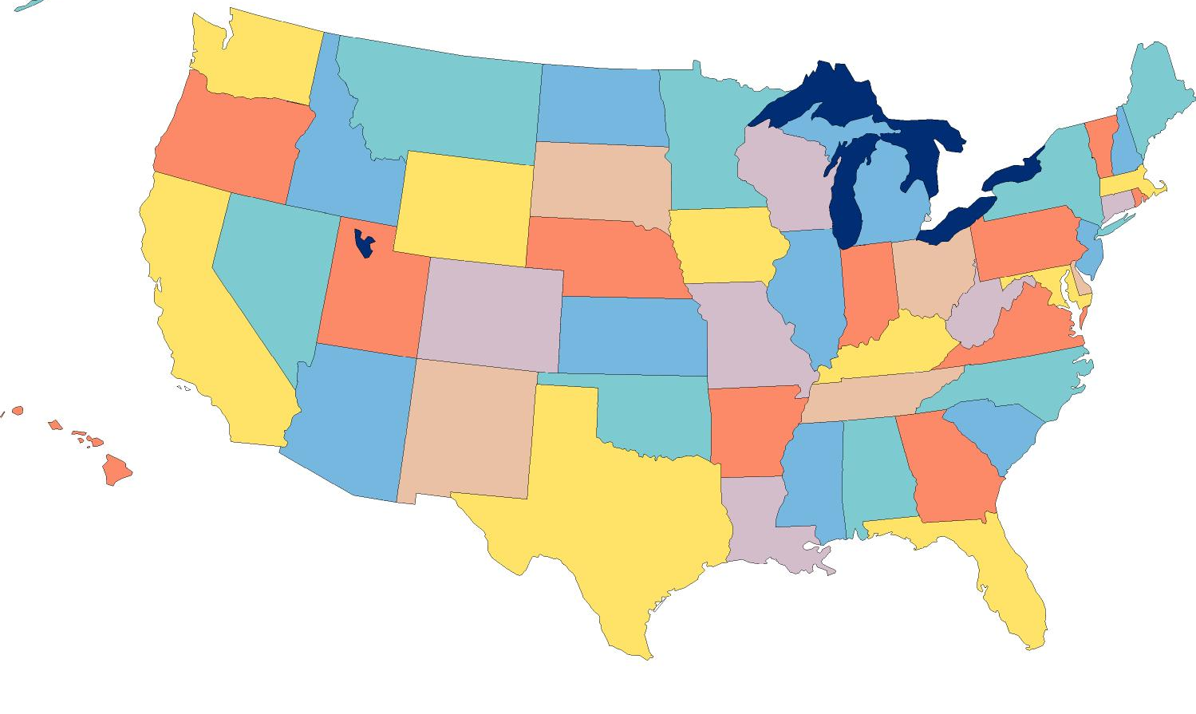
LOCATIONS??
Former HQ at Palo Alto (CA.) used as a office now
CURRENT HQ
DENVER, CO
Notes:
They mostly have offices in the US but also in Australia, Denmark, France, Canada

Slide 4
History & Development
Founded in 2003 by Peter Thiel, Alex Karp, Joe Lonsdale, Stephen Cohen, and Nathan Gettings.
Planned to use PayPal’s fraud detection software to fight terrorism.
Early backing by In-Q-Tel, which is the venture capital arm of the CIA.
Palantir Gotham was released in 2008.
Designed for defence and intelligence agencies.
Palantir Foundry was released in 2016.
Designed for commercial use.
Went public on the New York Stock Exchange (NYSE) in 2020, through a Direct Public Offering (DPO).

Slide 5

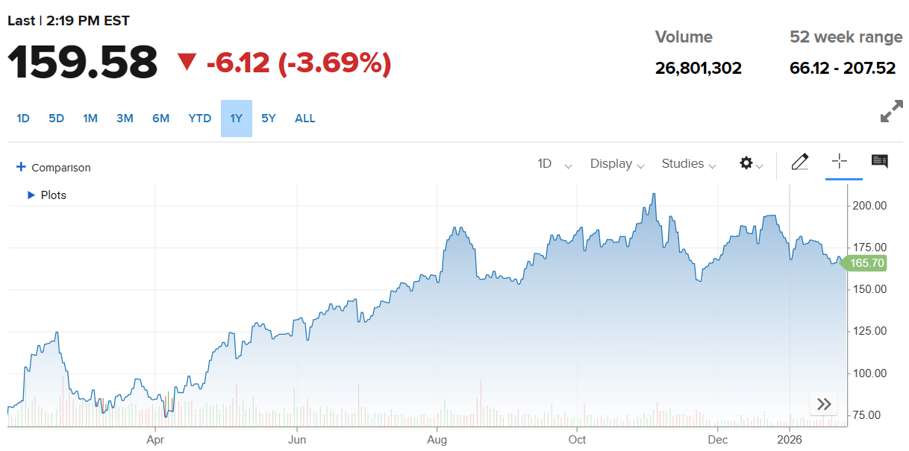
Finances
Quarterly revenue in Q3 of 2025: 1.18 bil $ (990 680 800€)
Revenue grew 63% year-over-year
Customer count grew 45% year-over-year
July 31, 2025, the U.S. Army awarded Palantir Technologies a 10-year Enterprise Service Agreement worth up to $10 billion
Notes:
Year-over-year (YoY) is a financial metric used to compare a company's or economy's performance against the same period in the previous year

Slide 6
Victories
In 2011, i2 Inc sued Palantir in Federal Court, alleging that we misappropriated their software through a shell company, registered to the family of one of our executives. Settled out-of-court for only $10 million.
In 2016, the U.S. Department of Labour filed a lawsuit against Palantir, alleging that we routinely discriminated against Asian job applicants during our hiring process. Settled for $1.7 million without admitting any wrongdoing.

Slide 7
Allies
Palantir has been working with the U.S. Immigrations and Customs Enforcement since 2014. Our software is critical for the agency’s deportation programs. At least 11 members of the current U.S. administration have investments in our stock.
In 2024 Palantir entered into a strategic partnership with the Israeli Defense Ministry to aid with the country’s war effort. We have provided them with AI and data analysis tools, that have enhanced their ability to strike combatants hiding out in civilian locations.

Slide 8
Products And Services
Palantir Gotham is a defense and intelligence software created for the United States Intelligence Community.
It is an AI-enabled operating system and data analytics platform primarily designed for government, defense and intelligence agencies which enables its users to identify hidden patterns, manage and secure data in real time
Palantir Foundry is a enterprise data management platform and operating system designed to integrate, analyze and secure large-scale disparate datasets for decision making
It is commonly used in supply chain management, manufacturing, healthcare and life sciences and finance.

Slide 9
Recruiting
Palantir is always looking for new open minded engineers from different fields of engineering.
Palantir offers jobs to wide range of engineers including American Tech Fellowship, Data Protection, Life Sciences,Utilities and many more that help make products for Palantir
Palantir also offers students and early talent an opportunity to work in week-long developments programs to fellowship opportunities.

