Slide 1
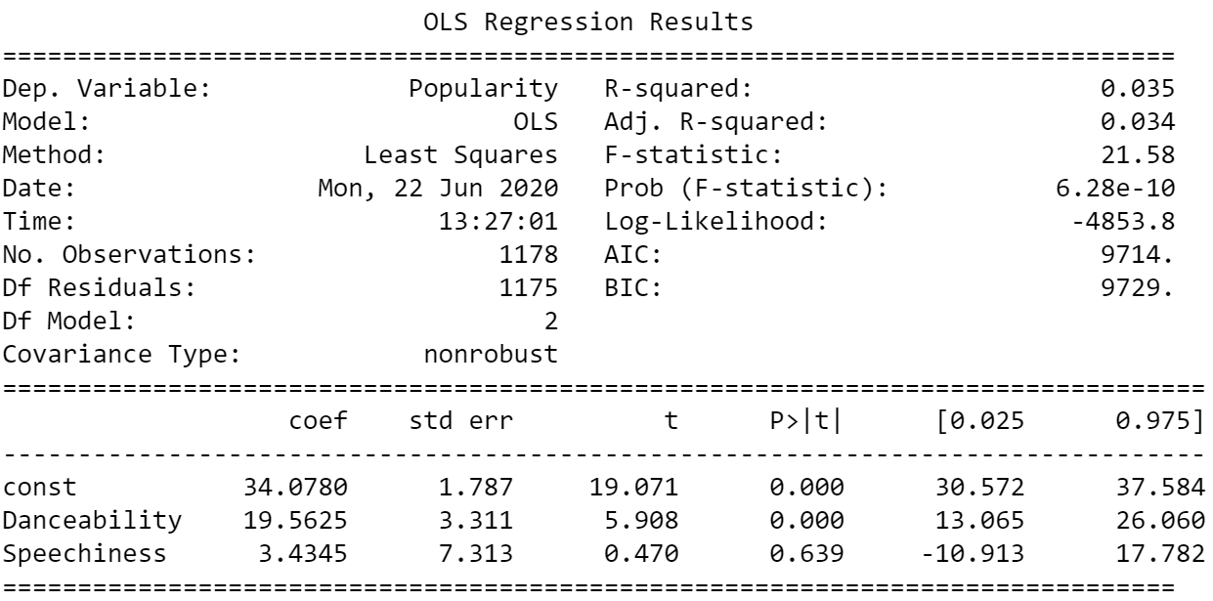
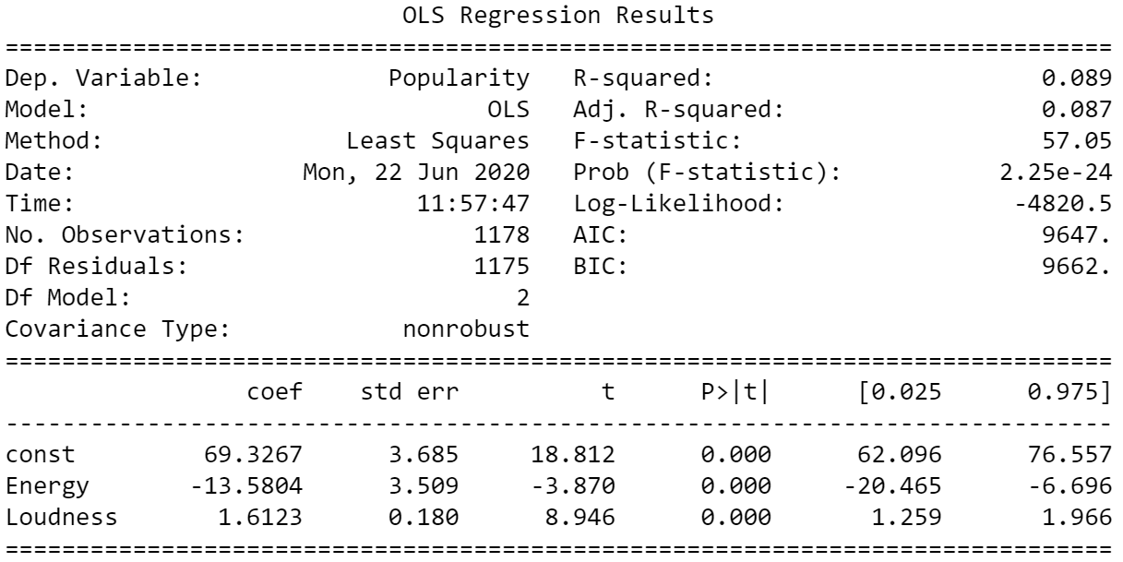
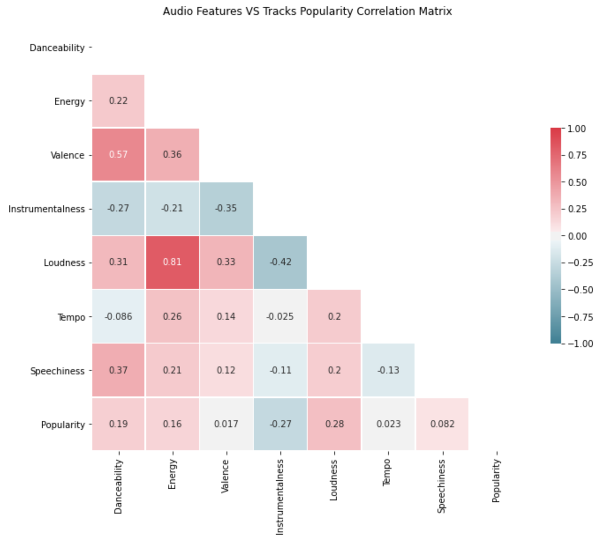
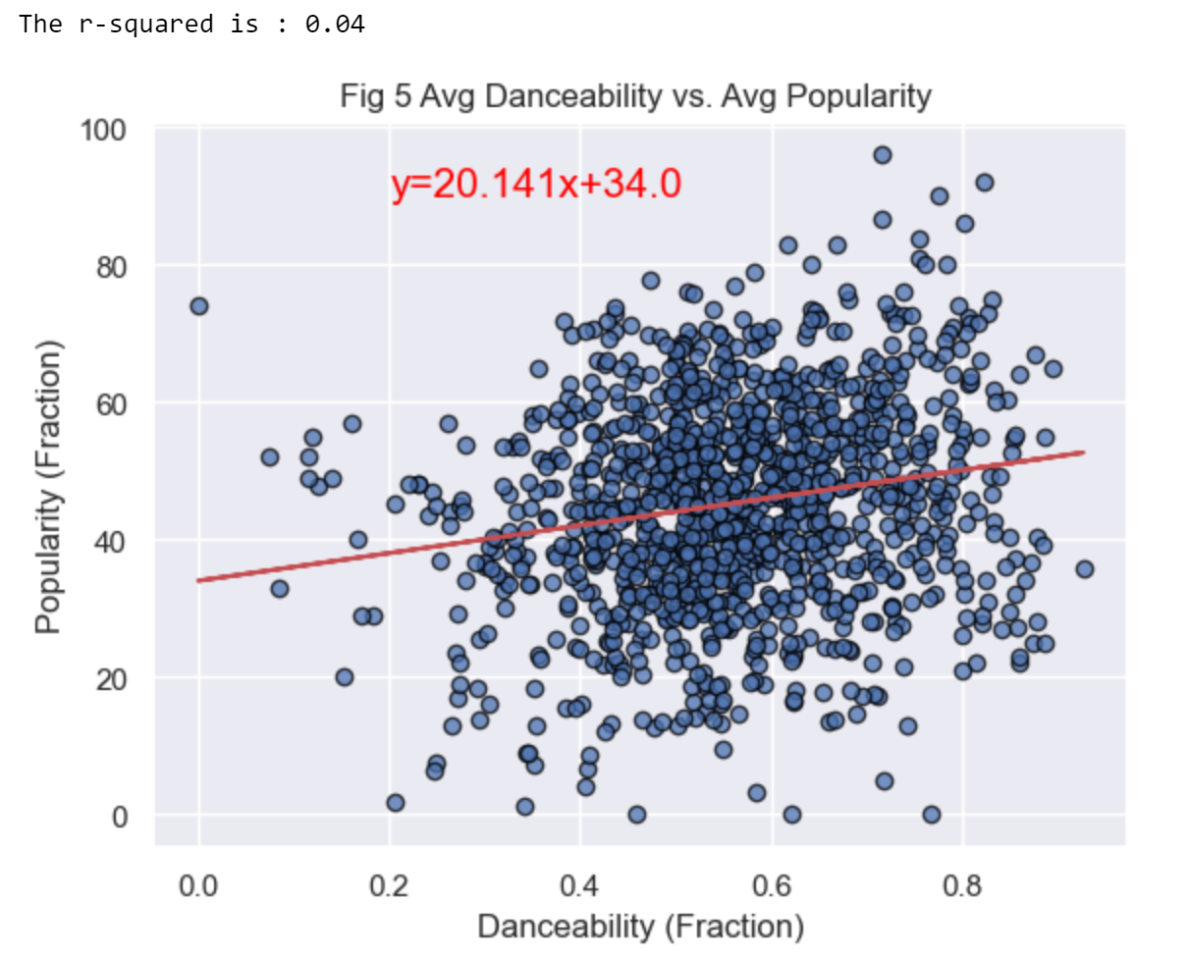
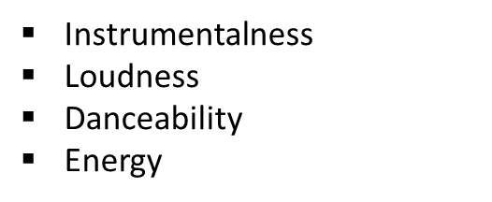

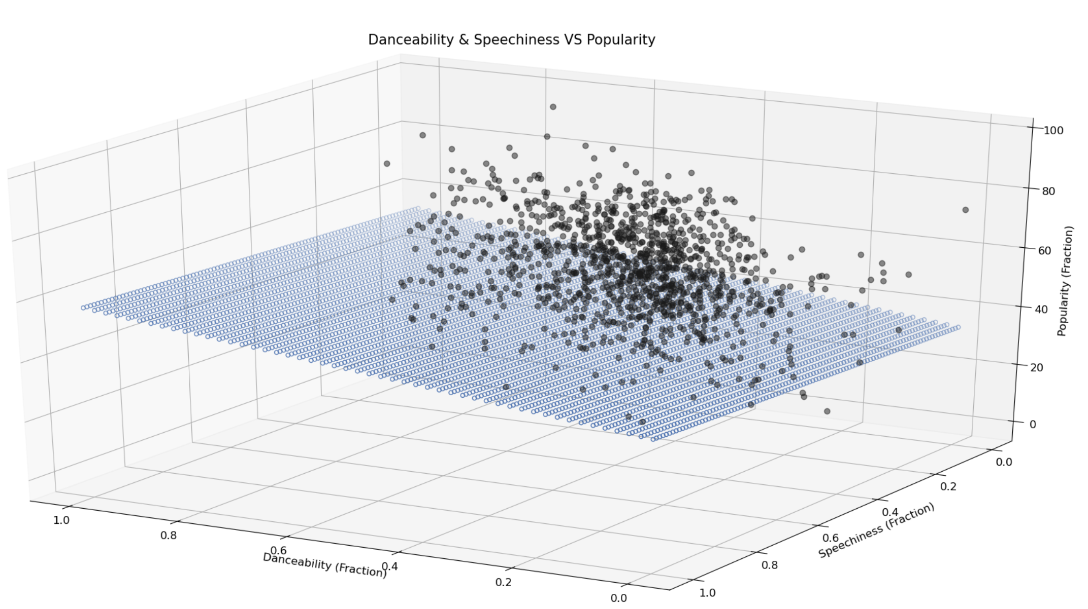
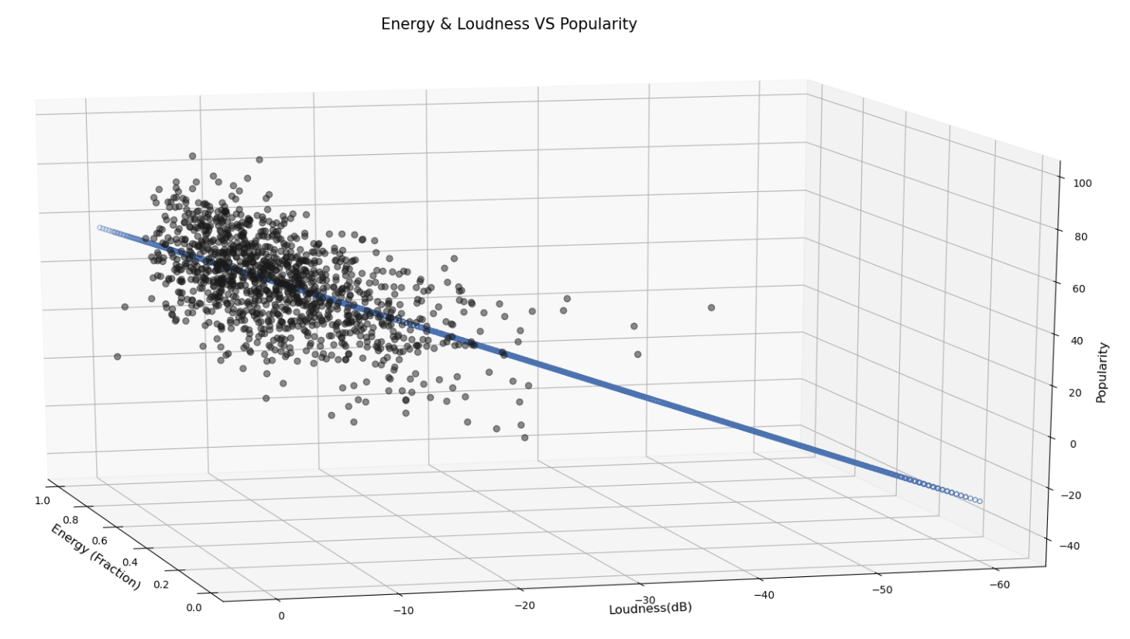
Data Analysis
Does Tracks Features (danceability, energy…) affect songs popularity? Any relationship?
Multiple Linear Regression
Source: An Introduction to Statistical Learning, James G., Witten D., Hastie., Tibshirani R.

Slide 2
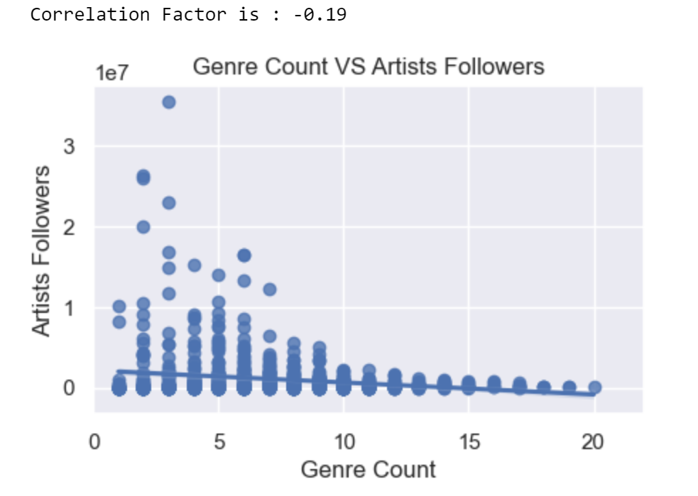
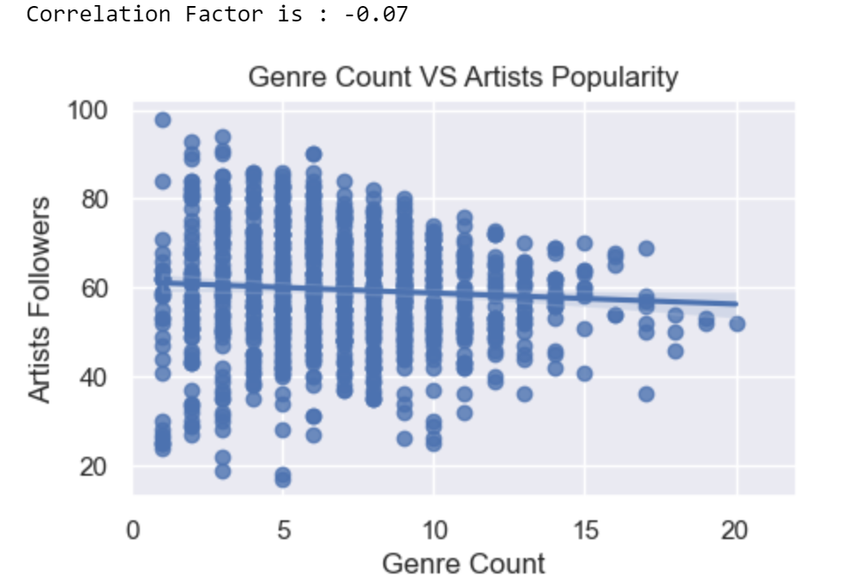
Data Analysis
The higher Genre Count per artist, the higher Artist Popularity and Artist Followers?

Slide 3
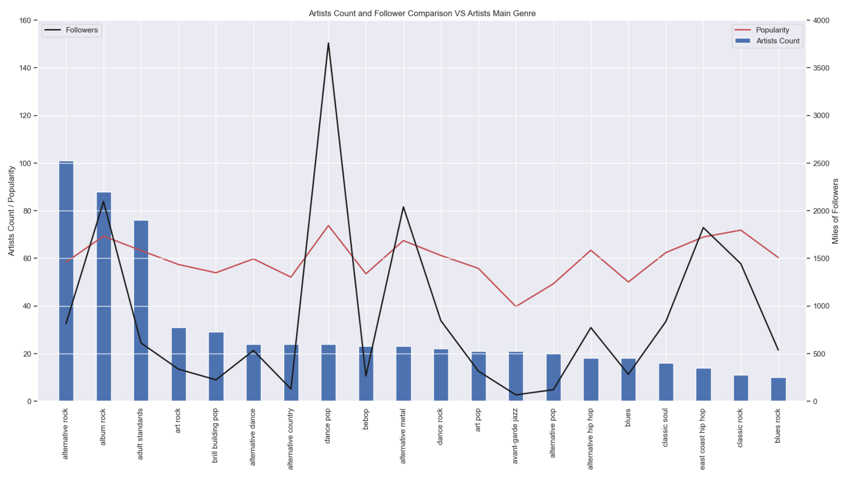
Data Analysis
Main Genre per Artist and the relationship with their Popularity and Followers

