Slide 1

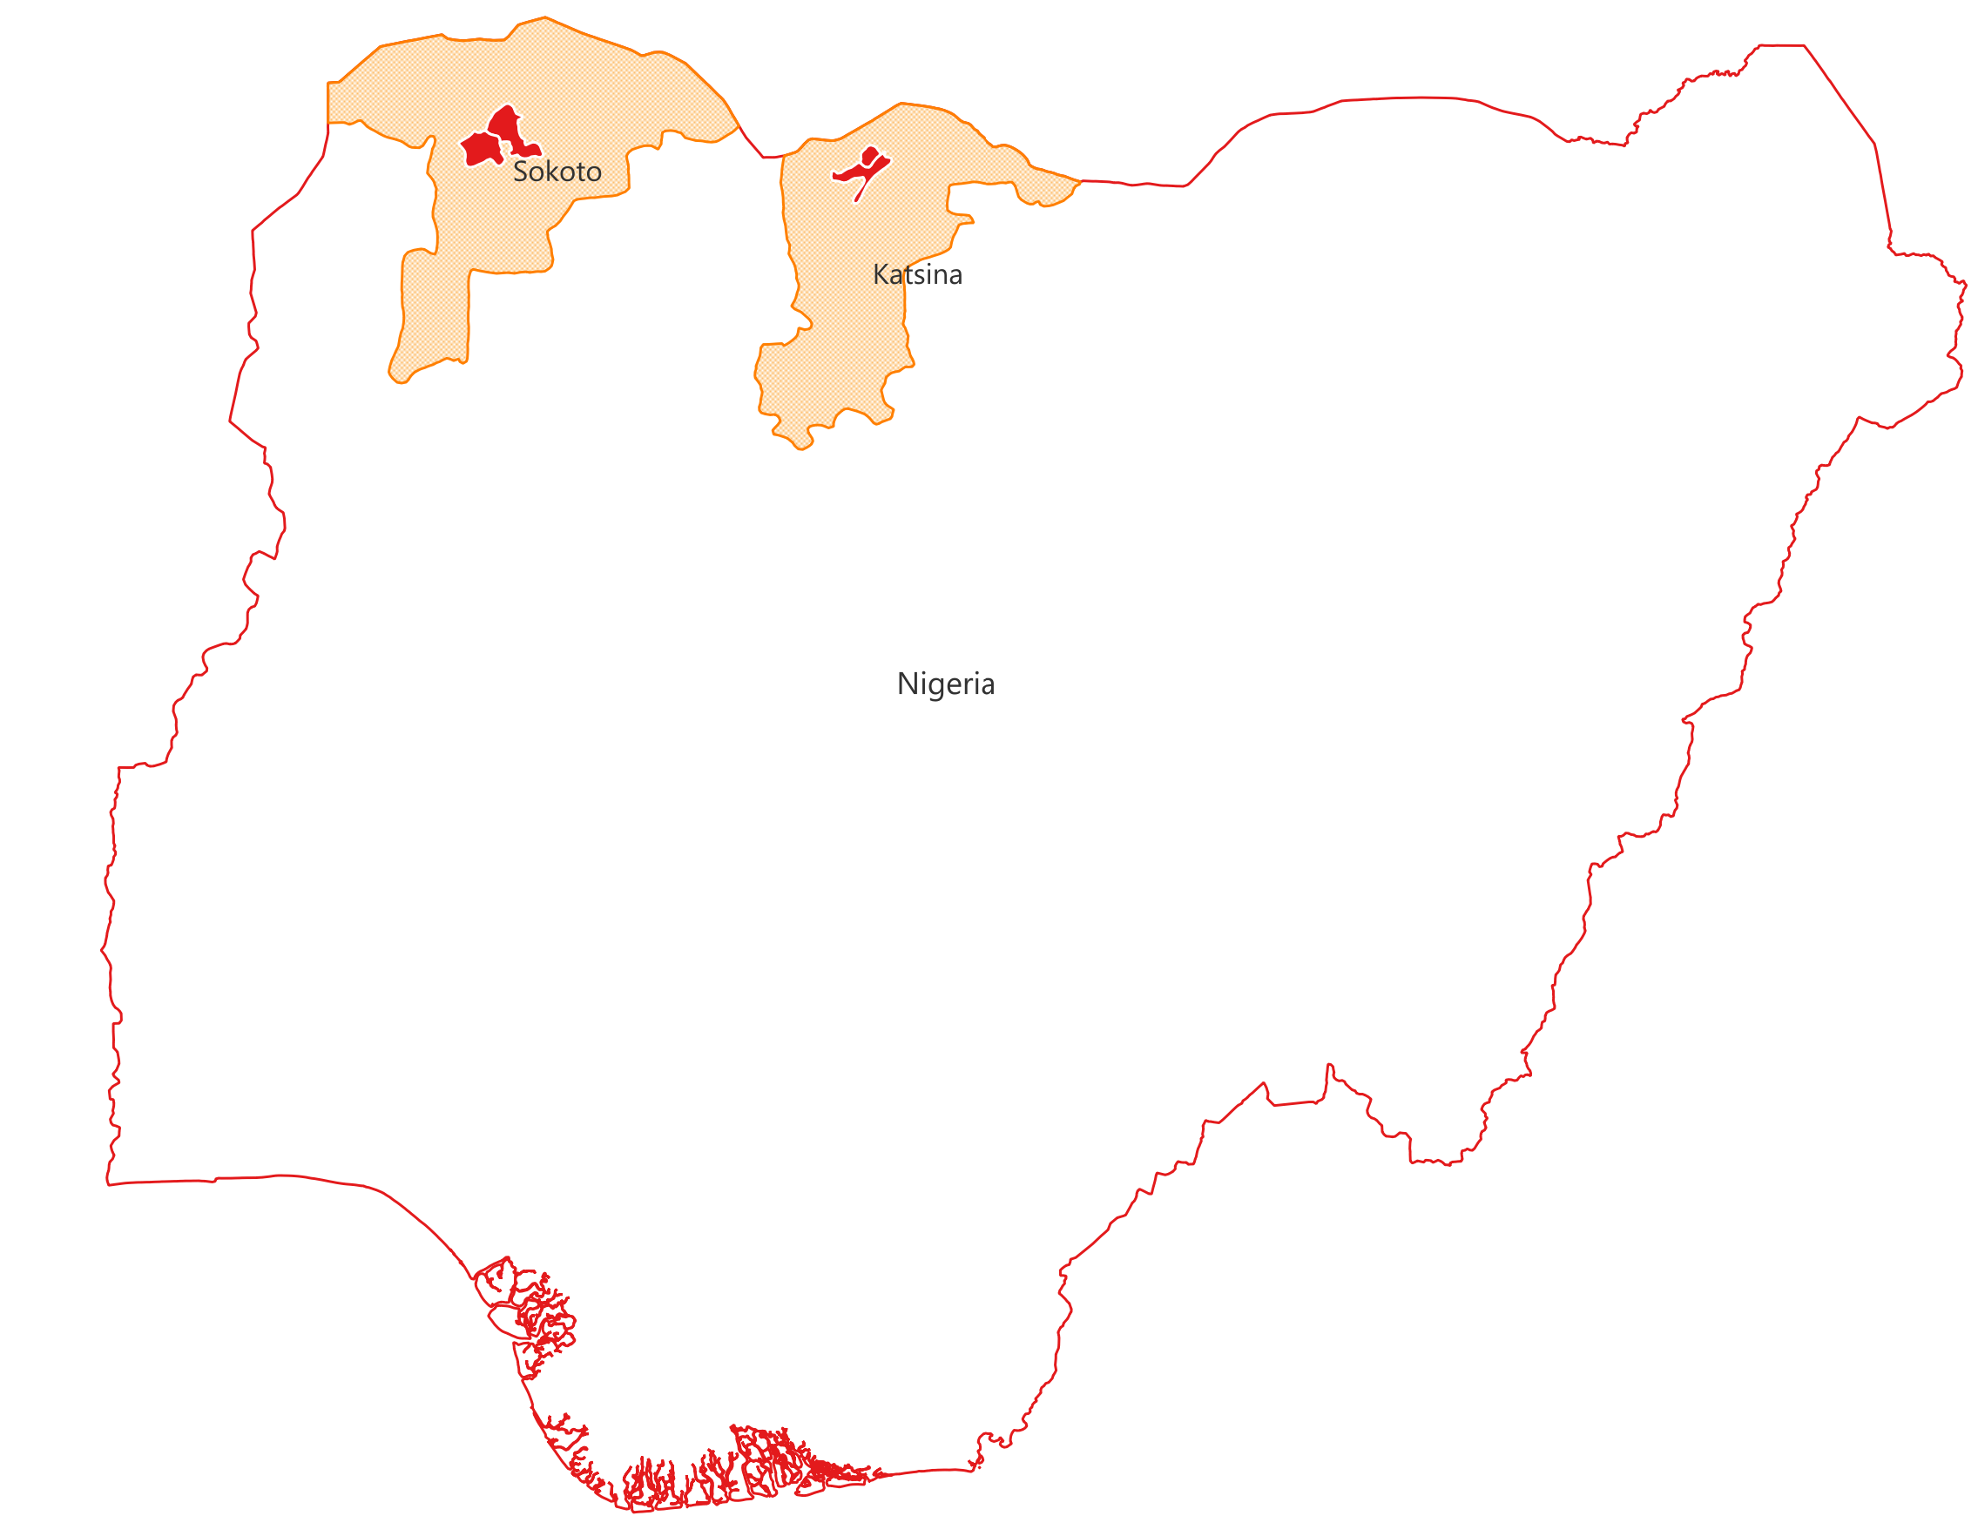





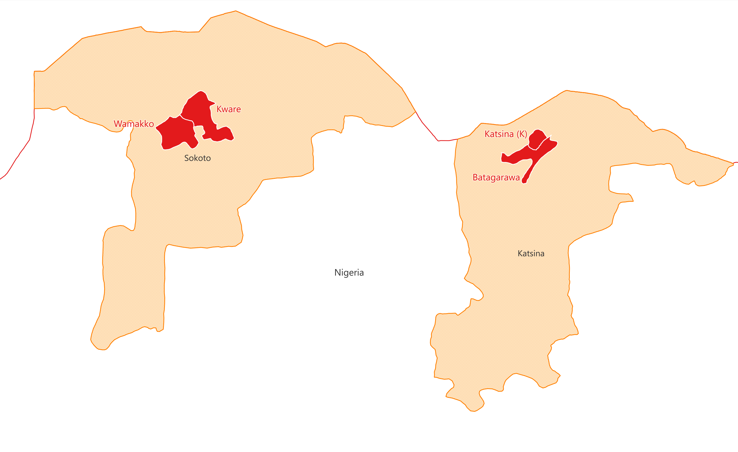




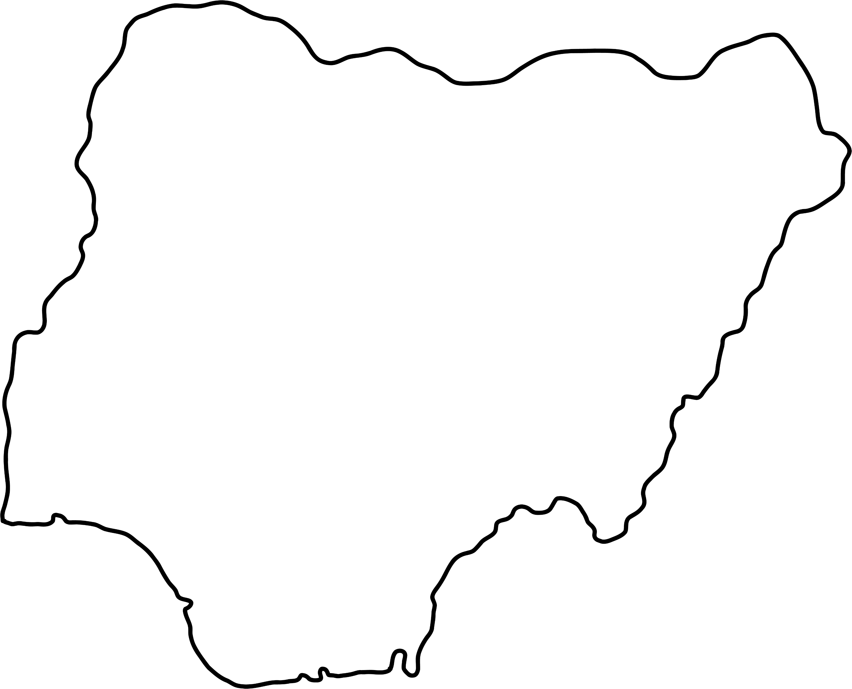







Resilience Building and Smallholder Farmers Support Project in Northwest Nigeria (Katsina and Sokoto)
| Total Head of Households
| Beneficiary by Marital Status
| Beneficiary by Residence Status
| People with Disabilities
Returnees
1,384
5,700
HOST
IDPs
63
4,807
830
11.1%
24.2%
84.3%
14.6%
Female HH
Male HH
| Beneficiary by Age Disaggregation
| Coverage
| Indirect Beneficiaries
1,657
4,043
16%
2
Youth
34%
States
LGAs
Wards
47,967
29.1%
70.9%
51%
Elderly
04
Adult
42
Household Members
| Support by Category
Cash Based Transfer
Small Holder Farmer
996
714
661
| Farmers’ 1st Seed Choice
58.2%
41.8%
16.6%
278
8
Residential Status
3229
Avg.
HH Size
PwD
16.3%
83.4%
17%
| Linked With NIMC
40%
292
43%
HOST
Farm Size
17.1%
84.2%
0.2-0.5
hec
| Linked With Bank
IDPs
48.5%
| Beneficiaries by State
1075
12.7%
Katsina
50%
50%
16.3%
Returnee
Sokoto
2.1%

Slide 2


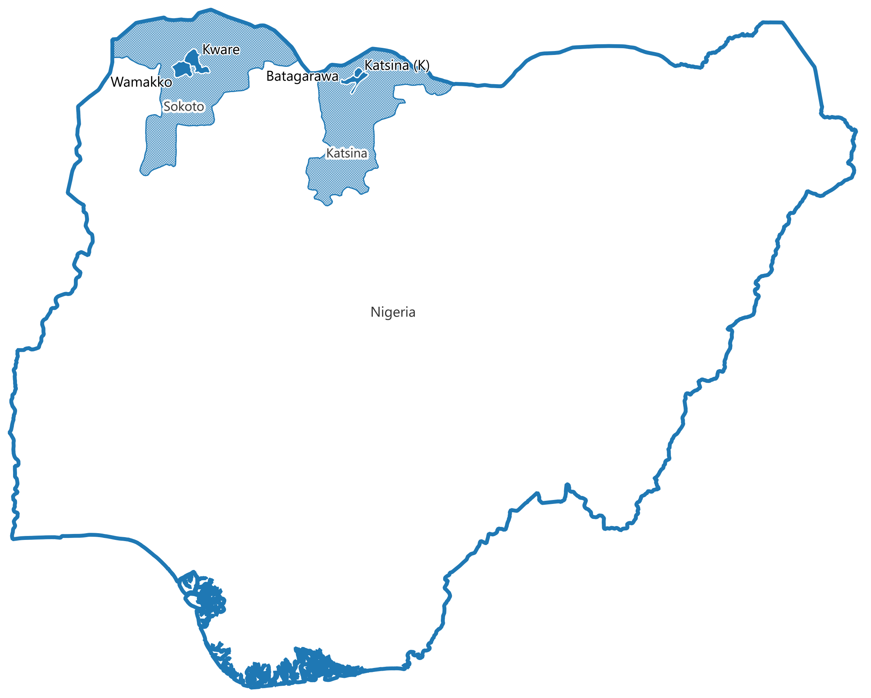











Resilience Building and Smallholder Farmers Support Project in Northwest Nigeria (Katsina and Sokoto)
FUNDED BY
| Total Households Supported
| Indirect Beneficiaries
| Coverage
| Beneficiary Supported by SHF
5,700
37,050
661
2
16.6%
Household Members
3229
Female HH
Male HH
States
| Beneficiary by Age Disaggregation
04
83.4%
1,657
4,043
04
LGAs
16%
34%
Avg. Farm Size
Youth
Elderly
42
0.3
29.1%
70.9%
51%
Wards
hec
Adult
48.5%
| Farmers’ 1st Seed Choice
| Beneficiary by Residence Status
| People with Disabilities
| Beneficiary Supported by Cash Based Transfer
HOST
IDPs
Returnees
1,384
4,807
830
63
996
714
HOST
84.3%
14.6%
11.1%
24.2%
84.2%
58.2%
41.8%
| Beneficiary by Marital Status
| Support by Category
IDPs
278
12.7%
16.3%
8
Returnee
PwD
Avg.
HH Size
MARITAL STATUS
2.1%
| Linked With NIMC
Age Disaggregation
292
17.1%
17%
40%
43%
| Linked With Bank
1075
Implemented by
16.3%

