Slide 1

Shaping Your Future: Career Opportunities in Cloud Computing
Unlocking New Possibilities in the Digital Era
Arun Venkatachalam

Slide 2
Agenda
Introduction to Cloud Computing
Importance of Cloud
Core Concepts
Career Paths
Skills & Certifications
Success Stories
How to Start
Q&A

Slide 3
What is Cloud Computing?
On-demand delivery of IT resources over the Internet
Examples: Gmail, Netflix, YOUTUBE

Slide 4
Types of Cloud
Public Cloud (AWS, Azure, GCP)
Private Cloud
Hybrid Cloud

Slide 5
Why Cloud Computing Matters
Scalability
Cost Efficiency
Faster Innovation
Global Reach

Slide 6


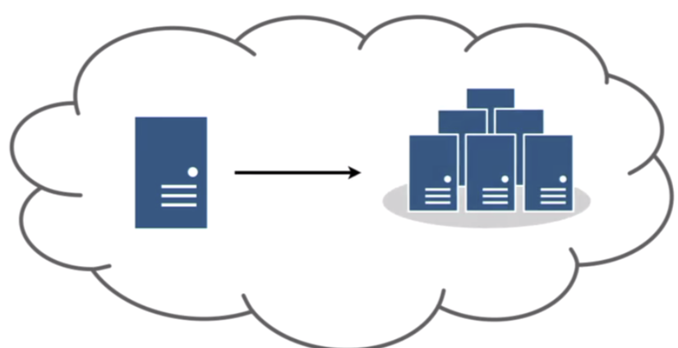
Scalability
Servers are scalable based load and scale down

Slide 7
Service Models
IaaS – Azure VM (You buy ingredients, chop veggies, make dough, bake the pizza)
PaaS – Heroku
(You choose toppings, and they make pizza for you)
SaaS- GMAIL
(You order the pizza)

Slide 8
Key Technologies
Virtualization 📺
Containers 🍱 (Docker, Kubernetes)
Serverless 💡 (AWS Lambda)
Cloud Databases (RDS, CosmosDB)

Slide 9
How AI Works in the Cloud
Train models on massive datasets using distributed compute power (e.g., TPUs/GPU clusters).
Host pre-trained models that businesses can use via APIs for tasks like text classification, translation, and image recognition.
Automate processes with AI-driven insights, like fraud detection, predictive analytics, and customer service automation.
Improve collaboration by leveraging cloud-based data pipelines, version control, and integrated platforms for cross-functional teams (data scientists, engineers, business analysts).

Slide 10
Career Opportunities
Cloud Engineer
Cloud Developer
DevOps Engineer
Cloud Solutions Architect
Cloud Security Specialist
Data/ML Engineer

Slide 11
Salary Expectations
Entry Level: 6-12 LPA (India), $80,000+ (USA)
Mid/Senior Level: 15-30 LPA (India), $130,000+ (USA)

Slide 12
Skills You Need
Linux Basics
Networking Fundamentals
Programming: Python, Java
Databases: SQL, NoSQL
Hands-on with AWS, Azure, GCP

Slide 13
Recommended Certifications
AWS Cloud engineer
Azure Fundamentals and AI
Google Associate Cloud Engineer
Redhat linux

Slide 14
Real-world Success Stories
AWS certification leading to internships
Netflix's cloud migration story
Cloud in healthcare and finance

Slide 15

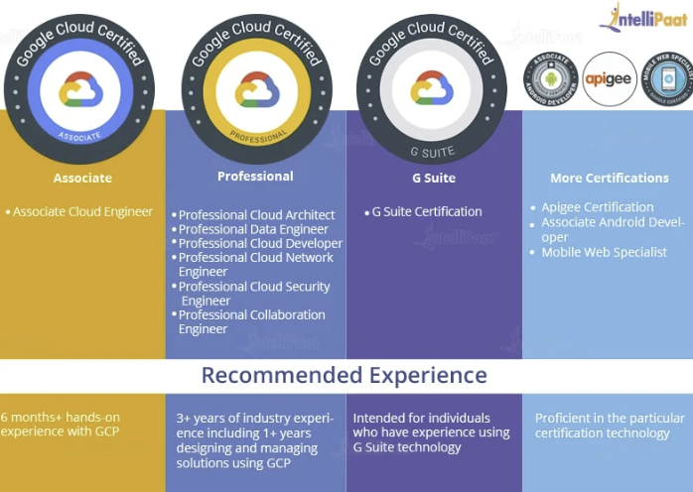
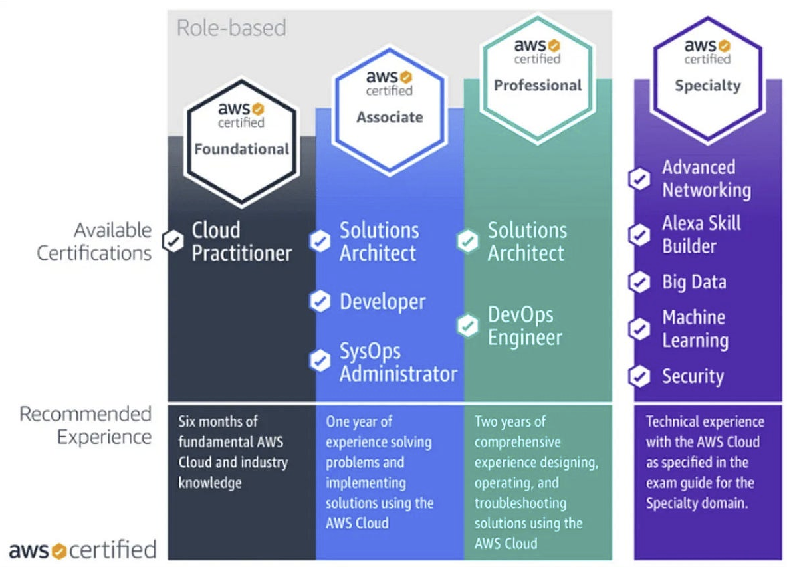
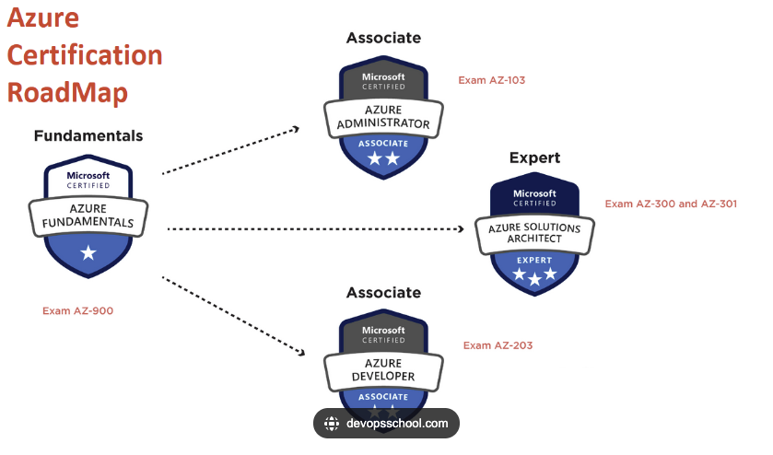
Certifications

Slide 16
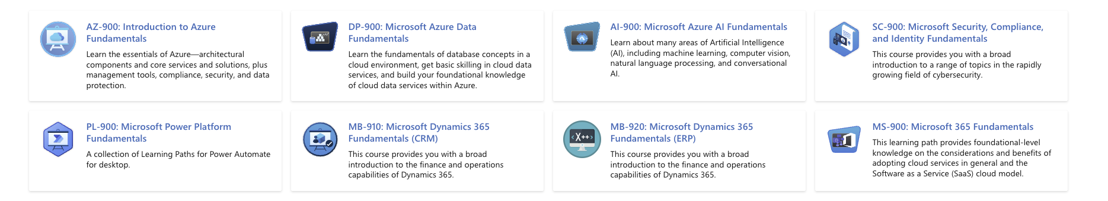
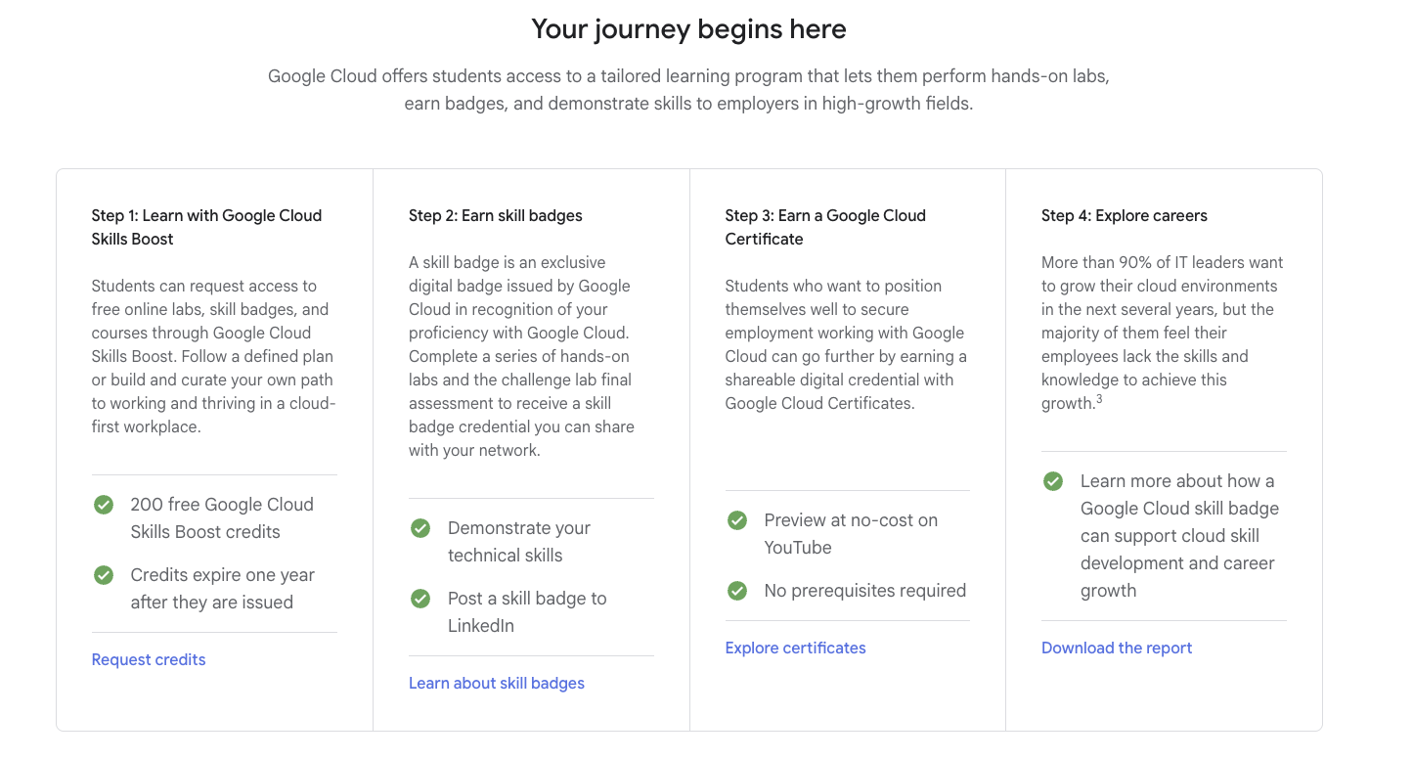
How to get certificates at free of costs?

Slide 17
Free Resources for Students
AWS Educate
Microsoft Learn
Google Cloud Free Tier
YouTube Channels: FreeCodeCamp, Nana

Slide 18
Final Tips
Stay Curious
1
Practice Daily
2
Join Cloud Communities
3
Never Fear Failure
4

Slide 19

Let’s build together
https://github.com/Life-of-DevOps/cloud-skillsets/tree/main

Slide 20
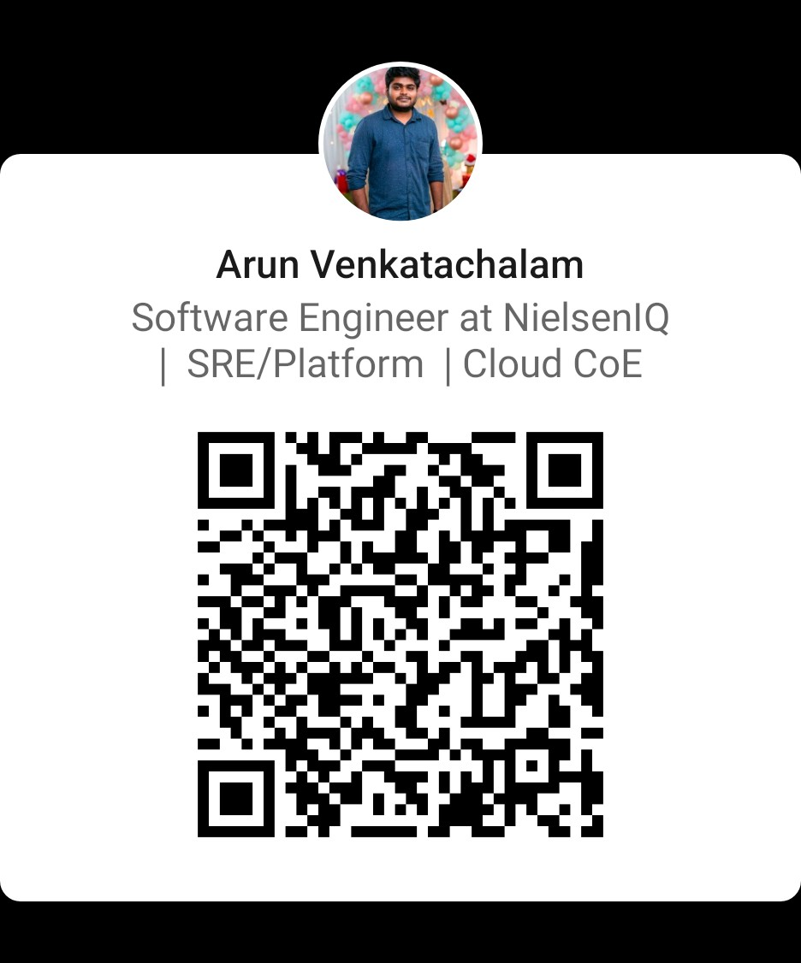
Let’s Connect
https://www.linkedin.com/in/arun-venkatachalam-engineer/

Slide 21
Thank You + Q&A
The Cloud is for Dreamers and Doers. Be Both.

