Slide 1

Experimental Civics
Presents
experimentalcivics.io
lifescihack.com

Slide 2
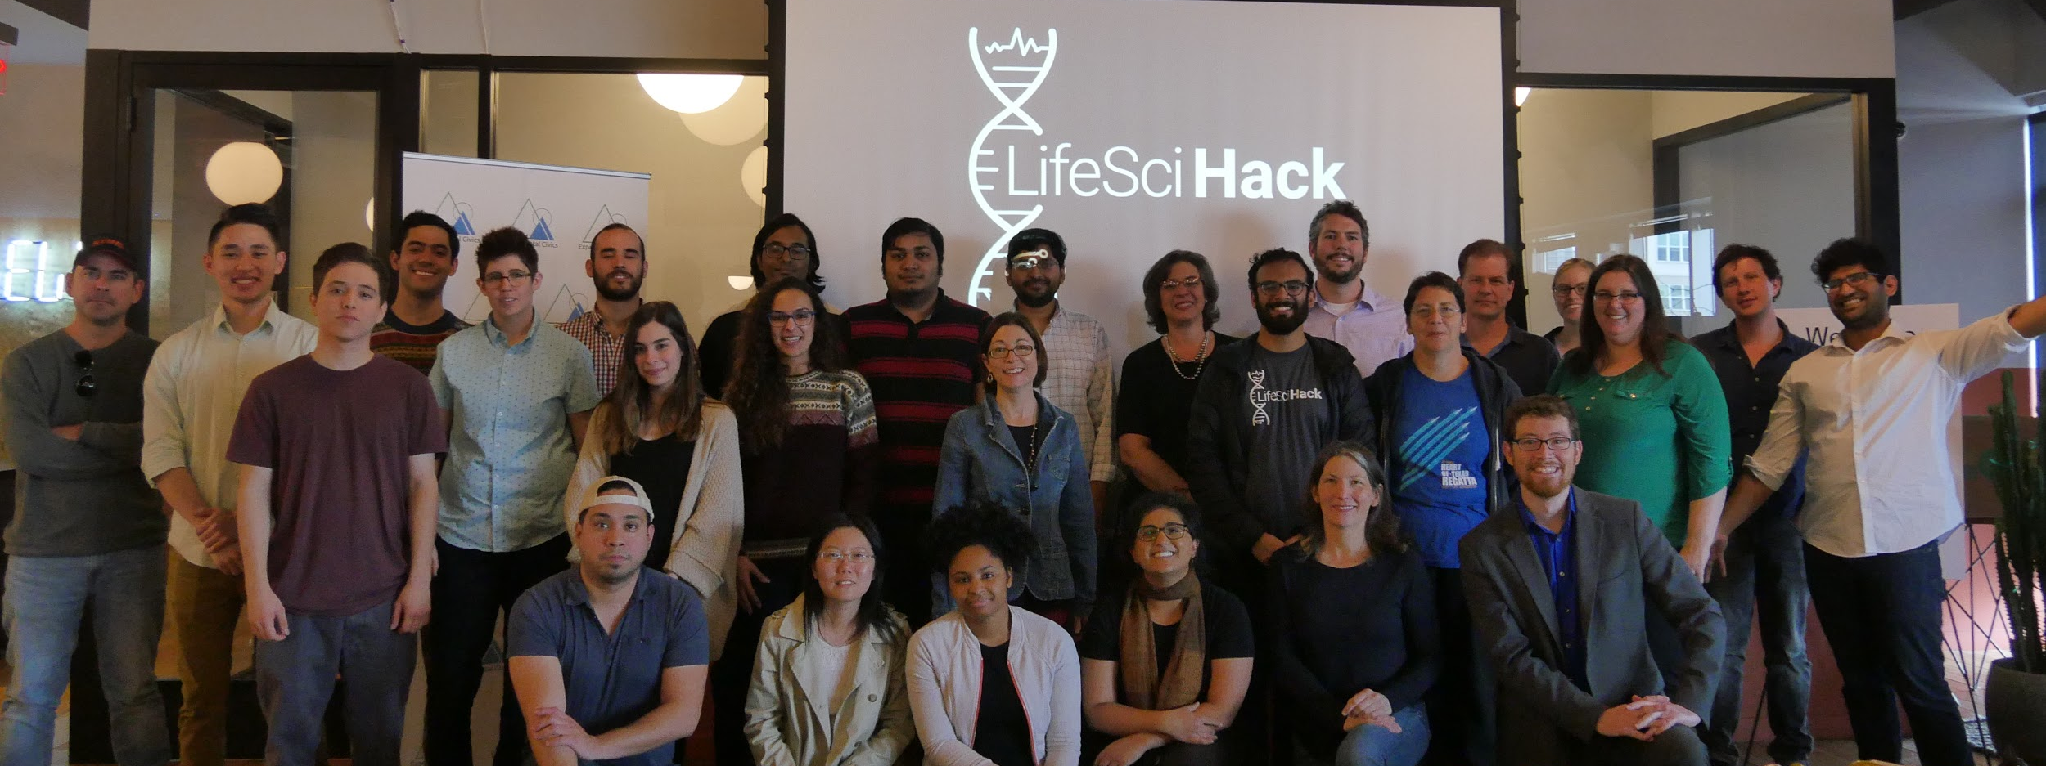
Remember?
(This video might help.)

Slide 3
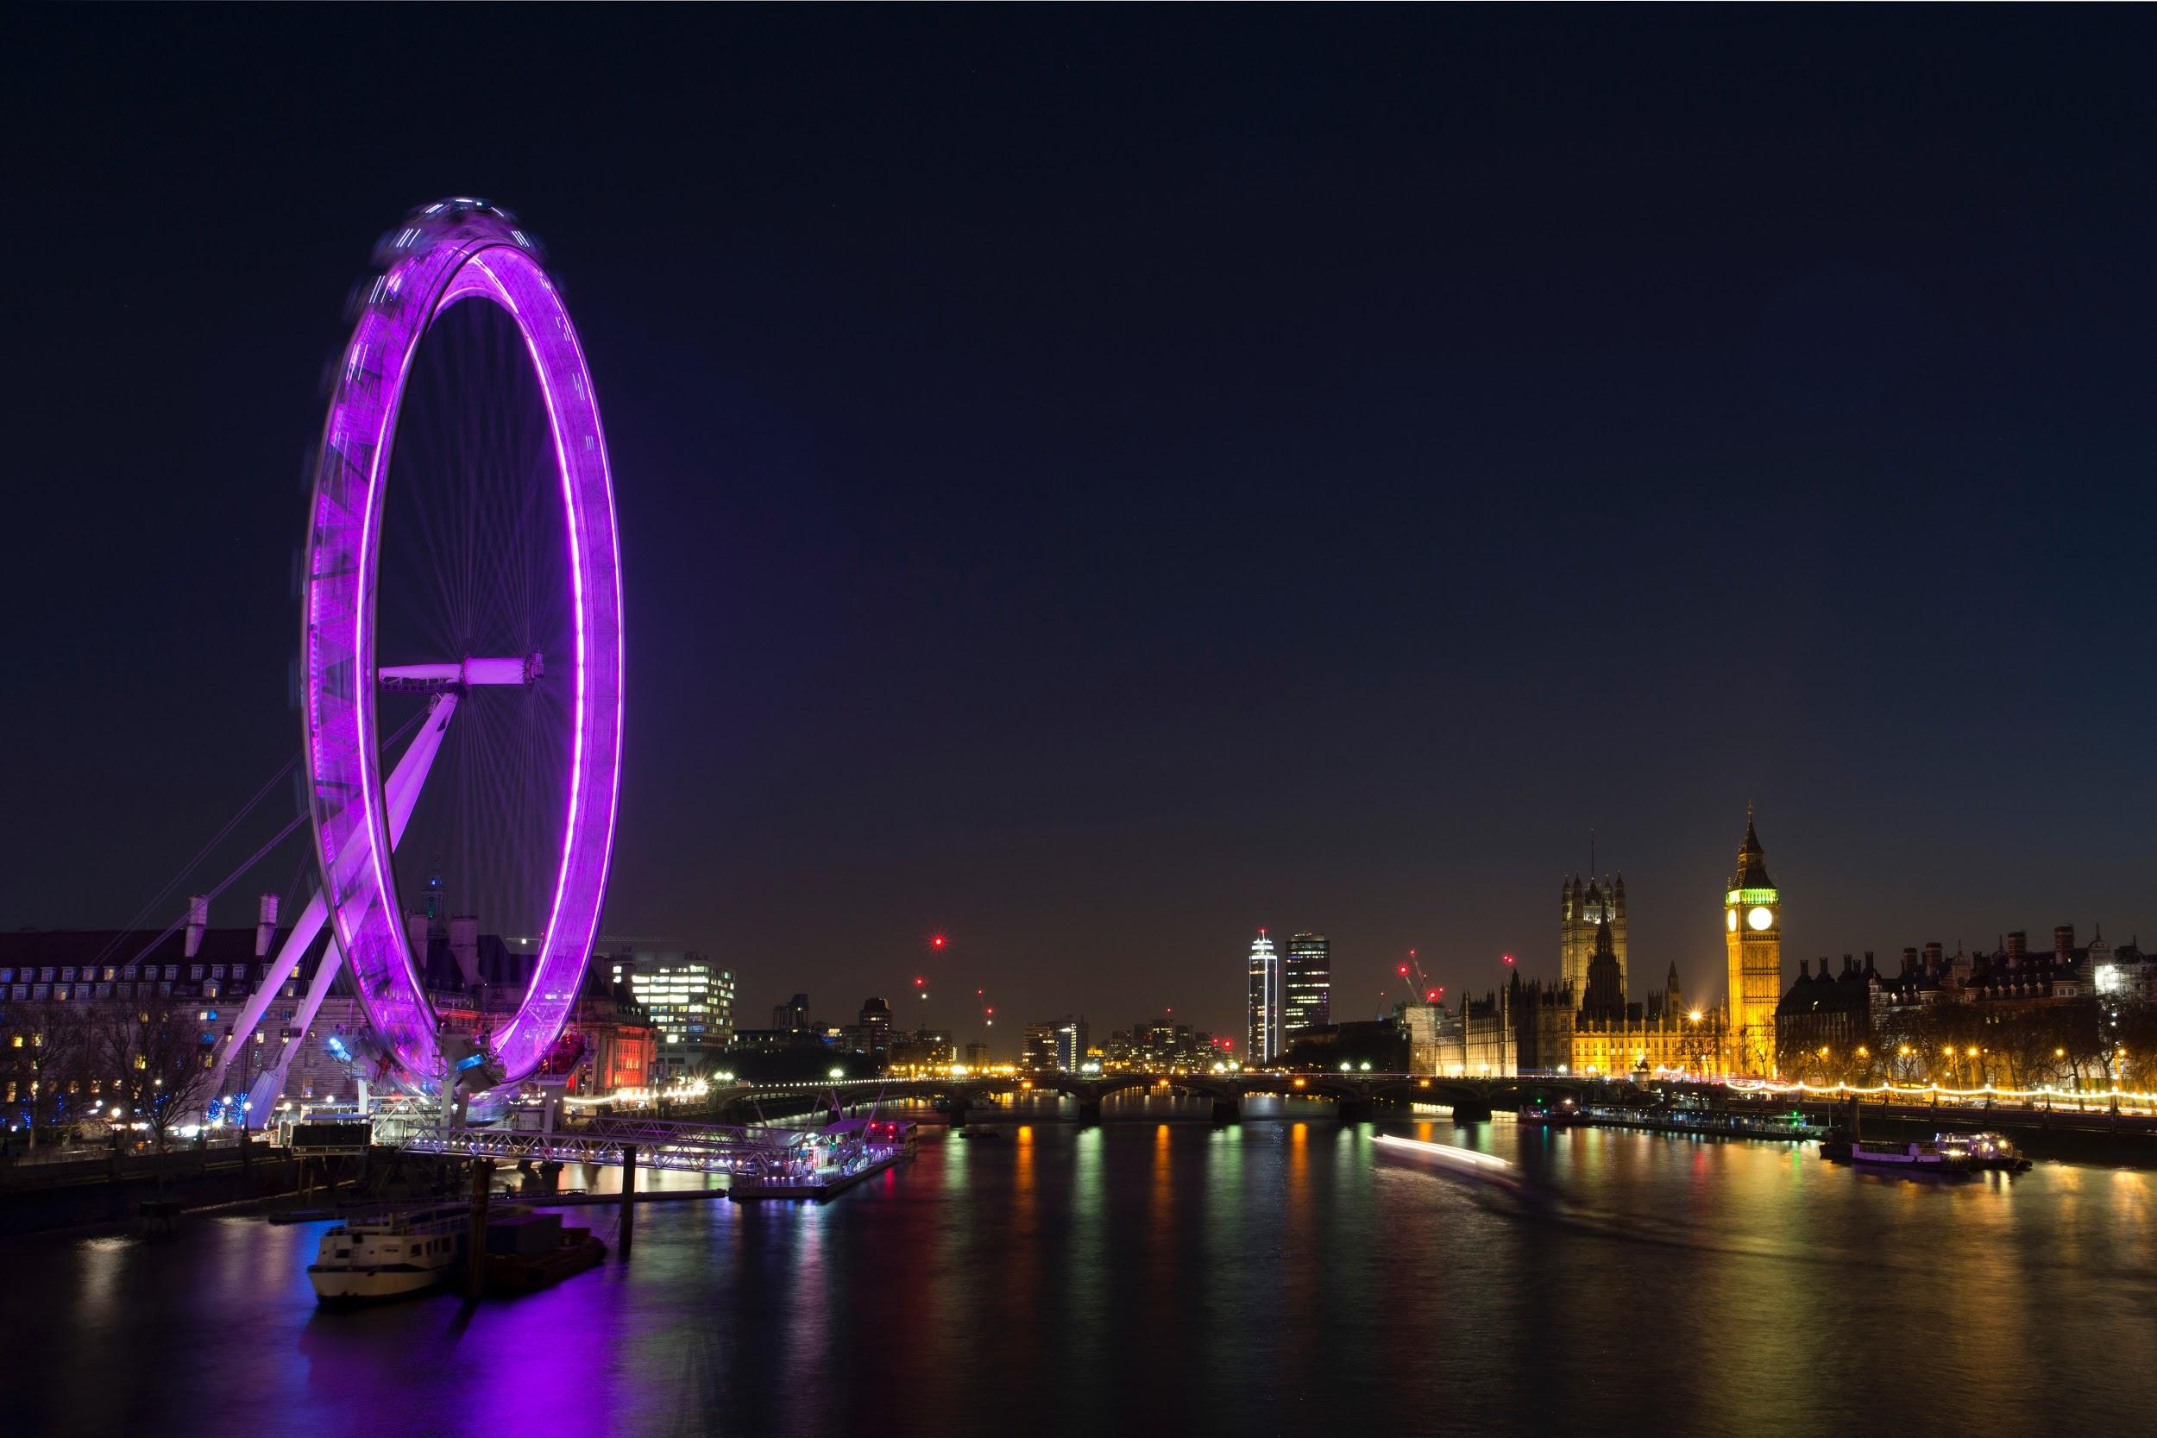
Guess Where
We’re Heading Next?
(Hint.)

Slide 4
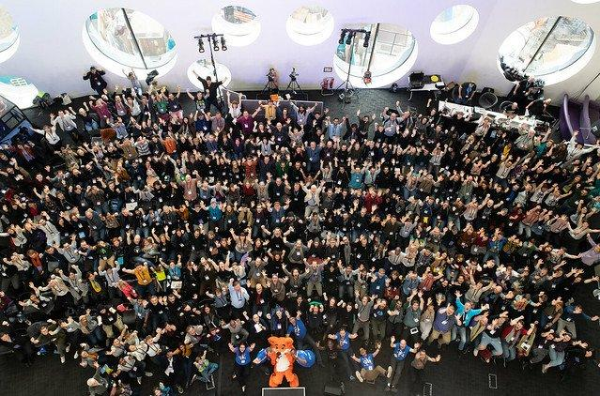
Hello Moz Fest!
(Some faces from last year.)

Slide 5
What
Life Sci Hack is a global traveling hackathon bridging the fields of engineering and the life sciences. We will be hacking 5 challenges: big data, data interoperability, software toolkits, education, and machine learning.
Our challenges are based on the largest pain points felt by all those in open science, engineering, and life science fields. Our hackathon is an opportunity to bring creative, diverse minds together so we can get back to curing diseases, improving human lives, conducting our research, and broadening our understanding of the universe.
Mozilla House, 8 John Adam Street, London, WC2N 6EZ
Oct 2019
Why
Where
When

Slide 6
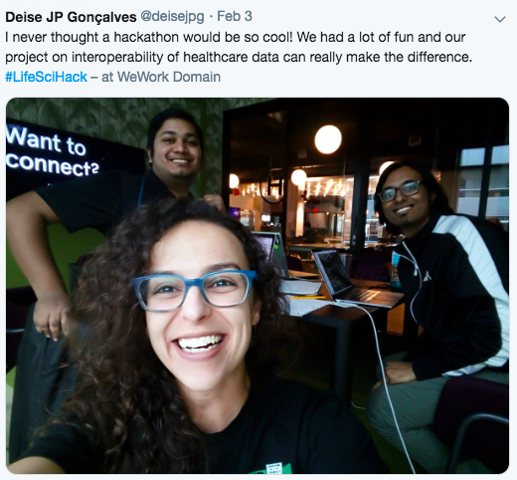
Who
Researchers
Entrepreneurs
Designers
Engineers
Scientists
Students
Imagineers
Developers
100 Hackers
(Just awesome humans.)

Slide 7
Timeline
Recruit partner and sponsors
Finalize event logistics and support
Draft and finalize all Marketing/PR communication
Promo, promo, and more promo
AUG 2019
OCT 2019
Let The Hacking Begin
JUN 2019
JUL 2019
SEP 2019
OCT
2019
Finalize all sponsors
Finalize all major contracts with event
Book all talent
Launch partner and sponsor campaigns
Build all event documentation
Recruit organizers
Build momentum from MozFest
Final recruitment push

Slide 8
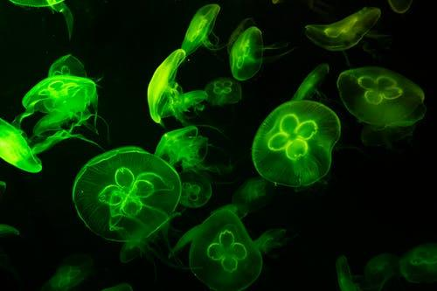
Sponsorship
HELIX $20K -- £15K
CHROMO $10K -- £8K
NUCLEUS $5K -- £4K
CELL $2K -- £1.5K

Slide 9
HELIX
By Invite Only
Exclusive showcase as headlining sponsor at Mozilla House during MozFest in Central London
Exclusive mentions in the London and European press outlets as headlining sponsor
Dedicated 10 min segment at all major hackathon events (kickoff, final, and evening social)
Designated tabling space all major hackathon events
Prominent logo placement included on all marketing and attendee materials
Capture leads and gain exposure for your brand, products, and services
Build relationships with attendees, speakers, industry leaders, and press

Slide 10
CHROMO
Limited Open Positions
Exclusive showcase at Mozilla House during MozFest in Central London
Dedicated 5 min segment during kickoff event
Designated tabling space at the kickoff and evening social
Prominent logo placement included on all marketing and attendee materials
Capture leads and gain exposure for your brand, products, and services
Build relationships with attendees, speakers, industry leaders, and press

Slide 11

NUCLEUS
Limited Open Positions
Exclusive showcase at Mozilla House during MozFest in Central London
Dedicated 2 min lightning talk during evening social
Designated tabling space at evening social
Prominent logo placement included on all marketing and attendee materials
Capture leads and gain exposure for your brand, products, and services
Build relationships with attendees, speakers, industry leaders, and press

Slide 12
CELL
Limited Open Positions
Exclusive showcase at Mozilla House during MozFest in Central London
Designated tabling space at Evening Social
Prominent logo placement included on all marketing and attendee materials
Capture leads and gain exposure for your brand, products, and services
Build relationships with attendees, speakers, industry leaders, and press

Slide 13
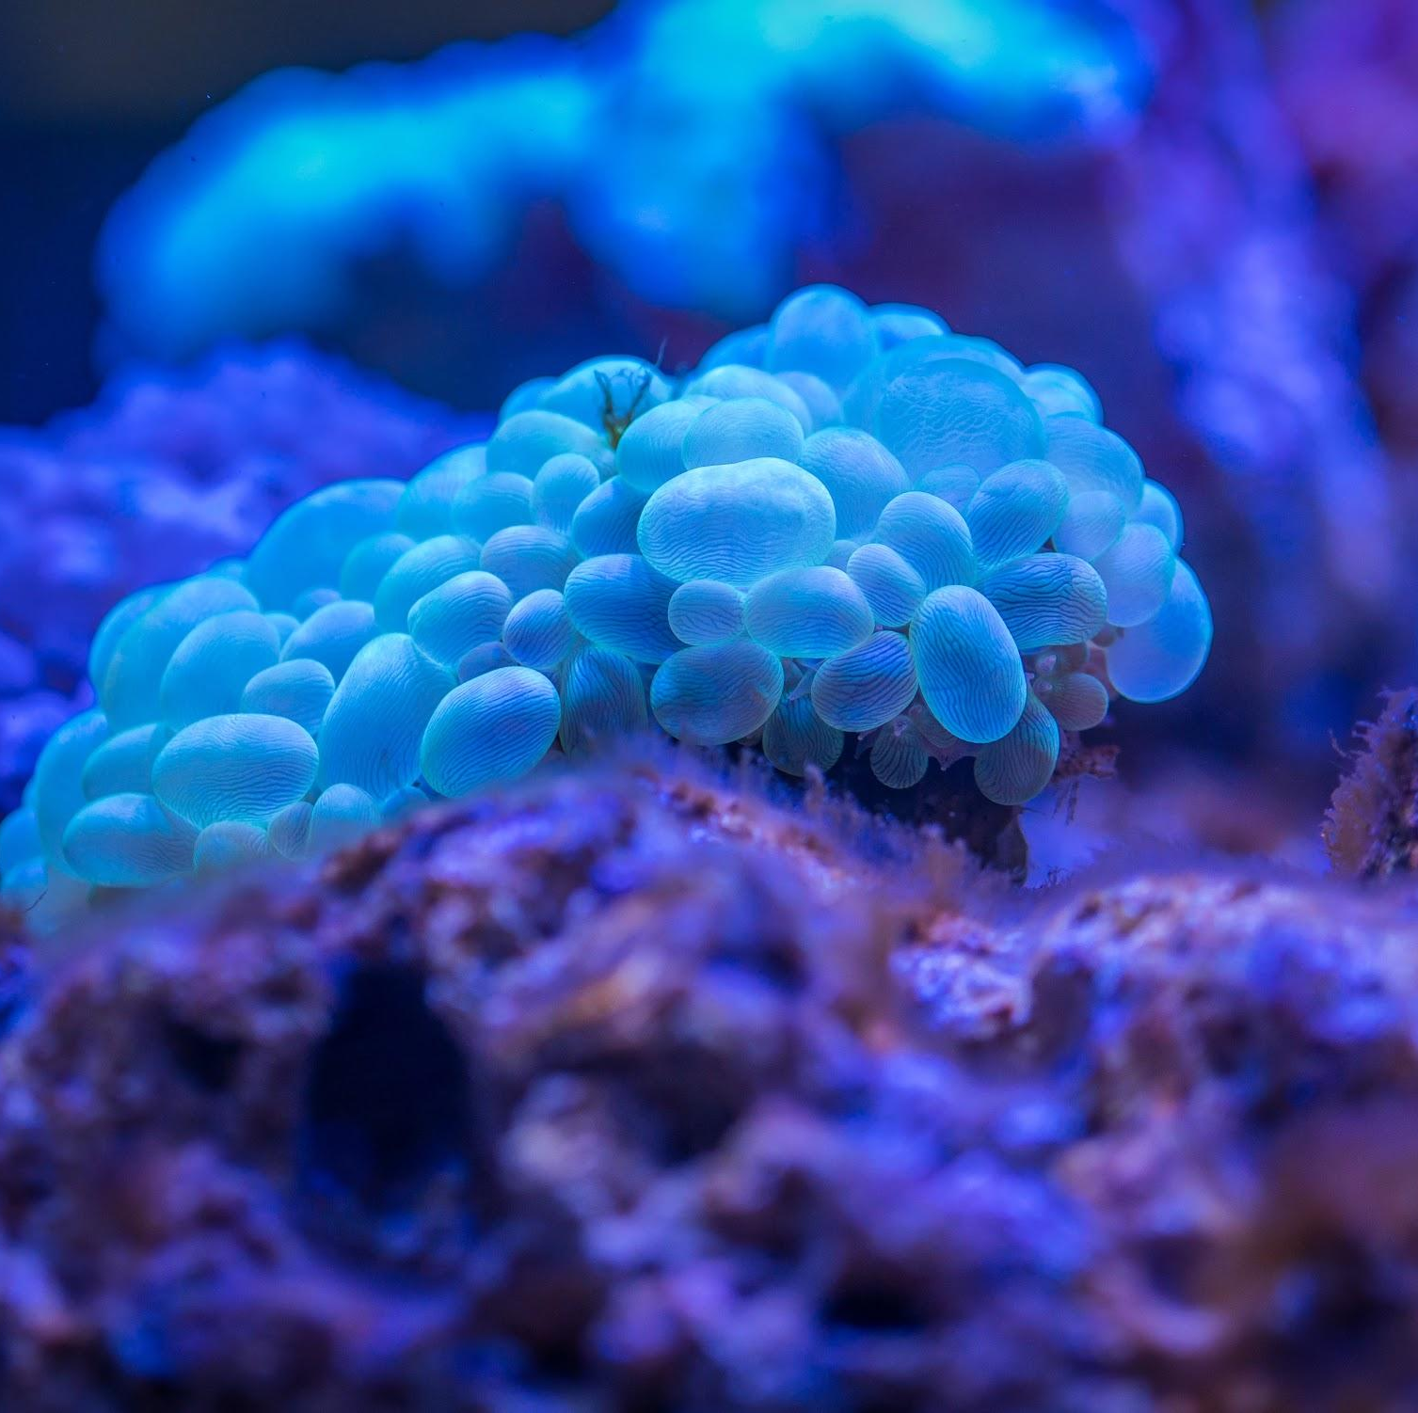
For sponsors:
sponsor@experimentalcivics.io
For everything else:
sarah@experimentalcivics.io
suliman@experimentalcivics.io
B O O K A M E E T I N G :
experimentalcivics.io
C O N T A C T U S

