Slide 1
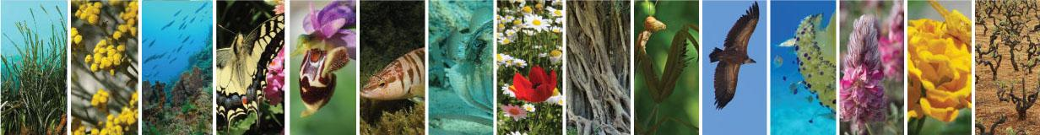




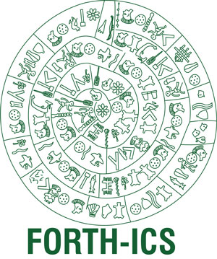


LifeWatch Greece data-services On supporting metadata and semantics integration for the biodiversity domain
Nikos Minadakis, Yannis Marketakis, Chryssoula Bekiari, Martin Doerr, Nicolas Bailly, Alexandros Gougousis, Stamatina Nikolopoulou, Dimitra Mavraki, Christos Arvanitidis

Slide 2


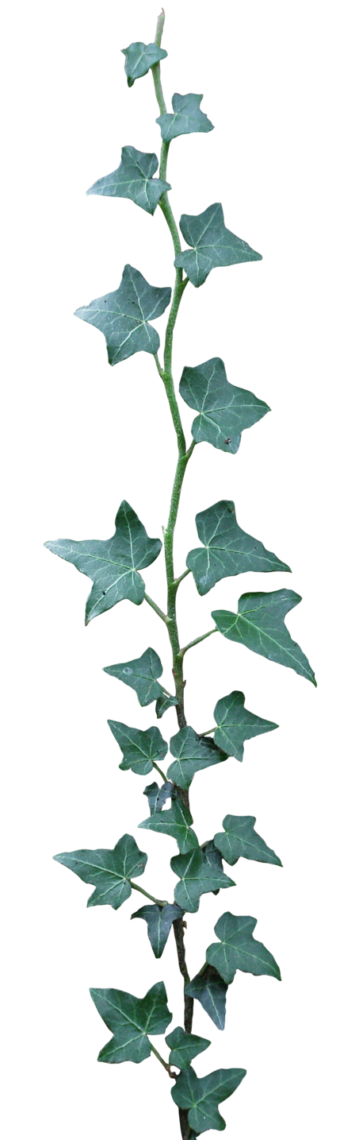
Outline
The Problem
The Goal
The Idea
Pre-design face
Data Services
User Interface / Examples
Conclusions
Notes:
This is the outline of the presentation. At first I will present the problem that exists, our goal in LW Greece and the Idea to overcome the problem. I will pass to the pre-design face of the services, the data services themselves, some example to make clear what our work was and the conclusions. I am lucky because Yannis Marketakis explained it the previous presentation a lot about semantic web and ontologies so I wont have to do it.

Slide 3
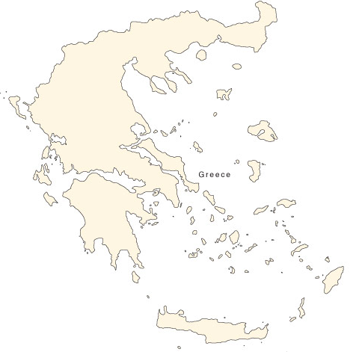




The problem
Main characteristics of biodiversity data:
Its cross-disciplinary character.
The extremely broad range of data types and structures.
The variety of semantic concepts which encompasses.
It remains widely distributed and unconnected.
Identification
Environmental
Occurrences
MicroCT Images
Notes:
The main characteristics of the biodiversity data are its cross-disciplinary character, an extremely broad range of data types and structure that vary from csv files, dwc Archives to simple word documents. The variety of semantic concepts and the wide distribution and lack of connectivity in many cases. So, for example as you can see in the map there may be some occurrences records in dwcA format in patra, identification records in xls in salonika, environmental parameters records in csv in Mitilini and MicroCT images in HCMR in Crete.

Slide 4
The goal
Our goal in the context of LW Greece:
support cataloguing and publishing of all the relevant meta-data information of the Greek biodiversity domain.
integrate data from heterogeneous sources by supporting the definitions of appropriate models.
efficiently discover biodiversity data of interest and enable the answering of complex queries that could not be answered from the individual sources.
Identification
Environmental
Occurrences
MicroCT Images
Notes:
Our goal in LW Greece was to 1) give the ability to the users/scientists to catalogue and publish all the relevant information of the greek biodiversity domain, to integrate data from heterogeneous sources and to support efficient discovery of data and answering of complex queries. So, in other words our goal was to link all this information together and to give the capability to the users to access it.

Slide 5
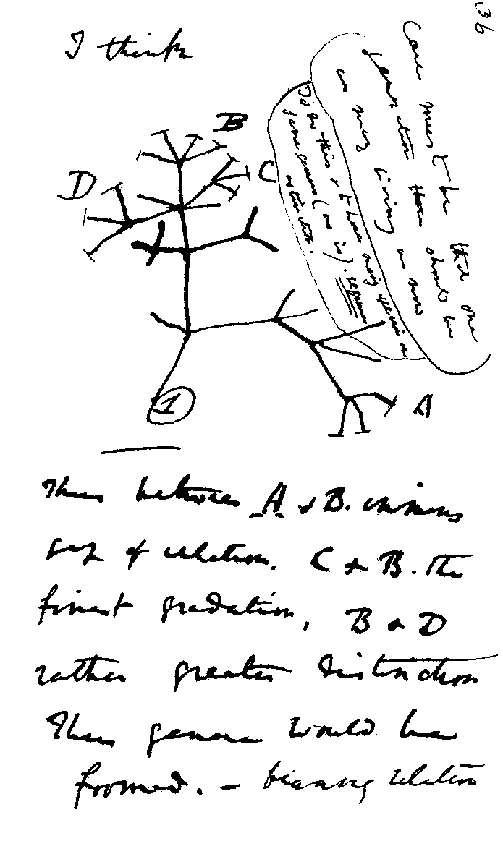

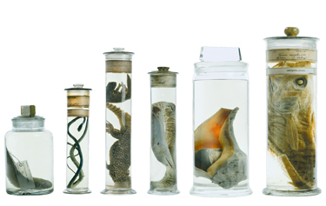
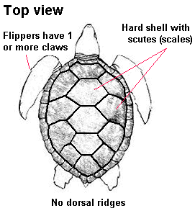
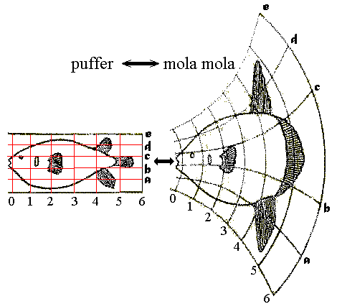
The Idea
Exploit the events’ information that is explicitly or implicitly contained in the datasets, model the different concepts and entities of the biodiversity domain and take advantage of the semantic graph’s capabilities to navigate efficiently through the different contents and discover data of interest.
Naming Event
Occurrence Event
Specimen Creation Event
Expedition Dataset
Identification Event
Measurement Event
Notes:
The idea was the following: to exploit the events’ information that is explicitly or implicitly contained in the datasets, model the different concepts and entities of the biodiversity domain and take advantage of the semantic graph’s capabilities to navigate efficiently through the different contents and discover data of interest. For example in an expedition dataset are contained information about a number of sub-events such as occurrences or identification events. So except the metadata of the dataset that can be stored in a registry, information about the sub events can be extracted, modeled and used to discover the for mentioned dataset.

Slide 6
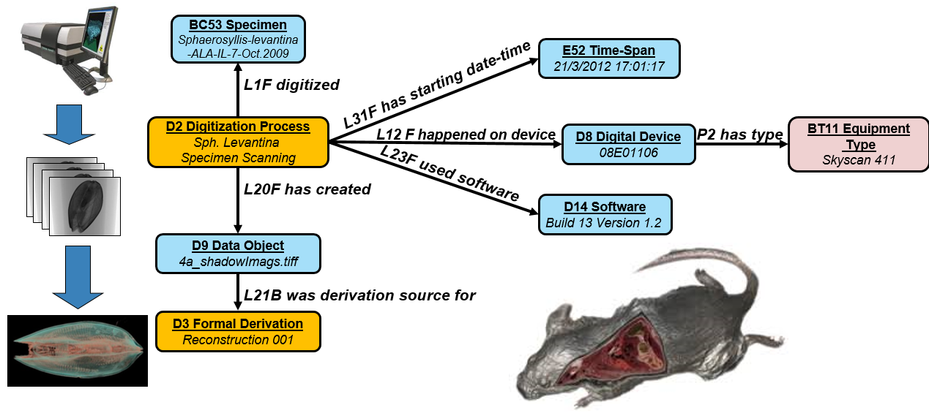
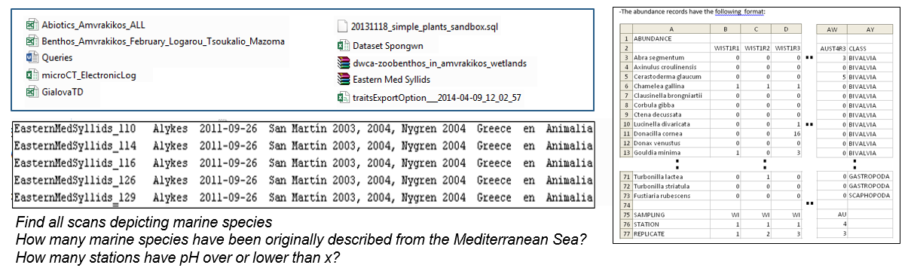
Pre-Design Phase
Collection and analysis of more than 100 datasets of the biodiversity domain.
Collection and analysis of more than 50 competency queries.
Identification of 12 main metadata categories
Selection and extension of semantic models.
Creation of schema mappings and modelling examples.
Identification of fundamental categories.
Notes:
To implement our idea in practice we followed a long predesign face. This consisted of the critical step of the data analysis. During this phase we collected and analysed more that 100 datasets of the biodiversity domain and 50 competency queries that are queries that come from the community and express the main scientific questions that we want to answer. We also identified 12 main metadata categories that cover the whole of our domain.

Slide 7
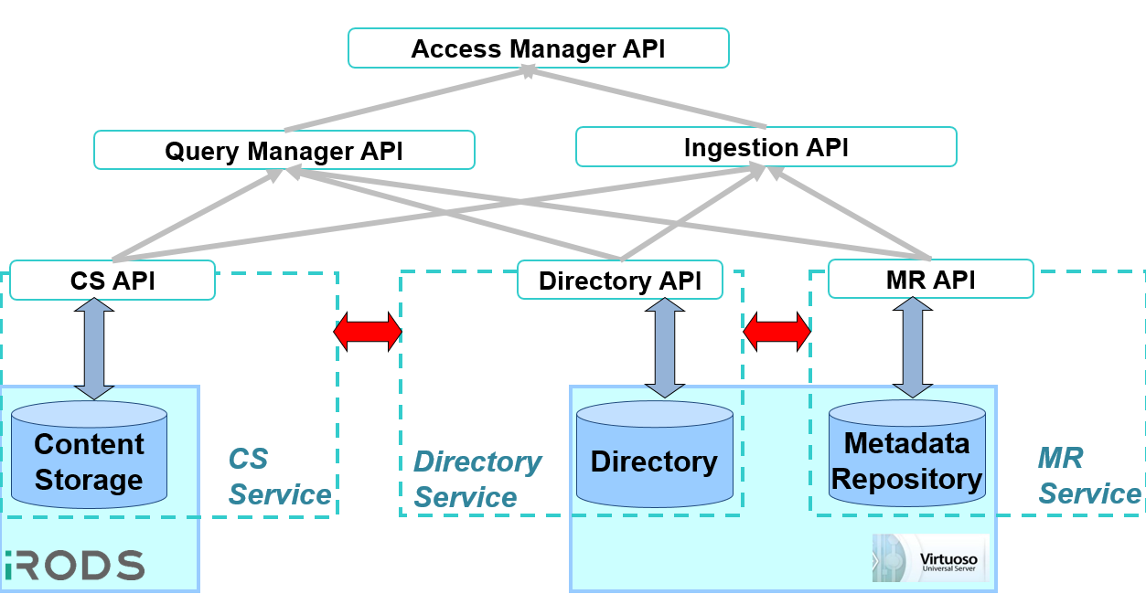
Design and Implementation
3 Components Architecture:
1) Directory Service
2) Metadata Repository
3) Content Storage
More than 20 Web Services.
1) Publishing Metadata/Data
2) Searching Metadata
3) Discovering Data
4) Browsing Services
5) Mapping Services
6) Transforming Metadata/Data
7) Annotation Services
The Web Application that is hosted by the LifeWatch Greece’s Portal making all these functionalities available to the LifeWatch users.
Notes:
The outcome of this process was the design and implementation of a new three component architecture that consists of lets say 3 different databases and the corresponding services. The first is the Directory where all the basic information about the datasets and the providers is store to as a graph and it provides simple query capabilities, the metadata repository where all the extracted metadata is stored in a graph in a format together with our models, and the inference mechanisms. Also more than 20 web services were produced with an api of more that 100.000 lines of code and finally our main product which is the webapplication that is hosted in the LW portal and makes all these functionalities available to the Lifewatch Users.

Slide 8
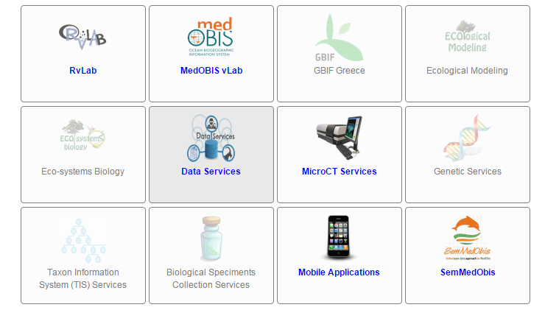
LW Greece Portal
http://metacatalogue.portal.lifewatchgreece.eu/
Notes:
This is the URL of our webapp, or if you enter the portal of LW Greece and click on the data services you will access our system.

Slide 9
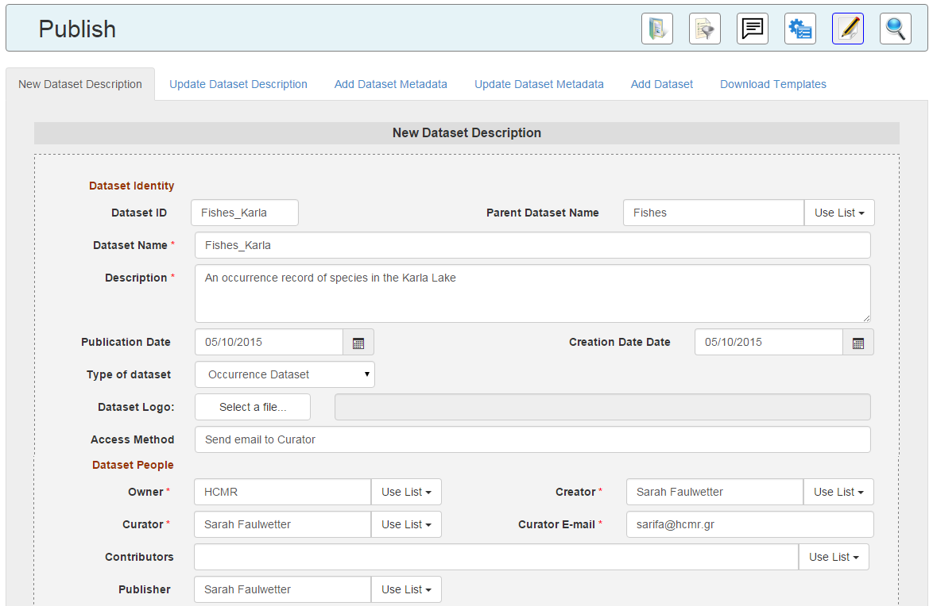
Publishing 1/2
Notes:
There are many functionalities that are provided to the users but I will show you some staff about the publishing and the search capabilities. So to publish the data there is a three steps process. The first one is the metadata about the dataset and the providers that can be provided by a form or by filling and uploading a template that we provide.

Slide 10
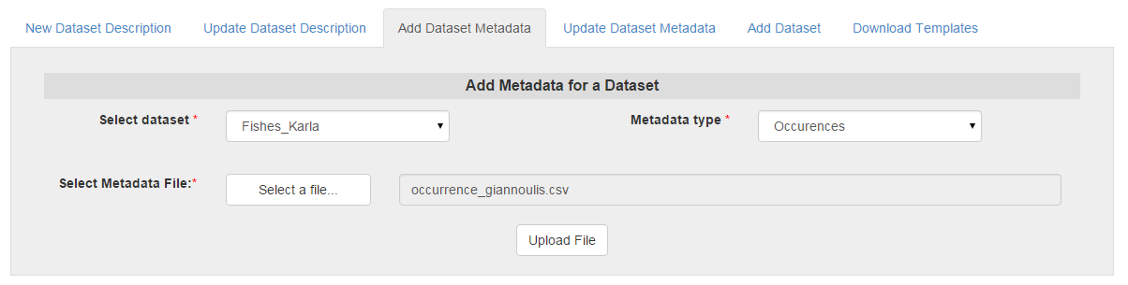
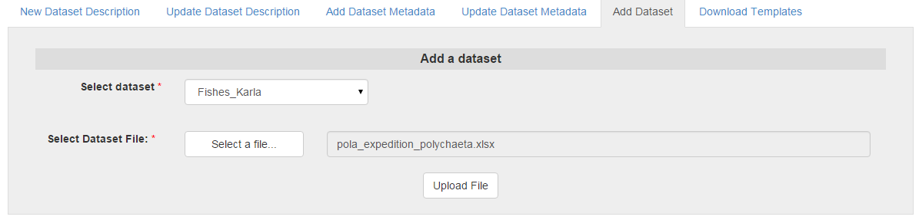
Publishing 2/2
Notes:
The second step is to provide the metadata about the events that are described in the dataset, this can be either by download a template, fill and upload it or by extracting automatically this info from the datasets, or by filling appropriate forms. The final optional step is to upload the dataset itself to our content storage. After these three steps the information has been automatically transformed into or underlying schema a unique identifier has been produced for each entity and everything has been stored in our infrastructure and it can be queried.

Slide 11
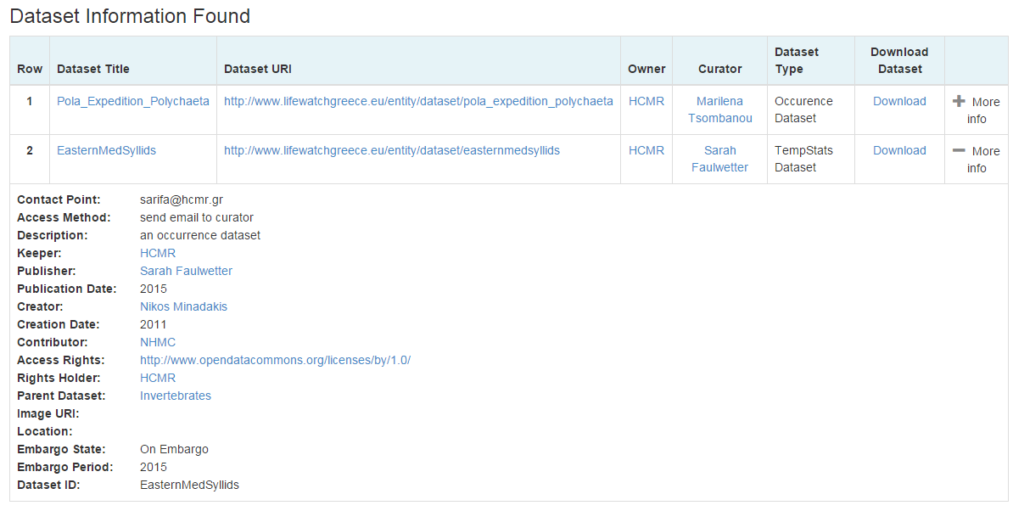
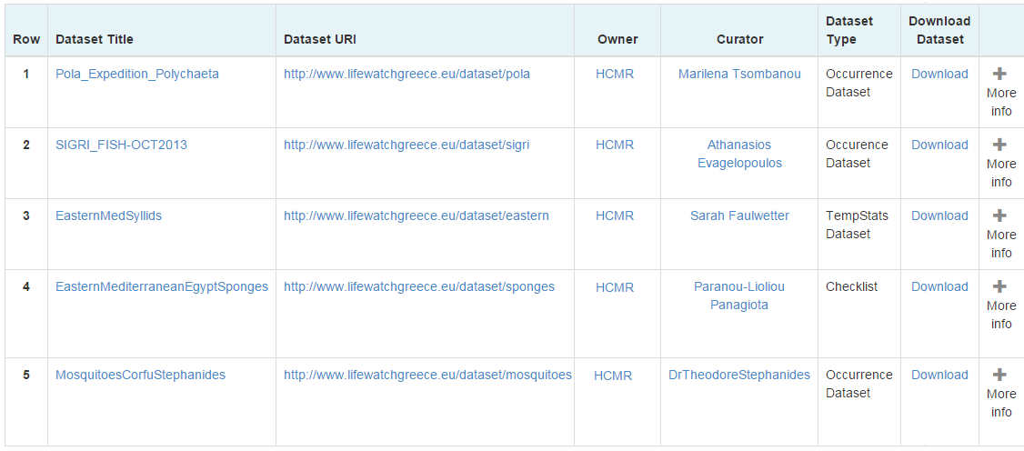
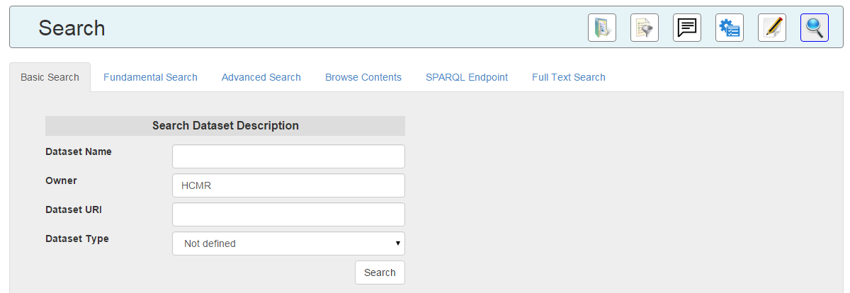
Searching
Notes:
Now regarding the searching functions we provide a variety of options. The basic search that is actually a search on our registry. So someone looks for datasets that come from HCMR this is what is returned. And if you click on the view more you take more information about the access method of the resource the curator and how to communicate. We focused a lot on including as much as possible the human factor in the directory’s schema. Information about just where the dataset is stored and how to access it is incomplete if you don’t keep information about the persons that participated to the creation and publishing processes and how to communicate with them. The user has the ability to download the dataset if it is available into our content storage and if he has the required rights.

Slide 12
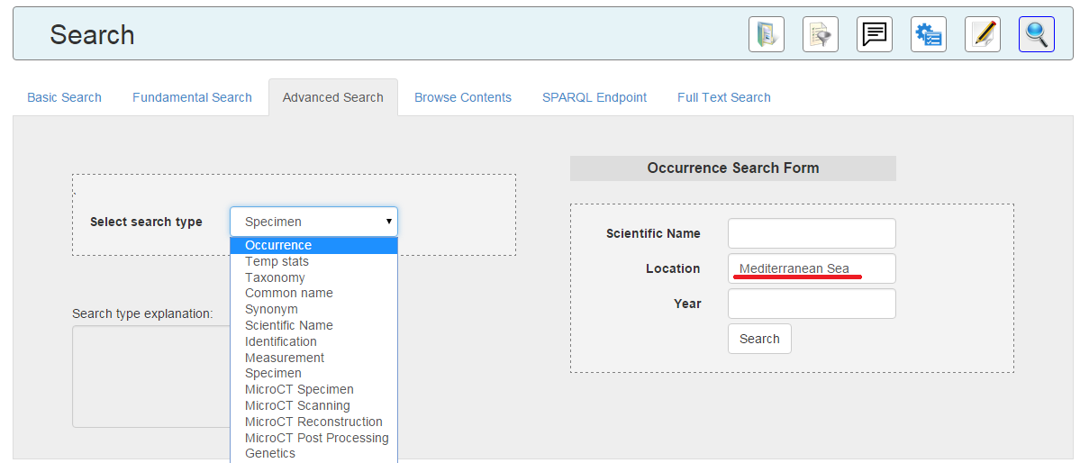
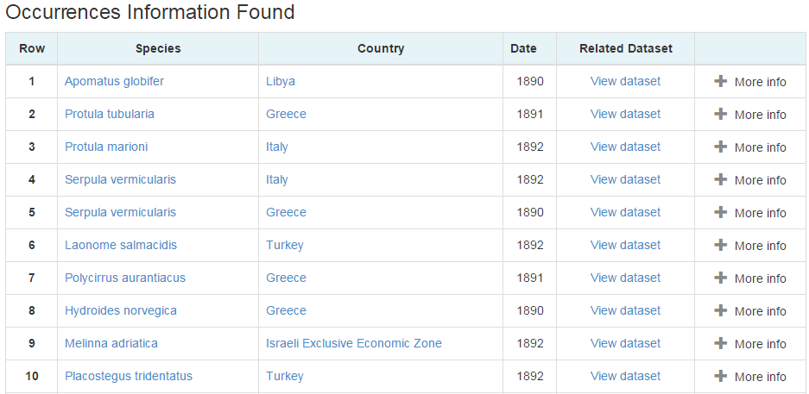
Searching
Notes:
It maybe that the user doesn’t know details about the dataset but that only he wants to find occurrences information from the mediterrannean sea. So this is what is returned to the user and by clicking more info more information about the event is returned to the user. By clicking on the view dataset the user will be redirected to the directory entry as I showed in the previous slide, find more information about the dataset that this event is described to and download it or access the curators/creators.

Slide 13
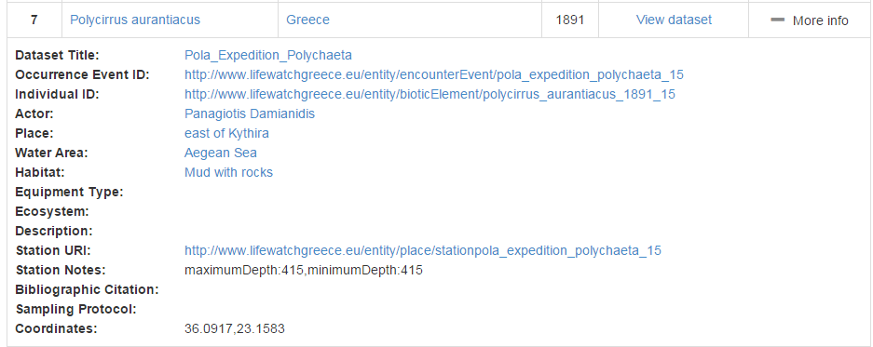
Searching
Notes:
As you can see there is a big number of links, or blue fonts. These links actually are created by using the unique identifiers that we produced and by using a number of browsing functions that we implemented by clicking it someone can find more information about the entity and navigate the semantic graph. So for example by clicking. Aegean Sea you will find more info about it, in which events it is related or by clicking diamantidis you will find information about the persons and its activities. Lets suppose that someone is interested in the individual that was found during the occurrence event. This individual has an id that has been automatically generated by the system.

Slide 14
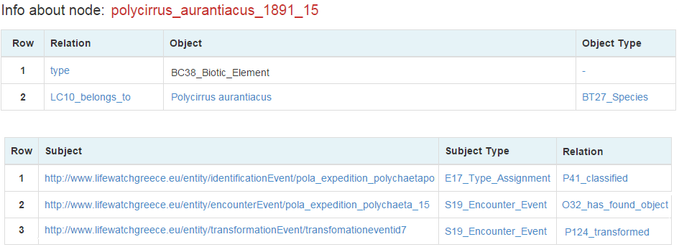
Notes:
Then more data related to the individual is returned such as other events that it took place like an identification event. But the user sees a transformed relationship and by clicking it is directed to a page about this event.

Slide 15
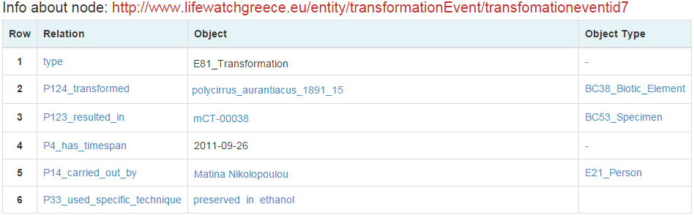
Notes:
There he finds out that the individual was transformed into a specimen by using a preservation in ethanol method and the new name is mCT-00038.

Slide 16
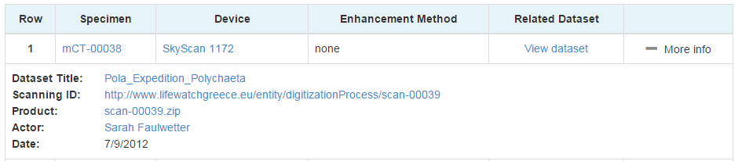
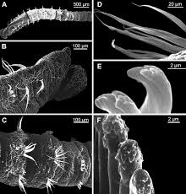
Notes:
By clicking on this name he find out that it was scanned by a Skyscann MicroCT tomograph by Sarah and a dataset was produced. So he can find information about this dataset and download it. This was just a simple example of information integration, navigation to the semantic graph, unique identifier assignment and efficient discovery of dataset. Beginning from a simple question the user found the datasets that he desired along with micro ct datasets that he didn’t even knew that existed.

Slide 17
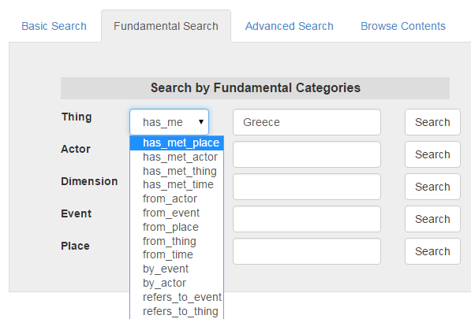
Notes:
We also by taking advantage of the deductions that semantic networks offer we give the capability to the users to perform very generic questions so to search even though they have no knowledge at all about biological terms. So by searching for things that have met Greece someone takes back the entities that fullfill this query.

Slide 18
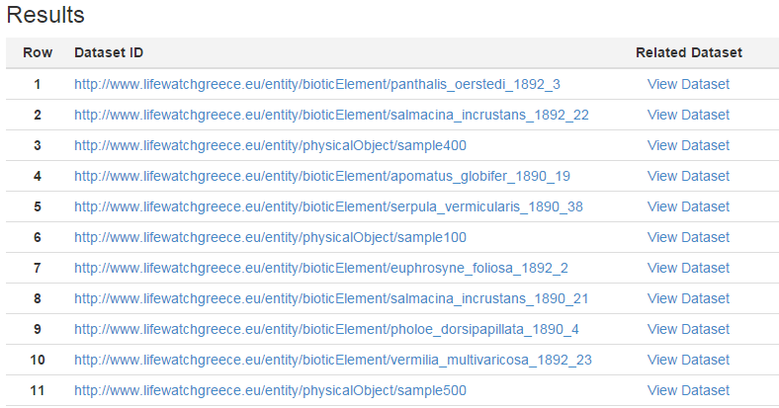
Individuals
DNA sample
Image
Notes:
Animals that have been found in Greece, dna sequences that were extracted from animals that live in Greece, images of animal that have been taken in Greece etc. All these entities are browsable so the users can continue the discovery like we showed in the previous slide and download the datasets of interest.

Slide 19
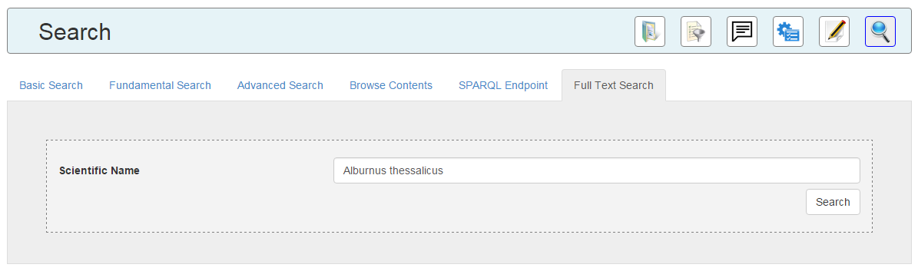
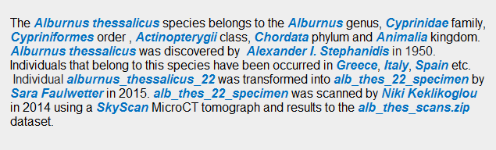
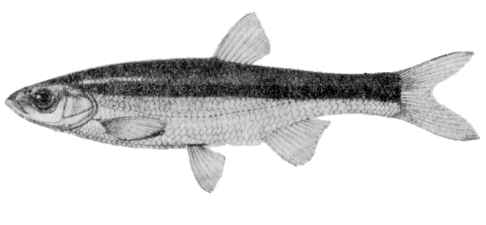
Notes:
Another service that we offer mostly for showcasing is one that the user can insert a scientific name and take back as a story or as a Wikipedia entry the aggregated information. All this text is produced automatically for example if a user enters the name alburnus thessalicus the following is returned to the user. Every link is what is extracted by our databases and is clickable allowing browsing.

Slide 20
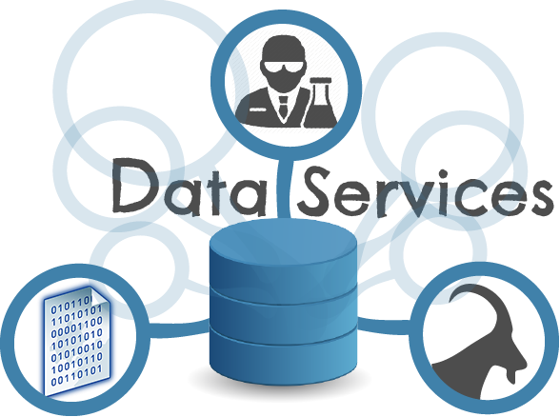
Also
Recovery Mechanisms
Update Functions
Browsing Service
Annotation Service
Data Refinement Service
Public Endpoints
Notes:
Except the services that I demonstrated we have done lots of work that there is no time to show in details. We have implemented new recovery and updating mechanisms. A new browsing service. A morphological characteristics annotation services a data refinement service and public endpoints for my web services.

Slide 21
Conclusions
First biodiversity fully semantic tech - based infrastructure.
New Prototypical Architecture for e-science research infrastructure.
Efficient data discovery.
Exploitation of deductions and implicit knowledge.
Implementation of web services, semantic models, e-services.
Innovation and cross disciplinary scientific interest.
Notes:
To conclude we constructed the first biodiversity fully semantic tech base infrastructure. We created a new architecture that is adopted by a number o European projects. We designed and implemented a efficient data discovery mechanism and a significant number of web services, semantic models and e-services. . We exploited the deductions and implicit knowledge by using inference. And last but not least all this was characterized by innovation and cross disciplinary scientific interest producing a number of publications in both biodiversity and computer science domains.

Slide 22
Thank you

