Slide 1

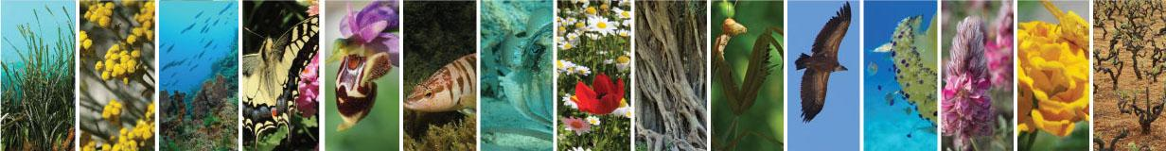









Carlo Allocca, Martin Doerr, Chryssoula Bekiari, Nicolas Bailly, Nikos Minadakis, Yannis Marketakis, Dimitra Mavraki, Stamatina Nikolopoulou, Christos Arvanitidis
Ontologies and Linked Open Data in the LifeWatch Greece Research Infrastructure
Presenter: Yannis Marketakis

Slide 2

Outline
Problem, Approach and Objectives
Ontologies and Linked Open Data
On Generating URIs
MarineTLO
CIDOC CRM and CRM SCI
Modeling the Sampling Process
Concluding Remarks

Slide 3
Problem, Approach and Objective
The problem:
Data providers usually use their own schemata to describe their data
Too much heterogeneity
The process is rarely well-documented
Our Approach:
Provide a conceptual framework that will allow modeling biodiversity data and the biological observation processes
Through the use of ontologies and publishing data as Linked Data
The Objectives:
Enhance the formal representation of biological data and biological observation process
Enable data integration
Make implicit knowledge explicit

Slide 4
Ontologies and Linked Open Data
An Ontology is the formal naming and definition of types, properties and interrelationships of the entities of a domain of discourse
People understand semantics, machines don’t
Linked Open Data
Use Unique Resource Identifiers (URIs) as names for things
Use HTTP URIs so that people can look up those names
Provide useful information about what a name identifies when it’s looked up
Refer to other things using their HTTP URI-based names

Slide 5
Ontologies and Linked Open Data – cont’d
Person
Bob Smith
TimeSpan
2015-09-08
Species
Engraulis encrasicolus
Genus
Thunnus
Event
Occurrence_1
Family
Scombridae
Species
Thunnus albacares
Ecosystem
Victoria Harbour
Order
Perciformes
Equipment
WA265/SS214
Appellation
Τόνος Μακρ.
Appellation
少环刺裂虫
Class
Actinopteri
Event
Morphometric Measurement
Language
Greek
Language
Chinese
Phylum
Chordata
Number
26
Dimension
MAT
Meas. Unit
mm
TimeSpan
2014-08-22
Person
Helen Jack
Animalia
Kingdom

Slide 6
On Generating URIs
Requirements
[R1] Avoid un-named (blank) nodes
Always assign URIs to resources
[R2] Avoid Collisions
Use a combination of attributes to minimize the risk of collisions (depending on the resource)
[R3] Avoid Duplications
Do not create URIs for resources that already exist
An example for Thunnus albacares
<Base>/<EntityCode>/<combination_of_attributes>
http://www.lifewatchgreece.eu/Dataset/Species/Thunnus_Albacares

Slide 7
MarineTLO
MarineTLO aims at being a global core model that
provides a common, agreed-upon and understanding of the concepts and relationships holding in the marine domain to enable knowledge sharing, information exchanging and integration between heterogeneous sources
covers with suitable abstractions the marine and the terrestrial domain to enable the most fundamental queries,
can be extended to any level of detail on demand, and
allows data originating from distinct sources to be adequately mapped and integrated
The Latest version (V.4)
127 Classes
81 Properties
(http://www.ics.forth.gr/isl/MarineTLO/)

Slide 8
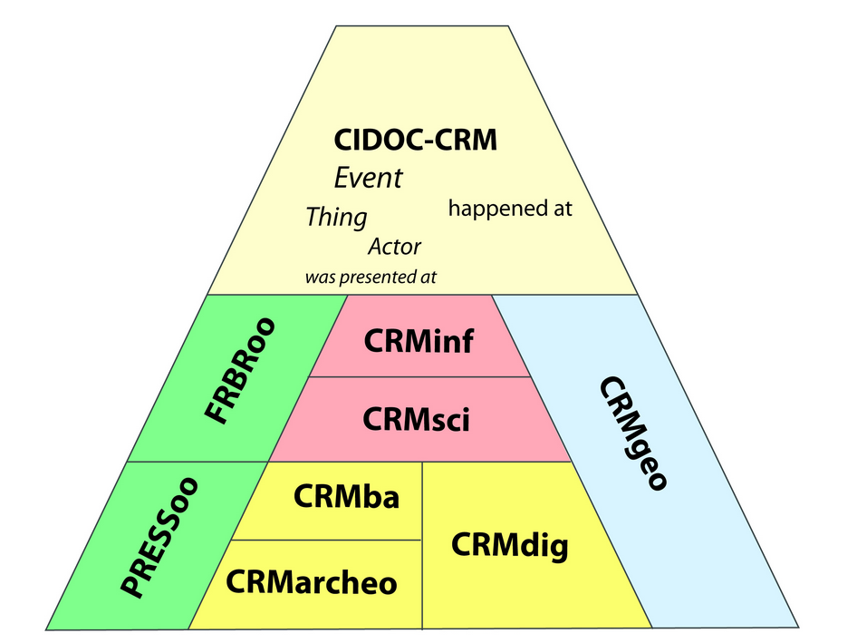
CIDOC CRM and CRMsci
CIDOC CRM is a core ontology which is intended to promote a shared understanding of cultural heritage information.
CRMsci is a formal ontology indented to be used as a global schema for integrating metadata about scientific observation, measurements and processed data in descriptive and empirical sciences such as biodiversity, geology, geography, archaeology, and others.
It uses and extends CIDOC CRM (ISO 21127) http://www.ics.forth.gr/isl/CRMext

Slide 9

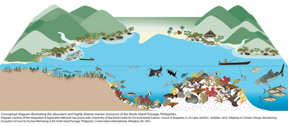


Modeling the Sampling Process
Standard Dataset
Dataset
refers to
Original (detailed) Dataset
S_A
2
Sampling Activity
S_A
1
S_A
3
Sampling Activity
Sampling Activity

Slide 10



Modeling the Sampling Process
Step1: the protocol tells me to measure the position,…ok!
Dimension
observed
dimension
Position Measurement
consists of
Sampling Activity
Dimension

Slide 11
Modeling the Sampling Process
I need to take samples at the depths of
(1m, 5m, 10m)
following the protocol…
S_A
1
1 m
s-1-A
Sampling Activity
s-1-B
s-1-C
s-5-B
5 m
s-5-A
s-5-C
s-10-B
10 m
s-10-A
s-10-C

Slide 12

Modeling the Sampling Process
I need to take samples at the depths of
(1m, 5m, 10m)
following the protocol…
S_A
1
s-1-A
Physical Object
Sampling Activity
1 m
s-1-B
s-1-C
Physical Object
Physical Object
s-5-B
Physical Object
consists of
5 m
s-5-A
s-5-C
Physical Object
Physical Object
s-10-B
Physical Object
s-10-A
Encounter Event
10 m
Physical Object
s-10-C
Physical Object

Slide 13
Modeling the Sampling Process
I need to take samples at the depths of
(1m, 5m, 10m)
following the protocol…
S_A
1
s-1-A
Physical Object
Sampling Activity
1 m
s-1-B
s-1-C
Physical Object
Physical Object
s-5-B
Physical Object
consists of
5 m
s-5-A
s-5-C
Physical Object
Physical Object
s-10-B
Physical Object
s-10-A
Encounter Event
10 m
s-10-C
Physical Object
Physical Object
has found object

Slide 14
Modeling the Sampling Process
I need to take samples at the depths of
(1m, 5m, 10m)
following the protocol…
S_A
1
s-1-A
Physical Object
Sampling Activity
1 m
s-1-B
s-1-C
Physical Object
Physical Object
s-5-B
Physical Object
consists of
5 m
s-5-A
s-5-C
Physical Object
Physical Object
s-10-A
s-10-B
Encounter Event
10 m
Physical Object
Physical Object
has found object

Slide 15
Modeling the Sampling Process
I need to take samples at the depths of
(1m, 5m, 10m)
following the protocol…
S_A
1
s-1-A
Physical Object
Sampling Activity
1 m
s-1-B
s-1-C
Physical Object
Physical Object
s-5-B
Physical Object
consists of
5 m
s-5-A
Physical Object
Physical Object
has found object
s-5-C
Encounter Event
10 m

Slide 16
Modeling the Sampling Process
I need to take samples at the depths of
(1m, 5m, 10m)
following the protocol…
S_A
1
Dimension
1 m
Sampling Activity
Dimension
measured- has dimension
Measurement
consists of
5 m
consists of
Dimension
Encounter Event
10 m

Slide 17
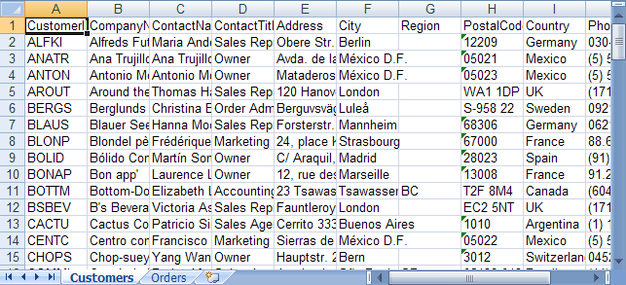

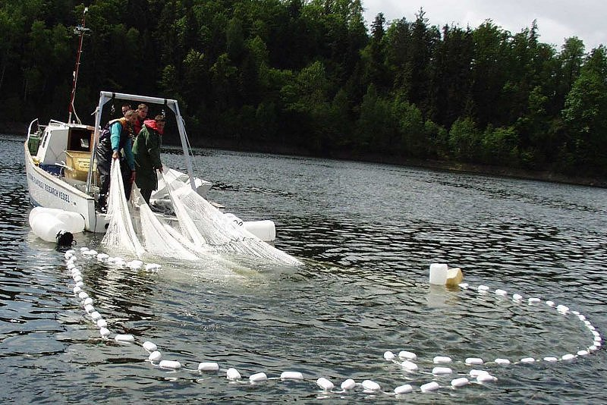

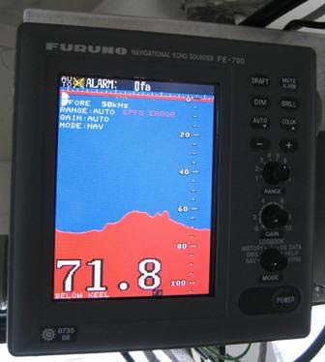

Modeling the Sampling Process
“flat” data
Dimension
observed dimension
consists of
Position Measurement
refers to
Sampling Activity
“linked”
data
consists of
Dataset
Physical Object
s-1-A
s-1-B
has found object
s-1-C
Encounter Event
consists of
measured
Measurement
Dimension

Slide 18
Concluding Remarks
The proposed approach allows:
Enhancing the formal representation of biological data and the biological processes
Expressing implicit knowledge, explicitly
Enabling the data integration from heterogeneous sources
Interlinking biological information
Answering complex queries that cannot be formulated, or answered from the particular data sources

Slide 19
Thank you
Thank You !

Slide 20
Thank you
Supplementary material

Slide 21
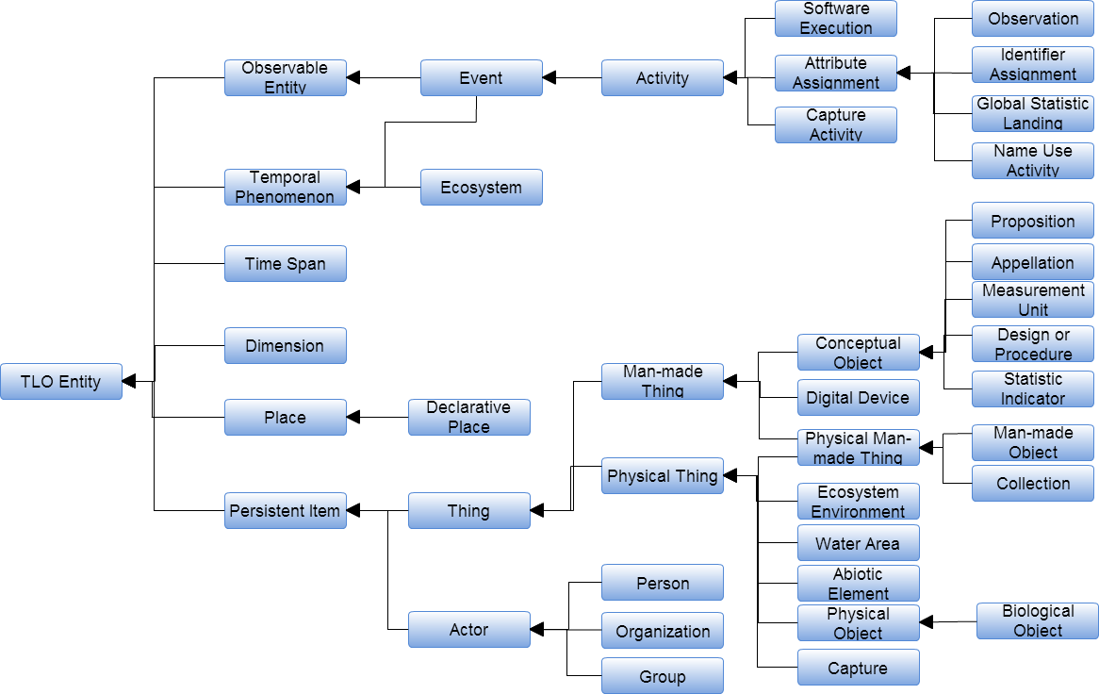
MarineTLO – cont’d

Slide 22
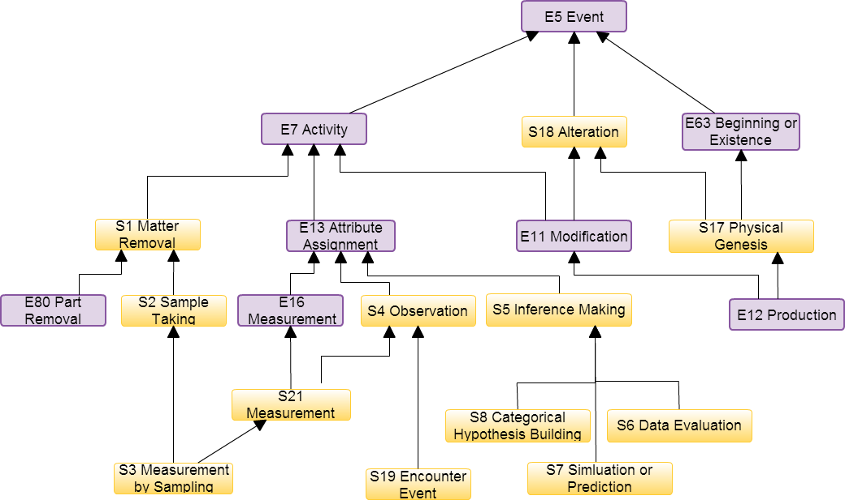
CIDOC CRM and CRMsci – cont’d

Slide 23
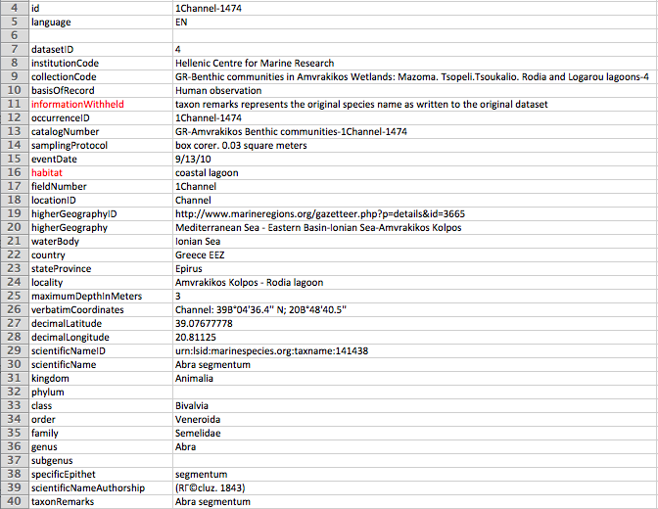
Generic info about the dataset
Geo-Info
Worms Taxonomic info
23

Slide 24
Modeling the Sampling Process
P7 took place at
BC61
Sampling Activity
P9 consists of
includes
SP2
Phenomenal Place
BC54_1
Position Measurement
S_A
1
BC20
Declarative Place
BC34
Geometric Place Expression
BC
Geometric Place Definition
produces
GMLLiteral
asGML
P2 has note
String
String
asFootPrintWKT

Slide 25
Modeling the Sampling Process
LC38_falls_within_or_overlaps
Use “P3 has note” for higherGeographicID and higherGeographic
SP2
Phenomenal Place
LC38_falls_within_or_overlaps
S_A
1
LC38_falls_within_or_overlaps
BC3
Place
BC3
Place
Locality
(Alykes)
LC38_falls_within_or_overlaps
municipality
(Preveza)
BC3
Place
stateProvince
(Epirus)
BC3
Place
E55
Type
LX2 has type
country
(GR)
Place
Terminology
LC4 has appellation
http://vocab.org/places/schema.html
BC26
Place Appellation

