Slide 1
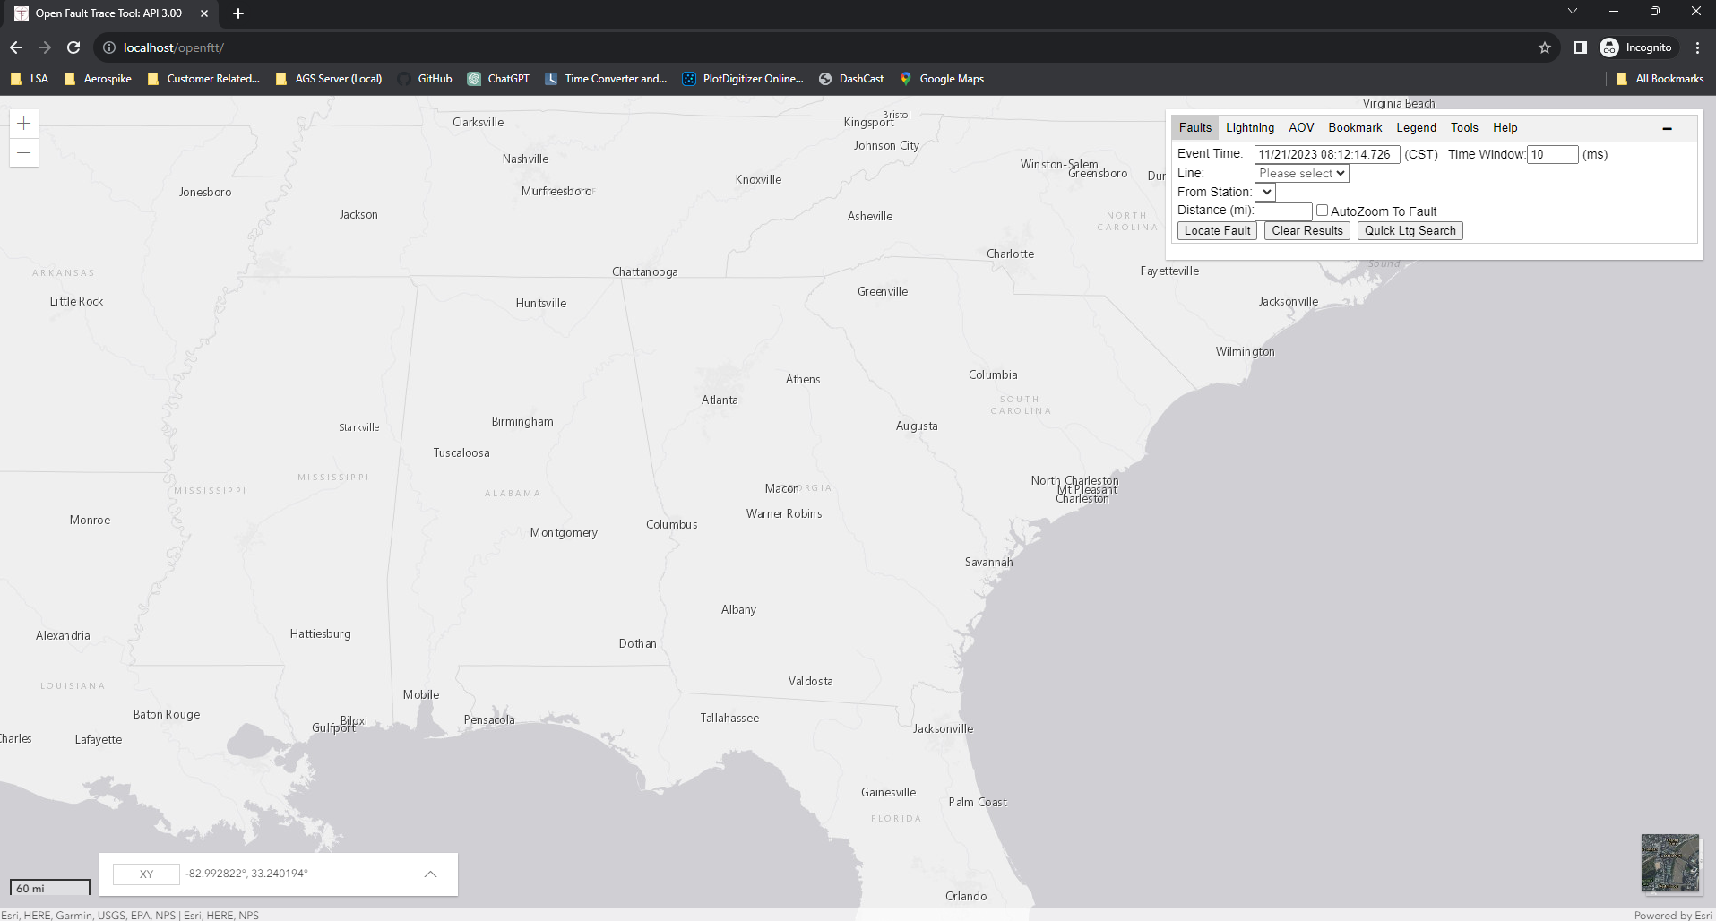

Slide 2
Version
Zoom
Control
Input Area
Map Area
Background
Selector
Scalebar
Coordinate Display

Slide 3

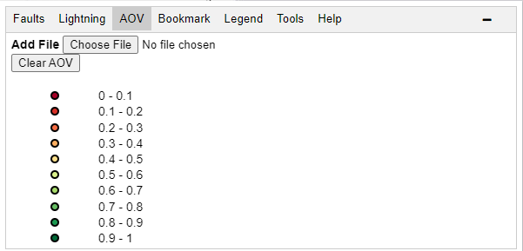

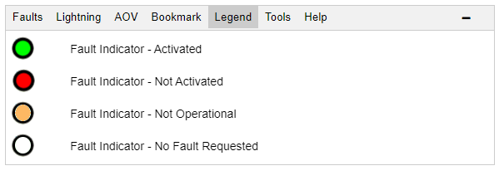




Slide 4




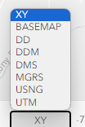

Slide 5
