Slide 1
Leaf Disease Identification

Slide 2
Objectives Proposed
To create the database of leaves using the images that are available.
To extract different morphological features of the leaf using convolution neural networks, in order to know if there is any affected area.
To classify if the leaf is healthy or unhealthy.
Check whether leaf is healthy or not . If unhealthy, then provide a remedy for it.

Slide 3
Objectives Achieved :
Created Leaf Database which consist 15 Variety of class.
Pre processing steps like Resizing , Grey Scale Conversion , Segmentation are done.
Data Augmentation is done to increase the database size.
Model is Trained and Tested.
Reduced Overfitting.
Images are classified.

Slide 4
Steps Followed :
Preprocessing
Data Augmentation
Building Convolutional Architecture.
Model training
Over fit Test
Change Hyper parameter and Retrain Model
Test Model
Develop Flask App
Deploy to Production.

Slide 5
Pre processing :
Resize Image.
Convert Image to Image Array
Convert Image to Gray Scale.
Data Augmentation.

Slide 6
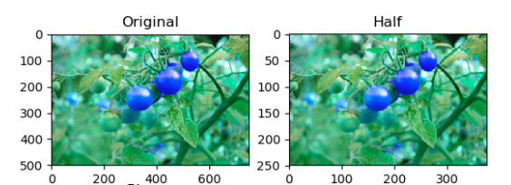


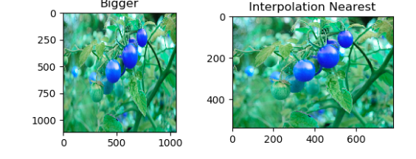
Resizing an Image :

Slide 7
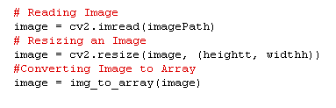
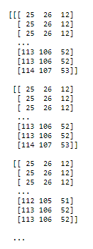
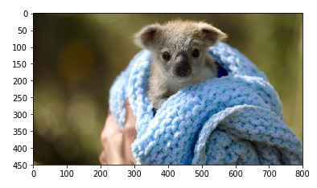
Converting Image to Image Array :

Slide 8
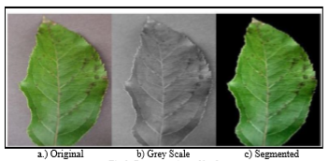
Convert Image to Gray Scale :
Normal Image
Gray Scale Image

Slide 9

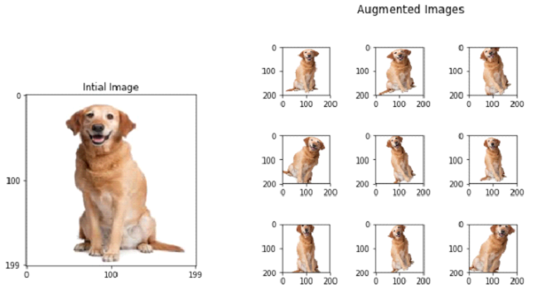
Image Augmentation :

Slide 10
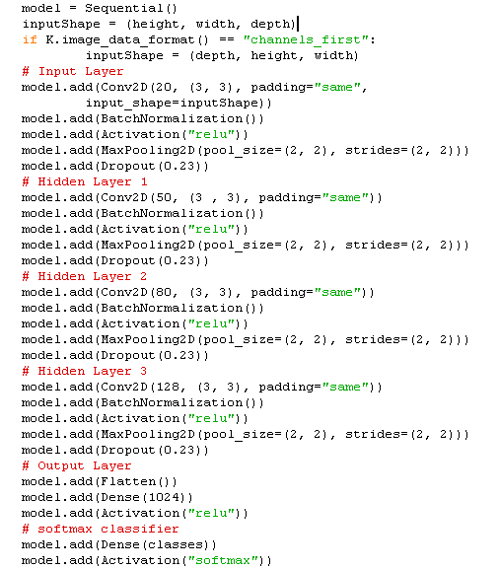
Model Architecture :

Slide 11
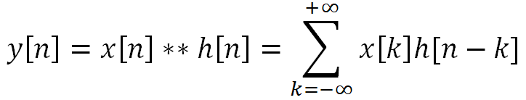
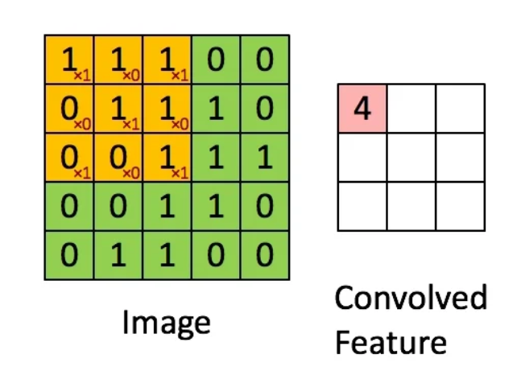
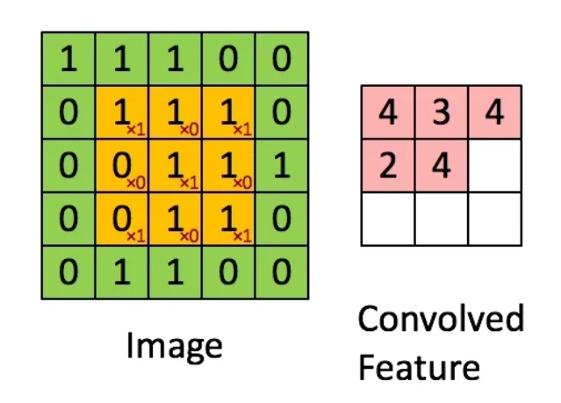
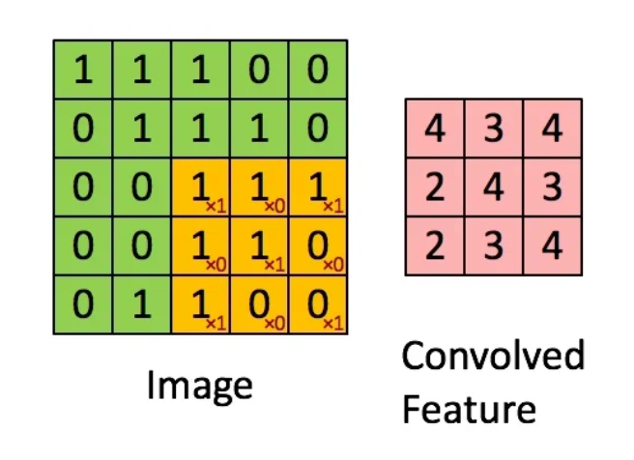
Convolution :
Step 1
Step 2
Step 3

Slide 12
Hyper parameters
Batch Normalization
Activation Function
Max Pooling
Drop Out

Slide 13
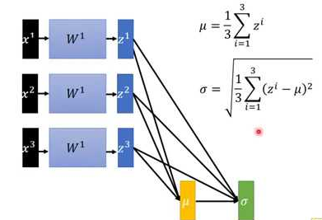
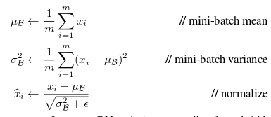
Batch Normalization :
Using batch normalization allows much higher learning rates, increasing the speed at which networks train. Makes weights easier to initialize — Weight initialization can be difficult, especially when creating deeper networks. Batch normalization helps reduce the sensitivity to the initial starting weights.
Normalizes values between 0 to 1.

Slide 14
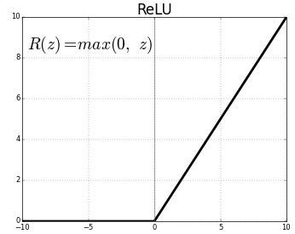

Activation Function :
Activation function used is “Relu” i.e. Rectified Linear Unit.
It’s cheap to compute as there is no complicated math. The model can therefore take less time to train or run.
It converges faster. Linearity means that the slope doesn’t plateau, or “saturate,” when x gets large. It doesn’t have the vanishing gradient problem suffered by other activation functions like sigmoid or tanh.
Expression : y = max(0 , x)
To remove Negative Values.

Slide 15
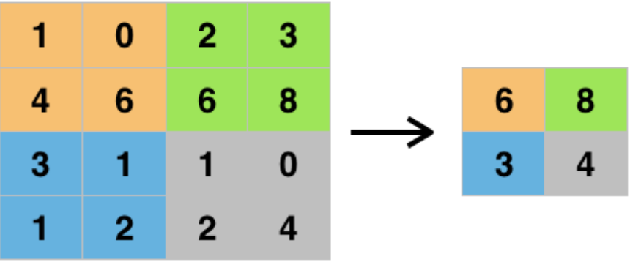

Max Pooling :
Max Pooling function is to progressively reduce the spatial size of the representation to reduce the amount of parameters and computation in the network. The most common form of pooling is max pooling. Max pooling is done to in part to help over-fitting by providing an abstracted form of the representation.

Slide 16
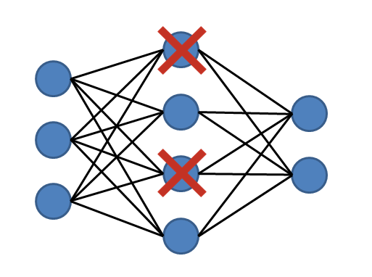

Drop out :
Dropout is a technique used to prevent a model from overfitting. Dropout works by randomly setting the outgoing edges of hidden units (neurons that make up hidden layers) to 0 at each update of the training phase.

Slide 17
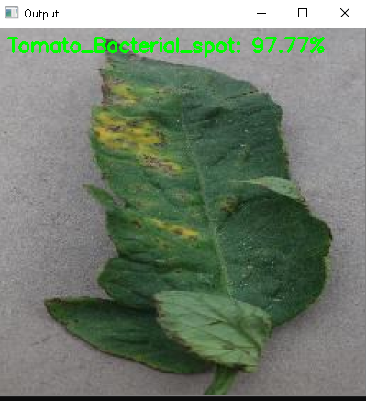
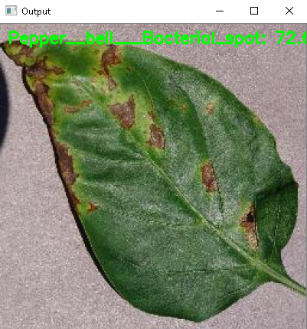
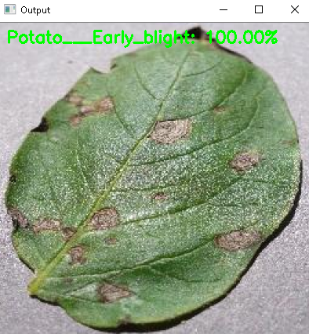
Output :

Slide 18
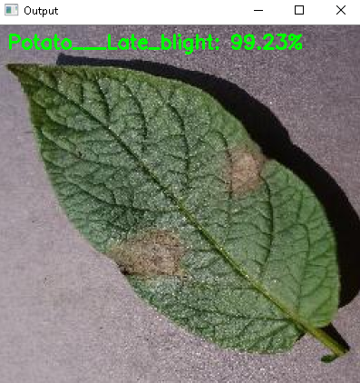
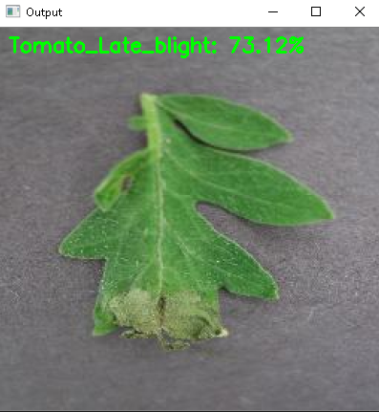
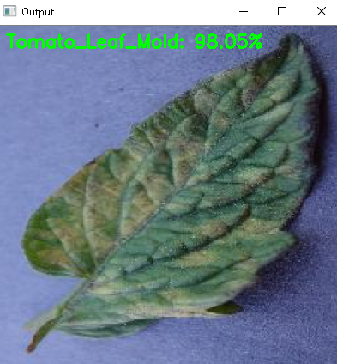

Slide 19
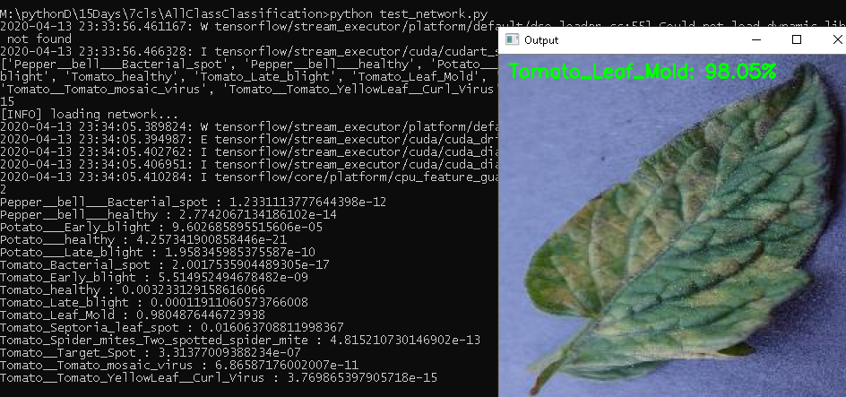
Testing :

Slide 20
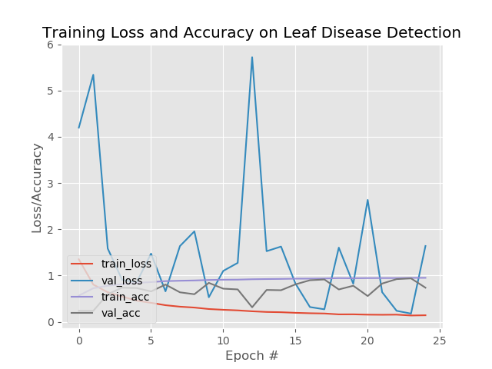
Output Validation and Loss Plot

Slide 21
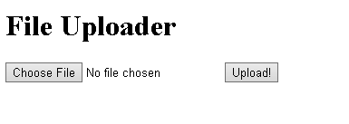

Deploying Model to Flask

Slide 22
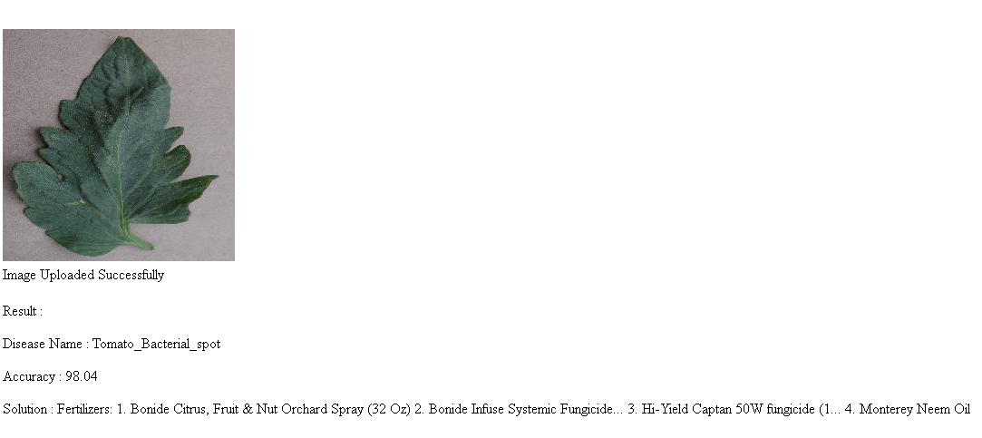
Output :

Slide 23
Conclusion :
Trained Model can classify up to 15 variety of class.
Model has accuracy about 86.80%.
Model neither under fits nor over fits.
Drawbacks :
Model is trained only on single leaf images . So proper result can be obtained only if testing images are focused on single image.
Accuracy decreases when image clarity drops.

Slide 24
Reference :
Sl. No | Paper reference : | Work Done | Drawbacks
1 | [1] | Real Time Detection Of Apple Leaf Disease Using Deep Learning Approach Based On Improved Convolutional Neural Networks. | Efficient only up to a 78.80%
2 | [2] | An optimised Method For Segmentation And Classification Of Apple Leaf Diseases Based On Strong Correlation And Genetic Algorithm Based Feature Extraction. | The system consists of many complex methods to be performed.
3 | [3] | Real Time Power Monitoring Using Field Programmable Gate array with IOT technology | Efficient only up to 80%.
4 | [4] | An Investigation Into Machine Learning Regression Techniques for The Leaf Rust Disease Detection Using Hyperspectral Measurement | This system is applicable only under greenhouse conditions.

Slide 25
Thank You!

