Slide 1
GitLab Inc. (GTLB)
Board of Advisors — Investment Recommendation
BUY
12-Month Price Target
$42.00
95% upside from current $21.51
Market Cap: $3.66B | NYSE: GTLB
Probability-Weighted Target: $45.98 (114% upside)
June 18, 2025 | Agent-Generated Analysis

Slide 2
THE THESIS — In the Agent's Own Words
1. Large & Growing TAM
DevOps market estimated at $30B+, growing 15-20% annually. GitLab's full-stack approach positions it to capture share from fragmented point solutions.
2. Proven Growth Engine
Revenue grew from $424M (FY2023) to $955M (FY2026), a 30% CAGR. 115% NRR and $860M ARR drive predictable growth.
3. Clear Path to Profitability
Operating margins improved 13pp annually: -50% → -32% → -19% → -7%. GAAP profitability projected by FY2028.
4. Strong Balance Sheet
$1.26B in cash & investments with negligible debt ($0.2M). Provides optionality for M&A, R&D, or weathering downturns.
5. What the Market Is Missing
AI monetization potential, operating leverage trajectory, and ARR quality are not fully priced in at 2.56x EV/Revenue.
Source: /input/repo/memo/gitlab_investment_memo.md — Investment Thesis section

Slide 3
WHAT WOULD CHANGE OUR MIND — Thesis Breakers
Three scenarios that would invalidate the BUY recommendation:
NRR Falls Below 110%
NRR has declined from 120% (FY2022) to 115% (FY2026). If this trend continues below 110%, revenue growth would slow significantly, undermining the growth thesis. The 115% NRR still implies $990M in next-year revenue from existing customers — below 110%, this drops below $950M.
What must be true: Enterprise customers stop expanding usage; AI features fail to drive upsells; competitive pressure forces price concessions.
GitHub Captures Full DevOps Workflow
Microsoft's GitHub Copilot has significant mindshare. If GitHub expands beyond code assistance into the full DevOps lifecycle (CI/CD, security, monitoring), GitLab's differentiation erodes. Currently, Copilot is a coding assistant, not a full platform.
What must be true: Microsoft invests heavily in DevOps platform features; GitHub Actions becomes a full CI/CD replacement; enterprise customers consolidate on GitHub.
Macro Recession Cuts Enterprise Software Spend
Enterprise software spending is cyclical. A recession could delay purchases, reduce NRR, and push back the profitability timeline. GitLab's $1.26B cash provides runway, but growth would slow.
What must be true: GDP contraction >2%; enterprise IT budgets cut by 15%+; customer churn increases; new logo acquisition slows.
Source: /input/repo/memo/gitlab_investment_memo.md — Risk Assessment section

Slide 4
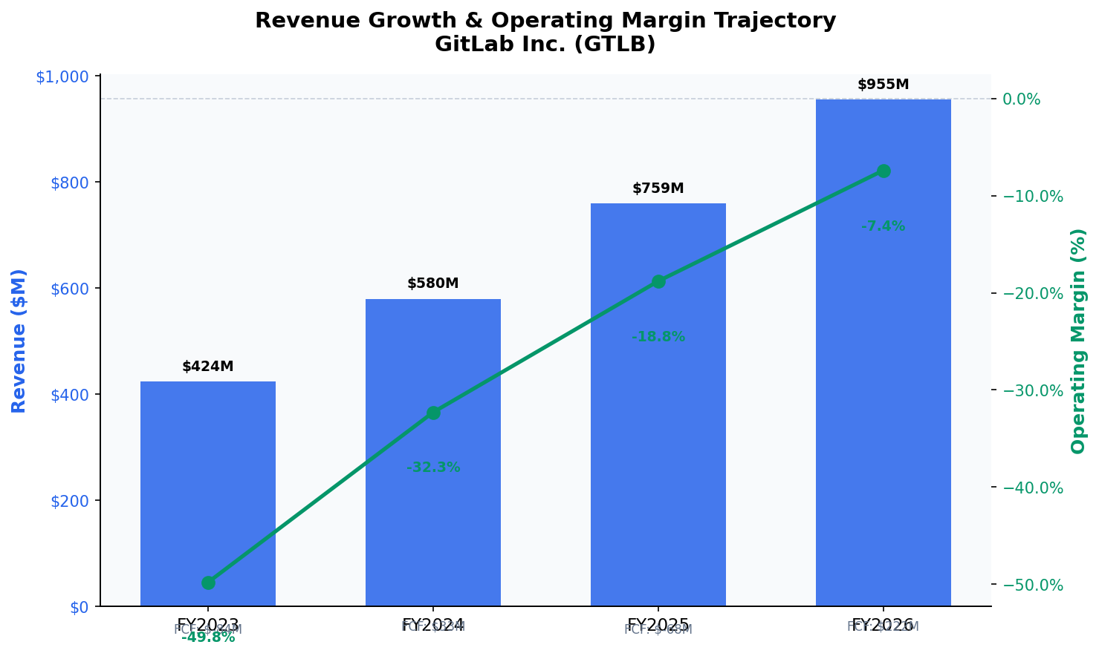
FINANCIAL TRAJECTORY — Revenue & Margins
▸ FY2024: FCF turns positive ($33M) — inflection point
▸ FY2026: Operating margin -7.4% — 13pp improvement per year
Source: /input/repo/extracted/income_statement_annual.csv, financial_summary.json
▸ FY2026: Revenue $955M — approaching $1B threshold for operating leverage

Slide 5
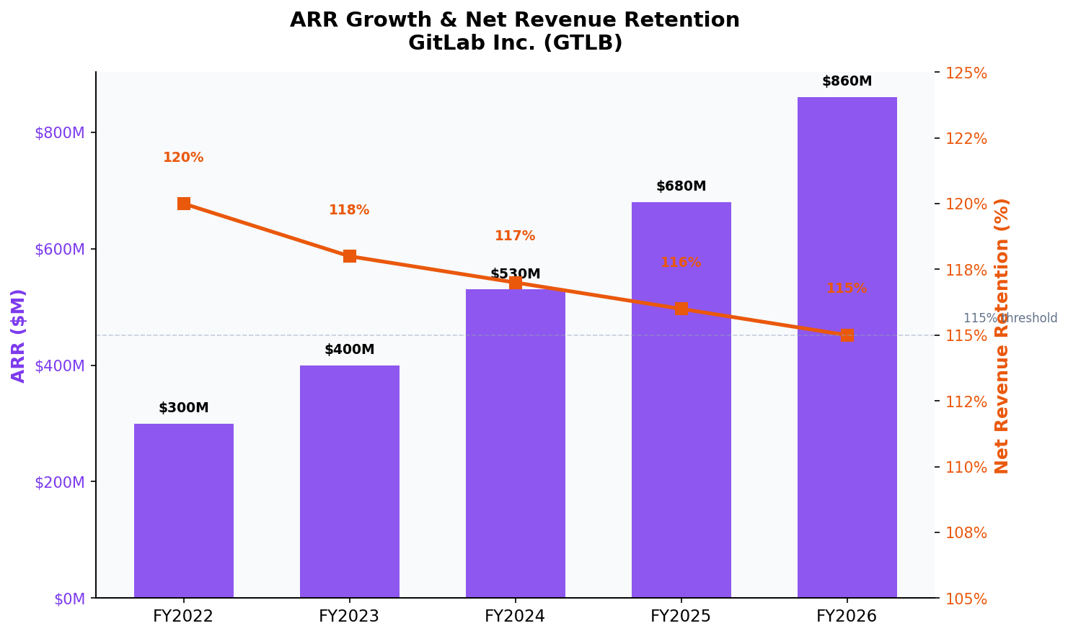
SaaS METRICS — The Growth Engine
$860M ARR
115% NRR
87.4% Gross Margin
$572M Deferred Revenue
Source: /input/repo/extracted/financial_summary.json, balance_sheet_annual.csv
FY2026
Declining from 120%
Stable 87-90%
High visibility

Slide 6
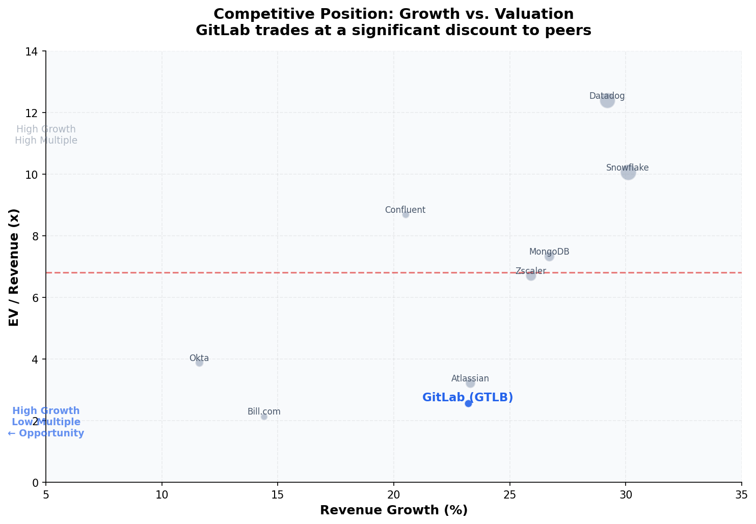
COMPETITIVE POSITION — Growth vs. Valuation
▸ GitLab trades at 2.56x EV/Revenue vs. peer average of ~6.8x — a 62% discount for similar growth rates
Comp set selected per ADR-002: 8 SaaS infrastructure/application peers with similar growth profiles
Source: /input/repo/extracted/competitor_data.json

Slide 7
THE MISPRICING THESIS — Why the Market Is Wrong
Current Price
DCF Base Case
Peer EV/Revenue
$21.51
$38.52
$53.25
2.56x EV/Revenue
10.5% WACC, 3% terminal
7.03x peer average
Market's current assessment
Intrinsic value from cash flows
Relative valuation to peers
Our Target $42.00
95% upside
Three factors the market is underpricing:
1. AI Monetization: GitLab Duo embedded in workflow creates natural upsell paths
2. Operating Leverage: Fixed costs spread over growing revenue base past $1B
3. Balance Sheet: $1.26B cash provides M&A optionality and downside protection
Source: /input/repo/memo/gitlab_investment_memo.md — Valuation section

Slide 8
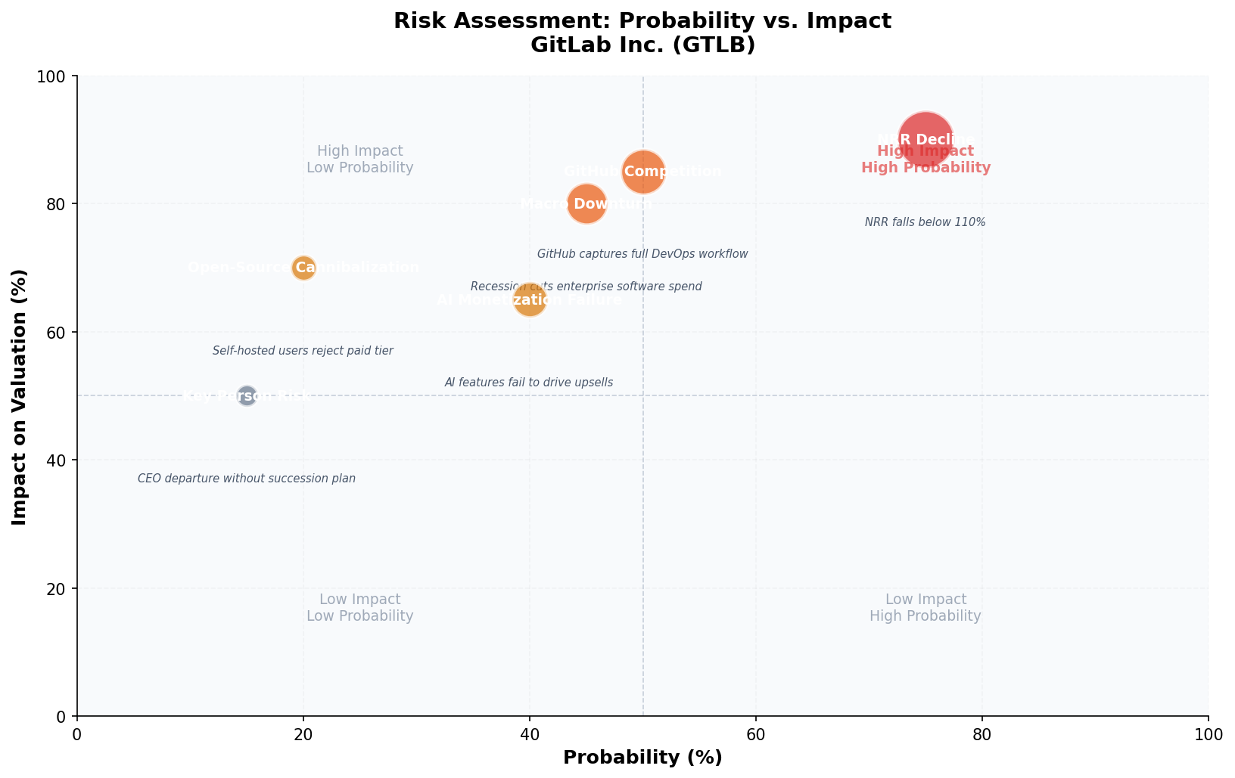
RISK ASSESSMENT — Prioritized by Probability & Impact
▸ Highest priority: NRR decline (75% probability, 90% impact) — monitor quarterly NRR trends
▸ Second priority: GitHub competition (50% probability, 85% impact) — watch Microsoft's DevOps roadmap
Source: /input/repo/memo/gitlab_investment_memo.md — Risk Assessment section

Slide 9
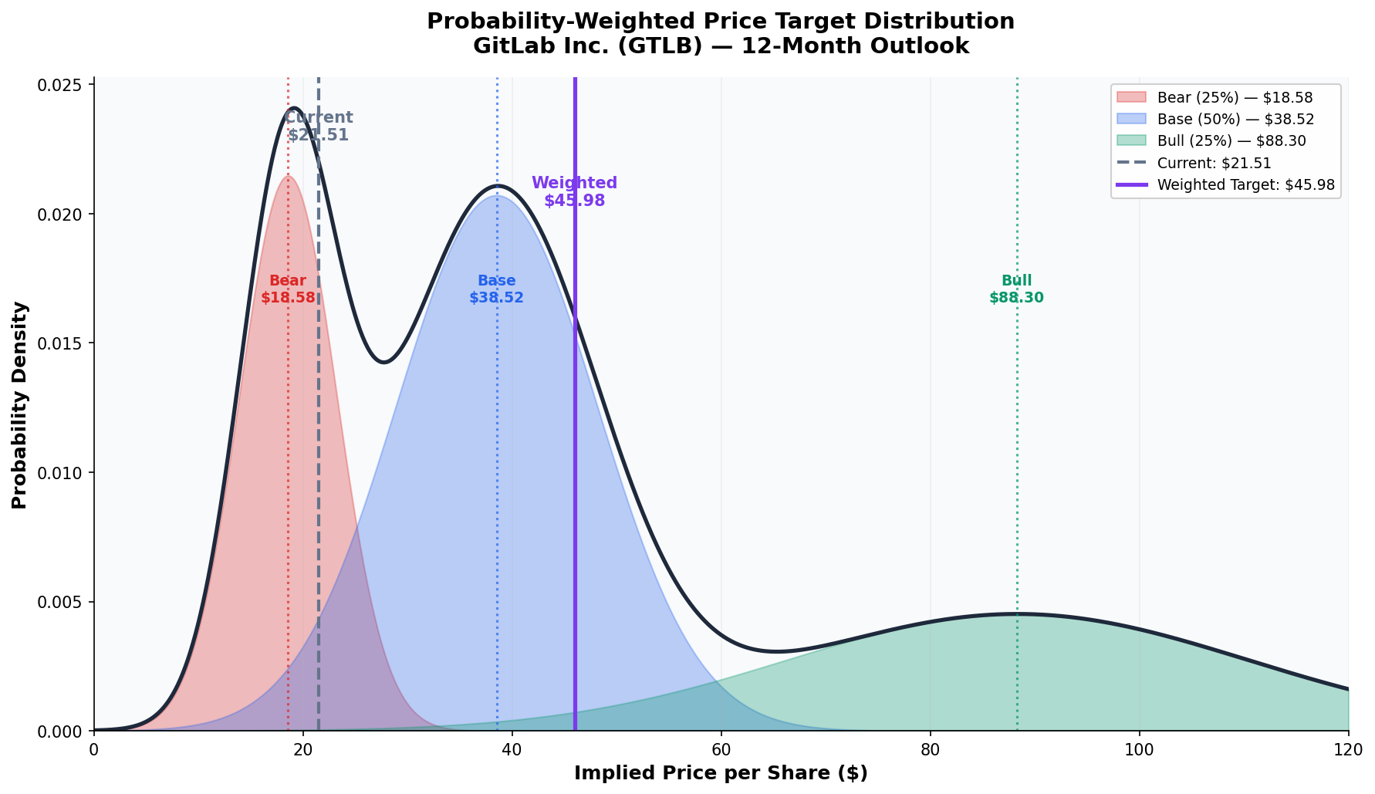
BEAR / BASE / BULL — Probability-Weighted Distribution
Bear (25%)
Base (50%)
Bull (25%)
$18.58
$38.52
$88.30
Source: /input/repo/memo/gitlab_investment_memo.md — Scenario Analysis table

Slide 10
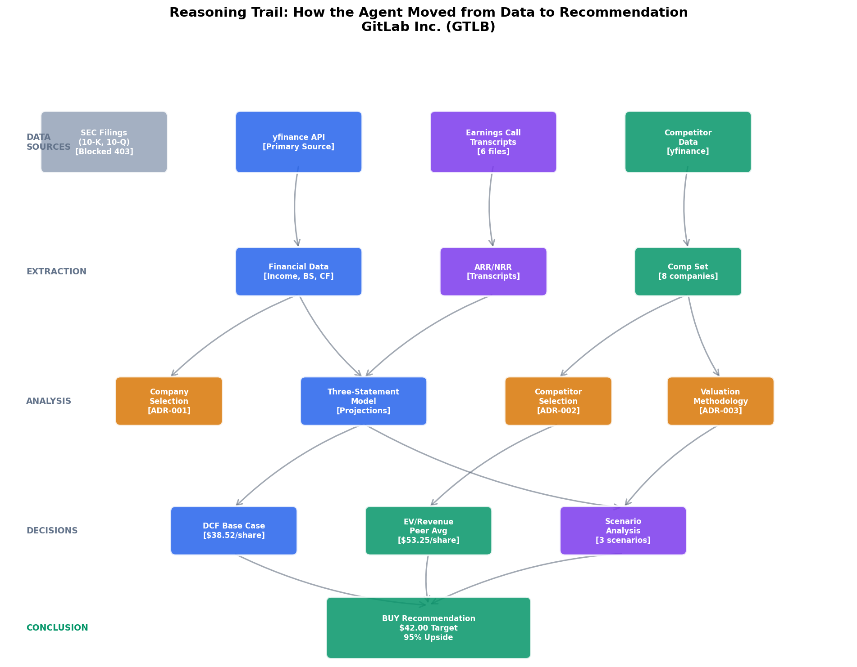
THE REASONING TRAIL — How We Got Here
Source: /input/repo/decisions/ (ADR-001 through ADR-003), /input/repo/tool-log.md

Slide 11
DEAD ENDS — What We Investigated and Rejected
Honest accounting of what didn't work — boards trust analysts who show their work.
SEC Filing Downloads
Attempted 10-K/10-Q downloads from sec.gov. All returned 403 (Forbidden). Tried multiple User-Agent headers, session-based requests, curl, text versions. SEC actively blocks automated access.
Resolution: Used yfinance data instead (SEC-derived secondary source)
GitLab IR Website
DNS resolution failed for investors.gitlab.com. Could not access official earnings presentations or press releases.
Resolution: Relied on Seeking Alpha transcripts instead
PRNewswire Press Releases
Search URL returned 404. PRNewswire may have changed their search API or blocked automated access.
Resolution: No press releases included in analysis
Initial CIK Lookup
CIK 0001687226 mapped to 'Harper James P' not GitLab. Found correct CIK 0001653482 through SEC full-text search.
Resolution: Correct CIK used for all subsequent data retrieval
Earnings Call Audio
No accessible audio sources. Seeking Alpha 'Play Call' buttons require JavaScript execution.
Resolution: Relied on text transcripts only
Source: /input/repo/research/dead-ends.md

Slide 12
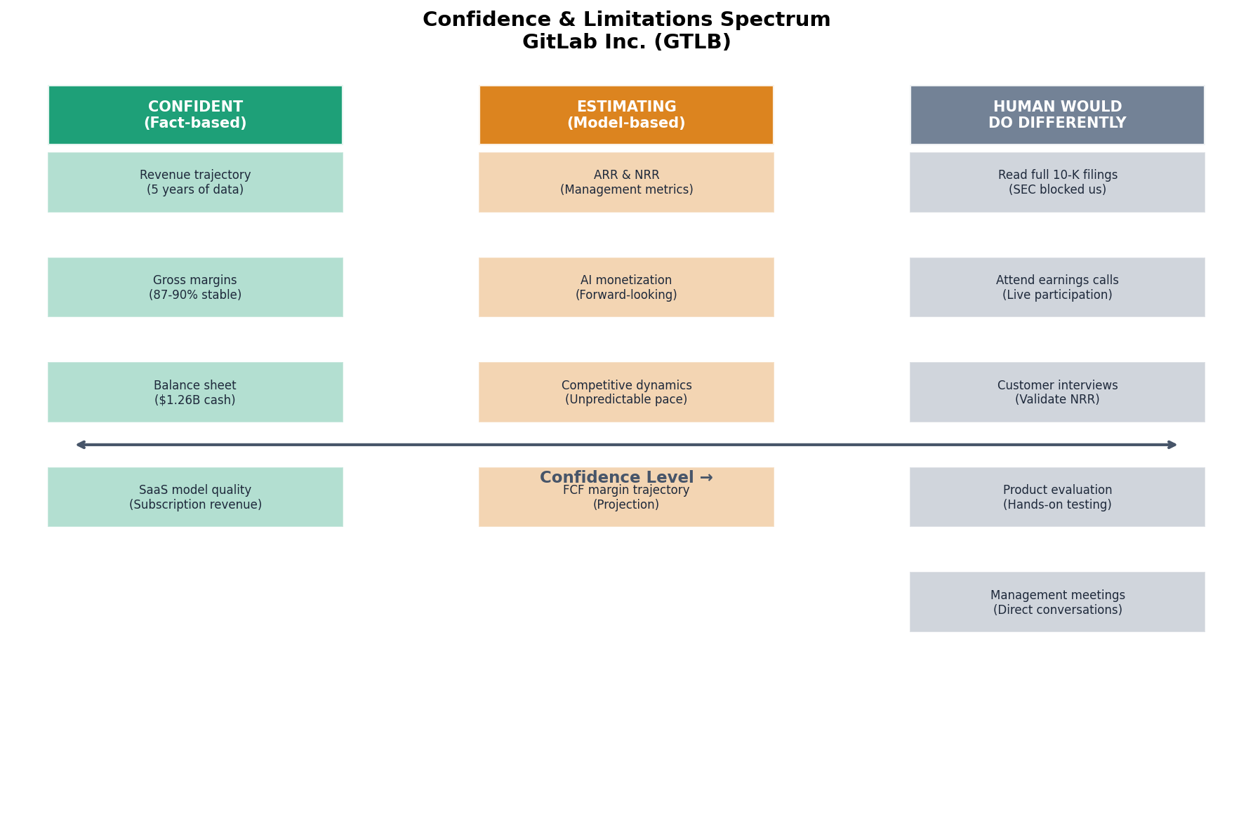
CONFIDENCE & LIMITATIONS — What We Know vs. What We Estimate
▸ We are most confident in revenue trajectory, gross margins, and balance sheet — these are facts, not estimates
▸ We are least confident in AI monetization and competitive dynamics — these are forward-looking estimates
Source: /input/repo/memo/gitlab_investment_memo.md — Confidence and Limitations section

Slide 13
HOW TO AUDIT THIS DECK — Self-Verification Guide
Any board member can verify any claim in this deck in under 2 minutes:
1. Clone the repo
git clone <repo-url> && cd <repo-dir>
Get the full audit trail
2. Pick any number
e.g., 'Revenue FY2026 = $955M' on Slide 4
Choose any claim to verify
3. Find the trace file
cat audit/traces/trace_02_revenue_fy2026.md
Trace file points to source
4. Follow to source
cat /input/repo/extracted/income_statement_annual.csv
Source data in input repo
5. Verify the number
Total Revenue, 2026-01-31: 955224000.0 → $955.2M → $955M
Number matches ✓
Key directories: /audit/traces/ (claim traces) | /audit/numbers.md (all numbers) | /audit/quotes.md (all quotes) | /assets/charts/ (reproducible scripts)

Slide 14
DESIGN & METHODOLOGY — Every Choice Documented
Valuation Methodology (ADR-003)
Chart Conventions (ADR-005)
▸ Primary: DCF with FCF projections (GitLab has positive FCF, predictable revenue)
▸ Dual-axis: Revenue (bars) + margins (line) for financial trajectory
▸ Secondary: EV/Revenue peer comparison (standard SaaS metric)
▸ Scatter: Growth vs. valuation for competitive positioning
▸ WACC: 10.5% (Rf=4.5%, Beta=1.2, ERP=5.5%)
▸ Distribution: Probability-weighted scenarios, not bullet points
▸ Terminal growth: 3.0% (conservative, below GDP growth)
▸ Heat map: Probability vs. impact for risk assessment
▸ Dependency graph: Top-down flow for reasoning trail
Competitor Selection (ADR-002)
Color Palette (ADR-004)
▸ 8 SaaS infrastructure/application peers with similar growth profiles
▸ Blue: Revenue, primary data, GitLab elements
▸ Excluded GitHub (private, owned by MSFT) and ServiceNow (too large)
▸ Green: Positive metrics, bull case, conclusion
▸ Mix of profitable and growth-stage companies for range of multiples
▸ Red: Negative metrics, bear case, risk
▸ Purple: ARR, SaaS metrics, scenario analysis
▸ Orange: Warnings, ADRs, estimating category
Every non-obvious aesthetic and analytical decision has an ADR in /decisions/. 'Used red for downside' is convention; 'chose sequential colormap over diverging because data has natural zero at current price' is an ADR.
Source: /workspace/decisions/ (ADR-001 through ADR-005)

Slide 15
RECOMMENDATION & NEXT STEPS
BUY $42.00 | 95% Upside
Position Sizing
2-3% of portfolio
Moderate position given high conviction but timing uncertainty
Holding Period
Key Catalysts
12 months
▸ FY2027 Q1 earnings (June 2026): First quarter with AI revenue contribution
▸ GAAP operating profitability: Expected FY2028
Re-evaluate at FY2027 Q1 earnings
▸ AI feature expansion: New AI capabilities driving upsell
▸ Potential M&A: $1.26B cash enables strategic acquisitions
GitLab is a high-quality SaaS company with a clear path to profitability, strong SaaS metrics, and a differentiated competitive position. The current valuation of 2.6x EV/Revenue is well below peer averages.
Source: /input/repo/memo/gitlab_investment_memo.md — Recommendation section

Slide 16
Q&A
Key Numbers at a Glance
Current Price
Price Target
Upside
$21.51
$42.00
95%
Market Cap
Revenue (FY2026)
ARR (FY2026)
$3.66B
$955M
$860M
NRR
Cash & Investments
EV/Revenue
115%
$1.26B
2.56x
Peer Avg EV/Revenue
~6.8x
Full audit trail: /audit/ | Chart scripts: /assets/charts/ | Decision records: /decisions/
Disclaimer: This memo is for informational purposes only and does not constitute investment advice.

