Slide 1
Minimum Edit Distance

Slide 2
Definition of Minimum Edit Distance
Many NLP tasks are concerned with measuring how similar two strings are.
Spell correction:
  The user typed “graffe”
  Which is closest? : graf grail giraffe
    the word giraffe, which differs by only one letter from graffe, seems intuitively to be
more similar than, say grail or graf,
The minimum edit distance between two strings is defined as the minimum number of editing operations (insertion, deletion, substitution) needed to transform one string into another.

Slide 3

Minimum Edit Distance: Alignment
The minimum edit distance between intention and execution can be visualized using their alignment.
Given two sequences, an alignment is a correspondence between substrings of the two sequences.

Slide 4
Minimum Edit Distance
If each operation has cost of 1
  Distance between them is 5
If substitutions cost 2 (Levenshtein Distance)
  Distance between them is 8

Slide 5
Other uses of Edit Distance in NLP
Evaluating Machine Translation and speech recognition
R Spokesman confirms
H Spokesman said
S
senior government adviser was shot
the senior I
adviser was shot dead
I
D
Named Entity Extraction and Entity Coreference
  IBM Inc. announced today
  IBM profits
  Stanford President John Hennessy announced yesterday
  for Stanford University President John Hennessy

Slide 6
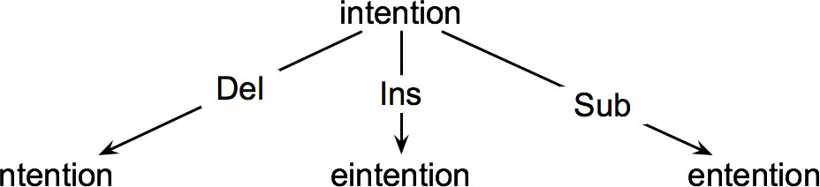
The Minimum Edit Distance Algorithm
How do we find the minimum edit distance?
– We can think of this as a search task, in which we are searching for the shortest path—a
sequence of edits—from one string to another.
The space of all possible edits is enormous, so we can’t search naively.
  Most of distinct edit paths ends up in the same state, so rather than recomputing all those paths, we could just remember the shortest path to a state each time we saw it.
  We can do this by using dynamic programming.
  Dynamic programming is the name for a class of algorithms that apply a table-driven method to solve problems by combining solutions to sub-problems.

Slide 7
Minimum Edit Distance between Two Strings
For two strings
  the source string X of length n
  the target string Y of length m
We define D(i,j) as the edit distance between X[1..i] and Y[1..j]
i.e., the first i characters of X and the first j characters of Y
The edit distance between X and Y is thus D(n,m)

Slide 8

Dynamic Programming for Computing Minimum Edit Distance
We will compute D(n,m) bottom up, combining solutions to subproblems.
Compute base cases first:
– D(i,0) = i
  a source substring of length i and an empty target string requires i deletes.
– D(0,j) = j
  a target substring of length j and an empty source string requires j inserts.
Having computed D(i,j) for small i, j we then compute larger D(i,j) based on previously computed smaller values.
The value of D(i, j) is computed by taking the minimum of the three possible paths
through the matrix which arrive there:

Slide 9

Dynamic Programming for Computing Minimum Edit Distance
If we assume the version of Levenshtein distance in which the insertions and deletions each have a cost of 1, and substitutions have a cost of 2 (except substitution of identical letters have zero cost), the computation for D(i,j) becomes:

Slide 10
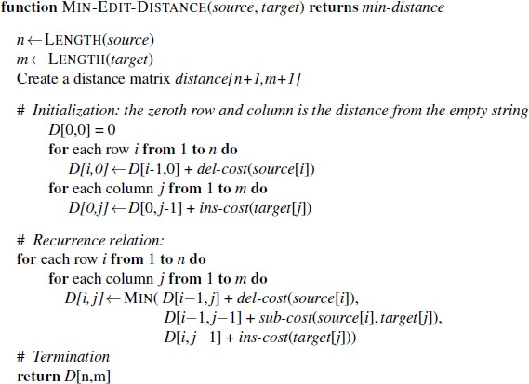
Minimum Edit Distance Algorithm

Slide 11
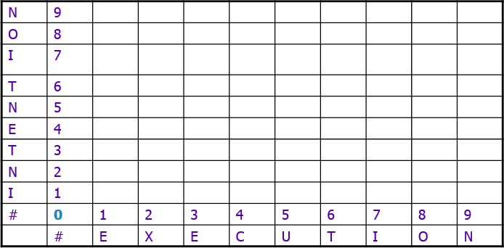
Computation of Minimum Edit Distance between intention and execution

Slide 12
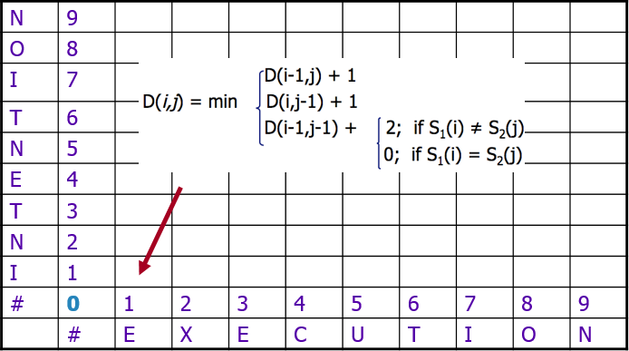
Computation of Minimum Edit Distance between intention and execution
deletion
insertion
substitution

Slide 13
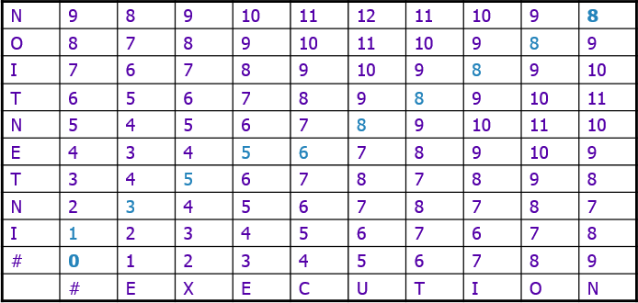






Computation of Minimum Edit Distance between intention and execution

Slide 14
Computing Alignments
Edit distance isn’t sufficient
  We often need to align each character of the two strings to each other
We do this by keeping a “backtrace”
Every time we enter a cell, remember where we came from
When we reach the end,
  Trace back the path from the upper right corner to read off the alignment

Slide 15
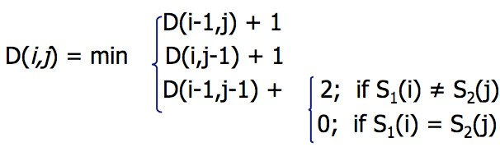
MinEdit with Backtrace
deletion
insertion
substitution

Slide 16
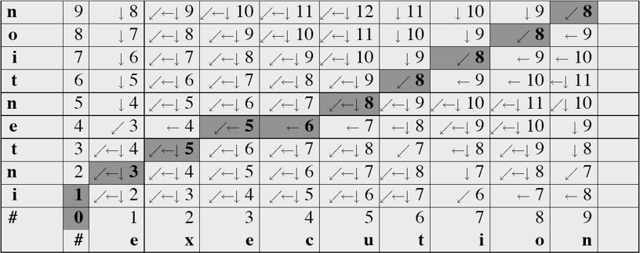
MinEdit with Backtrace

Slide 17
Adding Backtrace to Minimum Edit Distance
Base conditions: |  | Termination:
D(i,0) = i | D(0,j) = j | D(N,M) is | distance
Recurrence Relation:
For each i = 1…M For each j = 1…N
D(i-1,j) | + | 1
D(i,j)= min D(i,j-1) | + | 1
deletion
insertion
D(i-1,j-1) +
2; if X(i) ≠ Y(j)
0; if X(i) = Y(j)
substitution
LEFT DOWN DIAG
insertion
ptr(i,j)=
deletion
substitution

Slide 18
Performance of Minimum Edit Distance Algorithm
Time: O(nm)
Space: O(nm)
Backtrace: O(n+m)

