Slide 1
Semantic Analysis
An Introduction to Natural Language Processing, Computational Linguistics, and Speech Recognition, by Daniel Jurafsky and James H. Martin

Slide 2

Different Kinds of Meaning X means Y
Meaning as definition:
a bachelor means an unmarried man
Meaning as intention:
What did John mean by waving?
Meaning as reference: "Eiffel Tower " means
Introduction to Semantics
February 2009

Slide 3
Semantic Analysis
What is “Semantics”? Semantics is the study of meaning that is used tounderstand human expression through language
Semantics is perhaps the most difficult part of the grammar of a language to learn.The reason is because, basically, meanings in a language are indefinite/undetermined
Semantic can divide into
The study of meaning of individual words (lexical semantics)
The study of how individual words combine to give meaning to
sentence (or larger unit)
Principle of compositionality

Slide 4
Background
Semantic analysis
The process whereby meaning representations are composed and
assigned to linguistic inputs
Among the source of knowledge typically used are
the meanings of words,
the meanings associated with grammatical structures,
knowledge about the structure of the discourse,
Knowledge about the context in which the discourse is occurring, and
Common-sense knowledge about the topic at hand
Syntax-driven semantic analysis
Assigning meaning representations to input based solely on static knowledge from the lexicon and the grammar.

Slide 5
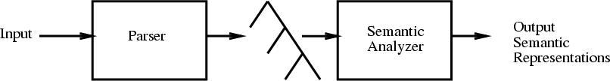
Syntax-Driven Semantic Analysis
Principle of compositionality
The meaning of a sentence can be composed from the meanings of its parts.
In syntax-driven semantic analysis, the composition of meaning representations is guided by the syntactic components and relations provided by the grammars discussed previously.
Assumption:
Do not resolve the ambiguities arising from the previous stages.

Slide 6
Meaning Representation
Verifiability
Unambiguous
Canonical Form
Inference and Variable
Expressiveness

Slide 7
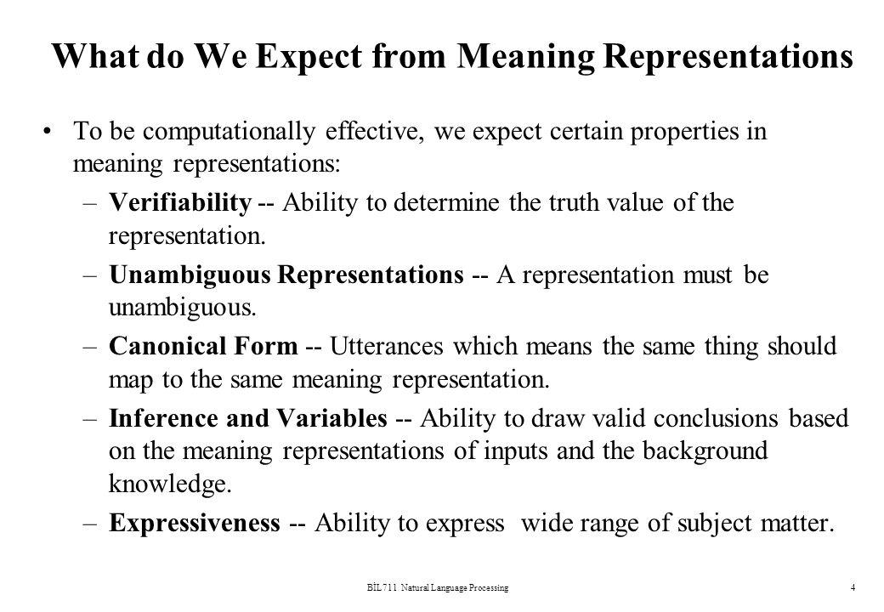
7

Slide 8
Verifiability
The representation of meaning must provide the ability to determine the relationship between meaning and the world as we know it
Does Maharani serve vegetarian food?
Serves(Maharani,VegetarianFood)
We determine the truth by comparing with a knowledge base in the domain
The representation should facilitate comaprison
8

Slide 9
Unambiguous Representation
There are two aspects of ambiguity
semantic ambiguity — inherent in the language
representational ambiguity — caused by interpretation of the representation scheme
I wanna eat someplace that's close to DJSCE.
9

Slide 10
Canonical forms
Contrasting the "one-to-many" problem of one sentence ambiguously mapping to more than one knowledge representation, i.e., having several possible meanings with its converse problem:
The "many-to-one" problem, where multiple sentences should have the same meaning, and hence, map to the same representation.
Example:-
Does Kingfisher serve Hyderabad?
Does Kingfisher offer a flight to Hyderabad?
Does Kingfisher have a flight Hyderabad?
10

Slide 11
Syntax-Driven Semantic Analysis
Input
Parser
Parse Tree
Semantic Analysis
Output Meaning Representation
What does it mean for syntactic constituents to have meaning?
What do these meanings have to be like so that they can be composed into larger meanings?

Slide 12
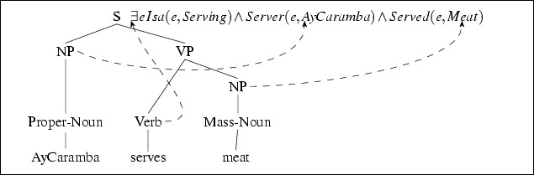
Syntax-Driven Semantic Analysis
What does it mean for syntactic constituents to have meaning?
What do these meanings have to be like so that they can be composed into larger meanings?

Slide 13
Using parse tree, a semantic analyzer produces a semantic representation in following steps:
First, it retrive a meaning representation from the sub-tree corresponding to the verb .The program that interprets the parse tree must have knowledge that it is the verb whose template will define the meaning representation of th whole sentence, and about position of arguments and their roles.
It then identifies the meaning representation corresponding to
the noun phrase.
Finally, it associate or bind the meaning representation of noun phrase

Slide 14
Semantic Attachment
Semantic attachment s are instructions that specify how to compute the meaning representation of construction from the meaning of its constituent parts.
The Semantic attachment are instructions on mapping components of rule to semantic representation
A → α₁ …α_{n} {f(α_{j}.sem, …α_{k}.sem)}
The text appearing {…} specifies that meaning representation assigned to construction A (represented as A.sem) is a function of semantic attachment of A’ s constituents.

Slide 15
Semantic attachment is the process of creating the semantics of a sentence by attaching pieces of semantics to the syntax tree.The problem lies in the composition.
sentence a representation consists of a set of predications: relations between objects and events.
Example : John walks
∃e1, o1 isa(e1, Walk) 𝖠 subject(e1, o1) 𝖠 name(o1, "John")
S
+--NP
| +-- proper noun: John
|
+--VP
+-- verb: walks
20
Source : http://www.garfixia.nl/k/n133/news/view/1440/15/semantic-attachment.html

Slide 16
Model theoretic semantics: correlation between Language & world via set theory & mappings
More specifically, a model
1. Consists of a set D (the domain) and
2. A set of variables,V;
3. A function F (the interpretation function)
4. F assigns to each individual constant a member of D;
5. Assigns to each one-place predicate (arity 1) a subset of D; to each 2-place predicate (eg, eat) a subset of D x D, etc.
Our lambda calculus version merely makes use of lambda functions to serve as these functions.
Lambda calculus (also written as λ-calculus) is a formal system in mathematical logic for expressing computation based on function abstraction and
application using variable binding and substitution.(Wiki)
21

Slide 17
verb node
S {Sem = VP.Sem(NP.sem) = λe isa(e,Walk) 𝖠 subject(e,
<name(y, "John")>)}
proper noun
+--NP {Sem = propernoun.Sem = λy name(y, "John")}
| +-- propernoun: John {Sem = λy name(y, "John")}
|
+--VP {Sem = verb.Sem = λx,e isa(e,Walk) 𝖠 subject(e, x)}
+-- verb: walks {Sem = λx,e isa(e,Walk) 𝖠 subject(e, x)}
Both the VP and the NP node inherit their semantics from their
child node
S node performs some actual composition by applying the semantics of VP, like a
function, to the semantics of the NP
22
S.Sem (the semantics of S) applies the function VP.Sem to the argument NP.Sem.This results in a new function with only one unbound argument.

Slide 18
The verb node gets its semantics from the dictionary entry of walk.
The proper noun get its semantics from a procedure that creates an predication, name(y, "John"), for the word john. Both the VP and the NP node inherit their semantics from their child node.
Only the S node performs some actual composition by applying the semantics of VP, like a function, to the semantics of the NP.
S.Sem (the semantics of S) applies the function VP.Sem to the argument NP.Sem. This results in a new function with only one unbound argument.
Semantic Analysis
23

Slide 19
THANKYOU!
??
??
CFILT - IITB
24

Slide 20

EXTRA SLIDES

Slide 21
LESK’s Algorithm
Two different words are likely to have similar meanings if they occur in identical local contexts.
E.g. The facility will employ 500 new employees.
Senses of facility
installation
proficiency
adeptness
readiness
toilet/bathroom
Subjects of “employ”
Word | Freq | Log Likelihood
ORG | 64 | 50.4
Plant | 14 | 31.0
Company | 27 | 28.6
Industry | 9 | 14.6
Unit | 9 | 9.32
Aerospace | 2 | 5.81
Memory device | 1 | 5.79
Pilot | 2 | 5.37
To maximize similarity select that sense which has the same hypernym as most of the other words in the context
26
CFILT - IITB

