Slide 1
Semantic Analysis

Slide 2
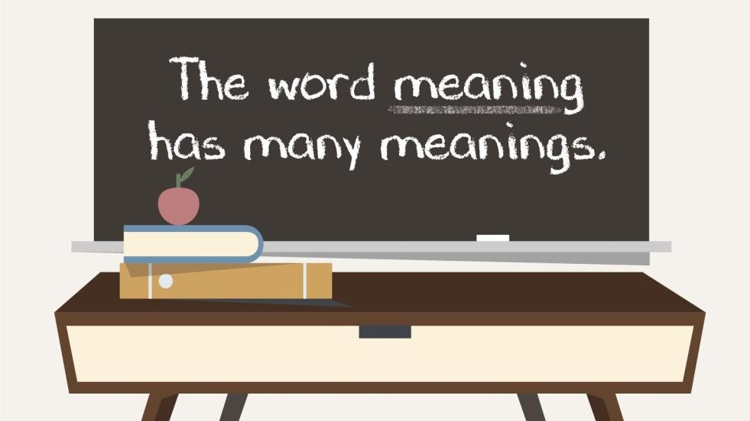
Relationships between word meanings
Homonymy
Polysemy
Synonymy
Antonymy
Hypernomy
Hyponomy
Meronomy
2
26/09/22

Slide 3
lemma and wordform
Wordform | Lemma
banks | bank
sung | sing
duermes | dormir
3
Semantic Analysis

Slide 4
Lemmas have senses
One lemma “bank” can have many meanings:
Sense 2:
Sense 1:
• ...a bank can hold the investments in a custodial 1
account...
“...as agriculture burgeons on the east bank the
river will shrink even more” 2
• Sense (or word sense)
• A discrete representationof an aspect of a word’s meaning.
• The lemma bank here has two senses 14
4
Semantic Analysis

Slide 5
Lemma pepper
Sense 1: spice from pepper plant Sense 2: the pepper plant itself
Sense 3: another similar plant (Jamaican pepper) Sense 4: another plant with peppercorns (California pepper)
Sense 5: capsicum (i.e. chili, paprika, bell pepper, etc)
A sense or word sense is discrete representation of one aspect of meaning of word.

Slide 6
Word Senses
A sense is discrete representation of one aspect of meaning of word.
A sense or “concept” is the meaning
component of a word
There are relations between senses
9
Semantic Analysis

Slide 7
Semantics is perhaps the most difficult part of the grammar of a language to learn.
The reason is because, basically, meanings in a language are indefinite/undetermined.
Remember that language is arbitrary (one of the characteristics of languages). It is arbitrary because the relationship between forms and their meanings are sometimes cannot logically proved
7
Semantic Analysis

Slide 8
“Denotation” (Primary Dictionary Meaning)
Although a form can have more than one meaning, there is always a primary or original meaning that is expresses.
The original meaning of a form in a language is normally
called “denotation”.
With respect to words (lexical terms), the primary (original) meaning is the meaning that we can find in a dictionary.
Example: “Rose” “A garden plant with thorns on its stem
and pleasant-smelling flowers, or a flower from this plant”.
⚫
8
Semantic Analysis

Slide 9
Connotation
Besides, there are additional meaning, which is known
as “connotation”.
With respect to words, connotation or additional meanings of a word are not listed in a dictionary; and therefore, we cannot find them in a dictionary
Normally, a person expresses a connotative meaning through a word, phrase, clause or sentence based on certain characteristics of the entity or event that he/she is referring to.
Example: one may call a beautiful girl a “rose” or a “lily”.
9
Semantic Analysis

Slide 10
HOMONYMY
sense relation in which one form has different meaning; different words with the same form (treated as such in dictionaries)
no relatedness in meaning
e.g. bank1-side of a river
bank2-financial institution
10
Semantic Analysis

Slide 11
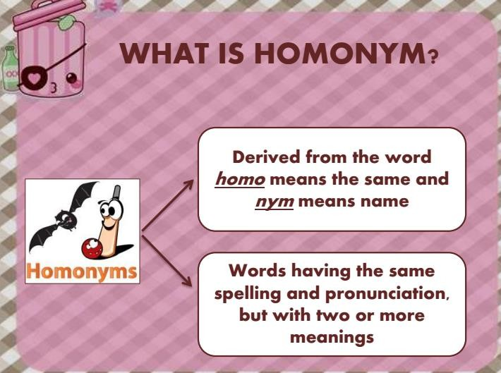
Semantic Analysis

Slide 12
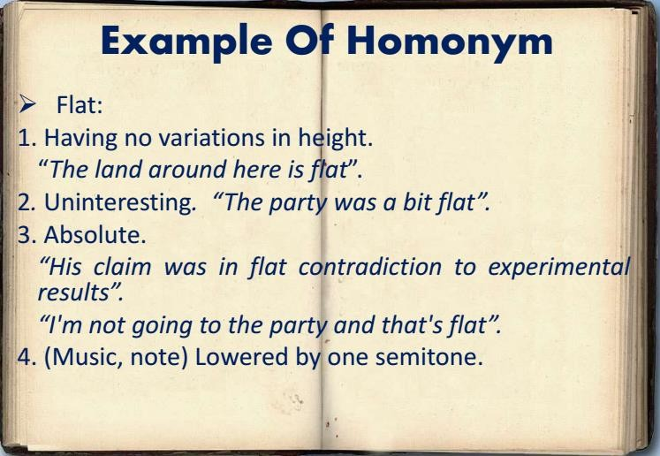
Semantic Analysis

Slide 13
POLYSEMY
One word having several closely related
senses
Native speaker has clear intuition that the different senses are related to each other
Polysemy-close relatedness in m. which is usually connected to metaphorical extension
meaning relatedness has to be synchronic
Semantic Analysis

Slide 14
Polysemy
The bank is constructed from red brick I withdrew the money from the bank
Are those the same sense?
Which sense of bank is this?
Is it distinct from (homonymous with) the river bank sense?
How about the savings bank sense?
A single lexeme with multiple related meanings (bank the building, bank the finantial institution)
25

Slide 15
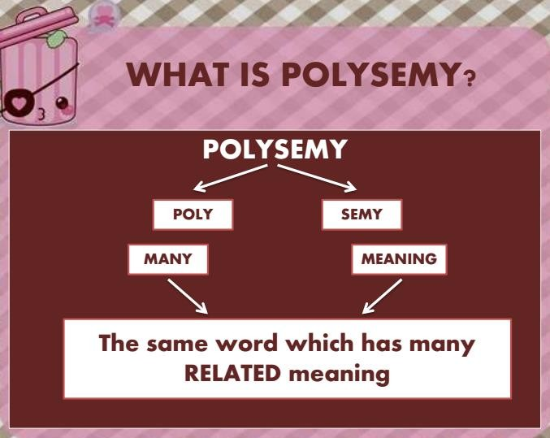
Semantic Analysis

Slide 16
Polysemy is the state or phenomenon in which the words that have more than one meaning.
In other words, it can be described as multiple meanings of words.The words are considered to be related etymologically.
The concrete form of polysemy is called “polyseme”.
Examples: Simple (e.g. English is extremely plain subject).
Plain With nothing added/not decorated in any way (e.g.This blouse is too plain)
Semantic Analysis

Slide 17
The following sentences contain some examples of polysemy.
He drank a glass of milk.
He forgot to milk the cow.
His cottage is near a small wood.
The statue was made out of a block of wood.
He fixed his hair.
They fixed a date for the wedding.
Semantic Analysis

Slide 18
HOMONYMY-POLYSEMY DISTINCTION
Homonymy-polysemy distinction: closeness or relatedness of senses of ambiguous w.
Homonymy- different senses of an ambiguous
are far apart from each other and not related via
speaker’s intuition;
matter of accident or coincidence e.g. bank, mug; kit, bar
Semantic Analysis

Slide 19
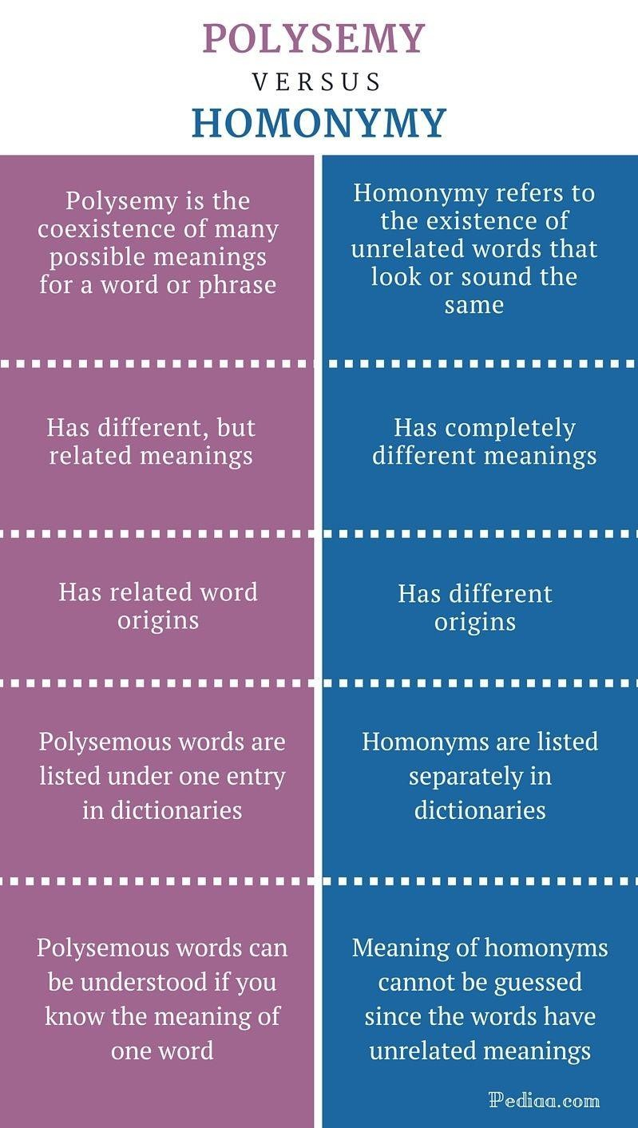
Semantic Analysis

Slide 20
Relation: Synonymy
Synonyms have the same meaning in some or all contexts.
filbert / hazelnut
couch / sofa
big / large
automobile / car
vomit / throw up
Water / H₂0

Slide 21
Relation: Synonymity
Note that there are probably no examples of perfect synonymy.
Even if many aspects of meaning are identical
Still may not preserve the acceptability based on notions of politeness, slang, register, genre, etc.
The Linguistic Principle of Contrast:
Difference in form -> difference in meaning

Slide 22
Synonymy is a relation
between senses rather than words
Consider the words big and large
• Are they synonyms?
How big is that plane?
Would I be flying on a large or small plane?
• How about here:
Miss Nelson became a kind of big sister to Benjamin.
?Miss Nelson became a kind of large sister to Benjamin.
• Why?
big has a sense that means being older, or grown up • large
lacks this sense
Semantic Analysis

Slide 23
Hyponymy and Hypernymy
One sense is a hyponym of another if the first sense is more specific, deno(ng a subclass of the other
• car is a hyponym of vehicle
• mango is a hyponym of fruit
Conversely hypernym/superordinate (“hyper is super”)
vehicle is a hypernym of car
fruit is a hypernym of mango
Semantic Analysis

Slide 24
Hyponymy (i.e. category membership)
fish
hypernym
snapper
trout bass [bæs] sole
salmon [ˈsæm ən]
(co)hyponyms
chinook [(ˌ)tʃɪ ˈnuːk]
spring coho [ˈkəʊ həʊ]
king
sockeye [ˈsɒk aɪ]
It may be problematic to identify the superordinate terms:
brother & sister < sibling (formal)
uncle & aunt < ?
cow & bull < cow/cattle (collective)/bovine (technical)
human being & animal < animal (vs. vegetable, mineral)

Slide 25
Hyponymy more formally
Extensional:
The class denoted by the superordinate extensionally
includes the class denoted by the hyponym
Entailment:
A sense A is a hyponym of sense B if being an A entails being a B •
Hyponymy is usually transitive
(A hypo B and B hypo C entails A hypo C)
• Another name: the IS-A hierarchy
A IS-A B (or A ISA B)
B subsumes A
43
Semantic Analysis

Slide 26
Antonyms
Senses that are opposites with respect to one feature of meaning
Otherwise, they are very similar!
dark/light short/long fast/slow rise/fall hot/cold up/down in/out
• More formally: antonyms can • define a binary opposition or
be at opposite ends of a scale
• long/short, fast/slow
• Be reversives:
rise/fall,up/down
44
Semantic Analysis

Slide 27
Metaphor and Metonymy
Specific types of polysemy
Metaphor:
Germany will pull Slovenia out of its economic slump.
I spent 2 hours on that homework.
Metonymy -the act of referring to something by the name of something else that is closely connected with it, for example using the White House for the US President
The White House announced yesterday.
This chapter talks about part-of-speech tagging
Bank (building) and bank (financial institution)
LING 138/238 Autumn 2004
26/09/22

Slide 28
How do we know when a word has more than one sense?
ATIS examples
Which flights serve breakfast?
Does America West serve Philadelphia?
The “zeugma” test:
?Does United serve breakfast and San Jose?
LING 138/238 Autumn 2004
26/09/22

Slide 29
Synonyms
Word that have the same meaning in some or all contexts.
filbert
youth
big
automobile car
hazelnut adolescent large
Two lexemes are synonyms if they can be successfully substituted for each other in all situations
LING 138/238 Autumn 2004
26/09/22

Slide 30
Synonyms
But there are few (or no) examples of perfect synonymy.
Why should that be?
Even if many aspects of meaning are identical
Still may not preserve the acceptability based on notions of politeness, slang, register, genre, etc.
Example:
Big and large?
That’s my big sister
That’s my large sister
LING 138/238 Autumn 2004
26/09/22

Slide 31
Antonyms
Words that are opposites with respect to one feature of their meaning
Otherwise, they are very similar!
Dark
Boy girl
Hot cold
Up
In
light
down out
LING 138/238 Autumn 2004
26/09/22

Slide 32
Word Similarity Computation
For various computational applications it’s useful to find words which
are similar to another word.
Machine translation (to find near-synonyms)
Information retrieval (to do “query expansion”)
Two ways to do this:
Automatic computation based on distributional similarity
Lsa.colorado.edu
Use a thesaurus which lists similar words.
WordNet (we’ll return to this in a few slides)
LING 138/238 Autumn 2004
26/09/22

