Slide 1
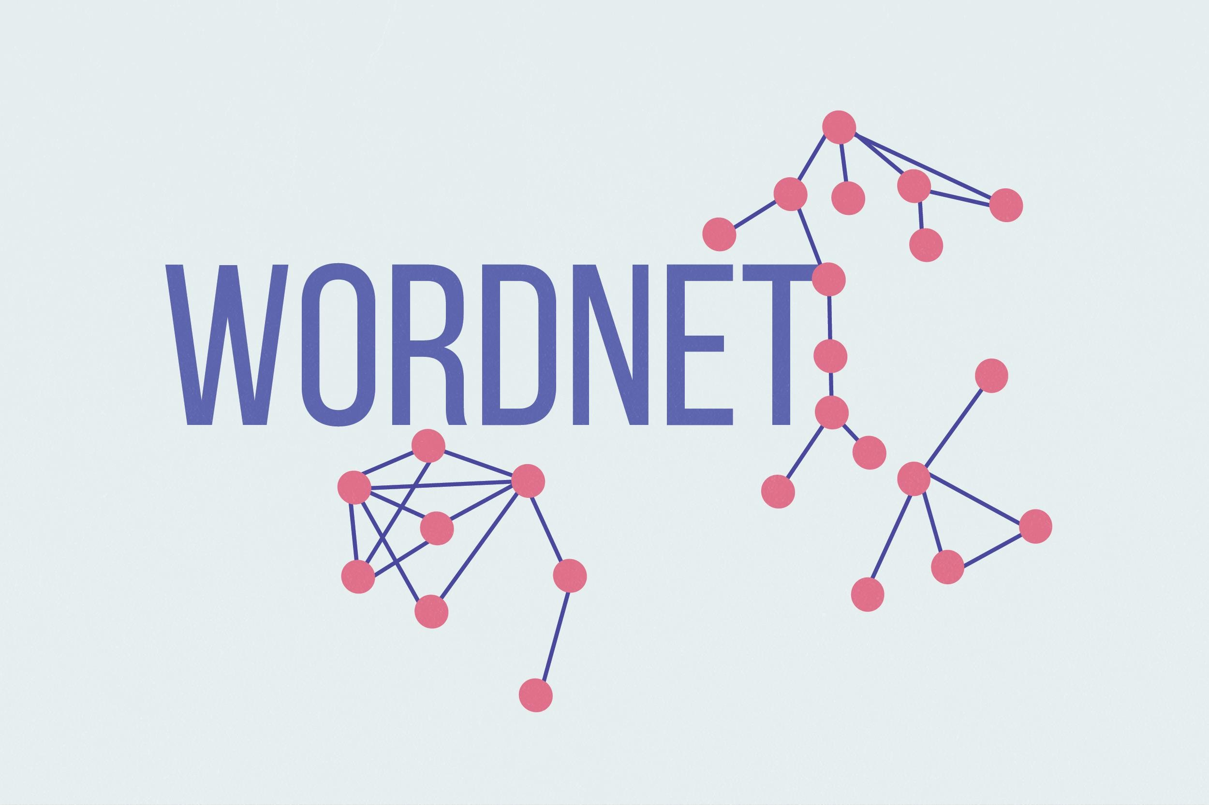
WordNet
Semantic Analysis
1

Slide 2
WordNet
A hierarchically organized lexical database
On-line thesaurus + aspects of a dictionary
Versions for other languages are under development
Category | Unique Forms | # of Senses
Noun | 114,648 | 141,690
Verb | 11,306 | 24,632
Adjective | 21,436 | 31,015
Adverb | 4,669 | 5808
26/09/22
LING 138/238 Autumn 2004
2

Slide 3
Wordnet
WordNet includes the lexical categories
nouns, verbs, adjectives and adverbs but ignores prepositions, determiners and other function words.
Words from the same lexical category that are roughly synonymous are grouped into synsets.
An example adjective synset is: gloss
good, right, ripe – (most suitable or right for a particular purpose; "a good time to plant tomatoes"; "the right time to act"; "the time is ripe for great sociological changes")
26/09/22
LING 138/238 Autumn 2004
3

Slide 4
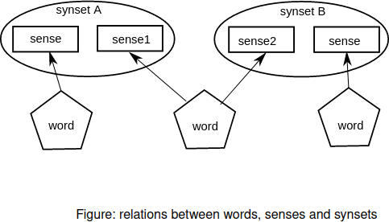
Words, Senses, and Synsets
the word bank has at least two senses: bank1: financial institution, like City Bank;
bank2: sloping land, like river b
Since synsets are group of words sharing the same concept, bank1 and bank2 are members of two different synsets On the other hand, different word forms may also convey the same concept, such as cab and taxi, these word forms
with the same concept are grouped together into one synset.
26/09/22
LING 138/238 Autumn 2004
4

Slide 5
WordNet
Demo:
– http://www.cogsci.princeton.edu/cgi-bin/webwn
26/09/22
LING 138/238 Autumn 2004
5

Slide 6
What is WordNet?
A large lexical database, or “electronic dictionary,” developed and maintained at Princeton
http://wordnet.princeton.edu
Includes most English nouns, verbs, adjectives, adverbs
Can be used by humans and machines
Princeton WordNet is for English only, but it is linked to wordnets is many other languages

Slide 7
WordNet
Synonym set (synset) network
for nouns, verbs, adjectives and adverbs
Synsets connected by semantic relations
E.g. isa, antonymy, etc.
It’s big!
139,000 entries (word senses)
10,000 verbs (polysemy 2)
20,000 adjectives (1.5)
Originally designed as a model of human semantic memory (Miller, 1985)

Slide 8
What’s special about WordNet?
Traditional paper dictionaries are organized alphabetically: words that are found together (on the same page) are not related by meaning
WordNet is organized by meaning: words in close proximity are semantically similar
Human users and computers can browse WordNet and find words that are meaningfully related to their queries (somewhat like in a hyperdimensional thesaurus)

Slide 9
What’s special about WordNet?
WordNet gives information about two fundamental, universal properties of human language:
polysemy and synonymy
Polysemy = one:many mapping of form and meaning
Synonymy = one:many mapping of meaning and form

Slide 10
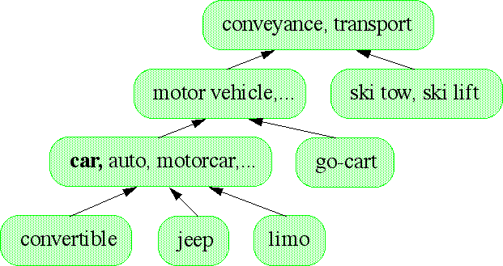
WordNet: Noun isa hierarchy

Slide 11
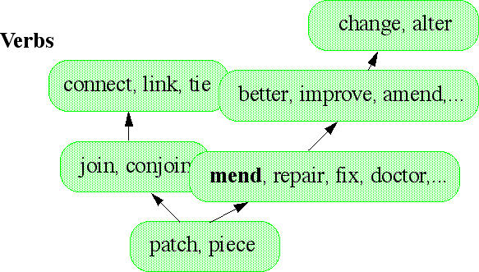
WordNet: Verb isa Hierarchy

Slide 12
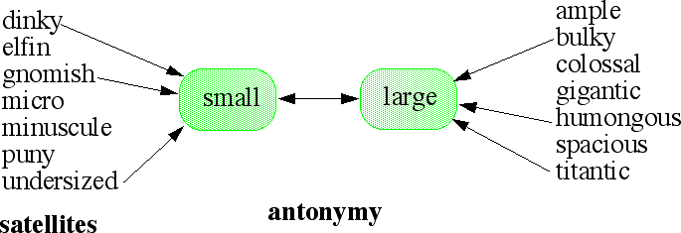
WordNet: Adjective dumbell Model

Slide 13
WordNet: Semantic Relations
Relation | Description | Example
x hyp y | y is a hypernym of x | x: repair, y: improve
x ent y | x entails y | x: breathe, y: inhale
x sim y | y is similar to x (A) | x: achromatic, y: white
x cs y | x causes y | x: anesthetize, y: sleep
x vgp y | y is similar to x (V) | x: behave, y: pretend
x ant y | x and y are antonyms | x: present, y: absent
x sa y | x, see also y | x: breathe, y: breathe out
x ppl y | x participle of y | x: applied, y: apply
x per y | x pertains to y | x: abaxial, y: axial

Slide 14
Polysemy
One word form expresses multiple meanings
{table, tabular_array}
{table, piece_of_furniture}
{table, mesa}
{table, postpone}
Note: the most frequent word forms are the most polysemous!

Slide 15
Synonymy
One concept is expressed by several different word forms:
{beat, hit, strike}
{car, motorcar, auto, automobile}

Slide 16
Synonymy in WordNet
WordNet groups (roughly) synonymous, denotationally equivalent, words into unordered sets of synonyms (“synsets”)
{hit, beat, strike}
{big, large}
{queue, line}
By definition, each synset expresses a distinct meaning/concept
Each word form-meaning pair is unique

Slide 17
Polysemy in WordNet
A word form that appears in n synsets is n-fold polysemous
{table, tabular_array}
{table, piece_of_furniture}
{table, mesa}
{table, postpone}
table is fourfold polysemous/has four senses
four distinct concepts are associated with the word form table

Slide 18
Some WordNet stats
Part of speech | Word forms | Synsets
noun | 117,798 | 82,115
verb | 11,529 | 13,767
adjective | 21,479 | 18,156
adverb | 4,481 | 3,621
total | 155,287 | 117,659

Slide 19
The “Net” part of WordNet
Synsets are interconnected
Bi-directional arcs express semantic relations Result: large semantic network (graph)

Slide 20
Hypo-/hypernymy relates noun synsets
Relates more/less general concepts
Creates hierarchies, or “trees”
{vehicle}
/ \
{car, automobile}
{bicycle, bike}
\
/ \
{convertible} {SUV} {mountain bike}
“A car is is a kind of vehicle” <=>“The class of vehicles includes cars, bikes” Hierarchies can have up to 16 levels

Slide 21
Hyponymy
Transitivity:
A car is a kind of vehicle An SUV is a kind of car
=> An SUV is a kind of vehicle

Slide 22
Meronymy/holonymy (part-whole relation)
{car, automobile}
|
{engine}
/ \
{spark plug} {cylinder}
“An engine has spark plugs”
“Spark plus and cylinders are parts of an engine”

Slide 23
Meronymy/Holonymy
Inheritance:
A finger is part of a hand A hand is part of an arm An arm is part of a body
=>a finger is part of a body

Slide 24
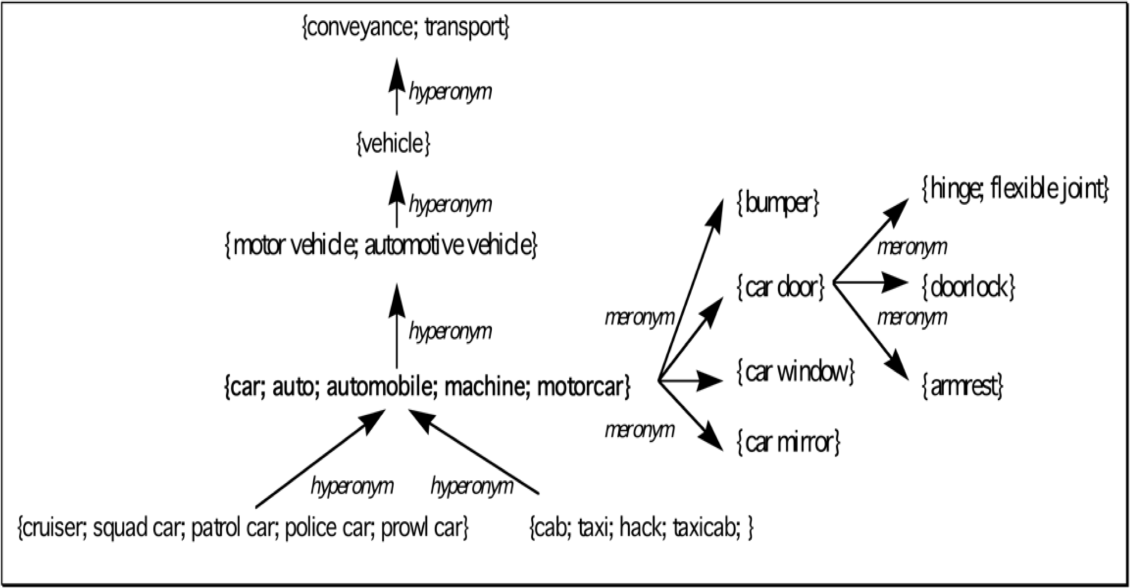
Structure of WordNet (Nouns)

Slide 25
WordNet Data Model
Relations Concepts Vocabulary of a language
bank
rec: 12345 - financial institute | 1
rec: 54321 | 2
- side of a river rec: 9876 |  | 1
- small string instrument rec: 65438 |  | 2
- musician playing violin rec:42654
- musician rec:35576 | 1
- string of instrument rec:29551 | 2
- subatomic particle rec:25876
- string instrument
fiddle violin
fiddler
violist
type-of
type-of
part-of
string

Slide 26
WN as a lexical resource
“Have concept, need words”
--depart from synset, travel in WordNet space
“Have word, need concept”
--query word form, find associated synsets

Slide 27
Is WordNet a Thesaurus?
Yes:
--it groups together meaningfully related words
No:
--it labels the relations
--the relations are limited
--related words are linked to specific concepts (disambiguated); thesaurus is a “bag of words”
--many words linked in WordNet do not co-occur in the same thesaurus entry
--WordNet allows one to measure and quantify the semantic similarity or distance among words and concepts

Slide 28
Web interface for WN search
Noun
S: (n) bicycle, bike, wheel, cycle (a wheeled vehicle that has two wheels and is moved by foot pedals)
direct hyponym / full hyponym
S: (n) bicycle-built-for-two, tandem bicycle, tandem (a bicycle with two sets of pedals and two seats)
ｷ
•
•
•
o
ｷ
ｷ S: (n) mountain bike, all-terrain bike, off-roader (a bicycle with a sturdy frame and fat tires; originally designed for riding in mountainous country)
ｷ
ｷ
ｷ
gear)
S: (n) ordinary, ordinary bicycle (an early bicycle with a very large front wheel and small back wheel)
S: (n) push-bike (a bicycle that must be pedaled)
S: (n) safety bicycle, safety bike (bicycle that has two wheels of equal size; pedals are connected to the rear wheel by a multiplying
ｷ
•
•
•
•
S: (n) velocipede (any of several early bicycles with pedals on the front wheel)
part meronym
S: (n) bicycle seat, saddle (a seat for the rider of a bicycle)
S: (n) bicycle wheel (the wheel of a bicycle)
S: (n) chain (a series of (usually metal) rings or links fitted into one another to make a flexible ligament)
S: (n) coaster brake (a brake on a bicycle that engages with reverse pressure on the pedals)
o
ｷ
ｷ ｷ
ｷ
S: (n) handlebar (the shaped bar used to steer a bicycle)
ｷ S: (n) kickstand (a swiveling metal rod attached to a bicycle or motorcycle or other two-wheeled vehicle; the rod lies horizontally
when not in use but can be kicked into a vertical position as a support to hold the vehicle upright when it is not being ridden)
Verb
ｷ
S: (v) bicycle, cycle, bike, pedal, wheel (ride a bicycle)

Slide 29
WordNet as a lexical resource
WN has been incorporated into many dictionaries
Google “define” usually brings up WN entry at the top of the list
User-created visual interfaces (e.g., visualthesaurus.com)

Slide 30
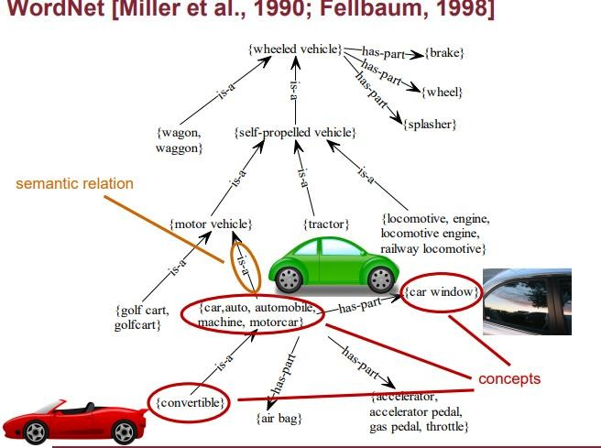

Slide 31
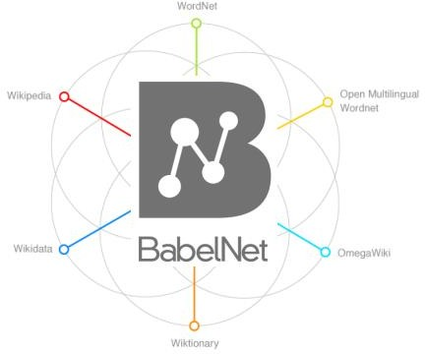
What is BabelNet?
A merger of resources of different kinds:

Slide 32
What is BabelNet?
• A merger of resources of different kinds: – WordNet: the most popular computational lexicon of English – Open Multilingual WordNet: a collection of open wordnets – WoNeF: a French WordNet – Wikipedia: the largest collaborative encyclopedia – Wikidata: the largest collaborative knowledge base – Wiktionary: the largest collaborative dictionary – OmegaWiki: a medium-size collaborative multilingual dictionary – GeoNames: a worldwide geographical database – Microsoft Terminology: a computer science thesaurus
– High-quality automatic sense-based translations BabelNet, Babelfy and Beyond! Roberto Navigli W

Slide 33
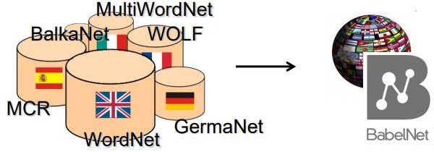
BabelNet is a very large, widecoverage multilingual semantic network. Key to our approach is the integration of lexicographic and encyclopedic knowledge from WordNet and Wikipedia.

Slide 34
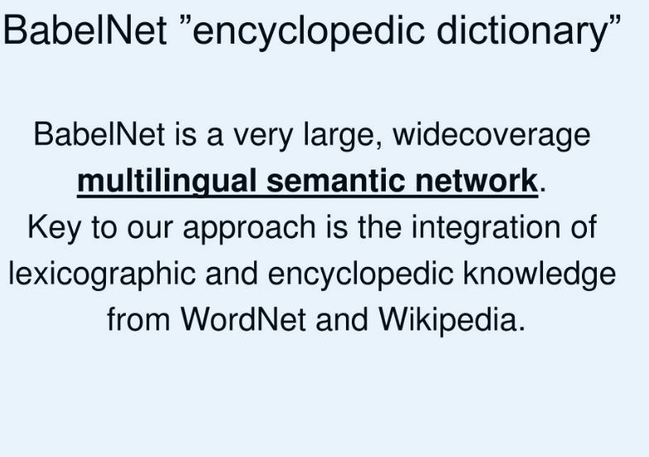

Slide 35
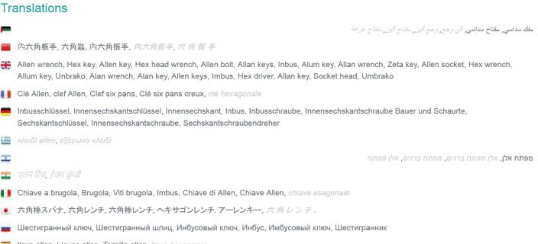
Why do we need BabelNet?
Multilinguality: the same concept is expressed in tens of languages

Slide 36
Why do we need BabelNet?
Multilinguality: the same concept is expressed in tens of languages • Coverage: 271 languages and 14 million entries! – 6M concepts and 7.7M named entities – 119M word senses – 378M semantic relations (27 relations per concept on avg.) – 11M images associated with concepts – 41M textual definitions – 2M concepts with domains associated

Slide 37
