Slide 1
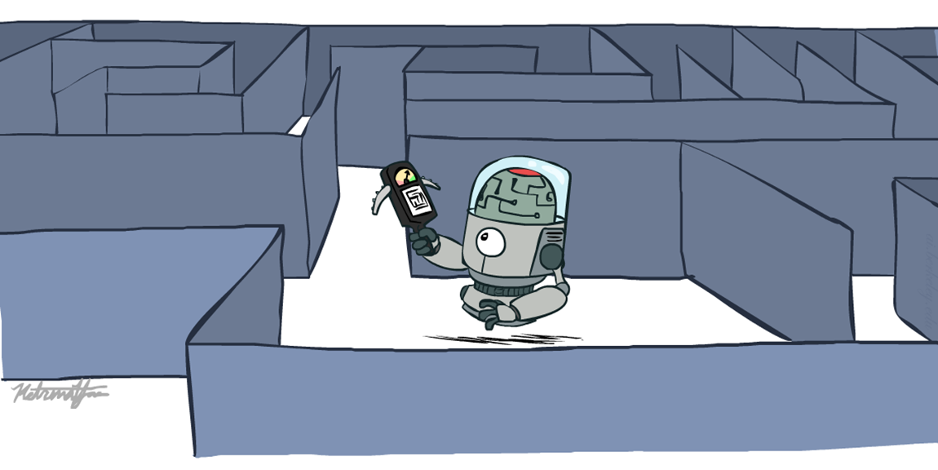
Informed Search
Heuristics Search

Slide 2
Recap: Search
Search problem:
States (configurations of the world)
Actions and costs
Successor function (world dynamics)
Start state and goal test
Search tree:
Nodes: represent plans for reaching states
Plans have costs (sum of action costs)
Search algorithm:
Systematically builds a search tree
Chooses an ordering of the fringe (unexplored nodes)
Optimal: finds least-cost plans

Slide 3
Uninformed vs. Informed Search
Feature | Uninformed Search (Blind) | Informed Search (Heuristic)
Knowledge | No domain-specific knowledge; only knows how to distinguish a goal state from a non-goal state. | Uses domain-specific knowledge (heuristics) to estimate the distance to the goal.
Efficiency | Generally less efficient; may explore many unnecessary paths. | Highly efficient; narrows down the search space significantly.
Performance | Can be slow and memory-intensive for complex problems. | Faster and more optimized for large-scale problems.
Cost | Usually higher in terms of time and space complexity. | Lower, provided the heuristic is good.
Key Algorithms | Breadth-First Search (BFS), Depth-First Search (DFS), Uniform Cost Search. | A* Search, Greedy Best-First Search, Hill Climbing.
Direction | Operates blindly in all possible directions. | Directed toward the goal using a Heuristic Function h(n).

Slide 4
Today
Informed Search
Heuristics
Greedy Search
A* Search

Slide 5
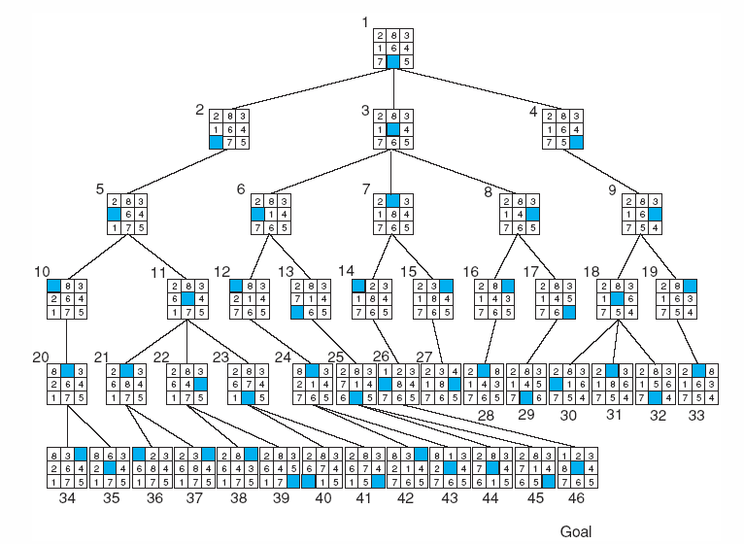
Breadth-first search of the 8-puzzle, showing order in which states were removed from open.

Slide 6
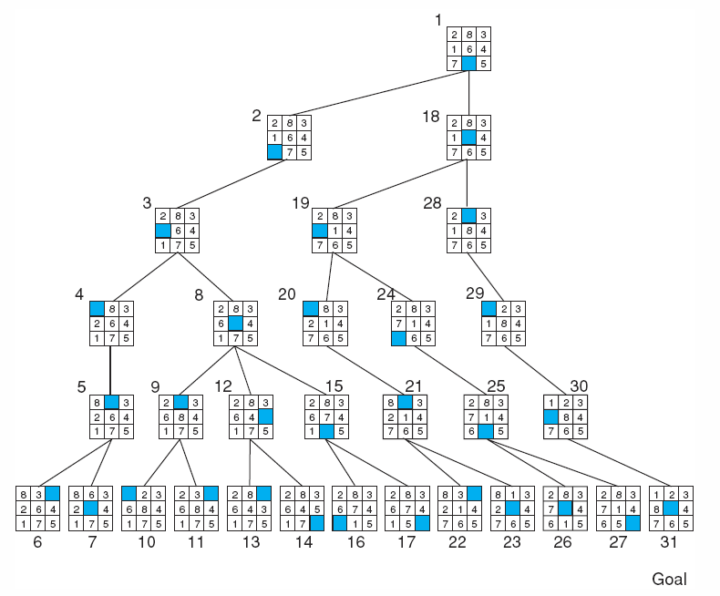
Depth-first search of the 8-puzzle with a depth bound of 5.

Slide 7
Using problem specific knowledge to aid searching
With knowledge, one can search the state space as if he was given “hints” when exploring a maze.
Heuristic information in search = Hints
Leads to dramatic speed up in efficiency.
A
B
C
D
E
Search only in this subtree!!
F
G
H
I
J
K
L
M
N
O

Slide 8
What are Heuristics?
Heuristics are know-hows obtained through a lot of experiences.
Heuristics often enable us to make decisions quickly without thinking deeply about the reasons.
The more experiences we have, the better the heuristics will be.

Slide 9
When Heuristics are used?
AI problem solvers employ heuristics in two basic situations:
A problem may not have an exact solution because of inherent ambiguities in the problem statement or available data.
Medical diagnosis: Given symptoms may have several possible causes;
Doctors use heuristics to choose the most likely diagnosis and formulate a treatment plan.
A problem may have an exact solution, but the computational cost of finding it may be prohibitive.
Chess: state space growth is combinatorically explosive, with the number of possible states increasing with the depth of the search.
Heuristics attack this complexity by guiding the search along the most “promising” path through the space.

Slide 10
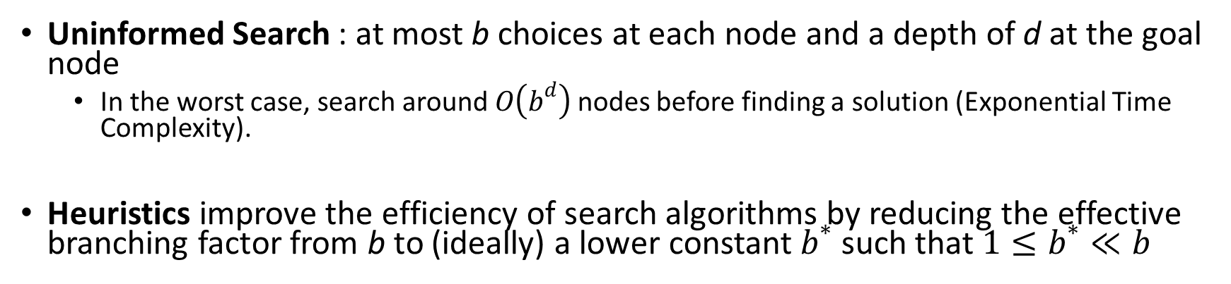
Why heuristic functions work?
Uninformed Search : at most b choices at each node and a depth of d at the goal node
In the worst case, search around $O\left(b^{d}\right)$ nodes before finding a solution (Exponential Time Complexity).
Heuristics improve the efficiency of search algorithms by reducing the effective branching factor from b to (ideally) a lower constant $b^{∗}$ such that$1≤b^{∗}≪b$
Guide search towards the goal instead of all over the place
Start
Goal
Start
Goal
Informed
Uninformed

Slide 11
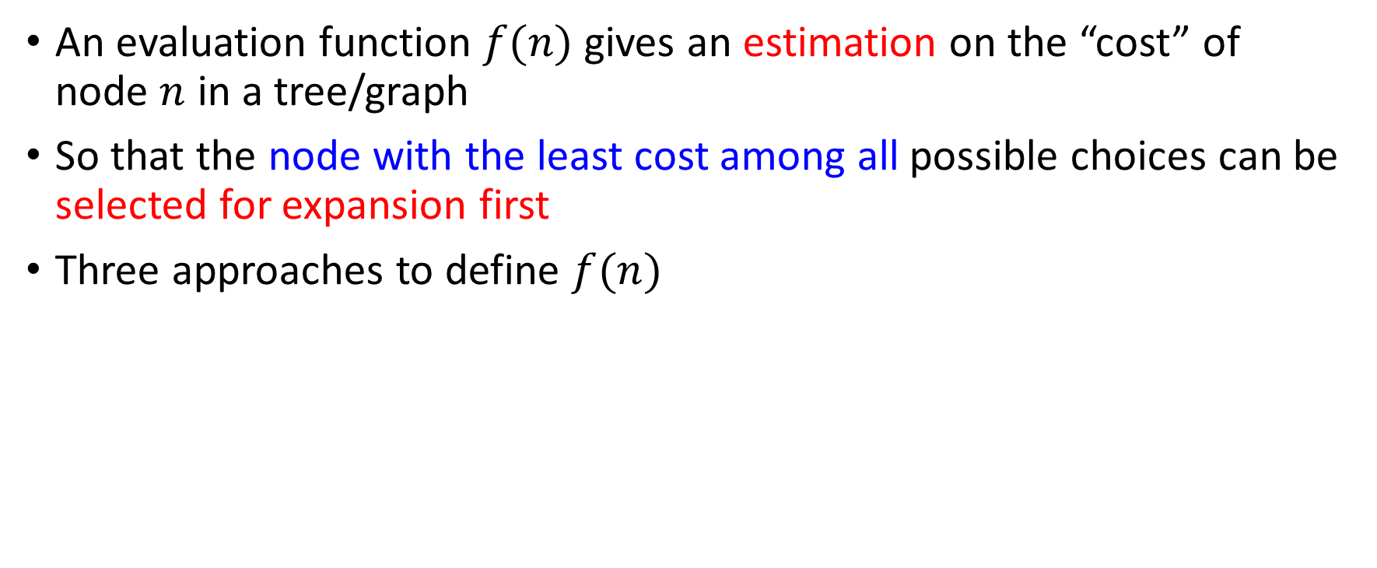
Evaluation Function
An evaluation function $f(n)$ gives an estimation on the “cost” of node $n$ in a tree/graph
So that the node with the least cost among all possible choices can be selected for expansion first
Three approaches to define $f(n)$

Slide 12
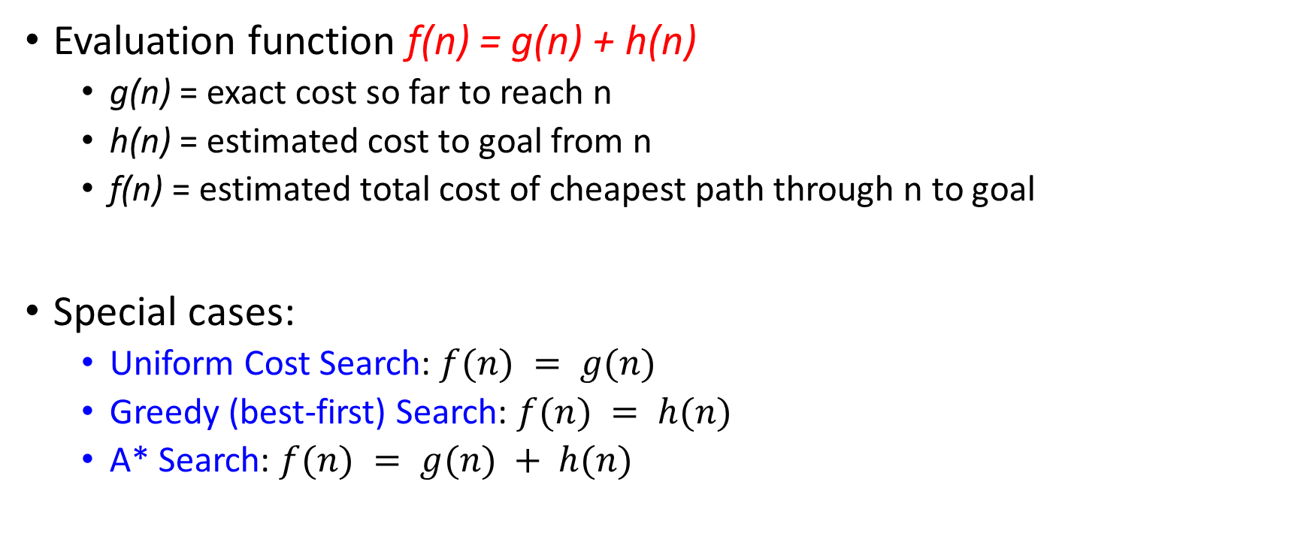
Evaluation / Heuristic Function
Evaluation function f(n) = g(n) + h(n)
g(n) = exact cost so far to reach n
h(n) = estimated cost to goal from n
f(n) = estimated total cost of cheapest path through n to goal
Special cases:
Uniform Cost Search: $f(n) = g(n)$
Greedy (best-first) Search: $f(n) = h(n)$
A* Search: $f(n) = g(n) + h(n)$

Slide 13
How it works?
Idea: use heuristic function for each node
that estimates desirability
Expands most desirable unexpanded node
Implementation:
fringe is a queue sorted in order of desirability
Special cases:
Uniform Cost Search (uninformed)
Greedy (best-first) Search (informed)
A* Search (informed)

Slide 14
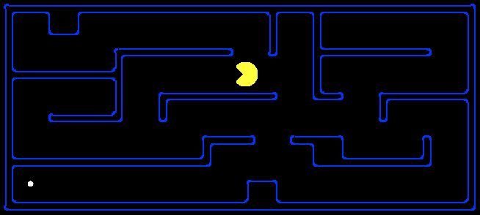
Heuristic Search
A heuristic is:
A function that estimates how close a state is to a goal
Designed for a particular search problem
Examples: Manhattan distance, Euclidean distance for pathing
PAC MAN MAZE
10
5
11.2

Slide 15
Example: Heuristic Function
h(x)

Slide 16
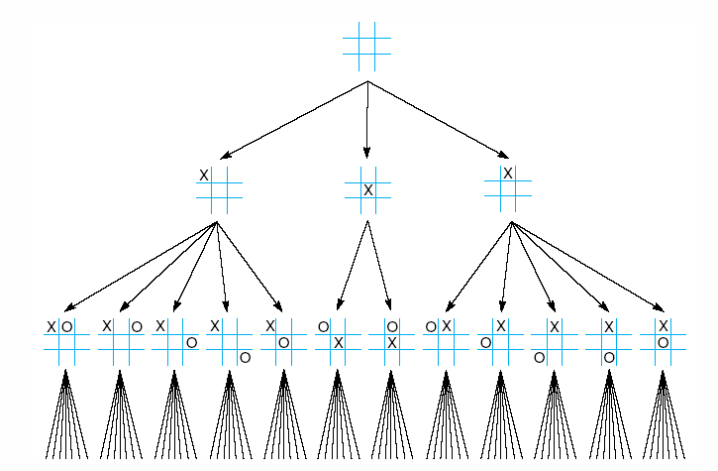
First three levels of the tic-tac-toe state space reduced by symmetry

Slide 17
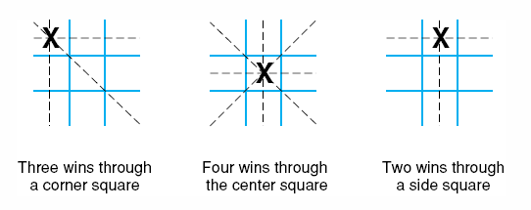
The “most wins” heuristic applied to the first children in tic-tac-toe.

Slide 18
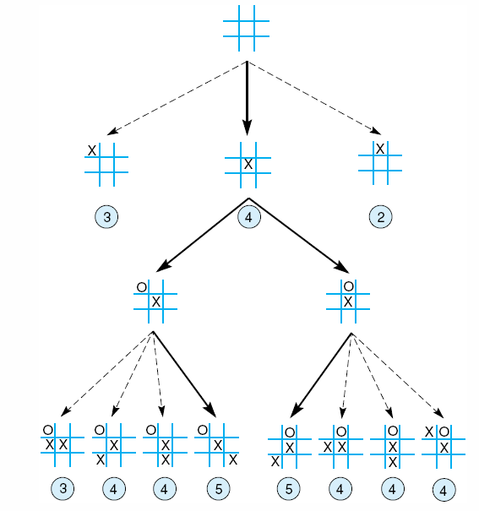
Heuristically reduced state space for tic-tac-toe.

Slide 19
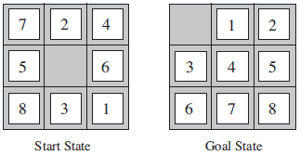
8–Puzzle: Heuristics?
h1: The number of misplaced tiles (squares with number).
h2: The sum of the distances of the tiles from their goal positions.

Slide 20
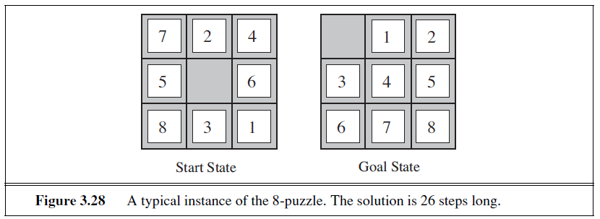
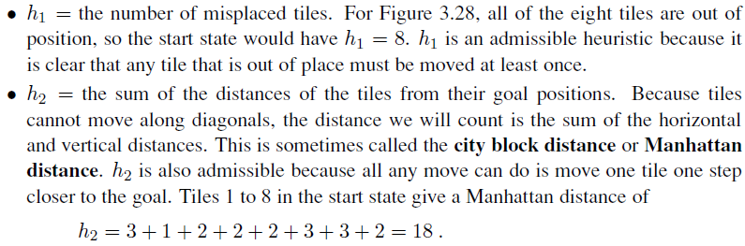

Slide 21
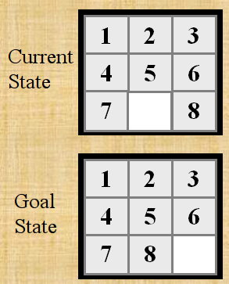

Slide 22
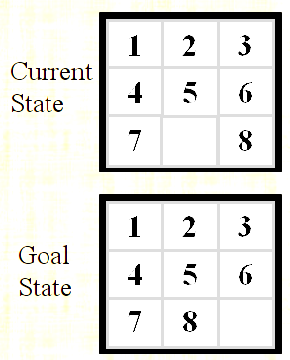
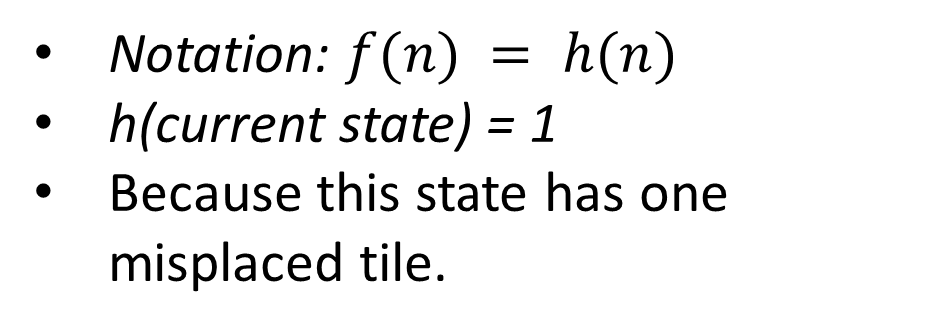
h1: The number of misplaced tiles (not including the blank)
Notation: $f(n) = h(n)$
h(current state) = 1
Because this state has one misplaced tile.
Only “8” is misplaced
So the heuristic function evaluates to 1.
The heuristic is telling us, that it thinks a solution might be available in just 1 more move.

Slide 23
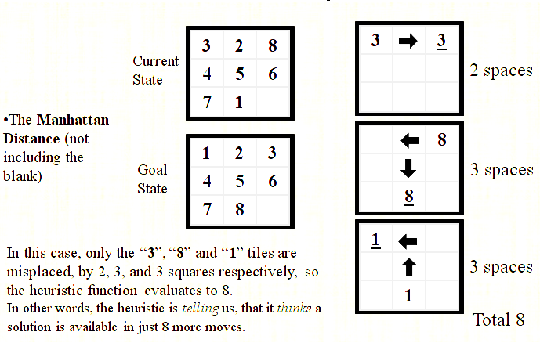
h2: The sum of the distances of tiles from goal positions
Notation: $f(n) = h(n)$, h(current state) = 8

Slide 24
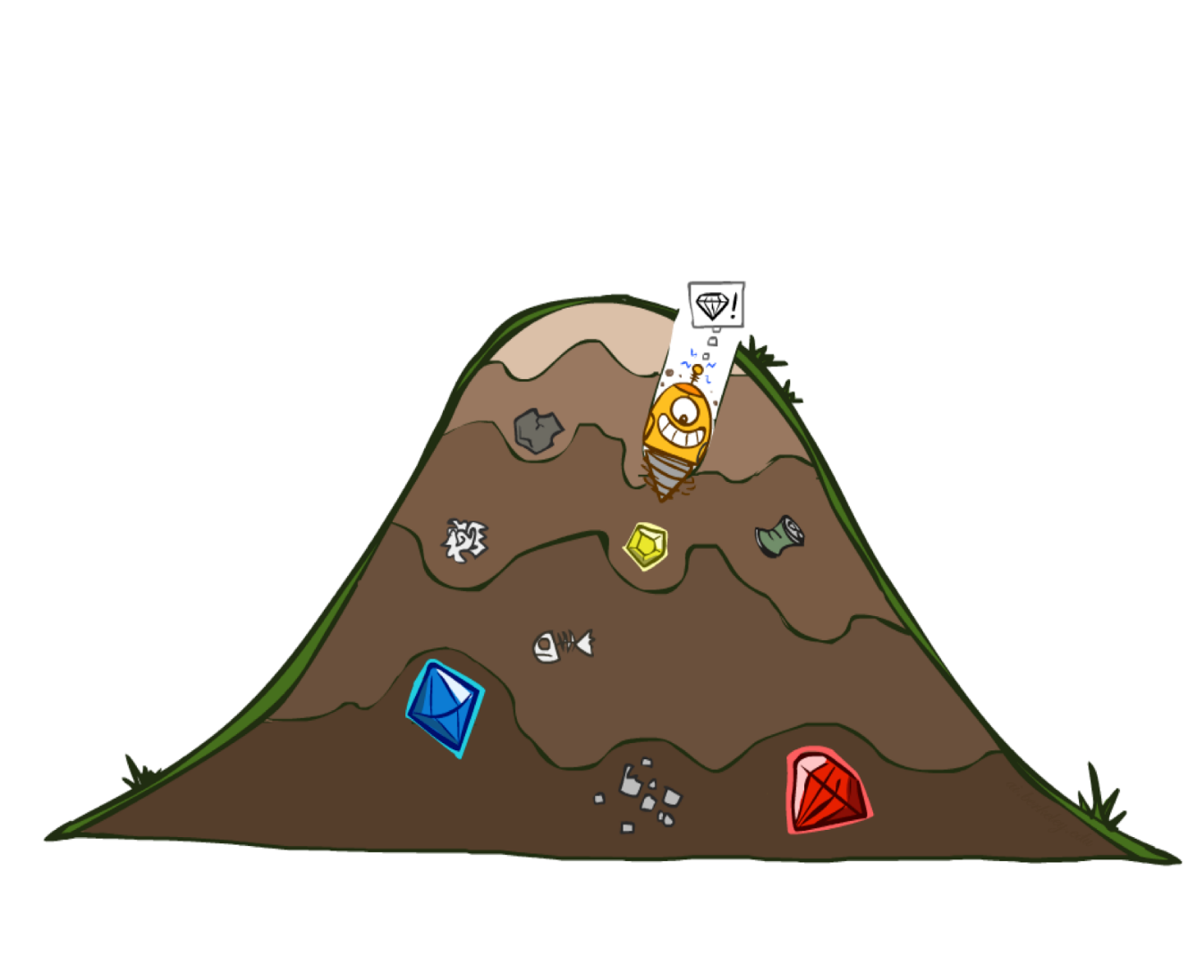
Greedy Best First Search
eval-fn: $f(n) = h(n)$

Slide 25
Greedy (Best-First) Search
Idea: Expand node with the smallest estimated cost to reach the goal.
Use heuristic function f(n) = h(n)
Best-first search tries to expand the node that is closest to the goal, on the grounds that this is likely to lead to a solution quickly.
Choose path with low heuristic value

Slide 26
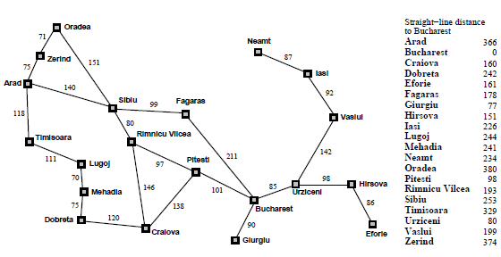

Slide 27

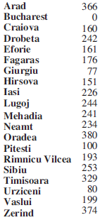
Greedy Search
Expand the node that seems closest…
What can go wrong?

Slide 28
Greedy Search
Expand the node that seems closest…(order frontier by h)
What can possibly go wrong?
Sibiu-Fagaras-Bucharest =
99+211 = 310
Sibiu-Rimnicu Vilcea-Pitesti-Bucharest =
80+97+101 = 278
h= 253
h=176
h=193
1000000
h=100
h=0

Slide 29
Greedy Search
b
…
Strategy: expand a node that you think is closest to a goal state
Heuristic: estimate of distance to nearest goal for each state
A common case:
Best-first takes you straight to the (wrong) goal
Worst-case: like a badly-guided DFS
b
…
Notes:
For any search problem, you know the goal. Now, you have an idea of how far away you are from the goal.

Slide 30
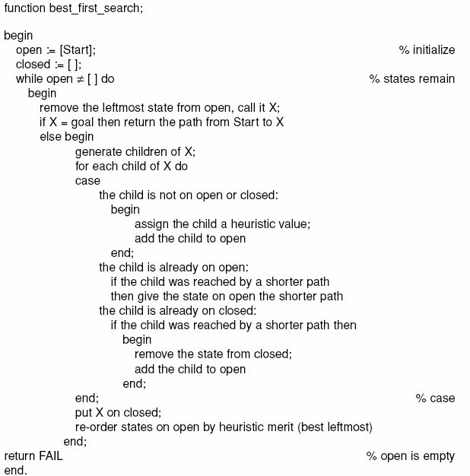

Slide 31
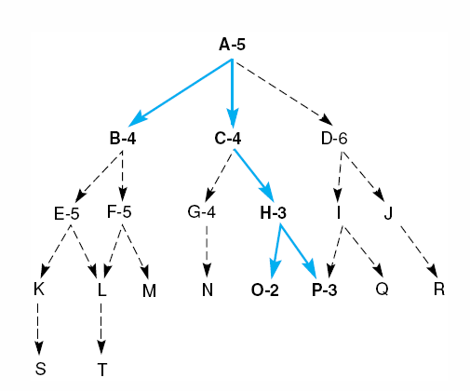
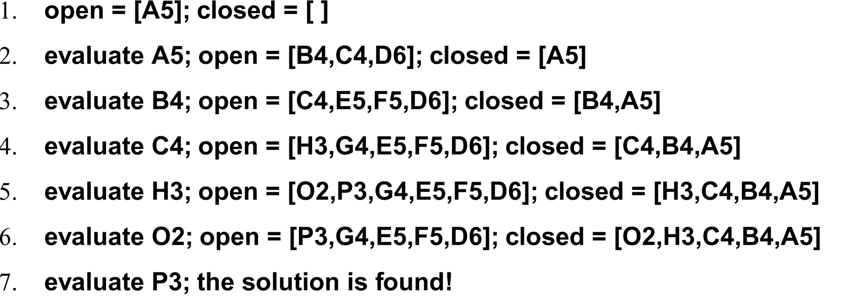
Best First Search

Slide 32
Greedy Search
State | Heuristic: h(n)
A | 366
B | 374
C | 329
D | 244
E | 253
F | 178
G | 193
H | 98
I | 0
Start
A
75
118
140
B
C
111
E
D
80
99
G
F
97
H
211
101
I
Goal
f(n) = h (n) = straight-line distance heuristic

Slide 33
Greedy Search: Tree Search
Start
A

Slide 34
Greedy Search: Tree Search
Start
A
75
118
[329]
140
[374]
B
C
[253]
E

Slide 35
Greedy Search: Tree Search
Start
A
75
118
[329]
140
[374]
B
C
[253]
E
80
99
[193]
[178]
G
F
[366]
A

Slide 36
Greedy Search: Tree Search
Start
A
75
118
[329]
140
[374]
B
C
[253]
E
80
99
[193]
[178]
G
F
[366]
A
211
[253]
I
[0]
E
Goal

Slide 37
Greedy Search: Tree Search
Start
A
75
118
[329]
140
[374]
B
C
[253]
E
80
99
[193]
[178]
G
F
[366]
A
211
[253]
I
[0]
E
Path cost(A-E-F-I) = 253 + 178 + 0 = 431
dist(A-E-F-I) = 140 + 99 + 211 = 450
Goal

Slide 38
Greedy Search: Optimal?
State | Heuristic: h(n)
A | 366
B | 374
C | 329
D | 244
E | 253
F | 178
G | 193
H | 98
I | 0
Start
A
75
118
140
B
C
111
E
D
80
99
G
F
97
H
211
101
I
Goal
f(n) = h (n) = straight-line distance heuristic
dist(A-E-G-H-I) =140+80+97+101=418
Not optimal!

Slide 39
Greedy Search: Complete ?
State | Heuristic: h(n)
A | 366
B | 374
** C | 250
D | 244
E | 253
F | 178
G | 193
H | 98
I | 0
Start
A
75
118
140
B
C
111
E
D
80
99
G
F
97
H
211
101
I
Goal
f(n) = h (n) = straight-line distance heuristic

Slide 40
Greedy Search: Tree Search
Start
A

Slide 41
Greedy Search: Tree Search
Start
A
75
118
[250]
140
[374]
B
C
[253]
E

Slide 42
Greedy Search: Tree Search
Start
A
75
118
[250]
140
[374]
B
C
[253]
E
111
[244]
D

Slide 43
Greedy Search: Tree Search
Start
A
75
118
[250]
140
[374]
B
C
[253]
E
111
[244]
D
Infinite Branch !
[250]
C

Slide 44
Greedy Search: Tree Search
Start
A
75
118
[250]
140
[374]
B
C
[253]
E
111
[244]
D
Infinite Branch !
[250]
C
[244]
D

Slide 45
Greedy Search: Tree Search
Start
A
75
118
[250]
140
[374]
B
C
[253]
E
111
[244]
D
Infinite Branch !
[250]
C
Even Incomplete in finite state space much like depth first search
(Complete in finite space with repeated-state checking)
[244]
D

Slide 46
Greedy Search: Time and Space Complexity ?
Start
Greedy search is not optimal.
Greedy search is incomplete
In the worst case, the Time and Space Complexity of Greedy Search are both O(b^{m})
Where b is the branching factor and m the maximum path length
A
75
118
140
B
C
111
E
D
80
99
G
F
97
H
211
101
I
Goal

Slide 47
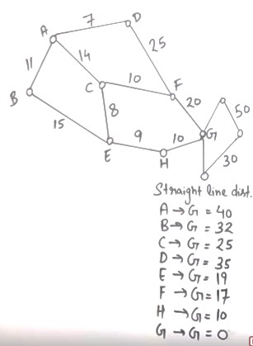
 | Frontier (Greedy) | Expand | Explored
1 | (A,40) | A | Empty
2 | (A-B,32)(A-C,25)(A-D,35) | C | A
3 | (A-B,32)(A-D,35) (A-C-E,19)(A-C-F,17) | F | A,C
4 | (A-B,32)(A-D,35) (A-C-E,19)(A-C-F-G,0) | G | A,C,F
5 | (A-C-F-G,0) Goal Found

Slide 48
 | Frontier (Greedy) | Expand | Explored
1 | (A,40) | A | Empty
2 | (A-C,25) (A-B,32)(A-D,35) | C | A
3 | (A-B,32)(A-D,35)(A-C-F,17)(A-C-E,19) | F | A,C
4 | (A-B,32)(A-D,35)(A-C-F-G,0)(A-C-E,19) | G | A,C,F
5 | (A-C-F-G) Goal Found |  | A,C,F,G
 | Frontier (UCS) | Expand | Explored
1 | (A,0) | A
2 | (A-B,11)(A-C,14)(A-D,7) | D | A
3 | (A-B,11)(A-C,14)(A-D-F,32) | B | A,D
4 | (A-B-E,26)(A-C,14)(A-D-F,32) | C | A,D,B
5 | (A-B-E,26)(A-C-F,24)(A-C-E,22)(A-D-F,32) | E | A,D,B,C
6 | (A-B-E,26)(A-C-F,24)(A-C-E-H,31)(A-D-F,32) | F | A,D,B,C,E
7 | (A-B-E,26)(A-C-F-G,44)(A-C-E-H,31)(A-D-F,32) | E | A,D,B,C,E,F
8 | (A-B-E,26)(A-C-F-G,44)(A-C-E-H,31)(A-D-F,32) | F
9 | (A-B-E,26)(A-C-F-G,44)(A-C-E-H,31)(A-D-F,32) | H
10 | A-C-E-H-G,41 Goal Found

Slide 49
Heuristics
Problem:
A heuristic is only an informed guess of the next step to be taken in solving a problem.
It is often based on experience or intuition.
Heuristics use limited information, such as knowledge of the present situation or descriptions of states currently on the open list.
They are not always able to predict the exact behavior of the state space farther along in the search.
A heuristic can lead a search algorithm to a suboptimal solution or fail to find any solution at all. This is an inherent limitation of heuristic search.

