Slide 1
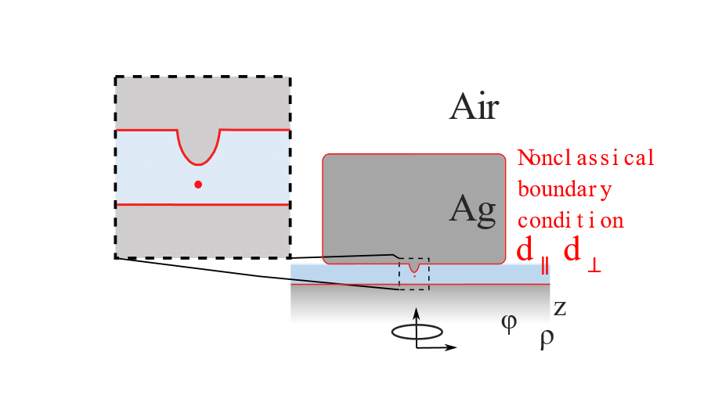

NonClassical Model
Contacts: Tong Wu <tong.wu@institutoptique.fr>,
Philippe Lalanne <philippe.lalanne@institutoptique.fr>
COMSOL model available on the website:
“nonclassical.mph’’
This model is used to compute the LDOS of an axisymmetric object when the Felbelman's d parameters are introduced. It can be used for generating the curves in Figure 4e of the article [https://dx.doi.org/10.1021/acsphotonics.0c01569]. The model is directly inspired from that initially proposed in ref. [Nature 576, 248-252 (2019)]. Our version uses the concept of transformation optics to covert the 2.5D problem to a 2D program. The model avoids the occurrence of irregular points for electric fields when the azimuthal index number m is not equal to 0.
We kindly ask that you cite the following paper in any published work for which you use or modify our model here: https://dx.doi.org/10.1021/acsphotonics.0c01569.

