Slide 1
MAGIS: Memory Optimization via Coordinated Graph Transformation and Scheduling for DNN
Renze Chen¹, Zijian Ding², Size Zheng¹, Chengrui Zhang¹,
Jingwen Leng³, Xuanzhe Liu¹, Yun Liang¹
¹Peking University
²University of California, Los Angeles
³Shanghai Jiao Tong University
Notes:
Hello every one, I'm here to present our work: MAGIS Memory Optimization via Coordinated Graph Transformation and Scheduling for DNN.

Slide 2
Motivation
Techniques
Eval-Results
Notes:
First I will introduce the background and motivation of our work.

Slide 3
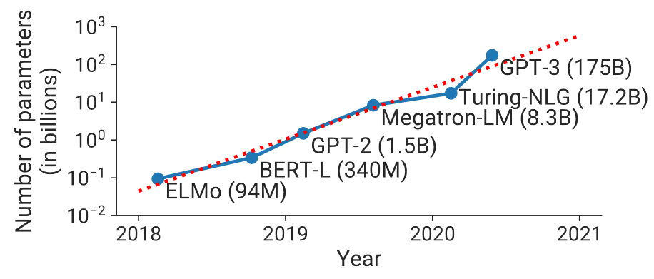
Memory Pressure in DNNs
Large Tensor Sizes
Large Model
Large Data
Large Hidden-dimensions, …
Large Batch-size, Long Text, …
e.g. recent models often hold billions of parameters
e.g. recent LLMs provide text-length in the thousands
Model | Text-length | #English-pages
GPT 3.5 | 4,096 | 6
GPT 4 | 8,192 | 12
GPT 4-32k | 32,768 | 49
Llama 1 | 2,048 | 3
Llama 2 | 4,096 | 6
Efficient Large-Scale Language Model Training on GPU Clusters Using Megatron-LM
https://agi-sphere.com/context-length/
Notes:
Recent DNNs face high memory pressure.
One important source is the large tensor size.
First, model size grows due to the increase of hidden dimensions. For example, recent models often have billions of parameters.
Second, data size also increases. For instance, state-of-the-art LLMs now supports text lengths ranging from thousands to millions.

Slide 4
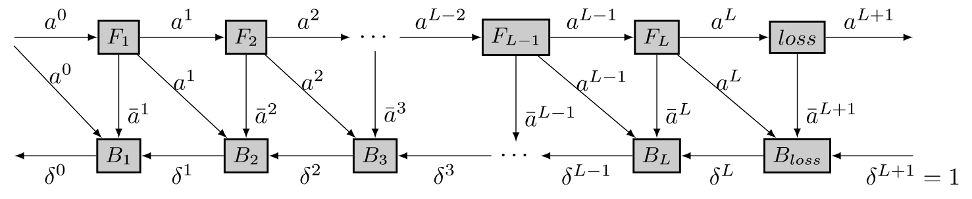
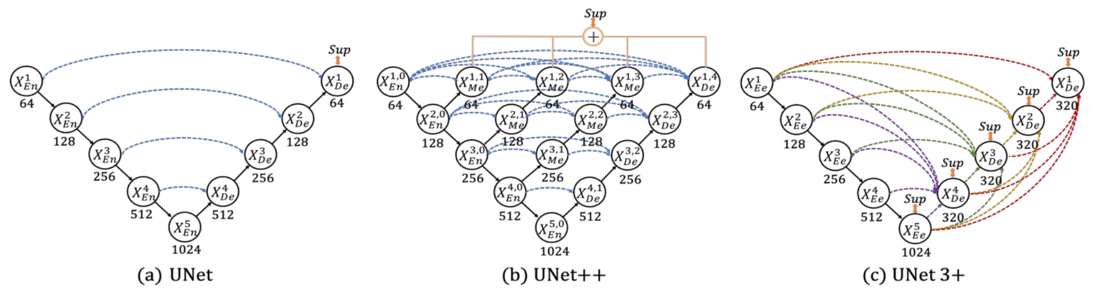




Memory Pressure in DNNs
Long Life-times of Tensors
$F_{1}$ life starts
Forward Activation Reused in Backward
$F_{1}$ life ends
Efficient Combination of Re-materialization and Offloading for Training DNNs
$X_{En}^{1}$ life starts
$X_{En}^{1}$ life ends
Tensor Reused After
Long Skip-Connections
e.g. DenseNet, UNet, Diffusion, …
UNet 3+: A Full-scale Connected UNet for Medical Image Segmentation
Notes:
Another source of memory pressure is the long lifetimes of some tensors, which occupy memory for a long time.
For instance, in the training graph of a DNN, activation computed in forward pass should reside in memory until being used in backward pass.
Additionally, in networks like U-Net, many tensors are reused after long skip-connections and should stay in memory until then.

Slide 5
Memory Optimization for DNNs
Model Compression
Graph Scheduling
Pruning
Quantization
Decomposition
Re-ordering
Re-materialization
Swapping
Compress tensor-sizes
at the cost of model accuracy
Manage tensor-lifetimes to reduce peak memory usage
PS: The goal of optimizing memory is to reduce peak memory usage
Notes:
Current DNN memory optimization methods can be roughly grouped into two categories.
First, Model Compression, including Pruning, Quantization, and Decomposition, aims to reduce memory usage by compressing parameters at the cost of model accuracy.
Second, Graph Scheduling, involving Re-ordering, Re-materialization, and Swapping, can reduce peak memory usage by managing the lifetimes of tensors.

Slide 6
Graph Scheduling
Re-ordering
Re-materialization
Swapping
Peak-mem=4
Peak-mem=3
Peak-mem=4
Peak-mem=3
Peak-mem=4
Peak-mem=3
A
A
A
A
A
A
A
A
A
A
A
A
A
B
B
B
B
B
B
B
B
B
B
B
B
B
Swap-out A
C
C
C
D
D
C
C
C
C
C
Discard B
C
C
C
D
D
C
D
C
D
D
D
D
D
D
D
D
D
Re-compute B
(using A)
E
E
E
E
E
B
E
E
E
E
E
E
E
F
F
F
E
Swap-in A
F
F
F
F
F
A
F
F
F
Time
Time
Time
Compute E, F
Time
F
F
Compute F
Time
Time
Optimize memory only
Trade latency for memory
Notes:
Among the sub-classes of Graph Scheduling,
Re-ordering optimizes peak memory by permuting computation sequence.
Re-materialization discards some tensors, and re-computes them later to reduce peak memory.
Swapping diminishes peak memory by temporally swapping-out some tensors and reloading them later.
Notably, re-ordering generally does not hurt latency,
whereas re-materialization and swapping optimize memory at the cost of latency overhead due to re-computation or data transfer.

Slide 7
Graph Transformation
Input
Node
Intermediate
Node
Output
Node
Graph scheduling only affects tensors lifetimes
Graph transformation can change tensor sizes
Interim Transformation (I-Trans)
Aggregation Transformation (A-Trans)
e.g. algebraic properties
e.g. merge parallel MatMuls into larger one
Add
Add
MatMul
MatMul
Slice
MatMul
Slice
Add
Add
X
W₁
W₂
Concat
A
B
C
A
B
C
X
W₁
W₂
Notes:
However, Graph Scheduling only affects tensor lifetimes without altering tensor sizes, thus its capability for memory optimization is limited.
Graph Transformation, a compilation optimization technique, can mutate the graph structure and tensor sizes.
Previous work introduced Interim Transformations, which are derived from some algebraic properties.
And Aggregation Transformations, which merge small operators into larger ones to improve hardware utilization.

Slide 8
Aggregation Transformation
Peak-mem=2
Input
Node
Intermediate
Node
Output
Node
Y₁
Memory
Y₁: MatMul
Y₂: MatMul
Lifetimes
Y₂
X
W₁
W₂
Exec. Seq.
Y₁
Y₂
Peak-mem=5
Y₁: Slice
Y₂: Slice
Lower Execution Latency
Larger Memory Footprint
A
Memory
B: MatMul
Time
B
Trade memory for latency
A: Concat
Lifetimes
X
W₁
W₂
Y₁
Exec. Seq.
A
Y₂
B
Y₁
Y₂
Time
Notes:
As shown in the slide, after applying an Aggregation Transformation on a graph,
the overall execution latency decreases due to higher hardware utilization, but the memory usage is temporally increased.
Thus Aggregation Transformation can trade memory for latency.

Slide 9
Fission Transformation (F-Trans)
Peak-mem=5
Input
Node
Intermediate
Node
Output
Node
The dual of Aggregation Transform
A
Memory
Fission Transformation (F-Trans)
Peak-mem=2.5
Y: Add
e.g. split some operators into multiple smaller ones
Lifetimes
B: MatMul
W₂
B
Higher Execution Latency
Smaller Memory Footprint
A: MatMul
W₁
X₁
Memory
X
Exec. Seq.
A
B
Y
Trade latency for memory
Y
A₁
Y₁: Add
Y: Concat
Y₂: Add
Time
B₁: MatMul
W₂
B₂: MatMul
B₁
A₁: MatMul
W₁
A₂: MatMul
Lifetimes
Y₁
X₁: Slice
X
X₂: Slice
X₂
A₂
Exec. Seq.
X₁
A₁
B₁
Y₁
X₂
A₂
B₂
Y₂
Y
B₂
Y₂
Y
Time
Notes:
If we reverse the Aggregation Transformation, that is, splitting operators into smaller ones, we get a new class of transformation, which we call Fission Transformation.
As depicted in the slide, after applying Fission Transformation, the latency increases due to lower hardware utilization, but the memory is reduced.
Thus Fission Transformation can trade latency for memory savings.

Slide 10
Motivation
Latency
Graph Scheduling
F-Trans
A-Trans
Memory
With the aid of Fission Transformation (F-Trans),
Graph Transformation can extend the memory & latency trade-off space,
enhancing the capability of Graph Scheduling for memory optimization.
Notes:
With the aid of Fission Transformation, Graph Transformation can greatly extend the memory & latency trade-off space, enhancing the capability of Graph Scheduling for memory optimization. Therefore, we propose MAGIS to coordinate graph transformation and graph scheduling for memory optimization.

Slide 11
Motivation
Techniques
Eval-Results
Notes:
Next I will introduce the techniques of MAGIS.

Slide 12
MAGIS Overview
Optimize memory/latency under a given latency/memory constraint
Search
Input Graph
M-Analyzer
M-Optimizer
Output Graph + Schedule
Initial
Search
State
Build Search Space for Fission Transformation
Apply Transformation Rules
Schedule Transformed Graphs
Frontend
Backend
MAGIS
Graph IR
Python Code with PyTorch API
Other Backends …
Notes:
MAGIS can optimize memory under a give latency constraint or vice versa. It consists of a Frontend, a Backend, an Analyzer, and a Optimizer. The Frontend parse user input into MAGIS Graph IR. The M-Analyzer builds a search space of Fission Transformation and generates an initial search state. The M-Optimizer iteratively applies transformation rules to generate new graphs and schedule them. The Backend generate executable code for optimized graph and schedule. I will first introduce the M-Analyzer and focus on the definition, representation, and search spscheduleace construction of Fission Transformation.

Slide 13
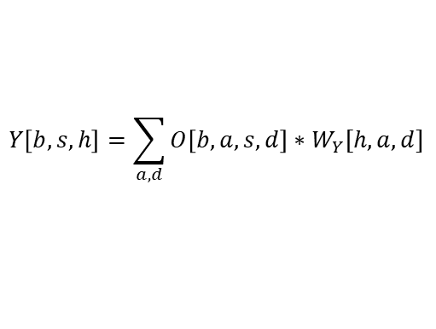
M-Analyzer: Dimension Graph (D-Graph)
To define a Fission Transformation, we need to represent graph-level dimensions
W_{Q}
X
W_{K}
W_{V}
W_{Q}
a
d
h
X
b
s
h
W_{K}
a
d
h
W_{V}
a
d
h
batch dimension
attn-head dimension
query-seq dimension
MatMul
Q
K
V
Q
b
a
s
d
h
K
b
a
s
d
h
V
b
a
s
d
h
b
a
a
a
s
D-Graph
b
b
b
a
a
a
s
Batch MatMul
S
S
b
a
s
s
d
Some
Connected Components
b
a
s
Softmax
P
P
b
a
s
s
b
a
s
b
a
a
s
O
W_{Y}
Batch MatMul
O
O
W_{Y}
O
b
a
s
d
s
h
a
d
W_{Y}
b
a
s
d
h
a
d
W_{Y}
Dimension Mappings
b
a
s
$$Y\left[b,s,h\right]=\sum_{a,d}{O\left[b,a,s,d\right]∗W_{Y}[h,a,d]}$$
Y
MatMul
Y
MatMul
Y
Y
b
s
h
a
d
b
s
h
a
d
b: batch-size
s: seq-length
h: hidden-size
a: #attn-heads
d: head-dim
spatial dim
reduce dim
Notes:
Before defining Fission Transformation, we need to represent the graph-level dimensions. This can be derived from the dimension mappings between adjacent operators.
For instance, there's an operator Y,
and based on its tensor expression we can derive the dimension mappings, where solid squares denote spatial dimensions and hollow squares represent reduction dimensions.
We can similarly build dimension mappings for each operator in a sub-graph, thus constructing a dimension graph.
The connected components within this Dimension Graph can serve as the graph-level dimensions to split along for Fission Transformation.

Slide 14







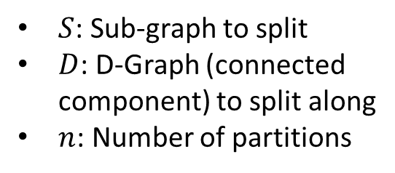


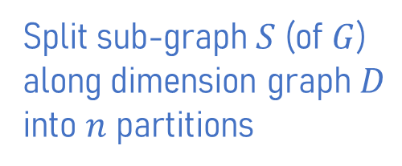


M-Analyzer: Fission Transformation Definition
...
...
$$f=(S,D,n)$$
$$D$$
0
0
b
S
0
S
b
h₁
h₁
0
3
$$S$$
$$S_{1}$$
$$S_{2}$$
3
b
3₁
3₂
b
h₁
1
h₁
1
h₂
3
1
h₂
h₁
$S$: Sub-graph to split
$D$: D-Graph (connected component) to split along
$n$: Number of partitions
h₁
1
4
4
2
2
4₁
S
2
S
4₂
b
2
4
b
h₂
h₂
h₁
b
h₁
b
h₂
h₂
6₁
5₁
5₂
6₂
5
6
5
5
6
6
b
b
h₂
b
h₂
b
h₂
h₂
8₁
7₁
7₂
8₂
Split sub-graph $S$ (of $G$)
along dimension graph $D$
into $n$ partitions
7
8
C
7
C
7
8
b
8
b
h₁
h₁
h₂
h₂
h₂
h₂
h₁
h₁
b
b
...
...
...
+
Part of D-Graph of $G$
Graph $G$
$$f=(S,D,2)$$
...
...
...
0, 2 have dims in $D$ $⇒$ sliced into sub-inputs
6, 7 have spatial-dims in $D$ $⇒$ merged from sub-outputs
1 has no dim in $D$ $⇒$ shared by sub-parts
8 has reduce-dim in $D$ $⇒$ summed-up from sub-outputs
Input of $S$
Output of $S$
Spatial Dim
Reduce Dim
b: batch-size
h: hidden-size
S
Slice
C
Concat
+
Add
Notes:
Now, we can define a Fission Transformation as a triple (S, D, n), which means splitting sub-graph S along dimension graph D into n partitions.
For instance, there's a part of a training graph of a MLP.
We select nodes 3 to 8 as sub-graph S, with nodes 0, 1, and 2 as inputs.
A part of the dimension graph is shown in the left.
We choose the highlight connected component as D.
Assuming a Fission Transformation (S, D, 2),
it uses slice operator to splits input nodes with corresponding dimensions in D.
While other input nodes are shared by both partitions S-1 and S-2.
It use concat operator to merge sub-outputs from all the partitions into the output nodes with spatial dimensions in D.
While other outputs nodes are accumulated from the sub-outputs.

Slide 15
















M-Analyzer: Fission Hierarchy Tree (F-Tree)
Graph complexity greatly grows after applying Fission Transformation
Record only the transformation itself instead of directly rewriting graph
$$S_{1}$$
$$×1$$
$$S_{2}$$
$$×1$$
$$S_{3}$$
$$×2$$
4
0
1
2
5
7
9
$$(S_{1},D_{1},1)$$
$$S_{1}$$
n=1
13
$$(S_{2},D_{2},1)$$
$$(S_{4},D_{4},4)$$
$$S_{2}$$
n=1
$$S_{4}$$
n=4
10
12
14
$$S_{4}$$
$$×4$$
$$(S_{3},D_{3},2)$$
$$S_{3}$$
n=2
3
6
8
11
Abbrev.
Graph with Fission Transformation
Fission Hierarchy Tree
Notes:
However, Fission Transformations will greatly increase the graph complexity, hindering the future optimizations.
To address such issue, we preserve the information about Fission Transformations without directly rewriting the graph.
For instance, there are four sub-graph regions S-1 to S-4 that we want apply Fission Transformation on.
Instead of directly mutating the graph's structure, we record these transformations
and construct a hierarchical tree based on the sub-graph containment relationships. We call it Fission Hierarchy Tree.

Slide 16


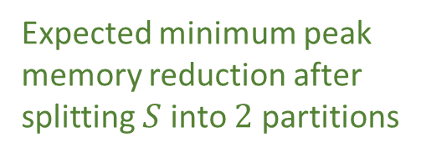

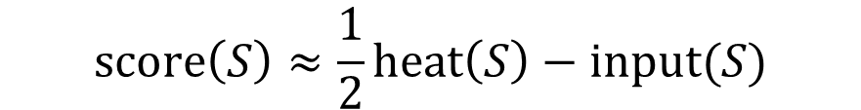

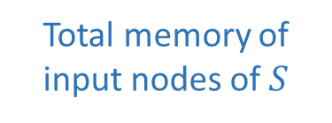

M-Analyzer: Estimate Peak Memory Reduction
Almost every sub-graph can be a candidate of Fission Transformation
Select sub-graph based on expected (minimum) peak memory reduction
$$input(S)$$
$$input(S)$$
Peak memory contribution of $S$
Memory
Memory
$$score\left(S\right)≈\frac{1}{2}heat\left(S\right)−input(S)$$
Expected minimum peak memory reduction after splitting $S$ into $2$ partitions
Total memory of input nodes of $S$
Time
$$heat(S)$$
Time
$$heat(S)/2$$
Only consider the sub-graph dominated by a single input node to minimize the total size of input nodes.
Notes:
Another problem is that Fission Transformations can be applied on almost any sub-graph, introducing a vast search space.
To address this, we estimate minimum peak memory reduction to select suitable sub-graphs for Fission Transformation.
As shown in the formula,
we use the function score to estimate the reduction of peak memory after splitting a sub-graph S into two parts,
where "heat S" represents the contribution of S to the peak memory.
Additionally, since the input nodes should remain in memory, the score further subtracts the memory occupied by the inputs.
To minimize input memory usage, we can only consider the sub-graph dominated by a single input node.

Slide 17










M-Analyzer: Construct Fission Hierarchy Tree
0
0
1
1
Memory Hot-spot
$$S_{0}$$
0
2
2
(nodes with contributions to peak memory)
1
21
10
node | 0 | 1 | 2 | 3
heat | 12 | 11 | 10 | 5
score | 6 | 5.5 | 5 | 2.5
10
$$S_{2}$$
2
19
11
11
3
3
20
$$S_{10}$$
10
17
18
3
$$S_{3}$$
12
12
4
4
$$S_{4}$$
4 | 10 | 11 | 12 | …
3 | 3 | 3 | 2 | …
1.5 | 1.5 | 0.5 | 1 | …
13
11
15
4
8
13
5
5
6
6
14
12
16
5
6
7
9
14
7
7
13
14
15
15
8
8
16
16
17
17
9
9
Recognize the memory hot-spots in the graph.
Construct the dominator tree of the graph.
Get the score of the sub-graph dominated by each node.
Select sub-graphs with scores in different intervals.
Construct initial Fission Hierarchy Tree (n=1) with these sub-graphs.
$$(S_{0},D,1)$$
18
18
19
$$(S_{2},D,1)$$
19
20
20
21
21
$$(S_{3},D,1)$$
$$(S_{10},D,1)$$
$$(S_{4},D,1)$$
Notes:
Given a computation graph, we first identify its memory hot-spots, that is, the nodes that have contributions to peak memory.
Second, we construct a dominator tree of the graph.
Third, we compute the score for each sub-graph dominated by a node to estimate its peak memory reduction after applying Fission Transformation.
We divide the scores into several intervals and choose the largest ones in each interval, and their corresponding sub-graphs are selected as Fission Transformation candidates,
thus creating an initial Fission Hierarchy Tree where n is equals to 1 for each tree node.

Slide 18
M-Analyzer: Fission Hierarchy Tree Mutation Rules
Fission Hierarchy Tree records the fission states of the sub-graphs in the nodes.
Define rules to apply transformations by mutating Fission Hierarchy Tree.
n=1
n=1
n=1
n=1
n=1
n=1
n=1
n=1
n=1
n=1
n=1
n=1
OR
OR
n=1
n=1
n=2
n=2
n=2
n=3
n=1
n=2
n=1
n=1
n=1
n=1
n=2
n=2
n=2
n=1
n=1
n=1
Apply Fission Transformation (Increase Fission Number from 1)
Increase Fission Number
Notes:
The Fission Hierarchy Tree serves as a record of the state of a Graph after applying several Fission Transformations.
We can transform the graph by mutating the Fission Hierarchy Tree.
For instance, increasing the fission number 'n' of a tree node is equal to applying Fission Transformation on the corresponding sub-graph.

Slide 19
M-Optimizer: Overview
Graph
Transformation Rules
I-Trans & A-Trans Rules
Queue
Apply Rules
F-Tree Mutation Rules
Tolerable Samples
New Graphs
Small-step trade-off for memory & latency
Schedule
Schedule
Large-step trade-off for memory & latency
Graph scheduling is frequently invoked
Graph transformation & scheduling are both multi-objective optimizations.
Each transform rule: small-step trade-off
Graph scheduling: large-step trade-off
Need to simplify graph scheduling process.
Notes:
Next I will introduce the M-Optimizer.
It iteratively applies transformation rules new graphs, schedules them to measure their memory and latency, and pushes well-performed graphs into a queue for future transformation.
The graph scheduling is frequently invoked for every new graph.
Moreover, both graph transformation and graph scheduling multi-objective optimization for memory and latency, which make the optimization much more complicated.
Therefore, we need to simplify graph scheduling process.

Slide 20
M-Optimizer: Scheduling-based Graph Transform
Re-mat. & Swapping trade memory & latency while Re-ordering does not.
Decouple Re-mat. & Swapping into graph transformation + Re-ordering.
Re-materialization
Graph Transformation
Re-ordering
trade latency & memory
trade latency & memory
optimize memory
A
Memory
A
A
A
A
A
A
A
B
B
B
B
B
B
B
B
B
C
C
C
C
Evict B
(set A as checkpoint)
C
B
C
D
D
D
D
C
D
D
C
Re-compute B
(using A)
E
E
B
E
D
B
B
D
F
F
E
F
E
E
E
E
Time
F
F
F
F
F
Notes:
Considering that re-materialization and swapping trade latency for memory while re-ordering only optimize memory,
we can decouple the former two into graph transformation and re-ordering.
For example, there's a re-materialization process,
we can decouple it into two stages.
First, we perform a graph transformation that duplicate node B, and let node E use the re-computed B.
Second, we schedule the graph using only re-ordering, achieving the same result as re-materialization.

Slide 21
M-Optimizer: Scheduling-based Graph Transform
Re-mat. & Swapping trade memory & latency while Re-ordering does not.
Decouple Re-mat. & Swapping into graph transformation + Re-ordering.
Swapping
Graph Transformation
Re-ordering
trade latency & memory
trade latency & memory
optimize memory
A
Memory
A
A
A
A
A
A
A
Store
Store
B
B
B
Swap-out A
B
Store
B
B
Load
Load
B
C
C
C
C
C
B
C
D
D
D
D
C
D
D
C
E
E
E
E
D
E
E
D
Swap-in A
E
Load
F
F
A
F
E
A
Time
F
F
F
F
F
Notes:
The swapping is similar.
For the example swapping process,
we first insert Load & Store operators between node A and F,
and schedule the graph using only re-ordering, achieving the same result as swapping.

Slide 22
M-Optimizer: Unified Trade-off Space
Each rule makes a small-step trade-off for memory & latency.
Graph scheduling focus on optimizing memory w/o trade-off.
Graph
Transformation Rules
I-Trans & A-Trans Rules
Queue
Apply Rules
F-Tree Mutation Rules
Small-step trade-off for memory & latency
Tolerable Samples
New Graphs
Scheduling-based Rules
Schedule (Re-ordering)
Optimize memory w/o trade-off
Incremental Scheduling
Further alleviate scheduling overhead by incrementally scheduling new graph based on previous schedule and newly mutated sub-graph.
Notes:
Now we can build a unified trade-off space for memory and latency, where each rule can make a small-step trade-off for memory and latency, while scheduling only considers re-ordering for memory optimization.
Moreover, to further alleviate the overhead of frequently invoked re-ordering, we introduce incremental scheduling to quickly schedule new graph based on previous schedule result and newly mutated sub-graph region.

Slide 23
Background
Techniques
Eval-Results
Notes:
Now I will show some evaluation results of MAGIS.

Slide 24
Experiment Setup
Platform
Intel(R) Xeon(R) Silver 4210R CPUs
NVIDIA GeForce RTX 3090 GPU
Baseline | Method
Torch (v2.1) | Basic Memory Recycling
POFO (NIPS’21) | Re-materialization + Swapping
DTR (ICLR’21) | Dynamic Heuristic Re-materialization
XLA (v2.15.0) | Compilation + Greedy Re-materialization
TVM (v0.14.0) | Compilation + Basic Memory Recycling
Torch-Inductor (v2.1) | Compilation + Basic Memory Recycling
Class | Network
CNN | ResNet
Transformer | BERT
 | ViT
Long-range Skip-links | UNet
 | UNet++
Large Transformer | GPT-Neo
 | BTLM
Notes:
Here is the experiment setup. We compare MAGIS with the 6 baselines and 7 networks shown in the tables.

Slide 25
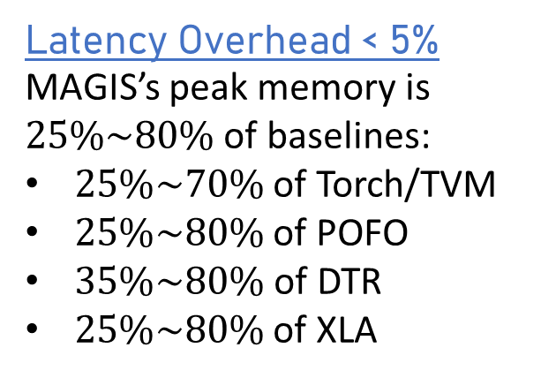
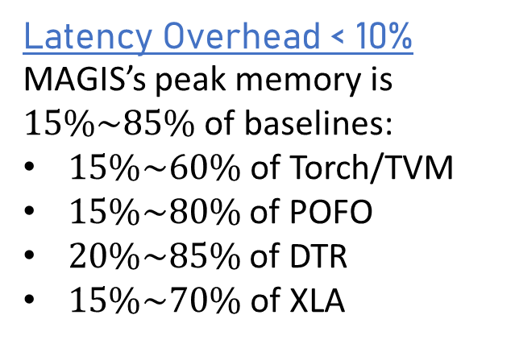
Memory Optimization with Latency Constraints
Latency Overhead < 10%
MAGIS’s peak memory is $15\%\sim 85\%$ of baselines:
$15\%\sim 60\%$of Torch/TVM
$15\%\sim 80\%$ of POFO
$20\%\sim 85\%$ of DTR
$15\%\sim 70\%$of XLA
(a) Latency Overhead < 10%
OOM
OOM
Latency Overhead < 5%
MAGIS’s peak memory is $25\%\sim 80\%$ of baselines:
$25\%\sim 70\%$ of Torch/TVM
$25\%\sim 80\%$ of POFO
$35\%\sim 80\%$of DTR
$25\%\sim 80\%$ of XLA
(b) Latency Overhead < 5%
OOM
OOM
Notes:
First, we compare the memory optimization capabilities of MAGIS against the state-of-the-art works under some latency constraints. With the 10% latency overhead constraint, MAGIS optimizes peak memory into 15 to 85% of baselines. With the 5% constraint, MAGIS optimizes peak memory into 25 to 80% of baselines.

Slide 26
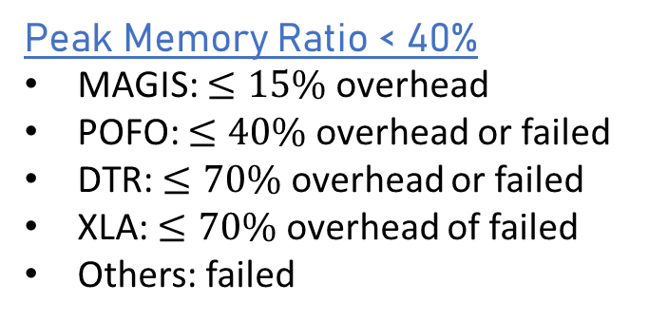
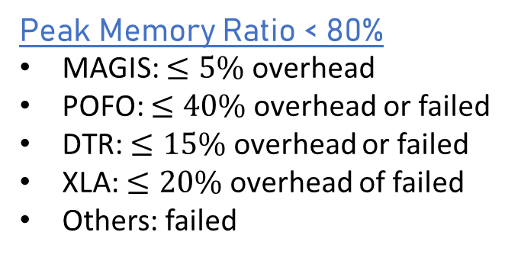
Latency Optimization with Memory Constraints
Peak Memory Ratio < 80%
MAGIS: $≤5\%$ overhead
POFO: $≤40\%$overhead or failed
DTR: $≤15\%$ overhead or failed
XLA: $≤20\%$ overhead of failed
Others: failed
(a) Peak Memory Ratio < 80%
FAILURE
Peak Memory Ratio < 40%
MAGIS: $≤15\%$ overhead
POFO: $≤40\%$overhead or failed
DTR: $≤70\%$ overhead or failed
XLA: $≤70\%$ overhead of failed
Others: failed
(b) Peak Memory Ratio < 40%
FAILURE
Notes:
Second, we compare the latency optimization. With the 80% memory ratio limit, MAGIS brings at most 5% latency overhead, while other baselines introduces at most 40% overhead. With the 40% limit, MAGIS brings at most 15% latency overhead, while other works involves at most 70% overhead or even failed to optimize memory to meet such constraint.

Slide 27

Summary
MAGIS: optimizing DNN memory via the coordination of graph transformation (particularly Fission Transformation) and graph scheduling
M-Analyzer: build search space for Fission Transformation
M-Optimizer: unified trade-off space for memory & latency
MAGIS uses only 15%~85% peak memory compared to SOTA works under the same latency constraint.
Scan to access our code
Our code is now open-sourced at https://github.com/pku-liang/MAGIS
Thanks for listening! E-mail us to ask follow-up questions: crz@pku.edu.cn
Notes:
In summary, we propose MAGIS to optimize DNN memory via the coordination of graph transformation, particularly Fission Transformation, and graph scheduling. MAGIS contains an M-Analyzer to build search space for Fission Transformation and an M-Optimizer with unified trade-off space for memory and latency. MAGIS uses only 15%~85% peak memory compared to SOTA works under the same latency constraint. Our code is now open-sourced. Thanks for listening.

Slide 28
Comparison to POFO with Fission Transformation
Compared to simple combination of POFO and Fission Transformation
Split the whole graph along batch dimension with different factors
MAGIS can achieve better memory & latency pareto frontier.
(w/o fission)
Notes:
Next, we compare MAGIS with the combination of graph scheduling technique and Fission Transformation. The results shows that compared to the combination of POFO and a simple Fission Transformation which splits the whole graph along batch-dimension with different factors, MAGIS can achieve better memory & latency Pareto frontier, since it can better optimize memory and latency with its unified trade-off space.

