Slide 1
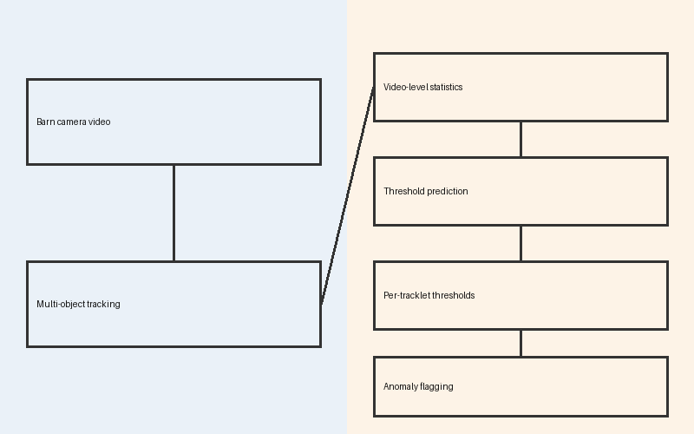
Video-level statistics
Barn camera video
Threshold prediction
Per-tracklet thresholds
Multi-object tracking
Anomaly flagging

