Slide 1
1. CNN Mnist 2. RNN Mnist
Team Members: Joseph Lavoie

Slide 2
1. CNN Project Functions cnn_model(features, labels, mode) -Contains information about how the images are processed such as the different layers and predictions main(unused_argv) -Trains the CNN
2. RNN Project Functions
recurrent_neural_network(x)
-creates the layer to be repeated
train_neural_network(x)
-trains the RNN

Slide 3
CNN Project Datasets (make sure the instructor can access the datasets, give the link)
Mnist Data Collection: http://yann.lecun.com/exdb/mnist/
RNN Project Datasets (make sure the instructor can access the datasets, give the link)
Mnist Data Collection: http://yann.lecun.com/exdb/mnist/

Slide 4
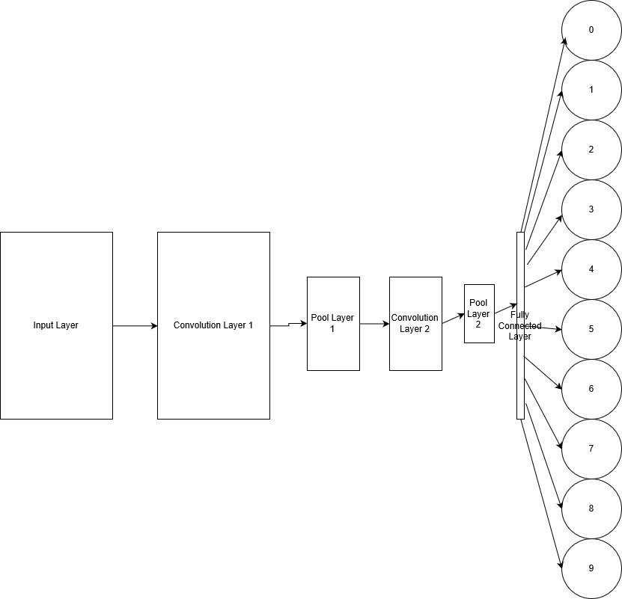
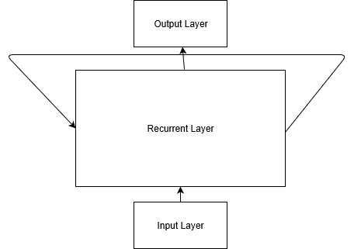
CNN Model (Give a high level diagram to show the model organization, such as convolutional layers, pooling, and fully connected layers)
RNN Model (Give a high level diagram to show the model organization, such as the input layers, output layers, and how the layers are connected)

Slide 5
CNN Training and Results (Give the criteria for evaluating the results such as accuracy, recall, or confusion matrix).
INFO:tensorflow:Saving checkpoints for 61463 into /tmp/mnist_convnet_model\model.ckpt.
INFO:tensorflow:Loss for final step: 0.03638979.
INFO:tensorflow:Starting evaluation at 2018-06-20-02:02:26
INFO:tensorflow:Restoring parameters from /tmp/mnist_convnet_model\model.ckpt-61463
INFO:tensorflow:Finished evaluation at 2018-06-20-02:03:00
INFO:tensorflow:Saving dict for global step 61463: accuracy = 0.9854, global_step = 61463, loss = 0.04723518
{'accuracy': 0.9854, 'loss': 0.04723518, 'global_step': 61463}
RNN Training and Results (Give the criteria for evaluating the results such as BLEU for natural language translation).
Epoch 0 completed out of 3 loss: 196.3456823937595
Epoch 1 completed out of 3 loss: 62.76186678931117
Epoch 2 completed out of 3 loss: 40.82541399542242
Accuracy: 0.9761
Decided to test smaller on this one since the CNN took a very long time on my computer

Slide 6
Summary
Links to the projects at Github
https://github.com/Light302/CNN-and-RNN.git
References of the projects
CNN-
https://www.tensorflow.org/tutorials/layers
RNN-
https://pythonprogramming.net/rnn-tensorflow-python-machine-learning-tutorial/

