Slide 1
Team Work 1
m5261170 Hikaru Takahashi
m5251131 Yuhei Nagai
m5261111 Naohiro Hamauzu

Slide 2
Outline
Problem settings
Data Preparation
Methods
Result
Discussion
Appendix
References

Slide 3
Problem Settings

Slide 4

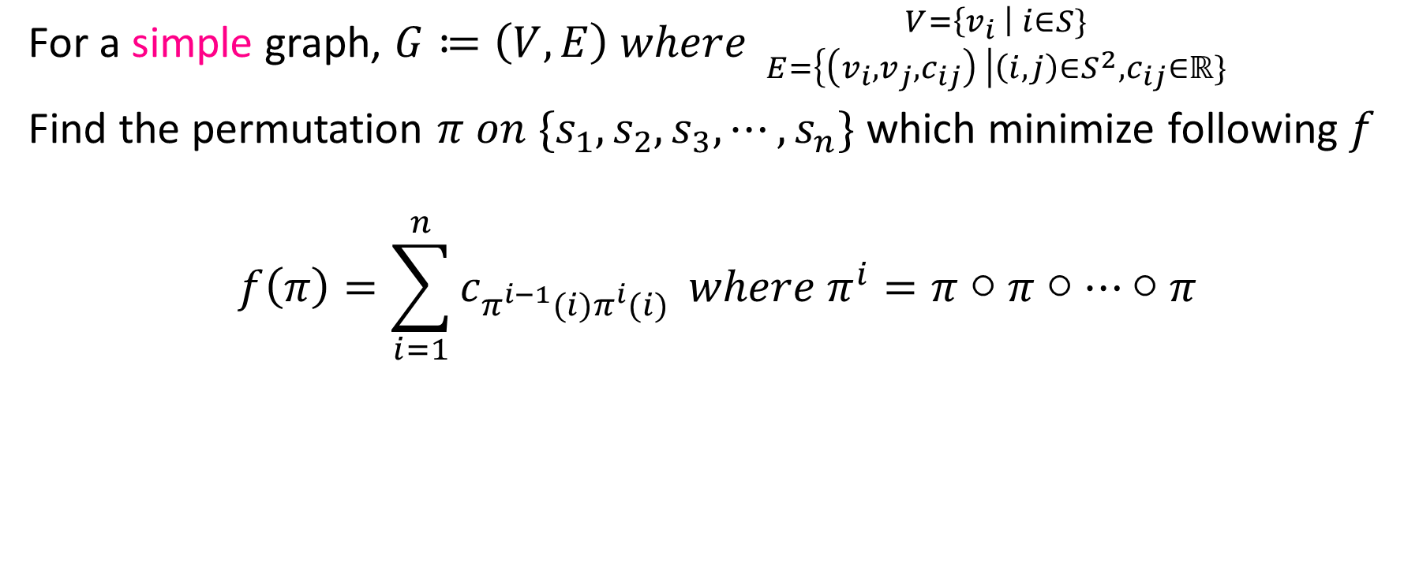
Definition of Traveling Salesman Problem
For a simple graph, $G≔\left(V, E\right) where {V=\left\{v_{i} \right| i∈S\} \atop E=\left\{\left(v_{i}, v_{j}, c_{ij}\right) \right|\left(i, j\right)∈S^{2}, c_{ij}∈ℝ\}}$
Find the permutation $π on \{s_{1}, s_{2}, s_{3}, ⋯, s_{n}\}$ which minimize following $f$
$$f\left(π\right)=\sum_{i=1}^{n}{c_{π^{i−1}(i)π^{i}(i)}} where π^{i}=π○π○⋯○π$$
$i$ times

Slide 5
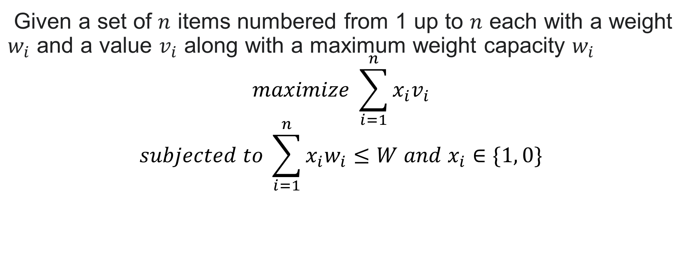
Definition of Knapsack Problem
Given a set of $n$ items numbered from 1 up to $n$ each with a weight $w_{i}$ and a value $v_{i}$ along with a maximum weight capacity $w_{i}$
$$maximize \sum_{i=1}^{n}{x_{i}v_{i}}$$
$$subjected to \sum_{i=1}^{n}{x_{i}w_{i}≤W and x_{i}∈\{1, 0\}}$$

Slide 6
Data preparation
TSP(Traveling Salesman Problem)
we use Japanese Cities Dataset(https://raw.githubusercontent.com/maskot1977/ipython_notebook/master/toydata/location.txt)
This dataset contains the names, latitude and longitude of the prefectural capitals of Japan's 47 prefectures
KP(Knapsack Problem)
we use Knapsak_01 dataset(https://people.sc.fsu.edu/~jburkardt/datasets/knapsack_01/knapsack_01.html)
P08 is a set of 24 weights and profits for a knapsack of capacity 6404180.

Slide 7
Methods

Slide 8
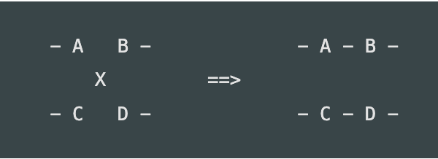
2-opt
2-opt is to choose two edges at random, and join them to the one with the lower cost.
The main idea behind it is to take a route that crosses over itself and reorder it so that it does not.

Slide 9
Tabu Search
Step 1 : Initialize best routes randomly.
Step 2 : Generate New routes.
Step 3 : Calculate Total Distance Cost.
Step 4 : If new routes are better, replace old best routes.
Step 5 : Update Tabu List and best routes.
Step 6 : Stop if terminating condition satisfied. else Return to Step 2.

Slide 10
Simulated Annealing
Step 1 : Initialize best routes randomly and T.
Step 2 : Generate New routes.
Step 3 : Calculate Total Distance Cost.
Step 4 : If new routes are better, replace old best routes. Else replace with probability p(s’|T)
Step 5 : If not replace, return to Step 2. else, update T.
Step 6 : Stop if terminating condition satisfied. else Return to Step 2.

Slide 11
Parameters TS and SA
【Tabu Search】 iteration : 3000 tabu list size : 300
【simulated Annealing】 initial T : 25000 T change rate : exp(- 9.210340371976184 * (current step / 50000))

Slide 12
Iterated Local Search(Brief Review)
A weak point of local search methods is that it can be trapped in Local Optimum(Local Solution).
In Iterated Local Search, perturbation(kick) is carried out to escape from those local optimum.
This algorithm assumes ‘clustered distribution of local minima’.

Slide 13

Application of ILS to TSP
We use following methods/parameters to implement a search.
Detailed Implementations Available On GitHub.
Terminate Condition | No improvement along 300 iteration
Maximum Iterations | 10000
Local Search Method | 2-opt
Perturbation Method | Double-Bridge^{[1]}(a.k.a. 4-opt)
[1]: Details written in Appendix 1.
https://github.com/LightBells/IntrouctionToMetaheuristics/tree/master/FirstHalf/experiments/IteratedLocalSearch

Slide 14
Application of ILS to Knapsack Problem
We use following methods/parameters to implement a search.
Detailed Implementations Available On GitHub.
Terminate Condition | No improvement along 3000 iteration
Maximum Iterations | 10000
Local Search Method | Execute a random insertion and random deletion until full capacity. (deletion is prevented statistically)
Perturbation Method | Random erase for i times. i ∊ UniformDistribution[1, n / 4]
https://github.com/LightBells/IntrouctionToMetaheuristics/tree/master/FirstHalf/experiments/IteratedLocalSearch

Slide 15
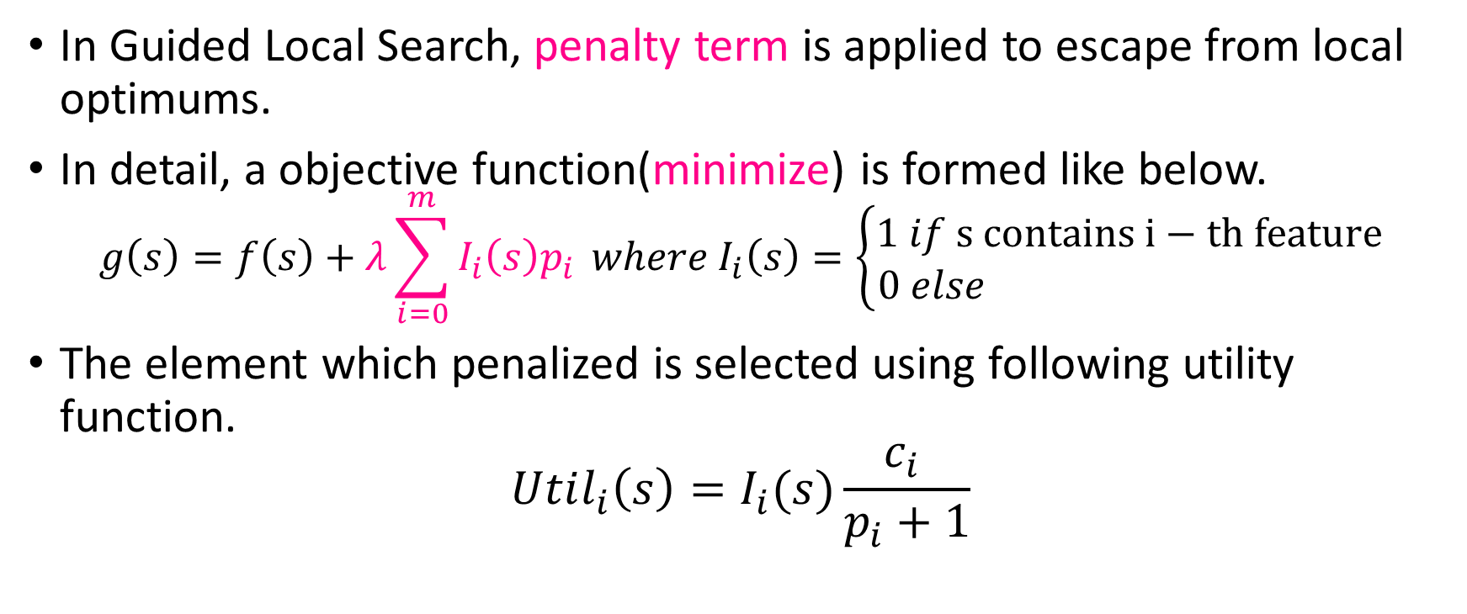
Guided Local Search(Brief Review)
In Guided Local Search, penalty term is applied to escape from local optimums.
In detail, a objective function(minimize) is formed like below.
$$g\left(s\right)=f\left(s\right)+λ\sum_{i=0}^{m}{I_{i}\left(s\right)p_{i}} where I_{i}\left(s\right)=\left\{\begin{aligned}1 if s contains i−th feature \\ 0 else \end{aligned}\right.$$
The element which penalized is selected using following utility function.
$$Util_{i}\left(s\right)=I_{i}(s)\frac{c_{i} }{p_{i}+1}$$

Slide 16

Application of GLS to TSP
We use following methods/parameters to implement a search.
Detailed Implementations Available On GitHub.
Terminate Condition | After 1000 Iterations
Local Search Method | 2-opt
Penalize Term | Next Page
Utility Function | Next Page
Adaptive penalty control | 2 pages later
https://github.com/LightBells/IntrouctionToMetaheuristics/tree/master/FirstHalf/experiments/GuidedLocalSearch

Slide 17
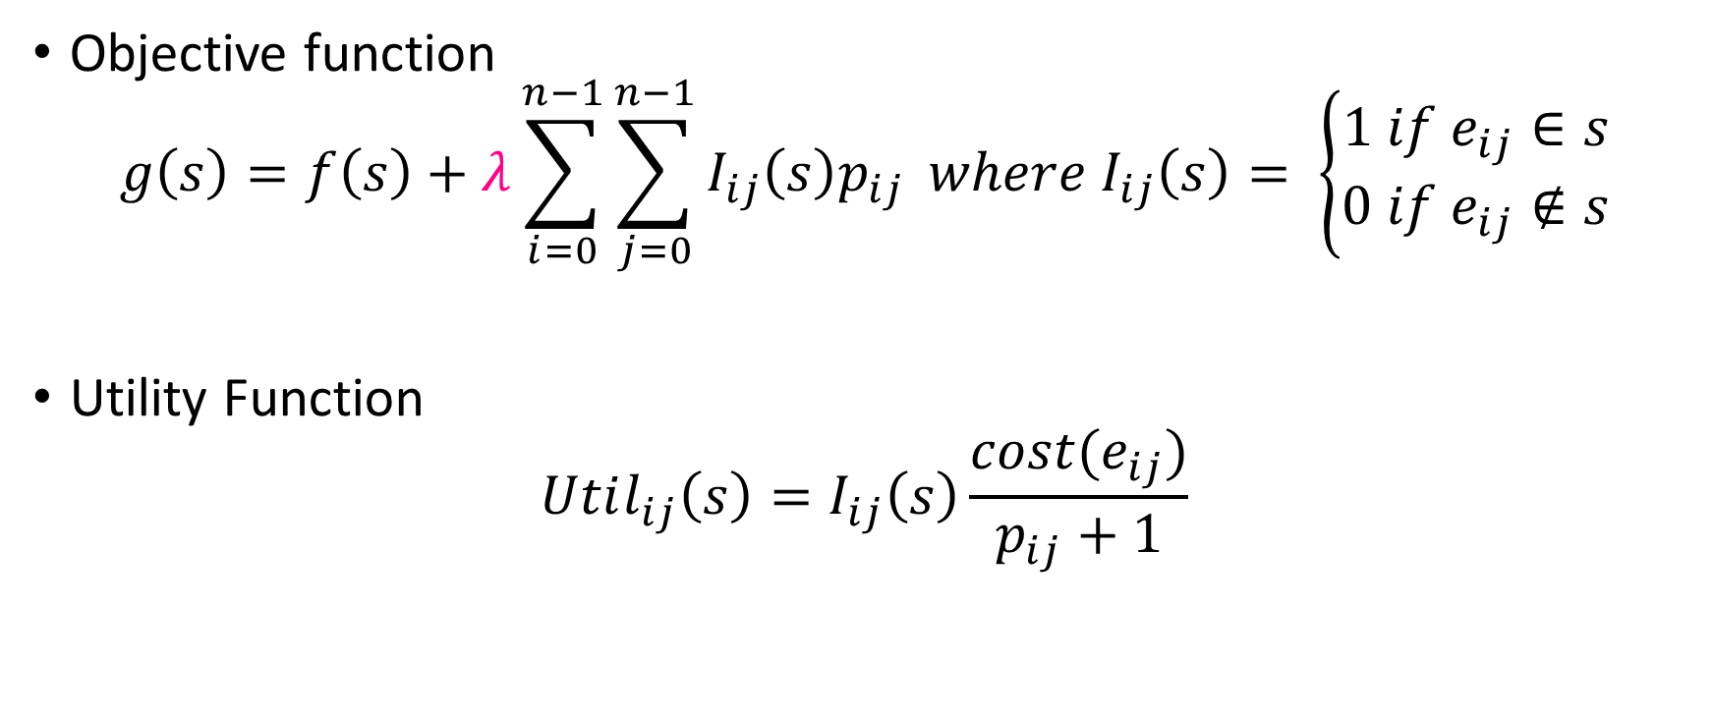
Objective function and Utility Function for TSP
Objective function
$$g\left(s\right)=f\left(s\right)+λ\sum_{i=0}^{n−1}{\sum_{j=0}^{n−1}{I_{ij}\left(s\right)p_{ij}}} where I_{ij}\left(s\right)= \left\{\begin{aligned}1 if e_{ij}∈s \\ 0 if e_{ij}∉s\end{aligned}\right.$$
Utility Function
$$Util_{ij}\left(s\right)=I_{ij}\left(s\right)\frac{cost(e_{ij})}{p_{ij}+1}$$

Slide 18
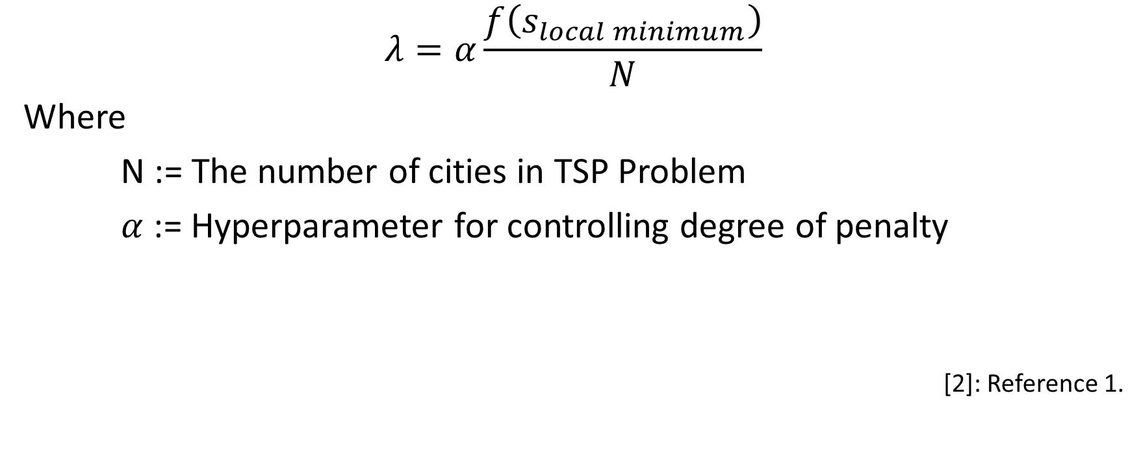
Adaptive penalty control^{[2]}
$$λ=α\frac{f\left(s_{local minimum}\right)}{N}$$
Where
N := The number of cities in TSP Problem
$α$ := Hyperparameter for controlling degree of penalty
[2]: Reference 1.

Slide 19
Results

Slide 20
Results for TSP
 | 2-opt | SA | TS | ILS | GLS
Max Value of the Objective function | 56.684277 | 60.936557 | 87.92697 | 54.96789 | 65.86642
Min Value of the Objective function | 55.211577 | 56.880257 | 59.41372 | 54.62209 | 54.62209
Average Value of the Objective function | 56.059988 | 58.440281 | 76.55935 | 54.6662 | 60.45095
Average Time Cost[sec] | 0.005 | 10.1 | 358.3 | 1.3 | 7.2
Average Memory Cost[MB] | 111.8 | 82.2 | 248.9 | 90.2 | 95.2

Slide 21
Results for Knapsack Problem
 | SA | ILS
Max Value of the Objective function | 13549094 | 13549094
Min Value of the Objective function | 13473708 | 13424474
Average Value of the Objective function | 13503066.8 | 13487167.8
Average Time Cost[sec] | 5.7 | 0.9
Average Memory Cost[MB] | 23.2 | 23.0

Slide 22
Discussion
We try 5 methods to solving Traveling Salesman problem.
ILS is the best method from the point of view of best value and average cost.
We get the same Max Value 54.6220975390543 from the ILS and GLS.
Since the same solution was calculated from different methods, we thought 54.6220975390543 may be global optimal solution in our data.

Slide 23
Discussion
Also we try 2 methods knapsack problem.
Same as TSP, we can say ILS is better solution than annealing.
Both methods get the same Max Value, but SA spend more time and average value is little worse than ILS.
In the first place, Max Value 13549094 is optimal solution in knapsack data we used.
So both methods cat get optimal solution in our trials.

Slide 24
Appendix

Slide 25
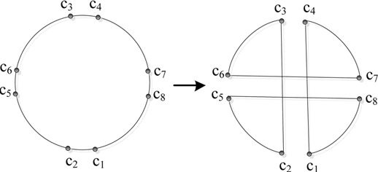
Appendix1. Double-bridge(4-opt)
Figure 1. Double-Bridge move. (refer to [1])
[1]: Reference 2.

Slide 26
References

Slide 27
References
Christos Voudouris, Edward Tsang, Guided local search and its application to the traveling salesman problem, European Journal of Operational Research, Volume 113, Issue 2, 1999, Pages 469-499
Yu-ting Wang, Jun-qing Li, Kai-zhou Gao, Quan-ke Pan, Memetic Algorithm based on Improved Inver–over operator and Lin–Kernighan local search for the Euclidean traveling salesman problem, Computers & Mathematics with Applications, Volume 62, Issue 7, 2011, Pages 2743-2754

