Slide 1
An Obstacle Avoidance System for Visual Impaired People Based on Object Tracking Algorithm and Semantic Segmentation
岡田研究室
2IE22102R 孟 祥昊

Slide 2
Contents
Introduction
Related works
Methods: ByteTrack & MMSegmentation
Existing System & Update
Experimental Results & Discuss
Conclusion & Future work

Slide 3
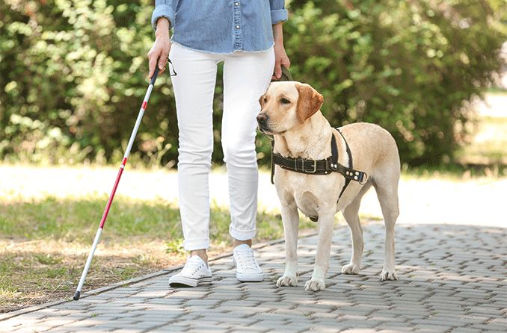
1. Introduction
Visually impaired individuals face difficulties in perceiving their surroundings, identifying obstacles, and avoiding collisions.
Traditional mobility aids, such as white canes and guide dogs, have limitations.
White canes are limited to stationary obstacles within its reach and provide no information about moving objects or hazards outside its range.
Guide dogs are expensive to train and maintain, and the demand for them far exceeds the supply.
Notes:
Visually impaired individuals face difficulties in perceiving their surroundings and avoiding collisions. Traditional mobility aids, such as white canes and guide dogs, have limitations. White canes are limited to stationary obstacles within its reach, while guide dogs are expensive to train and maintain. The ability to move safely and independently is crucial for their quality of life.

Slide 4
1. Introduction
Computer vision and machine learning have enabled sophisticated assistive devices
Multiple Object Tracking technology can detect and track multiple objects in real-time
Provides valuable information for visually impaired individuals to navigate safely
Semantic segmentation algorithms can classify and segment the environment
Provides detailed understanding of surroundings
Considering the above, the primary objective of this research is to develop an advanced obstacle avoidance system for visually impaired individuals by integrating Multiple Object Tracking and Semantic segmentation for avoiding stepping off the sidewalk and comprehensive environmental understanding.
Notes:
Technological advancements in computer vision and machine learning have enabled the development of sophisticated assistive devices. Multiple Object Tracking technology can detect and track multiple objects in real-time, providing valuable information for visually impaired individuals to navigate safely. However, existing solutions have limitations such as latency and inability to accurately detect road elements.

Slide 5
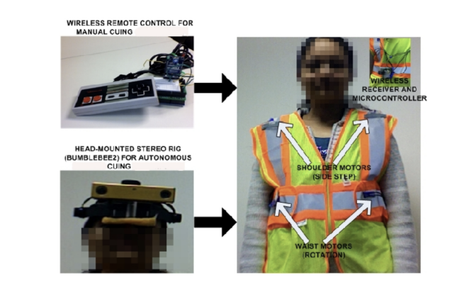
2. Related Work
Pradeep et al. (2019): Robot Vision for the Visually Impaired
A robot vision system for assisting visually impaired individuals
Mobile robots equipped with cameras and computer vision algorithms
Recognizes objects and provides navigational assistance through audio feedback
Strengths
Mobile platform allows for dynamic navigation and real-time assistance
Advanced object recognition
Intuitive audio feedback
Limitations
Dependency on mobile robots can limit flexibility and portability
Regular maintenance required
Effectiveness can be compromised in varying environments
Notes:
Pradeep et al. developed a robot vision system for assisting visually impaired individuals. The system uses mobile robots equipped with cameras and computer vision algorithms to recognize objects and provide navigational assistance through audio feedback. The system has strengths such as its mobile platform and advanced object recognition, but also has limitations such as its dependency on mobile robots and potential reliability issues.

Slide 6
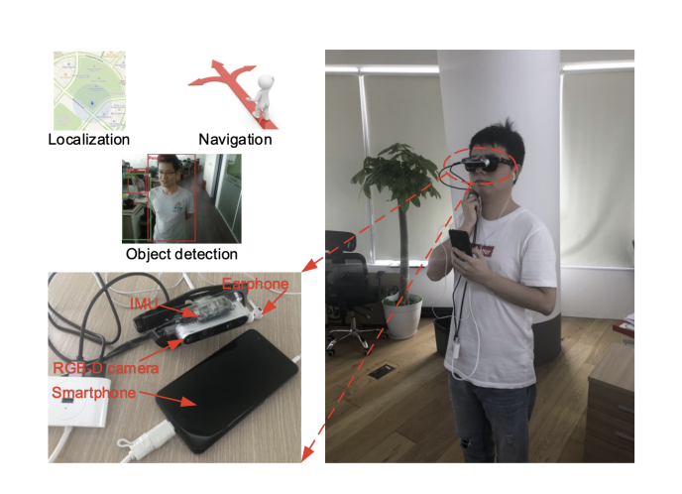
2. Related Work
Bai et al. (2019): Wearable Travel Aid for Environment Perception and Navigation
Strengths
Wearable design for portability and convenience
Multi-modal feedback for intuitive guidance
Advanced machine learning algorithms for accuracy
Limitations
Short battery life requiring frequent recharging
Limited processing power affecting performance
Performance influenced by environmental factors
Notes:
Bai et al. developed a wearable travel aid for visually impaired individuals. It uses cameras, sensors, and machine learning algorithms to provide audio and haptic feedback. The system has strengths such as its wearable design, multi-modal feedback, and advanced algorithms. However, it also has limitations such as short battery life, limited processing power, and environmental constraints.

Slide 7
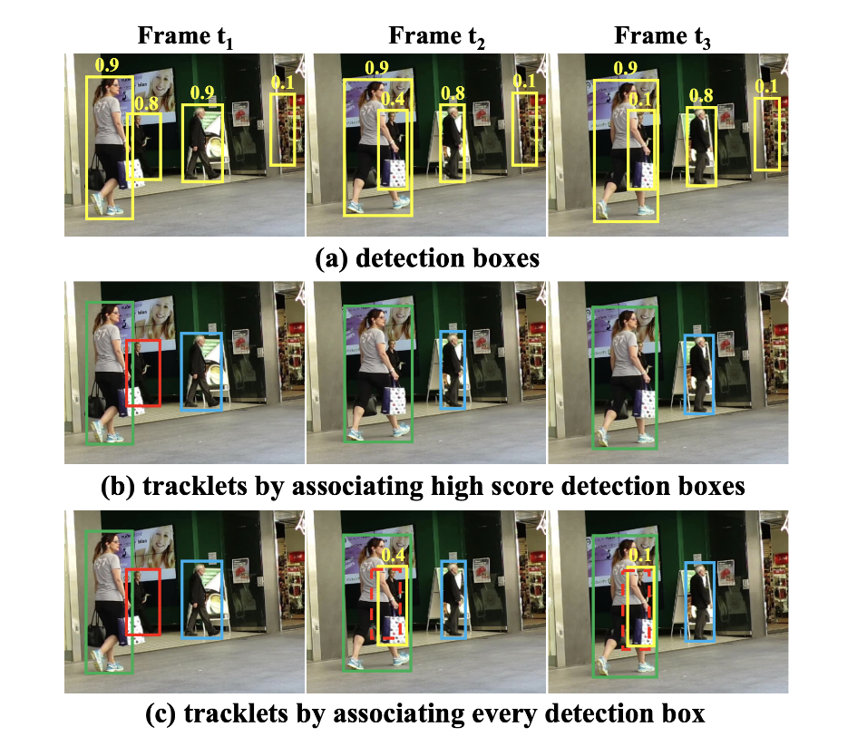
3. Methods: ByteTrack & MMSegmentation
3.1 ByteTrack: Multi-Object Tracking by Associating Every Detection Box
Detection
Uses high-performance object detector such as YOLOX
Outputs bounding boxes with confidence scores
Embedding Extraction
Extracts embeddings using a deep neural network
Uses a separate embedding model for high-quality feature extraction
Data Association
Two-stage process to link detections across frames
First stage matches high-confidence detections to existing tracklets
Second stage matches low-confidence detections to unmatched tracklets
Notes:
ByteTrack is a robust and efficient Multiple Object Tracking algorithm designed to handle real-world tracking challenges. It enhances traditional MOT algorithms by associating every detection box, including low confidence scores. This significantly improves tracking performance by reducing missed detections and maintaining object identities even in complex scenarios.

Slide 8
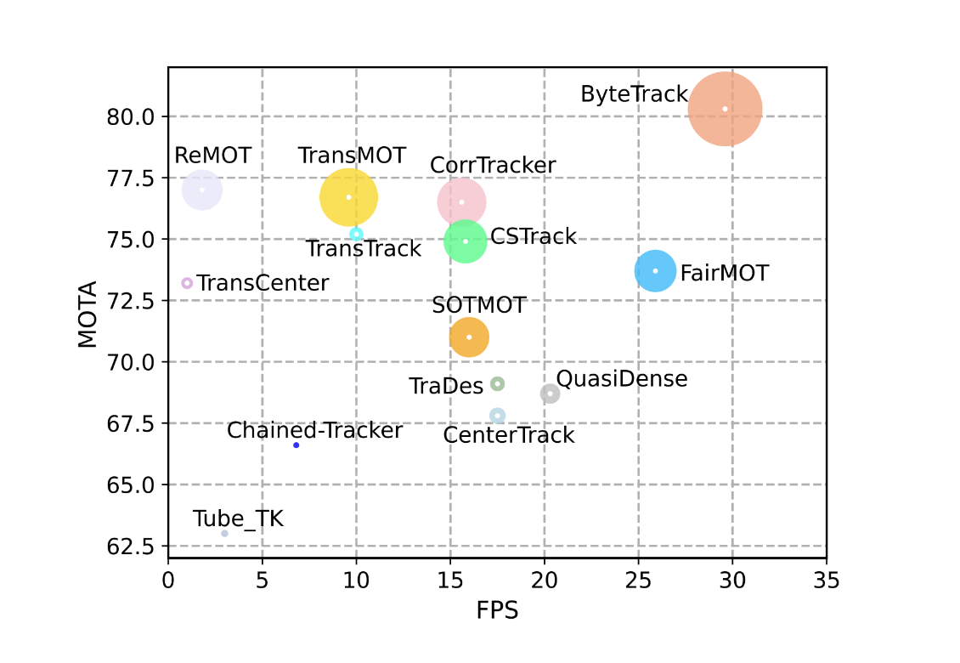
3. Methods: ByteTrack & MMSegmentation
3.1 ByteTrack: Multi-Object Tracking by Associating Every Detection Box
ByteTrack outperforms FairMOT with both higher MOTA and FPS, implying that it offers superior accuracy with lower latency, making it a comprehensive improvement over FairMOT.
After importing pretrained models and custom training on our dataset, we successfully achieved vehicle object detection（bicycles and cars etc.)
In addition, we attained higher accuracy and faster detection speed compared to FairMOT.
Notes:
ByteTrack uses pre-trained models for detection and embedding extraction. During inference, it processes each video frame sequentially, generating bounding boxes and extracting appearance features. It is evaluated using standard MOT benchmarks and achieves state-of-the-art results.

Slide 9
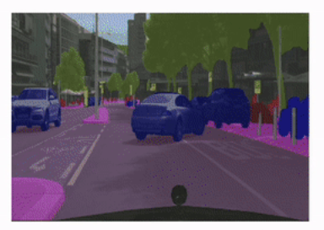
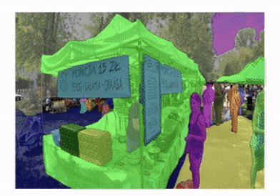
3. Methods: ByteTrack & MMSegmentation
3.2 MMSegmentation: Open-source semantic segmentation toolbox based on PyTorch
Semantic segmentation: pixel-wise classification
Classifies each pixel into predefined categories
Provides detailed understanding of environment
Essential for obstacle avoidance systems
Model Architecture
mmsegmentation supports various state-of-the-art segmentation models
Data Preparation
Training process requires a well-annotated dataset with pixel-wise labels
Notes:
mmsegmentation is an open-source toolbox for semantic segmentation, developed by the OpenMMLab team. It supports a wide range of algorithms and offers extensive customization options. Semantic segmentation involves classifying each pixel into predefined categories, providing a detailed understanding of the environment.
This slide covers the details of the algorithm used for image segmentation. It includes information on the model architecture, data preparation, training procedure, and inference process. The HRNet model was selected for its high accuracy and efficiency, and the Cityscapes dataset was utilized for training. The training procedure involves a customized pipeline with data augmentation techniques, and the final output is a segmented image with pixel-wise labels.

Slide 10
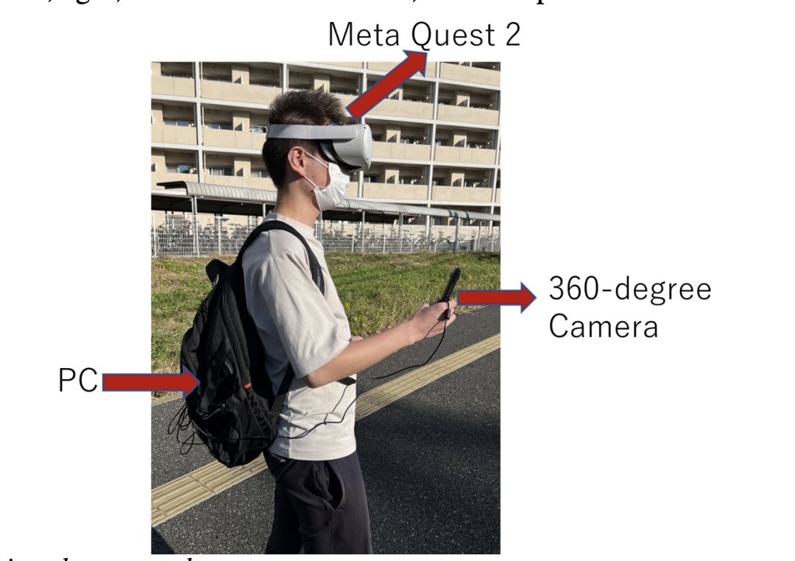
4. Existing System & System Design
4.1 Existing System:A Pedestrian Avoidance System for Visual Impaired People Based on Object Tracking Algorithm
Input Component
Uses RICOH R Development Kit 360-degree camera
Provides comprehensive view of user's surroundings
Data Processing Component
Uses FairMOT algorithm for object detection and re-identification
Built on top of CenterNet framework
Processes video feed to detect and track pedestrians
Output Component
Uses Meta Quest 2 VR headset to deliver feedback
Provides audio, visual, and haptic signals
Integrated with WebVR application for immersive experience
Notes:
The pedestrian avoidance system developed by Shan Rui et al. is designed to help visually impaired individuals navigate their environment safely by detecting and tracking pedestrians around them. The system uses a combination of a 360-degree camera, a VR headset, and advanced object tracking algorithms to provide real-time feedback to the user.
Shan Rui et al. conducted experiments to evaluate their system's performance. The average latency was found to be approximately 650.1 milliseconds. The system demonstrated high accuracy in most scenarios. User feedback was gathered through field testing, and participants found the system helpful in avoiding collisions.

Slide 11
4. Existing System & Update
4.1 Existing System:A Pedestrian Avoidance System for Visual Impaired People Based on Object Tracking Algorithm
Strengths
Comprehensive View: 360-degree camera provides complete view of environment
Real-Time Feedback: System delivers real-time feedback through VR headset
Object Tracking: Integration of FairMOT allows effective tracking of multiple pedestrians
Platform Accessibility: Use of WebVR technology for access on multiple platforms
Limitations
High Latency: System experiences latency in fast-changing environments
Limited Detection Scope: System primarily focuses on pedestrian detection
Lack of Semantic Segmentation: System does not incorporate semantic segmentation
Notes:
The system has several strengths, including a comprehensive view, real-time feedback, object tracking, multi-modal feedback, and platform accessibility. However, it also has limitations, such as high latency, limited detection scope, lack of semantic segmentation, device dependency, and false positives. These limitations can be addressed in future improvements.

Slide 12
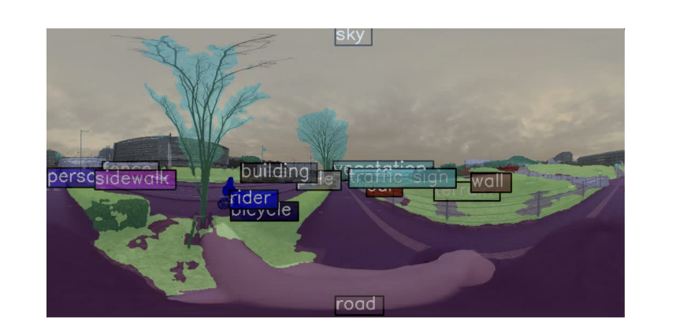
4. Existing System & Update
4.2 Update System
Integration of ByteTrack and mmsegmentation: Model & Training
Cityscapes dataset was utilized
Segmentation: HRNet chosen for high accuracy and efficiency
Training process involves model initialization, optimizer and scheduler, loss function, and training loop
Notes:
Integration of ByteTrack and mmsegmentation The integration of ByteTrack and mmsegmentation is a key innovation in our system. ByteTrack enhances multiple object tracking by associating every detection box, including those with low confidence scores, which are typically discarded by other methods. This approach significantly improves tracking performance by reducing missed detections and maintaining object identities even in complex scenarios.
mmsegmentation, on the other hand, provides a comprehensive understanding of the environment through pixel-wise classification. It supports various state-of-the-art segmentation models, including HRNet, which is chosen for its high accuracy and efficiency. HRNet maintains high-resolution representations throughout the network, enabling precise segmentation of fine details and complex structures.

Slide 13
4. Existing System & Update
4.2 Update System
Multi-GPU System
RTX 3070ti and RTX 2060
Distributes computational load across multiple GPUs
Significantly reduces time for object detection, tracking, and segmentation
Implementation Details
Model Parallelism: Distribute different parts of the model across multiple GPUs
Data Parallelism: Split input data across multiple GPUs
Asynchronous Processing: Overlap computation and communication tasks
Load Balancing: Ensure even distribution of computational load
Notes:
In this system, we use both an RTX 3070ti and an RTX 2060 for a multi-GPU system. This allows for parallel execution of tasks and significantly reduces the time required for object detection, tracking, and segmentation. Implementation details include model and data parallelism, asynchronous processing, and load balancing to maximize efficiency.

Slide 14
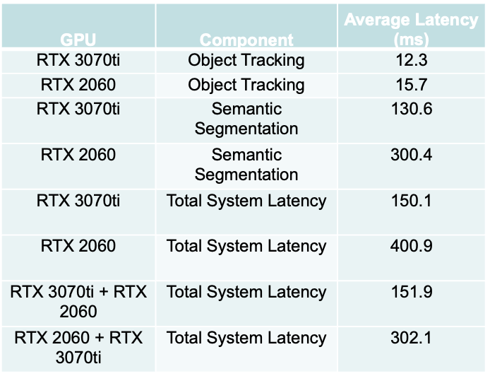
5. Experimental Results & Discuss
We conducted several experiments to evaluate the system’s performance in various scenarios.
The table on the right summarizes the latency data recorded under different conditions.
The computational resources required for segmentation are significantly greater than those needed for multi-object tracking.
A reasonable allocation of multiple GPU configurations becomes crucial in reducing the total system latency.
However, at times, using multiple GPUs increases the latency, which might be due to communication overhead. This requires further analysis and optimization.
Notes:
RTX 3070ti + RTX 2060 means using RTX 3070ti for Object Tracking and RTX 2060 for Semantic Segmentation. RTX 2060 + RTX 3070ti is the opposite.
In this research, we developed an advanced obstacle avoidance system for visually impaired individuals. We utilized ByteTrack for improved object tracking and mmsegmentation for detailed environmental understanding. We also implemented multi-GPU processing for real-time performance. Our system provides real-time, comprehensive feedback to users for safe navigation in dynamic environments.
In this section, we discuss the results of our experiments and the rationality of our system design. We measured key metrics such as latency.

Slide 15
6. Conclusion & Future work
Currently we have accomplished：
Enhanced Object Tracking
Utilizing ByteTrack for improved accuracy and reliability
Comprehensive Environmental Understanding
Integration of mmsegmentation for detailed pixel-wise classification
Real-Time Performance
Multi-GPU processing for reduced latency and prompt feedback
To be done：
Low-latency communication
Optimized data transmission protocols
Advanced networking technologies such as 5G or dedicated Wi-Fi
Scenario-Based Testing
Simulating common real-world situations to identify challenges and areas for improvement
Notes:
Haptic feedback will provide vibrations or gentle pulses, with customizable intensity and pattern based on the proxi
mity and severity of the obstacle.
In this slide, we discuss our plans to improve connectivity and processing efficiency by implementing network connectivity between the VR headset and computing device, leveraging cloud-based processing, and establishing low-latency communication through optimized data transmission protocols and advanced networking technologies.
And this slide outlines the steps for real-world application and testing of the system.

Slide 16
Thank you for listening！
九州大学大学院システム情報科学府
情報理工学専攻
孟 祥昊

Slide 17
Reference
World Health Organization. (2014). Visual Impairment and Blindness. Retrieved from: https://www.who.int/news-room/fact-sheets/detail/ blindness-and-visual-impairment
Pradeep, N., Medioni, G., & Weiland, J. D. (2019). Robot Vision for the Visually Impaired. Computer Vision and Image Understanding, 178, 2-13.
Bai, J., Liu, Z., Lin, Y., Li, Y., Lian, S., & Liu, D. (2019). Wearable Travel Aid for Environment Perception and Navigation of Visually Impaired People. Electronics, 8 (6), 697.
Shi, W., Shan, R., & Okada, Y. (2022). A Navigation System for Visual Impaired People Based on Object Detection. 12th International Congress on Advanced Applied Informatics (IIAI-AAI).
Shan, R., Shi, W., Teng, Z., & Okada, Y. (2023). A Pedestrian Avoidance System for Visual Impaired People Based on Object Tracking Algorithm. In Advances in Internet Data & Web Technologies: The 11th International Conference on Emerging Internet Data & Web Technologies (EIDWT-2023) (pp. 375-385).

